Slide 1
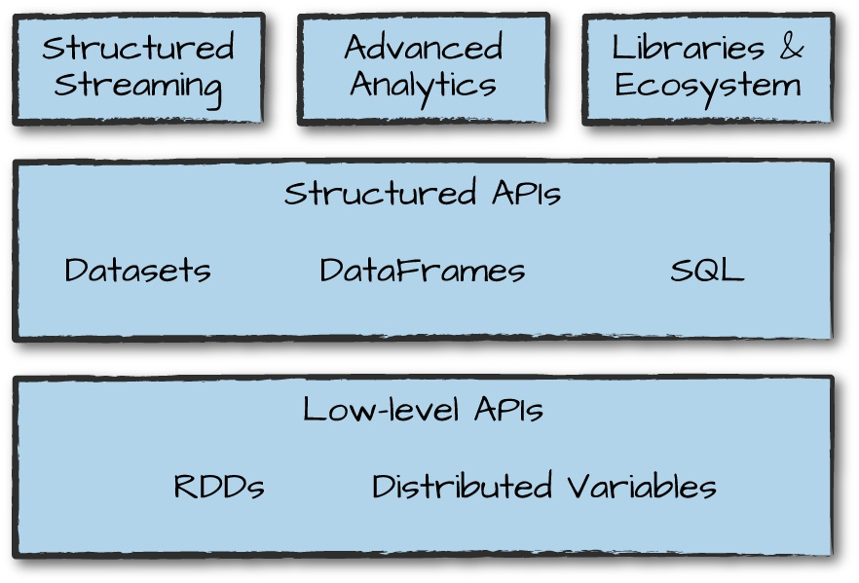
Spark Components

Slide 2
Spark Language APIs
Spark make possible to run spark code using various programming languances:
Scala
Java
Python
SQL
R

Slide 3
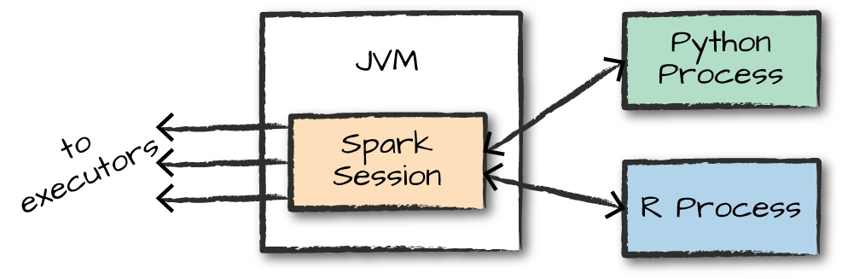
Spark API Interaction

Slide 4
Structured API
The Structured APIs are a tool for manipulating all sorts of data, from unstructured log files to semi-structured CSV files and highly structured Parquet files. APIs:
Datasets
DataFrames
SQL tables and views

Slide 5
Dataframes
DataFrames and Datasets are (distributed) table-like collections with well-defined rows and columns.
Each column must have the same number of rows as all the other columns (although you can use null to specify the absence of a value) and
Each column has type information that must be consistent for every row in the collection.

Slide 6
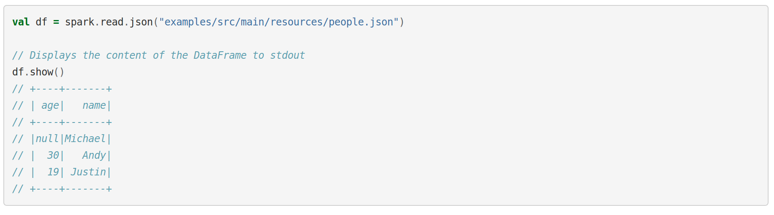
Dataframes Sample

Slide 7
Columns and Expressions
Spark allow to select, manipulate and remove columns from DataFrames.
Expression can be used to do any operations over the columns.
Columns cannot be manipulated at record lebel.

Slide 8
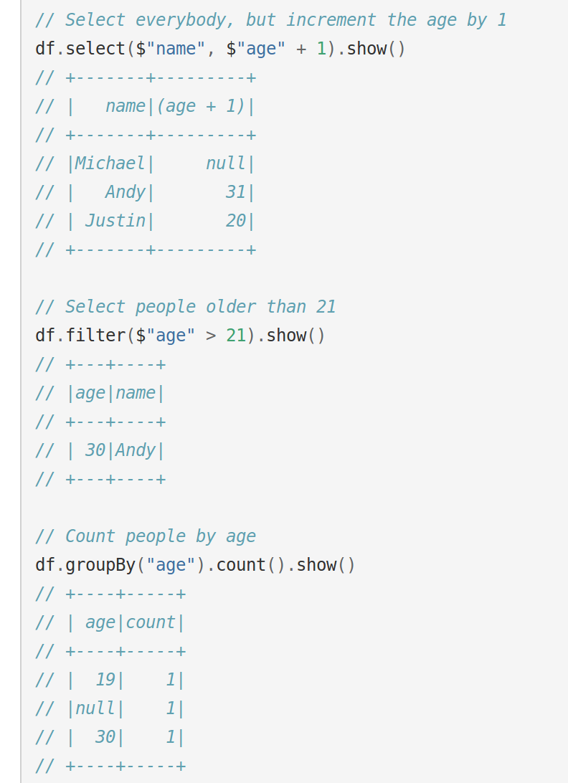
Columns Manipulation

Slide 9
Spark UDFs

Slide 10
Spark SQL
Spark SQL is arguably one of the most important and powerful features in Spark.
Spark SQL can run SQL queries against views or tables organized into databases.
Spark SQL integrates directly into the DataFrame and Dataset API
Spark SQL can connect directly to Hive Metastore

Slide 11
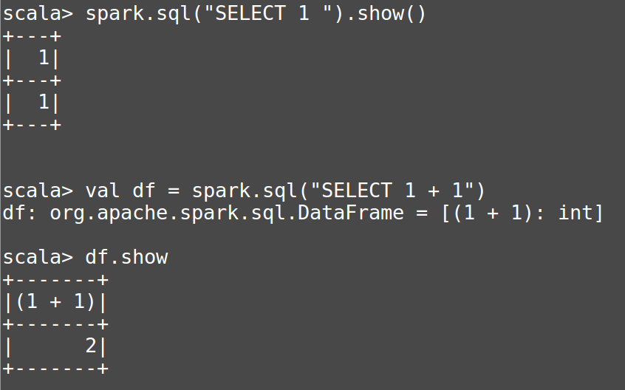
Sample Spark SQL

Slide 12
SparkSQL Hive

