Slide 1
Docker – The world of Containers
Thomas Gribnau
Brendan van Walstijn
Notes:
Thomas:

Slide 2

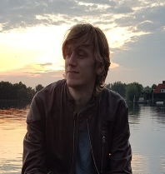
Who are we
Thomas Gribnau | Experienced Software Engineer Transport Post & Logistics | Rail | CGI
George Hintzenweg 89 | Postbus 8566 | 3009 AN Rotterdam | The Netherlands
M: +31 (0)6 1307 0037
thomas.gribnau@cgi.com
Brendan van Walstijn | Software engineer
Defensie, Transport post & logisitiek | Transport | CGI
George Hintzenweg 89 | Postbus 8566 | 3086AX Rotterdam | The Netherlands
M: +31 (0)6 1836 6194
Brendan.van.walstijn@cgi.com
Notes:
Beide:

Slide 3
What does an application need in order to be able to run?
Notes:
Thomas:

Slide 4
What does an application need in order to be able to run?
Runtime (e.g. JVM or .NET runtime)
Notes:
Platform om applicaties te runnen, bouwen en te shippen. Dit platform voorziet dus van alle benodigdheden om een applicatie te kunnen runnen.

Slide 5
How do we provide runtime for an application?
Notes:
Brendan

Slide 6
How do we provide runtime for an application?
Pc or laptop
Virtual Machine
Notes:
Typische productie/enterprise omgeving: VM’s. Wie weet wat een VM is?

Slide 7
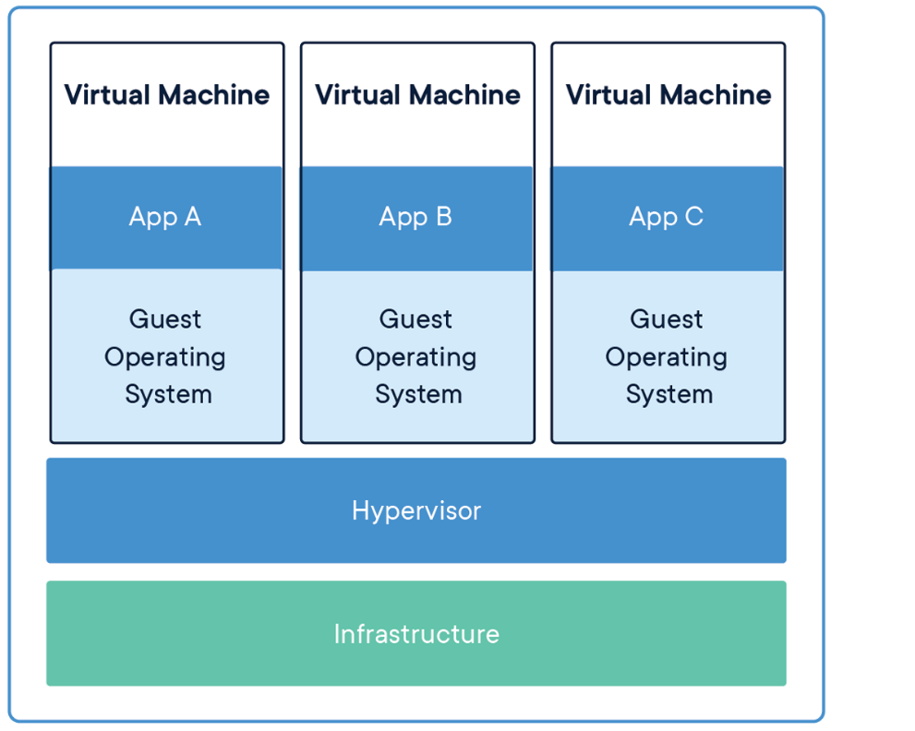
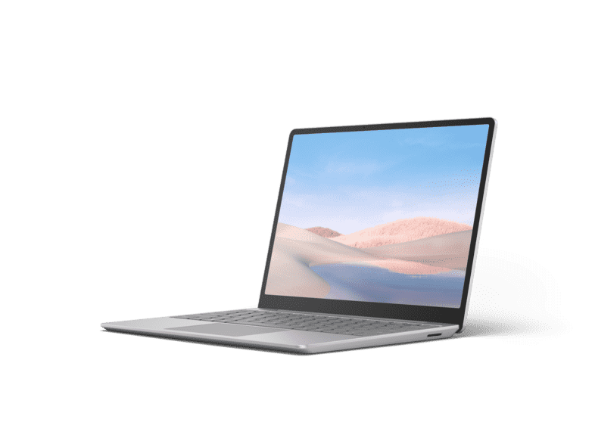
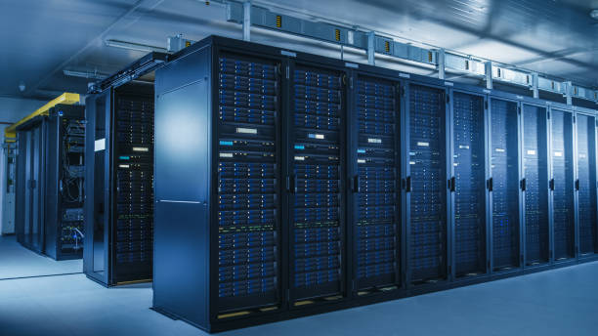
What is a VM?
Emulation of a computer
Contains:
Operating system
Networking
Memory & Storage
Etc.
Notes:
Typische productie/enterprise omgeving: VM’s. Wie weet wat een VM is?

Slide 8
Drawbacks of VM’s
Requires lots of configuration
Network
Storage & Memory etc.
Requires lots of resources
Each VM it’s own OS.
Requires maintenance
Updates etc.
SOLUTION: DOCKER
Notes:
Typische productie/enterprise omgeving: VM’s. Wie weet wat een VM is?

Slide 9
What is Docker?
Notes:
Thomas:

Slide 10

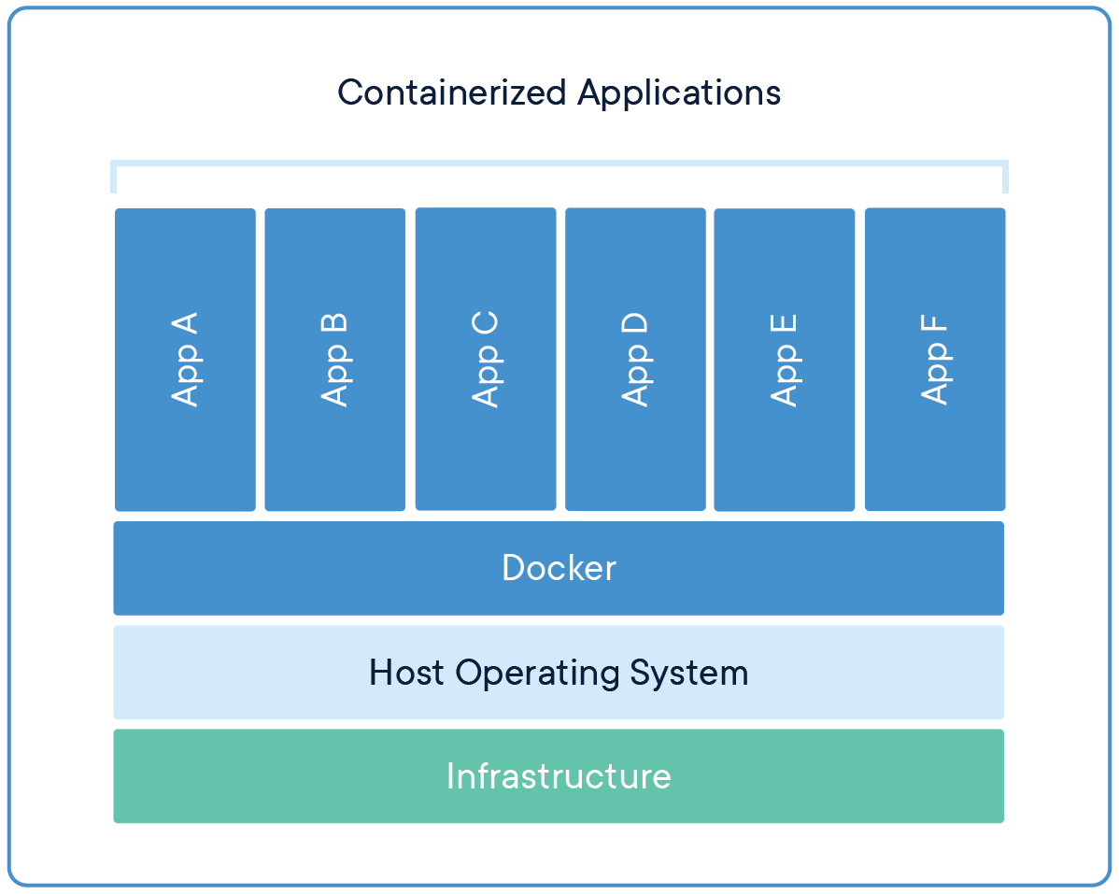
What is Docker?
A platform for building, running and shipping applications.
With docker you can create executable packages, with ONLY the required runtime and other dependencies. The Docker engine uses the host OS to run the ‘containerized’ applications, so only 1 OS is required.
Notes:
Platform om applicaties te runnen, bouwen en te shippen. Dit platform voorziet dus van alle benodigdheden om een applicatie te kunnen runnen.

Slide 11
What is a Container?
A standardized, running unit of software
Image: An executable package that contains everything needed to run the application (a blueprint, or recipe)
Container: A running instance of an image.
In OOP terms: An image is a class, and a container is the instantiation of that class.
Notes:
Platform om applicaties te runnen, bouwen en te shippen. Dit platform voorziet dus van alle benodigdheden om een applicatie te kunnen runnen.

Slide 12
Exercise 1: Hello world image.
Check Docker Hub:
docker pull hello-world
docker image ls
docker run hello-world
Notes:
Deelnemers:

Slide 13
Demonstration: Create your own Hello world.
Notes:
Brendan: Java
Thomas: .NET

Slide 14
Exercise: Create your own hello world.
Notes:
Deelnemers:

Slide 15
Exercise: Create your own Hello world container.
Step 1: Create 1 simple java program.
Step 2: Find base image. (with correct requirements e.g. JDK)
Step 3: Create Dockerfile.
Step 4: build and run container.

Slide 16
What is scalability?
Notes:
Brendan

Slide 17
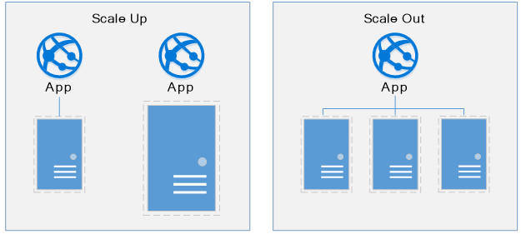
What is Scalability?

Slide 18
Exercise 2: Scaling your hello world program.
Notes:
Deelnemers:

Slide 19
What is a loadbalancer?
Notes:
Brendan

Slide 20
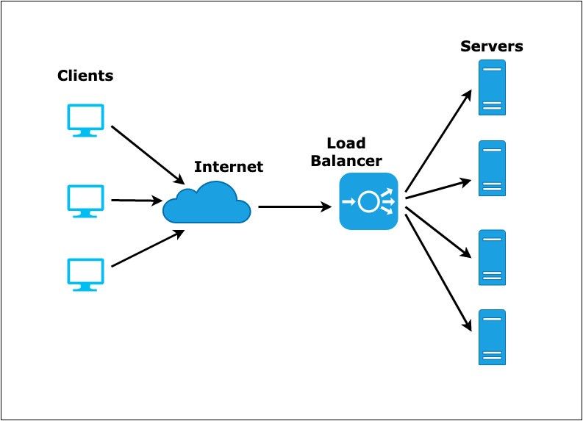
What is a loadbalancer?

Slide 21
Exercise 3: Loadbalancers.
Notes:
Deelnemers:

Slide 22
What does exercise 4 do?

