Slide 1
Docker – The world of Containers
Thomas Gribnau
Brendan van Walstijn
Notes:
Thomas:

Slide 2
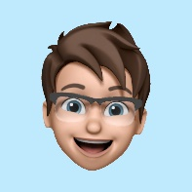
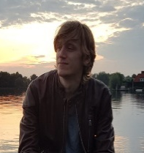
Who are we
Jeroen Claassens | Experienced Software Engineer Vital Civil Infrastructure | Rail | CGI
George Hintzenweg 89 | Postbus 8566 | 3009 AN Rotterdam | The Netherlands
M: +31 (0)6 5112 7382
j.claassens@cgi.com
Brendan van Walstijn | Experienced Software engineer
Defensie, Transport post & logisitiek | Transport | CGI
George Hintzenweg 89 | Postbus 8566 | 3086AX Rotterdam | The Netherlands
M: +31 (0)6 1836 6194
Brendan.van.walstijn@cgi.com
Notes:
Beide:

Slide 3


Who am I?
Jeroen Claassens (Experienced Software Engineer)
Started at CGI in March 2019
Rijkswaterstaat (1,5 years)
Fullstack TypeScript & Java developer
Primarily worked the new Asset Management frontend
ProRail (2 years)
Fullstack TypeScript & Java developer
Working on improving the front- and backend of the GMS/WLIS project

Slide 4
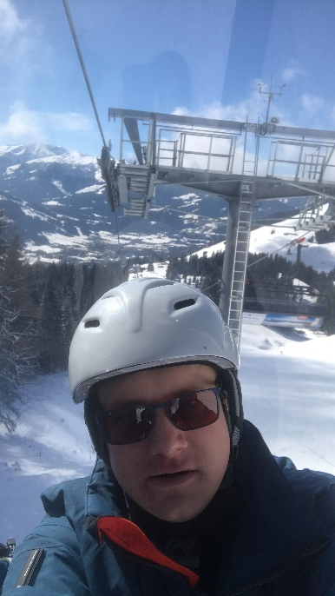
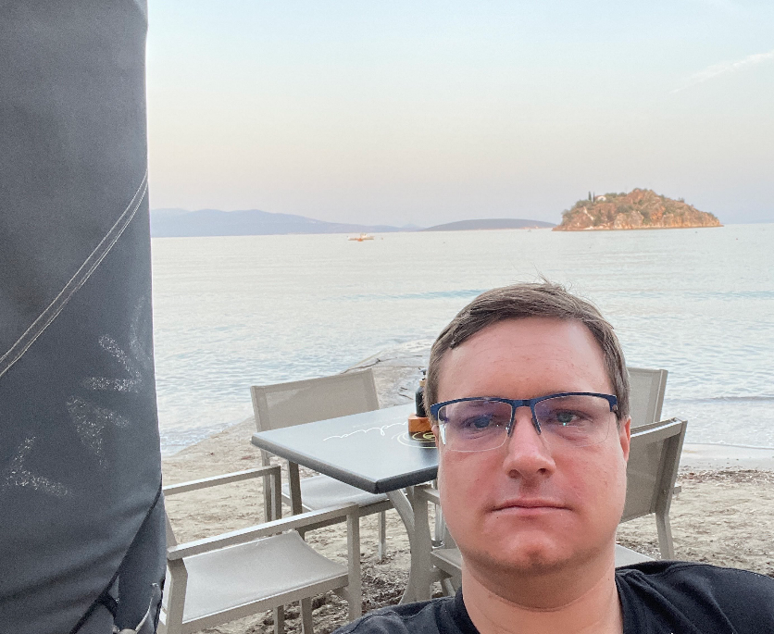
Who am I?
I Live in Delft
I’m a huge fantasy nerd (talk to me about Lord of The Rings, Pokémon, Stormlight Archives)
I do a lot of open source development in my free time.
I love building PCs and working with tech.

Slide 5




Who am I?
Brendan van Walstijn (Experienced Software Engineer)
Started at CGI in March 2021
Started with the Graduate Class
Loodswezen (6 months)
.NET Developer
Primarily worked on a decision tree for Beurtrollen
Athlon (11 months)
DevOps Engineer
SQR -> SQL rewrite
Worked on test automation using PowerShell
NextLogic (Current)
Azure Cloud Engineer
Primarily Administrative tasks
Transavia (Current)
Azure DevOps and Cloud Engineer.
Primary focus on Azure Infrastructure using bicep/ARM.

Slide 6
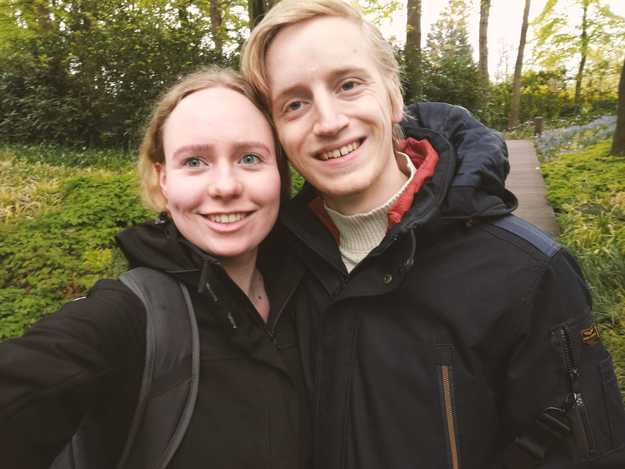
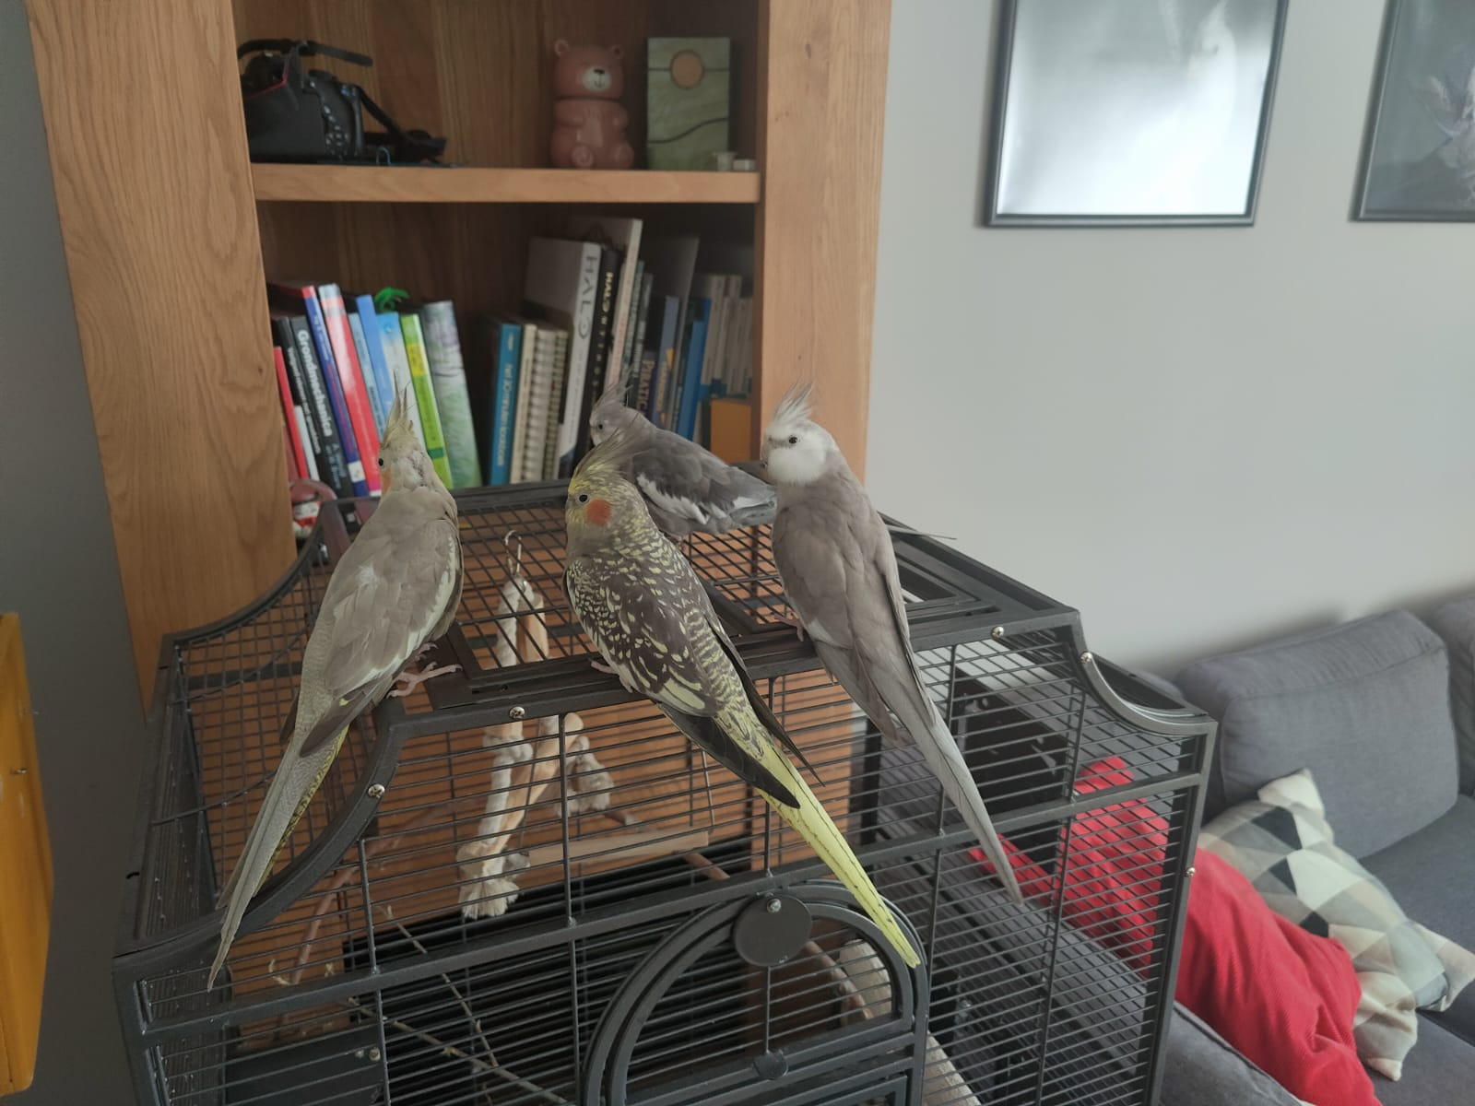
Who am I?
I Live in Noorden with my girlfriend. (if you know where Noorden is, I’ll buy you lunch)
And a number of birds
I Play Piano and guitar in a punk rock band.
I build PC’s for fun.

Slide 7
What does an application need in order to be able to run?
Notes:
Brendan:

Slide 8
What does an application need in order to be able to run?
Runtime (e.g. JVM or .NET runtime)
Notes:
Platform om applicaties te runnen, bouwen en te shippen. Dit platform voorziet dus van alle benodigdheden om een applicatie te kunnen runnen.

Slide 9
How do we provide runtime for an application?
Notes:
Brendan

Slide 10
How do we provide runtime for an application?
Pc or laptop
Virtual Machine
Notes:
Typische productie/enterprise omgeving: VM’s. Wie weet wat een VM is?

Slide 11
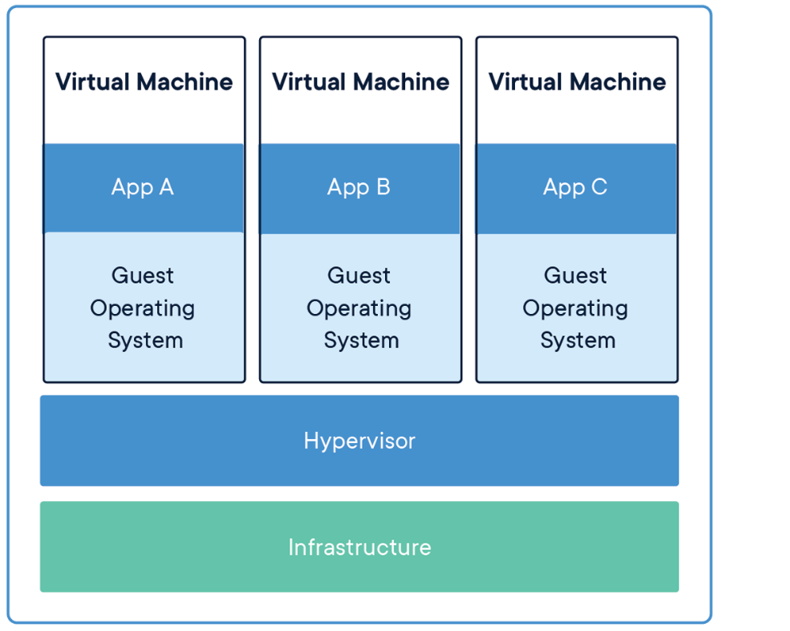
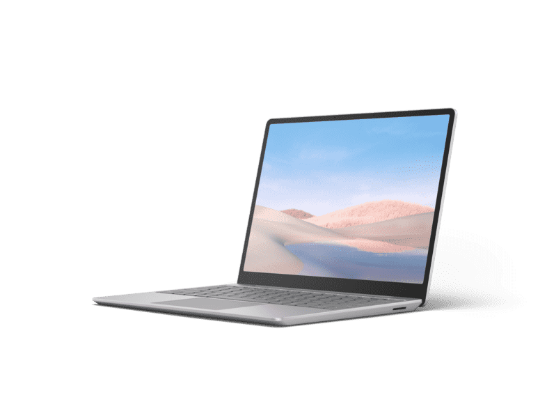
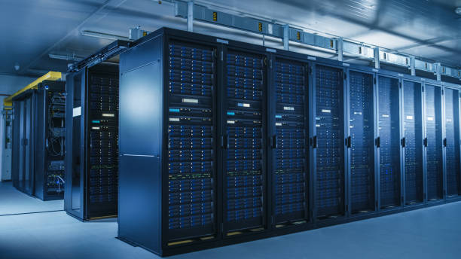
What is a VM?
Emulation of a computer
Contains:
Operating system
Networking
Memory & Storage
Etc.
Notes:
Typische productie/enterprise omgeving: VM’s. Wie weet wat een VM is?

Slide 12
Drawbacks of VM’s
Requires lots of configuration
Network
Storage & Memory etc.
Requires lots of resources
Each VM it’s own OS.
Requires maintenance
Updates etc.
SOLUTION: DOCKER
Notes:
Typische productie/enterprise omgeving: VM’s. Wie weet wat een VM is?

Slide 13
What is Docker?
Notes:
Jeroen

Slide 14

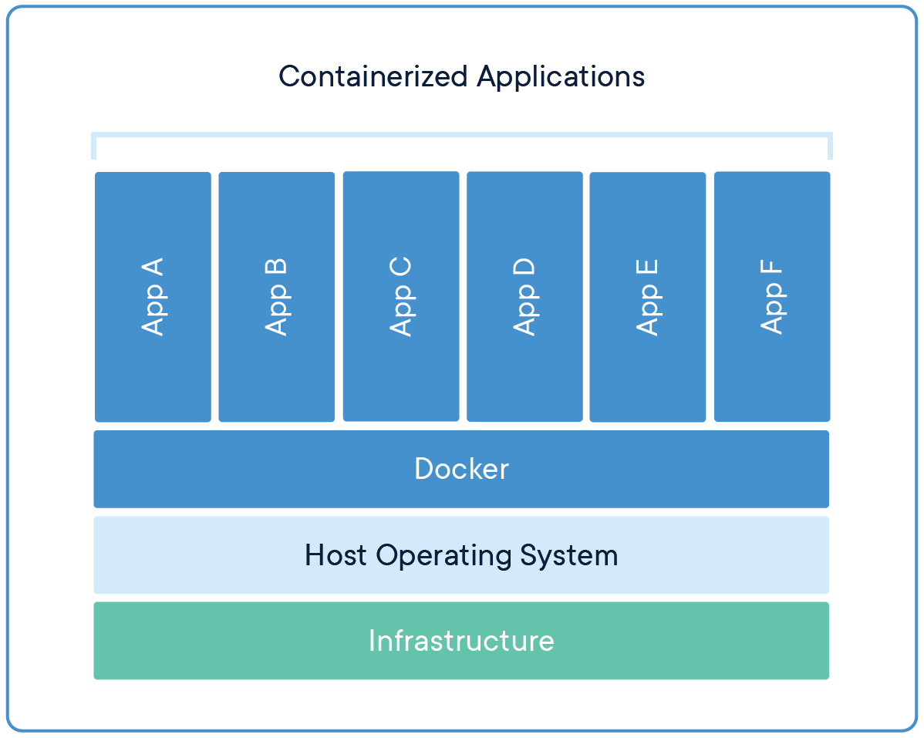
What is Docker?
A platform for building, running and shipping applications.
With docker you can create executable packages, with ONLY the required runtime and other dependencies. The Docker engine uses the host OS to run the ‘containerized’ applications, so only 1 OS is required.
Notes:
Platform om applicaties te runnen, bouwen en te shippen. Dit platform voorziet dus van alle benodigdheden om een applicatie te kunnen runnen.

Slide 15
What is a Container?
A standardized, running unit of software
Image: An executable package that contains everything needed to run the application (a blueprint, or recipe)
Container: A running instance of an image.
In OOP terms: An image is a class, and a container is the instantiation of that class.
Notes:
Platform om applicaties te runnen, bouwen en te shippen. Dit platform voorziet dus van alle benodigdheden om een applicatie te kunnen runnen.

Slide 16
Exercise 1: Hello world image.
Check Docker Hub:
docker pull hello-world
docker image ls
docker run hello-world
Notes:
Deelnemers:

Slide 17
Demonstration: Create your own Hello world.
Notes:
Brendan: Java

Slide 18
Exercise: Create your own hello world.
Notes:
Deelnemers:

Slide 19
Exercise: Create your own Hello world container.
Step 1: Create 1 simple java program.
Step 2: Find base image. (with correct requirements e.g. JDK)
Step 3: Create Dockerfile.
Step 4: build and run container.

Slide 20
What is scalability?
Notes:
Brendan

Slide 21
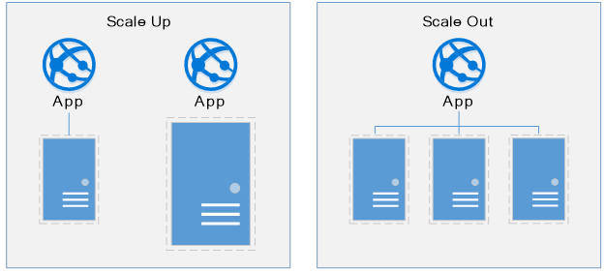
What is Scalability?

Slide 22
Exercise 2: Scaling your hello world program.
Notes:
Deelnemers:

Slide 23
What is a loadbalancer?
Notes:
Brendan

Slide 24
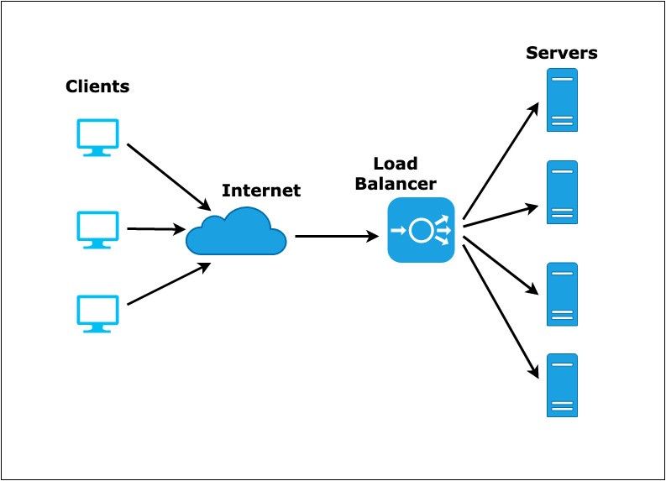
What is a loadbalancer?

Slide 25
Exercise 3: Loadbalancers.
Notes:
Deelnemers:

Slide 26
What does exercise 4 do?

