Slide 1
Docker – The world of Containers
Jeroen Claassens
Brendan van Walstijn
Notes:
Thomas:

Slide 2
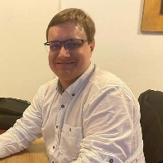
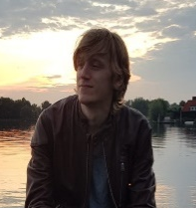
Who are we
Jeroen Claassens | Experienced Software Engineer Randstand & North Netherlands | Rail | CGI
George Hintzenweg 89 | Postbus 8566 | 3009 AN Rotterdam | The Netherlands
M: +31 (0)6 5112 7382
j.claassens@cgi.com
Brendan van Walstijn | Experienced Software engineer
Randstand & Central Netherlands | Transport | CGI
George Hintzenweg 89 | Postbus 8566 | 3086AX Rotterdam | The Netherlands
M: +31 (0)6 1836 6194
Brendan.van.walstijn@cgi.com
Notes:
Beide:

Slide 3


Who am I?
Jeroen Claassens (Experienced Software Engineer)
Started at CGI in March 2019
Rijkswaterstaat (1,5 years)
Full-stack TypeScript & Java developer
Primarily worked the new Asset Management frontend
ProRail (2,5 years)
Full-stack TypeScript & Java developer
Worked on improving the front- and backend of the GMS/WLIS project

Slide 4
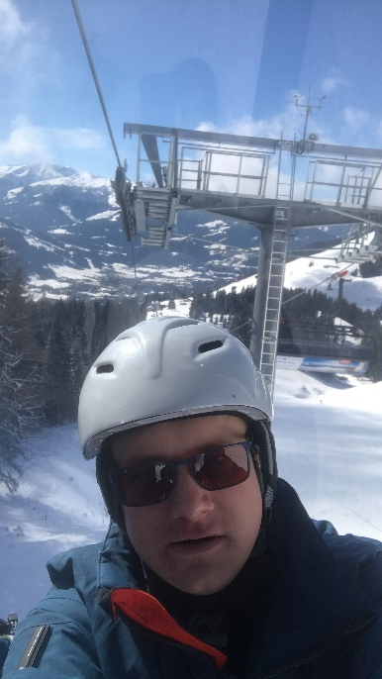
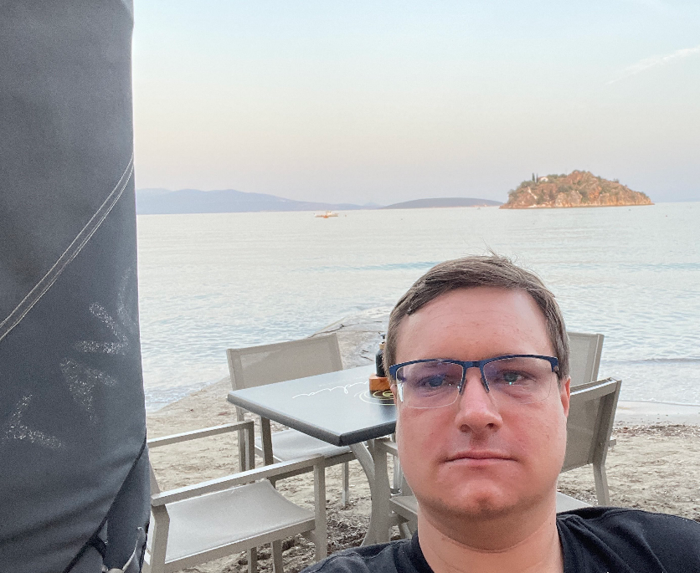
Who am I?
I Live in Delft
I’m a huge fantasy nerd (talk to me about Lord of The Rings, Pokémon, Stormlight Archives)
I do a lot of open source development in my free time.
I love building PCs and working with tech.

Slide 5




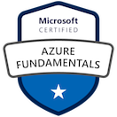
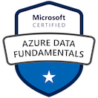
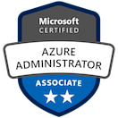
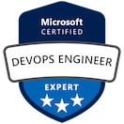
Who am I?
Brendan van Walstijn (Experienced Software Engineer)
Started at CGI in March 2021
Started with the Graduate Class and the .NET track
Loodswezen (6 months)
.NET Developer
Primarily worked on a decision tree for Beurtrollen
Athlon (11 months)
DevOps Engineer
SQR -> SQL rewrite
Worked on test automation using PowerShell
NextLogic (Current)
Azure Cloud Engineer
Primarily Administrative tasks
Transavia (Current)
Azure DevOps and Cloud Engineer.
Development of Partner Admin Portal in C# and Blazor/Radzen
Primary focus on Azure Infrastructure using bicep/ARM and configuration

Slide 6
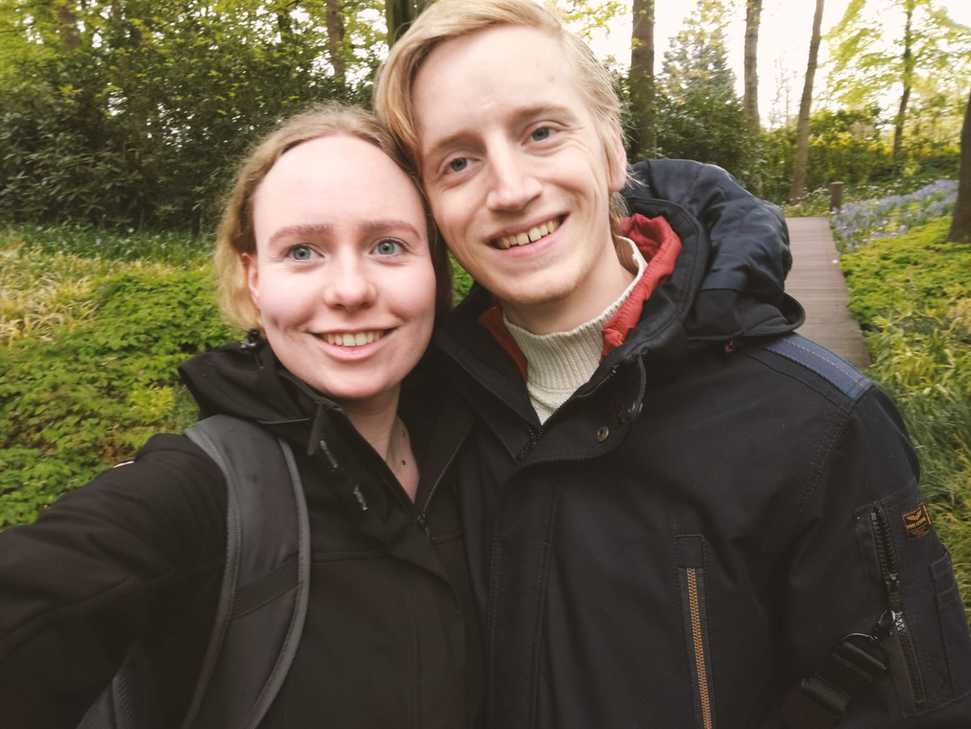
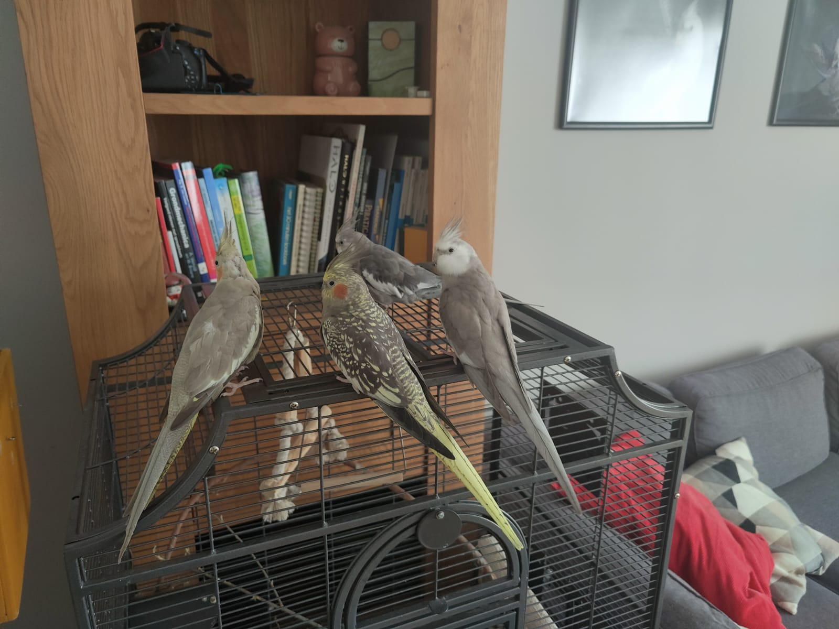
Who am I?
I Live in Noorden with my girlfriend Rosalie and a number of birds.
If you know where Noorden is, I’ll buy you lunch. (googling not allowed)
I Play Piano and (bass)guitar in a punk rock band. (Blink-182, Sum 41, Green day, Rage Against the Machine, and some own stuff)
Guitar of choice: Epiphone Les Paul Modern (sparkling burgundy)
Favourite song to play: Top gun Anthem by Steve Stevens.

Slide 7
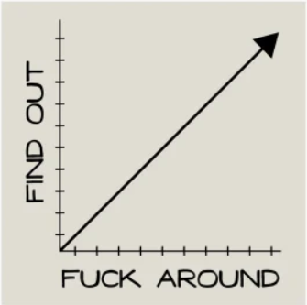
Our vision on this course

Slide 8
What does an application need in order to be able to run?
Notes:
Brendan:

Slide 9
What does an application need in order to be able to run?
Runtime (e.g. JVM or .NET runtime)
Notes:
Platform om applicaties te runnen, bouwen en te shippen. Dit platform voorziet dus van alle benodigdheden om een applicatie te kunnen runnen.

Slide 10
How do we provide runtime for an application?
Notes:
Brendan

Slide 11
How do we provide runtime for an application?
Pc or laptop
Virtual Machine
Notes:
Typische productie/enterprise omgeving: VM’s. Wie weet wat een VM is?

Slide 12
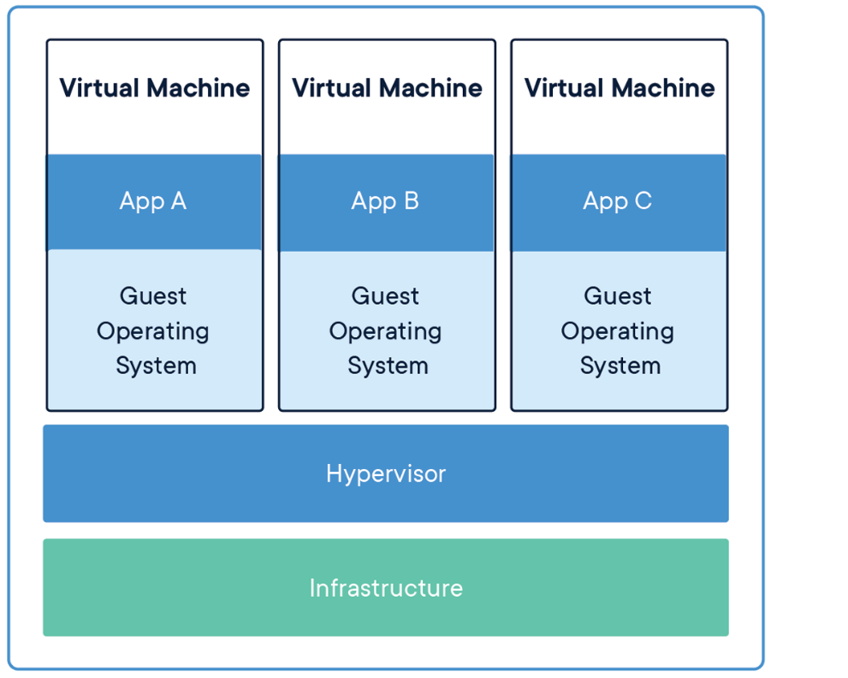
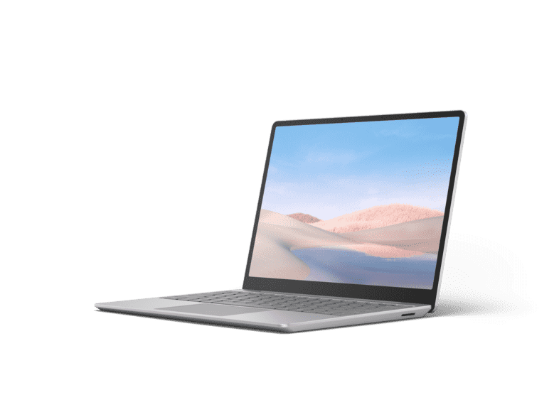
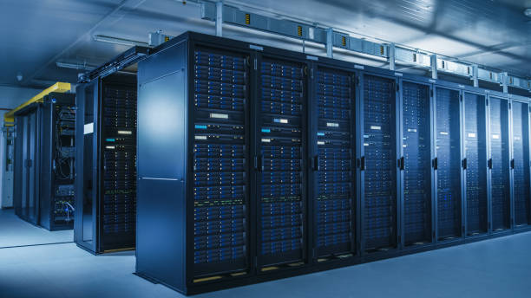
What is a VM?
Emulation of a computer
Contains:
Operating system
Networking
Memory & Storage
Etc.
Notes:
Typische productie/enterprise omgeving: VM’s. Wie weet wat een VM is?

Slide 13
Drawbacks of VM’s
Requires lots of configuration
Network
Storage & Memory etc.
Requires lots of resources
Each VM it’s own OS.
Requires maintenance
Updates etc.
SOLUTION: DOCKER
Notes:
Typische productie/enterprise omgeving: VM’s. Wie weet wat een VM is?

Slide 14
What is Docker?
Notes:
Jeroen

Slide 15

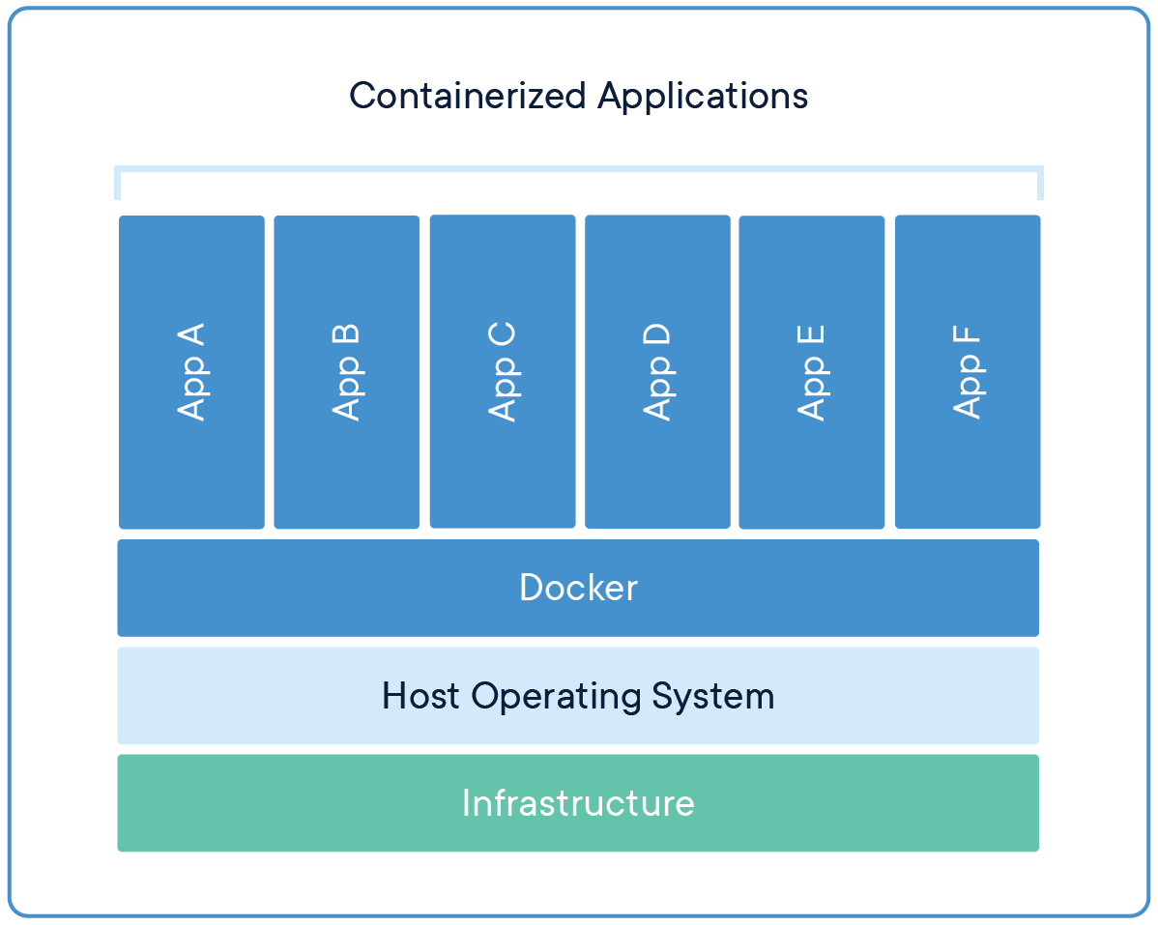
What is Docker?
A platform for building, running and shipping applications.
With docker you can create executable packages, with ONLY the required runtime and other dependencies. The Docker engine uses the host OS to run the ‘containerized’ applications, so only 1 OS is required.
Notes:
Platform om applicaties te runnen, bouwen en te shippen. Dit platform voorziet dus van alle benodigdheden om een applicatie te kunnen runnen.

Slide 16
What is a Container?
A standardized, running unit of software
Image: An executable package that contains everything needed to run the application (a blueprint, or recipe)
Container: A running instance of an image.
In OOP terms: An image is a class, and a container is the instantiation of that class.
Notes:
Platform om applicaties te runnen, bouwen en te shippen. Dit platform voorziet dus van alle benodigdheden om een applicatie te kunnen runnen.

Slide 17
Exercise 1: Hello world image.
Check Docker Hub:
docker pull hello-world
docker image ls
docker run hello-world
Notes:
Deelnemers:

Slide 18
Demonstration: Create your own Hello world.
Notes:
Brendan: Java

Slide 19
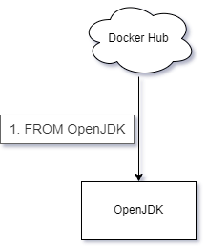
What did we just do?

Slide 20
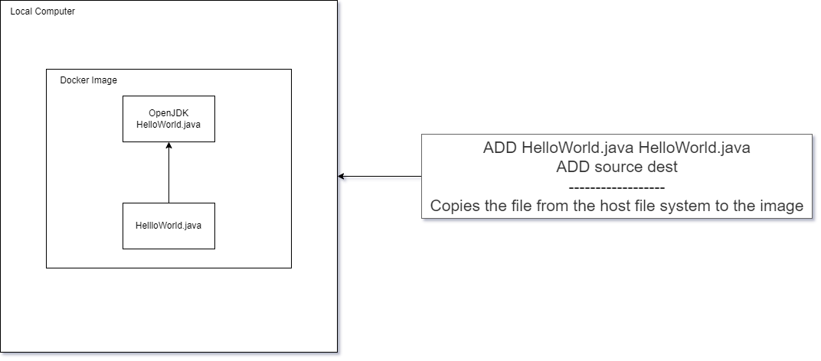
What did we just do?

Slide 21
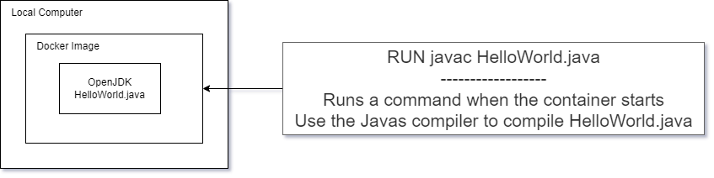
What did we just do?

Slide 22
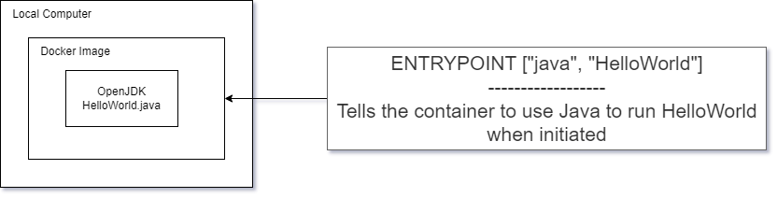
What did we just do?

Slide 23
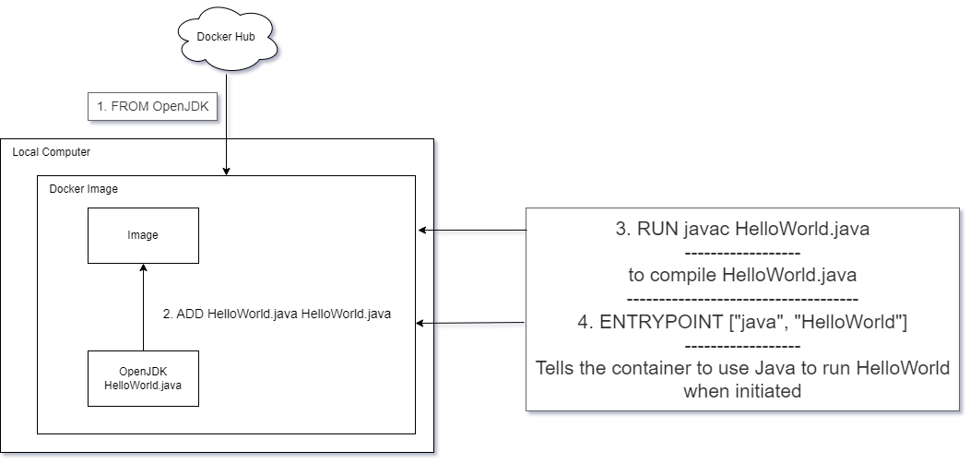
What did we just do?

Slide 24
Exercise: Create your own Hello world container.
Step 1: Create 1 simple java program.
Step 2: Find base image. (with correct requirements e.g. JDK)
Step 3: Create Dockerfile.
Step 4: build and run container.

Slide 25
Creating a Docker container
Find base image, create dockerfile, and commands to run

Slide 26
Exercise: Create your own hello world.
Notes:
Deelnemers:

Slide 27
What is scalability?
Notes:
Brendan

Slide 28
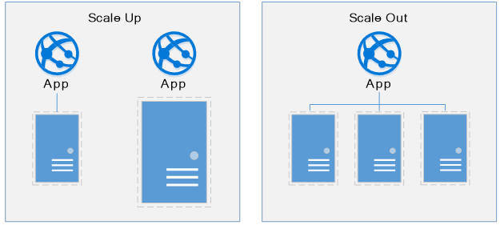
What is Scalability?

Slide 29
Exercise 2: Scaling your hello world program.
Notes:
Deelnemers:

Slide 30
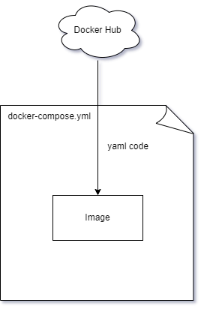
What the exercise achieved
Notes:
We used a docker compose file to have a scripted version of all the various docker commands we had to run manually before
Using a docker compose file we can have an easier time reproducing between systems without risking making copy paste mistakes.

Slide 31
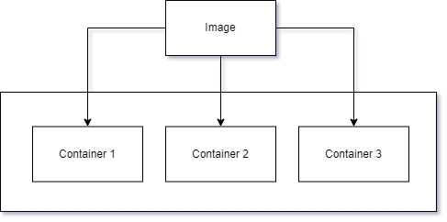
What the exercise achieved
Notes:
The docker image we build was spawned into 3 separate instances of the container

Slide 32
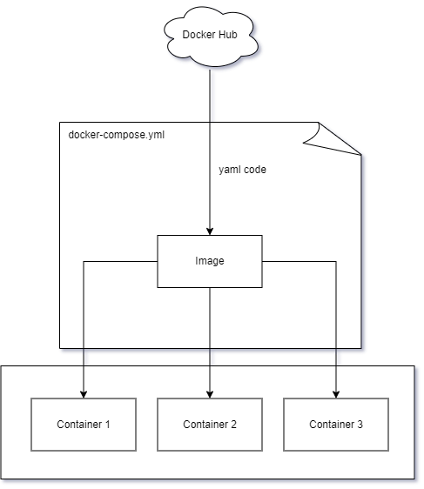
What the exercise achieved
Notes:
Putting it all together

Slide 33
What is a loadbalancer?
Notes:
Brendan

Slide 34
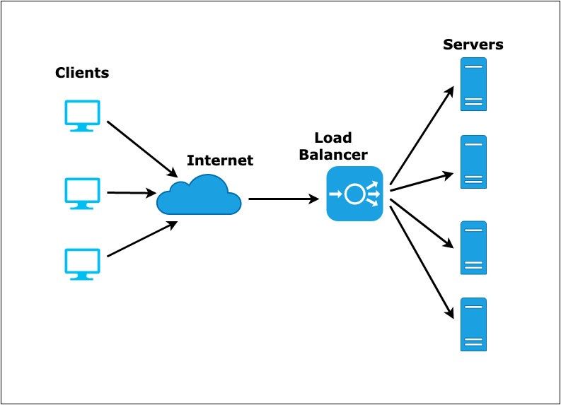
What is a loadbalancer?

Slide 35
Exercise 3: Loadbalancers.
Notes:
Deelnemers:

