Slide 1
Frontend for end-users
Jeroen Claassens & Martijn van Dueren den Hollander
Notes:
Good morning everyone. In the workshop today I will introduce you to the world of frontend development.

Slide 2


Who am I
Jeroen Claassens | Full-stack Software Engineer +31 (0)6 5112 7382
j.claassens@cgi.com
Martijn van Dueren den Hollander | Full-stack Software Engineer
+31 (0)6 1208 0458
martijn.duerendenhollander@cgi.com
Notes:
First a bit about us.
J: Hi! My name is Jeroen Claassens. I’ve been a developer for about 10 years now
M:

Slide 3


Who am I?
I’m a huge fantasy nerd (talk to me about Lord of The Rings, Harry Potter, Dungeons & Dragons, and more)
My free time is primarily spent with open source development and (table-top) gaming.
I love learning about and working with all tech.
I live in Delft
Notes:
J: I live in the city of Delft. In my spare time I’m a huge lover of all kinds of fantasy. My free time I primarily spent workin on various open source projects that I maintain and I also game a lot. In general I am also a big fan of all things tech.

Slide 4
Who am I?
Introduction
From Martijn
Goes here
Notes:
M:

Slide 5
General workshop information
The workshop will have both and morning and afternoon program
I encourage the taking of notes, because we will go through a lot of information
These slides will be sent to all participants after the course. The slide notes have a rough outline of what I have told you.
Notes:
First we would like to address some general notes for today. Today we will have both a morning and an afternoon program. Furthermore this is the first time that we are including a frontend fundamentals workshop in the graduate class, in advance we apologize for any mistakes haha. Because of this we can also not say entirely for sure at what time we will be finished, but at the latest we will stop at 4 30.
Next we encourage the taking of notes. We will go through a lot of information and there will be a lot of information to process. Notes can help you do so.
Lastly these slides are available in the GitHub repository you were sent before the workshop, in the documentation folder.

Slide 6
Has everyone managed to install NodeJS?
Notes:
Before we start we would like to check if everyone was able to complete their homework, installing NodeJS.
For those that have faced issued, we have reserved a about 10 minutes before the lunch to aid you.

Slide 7
Agenda
A brief introduction to frontend and its importance
HTML / CSS / JavaScript
Lunch 🥪🍽️
Frontend development in the field
Notes:
Now lets go over the agenda for today. To start we will give you a brief introduction to what frontend is, how we define frontend for the scope of this workshop, and why frontend should be considered as an important part of the services delivered by CGI. After this we will give you an introduction to HTML, CSS, and JavaScript which together make up the fundamental building blocks for developing a modern frontend. This should take until about a quarter to twelve after which there will be some time to help anyone who wasn’t able to complete their homework or time for longer questions and then we’ll have lunch until 1 o clock. After the lunch we’ll dive into the frontend development as you might see it being used in the field at CGI projects, this means we’ll start working with Node, looking into libraries like React, and more.

Slide 8
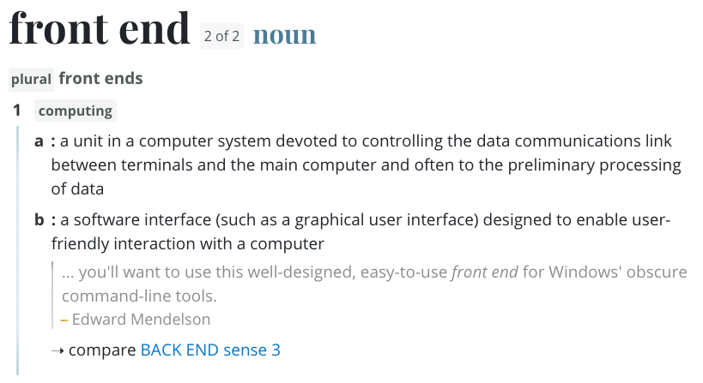
What does “frontend” even mean!?
Notes:
Lets stay by defining the term “frontend”. We like to think that it’s often best to start with a definition from the dictionary. The dictionary defines the frontend as a software interface, such as a graphical user interface, designed to enable user-friendly interaction with a computer. What this means is that for an end-user to use a program, they will always use a frontend of some kind. That frontend can be a program such as Microsoft Word or Notepad, or a website such as Google.

Slide 9
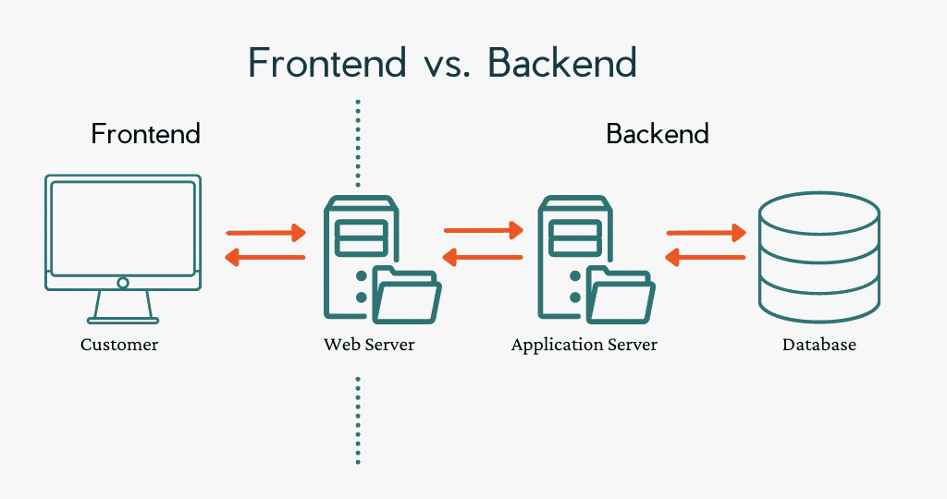
What does “frontend” even mean!?
Notes:
The opposite of a frontend is the backend, which is everything the user does not interact with. Frontend and backend are always coupled in some way, such as through a server.
As you can probably surmise, frontends are very important because without a frontend the end-user has nothing to interact with.

Slide 10

Focus for this workshop
Notes:
While the definition of frontend can be very broad, normally when we talk about frontend development we’re talking about developing for the web. It is about crafting a beautiful, intuitive and responsive looking application that runs in a web browser and can be used by anyone, anywhere and at any time.

Slide 11
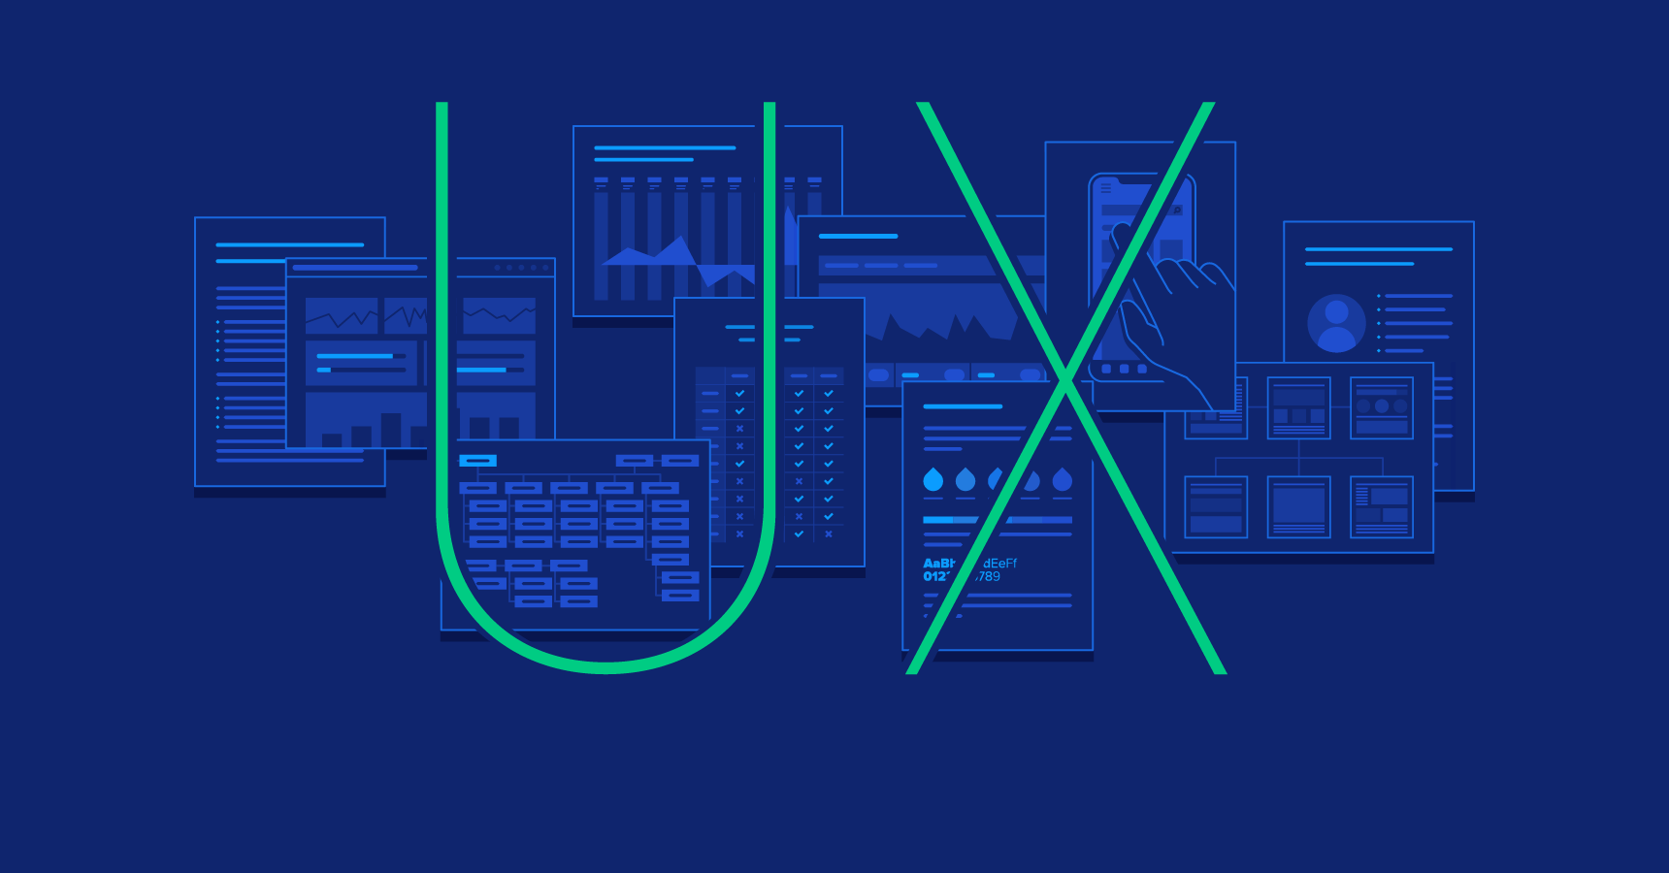
Focus NOT for this workshop
Look and feel
UI: Buttons, colours, fonts, images, layout
UX: Overall experience
A difference branch of IT
Notes:
Next I would like the address the matter of UX, or User Experience, and UI, or User Interface. UX and UI are two important factors in the software development cycle and together they ensure that the application has a good “look and feel”.
You can think of UI as the outer shell of the application, it’s like the clothes the app wears. UI is all about how the app looks – the buttons, colours, fonts, images and layout.
UX on the other hand is the overall experience the user the users have when they use the application. UX is more about the user’s journey through the application. It’s making sure the app is easy to understand and navigate and that it solves the user’s problem efficiently.
These concepts however will not be addressed in this workshop as they make up a different branch in the flow of creating an application. As opposed to these concepts, frontend development is all about creating the application so that it adheres to the UI/UX that was designed beforehand. It is about the realisation, not about the design beforehand.

Slide 12



HTML, CSS, and JS (JavaScript)
Notes:
With that covered lets look at the three programming languages that are used together to create frontends, HTML, CSS and JS, or JavaScript.

Slide 13
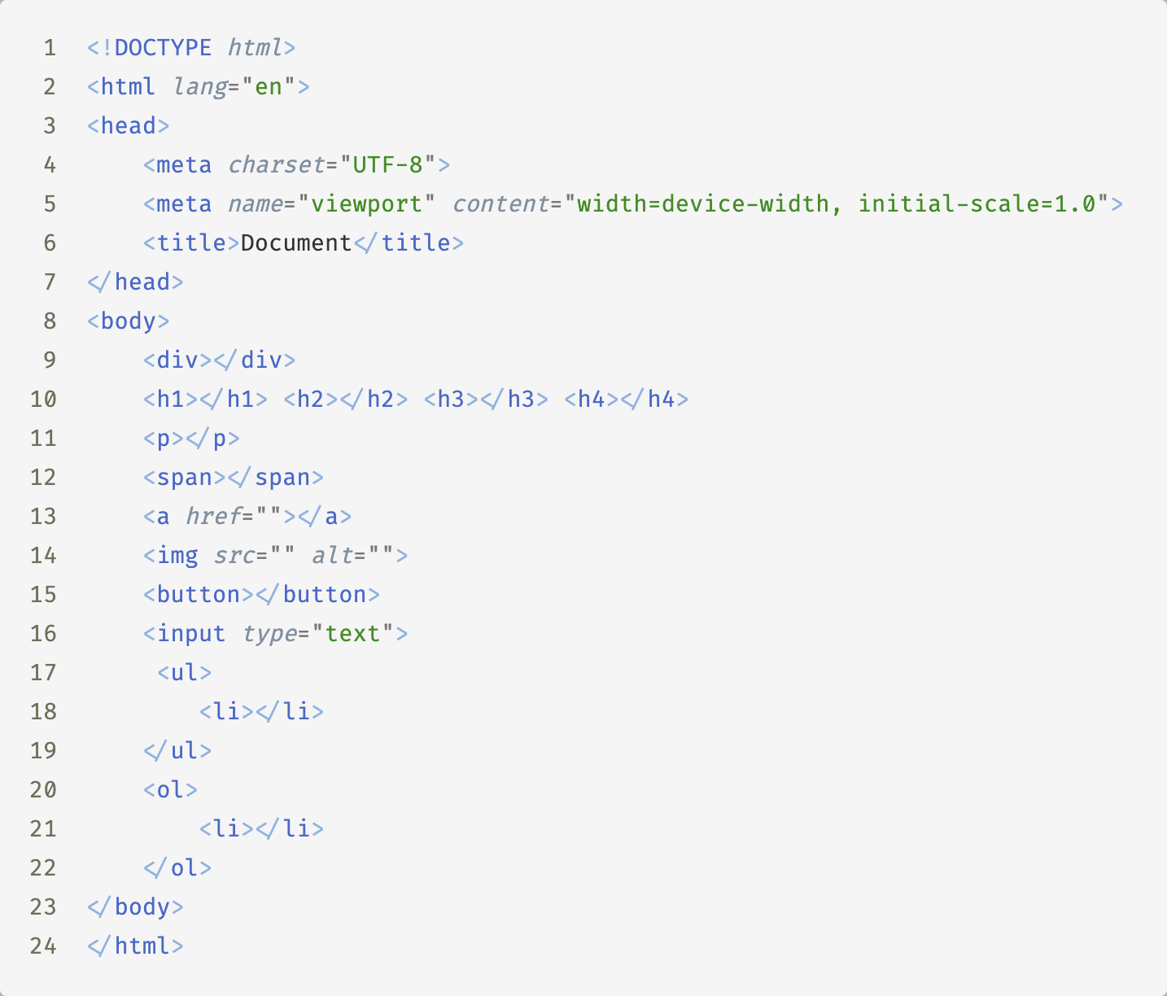
HTML
Structure
Content
Uses elements
Notes:
HTML, short for HyperText Markup Language, is the backbone of web pages. It provides the structure and content for your website. HTML uses a system of elements and tags to define the different parts of a web page, such as headings, paragraphs, images, links, and more. HTML elements are the building blocks that create the structure of your content. There are many many HTML elements these days and in the GitHub repository for this workshop you’ll find a text file called “important links” which has a link to a list of all elements and a description for each.

Slide 14
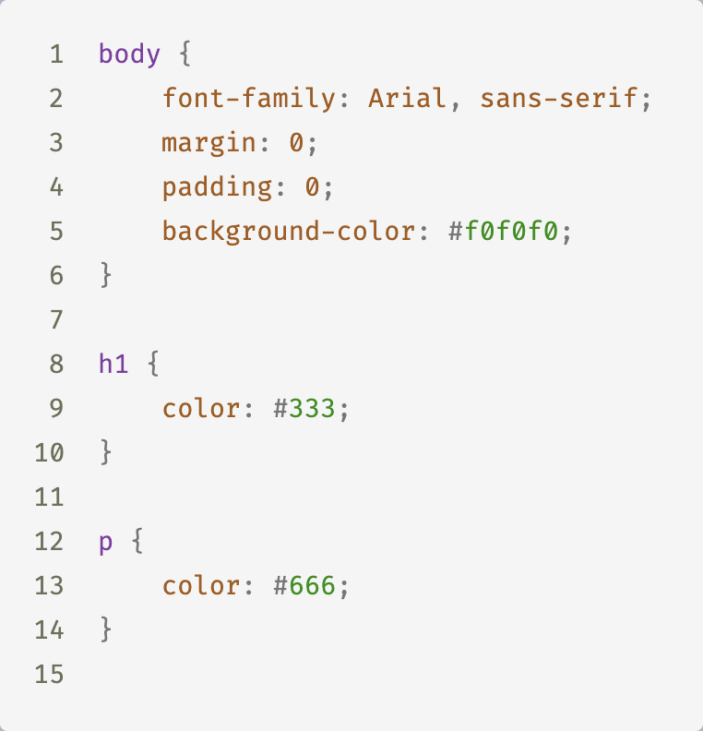
CSS
Layout
Colours
Fonts
Notes:
CSS, short for Cascading Style Sheets, is used to style your HTML elements and make your web page visually appealing. It controls how elements are presented on the screen, including their layout, colours, fonts, and spacing. CSS allows you to create a consistent and visually attractive design for your website.

Slide 15
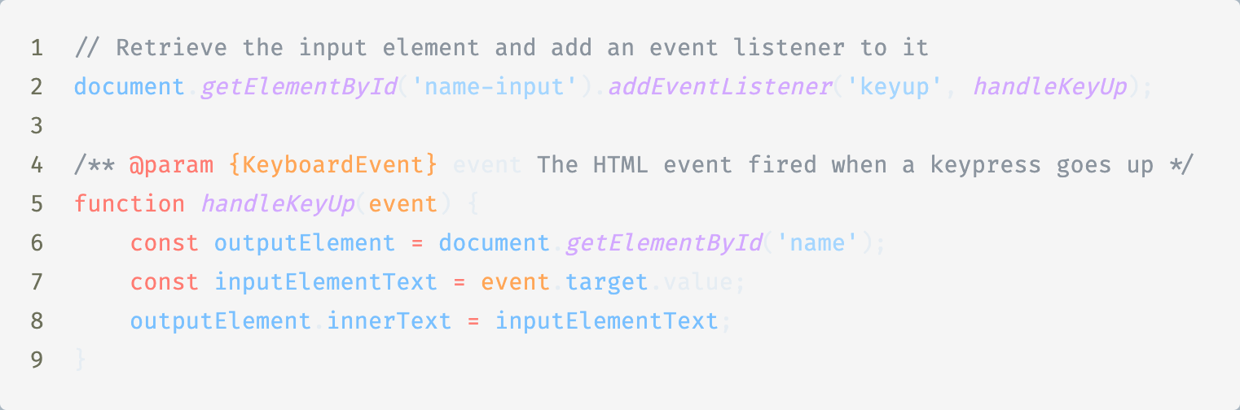
JS
Interactivity
Scripting
Dynamic
Notes:
And lastly, JavaScript. JavaScript is the programming language that enables you to add interactivity and dynamic behaviour to your web pages. With JavaScript, you can create animations, handle user input, update content without reloading the page, and more. It's what makes modern websites feel interactive and engaging.

Slide 16
Demo
Notes:
Now that we’ve covered some basics I would like to give a small demo of a simple web page, and after this demo I will ask you to start on the first exercise.

Slide 17
Exercise 1
Are you allowed to drink webapp
Notes:
As I said I would now like to have you all start with exercise 1. In this exercise your job is to create a very simple web application that asks the user’s age and then tells them if they are allowed to drink or not. You will find the exercise in the GitHub repository for this workshop, along with a README that has more information about the exercise.

Slide 18
Exercise 1 - Demo
Are you allowed to drink webapp
Notes:
Alright now that you’re all finished or nearly finished I would like to give a quick demo of the solution as I had originally designed it.
Explain HTML code with text insert element
Explain HTML input element, highlight the ‘id’ property and the ‘type’ property
Explain the JavaScript
Binding the event
Getting the value
Checking for NaN
Processing true/false
‘let’ vs ‘var’ vs ‘const’

Slide 19
Exercise 2
CSS Styling
Notes:
Alright now that we’re done with that exercise I would like to move on to a different branch, which is the CSS integration with HTML. For this I have prepared another exercise, number 2. The assignment here is to get as close as an approximation to the screenshot of the finished result that you will find in the README. You don’t need to match it exactly, but try to get as close as possible. If you want to know if your solution is close enough, you can ask me to review it.

Slide 20
Exercise 2 - Demo
CSS Styling
Notes:
Once again I would like to give a short demo on the solution as it was prepared
Explain different selectors CSS
Explain property chaining (li.special)
Explain child selectors

Slide 21
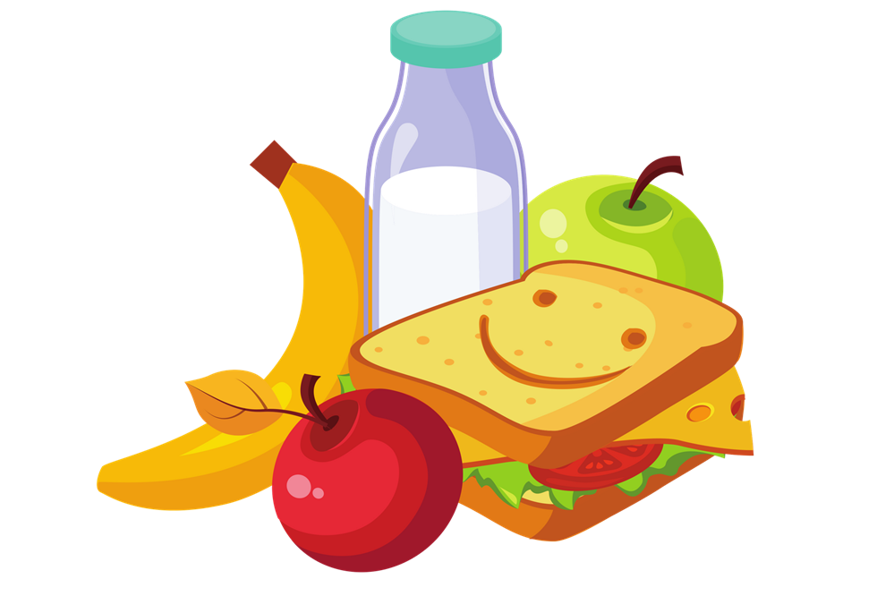
Lunch!

Slide 22
Frontend development in the field
Lets look at what frontend development looks like in the field, at CGI assignments
Notes:
Welcome back everyone, hope you had a good break. Before we looked at some of the basics of frontend development. Now we would like to go into how frontend development looks like when you might encounter it at a CGI assignment. As you will probably be able to imagine a lot more goes into that than simply making a webpage with an input box and some fancy colours.

Slide 23
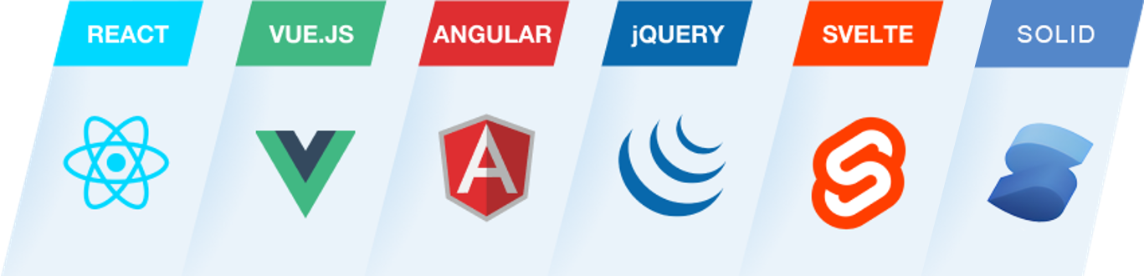
Frontend development in the field
Notes:
The first important factor to consider is that any frontend job will always use some kind of library. There are many libraries out there, and we’ve listed some of them here. The three most popular frameworks are React, Vue and Angular and within CGI you’ll mostly find React and Angular. For this workshop however we will focus on React because it has a lower learning curve than Angular has.
- Dit zijn libraries die HTML,CSS,JS genereren. Het zijn hulpmiddelen

Slide 24

But first, NodeJS
JavaScript everywhere
Node package manager
Runs web servers
Builds a webapp to a format better suited for browsers
Notes:
But before we can really start we need to quickly address NodeJS. Why did we ask you all to install this beforehand? Usually JavaScript is associated with browsers, but in the modern day it also runs on servers or computers, which is where NodeJS comes in. For the purposes of frontend development NodeJS is used as a package manager (like nuget) and script runner. Through these scripts it is able to run a web server, which you may have already utilitized for the first 2 assignments, build code into an optimal production-ready bundle. A bundle like this is the generated HTML, CSS and JS that we talked about before. Without NodeJS frontend development would be impossible as we know it today.

Slide 25
What is React?
Predictable code, simpler to understand and easy to debug.
Smaller components managing their own state composed into a complex UI.
Dynamically rewriting the current page vs Web page load from server
Notes:
React is a library designed by Meta. It was first released in 2013 and has been popular ever since. React code is all about writing predictable code that is simple to understand and easy to debug. When writing React code it is encouraged to write smaller components that encapsulate just one functionality, similar to many of the principles that you have already learned during the object oriented programming deep dive classes. By making sure that every component encapsulates only what it needs to you make it much easier to narrow into a problem if any arises down the line.
Lastly, with libraries like React you build what is called a Single Paged Application. Single Paged Applications are applications that live on one single page and use JavaScript to display different content to the user based on what they want to view, we call that the route of the page. This is contrast to way back in the day where websites would consist of many separate pages and you’d have to load a whole new page everytime you go to a different page.

Slide 26
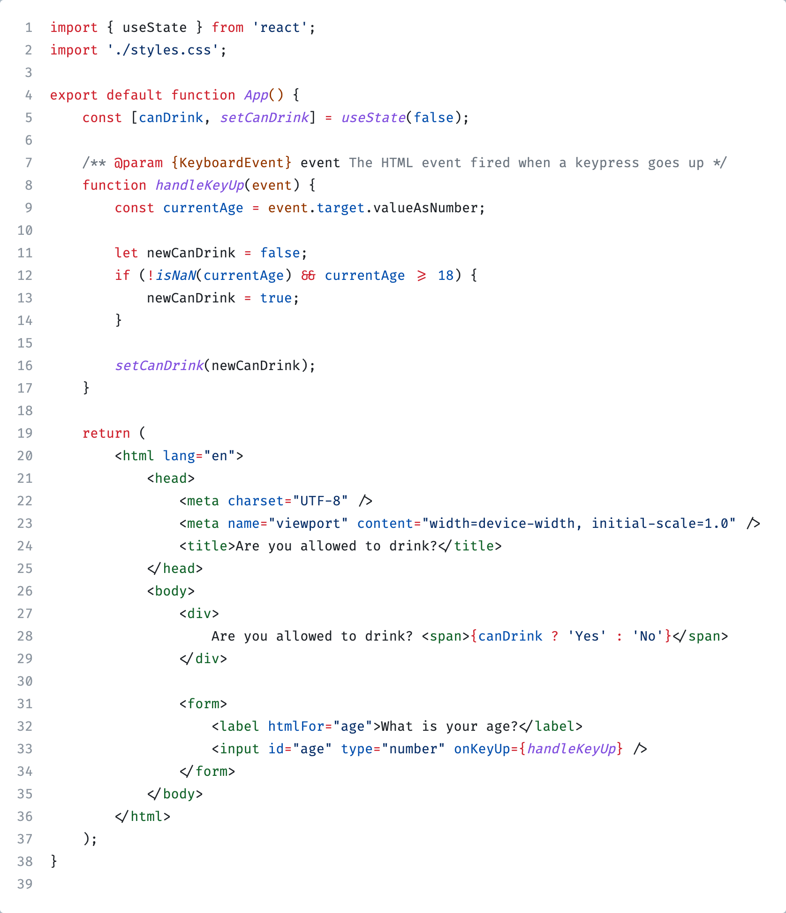
The React syntax - JSX
JavaScript and HTML combined
Example exercise 1 ⟶
Notes:
When writing React code we use the JSX syntax. What is this? JSX is like a special flavour of combining JavaScript and HTML into one. Before when we wrote simple HTML we had to write your JavaScript separately and retrieve the components to target, but with JSX this is no longer necessary, we can just write the JavaScript directly into the code. To the side here you see how this works for the first exercise you made this morning. Lets go over the notable differences.
We no longer have a separate HTML and JS file, it’s all just 1 file
We will go into a lot of this syntax later, but for now we want to give you all a general overview of what React syntax is like.
The order of code in this component matters a lot. Lets go over it from top to bottom, this shows the correct order that should be used
When writing React code we need to use state to keep track of values. For this React uses so called “hooks”. For now you just need to know that “useState” is a hook in which we can keep track of state. The first parameter, canDrink, is the current state and the second parameter, ”setCanDrink”, is how we write a new value to it.
Next we have largely the same event that we had before with the JavaScript code, except now instead of setting the value to the element like we had to do before, we update the React state.
And at the bottom we have the JSX code. Here you can see that we have removed the “id” properties because we no longer need to identify our components from JavaScript and we have instead embedded the code directly into this JSX.
This return at the bottom defines the actual syntax that should be rendered

Slide 27
Demo
Notes:
Now that we know what React is, lets look at a simple demo application using React.

Slide 28
Exercise 3
An about me page with React
Notes:
Now that I’ve shown a demo of a React application I would like you all to make a simple about page in exercise 3. Like with the previous demos a setup has been made for you and you can find the instructions in the by now expected place.

Slide 29
Exercise 3 - Demo
An about me page with React
Notes:
Alright now that you’re all finished or nearly finished I would like to give a quick demo of the solution as I had originally designed it.
Explain defining and using functions and constants
Explain using external components
Explain some React syntax
Styles
Displaying data
Defining functions inside React components

Slide 30
Lets dive into some of the React syntax
Extracting rendering to a function
Conditional rendering
Rendering lists
Responding to events
Properties (also called props)
Hooks
Notes:
We just looked at some of the react syntax that were used for exercise 3 but there are a few more concepts that we would like to cover. The first of these is conditional rendering

Slide 31
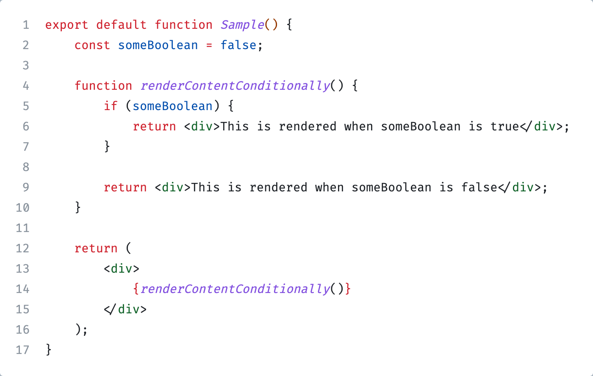
Extracting rendering to a function
Notes:
Lets start by extracting the rendering to a function. This can be particularily useful if you need to render a lot of code based on complex conditions, such as switch/case statements, multiple if/else statements, loops or different complexity. Lets have a look at some code that based on a condition renders different HTML code.We then call the function in the JSX code below and the content from the function will be rendered on the page appropiately.

Slide 32
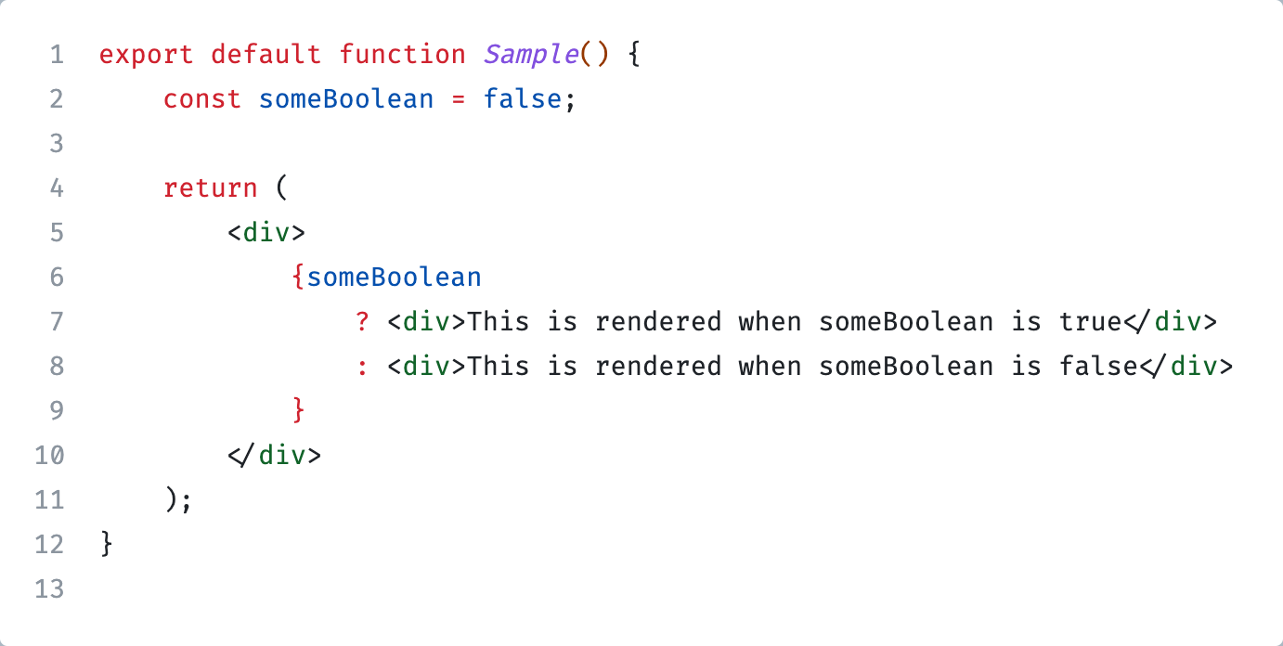
Conditional Rendering
Notes:
The next topic is inline conditional rendering. An example of when this may be needed is checking whether the user has toggled some kind of switch. Here you see the same code of the previous slide but with inline conditional rendering. In this case because the condition is very simple this is the preferred way. With JSX we leverage the “ternary operator”, which is the question mark and colon symbols. Code for when the case is true goes behind the question mark, code for when the case is false goes behind the colon. Ternary operators are a concept in many programming languages that allow you to write an if/else case without the explicit if/else keywords.

Slide 33
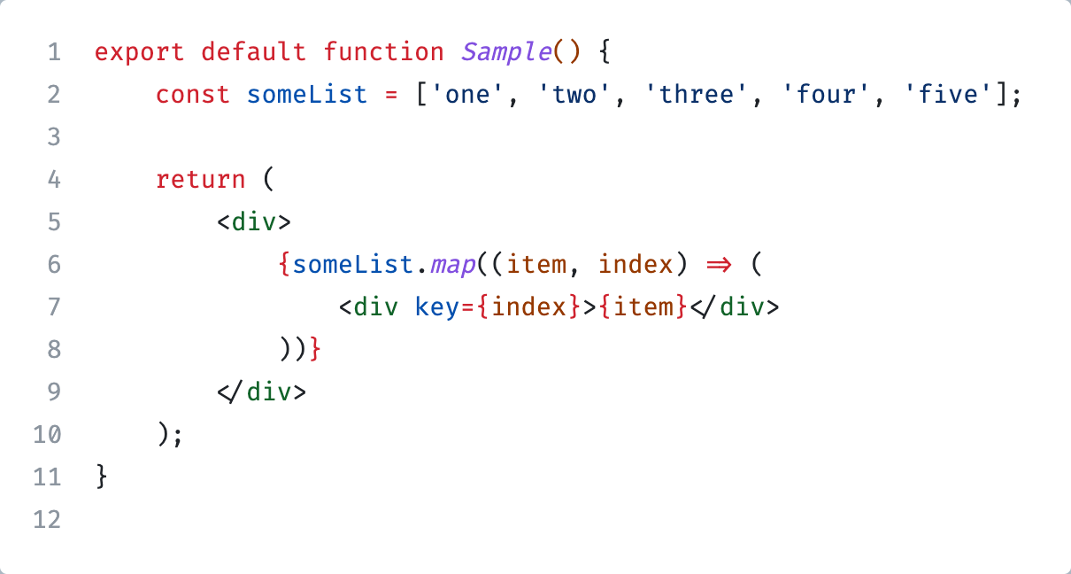
Rendering lists
Notes:
Now lets look at how to render lists. Over here we have a simple array with five items. If we want to render that to React components the easiest way is to leverage the “map” function on an array. A map goes over every item in the array and transforms the element from the original to something else.
When looping over items in this way it is important to read both the array element, here called item, and the array index. React requires being able to identify which element is which and for that using the index in the array is the easiest, you specify this through the reserved “key” property. We will go into properties a bit more later, but we would like to highlight here that “key” is reserved and you should never use it yourself for your own custom properties.

Slide 34
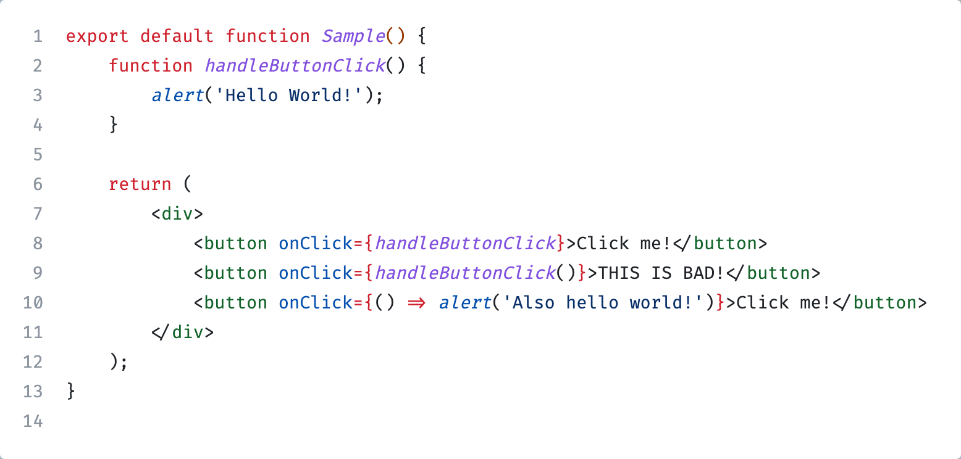
Responding to events
Notes:
We’ve covered the most common special rendering techniques and with that information you should have a good basis for creating React components. That still leaves out user interactivity however. Before when showing you about the JSX syntax we had an event handler for the onKeyUp event, but the most popular and probably the event you will use most is the onClick event, which you would use for any button clicks. In this bit of sample code we see two ways to handle on click events. At the top we use an externally defined function.
It is important to note here that you do NOT use functions like how the second line shows, in JavaScript there is a big difference between these two. In case of the first line you pass the function itself, whereas with the second line you execute the function and pass the result through, which in this case means that rather than the function triggering on the click, it triggers as soon as the button is visible.
As mentioned before there is also another way to handle the click event, which is the bottom row, these are called “arrow functions” in JavaScript and they let you completely inline the function and without having to give it a name. This can be particularly useful if whatever you want to execute is a single line and not a high complexity.

Slide 35
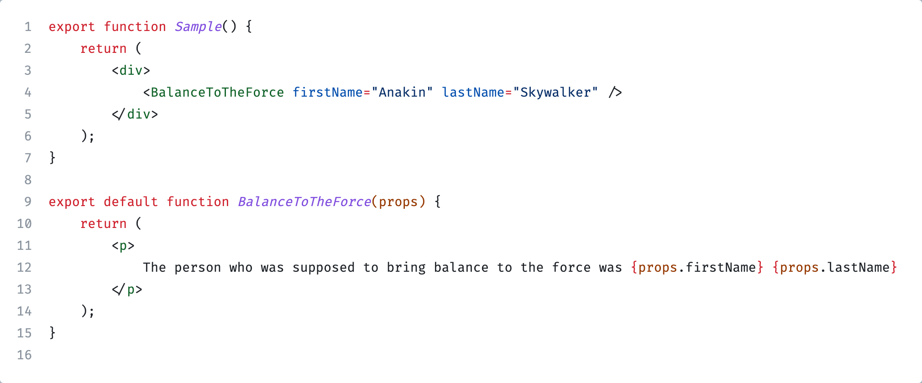
Props
Notes:
For the next bit of syntax we would like to look at props. You will have seen this a bit before already when we demo’d the Link component for exercise 3, but now we would like to dive a bit deeper. Using props you can pass values from a parent component to a child component in React. This parent-child relationship is very similar to a parent-child relationship in object oriented programming, except that in React because we write JSX code every child is itself a component that we use as a JSX component. In this sample “BalanceToTheForce” is the child component, and “Sample” is the parent component. To understand props, lets establish a few ground rules <next slide>

Slide 36
Props
A react components always receive one and only one parameter, and that is the props
Props is an object, so it has keys and those keys have values
You can pass both functions, variables and complete other React components as props
Notes:
First of all, react components always receive one and only one parameter, and that’s the props object. For example in this sample to the right we are passing 2 different properties, but the child component still only receive 1 parameter, the props.
Next, props is an object with keys and values, so as you can see here we access each of the props by the key.
And lastly you can pass functions, variables, and complete other React components as props.

Slide 37
React hooks
“use” prefix
useState
useEffect
useRef
Notes:
The last bit of syntax that we would like to address is one of the most important things in modern React, and that’s hooks. Hooks are special functions in React that always start with the “use” prefix. They are used to add some kind of functionality to the component that you’re writing. The 3 most important hooks to know are useState, useEffect and useRef. Lets look into these 3 a bit more

Slide 38
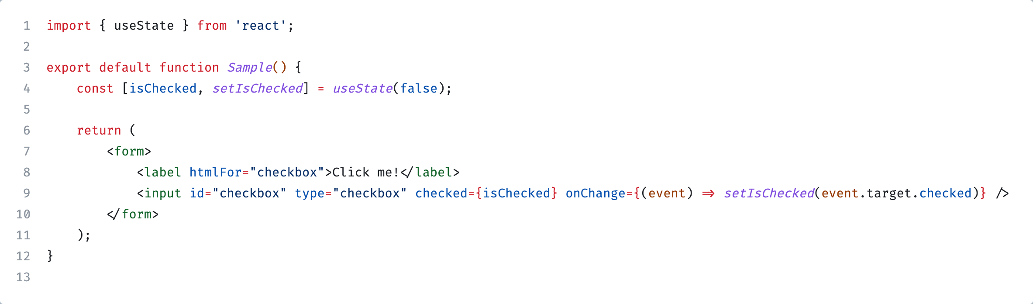
useState
Keeps track of state
Has a value and a setter
Notes:
useState is a hook that we briefly showed before when talking about the JSX syntax. As the name implies it’s a way to keep track of some kind of state. This is important because without it data would be lost when a component has to re-render, for example when the user changes an input field or clicks a button.
In this code snippet you can see how we define a bit of state to keep track of whether a checkbox is checked or not. First we define the state, isChecked and the setter for that state, setIsChecked, it is best practise in React to always name your setters the same as the state itself but with the “set” prefix. After that we have some kind of input checkbox where we need to know if it’s checked or not, so we pass the isChecked state. We also want to actually be able to change the state. For a checkbox that is through the onChange event and we can read whether the checkbox is checked or not by checking the checked property.
Now when the user checks the checkbox we can see if it was checked or not through the isChecked property. We can then use this for example to show some other bit of text, a button or anything else.

Slide 39
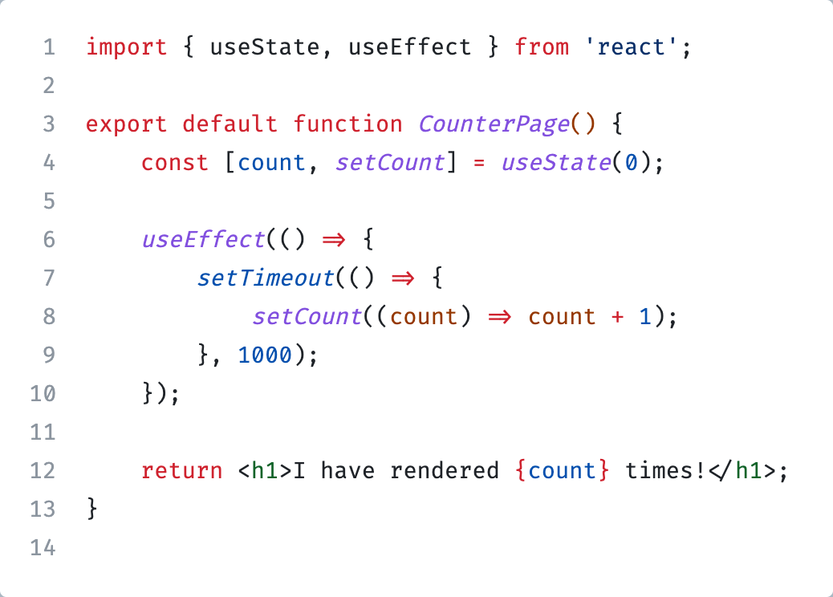
useEffect
Used to apply side effects to components
For example: fetching data from the backend
Notes:
The next hook to look at is the useEffect hook. It is very important for if you want to connect your frontend with a backend because in your useEffect hook you can asynchronously fetch data from the backend and then trigger an update to the current page based on that data. In this example to the side we simply have a ticker that increases every 1 second and renders that amount to the page.

Slide 40
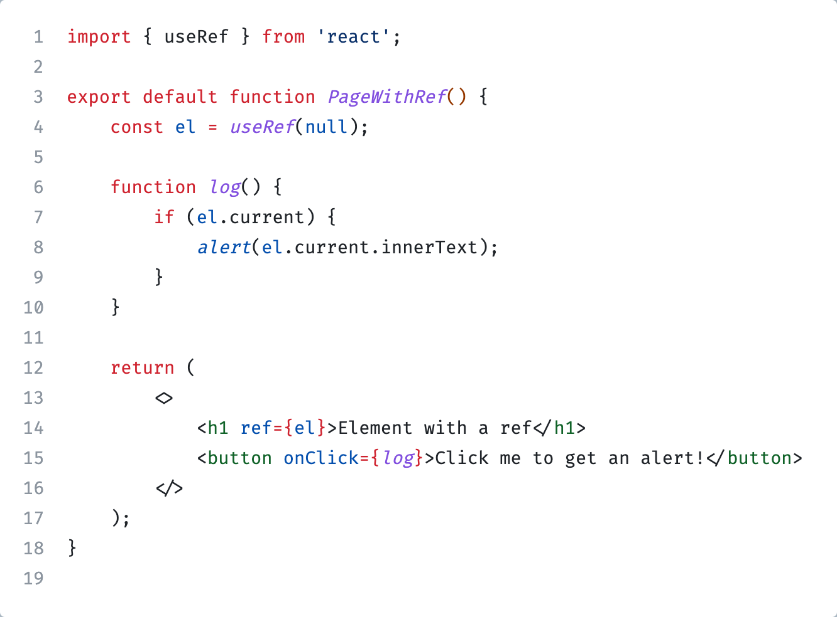
useRef
Used to reference elements
Unlike state does not cause re-renders when changed
Notes:
The last hook we would like to highlight is the useRef hook. This hook lets you reference HTML elements so you can read their properties elsewhere. At the start of this workshop we used “document.getElementById” to find the element and assign an event to it, with React you can instead use refs to retrieve an element.

Slide 41


Frameworks
Next.js, a framework by Vercel
Remix, a framework by Shopify
Notes:
The final topic that we would like to discuss in this workshop are frameworks. While you are definitely able to use React without a framework it is advised to use a framework because they offer many benefits. For example it saves you from a lot of menial tasks such as setting up your development and build environment, it comes with features such as routing to different pages built in, and it offers many different optimizations. Currently the 2 most popular frameworks for React are Next.js and Remix, but there are many other frameworks out there too. In fact, you may have noticed that for exercise 3 you were using Next.js! These frameworks could be a whole workshop onto themselve so we encourage you to check out their webpages, have a look at some of the documentation and get a grasp that way what they are all about.

Slide 42
Exercise 4
Advanced - Putting it all together
Notes:
We’ve given you a lot of information throughout the day and now we would like to give you one final excersise. This is an advanced exercise which you do not need to finish by the end of the day, and you will be putting all the knowledge of today to the test. If you do not finish it today then you can always work on it later to practise more.

