Slide 1
GIBBS SAMPLER FOR IDENTIFICATION OF SYMMETRICALLY STRUCTURED AND POSSIBLY SPACED DNA MOTIFS AND ITS VALIDATION ON THE ArcA BINDING SITES

Slide 2
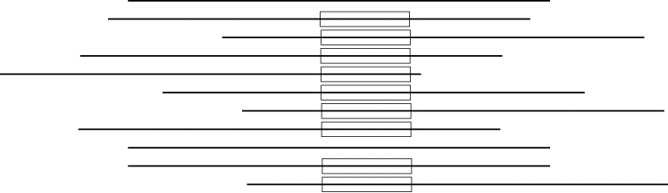
Multiple Local Alignment (MLA)

Slide 3
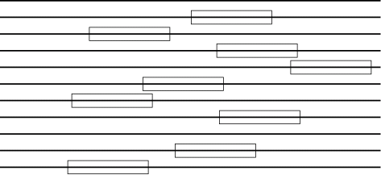
Other representation: motif and background

Slide 4
What is a motif
Motif in an a DNA sequence is a model for a protein binding site. As there is no a strict physical description of the interaction, a few approaches are used to create such a model.
  a consensus with possible mismatches: string-like model
  a positional-probabilistic (PPM), or a positional-weight (PWM) matrix: statistical model
  others

Slide 5
PPM and background
We mark a sequence into the motif site (occurrence), which is described by a probability-positional matrix q(i,r) , and the background, which is described by background symbol probabilities f(i).
r is a nucleotide (a residue); r ∈ {A,T,G,C}
i is a position in the site, i=1..s , s is the motif length

Slide 6
What is a motif
Two probabilistic models, foreground (the motif) and background, are formulated. We classify (mark) all the input sequences into these two models-obtained parts. The optimal classification is the one most probable in the Bayesian sense.

Slide 7
What and how do we want to optimize
We maximize the posterior of the given foreground-background classification of the DNA sequence data as a function of the site positions in the sequences.
Markov Chain Monte-Carlo (MCMC) technique is a natural algorithm for its optimisation.
The MCMC variant known as the Gibbs sampling has been originally applied to the MLA problem in (Lawrence et al, 1993) and then has become one of the most popular tools for motif extraction in biological sequences.

Slide 8
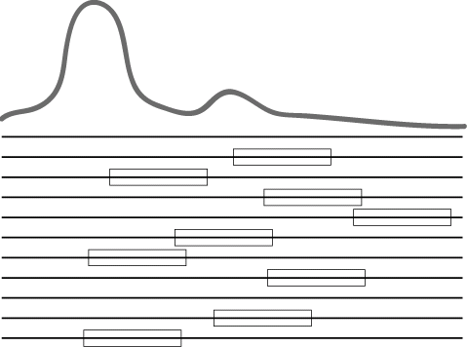
A Gibbs sampling step
A new site location is sampled from the distribution.
The probability distribution of the new site position or its absence in the current sequence is derived from the statistical models and the current sequence content.
Statistical models for the background and for the motif are formed using the counters.
The current sequence
Motif and background bases counters are computed from all the sequence fragments except the current one.

Slide 9

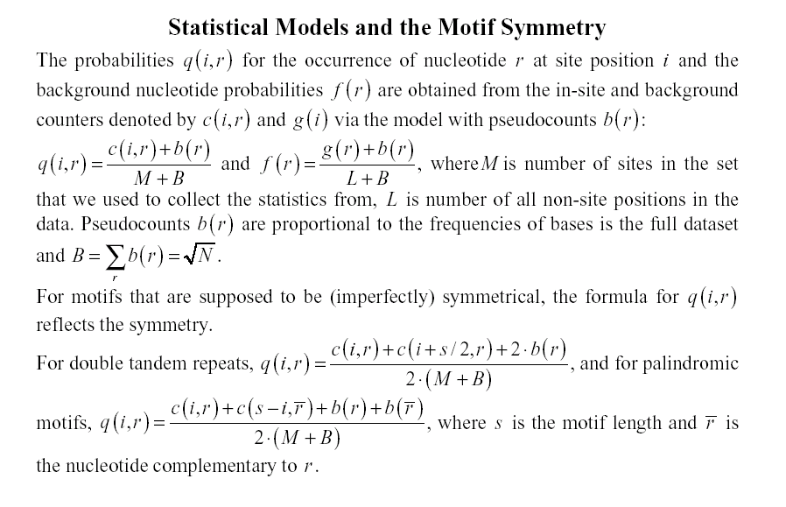

Slide 10
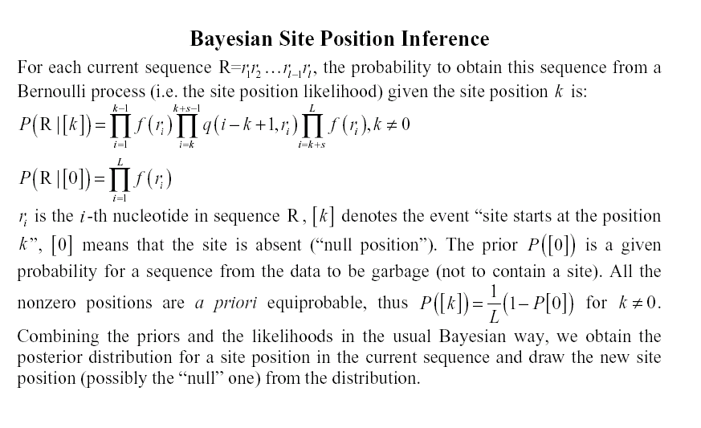

Slide 11
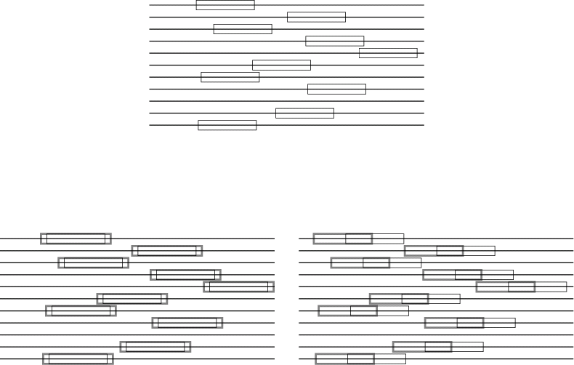
An adjustment
We test all possible site lengths, preserving the relative site positions.
For every length, we look for the best position of the entire collection (it slides as a solid body of sites).

Slide 12
Information content per letter
Structural component:
The motif PPM information content. It is difficult to use it as the maximization parameter, because it grows monotonously with the motif length. The same value when related to a position will be the best for the best position without any elongation.
Spatial component: distance between prior and posterior distributions of probability to obtain motif in a sequence position.

Slide 13
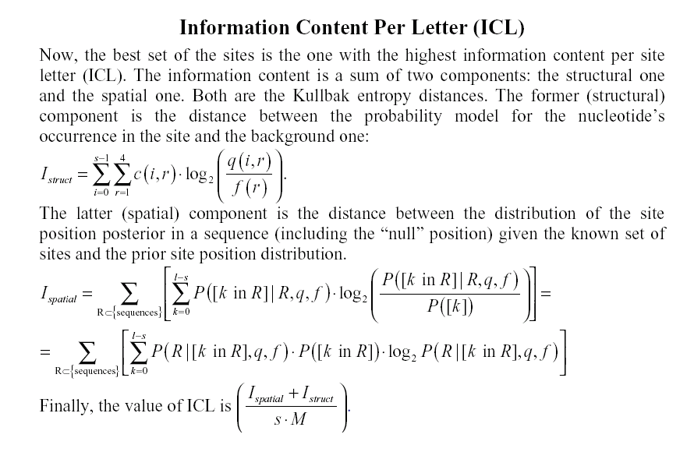

Slide 14
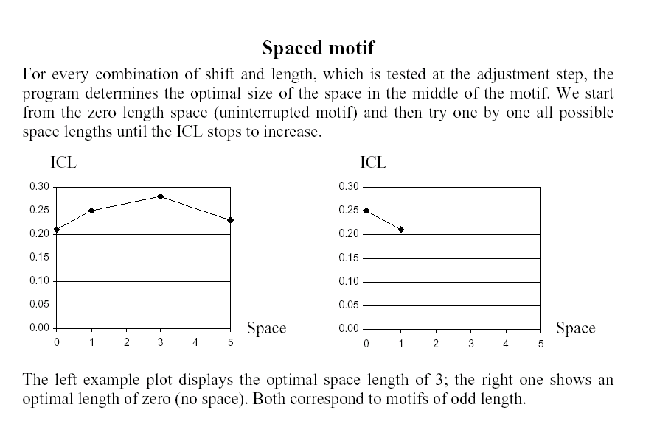

Slide 15
The algorithm differences
The modification is inspired by extensive practice of analysis and prediction of gene co-regulation in prokaryotes.
It is designed to look for symmetrical (repeated or palindromic) motifs as well as regular ones. The motif may be symmetrically spaced (i.e. some positions in the middle of the site can be ignored). The optimal length of the gap is determined along with the motif length.
It strictly accounts for the possibility of the site absence in a sequence.
The information measure that is used is the Kullbak entropy distance for both spatial and structural components.
We can optimise the motif length while looking for the best motif, thus reducing the runtime.

Slide 16
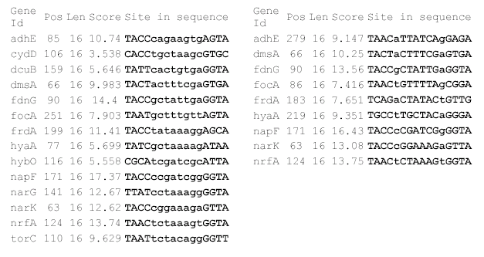
The major parameters
The preferred structure of the motif.
The prior for a sequence to be garbage and thus not to contain any motif.
Notes:
The parameter express our preference about what we want to obtain: a highly populated weak motif (low garbage prior) or strong, but poor one (high garbage prior).

Slide 17
Postprocessing procedures
The software can scan all the input sequences with the obtained motif profile, gathering all sites that are better than the worst in the obtained set. It is a very useful procedure to adjust the prior of garbage.
The sequence collection can be output with masked sites found to search for another motif in the data.

Slide 18
Application: ArcA signal
In Escherichia coli, gene expression is dependent on redox conditions, which is partially mediated by the Arc signal transduction system. The phosphorylated form of ArcA protein (ArcA-P) represses certain target operons (e.g. icd, lld, sdh and sodA) or activates others (e.g. cyd and pfl ) by interacting with promoter DNA. We used the tool to search for a common motif in upstream regions of the genes, which were extracted as ArcA-regulated from the DPInteract database.

Slide 19
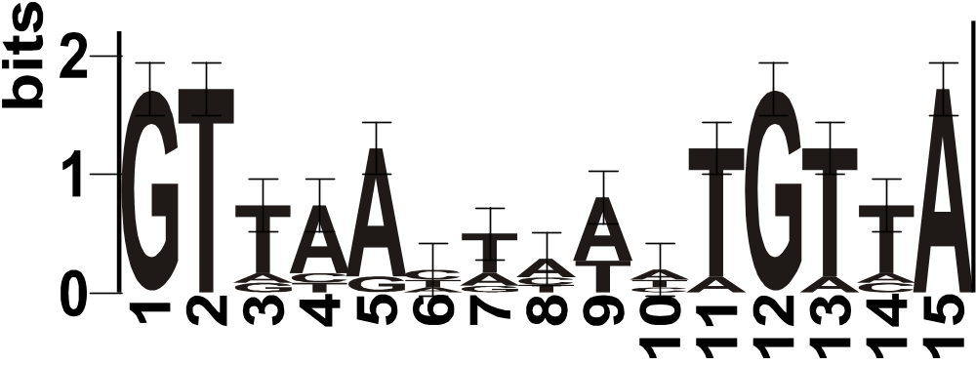
The parameters for the motif search were selected as a possibly spaced direct repeat of length between 6 and 22 bases located at any DNA strand. As a result 15-nucleotide motif was obtained, which refines the known ArcA binding site structure

Slide 20
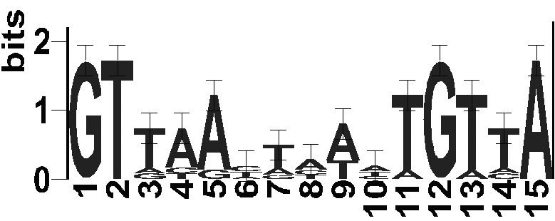
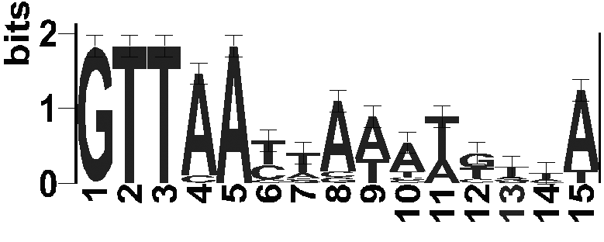
The refinement is a result of looking for a motif of a definite structure.

Slide 21
Recognition rule
The found set of sites was used to create a PWM. Genome Explorer software was used in all comparative genomics studies.
We we looking for E. coli genes with the upstream ArcA box scored better than 4,25 and with at least two orthologs in Y. pestis, P. multocida and V. vulnificus, which carry an ArcA boxes scored at least 4,00 in the upstream.

Slide 22
Test result
The search identified 23 E. coli genes. One of the found genes is the ArcA protein gene itself. 14 of these genes are mentioned in literature as oxygen-dependently regulated.

Slide 23
Test interpretation
The probability of a null-hypothesis of random gene selection by the recognition rule can be evaluated with a high estimation of 500 oxygen-dependent genes among 4404 genes in full E. coli genome. Fisher criterion for “14 9 // 500 3904” four-pole table gives the null-hypothesis probability of about 2x10^{‑7}. So, the null-hypothesis can be reliably rejected.

Slide 24
http://bioinform.genetika.ru/SeSiMCMC

Slide 25
Favorov, A.V. ¹, Gelfand, M.S. ^{1,2,3}, Gerasimova, A. V. ¹, Mironov, A.A. ^{1,3}, Makeev, V.J. ^{1,4}
¹ State Scientific Centre “GosNIIGenetica”, 1st Dorozhny pr., Moscow, 117545, Russia.
² Institute for Information Transmission Problems, Russian Academy of Sciences, Bolshoi Karetny per. 19, Moscow 127994, Russia.
³ Dept of Bioengineering and Bioinformatics, Moscow State University, Lab. Bldg B, Vorobiovy Gory 1-37, Moscow 119992, Russia.
⁴ Engelhardt Institute of Molecular Biology, Russian Academy of Sciences, Vavilova 32, Moscow 119991, Russia.

Slide 26
We are grateful to Dmitriy Rodionov for useful discussion, to Ludmila Danilova for assistance with the data, to Jeeping Weng for advices and to Valentina Boeva for help with the presentation. This study was partially supported by grants from the Howard Hughes Medical Institute (55000309 to M. Gelfand), from the Ludwig Cancer Research Institute (CRDF RBO-1268 to M. Gelfand), from the Russian Fund of Basic Research (04-07-90270 to V. Makeev) and from Program in Molecular and Cellular Biology of Russian Academy of Sciences (to V.G. Tumanian).

