Slide 1
Superstore Sales & Profit Dashboard
Task 3: Dashboard Design | Data Analyst Internship
Ogunronbi Favour

Slide 2
Objective & Tools
Objective
Tools & Dataset
Design an interactive dashboard that helps business stakeholders quickly understand sales performance, profitability, and trends across regions and product categories.
Tool: Microsoft Power BI Desktop
Dataset: Sample Superstore
Fields used: Sales, Profit, Order Date, Region, Category, Order ID

Slide 3
Key Performance Indicators (KPIs)
Four core metrics were chosen to summarize business health at a glance:
Total Sales
Total Profit
Profit Margin
Order Count
Overall revenue generated
Net profit earned
Profit as % of sales
Distinct orders placed
Displayed as color-coded card visuals for instant readability by stakeholders.

Slide 4
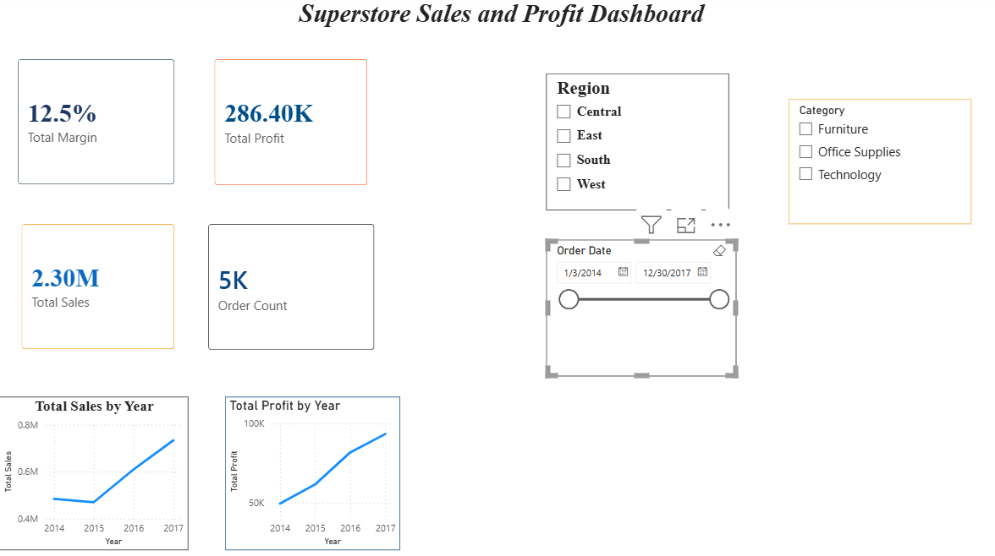
The Dashboard

Slide 5
Interactivity & Design Choices
1
Slicers
2
Time-Series Chart
Region, Category, and Order Date filters let users narrow the view instantly.
Line chart tracks Sales (and Profit) trends month by month.
3
KPI Cards
4
Consistent Theme
Four color-coded cards give an at-a-glance summary of totals.
A navy and white palette with distinct accent colors per KPI keeps the report cohesive.

Slide 6
Key Insights & Outcome
Sales and profit can be filtered instantly by region, category, and date range.
Profit margin sits around 12%, giving a quick health check on pricing/cost efficiency.
The time-series view makes it easy to spot seasonal peaks and dips in sales.
Stakeholders can self-serve answers without needing a new report for every question.
Outcome: Learned how to design a stakeholder-ready, interactive dashboard that turns raw sales data into decision-ready insight.

