Slide 1

VERITICS
Customer Shopping
Behavior Analysis
Findings and recommendations from 3,900 customer transactions
Prepared for TRYBEFUSE
Analytics Partner: Veritics

Slide 2

Executive snapshot
Five KPIs across 3,900 transactions, 25 items, and 50 US states
$233K
3,900
$59.76
3.75 / 5
27%
Total revenue
Total orders
Avg order value
Avg review rating
Subscription rate
The revenue base is broad and evenly spread across age, tier, and category. No single segment carries the business. That stability is the platform on which two clear, underexploited levers sit on:
a margin gap between Accessories and Clothing, and
a total subscription blind spot on Female customers.
Veritics × Trybefuse
2

Slide 3
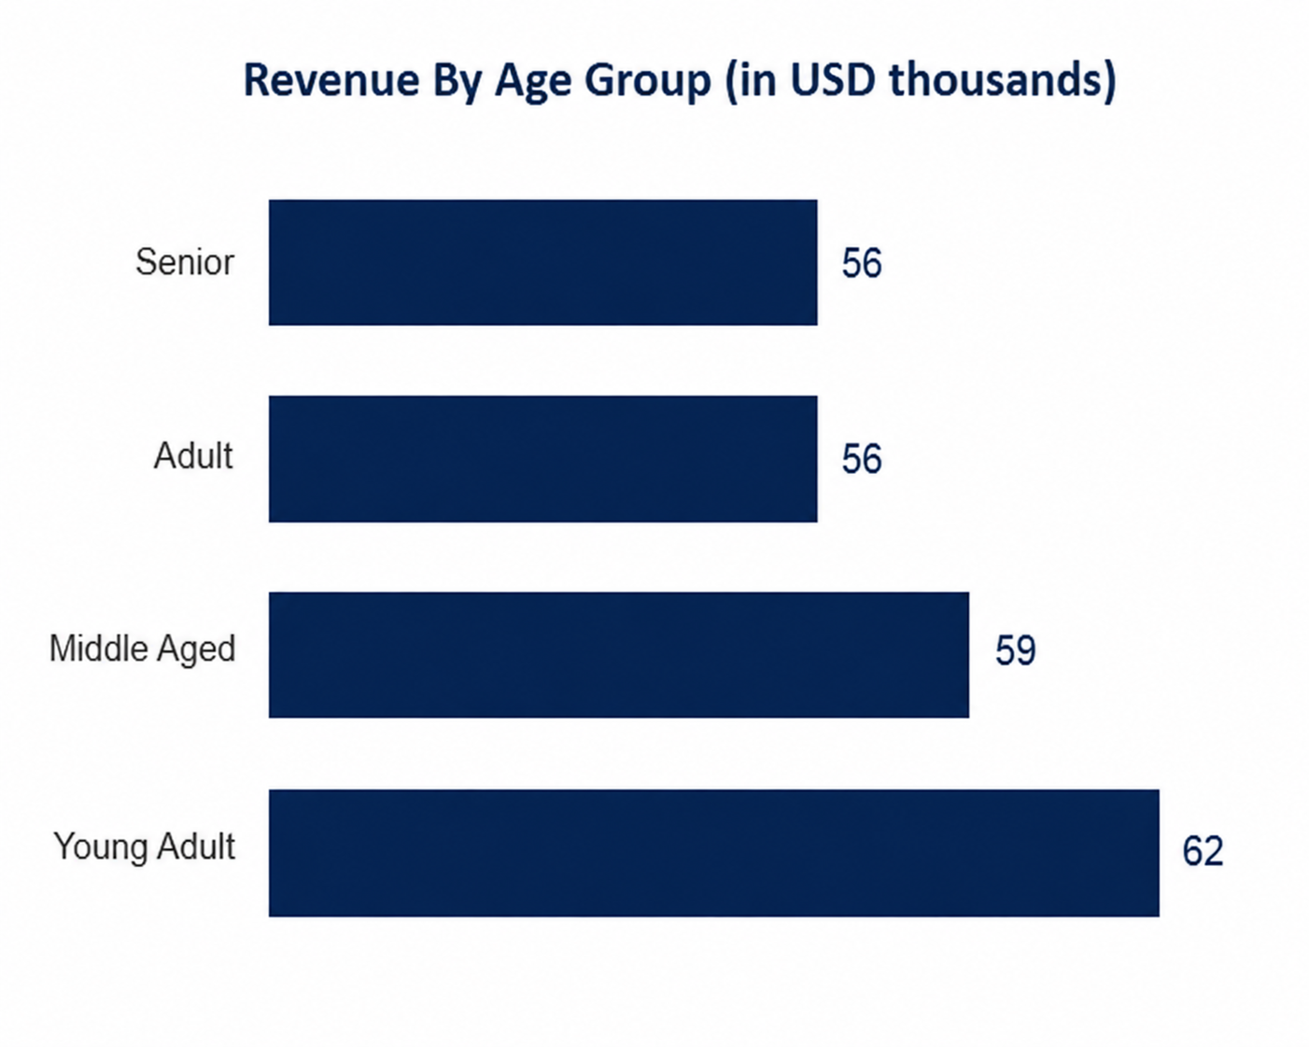
Revenue is broad-based, not concentrated
No age group or customer tier dominates — a stable, diversified customer file
Orders by customer value tier
Veritics × Trybefuse
3

Slide 4
Clothing drives volume — Accessories drives margin
The highest-revenue category is not the most profitable one
Revenue by category (USD)
Profit margin by category
Accessories
0.50
Clothing
0.45
Outerwear
0.40
Footwear
0.35
Accessories carries a 5-point margin advantage over Clothing despite generating 30K less revenue — a strong case for shifting promotional spend.
Veritics × Trybefuse
4

Slide 5
Top 10 items by revenue
A diversified product mix — no single hero SKU carries the catalog
Veritics × Trybefuse
5

Slide 6
Satisfaction is solid, not exceptional
Ratings cluster in the middle — room to convert satisfied customers into advocates
Rating distribution
3.75
out of 5
average review rating
Veritics × Trybefuse
6

Slide 7
The biggest opportunity in this dataset
Zero female customers are subscribed
despite Female average order value ($60.25) outpacing Male ($59.54)
27%
$60.25
1,248
overall subscription rate
female average order value
female customers with zero subscription reach
1,053 of 3,900 customers subscribed — all of them male
vs. $59.54 for male customers — the higher-spending segment isn't the one being retained
an entire, higher-value segment untouched by the current retention mechanism
Veritics × Trybefuse
7

Slide 8
Loyalty is even across age groups
Repeat purchasing behavior doesn't skew young or old, retention programs can not be dependent on age
Repeat customers by age group
Subscription vs. non-subscription
Veritics × Trybefuse
8

Slide 9

Recommendations
Four moves that convert these findings into revenue and retention gains
01
02
Close the subscription gender gap
Shift promotional weight to Accessories
Launch a targeted subscription campaign for female customers, an untapped, higher Average Order Value segment representing 32% of the customer base with zero current reach.
Reallocate a portion of Clothing's marketing spend toward Accessories, which carries a 5-point margin advantage despite lower revenue.
03
04
Convert 3-star reviewers to advocates
Build age-agnostic loyalty programs
1,585 customers sit at 3 stars — the largest single band. A targeted post-purchase follow-up could shift this cluster toward 4-5 stars.
Repeat purchase rates are flat across age groups (381-440), so retention programs don't need age-specific segmentation to be effective.
Veritics × Trybefuse
9

Slide 10
veritics
Thank you
Analytics Partner: Veritics • Client: TRYBEFUSE
Veritics × Trybefuse
10

