Slide 1

SIWES TECHNICAL REPORT
OBONG UNIVERSITY,
OBONG NTAK ,
ETIMEKPO, AKWA IBOM STATE
DONE BY : MARK, MFONIDO FRIDAY

Slide 2
STUDENT INDUSTRIAL WORK EXPERIENCE SCHEME (S.I.W.E.S) REPORT CARRIED OUT AT START INNOVATION HUB,
G11- E-LIBRARY, UYO, AKWA – IBOM STATE. PRESENTED BY MARK, MFONIDO FRIDAY U1CS1701DE

Slide 3
HIGHLIGHT
About Start Innovation Hub.
My Work Experiences
About Web Development and Web application
About Html5
Css3
Bootstrap
Java Script
Vuejs
My web Pages
Conclusion

Slide 4
ABOUT START INNOVATION HUB
Start Innovation Hub Nigeria is an ICT firm with innovation lab in Uyo, Akwa Ibom State, South-South of Nigeria. We are committed to helping technology startups with software and hardware ideas start up faster. Start Hub is a lab with business center facilities and all in one open space for entrepreneurs to leverage on Nigeria’s strength and capitalize on opportunities in the global economy.

Slide 5
Start Hub aims at stimulating economic growth in the technology community by providing key ingredients like seed funding, mentorship and access to business expertise. Others are networking opportunities, peer review, pitch development, product testing and introduction to investors.
Apart from developers and hackers, we also collaborate with government, social entrepreneurs, investors, technologists, media, tech companies and venture capitalists in and around Nigeria.

Slide 6
We also develop software solutions for local businesses. Our skills cut across research, analysis, design, development, testing, management and growth for both mobile and web platforms.
We provide space, internet, power and mentorship for tech entrepreneurs. Start Innovation Hub is a platform for people to live their tech dreams with deliberate intention of stimulating economic growth in the technology community by providing access to business expertise.

Slide 7
MY WORK EXPERIENCE
My Industrial experience has exposed me to various aspects of computer science like:
Web Development
Web Applications
Networking basics
Programming
Computer maintenance

Slide 8
Web development and web application
Web application development is the creation of application programs that reside on remote servers and are delivered to the user’s device over the Internet. A web application (web app) does not need to be downloaded and is instead accessed through a network. An end user can access a web application through a web browser such as Google Chrome, Safari, or Mozilla Firefox. A majority of web applications can be written in JavaScript, Cascading Style Sheets (CSS), and HTML5.
Web application development will typically have a short development life-cycle lead by a small development team. Front-end development for web applications is accomplished through client-side programming. Client refers to a computer application such as a web browser. Client-side programming will typically utilize HTML, CSS and JavaScript. HTML programming will instruct a browser how to display the on-screen content of web pages, while CSS keeps displayed information in the correct format. JavaScript will run JavaScript code on a web page, making some of the content interactive.

Slide 9
Server-side programming powers the client-side programming and is used to create the scripts that web applications use. Scripts can be written in multiple scripting languages such as Ruby, Java and Python. Server-side scripting will create a custom interface for the end-user and will hide the source code that makes up the interface.
A database such as MySQL or MongoDB can be used to store data in web application development.
Best Practices
Web applications will have a large amount of information that may contain mistakes, so the testing process for web applications tend to be more in-depth than other forms of software. Web application development tests may include security, performance, load, stress, accessibility, usability and quality assurance tests. Other tests that can be performed for web applications include HTML/CSS validation or cross-browser tests. Many of these tests can and should be automated whenever possible.
Tools

Slide 10
Helpful web application development tools include:
Bootstrap: an automation framework which manages HTML and CSS.
jQuery and Ruby on Rails: for JavaScript libraries and frameworks respectively.
js: is a JavaScript runtime used as a back-end programming tool.
VS Native and Hybrid Apps
Web applications are sometimes contrasted with native apps and hybrid apps. Native apps are applications that are developed specifically for a particular platform or device and installed on that device. Native apps can use device-specific hardware, such as GPS or cameras. Native apps typically have an advantage in functionality over web or hybrid apps.

Slide 11
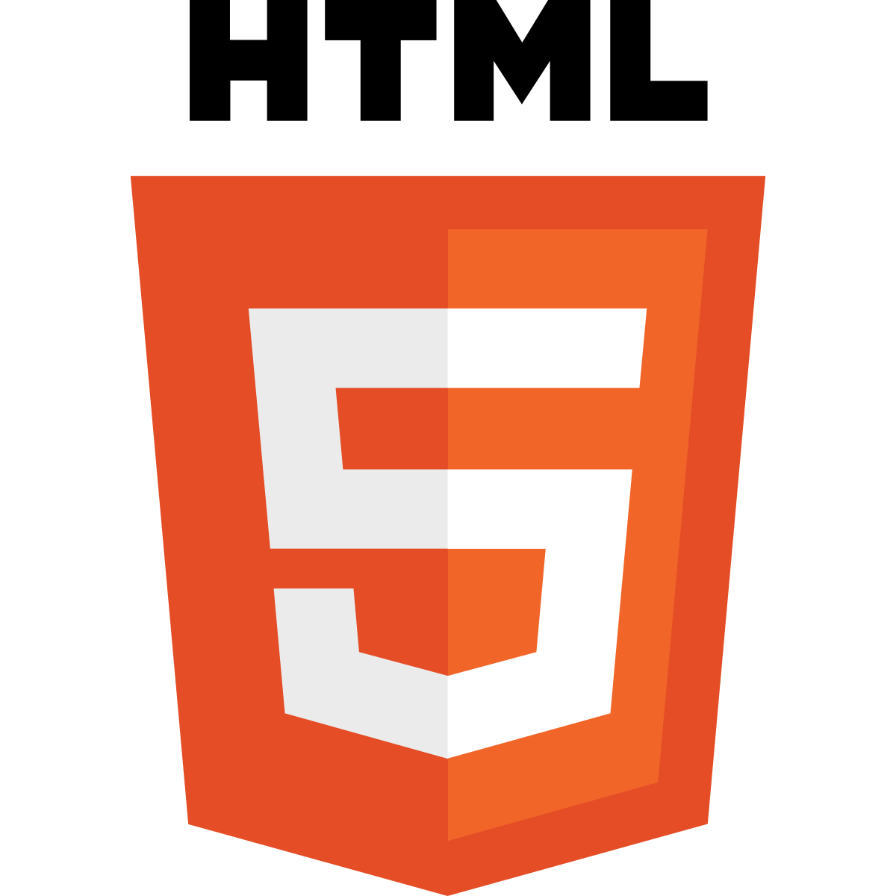
HTML5

Slide 12
HTML5
HTML5 is a software solution stack that defines the properties and behaviors of web page content by implementing a markup based pattern to it. HTML5 is the fifth and current major version of HTML, and subsumes XHTML. The current standard, the HTML Living Standard is developed by WHATWG, which is made up of the major browser vendors (Apple, Google, Mozilla, and Microsoft), with the Living Standard also existing in an abridged version.
HTML5 was first released in public-facing form on 22 January 2008,^{[3]} with a major update and "W3C Recommendation" status in October 2014.^{[2][4]} Its goals were to improve the language with support for the latest multimedia and other new features; to keep the language both easily readable by humans and consistently understood by computers and devices such as web browsers, parsers, etc., without XHTML's rigidity; and to remain backward-compatible with older software. HTML5 is intended to subsume not only HTML 4, but also XHTML 1 and DOM Level 2 HTML.^{[5]}

Slide 13
HTML5 includes detailed processing models to encourage more interoperable implementations; it extends, improves and rationalizes the markup available for documents, and introduces markup and application programming interfaces (APIs) for complex web applications.^{[6]} For the same reasons, HTML5 is also a candidate for cross-platform mobile applications, because it includes features designed with low-powered devices in mind.
Many new syntactic features are included. To natively include and handle multimedia and graphical content, the new <video>, <audio> and <canvas> elements were added, and support for scalable vector graphics (SVG) content and MathML for mathematical formulas. To enrich the semantic content of documents, new page structure elements such as <main>, <section>, <article>, <header>, <footer>, <aside>, <nav>, and <figure> are added. New attributes are introduced, some elements and attributes have been removed, and others such as <a>, <cite>, and <menu> have been changed, redefined, or standardized.
The APIs and Document Object Model (DOM) are now fundamental parts of the HTML5 specification^{[6]} and HTML5 also better defines the processing for any invalid documents.^{[7]}

Slide 14
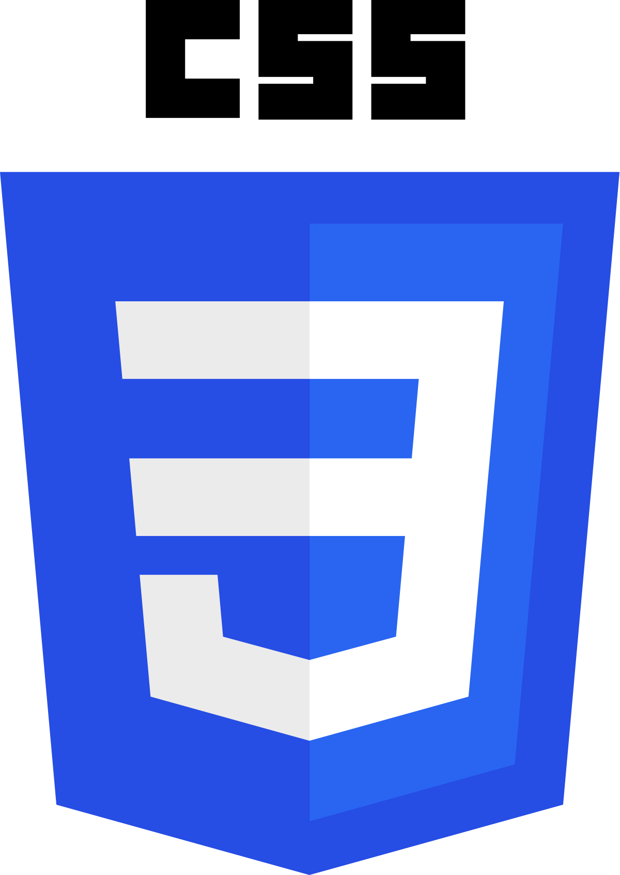
CSSS 3

Slide 15
CSS3
Cascading Style Sheets (CSS) is a style sheet language used for describing the presentation of a document written in a markup language like HTML.^{[1]} CSS is a cornerstone technology of the World Wide Web, alongside HTML and JavaScript.^{[2]} CSS is designed to enable the separation of presentation and content, including layout, colors, and fonts.^{[3]} This separation can improve content accessibility, provide more flexibility and control in the specification of presentation characteristics, enable multiple web pages to share formatting by specifying the relevant CSS in a separate .css file, and reduce complexity and repetition in the structural content. Separation of formatting and content also makes it feasible to present the same markup page in different styles for different rendering methods, such as on-screen, in print, by voice (via speech-based browser or screen reader),

Slide 16
and on Braille-based tactile devices. CSS also has rules for alternate formatting if the content is accessed on a mobile device.^{[4]}
The name cascading comes from the specified priority scheme to determine which style rule applies if more than one rule matches a particular element. This cascading priority scheme is predictable.
The CSS specifications are maintained by the World Wide Web Consortium (W3C). Internet media type (MIME type) text/css is registered for use with CSS by RFC 2318 (March 1998). The W3C operates a free CSS validation service for CSS documents.^{[5]}
In addition to HTML, other markup languages support the use of CSS including XHTML, plain XML, SVG, and XUL.

Slide 17

BOOTSTRAP

Slide 18
Bootstrap is a free and open-source CSS framework directed at responsive, mobile-first front-end web development. It contains CSS- and (optionally) JavaScript-based design templates for typography, forms, buttons, navigation and other interface components.
Bootstrap is the third-most-starred project on GitHub, with more than 135,000 stars, behind only freeCodeCamp (almost 305,000 stars) and marginally behind Vue.js framework.^{[2]} According to Alexa Rank, Bootstrap getbootstrap.com is in the top-2000 in US while vuejs.org is in top-7000 in US. Bootstrap, originally named Twitter Blueprint, was developed by Mark Otto and Jacob Thornton at Twitter as a framework to encourage consistency across internal tools. Before Bootstrap, various libraries were used for interface development, which led to inconsistencies and a high maintenance burden. According to Twitter developer Mark Otto:

Slide 19
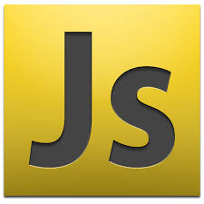
JAVASCRIPT (ECMASCRIPT)

Slide 20
JAVASCRIPT
JavaScript (/ˈdʒɑːvəˌskrɪpt/),^{[8]} often abbreviated as JS, is a high-level, interpreted scripting language that conforms to the ECMAScript specification. JavaScript has curly-bracket syntax, dynamic typing, prototype-based object-orientation, and first-class functions.
Alongside HTML and CSS, JavaScript is one of the core technologies of the World Wide Web.^{[9]} JavaScript enables interactive web pages and is an essential part of web applications. The vast majority of websites use it,^{[10]} and major web browsers have a dedicated JavaScript engine to execute it.
As a multi-paradigm language, JavaScript supports event-driven, functional, and imperative (including object-oriented and prototype-based) programming styles. It has APIs for working with text, arrays, dates, regular expressions, and the DOM, but the language itself does not include any I/O, such as networking, storage, or graphics facilities. It relies upon the host environment in which it is embedded to provide these features.

Slide 21
Initially only implemented client-side in web browsers, JavaScript engines are now embedded in many other types of host software, including server-side in web servers and databases, and in non-web programs such as word processors and PDF software, and in runtime environments that make JavaScript available for writing mobile and desktop applications, including desktop widgets.
The terms Vanilla JavaScript and Vanilla JS refer to JavaScript not extended by any frameworks or additional libraries. Scripts written in Vanilla JS are plain JavaScript code.^{[11][12]}
Although there are similarities between JavaScript and Java, including language name, syntax, and respective standard libraries, the two languages are distinct and differ greatly in design. JavaScript was influenced by programming languages such as Self and Scheme.^{[13]} The JSON serialization format, used to store data structures in files or transmit them across networks, is based on JavaScript.^{[14]}

Slide 22
JAVASCRIPT FRAME WORKS

Slide 23
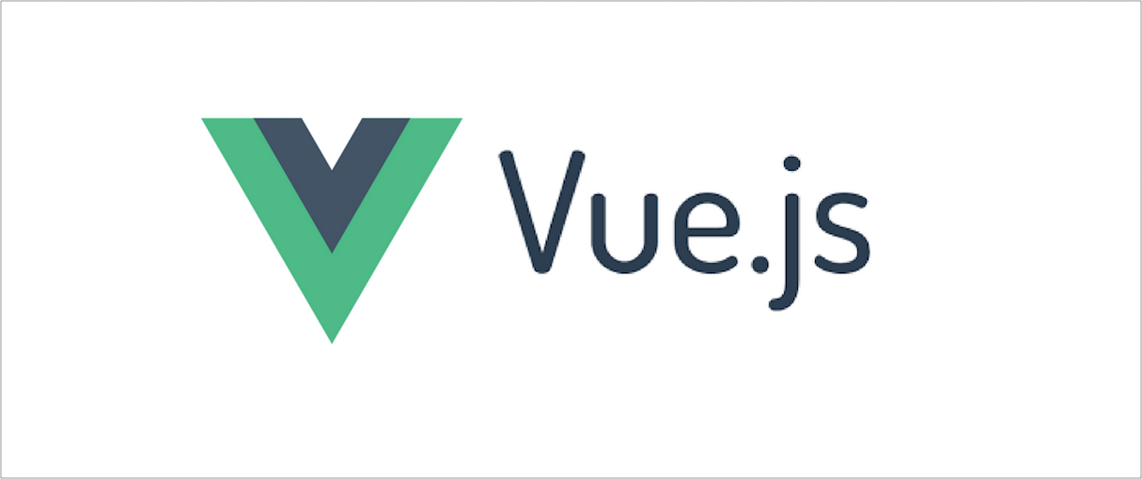
VUEJS

Slide 24
Vue.js (commonly referred to as Vue; pronounced /vjuː/, like view) is an open-source JavaScript framework for building user interfaces and single-page applications.^{[10]} It was created by Evan You, and is maintained by him and the rest of the active core team members coming from various companies such as Netlify and Netguru. Vue.js features an incrementally adoptable architecture that focuses on declarative rendering and component composition. Advanced features required for complex applications such as routing, state management and build tooling are offered via officially maintained supporting libraries and packages^{[12]}, with Nuxt.js as one of the most popular solutions.

Slide 25
FEATURES OF VUEJS
COMPONENTS
TEMPLATES
ROUTING
REACTIVITY

Slide 26
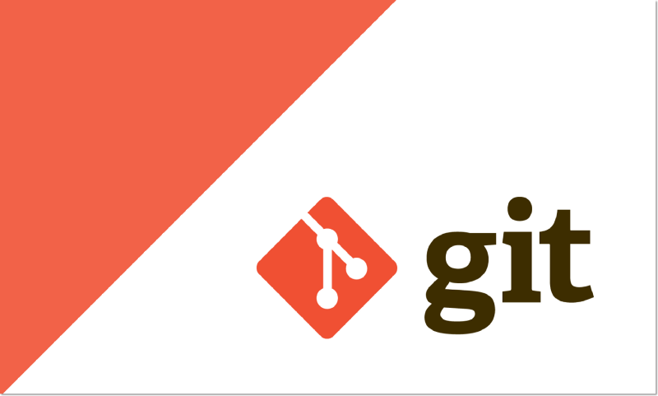

Slide 27
GIT AND GITHUB
Git (/ɡɪt/)^{[7]} is a distributed version-control system for tracking changes in source code during software development.^{[8]} It is designed for coordinating work among programmers, but it can be used to track changes in any set of files. Its goals include speed,^{[9]} data integrity,^{[10]} and support for distributed, non-linear workflows.^{[11]}
Git was created by Linus Torvalds in 2005 for development of the Linux kernel, with other kernel developers contributing to its initial development.^{[12]} Its current maintainer since 2005 is Junio Hamano. As with most other distributed version-control systems, and unlike most client–server systems, every Git directory on every computer is a full-fledged repository with complete history and full version-tracking abilities, independent of network access or a central server.^{[13]} Git is free and open-source software distributed under the terms of the GNU General Public License version 2.

Slide 28
MY WEB PAGES

Slide 29

Obonguniversity.netlify.com

Slide 30

Mfonidomark.netlify.com

Slide 31
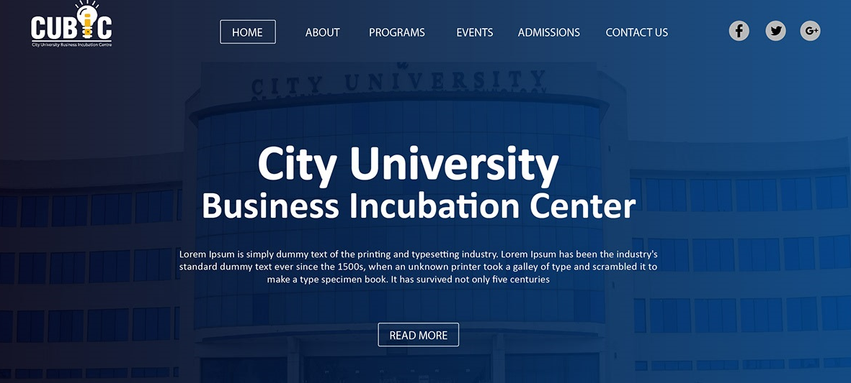
Cityuniversity.netlify.com

Slide 32
MY WEB APP

Slide 33
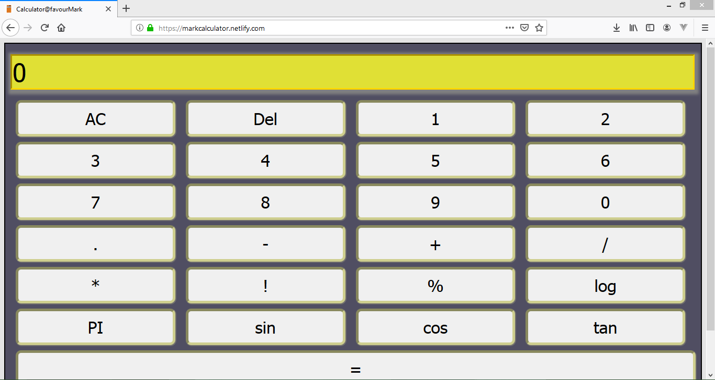

Slide 34
CONCLUSION
The Student Industrial work Experience Scheme (SIWES) gave me the privilege to relate with senior professionals and other students from different institutions. The knowledge acquired is not only academic or technical as I was also made to understand the importance of other fields of study and ultimately appreciate the roles they play to the success of any industry. The experience made me appreciate my chosen field of study both in the classroom and in the larger society.

