Slide 1
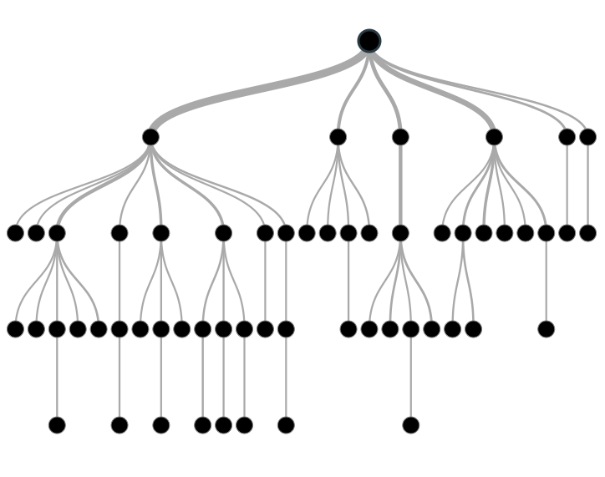
Gradient Boosting
Machine

