Slide 1
Variants of Populism
Support for Populism in 22 European countries
Marlon Schumacher, Quynh Nga Nguyen & Fabio Votta
2018/06/09 Slides: https://variants-of-populism.netlify.com/

Slide 2
Goal:
Populisum gerät

Slide 3
Outline
1. Challenges & Shortcomings
2. Progressive and Traditionalist Populists
3. Data & Methods
4. Results
5. Conclusions & Future Research

Slide 4
Challenges & Shortcomings

Slide 5
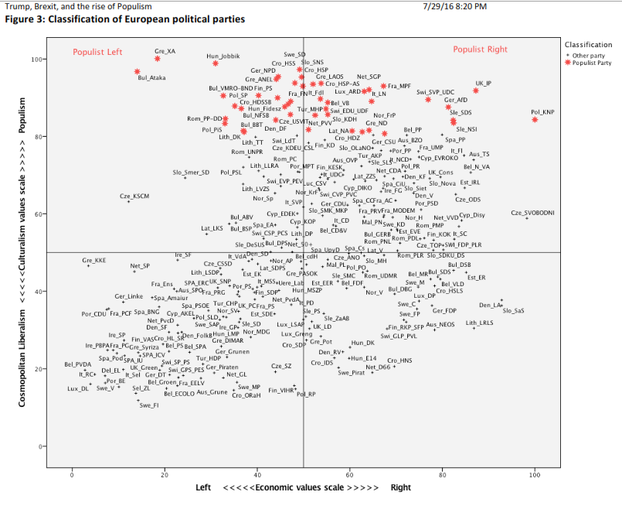
Notes:
Überleitung: NPD auf der falschen Seite

Slide 6
The problem with definitions ….
Left/Right? Liberal/Illiberal?
Inclusionary/Exclusionary?
Progressive and Traditionalist?

Slide 7
Our Approach
Minimalist Definition of Populism
-> Anti-Elite Sentiment etc.
-> Europskepticism
+ Progressive vs. Traditionalist Populism
-> GAL-TAN etc.
CHES Dataset

Slide 8
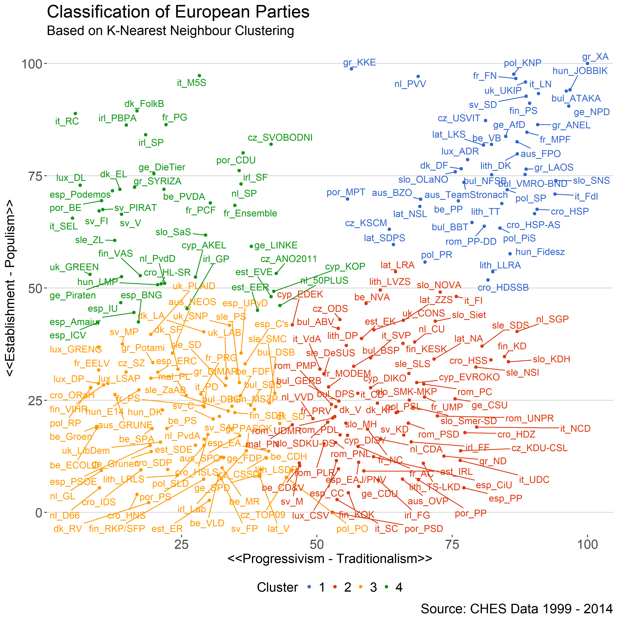

Slide 9
Our Approach
Merging with ESS (5-8)
Total 60.000 idiots in 22 countries
Multinomial Regression
Independent Variables: Socio-Economics
Two Validation thingies: Economic and Cultural dimensions

Slide 10
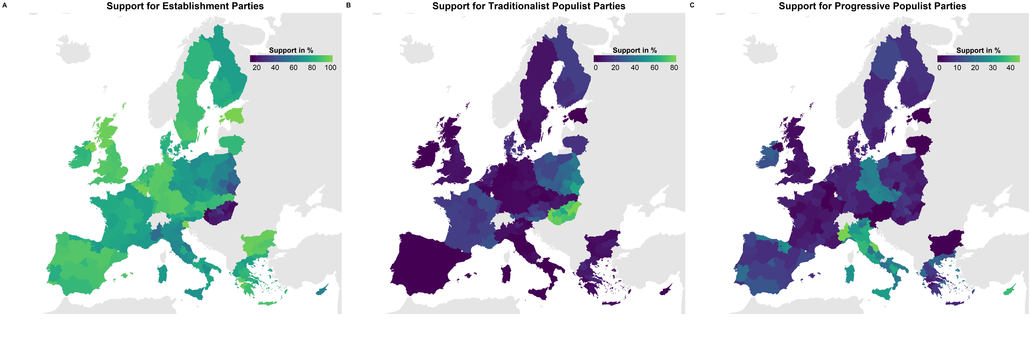
Wieviel Prozent insgesamt jeweils

Slide 11
Results
ECONOMIC BAYESIANS

Slide 12
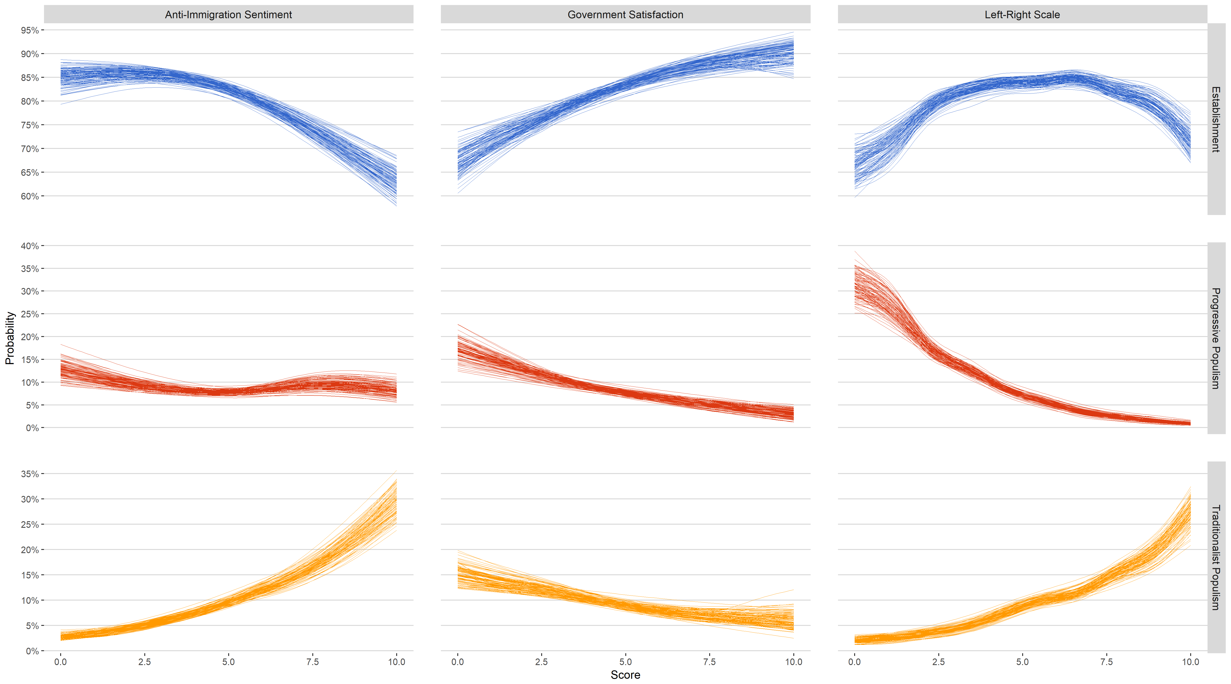

Slide 13
Conclusions & Future Research
Operationalization is ok (except for East.-Europ. Communists?)
Multilevel Model?
More fun?

Slide 14
Appendix

Slide 15
