Slide 1
🛡
ALPACA × LABLAB.AI · AI TRADING AGENTS HACKATHON 2026
Risk Gate
Honest Options AI
An autonomous options agent that trades through Alpaca's MCP server — its edge is discipline and risk gates, not hype.
github.com/fawad07/alpaca-options-agent · paper account only

Slide 2
The problem
Every “AI trading bot” promises easy money.
Almost all of them lose —
because a backtest that dazzles you has usually just memorized the past.
So we built the opposite of a hype bot — one whose edge is risk control and honesty, not a secret signal.
Risk Gate · Honest Options AI
2

Slide 3
Our thesis
The edge isn't a magic prediction. It's discipline.
1
2
3
Transparent
Risk-gated
Honest
Every trade is a simple, explainable rule — no black box.
Hard caps on size, exposure, and losses protect the account first.
We validate out-of-sample and report what's real — no cherry-picking.
Risk Gate · Honest Options AI
3

Slide 4
How it works
Price data
Signal
Risk gates
Alpaca MCP
Paper account
▸
▸
▸
▸
daily bars
EMA · RSI
size / block
place order
$100k
The signal decides direction; the risk gates decide if — and how big. Orders execute through Alpaca's MCP — autonomously each market-hours cycle, with every decision logged to a journal.
Risk Gate · Honest Options AI
4

Slide 5
The AI logic (transparent on purpose)
Signal
Action
Trend: 20-day EMA vs 50-day EMA
Filter: 14-day RSI (skip overbought/oversold)
Confidence scales with trend strength
Weak setups → no trade
Uptrend → BUY a CALL
Downtrend → BUY a PUT
Otherwise → no trade
Always defined-risk: a bought call or put, ~30 days out, near the money.
Risk Gate · Honest Options AI
5

Slide 6
Risk gates (the heart of it)
≤ 2%
≤ 5
5%
risked per trade
open positions
daily-loss halt
Long-only
14–60d
+50 / −50%
never sells naked
expiry window
take-profit / stop
Real evidence: at the 5-position cap the agent REFUSED further signals — and every block is logged in the decision journal.
Risk Gate · Honest Options AI
6

Slide 7
Built on MCP
The hackathon's core theme — the agent trades THROUGH Alpaca's official MCP server.
72
Tools the agent calls
• get_account_info
• get_option_contracts
MCP tools
available
• get_option_snapshot
• place_option_order
• get_all_positions
• close_position
Risk Gate · Honest Options AI
7

Slide 8
The honesty check
0 of 7
Out-of-sample, the signal beat buy-and-hold on ZERO of 7 stocks.
So we don't claim a magic edge. We compete on discipline, safety & transparency. Most teams hide this — we put it on a slide.
Risk Gate · Honest Options AI
8

Slide 9
Results
Aug 28 – Sep 4, 2026 · paper account PA327FXF8G6D
+1.82%
9
2 / 0
87
Final P&L
Trades
TP / Stops
Risk-gate blocks
Final equity $101,823 · +1.82% total return since the $100k start · 2 take-profits (+54% SPY, +74% NVDA) · 0 stop-losses · ~1% max drawdown
→ full equity curve on the next slide
Risk Gate · Honest Options AI
9

Slide 10
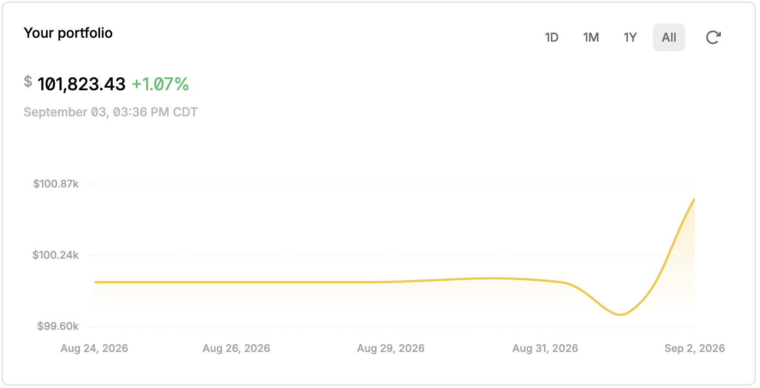
The week on Alpaca
Paper account PA327FXF8G6D · $100,000 → $101,823 · +1.82% total return
The green +1.07% is Alpaca's same-day change; +1.82% is the total return since the $100,000 start.
Risk Gate · Honest Options AI
10

Slide 11
🛡
Honest. Disciplined. Safe.
An autonomous options agent that's honest about risk. Every trade explainable, every risk capped.
github.com/fawad07/alpaca-options-agent · MIT
Account: PA327FXF8G6D · @lablabai @AlpacaHQ

