Slide 1
Car accident analysis

Slide 2
Problem Statement
Based on the reports from ASIRT, around 38,000 people die every year in road accidents in the United States. The fatality rate is quite significant which is aorund 12 deaths per 100,000 inhabitants. It is pretty apparent that as the amount of vehicles increase on the roads the number of accidents are also increasing, which obviously means as the number of vehicles increase exponentially it also increases the fatality rate within accidents. In this project we aim to analyze and predict the common causes of accidents allowing us to gain more insight towards this on going problem within the United States. We will be using data provided by the Seattle Department of Transport which will allow us to come to a final conclusion for this ongoing problem.

Slide 3
Data Used
To reach our target goal of analyze and predict the common causes of accidents we are going to use the data provided by the Seattle Department of Transport, the data set is a very extensive data set which includes around 40 columns which describe a particular accident including the road condition (dry or wet), people involved in the accident, the severity of the accident, if the accident place was a block or an intersection, the type of accident on how the accident occurred (MOTOR VEHICLE STRUCK MOTOR VEHICLE, FRONT END AT ANGLE), the weather and the light condition the accident occurred in. These types of data is very essential for us to actually reach to a final conclusion towards our analysis of the main conditions which actually cause accidents.

Slide 4
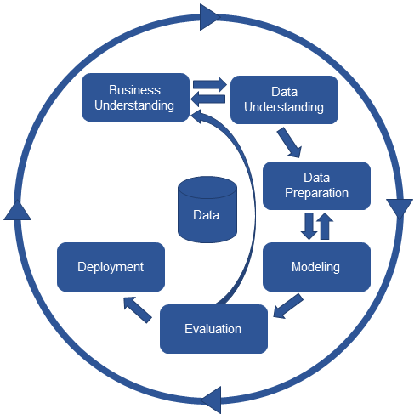
Methodology
CRISP DM framework for Machine Learning

Slide 5
Results
Logistic Regression
Score: 0.6261580874045284
Decision Tree Classifier
Score: 0.7552085687169522
Random Forest Classifier
Score: 0.7250418041307001
BEST ALGORITHM: Decision Tree Classifier

Slide 6
Discussion
Based on this analysis of the data set, it is a very unbalanced data set and with too many missing values, this resulted in a lot of data cleaning to give me a result which I was looking for in which the data can be worked in, for example according to me the "SPEEDING" factor does play a major role when it comes to accidents and the cause of accidents and had to be dropped due to multiple instances of missing values. This would also give police officers a way to add more stop signs and technology-based accident control systems which will allow them to stop people from speeding and causing accidents.

Slide 7
Conclusion
To conclude, this was a good insight which was gained, there are many other variables which need to be considered within our analysis since most of the accidents are minor and avoidable, but at the same time do cause traffic disruptions thus increased travel time and also costs towards increased loss of property for the council of the city.

