Slide 1
NFL Prediction
A Deep Learning Model
Fabian Weiland, Lennart Richter

Slide 2
Details
sport prediction models already exist, but not open for public
based on the data of the last NFL seasons and the current team roster, we will predict the season outcome of a team
Pro Reference Football for Dataset
Neural Network Model implementation with keras/tensorflow library

Slide 3
The Model
Multi Layer Perceptron with a total of 9 layers. 6 hidden (dense) layers, 2 Dropout layers and 1 output layer
First layer = 10 Perceptrons; Second to Sixth layer = 64 Perceptrons; Output layer has 17 Perceptrons
Dropout rate 0.2 (20% of input units will be randomly set to 0)
Number of input features = 13
split data in 80% training and 20% testing
activation function (hidden layer) = relu; activation function (output layer) = softmax

Slide 4
The Model
Dropout layer
Output layer
0
.
.
.
.
.
.
.
.
.
13 input Features
.
.
.
.
.
.
.
.
.
Softmax
.
.
.
.
.
.
.
.
.
output between 0 - 16
.
.
.
.
.
.
0
10 Perceptrons
64 Perceptrons
64 Perceptrons
17 Perceptrons

Slide 5
Amount of Parameters
Total Parameters (weights) + (biases)
First Layer: 130 weights + 10 bias = 140
Second Layer: 640 weights + 64 bias = 704
Third Layer: 4096 weights + 64 bass = 4160
Fourth Layer: 4096 weights + 64 bass = 4160
Fifth Layer: 4096 weights + 64 bass = 4160
Sixth Layer: 4096 weights + 64 bass = 4160
Seventh Layer: 1088 weights + 17 bias = 1105
TOTAL:
18,589

Slide 6
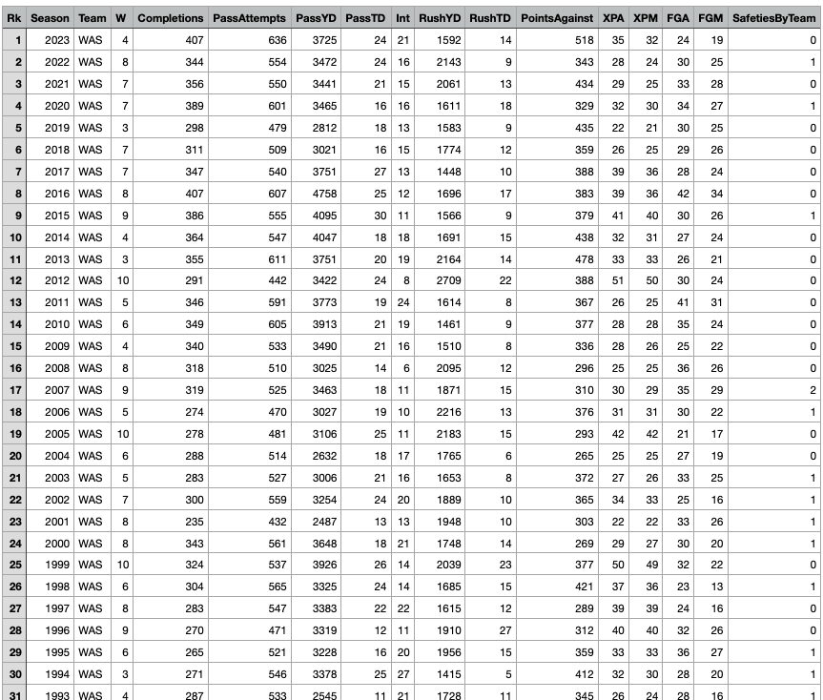
Data Set
1706 Data points
Training: 1365
Test: 341

Slide 7
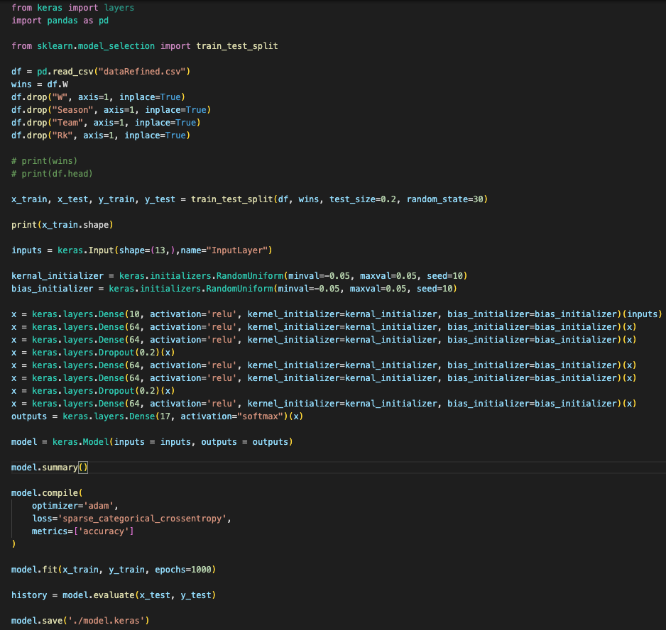
Implementation

Slide 8
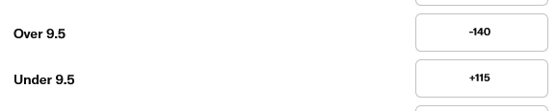
Intro to Sports Betting
-140 = Bet $140 to win 100 (Favorite)
+115 = Bet $100 to win 115 (Underdog)

Slide 9
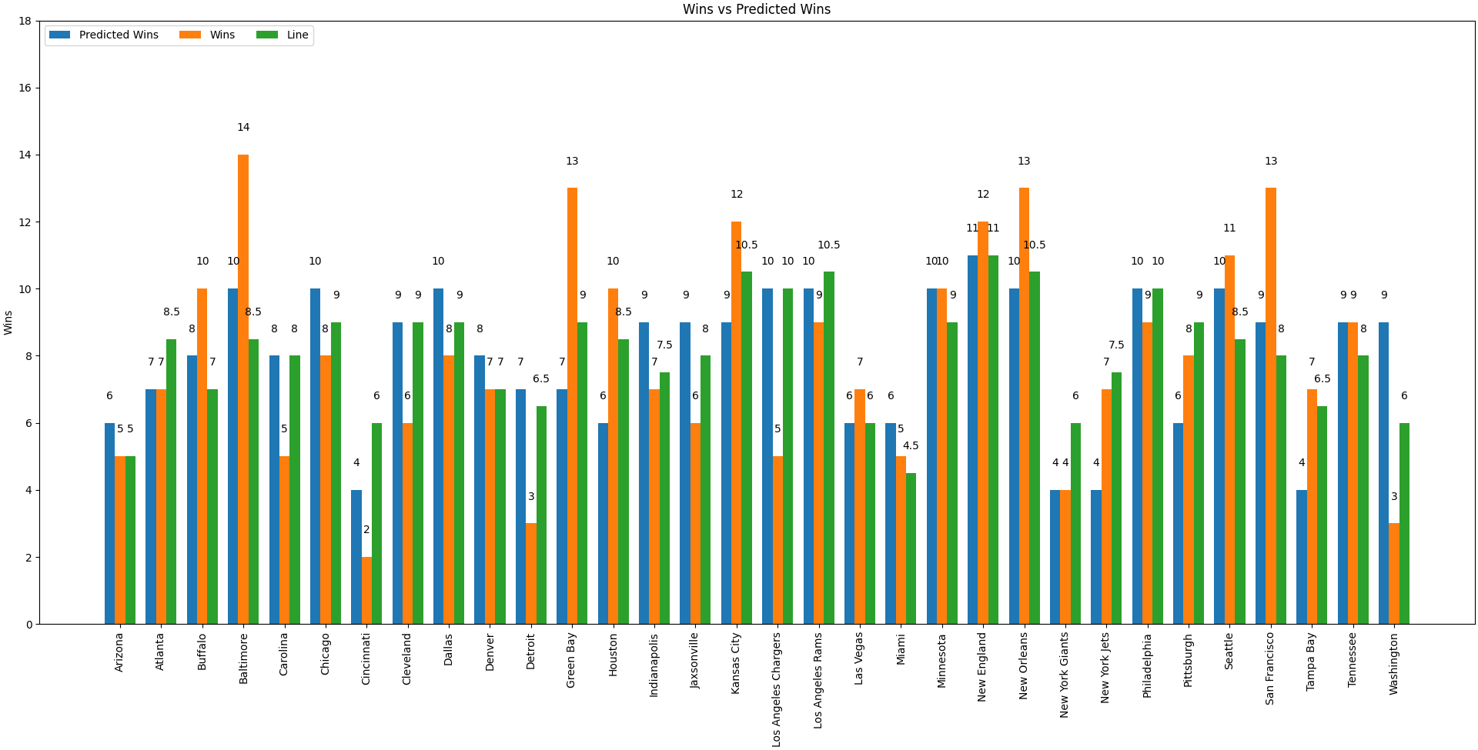
Let’s Talk About Accuracy
For this model to be successful do we need a high accuracy?
Our model has about 30% accuracy

Slide 10
Let’s look at a live example!

