Slide 1
Evaluate OGM as mapping framework for MongoDB
Project of Data Management

Slide 2

Project idea
ORM Mapping framework. Help to build and work with a relationship model from an OO model
Hibernate OGM: Help build and work with one of the possible NoSQL models
In this project we’ve explored the MongoDB (Document) dialect.
We builts 2 applications:
Native Application (using the MongoDB native client API directly)
Application using Hibernate OGM MongoDB dialect
To evaluate the pros / cons of the two approaches

Slide 3


Dataset Description
TV shows and movie: Netflix, HBO Max, Disney Plus and Amazon Prime
2 files each:
credits.csv: person_id, id, name, character, role
titles.csv: id, title, type, description, release_year, age_certification, runtime, genres, production_countries, seasons, imdb_id, imdb_score, imdb_votes, tmdb_popularity, tmdb_score
With Hibernate OGM we started from OO Entity model…

Slide 4
Evaluate OGM as mapping framework for MongoDB
PART ONE: MongoDB Hibernate OGM Application

Slide 5

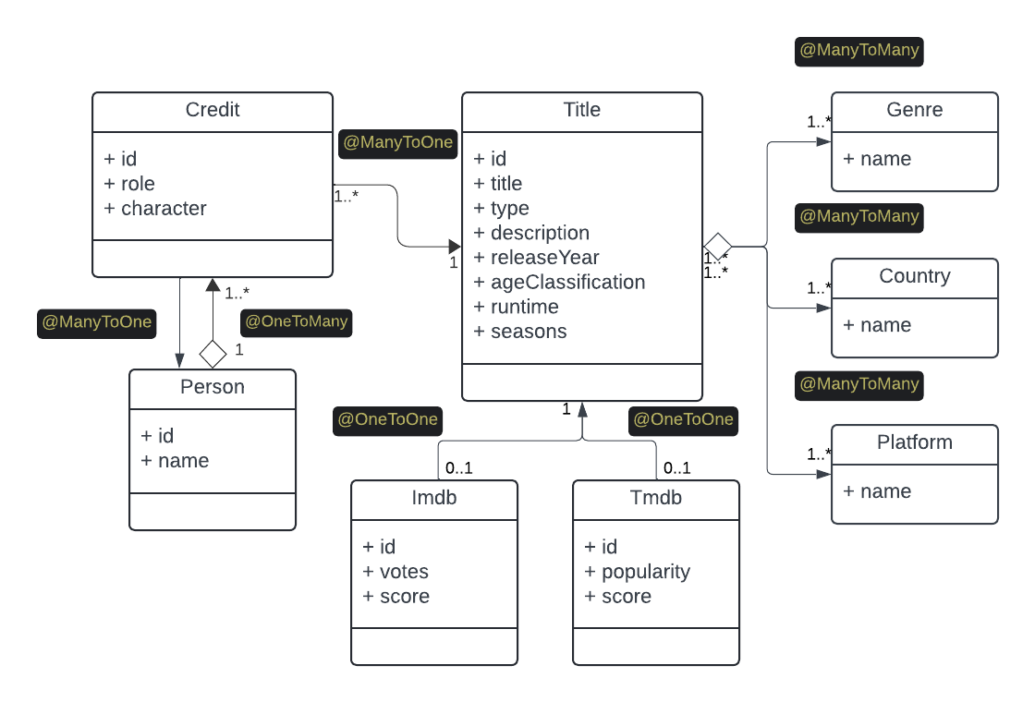
Entity model (mapping)
@Entity
Credit
Person
Title
Genre
Country
Platform
Imdb
Tmdb
persistence.xml

Slide 6
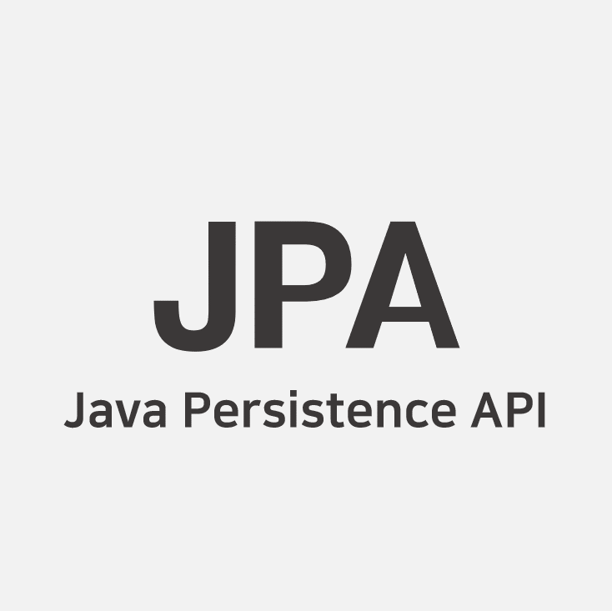
Persistence config
<persistence-unit name="ogm-jpa-tutorial" transaction-type="RESOURCE_LOCAL">
<!-- Use Hibernate OGM provider: configuration will be transparent -->
<provider>org.hibernate.ogm.jpa.HibernateOgmPersistence</provider>
<properties>
<property name="hibernate.ogm.datastore.provider" value="mongodb" />
<property name="hibernate.ogm.datastore.host" value="127.0.0.1"/>
<property name="hibernate.ogm.datastore.port" value="27017"/>
<property name="hibernate.ogm.datastore.create_database" value="true"/>
<property name="hibernate.ogm.datastore.database" value="movies-ogm"/>
</properties>
</persistence-unit>

Slide 7

OGM Application
@Service / @Repository: ShowsAndMoviesService, ShowsAndMoviesQueries
@Logger: ShowsAndMoviesLogger
@RestController: ShowsAndMoviesRest
@SpringBootTest: ShowsAndMoviesServiceTest, ShowsAndMoviesQueriesTest
All the code => https://github.com/fax4ever/mapping-framework-evaluation
On the maven sub-project: mongodb-ogm-application

Slide 8

Load the dataset procedure
docker run -i --rm -p 27017:27017 --name=mongodb-sever mongo:latest
Compile and run the automated test:
mvn clean install
Run the application (as standalone server process)
mvn spring-boot:run
To get the counts all of the entities loaded
http http://localhost:8080/report
To load more datasets (amazon-prime, disney-plus, hbo-max, netflix)
http POST http://localhost:8080/load/amazon-prime

Slide 9


Entity loading
Processed 31 chunks. Total titles loaded from DISNEY_PLUS: 1550. Load completed.
Processed 529 chunks. Total credits loaded from DISNEY_PLUS: 26450. Load completed.
Processed 117 chunks. Total titles loaded from NETFLIX: 5850. Load completed.
Processed 1557 chunks. Total credits loaded from NETFLIX: 77850. Load completed.
Processed 198 chunks. Total titles loaded from AMAZON_PRIME: 9900. Load completed.
Processed 2485 chunks. Total credits loaded from AMAZON_PRIME: 124250. Load completed.
Processed 66 chunks. Total titles loaded from HBO_MAX: 3300. Load completed.
Processed 1328 chunks. Total credits loaded from HBO_MAX: 66400. Load completed.
{
"Country": 148,
"Credit": 290312,
"Genre": 19,
"Imdb": 18528,
"Person": 154857,
"Platform": 4,
"Title": 20313,
"Tmdb": 19634
}
Batching the loading with chunks of size 50
Making the loading idempotent

Slide 10
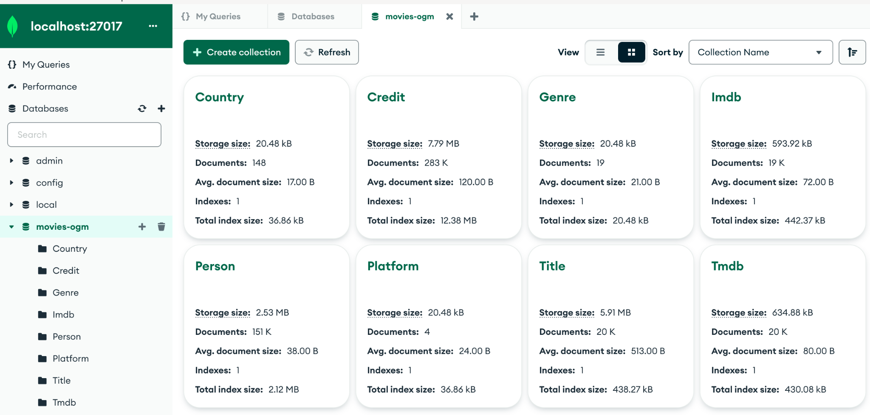
MongoDB data

Slide 11
MongoDB data
MongoDB's data mapped by Hibernate OGM is very normalized among the 8 collections. Joining collections will be necessary for meaningful queries. We will use the aggregation framework.
Normalized data is more flexible, since the joins are defined at query time.
The denormalized data model represents the ability of a document to contain nested structures and arrays, allowing for the representation of complex and hierarchical data in a single document.
Denormalized data is less flexible, the nesting structures should be defined at mapping time.

Slide 12
Working with normalized data
Lookup operator can be used to perform a left outer join between two collections.
Aggregation pipelines consists of multiple stages. At each stage, an operation is performed on the data and is passed to the next stage.
On the other hand, with Hibernate OGM we can fetch the entities following the object links.
The framework will operate a lazy loading under the hood each time a reference having n multiplicities is traversed.

Slide 13
Query the data domain
Given a name of a person, find all credits referred to that person, presenting also the all the titles with scores and details associated to those credits.
http --raw "Oscar Isaac" http://localhost:8080/findCredits
Given a genre, return the n^{th} page of size m of all titles ordered by Tmdb score in descendant order. All title attributes should be presented, including the genres, the countries and the platforms providing it.
http http://localhost:8080/titlesOrderByScore/genre/scifi/page/1/page-size/10
Find all movies provided by a given platform having release year included in a range of years. All title attributes should be presented, including the genres, the countries and the platforms providing it.
http http://localhost:8080/findMovies/platform/disney-plus/start-year/2018/end-year/2019

Slide 14
Query the data domain
Given a name of a person, find all credits referred to that person, presenting also the all the titles with scores and details associated to those credits.
public String findCreditsByPersonName(String name) {
try (Session session = service.sessionFactory().openSession()) {
Query<Person> query = session.createQuery("from Person where name = :name", Person.class);
query.setParameter("name", name);
List<Person> list = query.list();
if (list.isEmpty()) {
return "[]";
}
Person person = list.get(0);
if (list.size() > 1) {
logger.warn("There is a homonym for the name {}, we'll return only the titles of person with id {}.", name, person.getId());
}
try {
return objectMapper.writeValueAsString(person.getCredits());
} catch (JsonProcessingException e) {
throw new RuntimeException(e);
}
}
}
JPQL query + lazy loading traversing the relationships

Slide 15
Query the data domain
Given a genre, return the n^{th} page of size m of all titles ordered by Tmdb score in descendant order. All title attributes should be presented, including the genres, the countries and the platforms providing it.
private static final String SCORE_AGGREGATION =
"db.Imdb.aggregate( [ {'$lookup': {'from': 'Title', 'localField': 'title_id', 'foreignField': '_id', 'as': 'title' } }, {'$match': {'title.genres': '{0}' } }, {'$sort': {'score': -1 } } ] )";
public String titlesOrderByScore(String genre, int pageNumber, int pageSize) {
try (Session session = service.sessionFactory().openSession()) {
String query = SCORE_AGGREGATION.replace("{0}", genre);
List<Imdb> list = session.createNativeQuery(query)
.addEntity(Imdb.class)
.setFirstResult((pageNumber-1) * pageSize)
.setMaxResults(pageSize)
.list();
try {
return objectMapper.writeValueAsString(list);
} catch (JsonProcessingException e) {
throw new RuntimeException(e);
}
}
}
MongoDB aggregation + lazy loading traversing relationship

Slide 16
Query the data domain
Find all movies provided by a given platform having release year included in a range of years. All title attributes should be presented, including the genres, the countries and the platforms providing it.
private static final String RANGE_NATIVE_QUERY =
"db.Title.find( { releaseYear: { $gte: {0}, $lte: {1} }, platforms: '{2}', type: 0 } )";
public String findMovies(String platformName, int startYear, int endYear) {
try (Session session = service.sessionFactory().openSession()) {
String query = RANGE_NATIVE_QUERY.replace("{0}", startYear + "").replace("{1}", endYear + "").replace("{2}", platformName);
List<Title> list = session.createNativeQuery(query)
.addEntity(Title.class)
.list();
try {
return objectMapper.writeValueAsString(list);
} catch (JsonProcessingException e) {
throw new RuntimeException(e);
}
}
}
MongoDB Find + lazy loading traversing relationship

Slide 17
Evaluate OGM as mapping framework for MongoDB
PART TWO: MongoDB Native Application

Slide 18
Building MongoDB native app
Starting from all data (4 platforms) movies-ogm db
We’re going define a new database movies-native:
Possibly optimized to perform the same queries we defined before
Using directly the MongoDB Java client (no ORM).
And fill it using two aggregation pipelines:
Person { id, name, [ { title-id, role, character } ] }
Title { id, tmdb-score, tmdb-votes, title, release-year, type, age-certification, description, [ genre ], [ platform ], [ country ], runtime, seasons }

Slide 19

People pipeline
movies-ogm
{
"$project": {
"name": 1,
"credits": {
"$map": {
"input": {
"$zip": {
"inputs": [
"$credits","$titles"
]
}
},
"as": "tuple",
"in": {
"character": {
"$arrayElemAt": [
"$tuple", 0
]
},
"title": {
"$arrayElemAt": [
"$tuple", 1
]
}
}
}
}
}
}
{
'$lookup': {
'from': 'Credit',
'localField': 'credits',
'foreignField': '_id',
'as': 'credits'
}
}, {
'$lookup': {
'from': 'Title',
'localField': 'credits.title_id',
'foreignField': '_id',
'as': 'titles'
}
}
movies-native
mvn spring-boot:run
http POST http://localhost:8081/people

Slide 20
Titles pipeline
movies-ogm
MongoCollection<Document> titles = ogmDB.getCollection( "Title" );
AggregateIterable<Document> result = titles.aggregate( Arrays.asList(
new Document( "$lookup", new Document( "from", "Imdb" )
.append( "localField", "_id" )
.append( "foreignField", "title_id" ) ← indexed!
.append( "as", "imdb" ) ),
new Document( "$unwind", new Document( "path", "$imdb" )
.append( "preserveNullAndEmptyArrays", true ) ),
new Document( "$out", new Document( "db", MOVIES_NATIVE )
.append( "coll", "titles" ) )
) );
result.batchSize( 50 );
result.allowDiskUse( true );
result.toCollection();
movies-native
@Table(indexes = {@Index(columnList = "title_id", name = "title")})
http POST http://localhost:8081/titles

Slide 21
Titles pipeline
fax@fax-workstation:~/code/mapping-framework-evaluation$ http http://localhost:8080/report
HTTP/1.1 200
Content-Type: application/json
{
"Country": 148,
"Credit": 290312,
"Genre": 19,
"Imdb": 18528,
"Person": 154857,
"Platform": 4,
"Title": 20313,
"Tmdb": 19634
}
fax@fax-workstation:~/code/mapping-framework-evaluation$ http http://localhost:8081/report
HTTP/1.1 200
Content-Type: application/json
{
"people": 154857,
"titles": 20313
}
http http://localhost:8081/report

Slide 22
Query the data domain
Queries are very simple, since we design the collections of the native application looking at them.
Given a name of a person, find all credits referred to that person, presenting also the all the titles with scores and details associated to those credits.
people.find(eq("name",:name))
Given a genre, return the nth page of size m of all titles ordered by Tmdb score in descendant order. All title attributes should be presented, including the genres, the countries and the platforms providing it.
titles.find(eq("genres",:genres).sort(ascending("imdb.score")).skip(:skip).limit(:limit)
Find all movies provided by a given platform having release year included in a range of years. All title attributes should be presented, including the genres, the countries and the platforms providing it.
titles.find(and(gte("releaseYear",startYear),lte("releaseYear",endYear ),eq("type",0),eq("platforms",platformName)))

Slide 23
Evaluate OGM as mapping framework for MongoDB
PART THREE: Demo time

