Slide 1

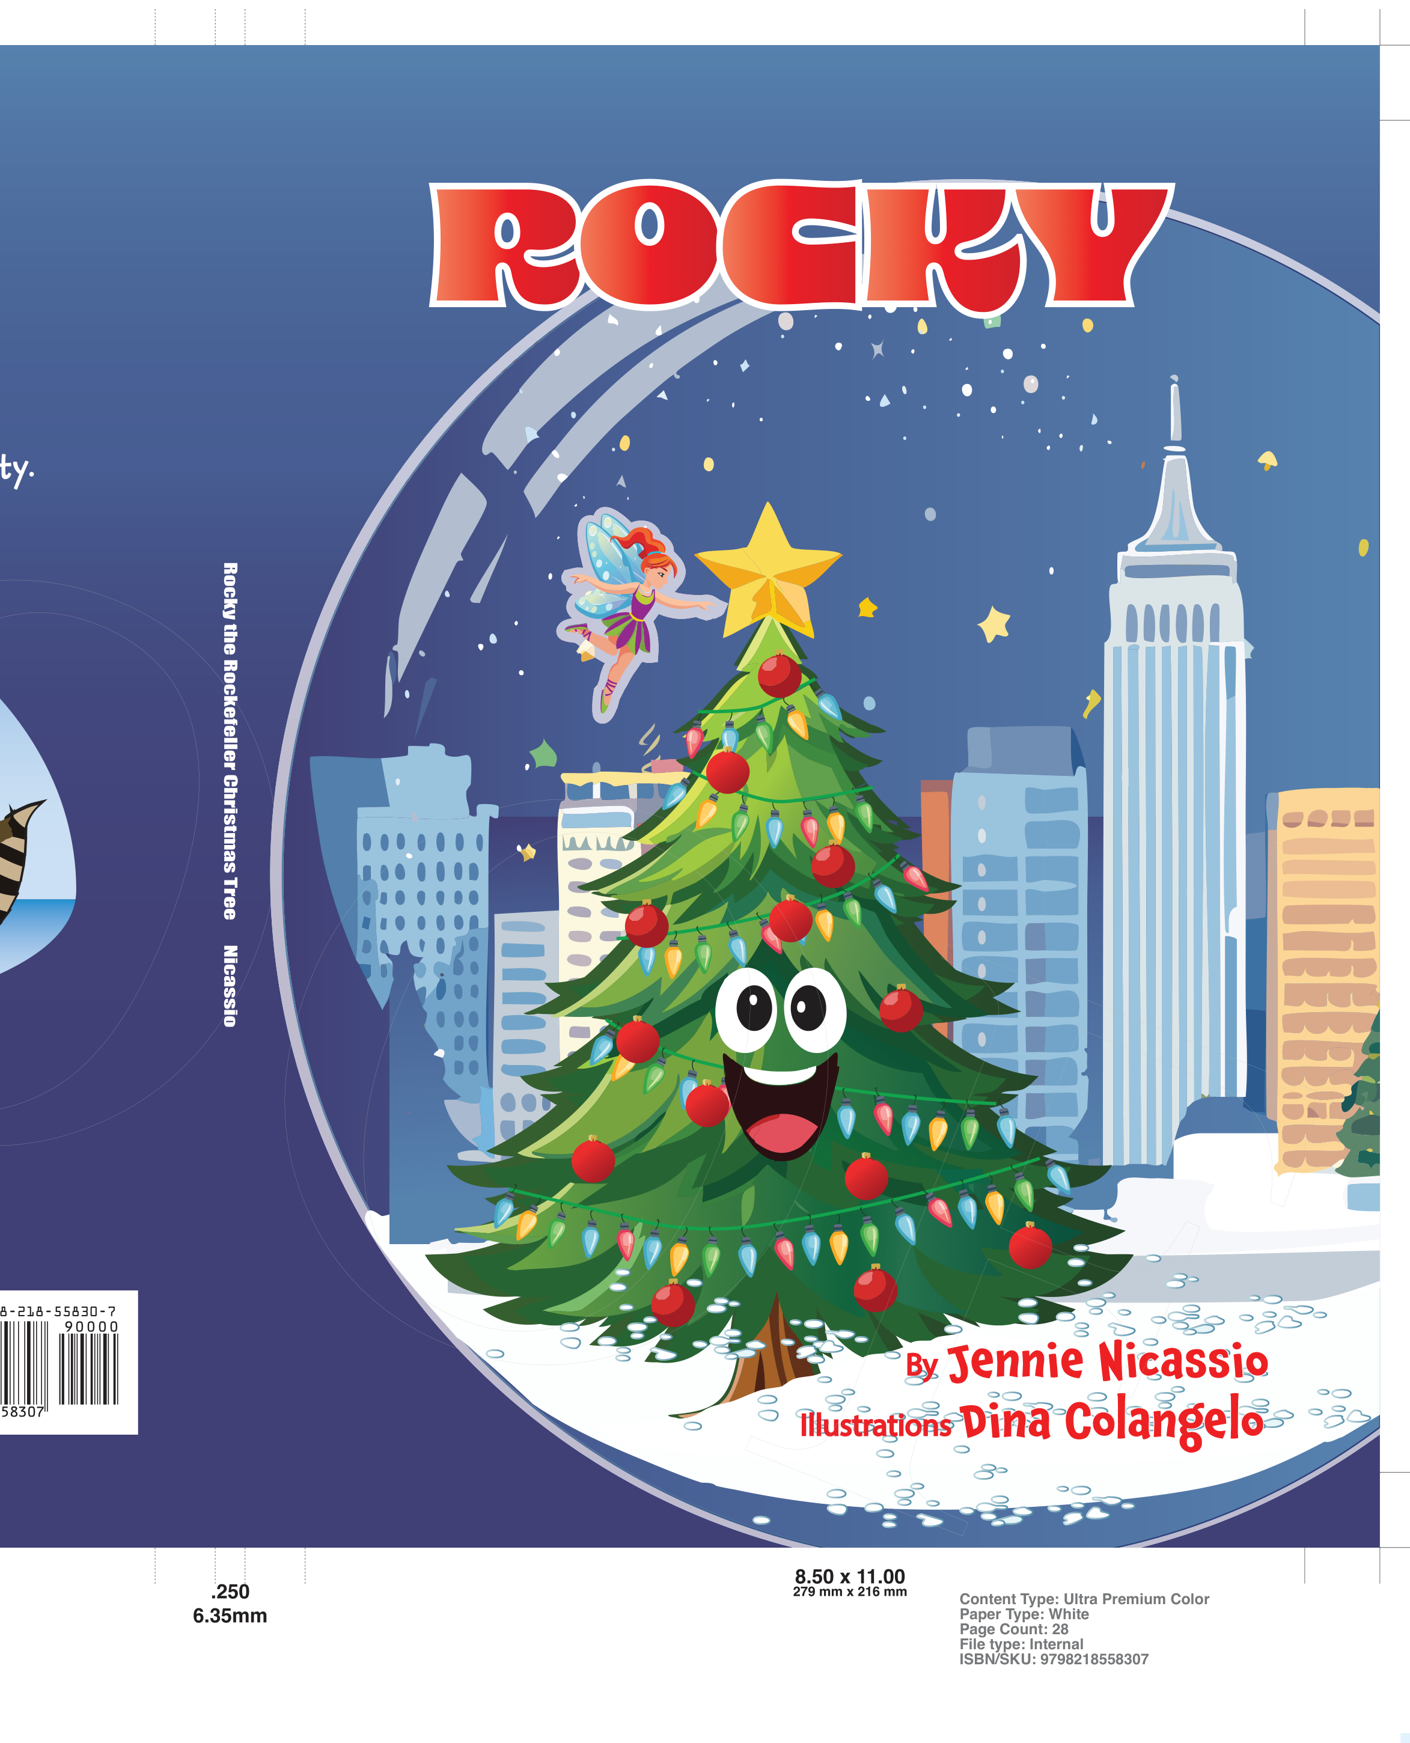

NEO GEN TECHNOLOGIES • CREATIVE & 2D ANIMATION DIVISION
CONFIDENTIAL MASTER PROPOSAL | NGT-SOW-2026-ROCKY-V1
Official Scope of Work & Production Agreement
ROCKY: THE ROCKEFELLER CHRISTMAS TREE
2D Animated Master Movie & 10 Viral Highlights Series Adaptation
A comprehensive broadcast-grade production and digital distribution plan engineered by Neo Gen Technologies for creator and screenwriter Jennie E. Nicassio. Delivering 16:9 Cinema 4K animation, high-retention 9:16 vertical series adaptation, dedicated 6-actor voice cast, bespoke sound design, and turnkey YouTube channel management.
IP Creator & Client: Jennie E. Nicassio (Author, Creator & Screenwriter)
Book Title: Rocky: The Rockefeller Christmas Tree (ISBN 979-8-218-55830-7)
Production Agency: Neo Gen Technologies
Executive Producer & AM: Ayaz (ayaz@neogentechnologies.com)
Original Published Book IP & Official Proofs

Slide 2
EXECUTIVE BRIEF & PARTNERSHIP MEMORANDUM
NEO GEN STUDIOS
Strategic Vision: From Book to Global Holiday Classic
NARRATIVE ARCHITECTURE
DISTRIBUTION ARCHITECTURE
COMMERCIAL FLYWHEEL
From Storybook to Living Classic
The Dual-Audience Engine
Multi-Platform Monetization
Transforming Jennie Nicassio's acclaimed holiday literature into an animated holiday classic. Rocky's journey of sacrifice, self-worth, and resilience is engineered to become an annual holiday viewing tradition across families worldwide.
Pairing a prestige 16:9 cinematic master (for streaming acquisitions and festivals) with 9:16 vertical serialized micro-dramas. Captures traditional family viewing while dominating algorithmic feeds on YouTube Shorts, TikTok, and Instagram.
Every animated release functions as an active sales funnel driving directly to the published book on Amazon. Built-in Content ID audio/visual fingerprinting guarantees 100% of global AdSense and licensing royalties flow directly to creator Jennie Nicassio.
Demographic: Multi-Generational Family Co-Viewing
Format: 16:9 Cinema 4K + 9:16 Vertical Shorts
Ownership: 100% Client IP & AdSense Revenue
NEO GEN TECHNOLOGIES | ROCKY: THE ROCKEFELLER CHRISTMAS TREE | EXECUTIVE SOW | SLIDE 2

Slide 3
STORY ENGINE & CHARACTER ARCHITECTURE
NEO GEN STUDIOS
The Core Cast & Dramatic Ensemble
LEAD PROTAGONIST
THE TOWERING RIVAL
THE FOREST FAIRY
Rocky
Bruce Spruce
Mary Louise
Small, resilient evergreen tree with big dreams. Sacrifices his needles to shield tiny sapling Pip from the brutal winter ice storm.
Arrogant 85-foot Norwegian spruce boasting flawless symmetry, who learns humility and respect when Rocky's heart shines brighter.
Ancient guardian living in a teapot cottage. Tests Rocky's courage and rewards true devotion with transformative resilience.
"I will grow strong and tall!"
"Look upon perfection, little twig!"
"True splendor is never measured in height."
COMIC FOIL & ALLY
THE SKUNK DIVA
CHORUS & LEGACY
AJ the Squirrel
Mrs. Pickles
Old Oak & Pip
Acrobatic, rapid-tempo singer who mocks Rocky with rhymes before realizing true courage and stowing away to NYC.
Melodramatic vanity diva obsessing over her silver mirror, who places it face-down in solemn solidarity with Rocky.
Old Oak holds the ancient history of chosen trees; young sapling Pip carries Rocky's legend into future generations.
"You'll never make Rockefeller Plaza!"
"Nobody look at me until my tail is fluffed!"
"Where do chosen trees go? Into homes of families."
NEO GEN TECHNOLOGIES | ROCKY: THE ROCKEFELLER CHRISTMAS TREE | EXECUTIVE SOW | SLIDE 3

Slide 4
SCREENPLAY BEAT BOARD
NEO GEN STUDIOS
33 Sequential Story Beats (Acts 1, 2 & 3)
ACT 1: THE HOLLOW
ACT 2: THE SACRIFICE & ICE
ACT 3: NEW YORK CITY
Beats 01–08 (Setup & Call)
Beats 09–24 (Conflict & Choice)
Beats 25–33 (Climax & Legacy)
• 01. The Little Tree with Big Dreams (Opening)
• 02. The Song of the Forest (AJ's taunts)
• 03. The Legend of the Plaza (Old Oak's tale)
• 04. Bruce Spruce's Grand Shadow (Rivalry)
• 05. Mary Louise's Whisper (Inciting Incident)
• 06. The Measure of Grandeur (First Trial)
• 07. Warning from the Winds (Foreshadowing)
• 08. Crossing the First Ridge (Act 1 Climax)
• 09. The Freezing Night (Rising Tension)
• 11. Protecting Young Pip (The Big Choice)
• 13. Breaking Branches (The Core Sacrifice)
• 16. The Dawn After the Storm (All is Lost)
• 19. The Helicopters Arrive (Selection Day)
• 21. The Selection Crew Judges the Forest
• 23. Mrs. Pickles' Mirror Solidifies Belief
• 24. The Red Ribbon on Rocky (Act 2 Climax)
• 25. The Flatbed Highway Journey to Manhattan
• 27. Entering 5th Avenue & Cheering Crowds
• 28. Hoisted into Rockefeller Center Plaza
• 29. Midnight Despair (The Flat Needles)
• 30. Believing for Others (Selfless Heart)
• 31. 50,000 Bulb Illumination (Grand Climax)
• 32. One More Gift (Timber Builds a Home)
• 33. Eternal Legend (North Pole Finale)
NEO GEN TECHNOLOGIES | ROCKY: THE ROCKEFELLER CHRISTMAS TREE | EXECUTIVE SOW | SLIDE 4

Slide 5
DISTRIBUTION ARCHITECTURE & FORMAT STRATEGY
NEO GEN STUDIOS
The Dual-Track Methodology: Cinema 4K + Viral 9:16 Shorts
TRACK A: PRESTIGE HORIZONTAL MASTER
TRACK B: VIRAL MOBILE-FIRST SERIES
16:9 Cinema 4K UHD Feature / Pilot
9:16 Vertical Viral Highlights Series
A classically animated widescreen master engineered for prestigious family co-viewing, international film festival circuits, and streaming licensing acquisitions.
Engineered directly to Jennie Nicassio's vertical drama storytelling expertise, converting viewers into dedicated fans and direct Amazon book buyers.
✓ Aspect Ratio: 16:9 Cinema 4K UHD (3840×2160) @ 24fps Native
✓ Visual Style: Rich textured storybook aesthetic with volumetric lighting
✓ Sound Mix: Full 5.1 surround sound + broadcast stereo master
✓ Color Grade: DaVinci Resolve Academy Color Encoding (ACES)
✓ Target Outlets: YouTube Prestige Premieres, Amazon Prime, Film Festivals
✓ Aspect Ratio: 9:16 Fullscreen Mobile (1080×1920) High-Retention
✓ Algorithmic Virality: 3-second visual hook, fast cliffhanger per episode
✓ Shorts Remixing: Extracted highlights mapped to trending holiday audio
✓ Direct Funnel: Pinned comment driving directly to Amazon book purchases
✓ Distribution: YouTube Shorts, Instagram Reels, TikTok syndication
NEO GEN TECHNOLOGIES | ROCKY: THE ROCKEFELLER CHRISTMAS TREE | EXECUTIVE SOW | SLIDE 5

Slide 6
STUDIO WORKFLOW & QUALITY CONTROL
NEO GEN STUDIOS
The 5-Phase 2D Animation Production Engine
PHASE 01
PHASE 02
PHASE 03
PHASE 04
PHASE 05
Pre-Production
Backgrounds
2D Animation
Compositing
Sound & Master
Weeks 1–4
Weeks 5–8
Weeks 9–14
Weeks 15–16
Weeks 17–18
• Script Breakdown & Acts
• 360° Model Sheets
• Color Script & Lighting
• 33-Beat Animatic Pass
• Scratch Voice Sync
• Hidden Forest Valley
• Rocky's Snowy Hollow
• 5th Avenue NYC Skyline
• Rockefeller Plaza Night
• Props & Ice Crystals
• Rigging & Character Physics
• Phoneme Lip-Sync Pass
• Secondary Needle Motion
• Snow & Wind Dynamics
• Clean Line Art Cleanup
• Multiplane Parallax Depth
• 50,000 Bulb Glow Effects
• Atmospheric Snow VFX
• Searchlight Volumetrics
• DaVinci Color Grading
• Broadcast Voice Track Master
• Foley & Custom Sound FX
• Original Holiday Score
• 5.1 Surround & Stereo Mix
• ProRes 4444 XQ Masters
INDUSTRY-STANDARD PIPELINE: Toon Boom Harmony 22 • Storyboard Pro • DaVinci Resolve Studio • Pro Tools HD • ProRes 4444 XQ Masters
NEO GEN TECHNOLOGIES | ROCKY: THE ROCKEFELLER CHRISTMAS TREE | EXECUTIVE SOW | SLIDE 6

Slide 7
AUDIO ENGINEERING & VOICE CAST
NEO GEN STUDIOS
Voice-Over Matrix & Registered Script Breakdown
OFFICIAL SCREENPLAY AUDIT (CTXu001371329): 40 Script Pages | 172 Speech Cues | 305 Exact Lines | 1,364 Words | 14.5 Studio Hours
Character Role | Vocal Archetype | Cues | Lines | Words | Studio Hours
Rocky (Lead Protagonist) | Youthful, tender, determined child or teen sound | 55 Cues | 78 Lines | 313 Words | 3.0 Hours
Old Oak / Narrator | Warm, resonant storybook grandfatherly baritone | 25 Cues | 66 Lines | 340 Words | 2.5 Hours
AJ the Squirrel | Rapid comic tenor, acrobat, musical rhymes | 26 Cues | 40 Lines | 151 Words | 2.0 Hours
Mary Louise (Forest Fairy) | Bright soprano, witty authority, magical shimmer | 19 Cues | 36 Lines | 155 Words | 2.0 Hours
Bruce Spruce (The Rival) | Booming, pompous resonant baritone | 12 Cues | 30 Lines | 172 Words | 1.5 Hours
Mrs. Pickles (The Skunk) | Prim, melodramatic diva alto with comedic timing | 8 Cues | 20 Lines | 89 Words | 1.0 Hours
Pip / Young Saplings | Inquisitive, enthusiastic child voice | 13 Cues | 15 Lines | 62 Words | 1.0 Hours
Forest Wildlife & Crowd | Blue Jay, chipmunk, selection crew crowd ADR | 14 Cues | 20 Lines | 82 Words | 1.5 Hours
INCLUDED BENEFIT: Dedicated 6-actor ensemble voice cast and bespoke sound effects (SFX & Foley) are 100% included ($0 extra) in the Flagship Streamline Master Suite.
NEO GEN TECHNOLOGIES | ROCKY: THE ROCKEFELLER CHRISTMAS TREE | EXECUTIVE SOW | SLIDE 7

Slide 8
MASTER INVESTMENT ARCHITECTURE
NEO GEN STUDIOS
Production Packages & Milestone Investment Flow
FLAGSHIP MASTER PRODUCTION SUITE | RECOMMENDED ALL-IN-ONE SOLUTION
Streamline Master: Full Movie + 10 Viral Highlights
TOTAL SOW INVESTMENT
$25,950
Combines the full 33-beat animated cinema feature (16:9 Cinema 4K UHD) with 10 high-velocity viral short-drama highlight clips (9:16 vertical). Complete turn-key package engineered to capture both prestige family co-viewing and algorithmic mobile dominance.
50% Inception Kickoff: $12,975
Two 25% Review Gates: $6,487.50 each
✓ 6-Actor Ensemble Voice Cast: INCLUDED ($0)
✓ Bespoke Sound Effects, Foley & Orchestral Mix: INCLUDED ($0)
✓ Full 16:9 Cinema 4K UHD Master + 10 Vertical 9:16 Shorts
50% | $12,975
25% | $6,487.50
25% | $6,487.50
Gate 1: Inception & Pre-Production
Gate 2: Animation & Rough Cut Review
Gate 3: Final Master & YouTube Delivery
Script breakdown, character model turnarounds, 33-beat animatic, scratch voice audio sync.
Mid-point review, character rigging, lip-sync animation, background painting passes.
4K color grading, 5.1 sound mix, ProRes 4444 delivery, YouTube channel launch.
NEO GEN TECHNOLOGIES | ROCKY: THE ROCKEFELLER CHRISTMAS TREE | EXECUTIVE SOW | SLIDE 8

Slide 9
POST-LAUNCH GROWTH & AUDIENCE RETENTION
NEO GEN STUDIOS
Monthly Social Media Management & Syndication
STARTER LAUNCH
GROWTH ACCELERATOR
OMNICHANNEL SYNDICATE
$1,250
/ month
$2,400
/ month
$3,800
/ month
Essential post-launch social distribution for consistent holiday visibility.
High-velocity distribution designed to trigger YouTube & TikTok recommendation algorithms.
Dominant holiday campaign running full multi-platform publishing and rights enforcement.
✓ 12 Vertical Shorts / Reels / TikToks per month
✓ Custom holiday cover thumbnail design
✓ Audience reply management & comment pinning
✓ Weekly performance and retention report
✓ 20 Vertical Shorts / Reels / TikToks per month
✓ Native A/B thumbnail testing & title iteration
✓ YouTube Community Tab polls & story posts
✓ Amazon book conversion tracking & optimization
✓ Monthly 1-on-1 strategy call with Producer Ayaz
✓ Daily Publishing (30+ Short-form videos / mo)
✓ Content ID anti-piracy audio/video fingerprinting
✓ Podcast and audio excerpt syndication
✓ Dedicated Social Account Producer on 24/7 Slack
✓ Influencer holiday duet and remix management
PLATFORMS: TikTok • Instagram • Facebook
PLATFORMS: TikTok • Instagram • Facebook
PLATFORMS: TikTok • Instagram • Facebook
NEO GEN TECHNOLOGIES | ROCKY: THE ROCKEFELLER CHRISTMAS TREE | EXECUTIVE SOW | SLIDE 9

Slide 10
TURN-KEY CHANNEL OPERATIONS
NEO GEN STUDIOS
8-Point YouTube Publishing Engine & Rights Protection
01. Content ID Audio/Visual Fingerprinting
02. Native A/B Thumbnail Optimization
Automated digital fingerprinting prevents piracy and unauthorized reposts, ensuring all global AdSense flows directly to Jennie Nicassio.
Multi-variant visual thumbnails deployed concurrently to maximize click-through rates across family and animation fan audiences.
03. Community Tab & Fan Cultivation
04. Shorts Remixing & Sound Virality
Weekly behind-the-scenes concept art, character trivia, and polls building active subscriber loyalty prior to the winter premiere.
Key emotional scenes and musical moments packaged into native YouTube Shorts to tap into algorithmic recommendations.
05. SEO Metadata & Semantic Tagging
06. Amazon Holiday Book Conversion
Search-optimized titles, comprehensive holiday descriptions, chapter timestamps, and closed-caption transcripts.
Pinned cards, end-screens, and tracked bio links engineered to convert video viewers into verified Amazon book purchases.
07. Multi-Format Master Archival
08. Monthly Strategy Calls with Producer Ayaz
Master files archived in ProRes 4444, stereo broadcast, and 5.1 surround ready for instant festival or broadcast submission.
Direct video conference reviews analyzing watch time, viewer retention graphs, and upcoming seasonal holiday pushes.
NEO GEN TECHNOLOGIES | ROCKY: THE ROCKEFELLER CHRISTMAS TREE | EXECUTIVE SOW | SLIDE 10

Slide 11
TIMELINE & STUDIO GOVERNANCE
NEO GEN STUDIOS
18-Week Production Master Timeline & 24/7 SLA
Weeks 1–4
Weeks 5–8
Weeks 9–14
Weeks 15–16
Weeks 17–18
Phase 1: Inception
Phase 2: Assets
Phase 3: Animation
Phase 4: Compositing
Phase 5: Mix & Master
Script breakdown, character model turnarounds, color scripts, 33-beat animatic.
Background environment paintings, Rocky hollow, Rockefeller Plaza, character rigs.
Full 2D animation, phoneme lip-sync, secondary needle dynamics, pencil cleanup.
Lighting passes, 50,000 bulb illumination glow, atmospheric snow, color grading.
5.1 sound mastering, final orchestral mix, 4K ProRes archival, YouTube publishing.
24/7 PRODUCTION SLA & DIRECT ACCESS
REVISION GATES & CLIENT CREATIVE CONTROL
Direct Account Management with Producer Ayaz
Guaranteed Milestone Approvals
• Dedicated private Slack/Discord studio channel for real-time production queries
• Weekly synchronous sprint video reviews with screen-share animatics
• Maximum 4-hour response SLA on all production feedback and inquiries
• Direct email access: ayaz@neogentechnologies.com
• Two comprehensive revision rounds included per milestone phase
• No work progresses to subsequent phase without Jennie Nicassio's formal sign-off
• Complete intellectual property ownership retained 100% by the creator
• All raw source files (Toon Boom, Pro Tools, DaVinci) provided upon master delivery
NEO GEN TECHNOLOGIES | ROCKY: THE ROCKEFELLER CHRISTMAS TREE | EXECUTIVE SOW | SLIDE 11

Slide 12
EXECUTIVE ACCEPTANCE & BINDING AGREEMENT
NEO GEN STUDIOS
Official Scope of Work Authorization & Sign-Off
This document represents the formal Scope of Work and Production Master Agreement between Jennie E. Nicassio and Neo Gen Technologies. Upon mutual countersignature, production will initiate in accordance with the 18-week master schedule.
CLIENT AUTHORIZATION & ACCEPTANCE
AGENCY COUNTERSIGNATURE & ACCEPTANCE
Authorized Signature Line
Producer Countersignature Line
Jennie E. Nicassio
Ayaz
Author, Creator & Screenwriter
ROCKY: THE ROCKEFELLER CHRISTMAS TREE
Direct Email: Jennie3963@gmail.com
Date: ____________________________________
Senior Account Manager & Producer
Neo Gen Technologies (Creative & Animation Division)
Direct Email: ayaz@neogentechnologies.com
Date: ____________________________________
NEO GEN TECHNOLOGIES | ROCKY: THE ROCKEFELLER CHRISTMAS TREE | EXECUTIVE SOW | SLIDE 12

