Slide 1
Cluster Analysis and Near Neighbor Matching: Demographic Factors Affecting Graduation and Retention Rates for Mathematics-Intensive Majors
Eric O’Leary
Towson University
MA RUME Conference
Notes:
Hello everyone. I am Eric O’Leary, a grad student at Towson, and today I’ll be discussing my work in analyzing a scholarship program. In particular, we look at the S-STEM program at Towson, funded by the NSF, and we want to determine how effective the program is.

Slide 2

Acknowledgements
This work was supported by the National Science Foundation through grant NSF-DUE-2031345
Notes:
This work was funded by the NSF.

Slide 3
Presentation Overview
Data, Research Questions, and Definitions
Cluster Analysis
Decision Trees
Near Neighbor Matching
Discussion

Slide 4
Data
Mathematics, physics, and computer science majors at Towson from Fall 2011 to Spring 2025
n = 6567
Financial data (Pell eligibility, unmet need, federal expected family contribution)
Demographic data (transfer status, sex, race/ethnicity, age, matriculation year)
Notes:
The data we have is of math, physics, and computer science majors starting in Fall 2011; roughly six and a half thousand of them.
We have financial data – Pell eligibility, unmet need, and expected family contribution – and demographic data – transfer status, sex, and race/ethnicity

Slide 5
S-STEM Scholarship
S-STEM scholars:
Pure or applied math majors
Pell eligible
GPA ≥ 3.0
Receive up to $5000 per semester of unmet need and social support
n = 24
Notes:
The program we’re analyzing is Towson’s S-STEM scholarship, which is open to pure/applied math majors who are Pell eligible and have a strong GPA.
Scholars receive funding and social support, and we have 24 of them in the dataset.

Slide 6
Research Questions
How can we analyze the effectiveness of an S-STEM program?
Is financial need a key predictive factor of student performance for our dataset?
Does its importance differ between types of students?
Notes:
Ultimately, we want to analyze the effectiveness of the S-STEM program at Towson.
We’ll try to directly answer that question later, but we can also try to answer it indirectly through seeing if financial need is a major factor in student performance.
That’s not new information, but the analysis we do is.
In particular, we look at whether the importance of financial need varies between “types” of students; more on what a “type” of student is later.

Slide 7
Student Performance
Performance metrics:
4-year graduation rate
6-year graduation rate
Cumulative GPA at last semester at Towson
For the next sections, we focus on 4-year graduation rate
Notes:
There are three primary performance metrics we used in our research. For the next two sections, we use 4-year graduation rate to demonstrate the process.

Slide 8
Clusters – why?
Want to define distinct groups of students to compare impact of financial factors within each group
Rather than choosing best way to make groups, let data speak for itself through algorithm
Data used for clustering is demographic and financial only
k-means style algorithm
Notes:
Students are diverse population, and broad statements and results can easily overgeneralize
Different "groups" of students may behave differently
Rather than our choice of "group," let data find most distinct groups

Slide 9
Clusters - details
k-means algorithm will find k subgroups in the data
We need to know k before running the algorithm
Algorithms find k=5 is best for the given dataset and features
The subgroups it finds may or may not be human readable or carry much meaning
Clustering is typically unstable – small changes in dataset can result in large changes in clusters
Notes:
Mention choice of number of clusters (we choose k=5 based on an algorithm that finds that as ideal).
Mention stability somehow?
Computer will create subgroups; emphasize that we hope for human-readable clusters

Slide 10
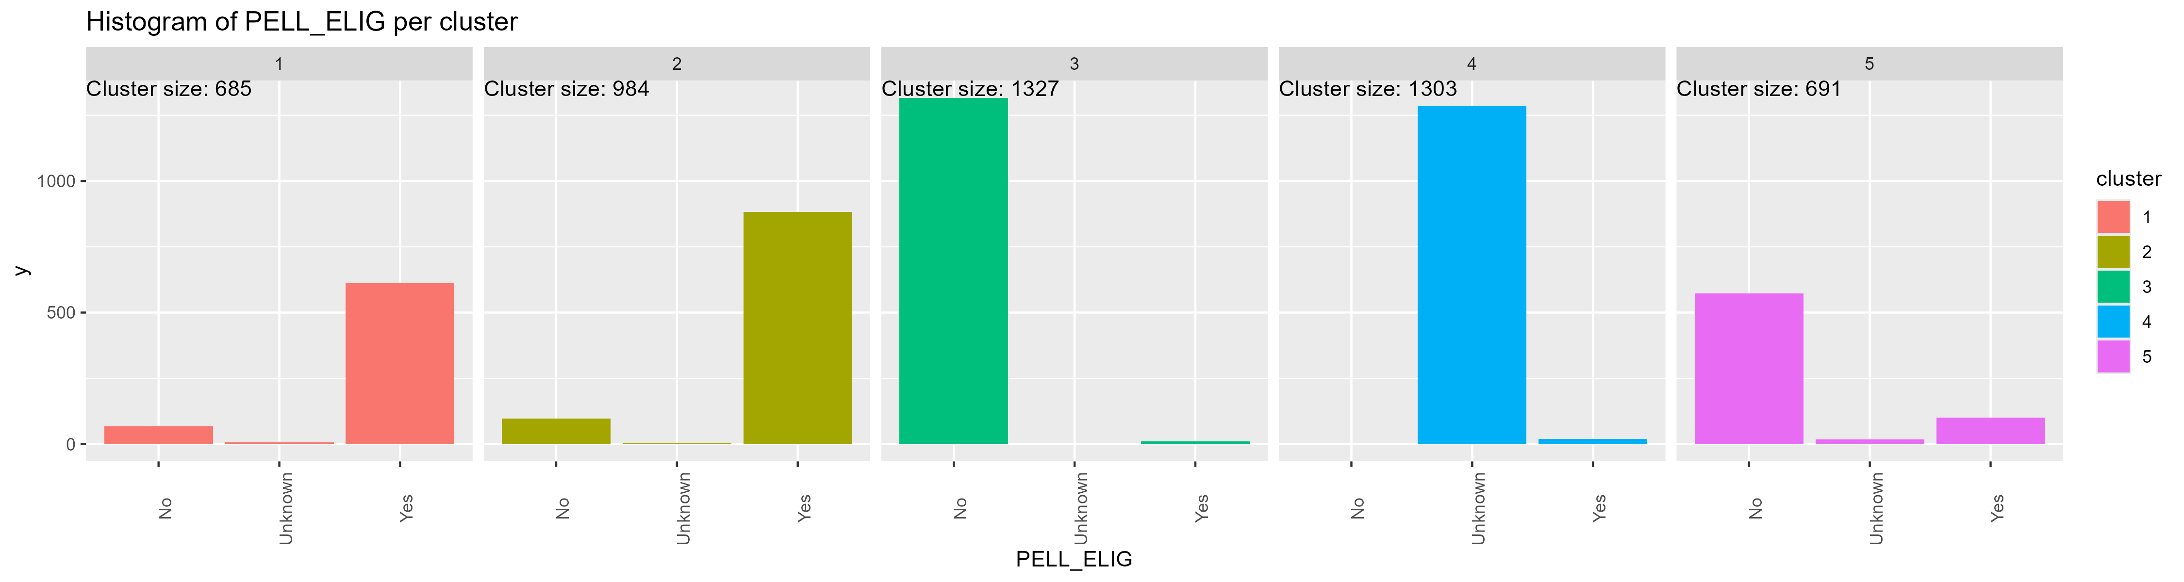
Clusters – results
Clusters 1, 2 are Pell eligible
Clusters 3, 5 are non-Pell eligible
Cluster 4 has unknown Pell eligibility – mostly, no FAFSA
Notes:
When we complete our clustering, we check the distributions of different variables between each cluster.
Here, we see clusters 1 and 2 in red and gold are primarily Pell eligible, clusters 3 and 5 in green and purple are non-Pell eligible, and cluster 4 in blue is for when that data is missing. Most of that missing data is from students who did not submit their FAFSA.

Slide 11
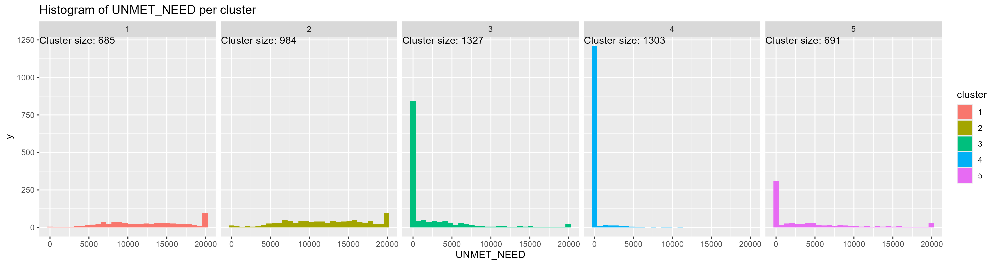
Clusters – results 2
Clusters 1, 2 have high unmet need
Clusters 3, 5 have low unmet need
Cluster 4 has primarily 0 unmet need (represents missing value)
Notes:
Here, we see similar patterns in unmet need. Clusters 1 and 2 have high unmet need, clusters 3 and 5 have low, and cluster 4 has mostly 0, which represents missing data.

Slide 12
Clusters – results, summary
Clusters 1, 2 – poor students
Clusters 3, 5 – wealthy students
Cluster 4 – financial information missing
Splits within financial pairs are by demographic factors
Cluster 1 is transfer students
Cluster 2 is first time students
Cluster 3 is male students
Cluster 5 is female students
Notes:
In summary, clusters 1 and 2 are poorer students, clusters 3 and 5 are wealthy students, and cluster 4 is for missing financial information.
The difference within financial categories are by transfer status, gender, and race/ethnicity.

Slide 13
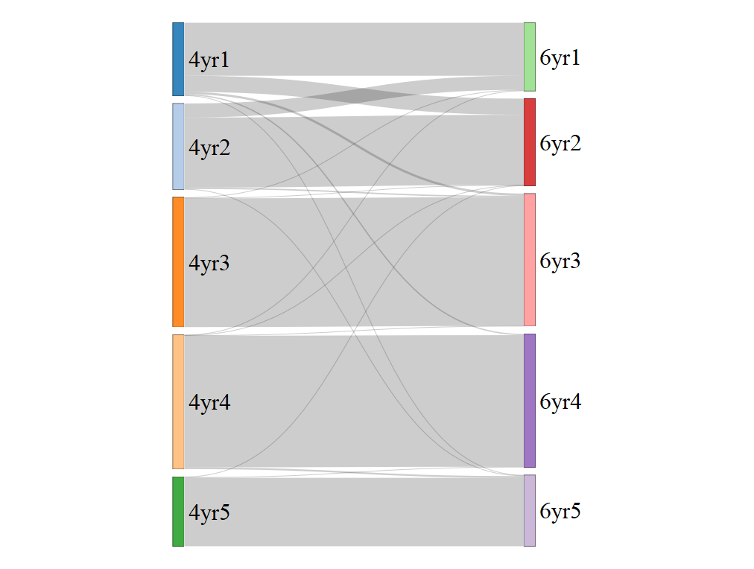
Clusters – analysis
Sanity check – are clusters worth using?
Relatively stable – 4-year and 6-year graduation populations have few swaps between clusters
Notes:
Clustering is notoriously unstable in general, but our data behaves nicely.
Our 4-year and 6-year graduation populations have pretty similar clusters, with only clusters 1 and 2 having significant switches. The financial identities still remain though.

Slide 14
Clusters – analysis 2
Noticeable performance difference between clusters:
Cluster 2 has 35% overall graduation rate
Cluster 4 has 47%
Cluster 5 has 53%
Recall that clustering did not use academic data at all
Notes:
We also see that our clusters, as is, perform differently.
Cluster 2, of non-transfer poorer students, has the lowest graduation rate at 35%, whereas cluster 4 of unknown financial status has 47% graduation rate, and cluster 5, of female wealthy students, has 53% graduation rate.
Importantly, these clusters are on demographic and financial data only. So, the academic differences implies there’s merit to these factors predicting performance
Careful wording – there is an association between lower financial info and lower performance, but not causation or prediction
Different performance may mean that institutional support may need to be increased for certain clusters of students

Slide 15
Tree Analysis – why?
Decision trees are well understood and very interpretable
Want to understand data, not predict
Gives good overview of what is most determinate of performance, what order, and roughly what breakpoint
Notes:
Speaking of, we now turn to decision trees to further refine what factors influence student success.
We choose decision trees because they’re very easy to interpret and give a good look at the shape of the data, and we don’t care about their poor predictive performance for this application.

Slide 16
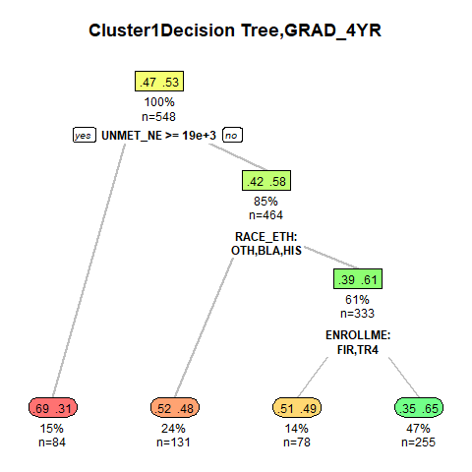
Tree Analysis – results
Cluster 1 (poor, transfer students)

Slide 17
Tree Analysis – results
Cluster 1 (poor, transfer students)
Unmet need is still key predictor

Slide 18
Tree Analysis – results
Cluster 1 (poor, transfer students)
Unmet need is still key predictor
Students with need ≥19k have 31% graduation rate

Slide 19
Tree Analysis – results
Cluster 1 (poor, transfer students)
Unmet need is still key predictor
Students with need <19k have 58% graduation rate

Slide 20
Tree Analysis – summary
Unmet need or expected family contribution show up in every single tree, except for the cluster with missing financial data
Top splits:
Cluster 1: Unmet need, 19,000
Cluster 2: Federal EFC, 397
Cluster 3: Enrollment type, transfer from 2-year institution
Cluster 4: Enrollment type, transfer from 2-year or 4-year institution
Cluster 5: Federal EFC, 13,000
Notes:
To summarize, every single cluster has at least one split based on unmet need or expected family contribution, except the cluster where financial information is missing.
The top splits overall per cluster, as you can see, reflect that. The only non-financial top split is by enrollment type, which makes sense too.

Slide 21
Tree Analysis – conclusions
Financial information is key in splitting clusters
Financial information is key in determining performance within clusters
Overall, financial data is our primary factor for success

Slide 22
Near Neighbors – why?
Borrows ideas from propensity score analysis
To analyze program effect, directly compare students of interest to most similar students
Match S-STEM scholars within some small distance, measure S-STEM scholar ending GPA versus average ending GPA of their neighbors
When matching, we use S-STEM students’ unmet need without the scholarship
Notes:
For a different method of analysis, we want to analyze scholarship effect directly. To do so, we take S-STEM scholars and match them with all students who are mostly similar, then compare GPA of the scholar to the average GPA of their neighbors.

Slide 23
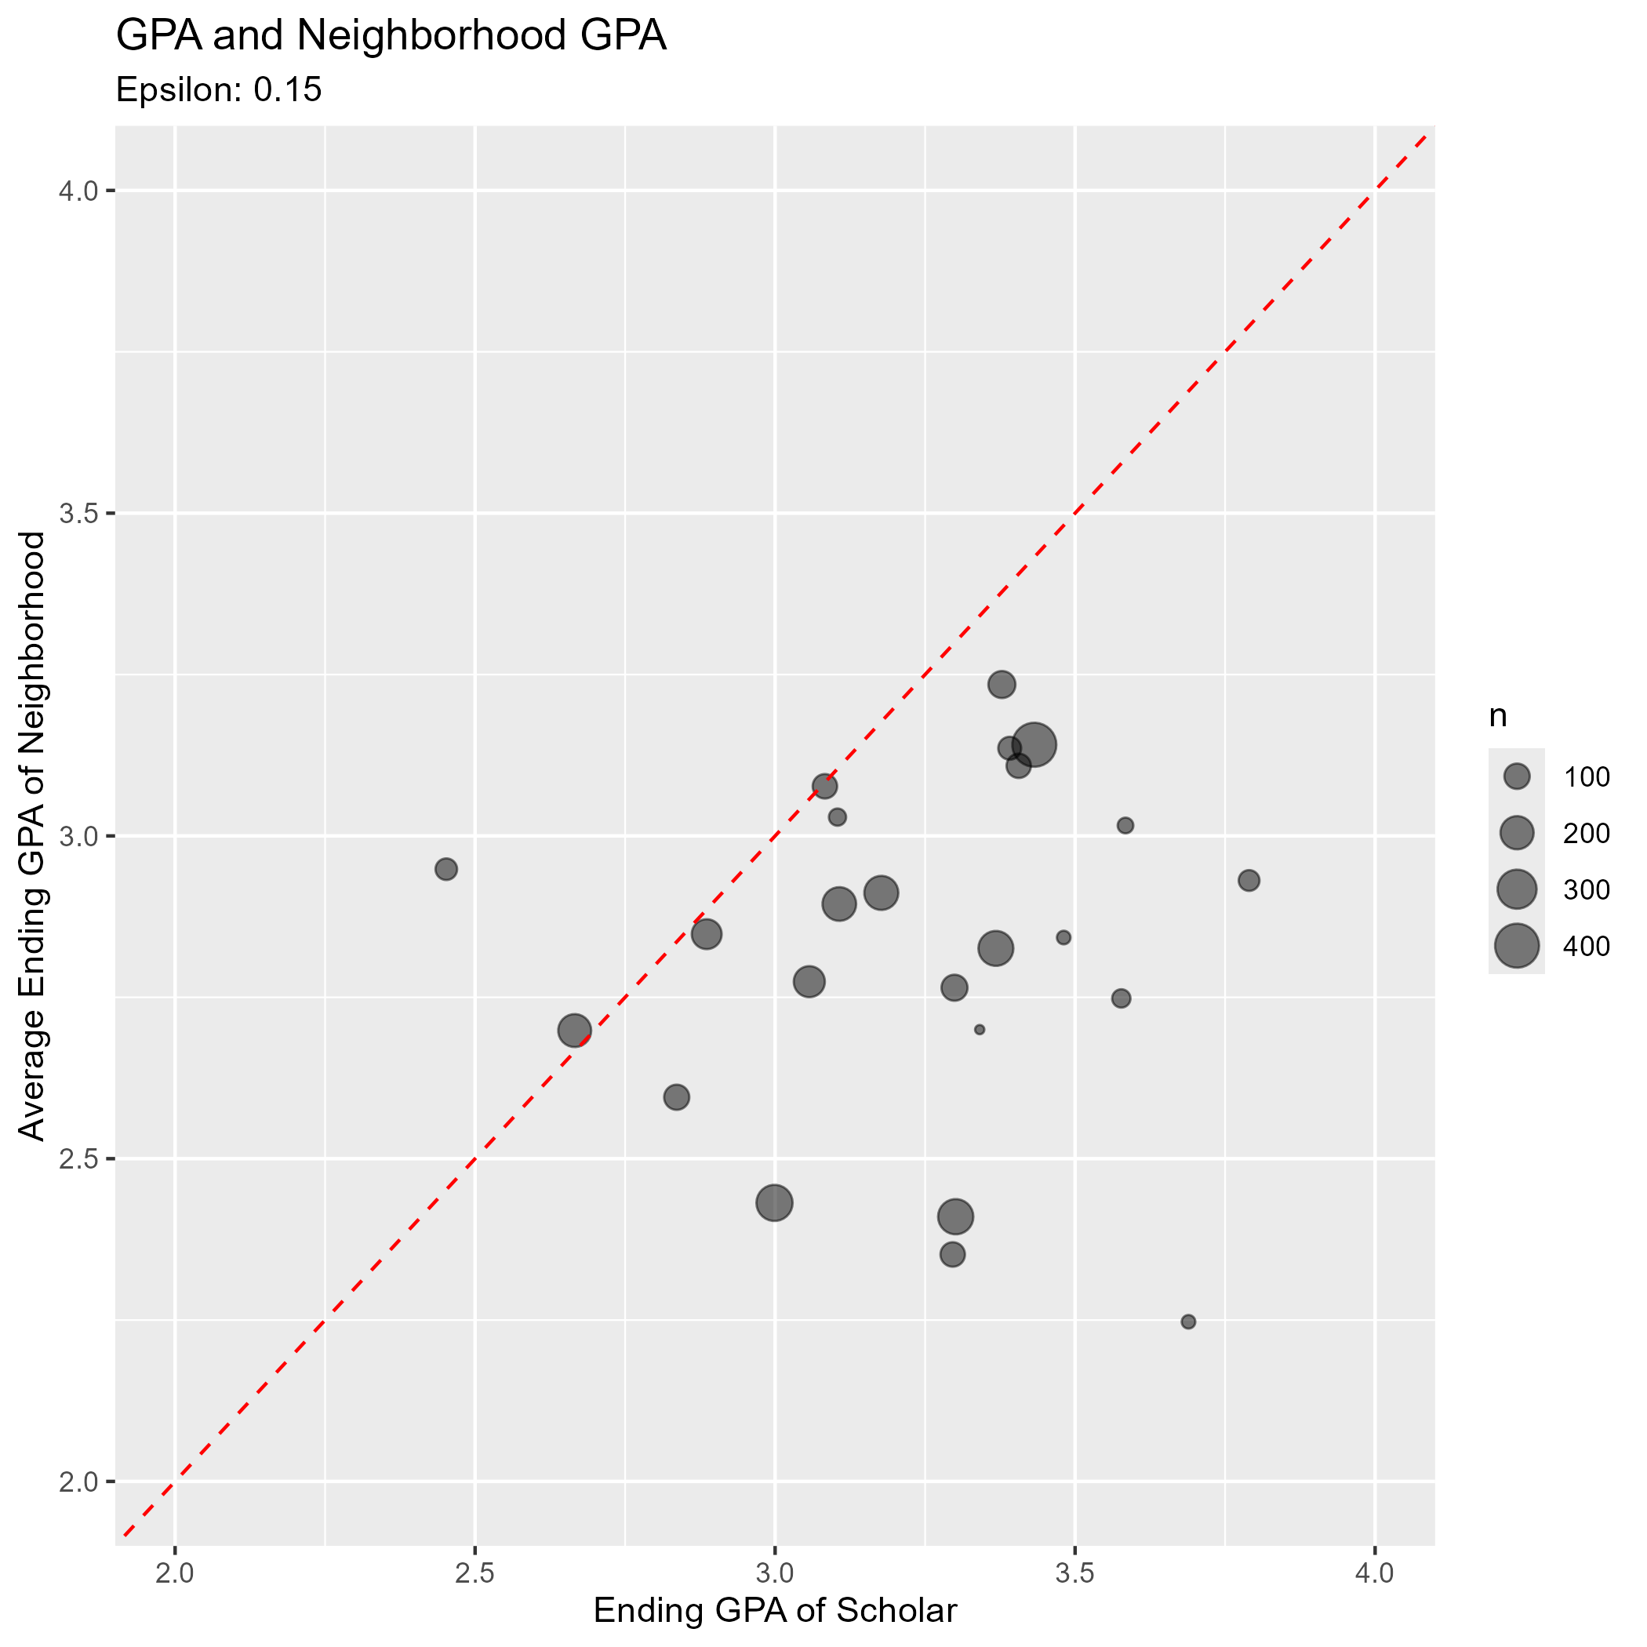
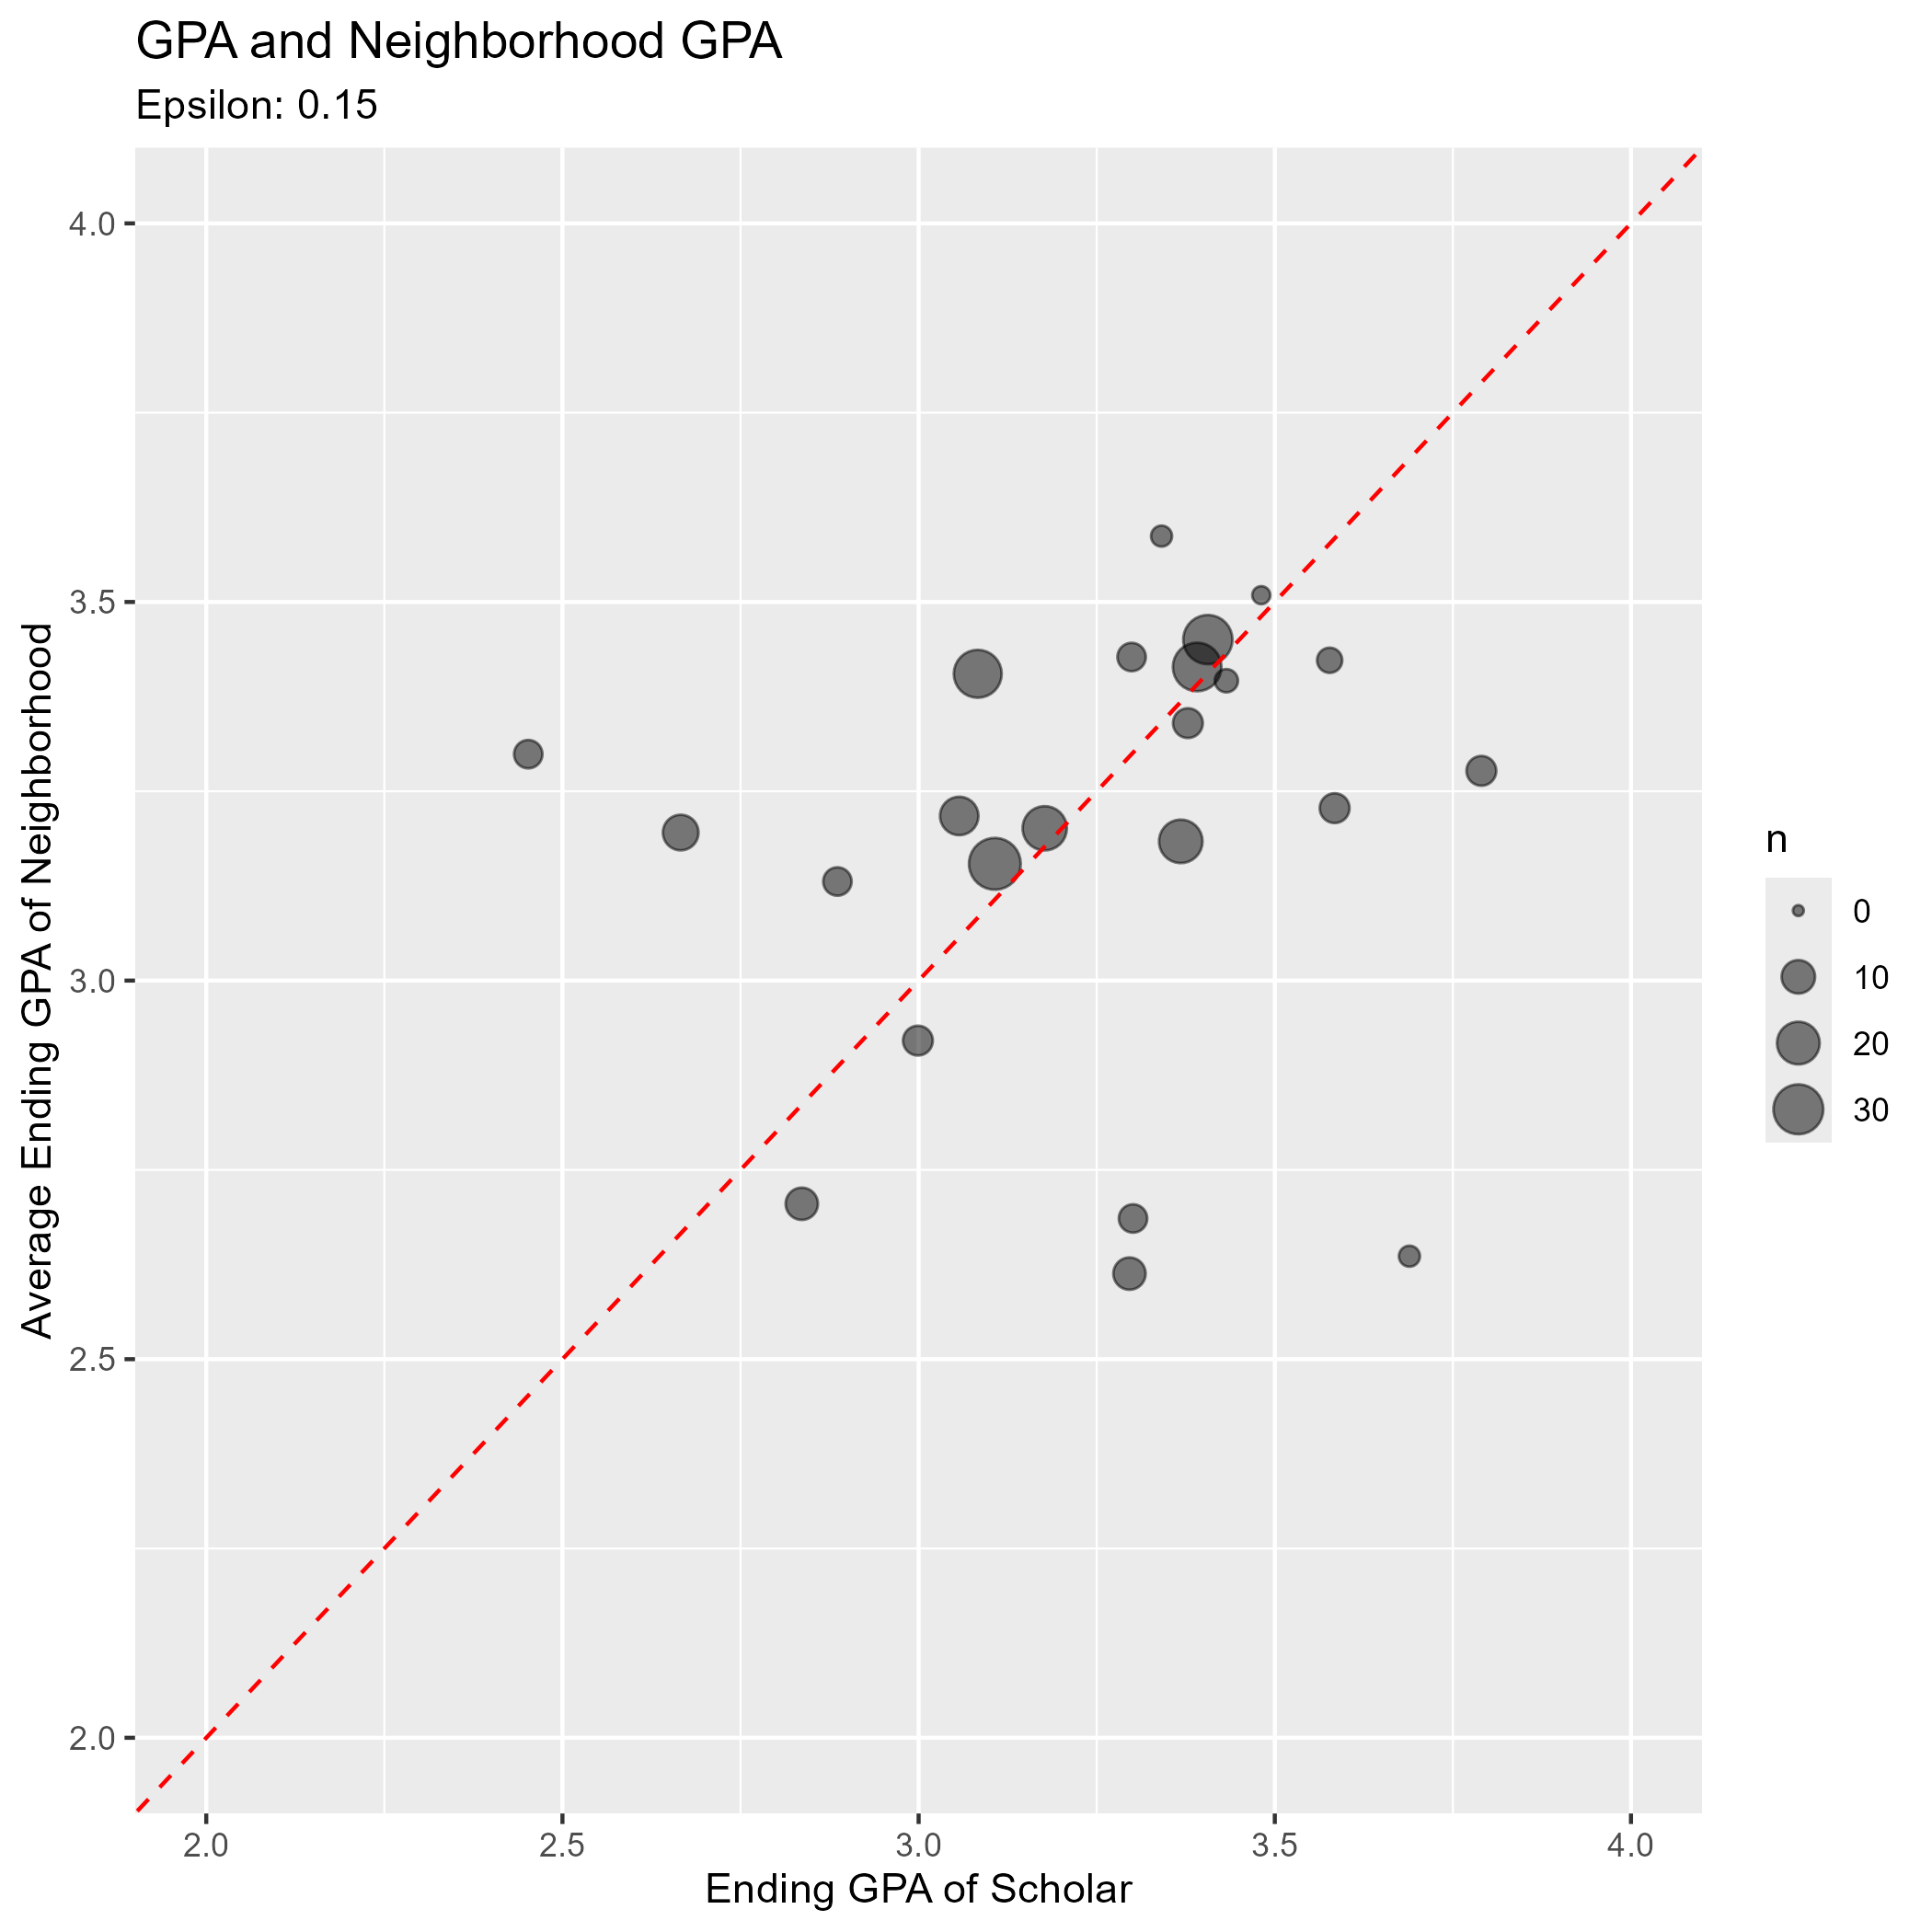
Near Neighbors – results
All neighbors
Eligible neighbors only
Notes:
Take a look at this graph on the right.
The x-axis represents the ending GPA of an S-STEM scholar, and the y-axis represents the average GPA of their matched neighborhood.
You’ll notice a dotted diagonal line of y=x. Points on that line are S-STEM scholars who perform the same as their neighborhood.
Points below that line have a higher x value than y value, which means the S-STEM student has a higher GPA than their neighbors.
So, on the right, when we allow matches from all students, we see the S-STEM students performing noticeably better than their neighbors.
However, over on the left, when we compare with only eligible students – Pell eligible math majors with a high GPA – the scholars perform about as well their eligible neighbors

Slide 24
Near Neighbors – conclusions
S-STEM scholars perform significantly better than general neighbors; roughly .4 GPA difference
t-test has p-value <.0001 for different means
S-STEM scholars do not perform notably better than similar students who are also eligible for the program
t-test has p-value .6041
Cannot point to scholarship as key factor for raising student GPA – but that’s not the point
Notes:
Running t-tests, we confirm those differences.
So, we can’t say that our scholarship is raising students’ GPAs, but we can say it’s allowing talented students to remain at Towson.
In fact, the high retention rate of our S-STEM scholars is something we want to research further, but haven’t successfully designed a convincing study yet.

Slide 25
Discussion
Consider a student retained if they were present in Spring 25 or graduated at some point
Group | Sample Size | NOT Retained | Proportion
Eligible, not in S-STEM | 282 | 45 | 15.96%
Eligible AND neighbor | 149 | 23 | 15.44%
S-STEM scholar | 24 | 1 | 4.17%

Slide 26
Discussion 2
A t-test for proportions between S-STEM and both eligible groups is not significant
This is untrustworthy due to low sample size
Further research and more data is required
If we calculate the retention rate of S-STEM scholars’ neighbors and use that as the probability of retention for each S-STEM scholar, then the probability of getting at most 1 student not retained is at most .0235, depending on missing value replacement
Notes:
The S-STEM scholarship seems to be allowing talented students to remain at Towson and maintain high performance

Slide 27
References
AAAS. (2025). Bridging Potential and Opportunity: The Experiences of NSF S-STEM Scholars. https://sstemrec.aaas.org/wp-content/uploads/2025/05/NSF_S-STEM_REC_Y3_Outcomes_Impact_Report_Final.pdf
Chapman, A. (2017). Quantitative Analysis of an Urban Community College S-STEM Program. https://www.proquest.com/docview/1972113187?%20Theses&fromopenview=true&pq-origsite=gscholar&sourcetype=Dissertations%20
Erwin, C., Binder, M., Miller, C., & Krause, K. (2021, March). Performance-Based Aid, Enhanced Advising, and the Income Gap in College Graduation: Evidence From a Randomized Controlled Trial. https://files.eric.ed.gov/fulltext/EJ1284205.pdf
Maryland Higher Education Commission. (2016, September). Report on Unmet Need and Student Success at Maryland Public Four-Year Institutions. https://mhec.maryland.gov/publications/Documents/Research/AnnualReports/Unmet%20Need%202016%20Final%20Report.pdf
Tinto, V. (1975). Dropout from Higher Education: A Theoretical Synthesis of Recent Research. 45(1), 89–125.
Slides, code, and results available at: https://github.com/faxmachine19/SSTEM-Towson

Slide 28
Thank you!

