Slide 1
Semantic Search
Built a COVID-19 Assistant Powered by NLP

Slide 2
Syllabus
Context
Search Engine Methodology
Scraping the data
Semantic Search using NLP
Building the API

Slide 3
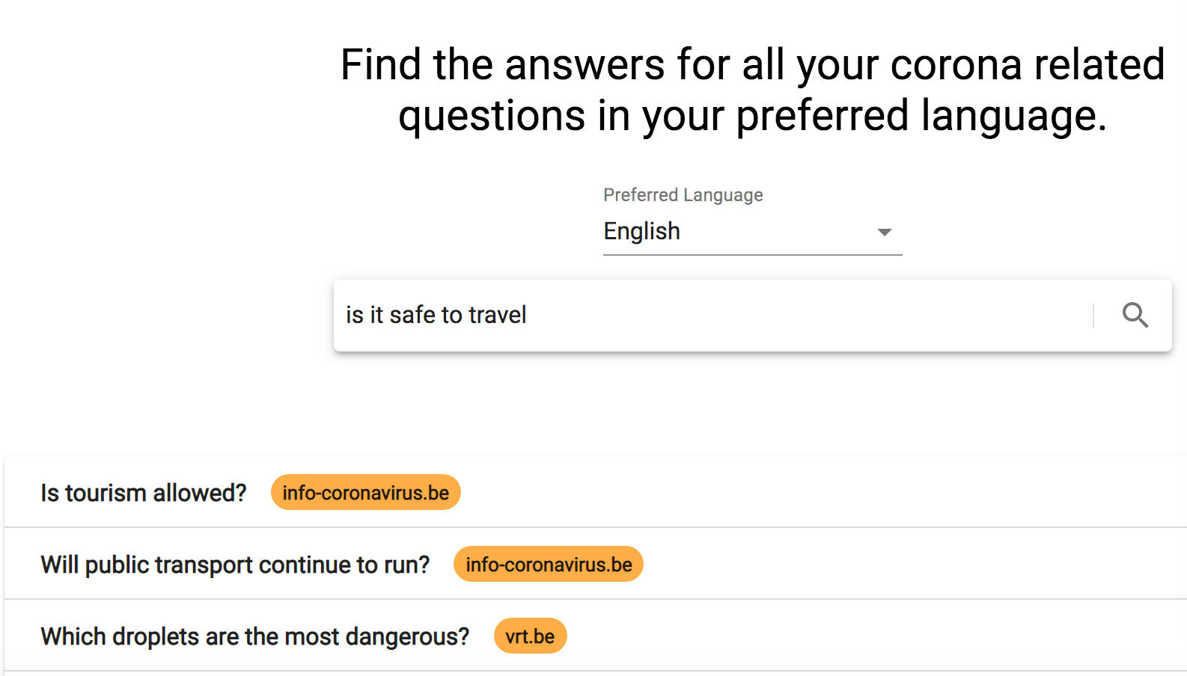
Context
The COVID-19 pandemic is changing the world rapidly and keeping people well-informed is an important step in flattening the curve. This is why ML6 decided to build a multilingual COVID-19 assistant powered by AI, more specifically Natural Language Processing (NLP).

Slide 4
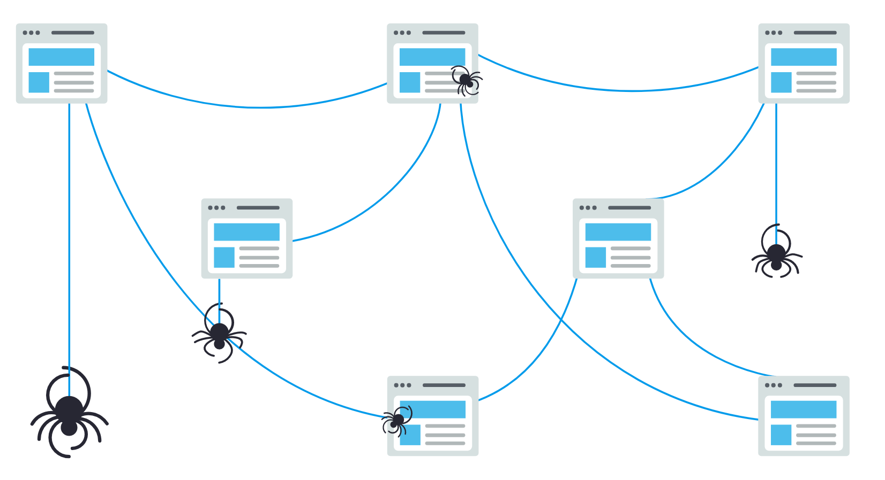
Search Engine Methodology
How do search engines work?
Crawl: Scour the Internet for content, looking over the code/content for each URL they find.
Index: Store and organize the content found during the crawling process. Once a page is in the index, it’s in the running to be displayed as a result to relevant queries. This type of index is called an inverted index, because it inverts a page-centric data structure (page->words) to a keyword-centric data structure (word->pages).
Rank: Provide the pieces of content that will best answer a searcher's query, which means that results are ordered by most relevant to least relevant.

Slide 5

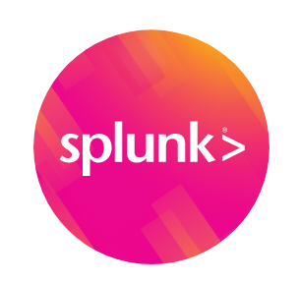


Search Engine Solutions
Soir VS ElasticSearch
Lucene Basic Concept

Slide 6
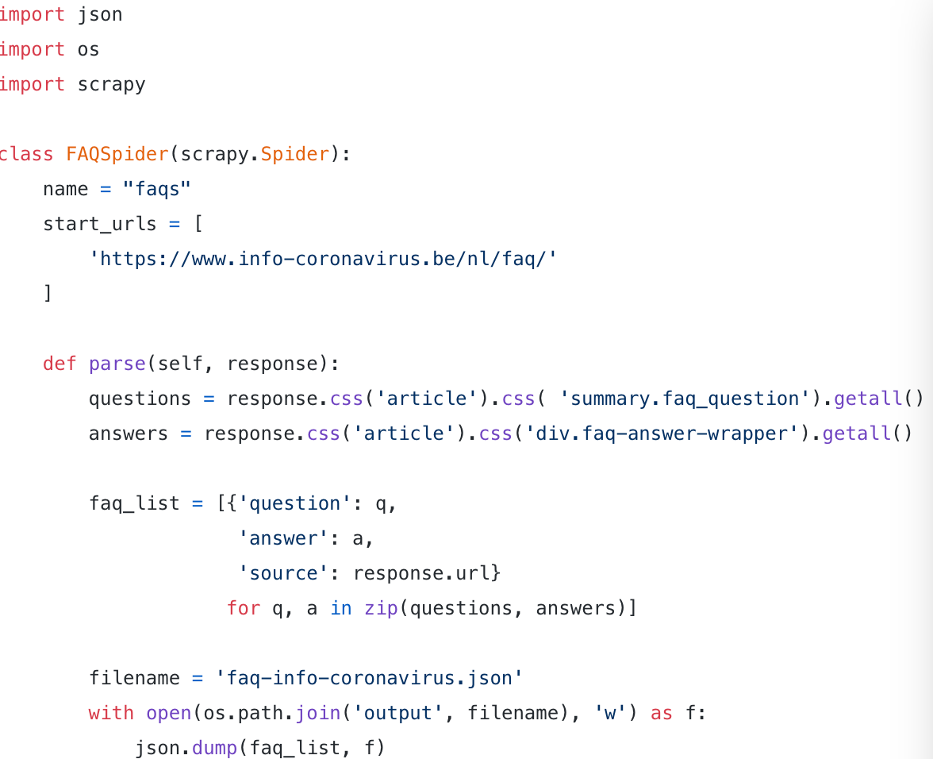
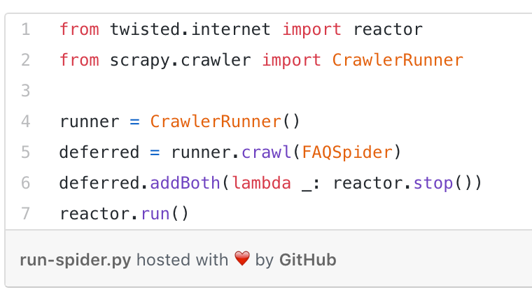

Scraping the data
Selected a small set of trustworthy FAQs URLs that are being kept up to date by official organizations. Web scraping can easily be done using the python library scrapy. All you need to do is define a “spider” containing the URLs you want to scrape as well as the logic for parsing the underlying HTML.
Around 500 question-answer pairs saved to local files in json format. Each of the json files contains a list with question-answer pairs along with their source URL.

Slide 7
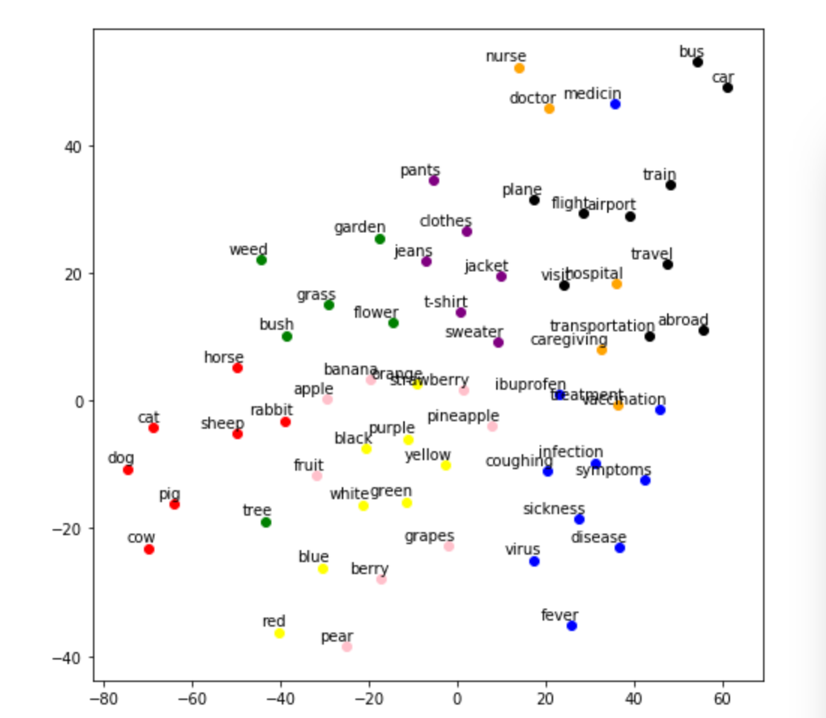
Word2Vec
Traditional Search Engine VS Semantic Search
Traditionally, search engines are based on keyword search where you only get results matching the exact keyword that you typed.
However, you are probably also interested in results containing synonyms for your input keyword or just any related word. In modern NLP, text is usually represented as (high-dimensional) mathematical vectors, also called embeddings, that capture the semantics of the text.

Slide 8
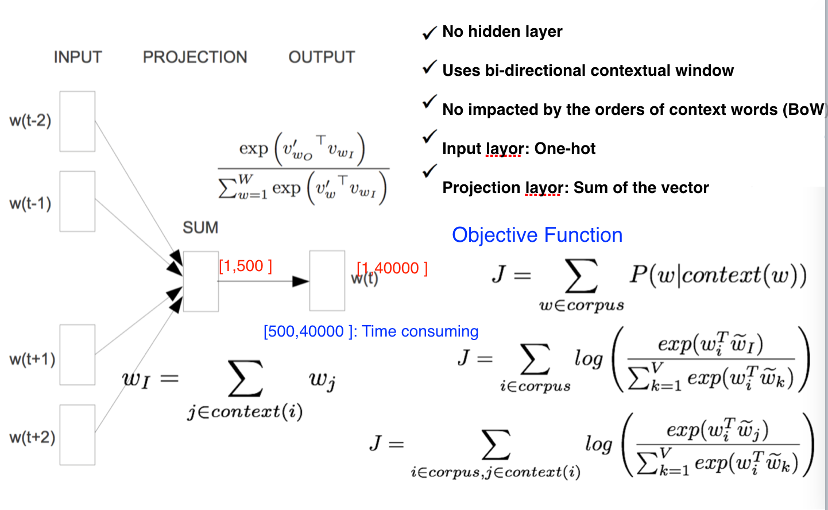
Word2vec: CBOW

Slide 9
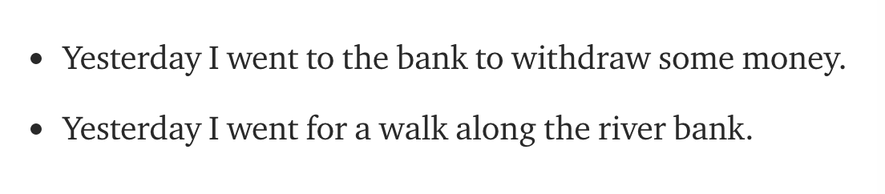
Sentence Embeddings
Word embeddings are great but we typically want to capture the meaning of a whole sentence, not just separate words.
A recent trend in NLP is to learn contextualized embeddings, where the whole sentence (“context”) is taken into account before computing its embedding.

Slide 10
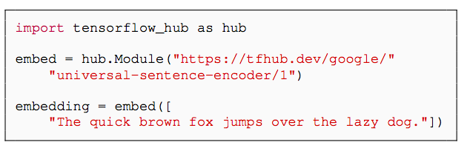
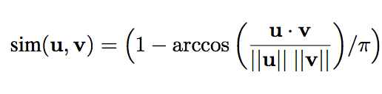
Universal Sentence Encoder
The Universal Sentence Encoder developed by Google is a state-of-the-art model for computing contextualized sentence embeddings.
Encoders
Transformer architecture targets high accuracy at the cost of greater model complexity and resource consumption.
Deep Averaging Network (DAN) whereby input embeddings for words and bi-grams are first averaged together and then passed through a feedforward deep neural network (DNN) to produce sentence embeddings.
Transfer Learning Models
For the pairwise semantic similarity task, we directly assess
the similarity of the sentence embeddings produced by our two encoders. we
first compute the cosine similarity of the two sentence embeddings and then use cosine similarity into an angular distance.

Slide 11
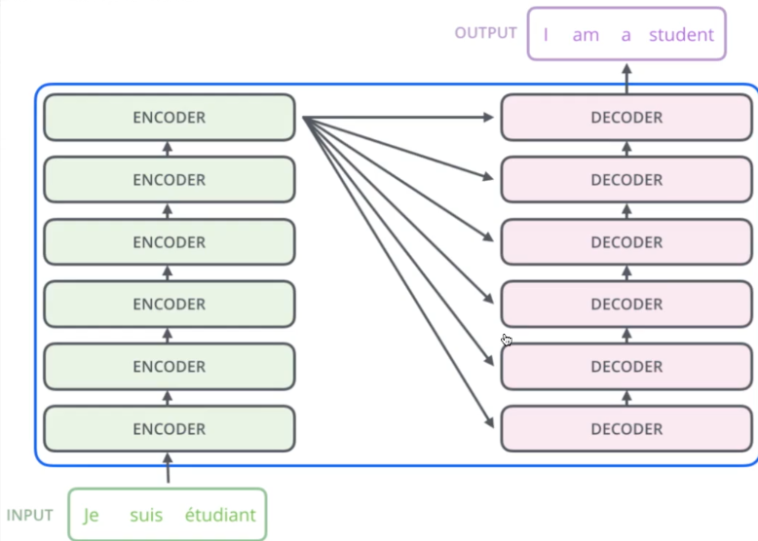
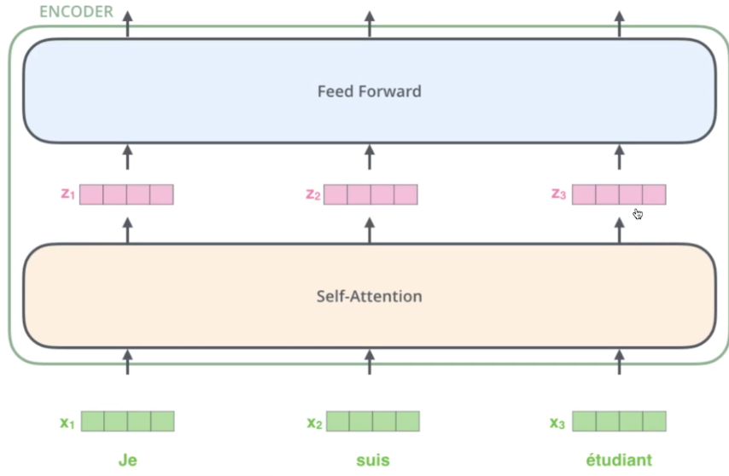
Transformer Encoder

Slide 12
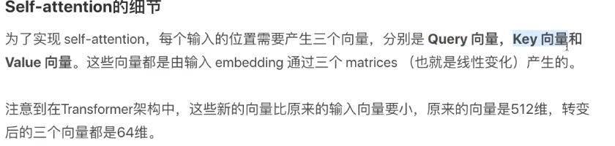
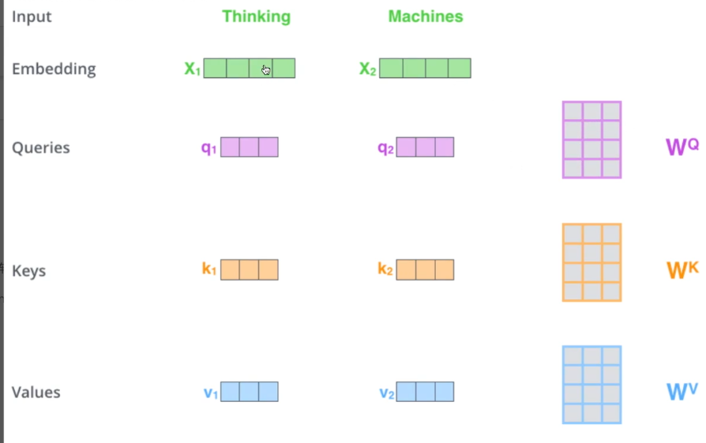
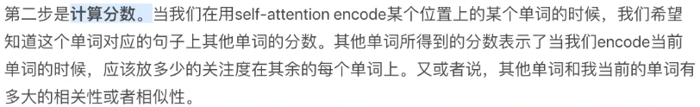
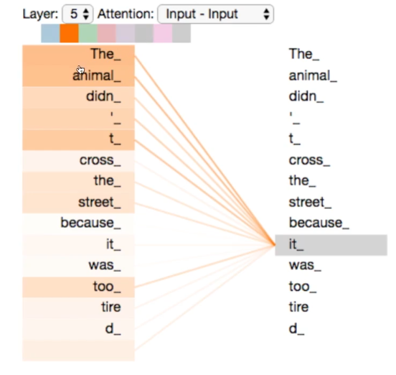
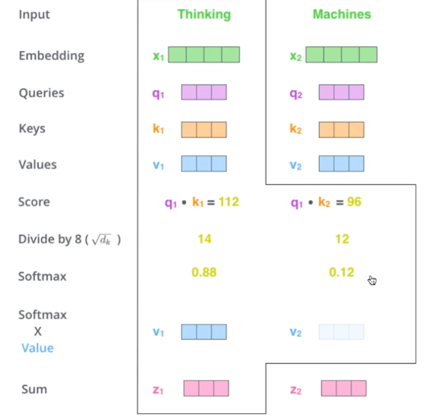
Transformer Encoder

Slide 13
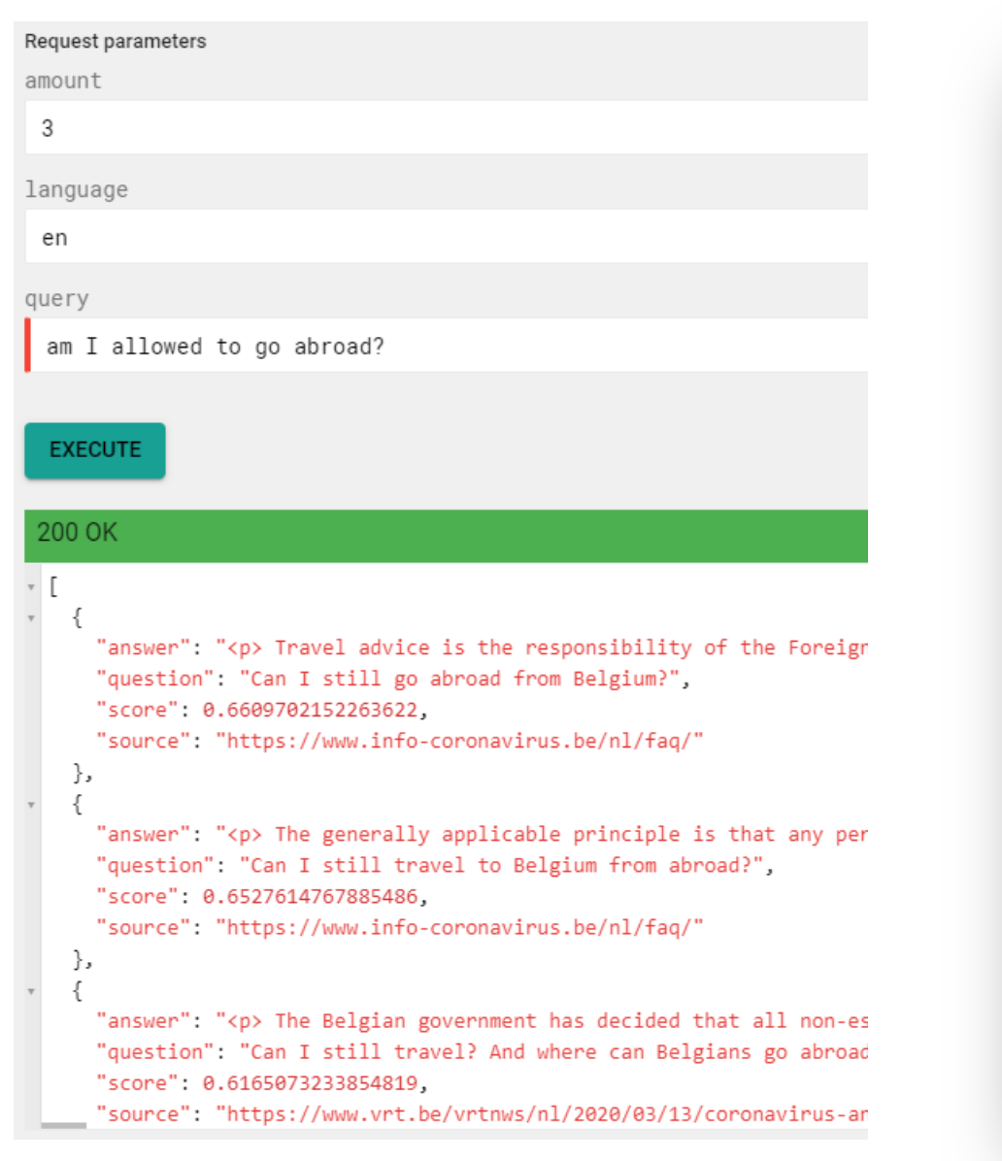
Building the API
The API is implemented with the Connexion framework of Zalando, which is a Swagger/OpenAPI first framework for Python on top of Flask.
Why Connexion
With Connexion, you write the spec first. Connexion then calls your Python code, handling the mapping from the specification to the code. This incentivizes you to write the specification so that all of your developers can understand what your API does, even before you write a single line of code.

Slide 14
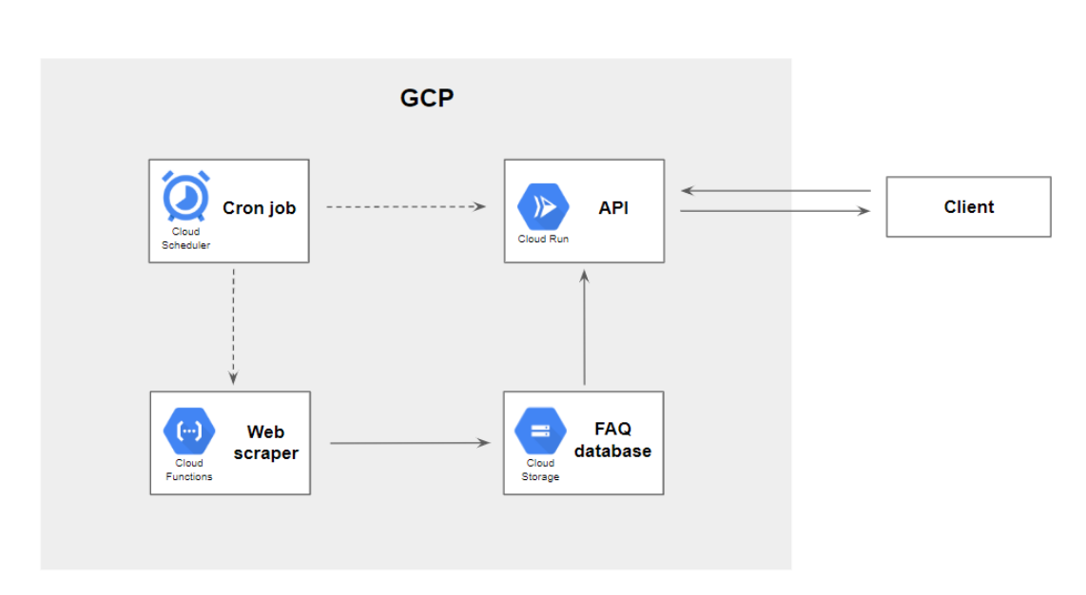

Building the API
Cloud Run, which is a fully managed compute platform for deploying containerized applications
How to keep the FAQ database up to date over time?

