Slide 1

Semantic Search
Built a COVID-19 Assistant Powered by NLP
1
© NEC Corporation 2017
NEC Group Internal Use Only

Slide 2
Syllabus
• Context
• Search Engine Methodology
• Scraping the data
• Semantic Search using NLP
• Building the API
2
© NEC Corporation 2017
NEC Group Internal Use Only

Slide 3
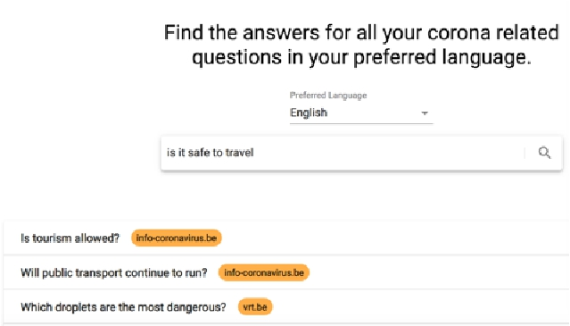
Context
The COVID-19 pandemic is changing the world rapidly and keeping people well-informed is an important step in
flattening the curve. This is why ML6 decided to build a multilingual COVID-19 assistant powered by AI, more
specifically Natural Language Processing (NLP).
3
© NEC Corporation 2017
NEC Group Internal Use Only

Slide 4
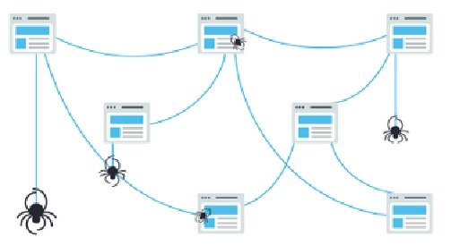
Search Engine Methodology
How do search engines work?
•
•
Crawl: Scour the Internet for content, looking over the code/content for each URL they find.
Index: Store and organize the content found during the crawling process. Once a page is in the
index, it’s in the running to be displayed as a result to relevant queries. This type of index is called
an inverted index, because it inverts a page-centric data structure (page->words) to a keyword-
centric data structure (word->pages).
•
Rank: Provide the pieces of content that will best answer a searcher's query, which means that
results are ordered by most relevant to least relevant.
4
© NEC Corporation 2017
NEC Group Internal Use Only

Slide 5

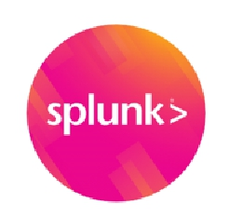
Search Engine Solutions
Soir VS ElasticSearch
Lucene Basic Concept
5
© NEC Corporation 2017
NEC Group Internal Use Only

Slide 6
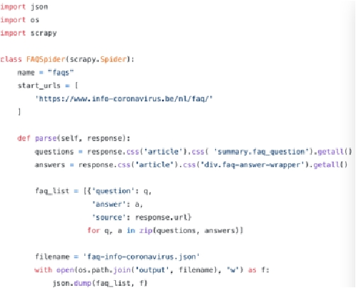
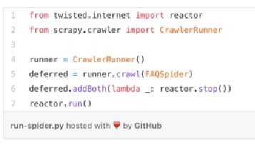

Scraping the data
• Selected a small set of trustworthy FAQs URLs that are being kept up to date by official organizations. Web
scraping can easily be done using the python library scrapy. All you need to do is define a “spider” containing the
URLs you want to scrape as well as the logic for parsing the underlying HTML.
• Around 500 question-answer pairs saved to local files in json format. Each of the json files contains a list with
question-answer pairs along with their source URL.
6
© NEC Corporation 2017
NEC Group Internal Use Only

Slide 7
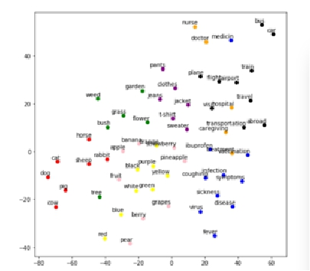
Word2Vec
Traditional Search Engine VS Semantic Search
Traditionally, search engines are based on keyword search where you only get results matching the exact
keyword that you typed.
However, you are probably also interested in results containing synonyms for your input keyword or just any
related word. In modern NLP, text is usually represented as (high-dimensional) mathematical vectors, also called
embeddings, that capture the semantics of the text.
7
© NEC Corporation 2017
NEC Group Internal Use Only

Slide 8
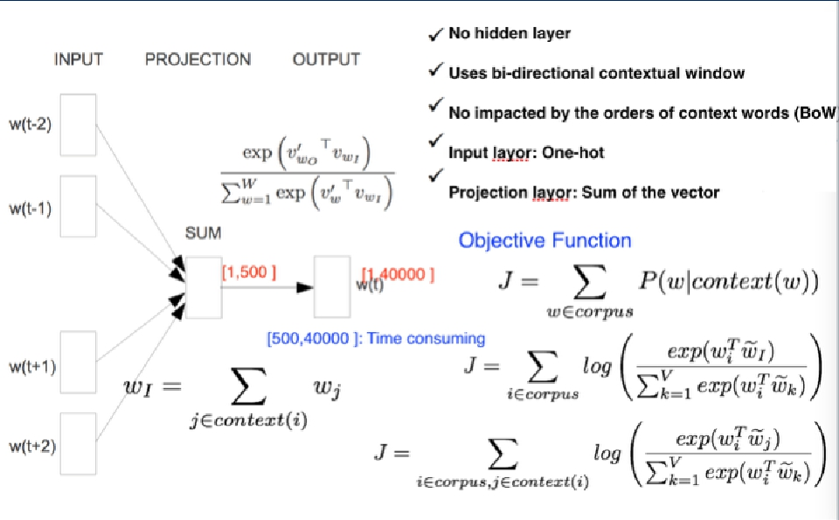
Word2vec: CBOW
8
© NEC Corporation 2017
NEC Group Internal Use Only

Slide 9
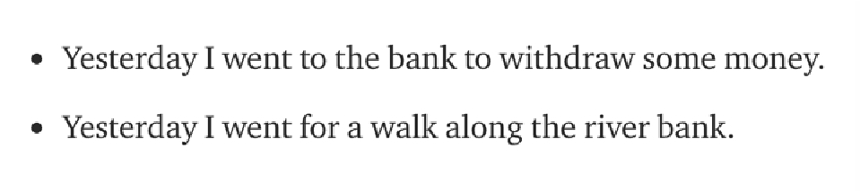
Sentence Embeddings
• Word embeddings are great but we typically want to capture the meaning of a whole sentence, not just separate
words.
• A recent trend in NLP is to learn contextualized embeddings, where the whole sentence (“context”) is taken into
account before computing its embedding.
9
© NEC Corporation 2017
NEC Group Internal Use Only

Slide 10
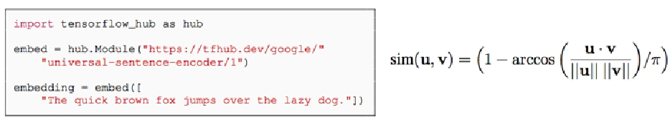
Universal Sentence Encoder
• The Universal Sentence Encoder developed by Google is a state-of-the-art model for computing contextualized
sentence embeddings.
Encoders
• Transformer architecture targets high accuracy at the cost of greater model complexity and resource
consumption.
• Deep Averaging Network (DAN) whereby input embeddings for words and bi-grams are first averaged together
and then passed through a feedforward deep neural network (DNN) to produce sentence embeddings.
Transfer Learning Models
For the pairwise semantic similarity task, we directly assess
the similarity of the sentence embeddings produced by our two encoders. we
first compute the cosine similarity of the two sentence embeddings and then use cosine similarity into an angular
distance.
© NEC Corporation 2017
NEC Group Internal Use Only

Slide 11
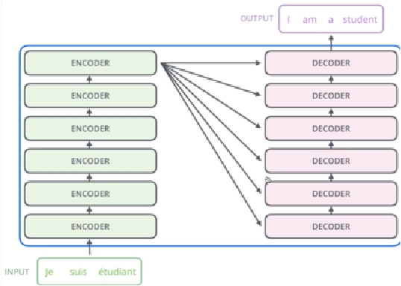
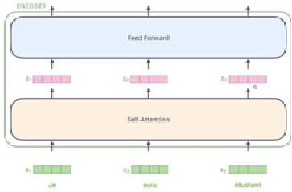
Transformer Encoder
© NEC Corporation 2017
NEC Group Internal Use Only

Slide 12
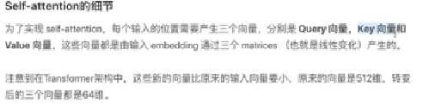
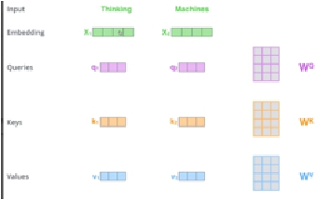

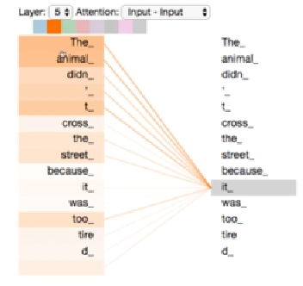
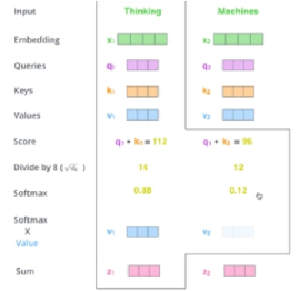
Transformer Encoder
© NEC Corporation 2017
NEC Group Internal Use Only

Slide 13
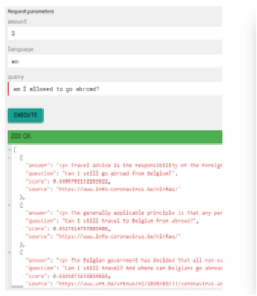
Building the API
• The API is implemented with the Connexion framework of Zalando, which is a Swagger/OpenAPI first framework
for Python on top of Flask.
Why Connexion
With Connexion, you write the spec first. Connexion then calls your Python code, handling the mapping from the
specification to the code. This incentivizes you to write the specification so that all of your developers can
understand what your API does, even before you write a single line of code.
© NEC Corporation 2017
NEC Group Internal Use Only

Slide 14
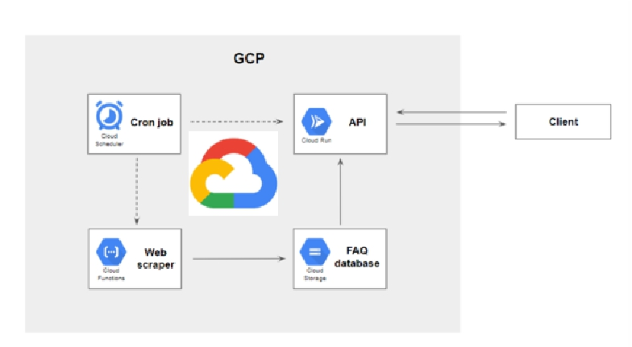
Building the API
Cloud Run, which is a fully managed compute platform for deploying containerized applications
How to keep the FAQ database up to date over time?
© NEC Corporation 2017
NEC Group Internal Use Only

