Slide 1
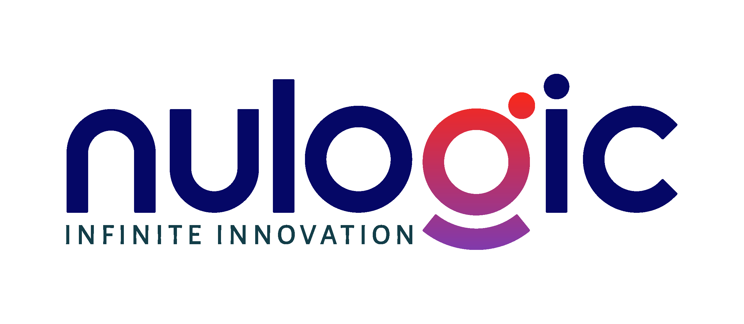
AI for Modern Teams: Real-World Usage
How we actually use AI daily
Practical workshop for developers, architects, tech leads, and business teams
Focused on daily execution, not AI theory
Covers tools, workflows, prompts, and role-based examples
Everything shown is intended to be reusable after this session
01
Notes:
Set the expectation: this is a practitioner deck. The goal is immediate usability, not abstract AI education.

Slide 2
The Reality Shift
AI is already embedded in daily work across product, engineering, and operations
The speed gap is now visible: early adopters finish routine work much faster
Strong teams use AI to compress cycle time, not to avoid thinking
AI augments judgment-heavy work; it does not replace domain ownership
The new skill is not just using tools, but using them deliberately
02
Notes:
I frame AI as a workflow shift. Teams that use it well move faster on both output and iteration quality.

Slide 3
Where AI Fits in Daily Work
Coding: scaffolding APIs, refactors, tests, debugging, code explanations
Writing: docs, summaries, release notes, stakeholder updates, meeting outputs
Analysis: tradeoffs, root-cause exploration, option comparison, pattern matching
Planning: breaking vague requests into actionable next steps
Communication: adjusting tone, clarity, and structure for different audiences
03
Notes:
This is the broad applicability slide. The pattern is simple: AI helps wherever context must be turned into structured output.

Slide 4
Tools I Use in Real Work
ChatGPT: general-purpose thinking, brainstorming, drafting, and first-pass structuring
Claude: deep reasoning, long-context synthesis, architecture work, and better structured outputs
Codex: execution-focused coding, file-aware implementation, and task completion in a repo
GitHub Copilot: in-IDE acceleration for boilerplate, completions, tests, and local edits
The practical pattern: I switch tools based on stage, not brand preference
04
Notes:
Daily pattern: ChatGPT for framing, Claude for deeper reasoning, Codex for getting work done in the codebase, Copilot for IDE speed.

Slide 5
AI Tools Comparison
ChatGPT is strongest when you need a quick start, idea generation, or broad assistance
Claude is strongest when the problem is complex, ambiguous, or requires long context
Codex is strongest when the goal is execution, code changes, and tool-driven task completion
Copilot is strongest when you are already coding and want to move faster inline
The wrong tool usually shows up as extra prompt effort, shallow output, or more manual cleanup
05
Notes:
I want the audience to stop asking which tool is best overall. The useful question is best for what stage of work.

Slide 6
Use the Right Tool at the Right Stage
Start with ChatGPT to understand the problem and sketch an initial approach
Move to Claude to refine architecture, identify edge cases, and improve structure
Use Codex to execute changes, generate code, or complete repository tasks end to end
Use Copilot while implementing to accelerate repetitive edits and local coding flow
The win comes from chaining tools intentionally instead of forcing one tool to do everything
06
Notes:
My actual workflow is multi-tool. The stage-based handoff is what keeps output quality high without slowing me down.

Slide 7
How to Use AI: Universal Workflow
Step 1: define the exact goal, success criteria, and target audience
Step 2: provide context such as role, stack, constraints, and current state
Step 3: ask for a structured output like bullets, code, table, plan, or checklist
Step 4: review critically, fix assumptions, and narrow weak sections
Step 5: iterate in smaller loops until the output is ready to use
07
Notes:
This five-step loop is the backbone. It saves time because it forces clarity before asking the model to produce anything.

Slide 8
Prompting Framework I Use Daily
Act as: define the role you want the model to simulate
Context: provide business situation, technical stack, and known constraints
Task: state the job clearly in one sentence with an outcome
Output format: request a table, bullets, code, slides, test plan, or ADR
Constraints: include style, depth, length, security, and do-not-do rules
08
Notes:
This is the simplest prompt structure that scales across coding, planning, documentation, and business communication.

Slide 9
Prompt Quality: Before vs After
Weak prompt: “Write an API for leave requests.”
Weak result: generic code, missing validation, unclear assumptions, no tests
Strong prompt: include stack, endpoint scope, auth rules, output format, and edge cases
Strong result: structured API, validation, permission handling, and test-ready output
Prompt quality usually determines whether AI is a time saver or a cleanup burden
09
Notes:
One of the biggest mistakes early on is assuming the model should infer context. Better prompts reduce rework dramatically.

Slide 10
Developers: Where AI Helps Most
Writing APIs, DTOs, validation, service methods, and database access patterns
Debugging stack traces and isolating the likely fault line faster
Generating unit tests, edge cases, mocks, and test data
Understanding legacy code and converting unfamiliar code into plain English
Refactoring repetitive code with guardrails instead of rewriting from scratch
10
Notes:
For developers, the biggest time savings usually come from generation plus explanation, not generation alone.

Slide 11
Developer Workflow Example
Prompt AI with the stack, endpoint contract, validation rules, and expected response model
Generate the API skeleton, then ask for input validation and error handling
Refine for edge cases like pagination, null handling, auth, and testability
Generate tests and ask the model to explain what is still missing
Move to Copilot for the final coding pass and small local edits
11
@PostMapping("/leave-requests")
public LeaveResponse create(@Valid @RequestBody CreateLeaveRequest request) {
return leaveService.create(request);
}
Notes:
This pattern typically saves 30 to 40 percent of implementation time for routine service and controller work.

Slide 12
Architects and Tech Leads: Where AI Helps
Exploring system design options before locking into one direction
Comparing tradeoffs across scalability, cost, complexity, and delivery risk
Drafting HLDs, LLDs, ADRs, sequence flows, and implementation breakdowns
Pressure-testing assumptions by asking AI to argue against the proposed design
Reviewing architecture decisions in a more structured and repeatable way
12
Notes:
Architect use is less about generating a perfect design and more about making assumptions explicit faster.

Slide 13
Architect Example: Prompt for a Scalable Design
Prompt with system context, expected load, failure tolerance, and current constraints
Ask for components, data flow, integration points, and likely bottlenecks
Request at least two alternatives with operational and cost tradeoffs
Ask what would break first at 10x scale and how to mitigate it
Use the output as a discussion starter, not an auto-approved design
13
Notes:
My default move is to ask for alternatives and bottlenecks explicitly. That usually surfaces more useful thinking than a single design answer.

Slide 14
Product and Business Teams: Where AI Helps
Turning rough ideas into PRDs, user stories, and acceptance criteria
Refining requirements before they reach engineering and design
Summarizing meetings, customer calls, and stakeholder feedback faster
Drafting emails, updates, reports, and executive summaries with better structure
Creating repeatable templates for weekly communication and planning work
14
Notes:
For PM and business teams, AI is most valuable when input is messy and the output must be structured and clear.

Slide 15
PM and Business Workflow Example
Input a rough problem statement, target user, and business goal
Ask AI to draft a PRD with scope, assumptions, risks, and metrics
Convert the PRD into user stories and acceptance criteria
Refine unclear requirements with the team instead of starting from a blank page
Use AI again for status updates, summaries, and stakeholder communication
15
Notes:
This is one of the cleanest business use cases because it turns unstructured notes into artifacts the team can act on immediately.

Slide 16
Live Demo #1: Developer Flow
Scenario: build a small REST API from a clear business requirement
Show the prompt, then the first-pass output from the AI tool
Refine for validation, error handling, permission checks, and tests
Highlight what the model got right and what still required engineering judgment
End with a reusable prompt pattern the audience can try today
16
Notes:
I’ll keep this demo realistic: prompt, output, critique, refine. The goal is to show how real usage looks, including corrections.

Slide 17
Live Demo #2: PM and Business Flow
Scenario: convert messy meeting notes into a structured summary and action plan
Show raw notes, then ask AI for key decisions, risks, and next steps
Refine into a stakeholder-ready update with cleaner language and ownership
Highlight how tone and output format change the usefulness of the result
End with a prompt template for summarization and follow-up communication
17
Notes:
This demo usually lands well with mixed audiences because everyone recognizes the pain of turning raw notes into something usable.

Slide 18
Risks, Best Practices, and Takeaways
Main risks: hallucinations, sensitive data exposure, over-reliance, and licensing blind spots
Best practice: treat AI like a junior engineer or analyst, not an autonomous authority
Always review outputs, especially code, decisions, data, and external claims
Break bigger work into steps and reuse the prompts that consistently work
Key takeaway: start small, use AI daily, and build team-specific workflows fast
18
Notes:
I close by grounding the audience: AI is a multiplier when paired with judgment, review discipline, and good workflow habits.

