Slide 1

Exploratory Data Analysis on FedEx Delivery Operations
Submitted By:
Shaik Fayaz Ahammed

Slide 2
Objective
• Analyze FedEx delivery operations using EDA
• Identify delivery patterns
• Detect operational bottlenecks
• Generate business recommendations

Slide 3
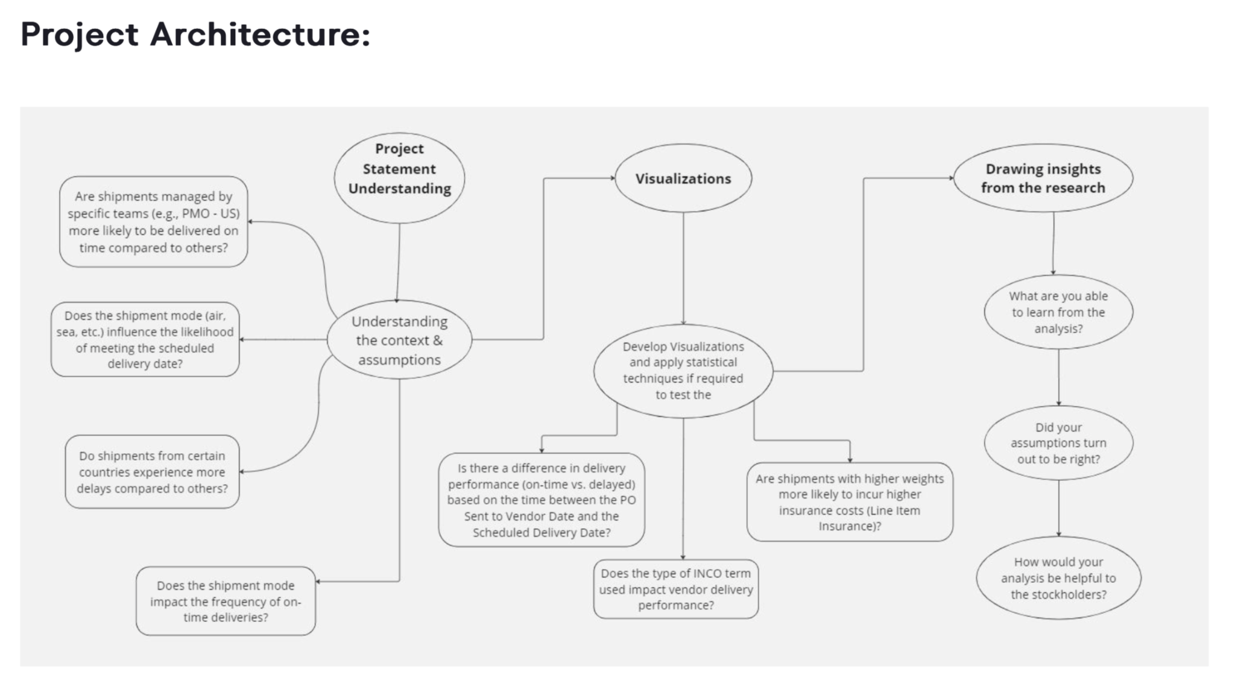

Slide 4
Dataset Description
ShipmentID
Origin
Destination
Pickup_Date
Delivery_Date
Delivery_Status
Distance_KM
Shipment_Mode
Weight_KG
Cost_USD
Customer_Segment
Delay_Reason
By this I created the dataset “fedex_deliveries.csv”

Slide 5
Data Cleaning
Loaded dataset
Checked missing values
Converted date columns
Created Delivery_Time_Days
Checked outliers

Slide 6
EDA
Delivery Time Distribution
Shipment Mode Count
Customer Segment Cost
Delivery Status
Weight vs Cost

Slide 7
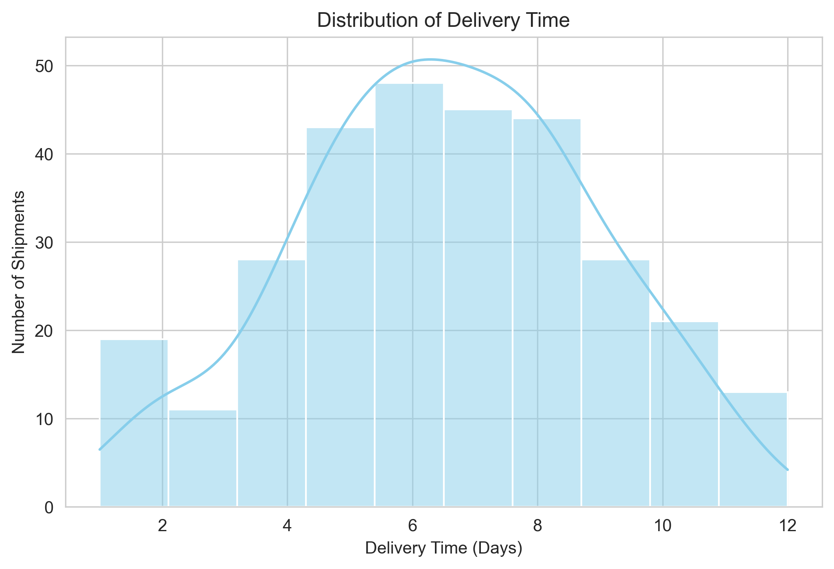
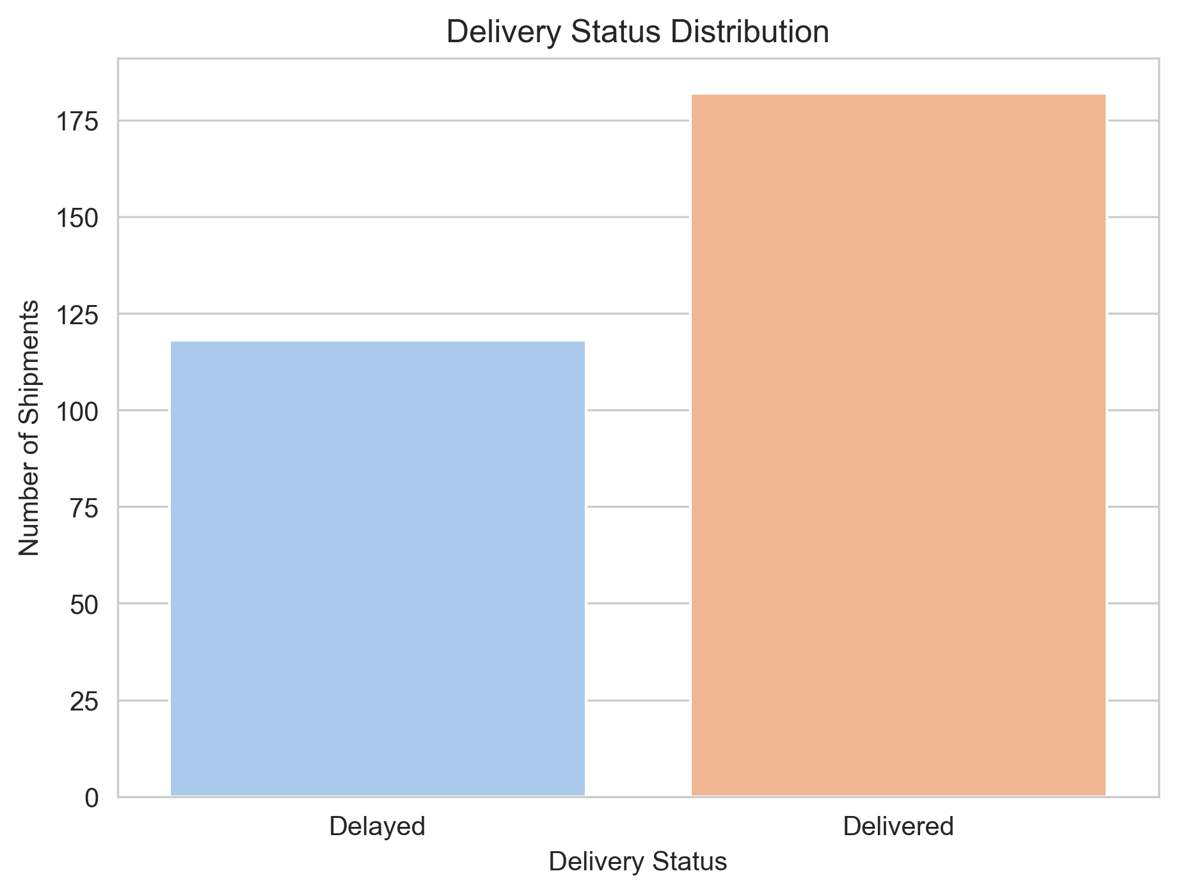
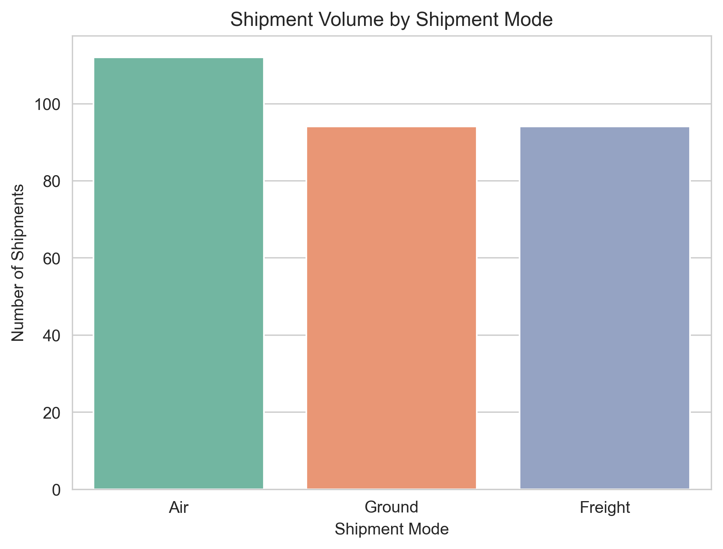
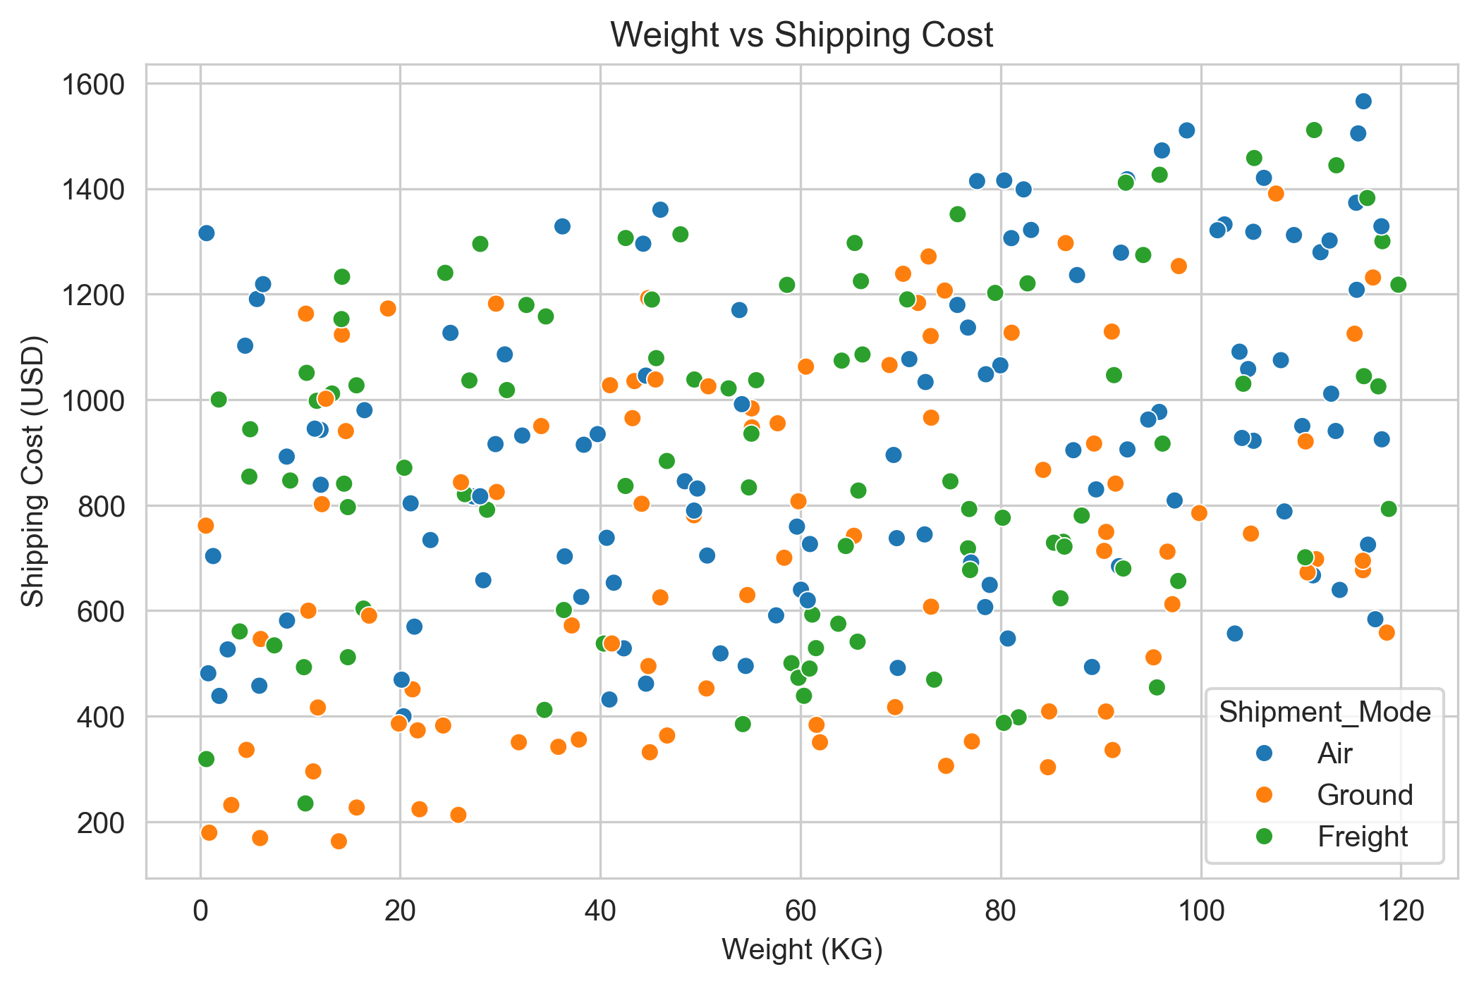
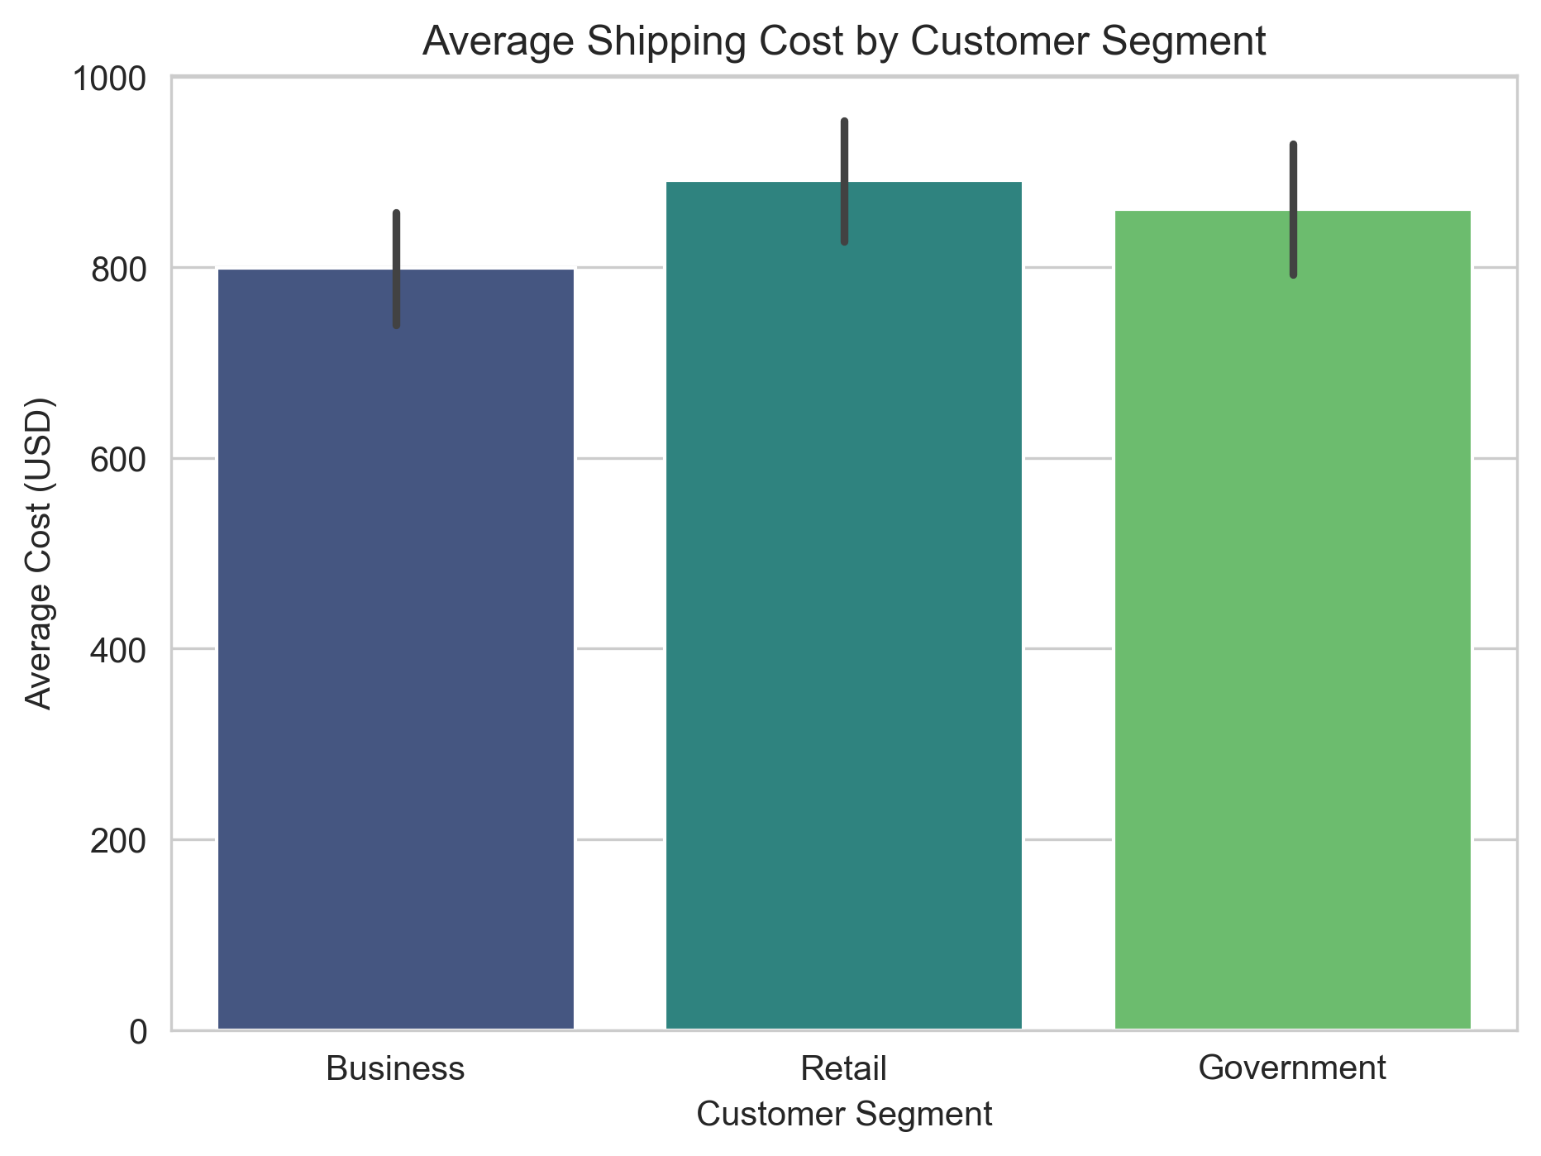

Slide 8
Geographic & Operational Insights
Top 5 City Pairs
Delays by Shipment Mode
Correlation Heatmap
Delay Reason Analysis
Delivery Time by Shipment Mode

Slide 9
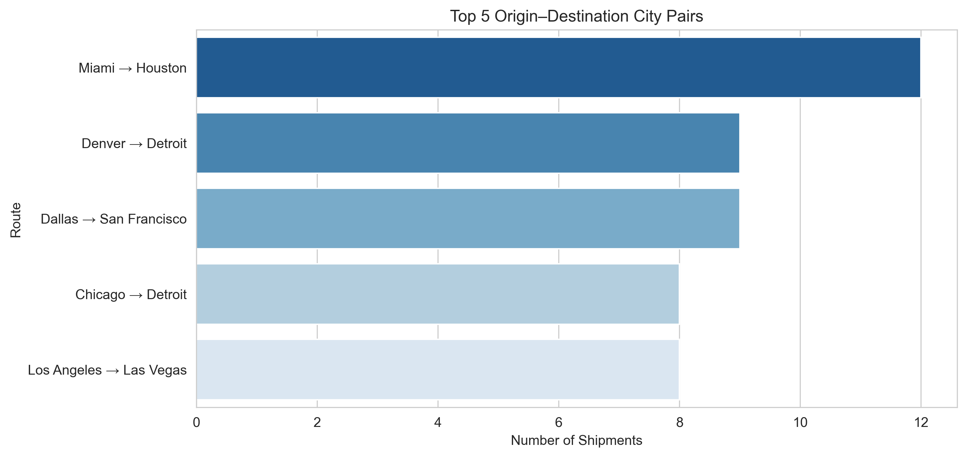
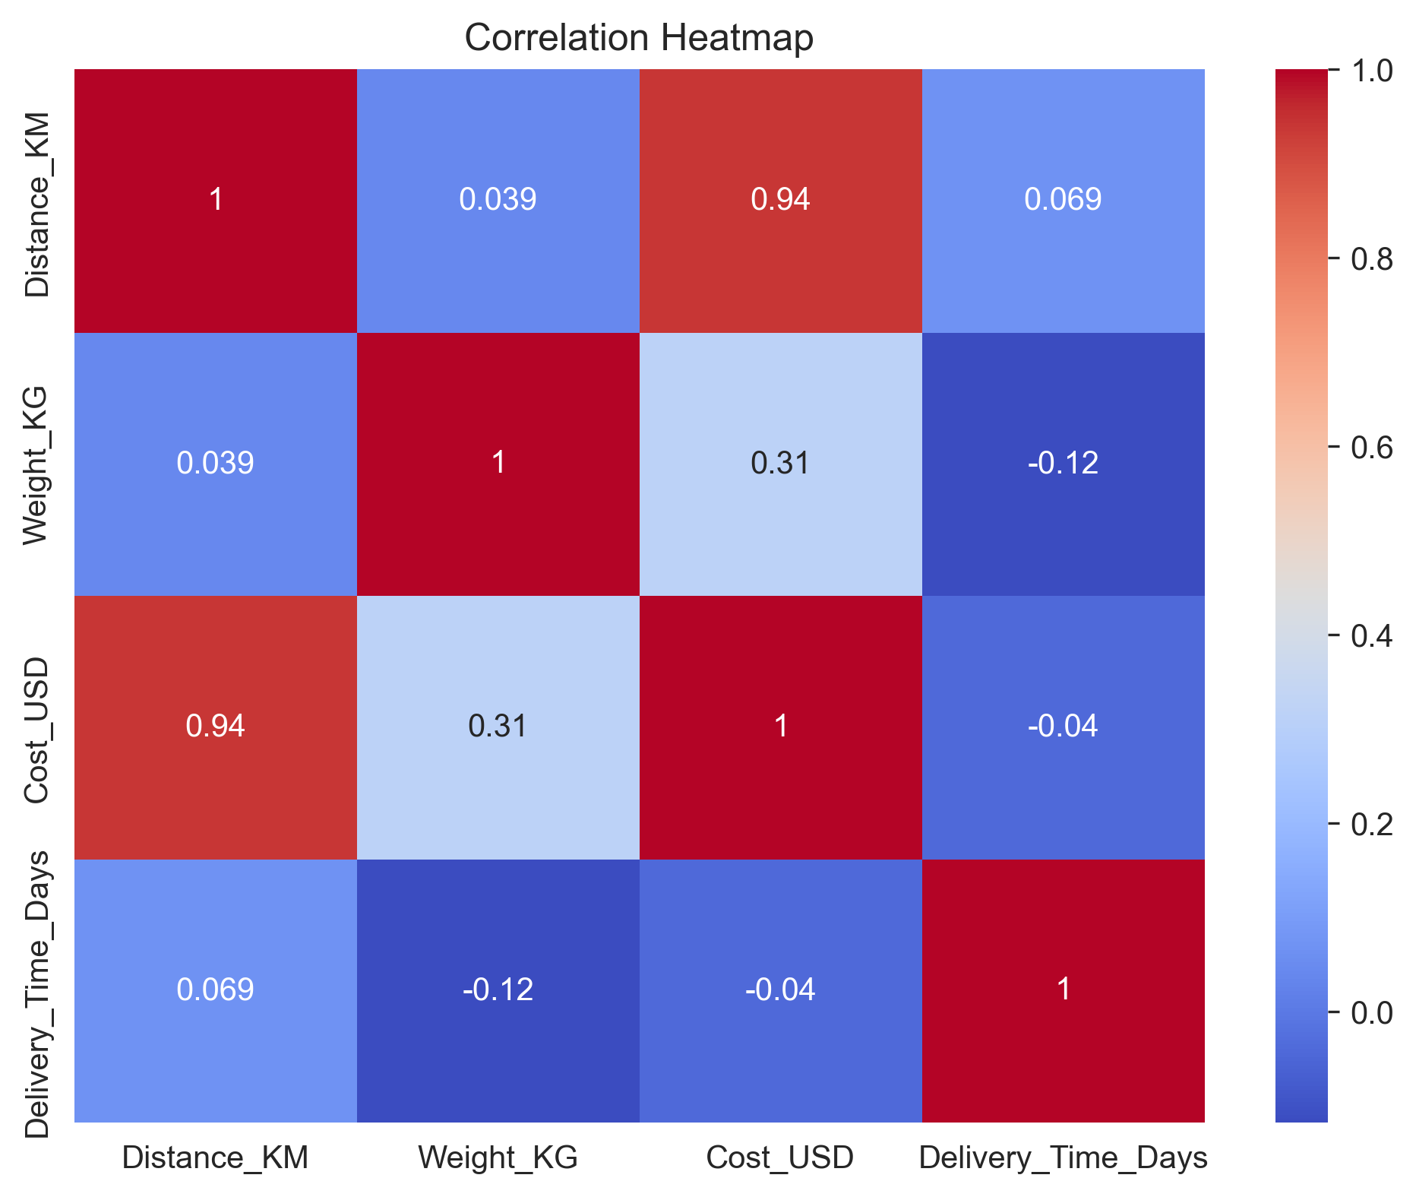
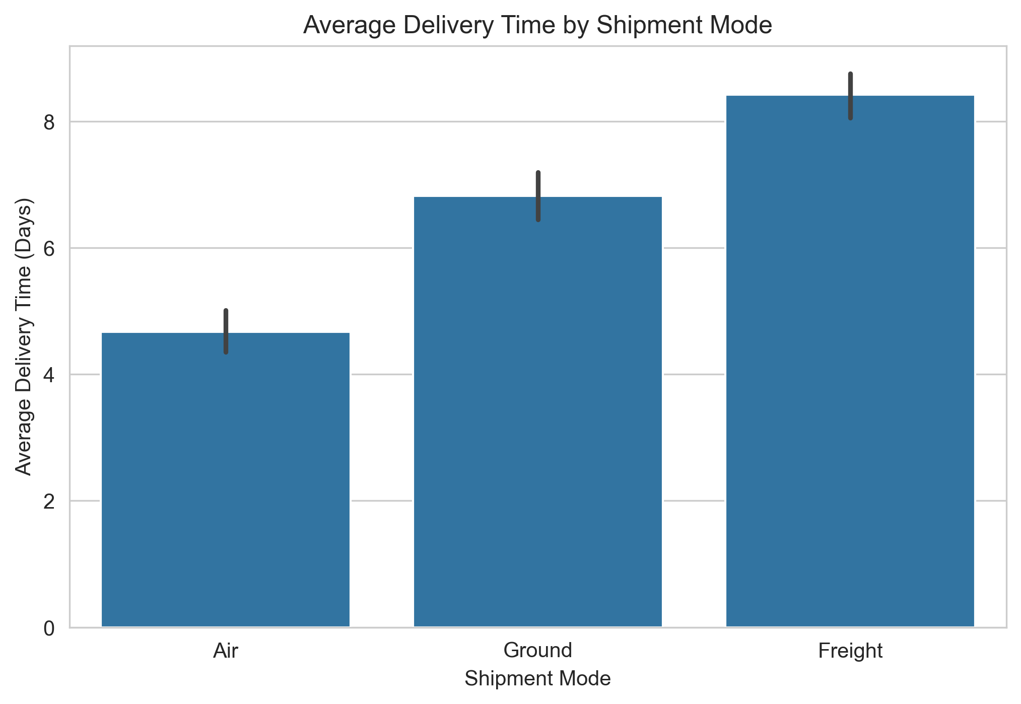
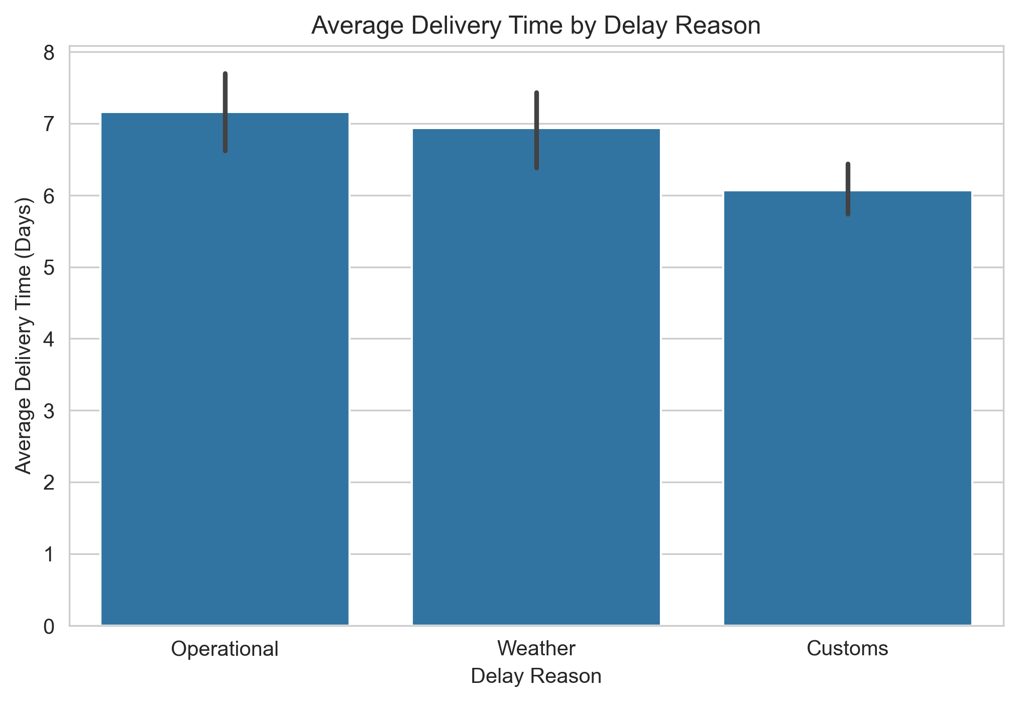
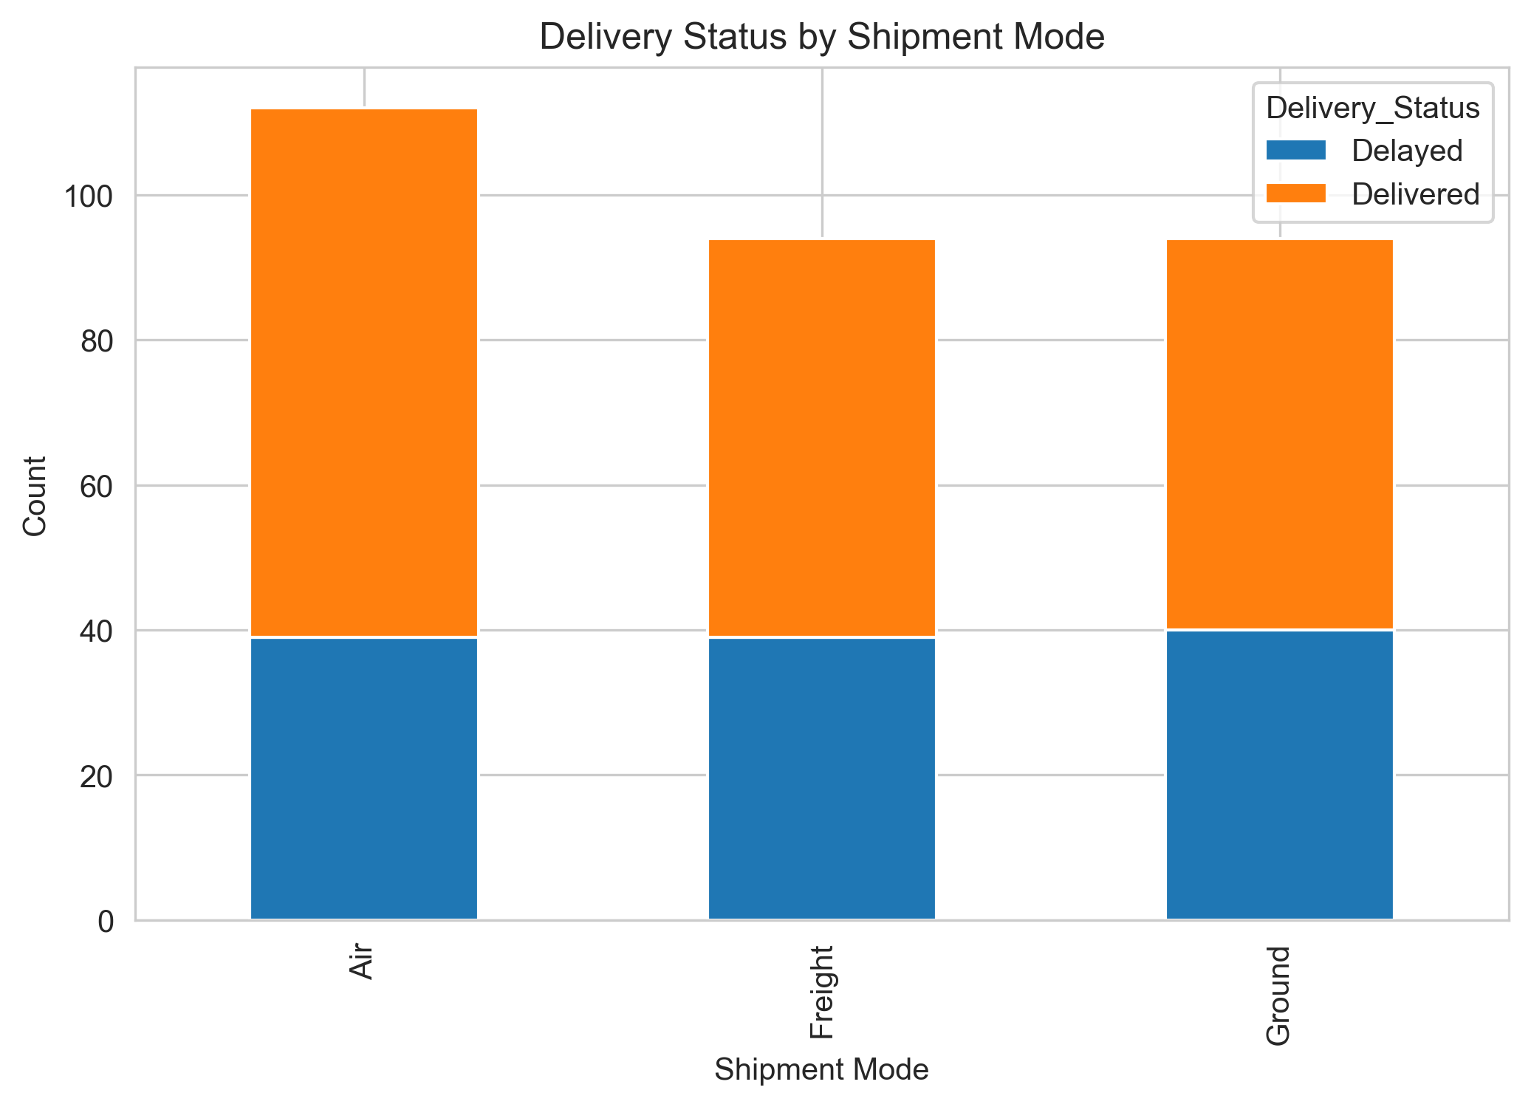

Slide 10
Business Recommendations
Improve route planning
Optimize shipment mode
Reduce shipping costs
Notify customers about delays

Slide 11
Conclusion
Delivery patterns identified
Shipment mode impacts delivery time
Delay reasons affect operations
Data supports better logistics decisions

