Slide 1
金融风控反欺诈模型
financial risk control anti-fraud model
汇报人：彭凡琳

Slide 2
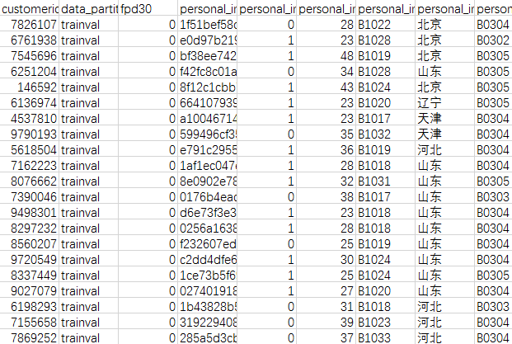
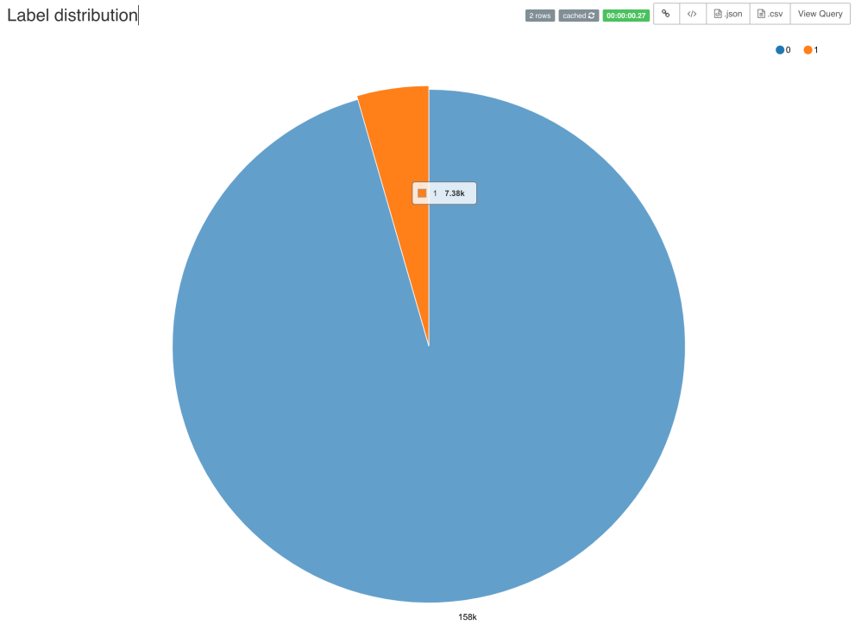
1.Data Processing
Pic2. label distributions
Pic1.user information table
Notes:
模板来自于 http://docer.wps.cn

Slide 3
五十个特征-- 17万条脱敏数据
"customerid", "data_partition", "fpd30", "personal_info_certid", "personal_info_sex", "personal_info_age", "personal_info_industry", "personal_info_province", "personal_info_edu", "personal_info_marriage", "credit_card_num", "credit_bank_num", "credit_limit_avg", "credit_limit_total", "credit_limit_max", "credit_limit_min", "operator_carrier", "operator_time_to_auth", "operator_time_to_2000", "operator_duration_one_month", "operator_dial_num_one_month", "operator_dial_num_three_month", "operator_num_one_month", "operator_num_three_month", "operator_duration_avg", "operator_duration_stddev", "operator_dial_duration_percent", "operator_dial_num_percent", "operator_dial_0_6_dur_per", "operator_dial_0_6_num_per", "operator_dial_6_12_dur_per", "operator_dial_6_12_num_per", "operator_dial_12_18_dur_per", "operator_dial_12_18_num_per", "operator_dial_18_24_dur_per", "operator_dial_18_24_num_per", "operator_dial_work_dur_per", "operator_dial_work_num_per", "devinfo_devicetype", "devinfo_brand", "devinfo_model", "debit_regionalmobility", "debit_capacity", "debit_transmonthcount", "debit_residentcity", "debit_transmostarea", "debit_avgamountmonthly", "debit_avgcountmonthly", "debit_diffday", "debit_maxtransinterval" ]

Slide 4
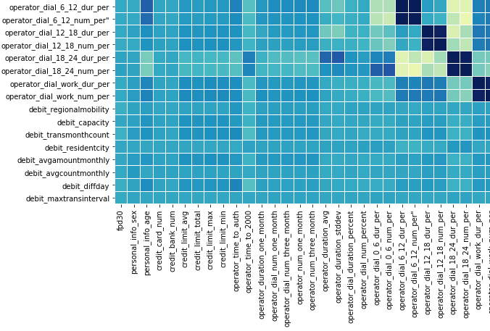
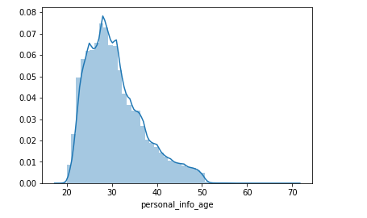
2.Detailed Introduction
data visualization
Pic4
Pic3.Heat Map
Notes:
模板来自于 http://docer.wps.cn

Slide 5
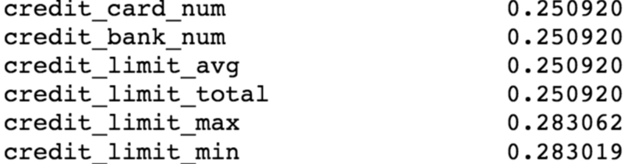
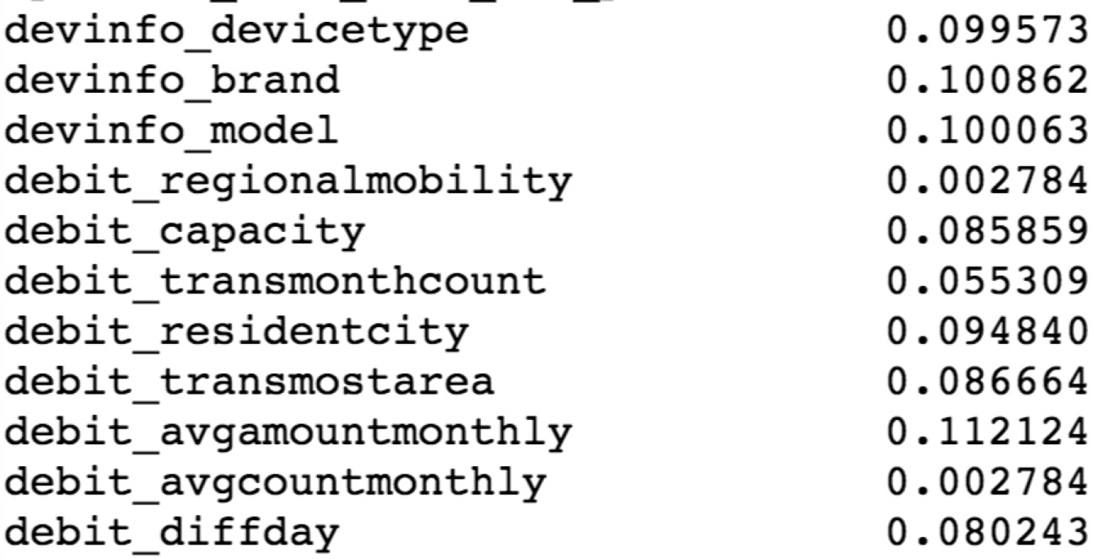
缺失值比例
信用卡数据缺失严重
借记卡数据缺失

Slide 6
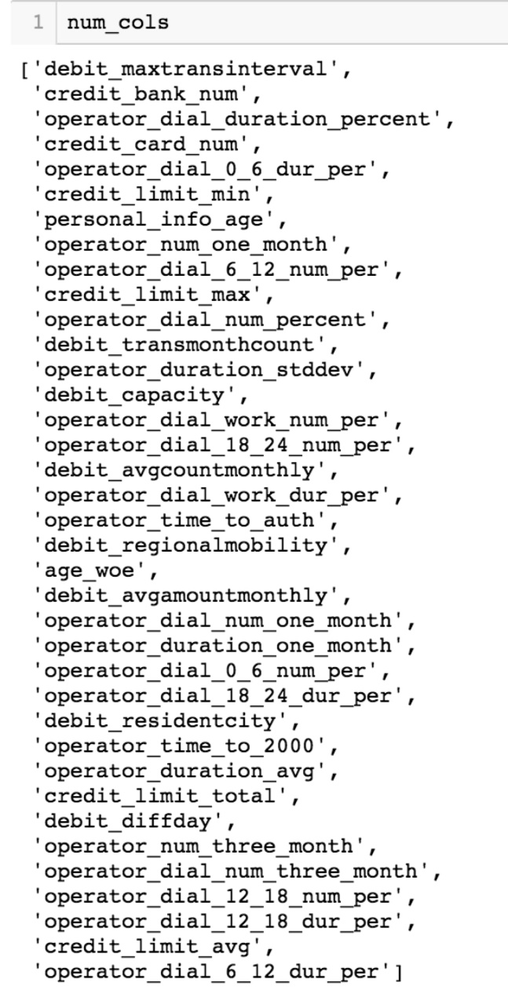
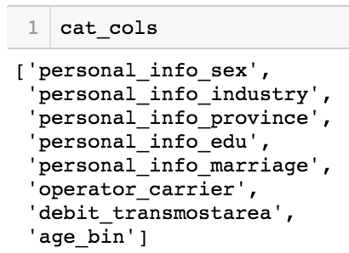
缺失值填补
众数(Mode)
Average
Drop

Slide 7
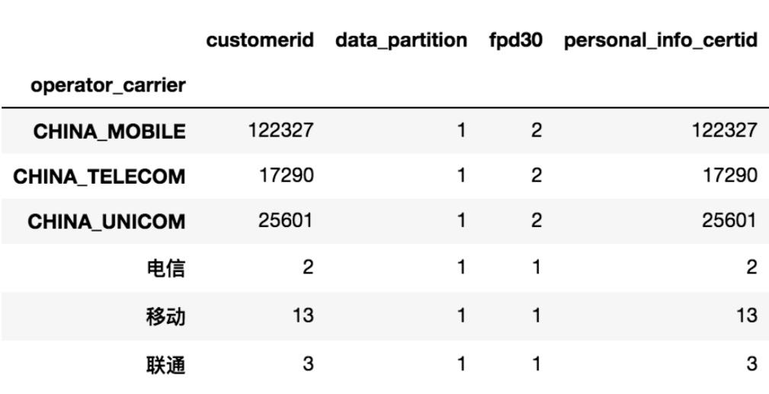
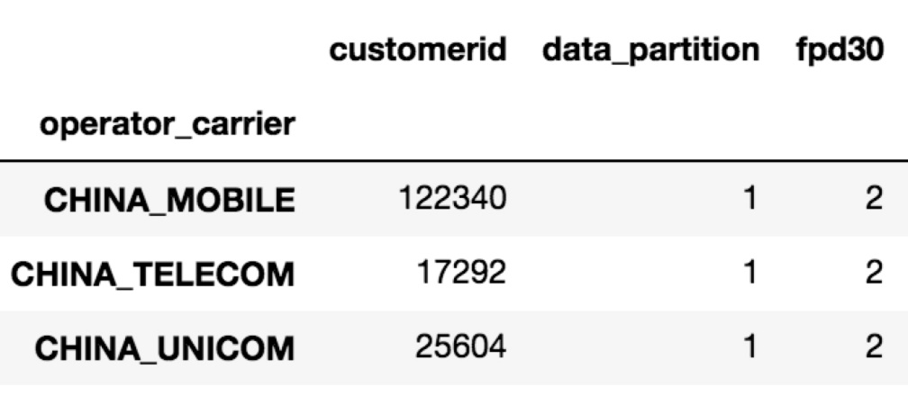
相同数据合并

Slide 8
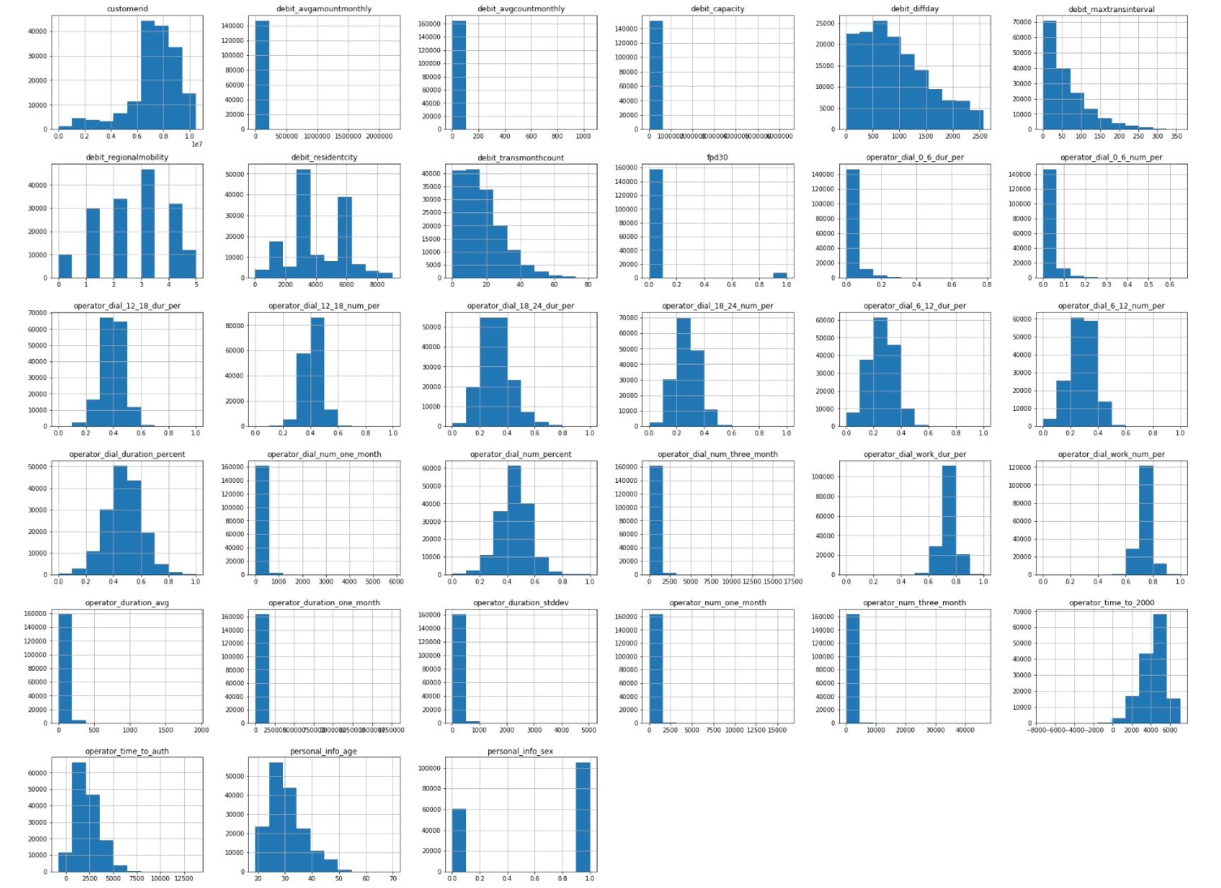
总体分布
对于skewness
考虑使用log弱化“尾部”

Slide 9
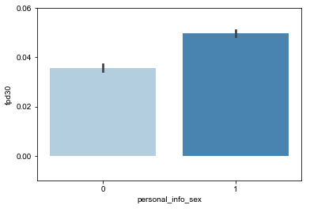
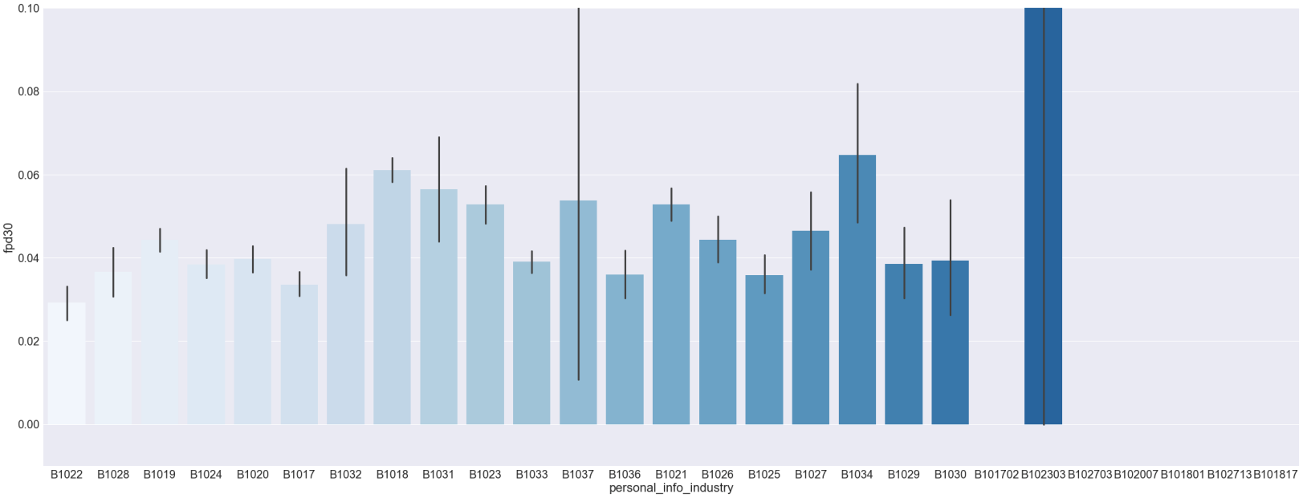
单个特征分析（baseline:0.044657338594495145）
女性逾期率：0.03572139633660738
男性逾期率：0.04978849891391334
高危职业
制造业逾期率:0.061037639877924724
公共设施管理逾期率：0.06465517241379311
居民服务业逾期率：0.14285714285714285

Slide 10
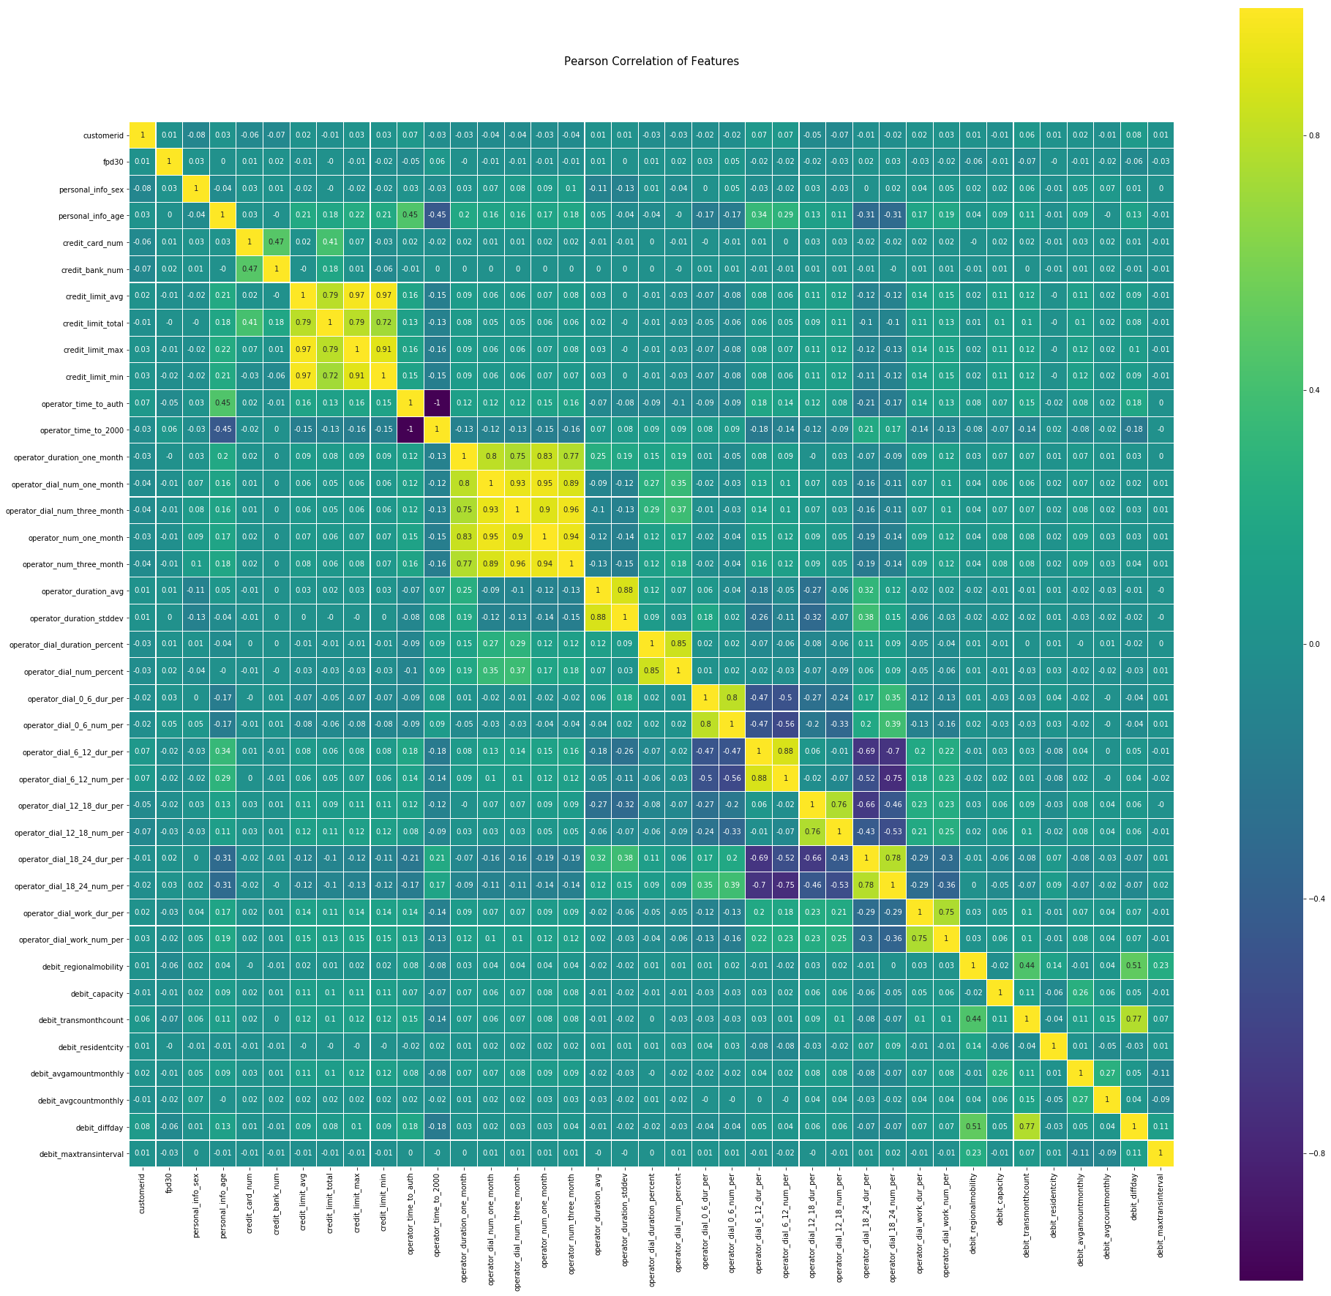
特征关联性
信用卡特征正重叠性高
运营商特征正重叠性高
运营商月记录特征负重叠性高？？？

Slide 11
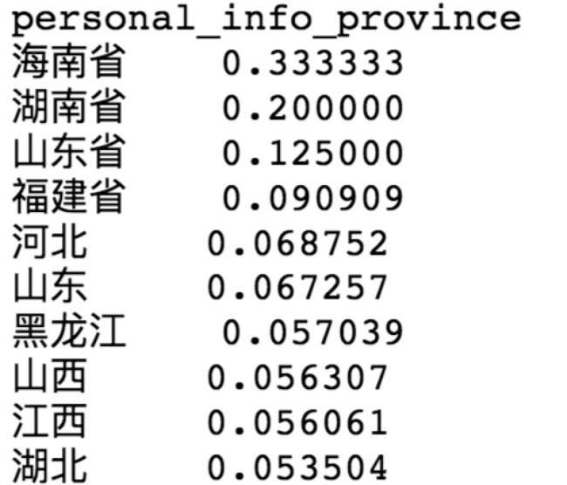
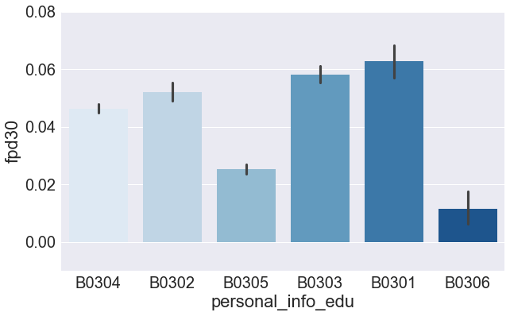
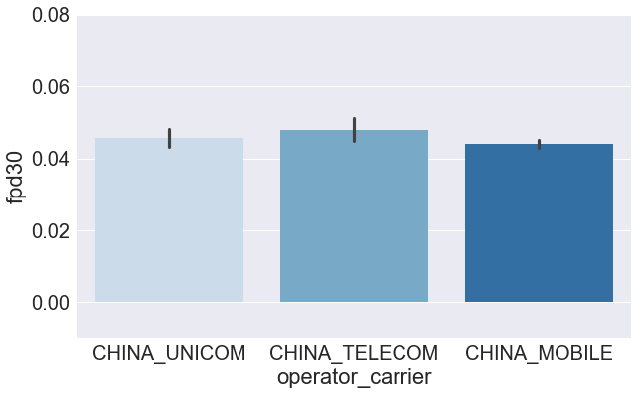
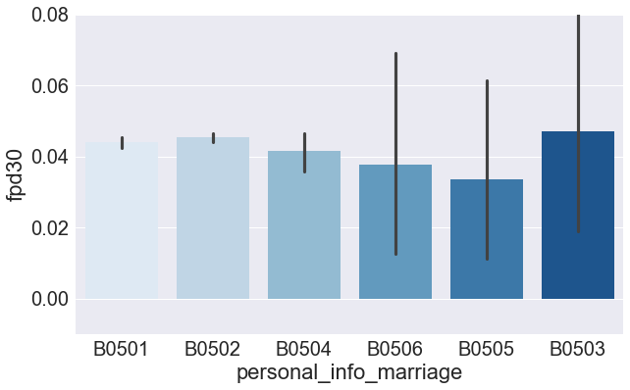
单个特征分析（baseline:0.044657338594495145）
高危省份
高危学历：B0301,B0303
无高危运营商
无高危婚姻

Slide 12
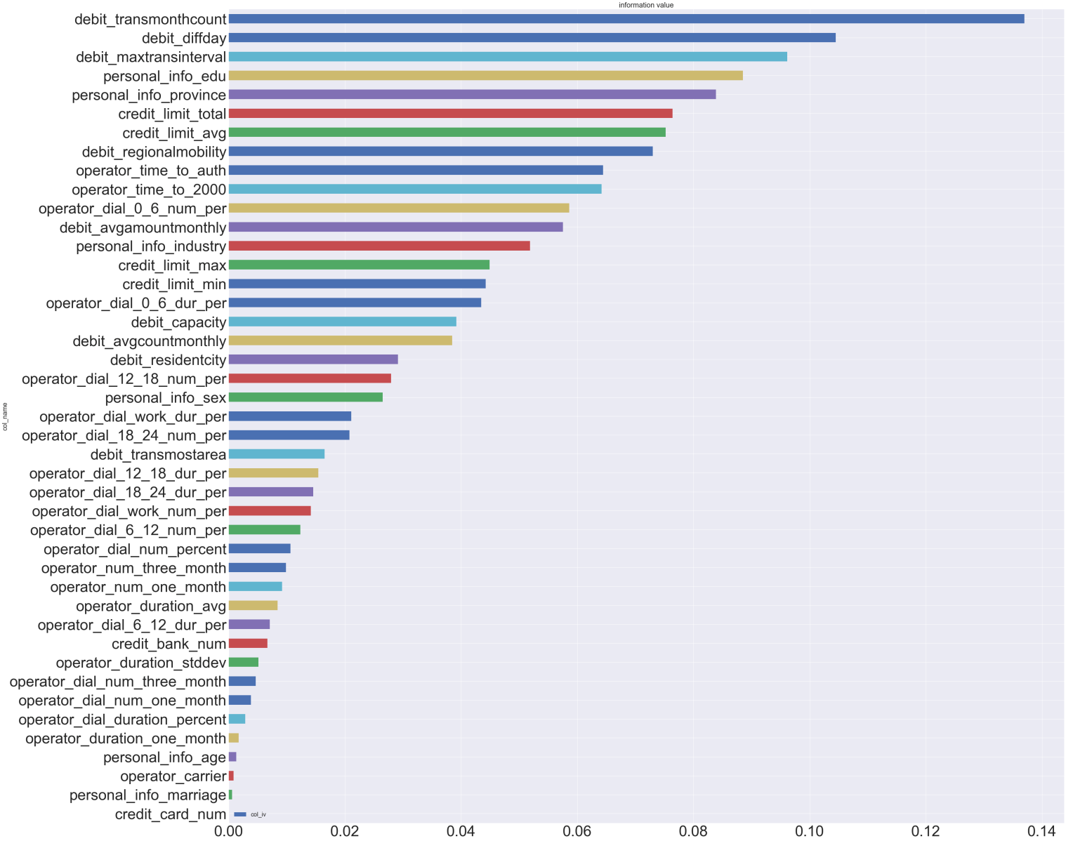
等频分箱

Slide 13
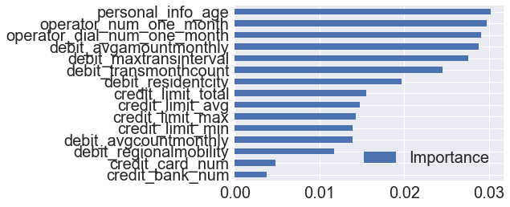
随机森林

Slide 14
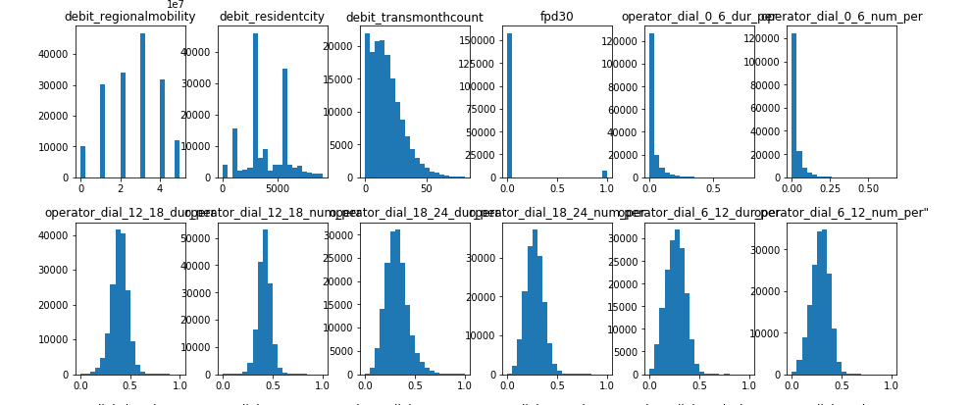
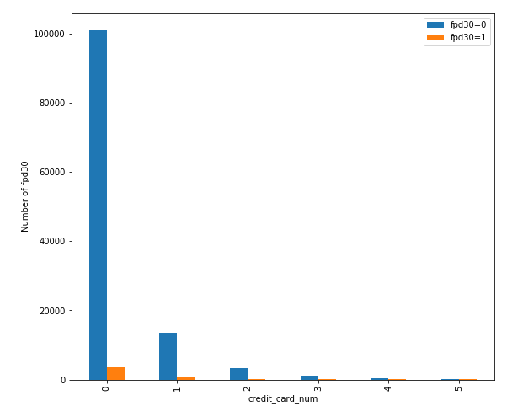
Anti-black industry chain
Pic6.信用卡数与逾期之间的关系
Pic5.不同时间段通话记录比较

Slide 15
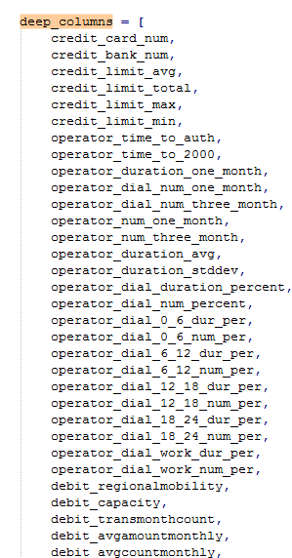
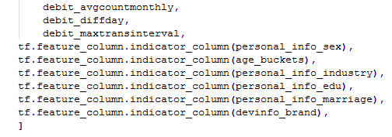

Slide 16
crossed_columns = [
tf.feature_column.crossed_column(['personal_info_sex', age_buckets, 'personal_info_industry', 'personal_info_province', 'personal_info_marriage'], hash_bucket_size=2000),
tf.feature_column.crossed_column(['personal_info_sex', age_buckets, 'personal_info_industry', 'personal_info_edu'], hash_bucket_size=2000),
tf.feature_column.crossed_column(['personal_info_sex', age_buckets, 'devinfo_brand'], hash_bucket_size=2000),
tf.feature_column.crossed_column([bucketized_operator_dial_0_6_num_per, bucketized_operator_dial_6_12_num_per, bucketized_operator_dial_12_18_num_per, bucketized_operator_dial_18_24_num_per], hash_bucket_size=2000),
]
对个体特定时间段行为的研究来判断该个体是否属于黑产产业链，进而达到反黑产的效果。

Slide 17
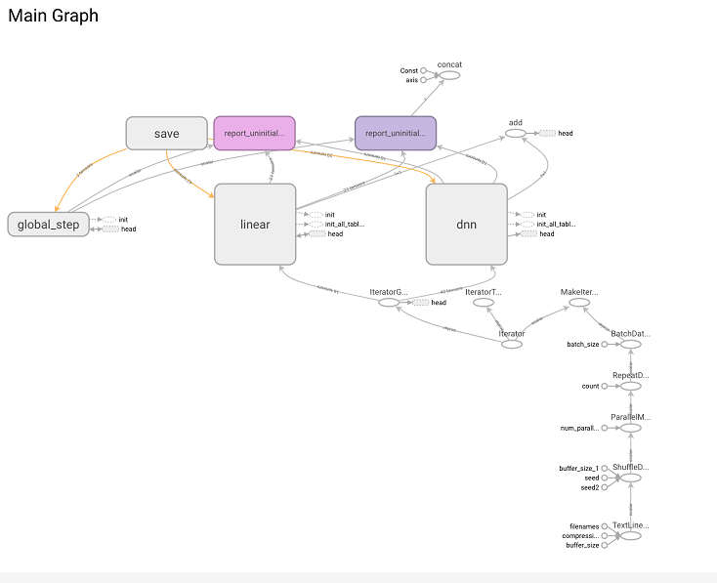

Slide 18


In this experiment, three methods were adopted to train the models: logistic regression, neural network (DNN), and wide-deep
training set：trainval_wkfpd30_subset5.csv
test set：adult.data
● logistic regression
Parameter form of logistic regression model:
Method Introduction
(1)
(2)

Slide 19
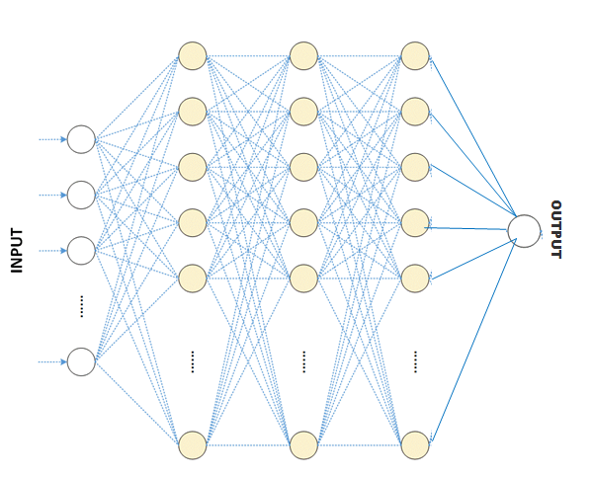
● neural network(DNN)
一个神经网络图：
Then use the matrix method, the output of the first layer is:
(3)

Slide 20
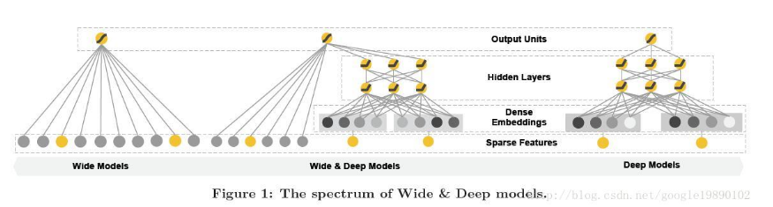
● wide-deep
This paper proposes the Wide & Deep model, which aims to enable the trained model to acquire both memorization and generalization capabilities.
Memorization : the discovery of the correlation between items or features from historical data.
Generalization : the transfer of correlations, reveals new combinations of features that rarely or not appear in historical data.
Pic9.The spectrum of Wide&Deep models

Slide 21
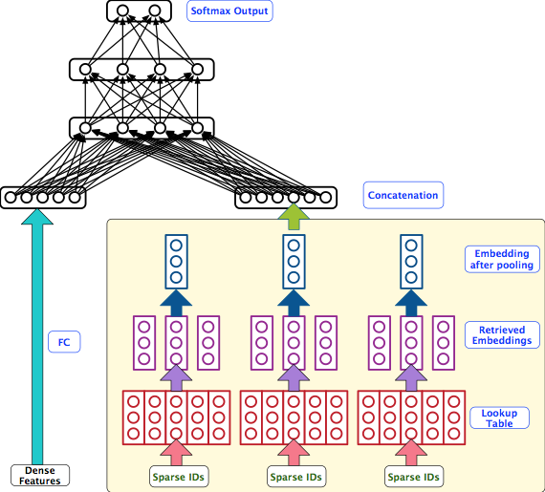
● wide-deep
It’s able to consumes both dense features and raw sparse features. Traditionally, sparse data needs to be engineered into dense features to be learned by models.
We only used dense features in our model, since all raw data that we got are dense
To deal with overfitting:
Dropout was set to 0.5
Used Proximal Adagrad algorithm to do GD
Pic10. The structure of “deep” side of the wide-deep

Slide 22
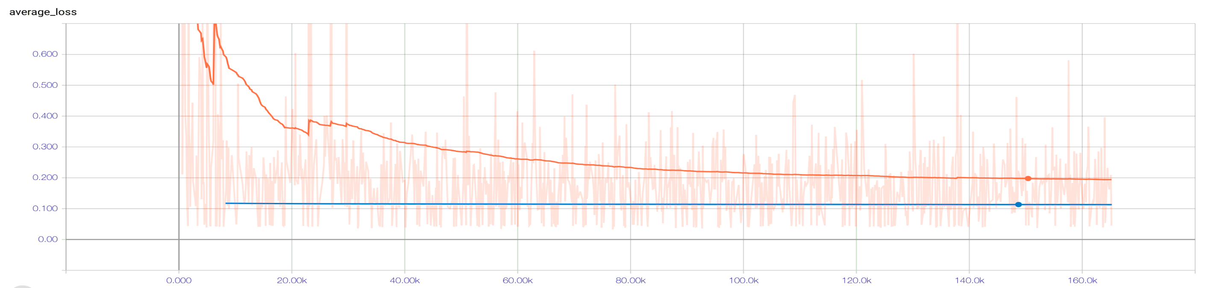
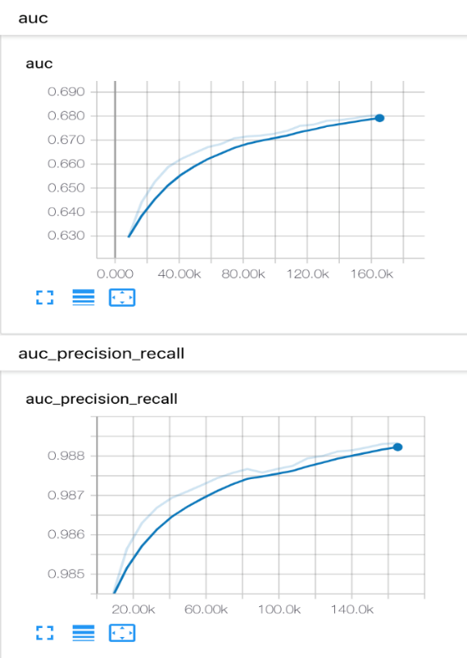

Slide 23
● 三种方法的对比
 | Wide | Wide and Deep | Deep
Accuracy | 0.9649 | 0.9660 | 0.960
Average Loss | 0.1205 | 0.1116 | 0.1201
Auc Precision Recall | 0.9770 | 0.9783 | 0.9690
Precision | 0.9660 | 0.9660 | 0.9660
Recall | 0.9889 | 0.98 | 0.96

Slide 24
ANSWER
ASK
!
AND

