Slide 1
2022 application for editor of North Avenue Review
Faye Holt

Slide 2
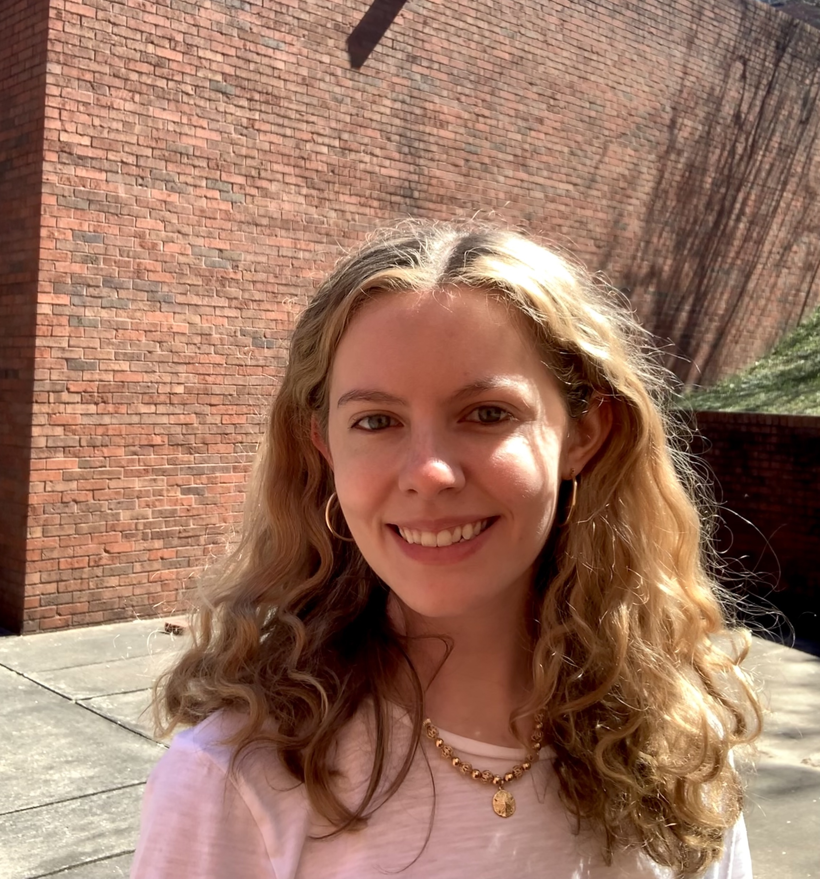
Hello!
My name is Faye Holt, and I am a third-year undergraduate here at Georgia Tech studying computer science and linguistics. I have been involved in the North Avenue Review since the first semester of my second year and have been very fortunate to serve as assistant editor under Jared Butler since Fall 2021.

Slide 3
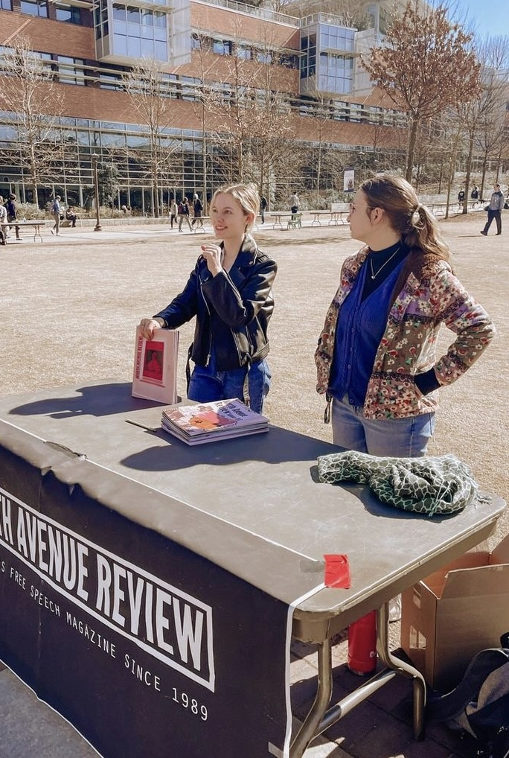
As assistant editor for NAR some of my initiatives/responsibilities have been…
Tabling
Organized tabling for recruitment, advertising for new issues, and student publication events. Created a new organizational structure for tabling using an excel spreadsheet to make sure people could easily sign up for slots in the future
Organized the new Annual Review Issue of NAR that serves as a solution to an overflow problem content was facing. Led several collage workshops throughout the semester to complete this issue
NAR Annual Review
Onboarding
Oversaw onboarding and created a new organization format in our Google Drive to ensure we had all the correct contact information for each member

Slide 4
Continued…
Deadlines
Kept track of deadlines for editing and layout for both the Fall and Spring issues and followed up with students individually to keep track of pieces and check on progress
Editing
Assisted our Content Editor with editing and proofreading all submissions
Contacted outside submissions to accept edits on their pieces
Kept track of rack distribution and reminded members individually to restock their racks
Internal Communication
Ran meetings when Jared had other obligations and kept members up to date through Slack
Budget/Logistics
Assisted Jared with budget/registration/logistical tasks and attended budget orientation sessions with SGA when needed
Outside Submissions
Rack Distribution

Slide 5
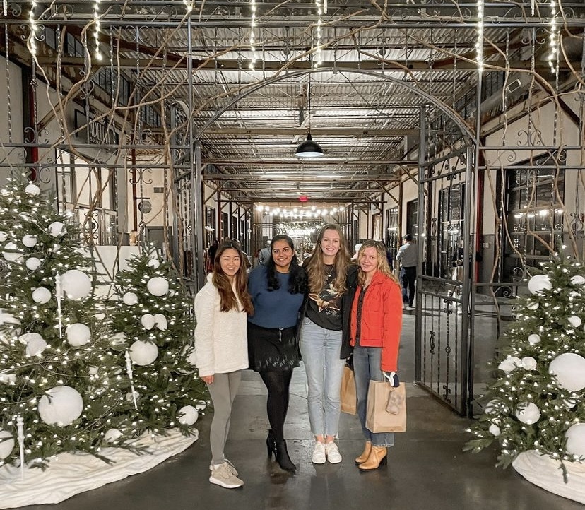
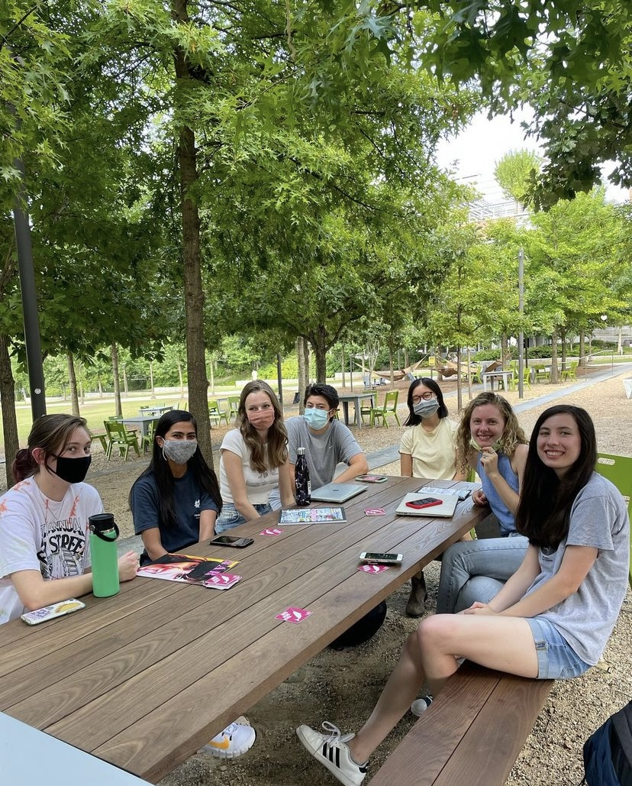
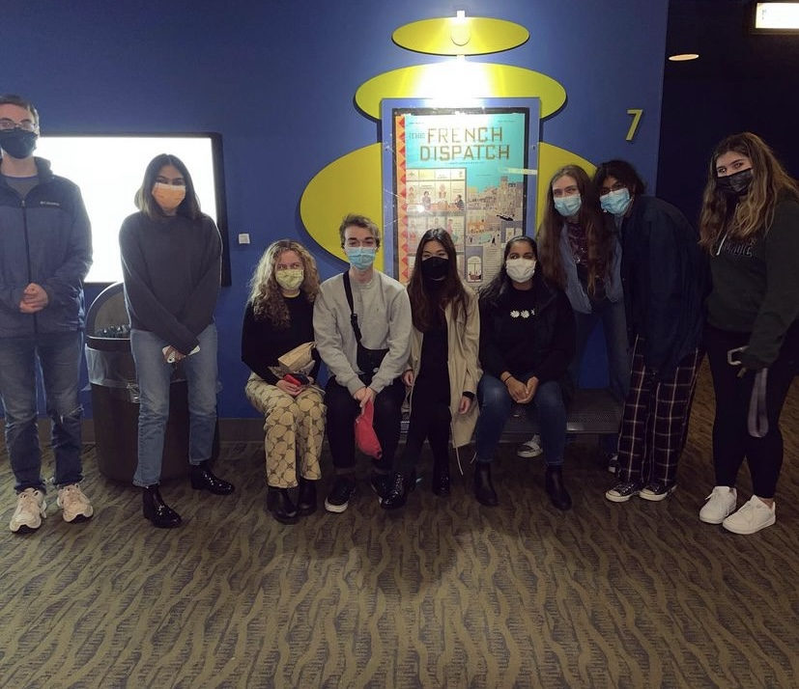
And lastly, organized social outings where members of NAR can get to know one another better!
Staff trip to Lincoln Theater
Issue #92 release celebration
“The French Dispatch” later became the theme of issue #93
Outdoor meeting at Tech Green

Slide 6
Employment history…
Currently
This semester, I am working as a copy-editor for Dr. Lelia Glass in the Modern Languages Department where I am helping edit her new textbook on Language & Computers (position ends this May 2022)
I am a student writing fellow for Reboot – an online publication writing at the intersection of technology and education (Position ends April 2022)
Previously
I interned at Carrier Global as a machine learning intern
Here is my website with my CV and additional work experience (if needed)

Slide 7
Outside Interests
My main outside interest/involvement is in the linguistics community at Georgia Tech and the wider Atlanta area. Currently I am part of the SALT Lab on campus and am involved in research on dialects of English. I really love working with language and hope to continue this work after graduation :)
I also enjoy creative writing, especially poetry and short stories (which is why I originally joined NAR!) and I love the Poetry at Tech community here on campus. Along the same vein, I’m an avid reader and love exploring local bookstores. (Am also a big movie buff!)
As I’ve continued on in undergrad, I’ve changed my involvement on campus and prefer to be deeply involved in only a couple things rather than a lot of different commitments. If selected as NAR EIC, this is the mentality I would like to bring to the position and hope this deep involvement will be reflected in my work ☺

Slide 8

Role of NAR
I think NAR’s role on Georgia Tech’s campus is best understand by looking at its origin. Founded in response to the 1989 Tiananmen Square Protests, NAR has since served as an outlet of free speech for Tech students and an opportunity for open forum “anything goes” (within reason) expression.

Slide 9
Role of NAR cont.
Having an open forum magazine on campus is, in my opinion, invaluable. It allows for the expression and circulation of ideas inherent to the ideals of university life. At NAR, because we attempt to publish everything we receive, there is no pressure to pander to a certain viewpoint or write an opinion that is popular in hopes of receiving a publication. Having this open space, therefore, allows students to honestly critique institutions, systems, opinions, etc. that they disagree with. In our newest issue (#93) there are pieces ranging from a criticism of Hollywood celebrities’ hypocrisy to a personal photography gallery on childhood cancer. This range of pieces offers a kind of catch-all space where Tech students can contribute op-eds, art, and a combination of expressions that would be difficult to publish in more formal, structured publications. One of NAR’s slogans is, “READ, THINK, SPEAK” – I think this perfectly encapsulates a secondary value of NAR; not only is NAR an outward facing publication for Tech’s campus it also serves as a communal space where students can collaborate with one another and encourage creativity and understanding.
While NAR has undoubtedly changed over the years, its core purpose remains the same: as an outlet for students.

Slide 10
Libel & Slander
From my understanding of libel and slander, libel refers to anything in writing or print that tries to defame someone using false/inaccurate points. In Georgia, libel is considered published as soon as it is communicated to anyone other than the subject of the libel. Additionally, libel as it concerns public figures (such as celebrities or politicians) has a higher threshold as actual malice must be proved. As it relates to NAR, libel is an important point to keep in mind as we do publish many op-eds and often will have pieces that critique groups. While these ”groups” are usually public figures, so there is less chance for libel, in all our writing it is important to make sure we are publishing only true and verifiable statements to prevent any libel, and as such, this is a part of the editing process.
Slander, on the other hand, is similar but spoken instead of printed. As NAR is concerned, we currently are not pursuing any spoken mediums (such as video interviews), but if we do in the future, slander should be handled similarly to libel.

Slide 11
Where would I take NAR?
If selected as EIC, one of my primary goals would be to grow NAR into a more connected, multi-media organization. NAR has seen a lot of regrowth since COVID and we have a consistent printing schedule, so I think it would be a great time to start re-exploring online content that was started pre/during COVID. Currently, we have several new members, to the point where people are often without work as we transition from content to layout. To address this gap, and make NAR more engaging throughout the semester, I would like to explore expanding our website and online content through monthly releases and more interactive pieces to engage the wider campus with student publications.
In addition to this goal, I would try to make NAR more connected with student pubs as a whole. Currently, NAR uses the student pubs office only for weekly meetings and doesn’t have a lot of engagement with the other media platforms. Next year, I would like to encourage members to use the office space to work on pieces throughout the week and also collaborate more with other publications, such as Erato, when fitting.
Lastly, I think onboarding for new members is confusing at the moment. So, I would like to introduce a more structured onboarding process where we thoroughly walk new members through everything they need to know about our organizational structure. I’m hoping this change will lead to more new members continuing on with NAR for multiple semesters.

Slide 12
Responsibilities of EIC
As EIC, I would be responsible for overseeing all internal communications with NAR such as running meetings with the staff and editors, keeping track of deadlines, and running onboarding. Many of these internal communications tasks could also fall under the domain of the asst. editor, so I think the main difference between EIC and asst. editor is the external communication responsibilities of the EIC.
These include budgeting for NAR and submitting a fiscal year budget for our printing needs, plus any bills that might be needed. EIC also has the responsibility of making sure that club registration is complete every spring. Additionally, EIC is the main point of contact between NAR members and Stu Pubs as a whole, so the EIC has to make sure that staff has all the relevant information they need from wider student media. Other responsibilities that come to mind are signing NAR up for org fairs, managing outside submissions, and managing all our organizational mediums such as Slack, Drive, and our website.

Slide 13
Responsibilities of EIC cont.
While I’m sure this doesn’t cover each and every responsibility of the EIC, these are some of the most important ones that come to mind. Summarizing these responsibilities, EIC’s main role is to keep track of external communications between SGA and Stu Pubs and organize NAR internally to keep track of communication platforms, printing, and submissions. One way I would look to change this role is to be more transparent to the wider NAR staff about the budgeting and SGA process. This process can be kind of confusing, so I think it would be beneficial if multiple editors/staff members could follow along, that way the club as a whole is more educated on the process. I think this wider education would also be helpful in creating a very smooth club hand-off when the EIC graduates.
As a bit of a footnote, another goal I would have as EIC is to update and organize the club manuals in our google drive. I have been working on this somewhat as asst. editor, but this would be a primary goal if selected as EIC. I would especially like to add a how-to manual on budgeting with SGA and what NAR has done in the past, so future editors have a helpful resource.

Slide 14
Office of Student Media
While I’m not very knowledgeable about the wider structure of Student Media, my understanding is that tech publications (such as The Technique, Erato, T-Book) all fall under the Office of Student Media, which oversees these publications and provides resources. As a member of Student Publications, NAR shares certain resources (such as the office) with other publication but is responsible for submitting our own fiscal year budgets to SGA and responsible for our own club registration in the spring.

Slide 15
EIC & Board of Student Publications, Director of Student Media, Faculty Advisor

Slide 16
Why I want to be editor of NAR

