Slide 1

Simple Ways to AI Workshop Session
By: Zouari Fayez

Slide 2
TABLE OF CONTENTS
01
02
03
What’s Happening?
How?
HOW!
About our project
Theoritical approach
Technical Approach

Slide 3
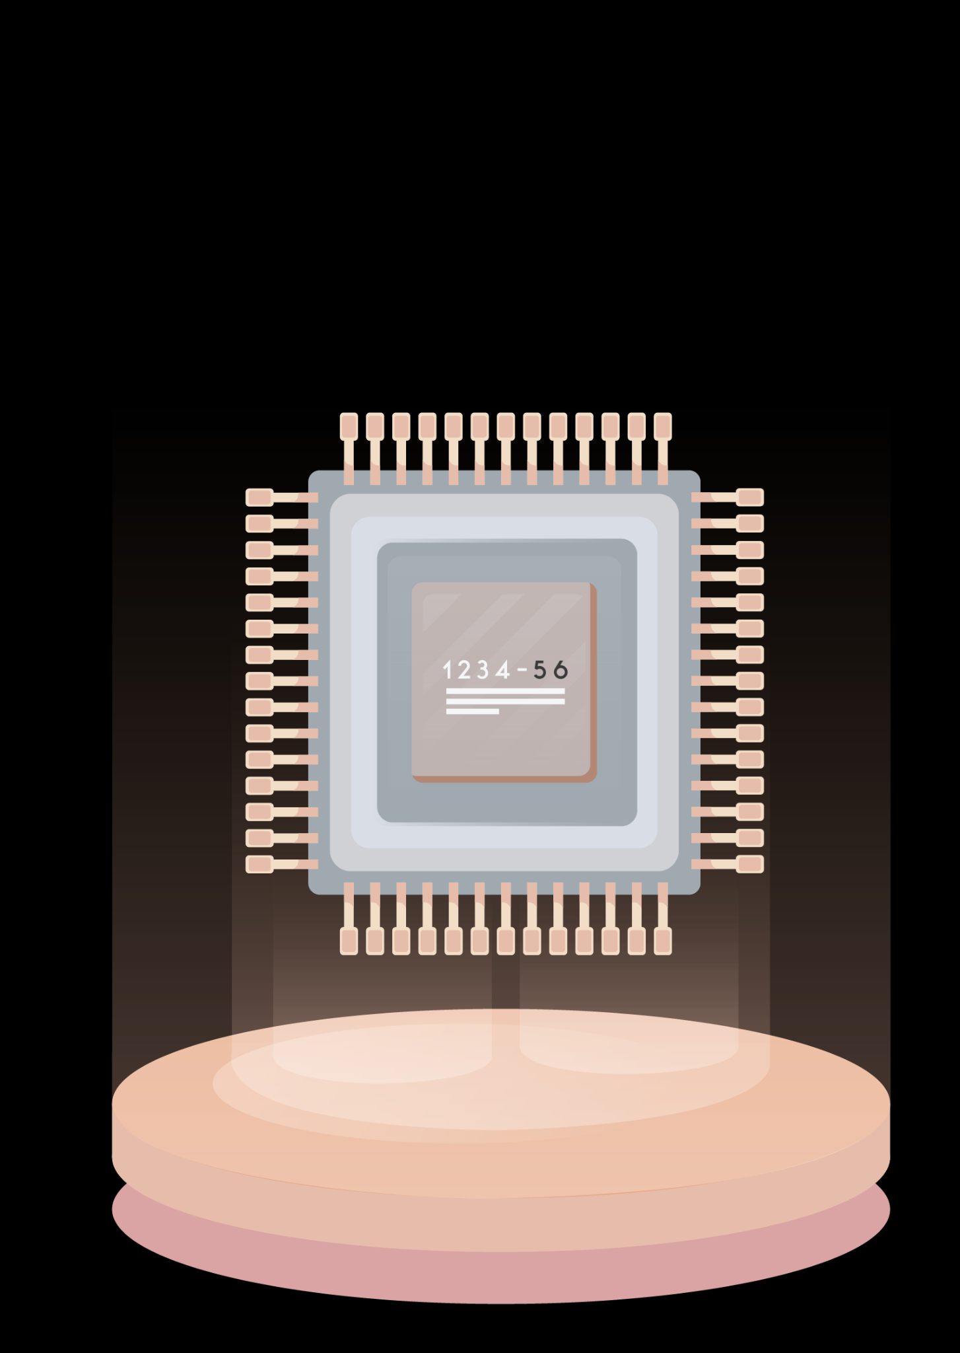
01
What’s happening

Slide 4
The Plan
Server
Image
Classification
Esp32-cam
Notification
To User

Slide 5
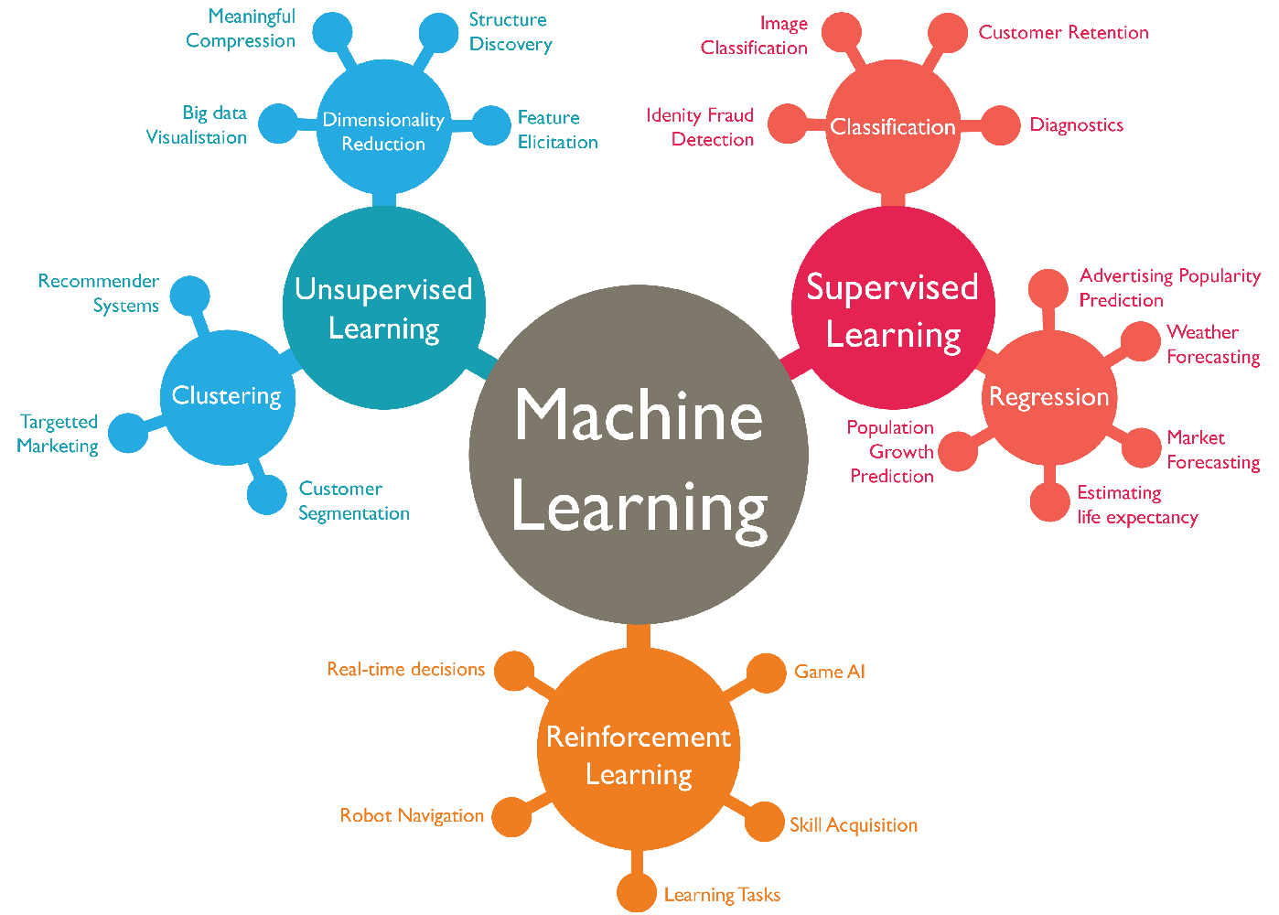
About Machine Learning

Slide 6
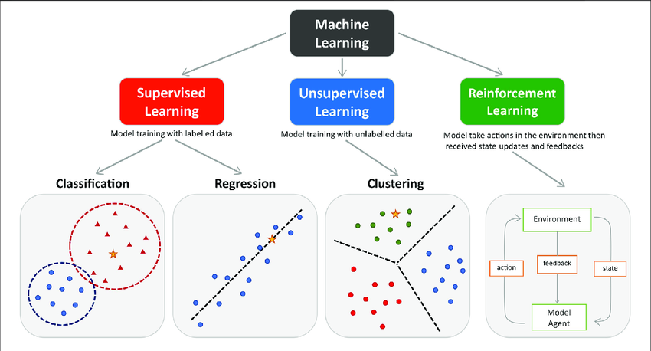

Slide 7

How?
02

Slide 8
OUR SOLUTION
Receive Images from ESP32CAM
Recognition
(Output generation)
Classification

Slide 9
Classifier?
Define classes of objects
Training Model
Model Ready

Slide 10

HOW BERASMI?
03

Slide 11





Tools?

Slide 12
HAY NABDOU
BEL KHEDMA

