Slide 1

The Next Wave of Tech:
A Comprehensive Report on In-Demand Developer Skills
Name: Feifei Li
1/1/2026

Slide 2

OUTLINE
Executive Summary
Introduction
Methodology
Results
  Visualization – Charts
  Dashboard
Discussion
  Findings & Implications
Conclusion
Appendix

Slide 3

EXECUTIVE SUMMARY
Analyzed global developer skill trends using survey, job posting, and dashboard data
Identified top programming languages and databases in current and future demand
Found strong alignment between employer demand and developer learning interests
Results support strategic workforce planning and targeted upskilling initiatives
Notes:
Current Market Leaders: JavaScript and SQL remain the most widely used
The Next Wave (Future Demand): significant shift-> Python and Rust
Database Evolution:While relational databases like MySQL and PostgreSQL dominate current usage, there is growing momentum toward NoSQL and cloud-native solutions like MongoDB and Redis for future projects.
Compensation & Experience:Data analysis confirms a strong positive correlation between years of professional experience and annual compensation, emphasizing the high value of senior-level expertise.
Global Developer Profile:Insights are derived from a diverse global dataset representing over 185 countries, with a median developer age of approximately 33 years.
Workplace Shift:A clear majority of developers now prefer remote or hybrid work environments, which has become a key factor in talent retention and recruitment.

Slide 4

INTRODUCTION
Purpose: Identify emerging technology trends to support data-driven workforce decisions
Audience: Executive leadership, HR teams, and technology consultants
Value: Enables proactive hiring strategies, targeted training investments, and competitive advantage
Notes:
Purpose of the Report:
To analyze the current global developer landscape and identify the most sought-after programming languages and database technologies.
To leverage data from the Stack Overflow Developer Survey, Job APIs, and training portals to forecast future skill requirements for our consulting firm.
Target Audience:
Executive Leadership: To assist in strategic long-term planning.
Talent Acquisition & HR: To guide recruitment strategies and competitive compensation packages.
Internal Training Departments: To identify emerging technologies for employee upskilling.
Value of the Analysis:
Ensures the organization remains competitive by staying ahead of the "Next Wave" of technology trends.
Provides data-driven evidence to prioritize hiring and training resources for high-growth languages like Python and Rust.
Benchmarks salary expectations against industry experience and job roles to ensure talent retention.

Slide 5

METHODOLOGY
Data Sources:
  Stack Overflow Annual Developer Survey
  Job postings API data
  Web-scraped programming language data
Data Cleaning:
  Removed duplicate responses
  Handled missing values using mode/median imputation
  Removed salary outliers using IQR method
Tools: Python (Pandas), SQL, Power BI

Slide 6
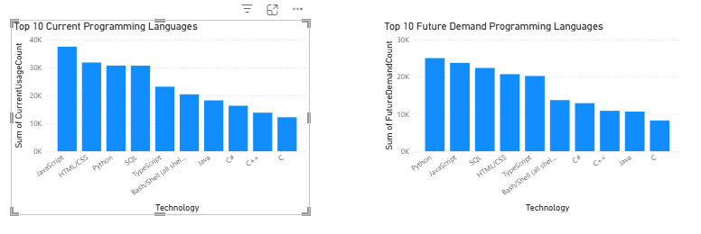
PROGRAMMING LANGUAGE TRENDS
Current Year
Next Year
<Bar chart of top 10 programming languages for the current year goes here.>
< Bar chart of top 10 programming languages for the next year goes here.>
Python, JavaScript, and SQL dominate current usage across industries.

Slide 7
PROGRAMMING LANGUAGE TRENDS - FINDINGS & IMPLICATIONS
Findings
Python remains the most dominant language
JavaScript continues strong demand
AI-oriented languages show increased interest
Implications
Organizations should prioritize Python-centric skill development
Future hiring should emphasize full-stack and data-driven roles

Slide 8
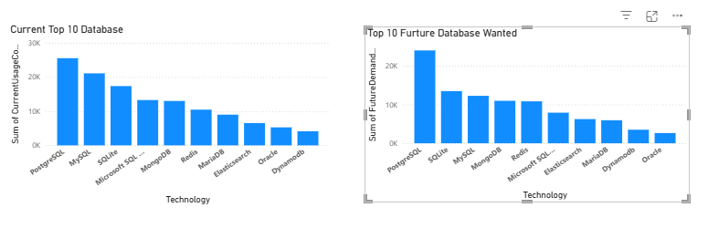
DATABASE TRENDS
Current Year
Next Year
< Bar chart of top 10 databases for the current year goes here >
< Bar chart of top 10 databases for the next year goes here.>

Slide 9
DATABASE TRENDS
Findings
Relational databases (PostgreSQL, MySQL) remain foundational
Cloud-native and NoSQL databases show growing demand
Implications
Companies should modernize data infrastructure
Training should include both SQL and cloud database technologies

Slide 10
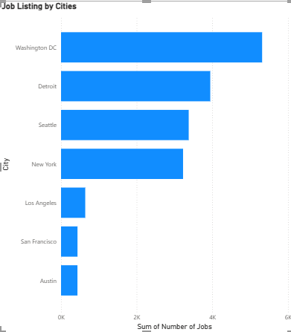

DASHBOARD
Major metropolitan areas show significantly higher demand for developer roles.

Slide 11
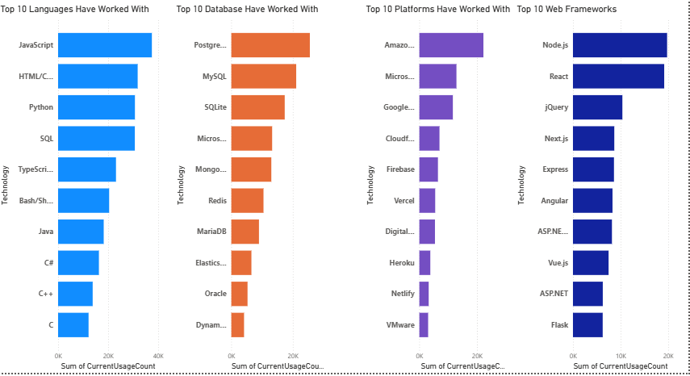
Current Tech Usage
Highlights primary languages in use.
Visualizes current database market share.

Slide 12
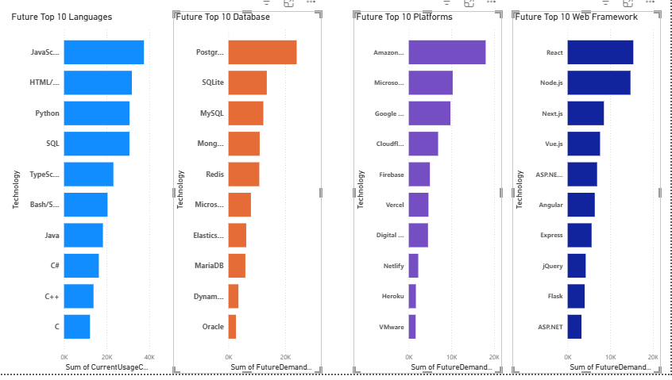
Future Trends
Shows "Want to Work With" data.
Identifies the "Next Wave" technologies.

Slide 13
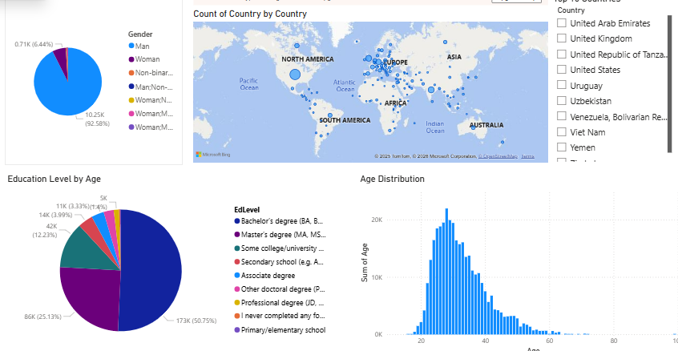
Demographics & Geography
Distribution of developers by country.
Age and gender diversity metrics.

Slide 14
DISCUSSION
Python and SQL dominate both current use and future interest
Cloud and data-focused technologies are growing rapidly
Developer demographics show global participation with regional concentration

Slide 15
OVERALL FINDINGS & IMPLICATIONS
Strong alignment exists between industry demand and developer skill interests
Data and cloud technologies are central to future tech strategies
Organizations that invest early in upskilling will gain competitive advantage

Slide 16

CONCLUSION
Python, SQL, and JavaScript remain critical core skills
Database expertise is shifting toward scalable, cloud-ready solutions
Data-driven insights can guide effective hiring and training strategies

Slide 17

APPENDIX

Slide 18
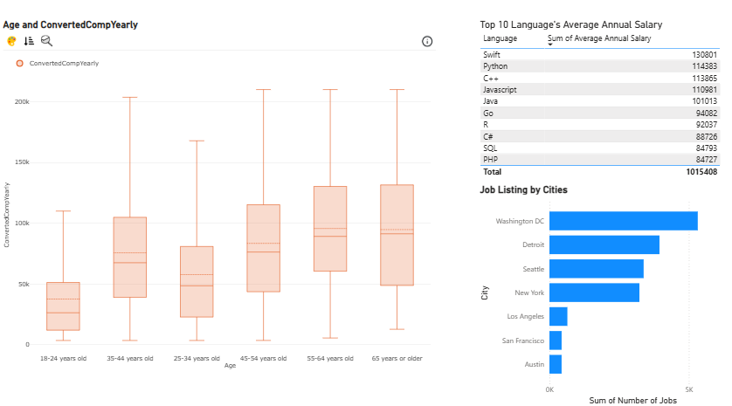
JOB POSTINGS
Job API Data: Bar chart of postings by city.
Web Scraped Table: List of top 10 languages.
Outlier Plot: Box plot of salary cleaning..

Slide 19
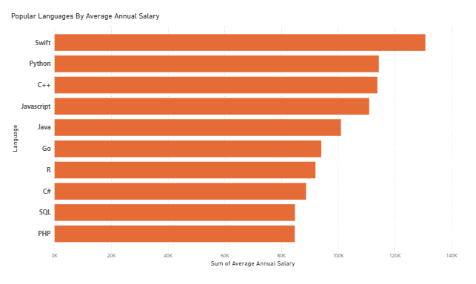
POPULAR LANGUAGES
In Module 1 you have collected the job postings data using web scraping in a file named “popular-languages.csv”. Present that data using a bar chart here. Order the bar chart in the descending order of salary.

