Slide 1


Optimization and Simulation Simulation project
“Airline Yield Management”
Group 4:
Florian Aymanns
Vasiliki Bikia
Dimitrios Tsitsokas
MATH-600: Optimization and Simulation
10/04/2018
1/333

Slide 2
Yield management: a variable pricing strategy based on understanding and anticipating consumer behavior in order to maximize revenue or profits.
*Source: https://en.wikipedia.org/wiki/Yield_management
MATH-600: Optimization and Simulation
10/04/2018
1/333

Slide 3
Project Description
A single flight scheduled from Geneva to Washington, DC.
The airline company:
- offers nine fare products;
- classifies the passengers into three segments (Business, Leisure, Economy).
Each passenger segment has a different arrival rate.
Passengers from each segment have similar behavior represented by preference weights for each fare.
The plane has a capacity of 180 seats.
MATH-600: Optimization and Simulation
10/04/2018
1/333

Slide 4
Discrete event simulation
State variables:
t: Time
r: Revenue at time events
s: Segment type at time events
Parameters (scenario):
T: Planning horizon
N: Number of fare products
λ1, λ2, λ3: Rates for passenger segments generation
w: Preference weights for each passenger segment
R: Revenue for each fare product
Control variables:
available_seats_for_fare
: Booking limit for each fare
A: Available products at time events
MATH-600: Optimization and Simulation
10/04/2018
1/333

Slide 5
Discrete event simulation
Flow chart
MATH-600: Optimization and Simulation
10/04/2018
1/333

Slide 6
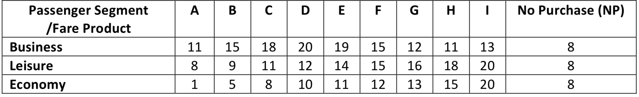
Discrete event simulation
MATH-600: Optimization and Simulation
10/04/2018
1/333

Slide 7
Two scenarios to be investigated
All fares available from t = 179.
Only one product offered at a time. Starting with the most cost-effective product to the most expensive one. Continues till all fare products are sold out or plane departure.
Booking limit of 20 seats for both scenarios.
MATH-600: Optimization and Simulation
10/04/2018
1/333

Slide 8
Metrics
Number of “No purchases”
Number of passengers that couldn’t purchase (flight fully-booked)
Quality of Service
Total revenue
Company’s profit
MATH-600: Optimization and Simulation
10/04/2018
1/333

Slide 9
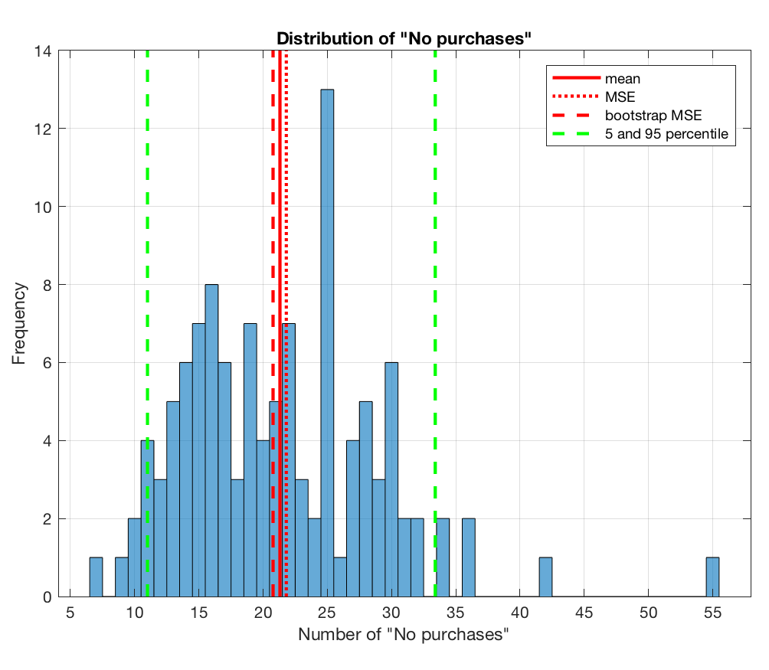
Scenario (1) - Results
Statistics of mean-of-number-of-no purchase:
Mean = 11.857 (MSE = 0.241, BootstrapMSE = 0.201)
95 percentile = 21.550 (BootstrapMSE = 2.7627)
Worst = 30 (BootstrapMSE = 6.020)
MATH-600: Optimization and Simulation
10/04/2018
1/333

Slide 10
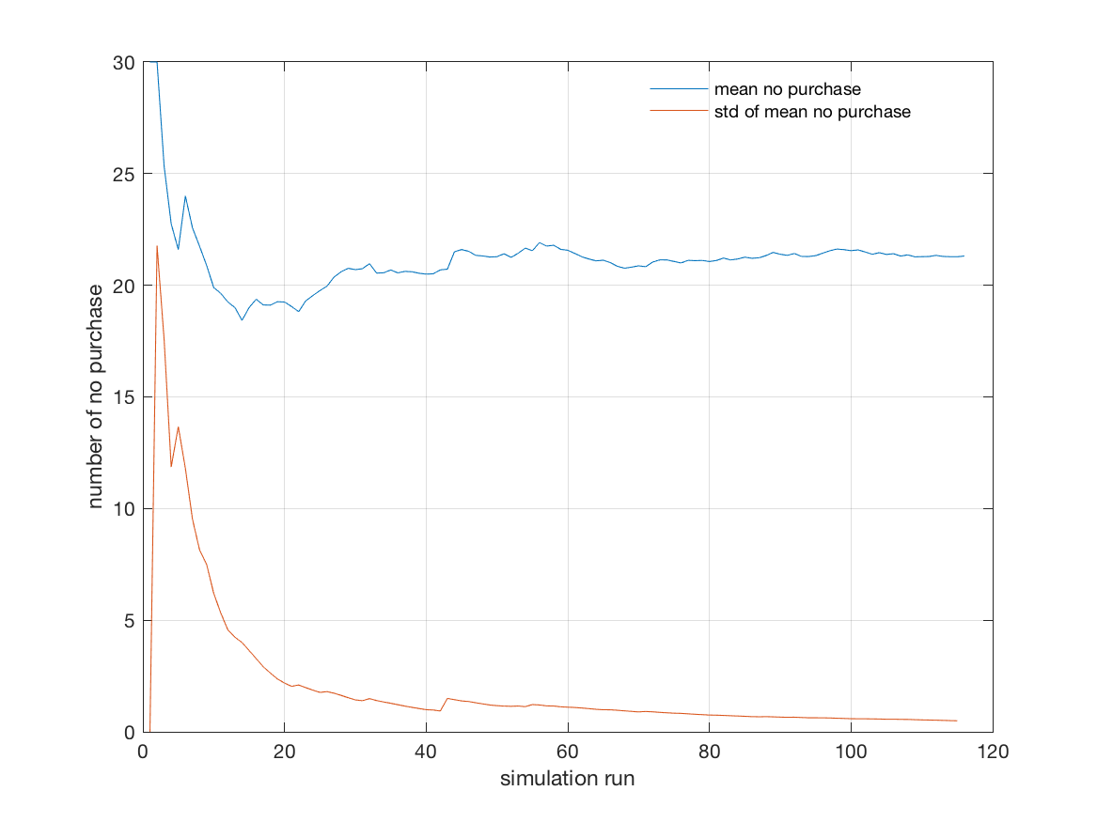
Scenario (1) - Results
MATH-600: Optimization and Simulation
10/04/2018
1/333

Slide 11
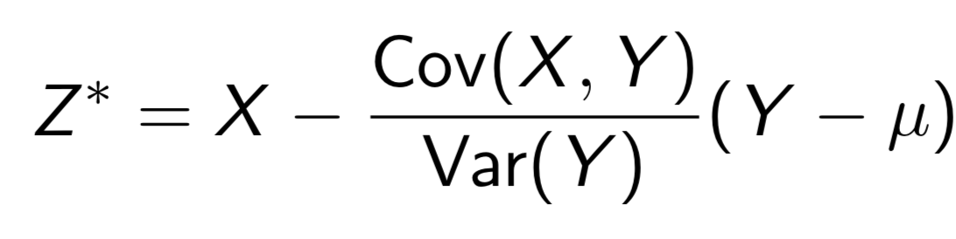
Scenario (1) - Variance Reduction | Control Variates
Theoretical value of E[Y] bla bla
MATH-600: Optimization and Simulation
10/04/2018
1/333

Slide 12
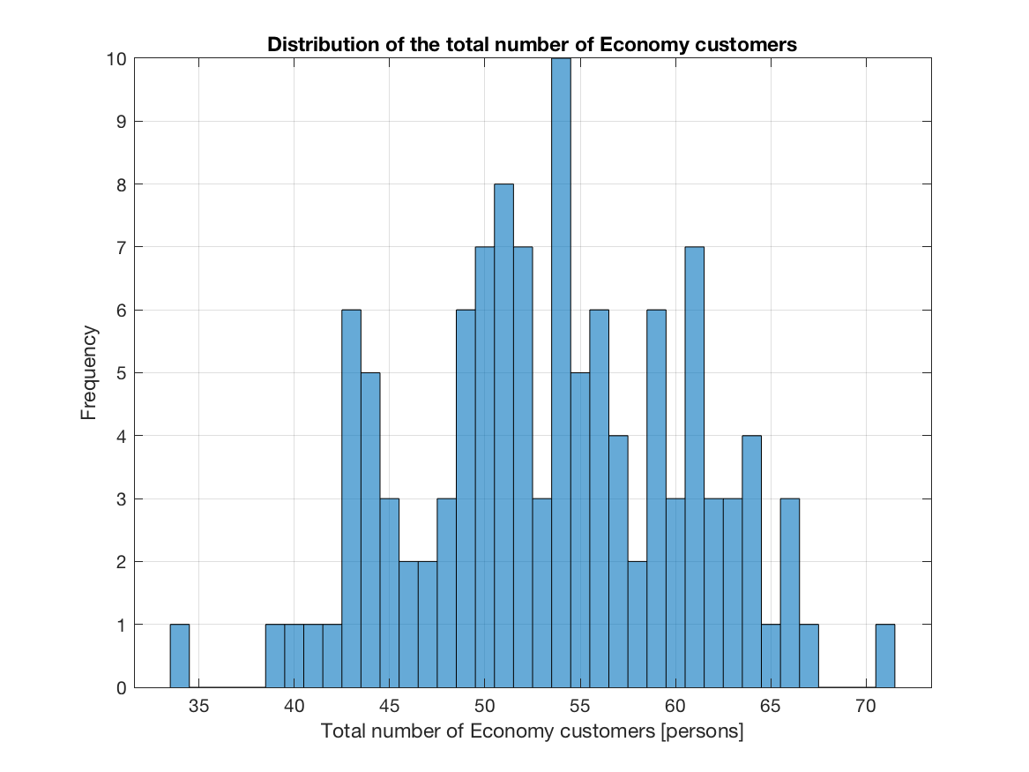
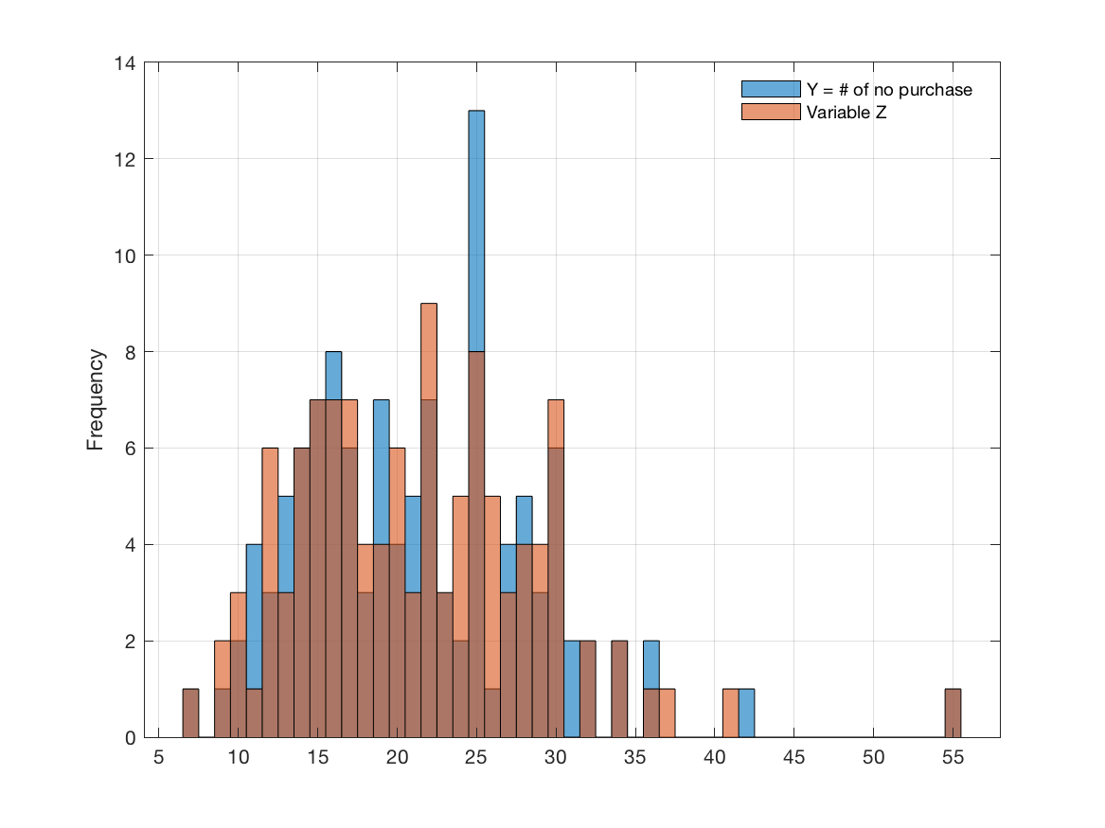
Scenario (1) - Variance Reduction | Control Variates
Means
Difference of variance
MATH-600: Optimization and Simulation
10/04/2018
1/333

Slide 13
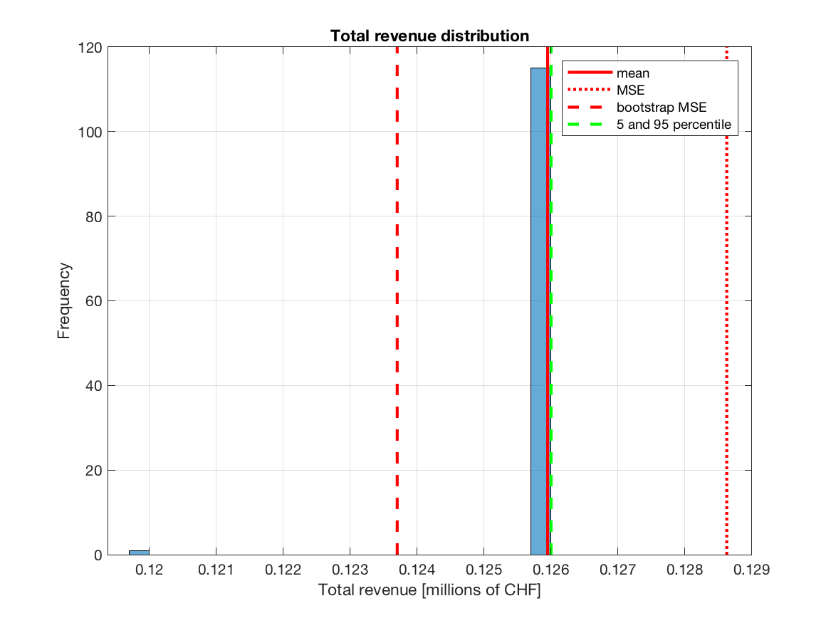
Scenario (1) - Total revenue
Statistics of mean-of-total-revenue:
Mean = 11.857 (MSE = 0.241, BootstrapMSE = 0.201)
95 percentile = 21.550 (BootstrapMSE = 2.7627)
Worst = 30 (BootstrapMSE = 6.020)
MATH-600: Optimization and Simulation
10/04/2018
1/333

Slide 14
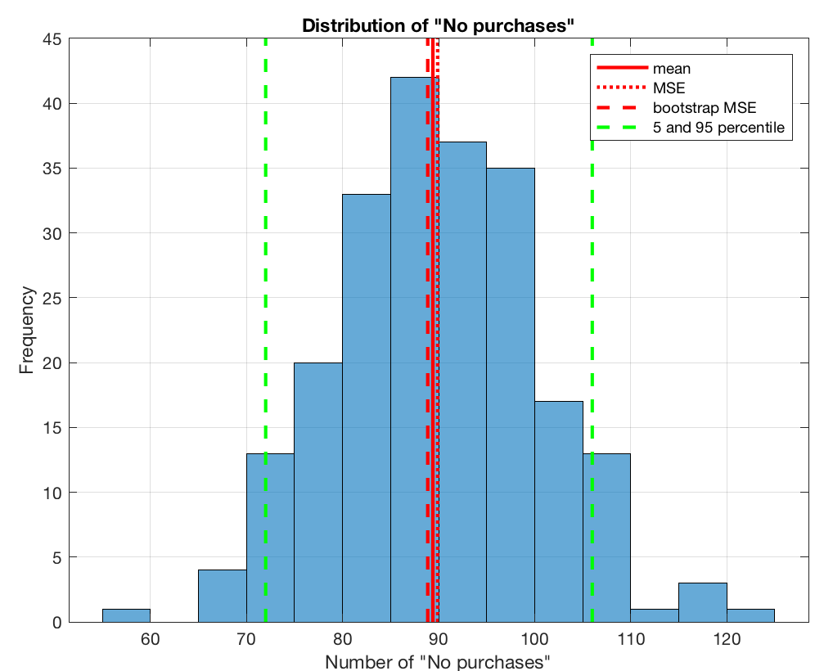
Scenario (2) - Results
Statistics of mean-of-number-of-no purchase:
Mean = 11.857 (MSE = 0.241, BootstrapMSE = 0.201)
95 percentile = 21.550 (BootstrapMSE = 2.7627)
Worst = 30 (BootstrapMSE = 6.020)
MATH-600: Optimization and Simulation
10/04/2018
1/333

Slide 15
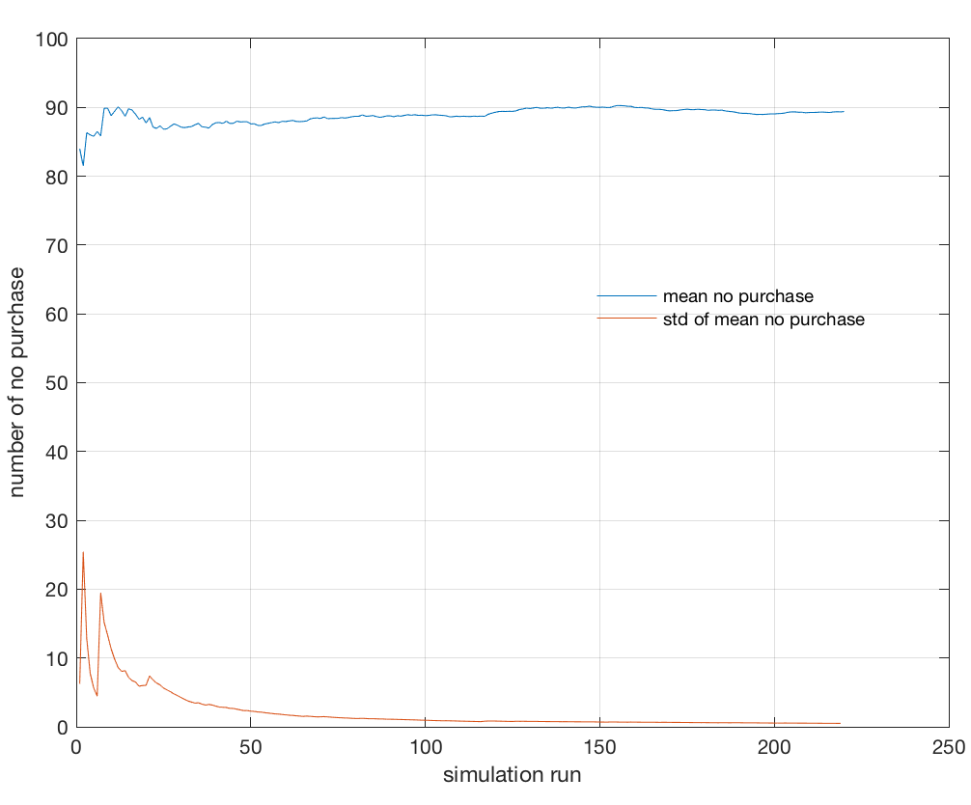
Scenario (2) - Results
MATH-600: Optimization and Simulation
10/04/2018
1/333

Slide 16
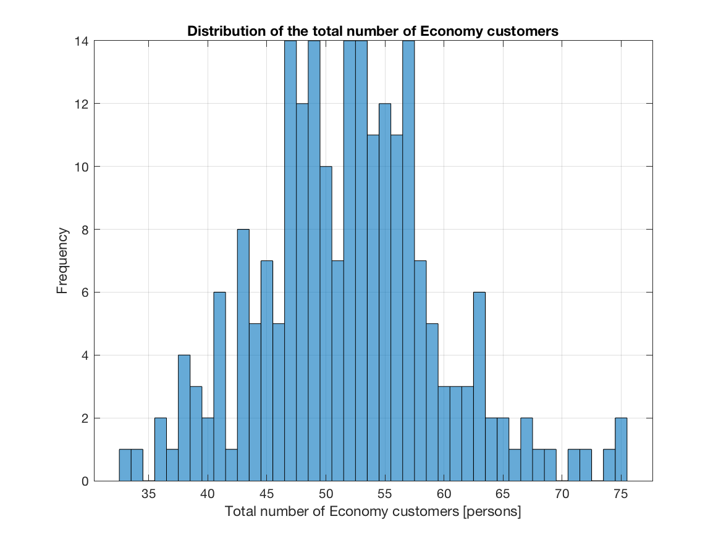
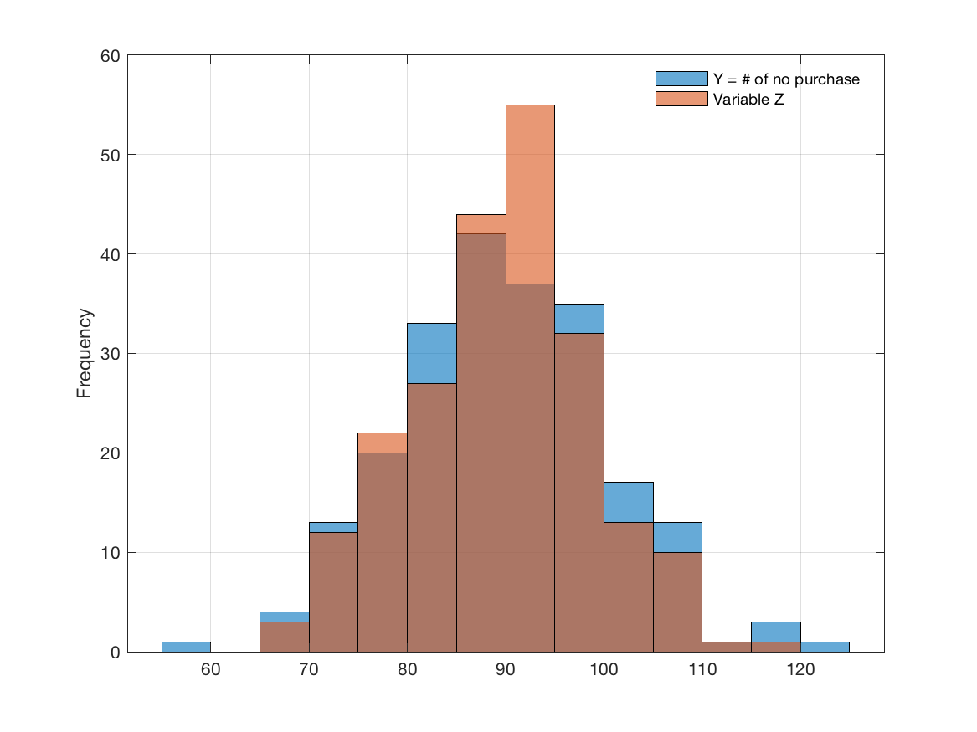
Scenario (2) - Variance Reduction | Control Variates
Means
Difference of variance
MATH-600: Optimization and Simulation
10/04/2018
1/333

Slide 17
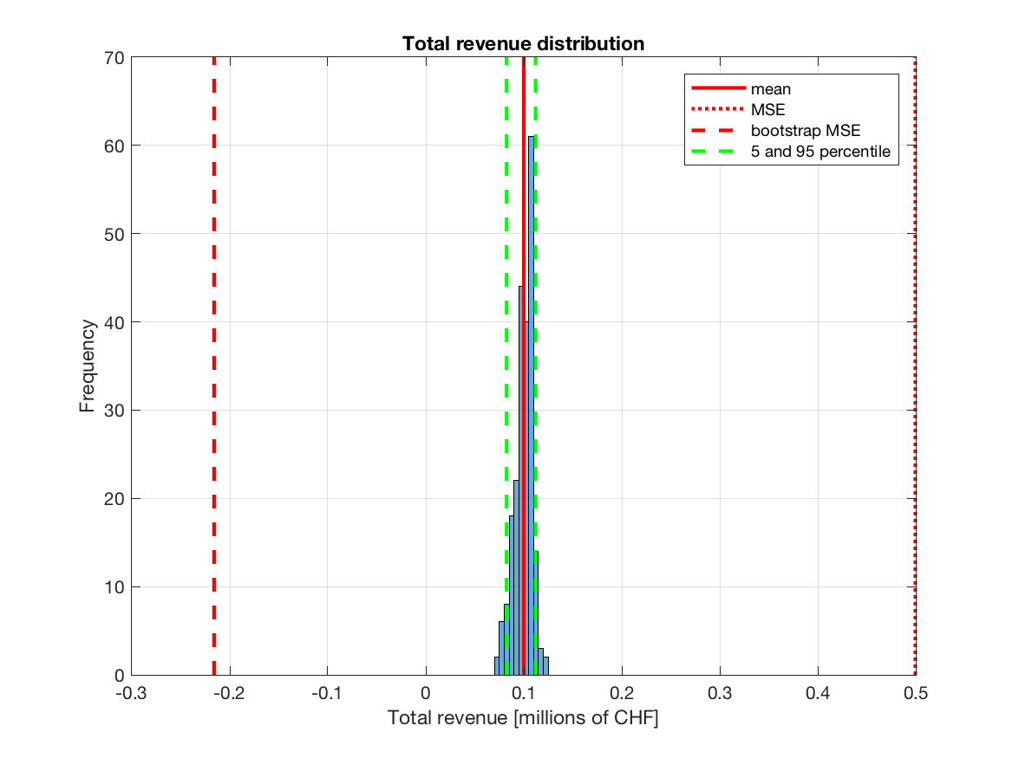
Scenario (2) - Total revenue
MATH-600: Optimization and Simulation
10/04/2018
1/333

Slide 18
Discussion
1st scenario almost always sold out
There are always costumers that couldn’t purchase (not enough for recruiting a new plane)
1st scenario vs 2nd scenario: mean values of no purchase etc.
Probability of low revenue for the 2nd scenario
MATH-600: Optimization and Simulation
10/04/2018
1/333

Slide 19
Thank you!
MATH-600: Optimization and Simulation
10/04/2018
1/333

