Slide 1

Reopening the Restaurant Industry in NYC: An analysis of data scraped from OpenTable Matthew Fay

Slide 2

COVID-19 Pandemic Disruption of the Restaurant Industry
Estimated $240 billion in losses due to COVID-19 pandemic
100,000+ businesses in the industry closed, either temporarily or permanently
National Restaurant Association, 2021

Slide 3
Lasting impacts of the pandemic into 2021 and industry recovery
Integration of technology:
Explosion in usage of online ordering services
Websites and online reviews and are the second-largest source of new customers at 35%, behind only recommendations from friends and family at 49% (Toast, 2020)
Pent-up demand remains high:
In April 2020, 83% of adults said they were not eating on-premise at restaurants as often as they’d like, up from 45% in January 2020 (National Restaurant Association, 2021)
Global dining reservations as of July 2021 are approaching pre-pandemic levels (OpenTable, 2021)

Slide 4
As the return to in-person dining continues, how can a restaurant maximize the value gained through online reservation systems?
Scraped information about every restaurant in New York City currently active on OpenTable: ~1100 restaurants with 25 features
Scraped number of bookings at each restaurant in NYC over the past week
Analysis focused on 3 major groups of factors:
Type of food or other experiences offered
User reviews and promoted status
Management of COVID-19 safety concerns

Slide 5
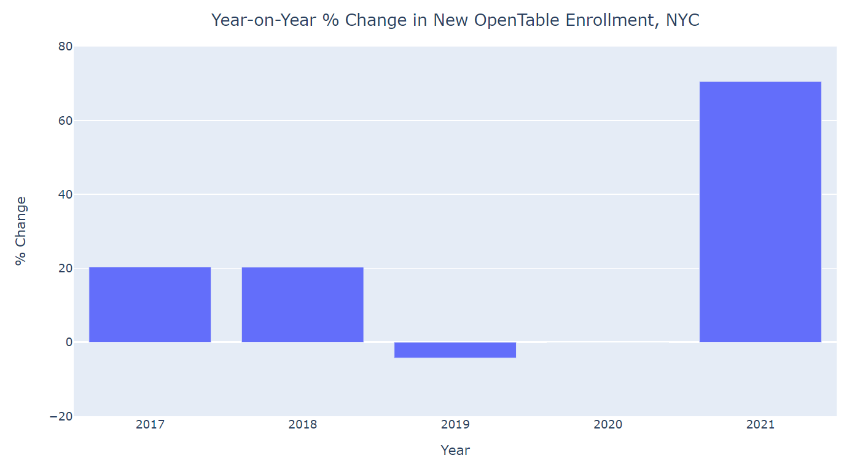
New enrollment on OpenTable in 2019 and 2020 in NYC was stagnant at best
2021 has seen a 70% increase from 2020 in new restaurants
This data does not account for restaurant closure or leaving the platform

Slide 6
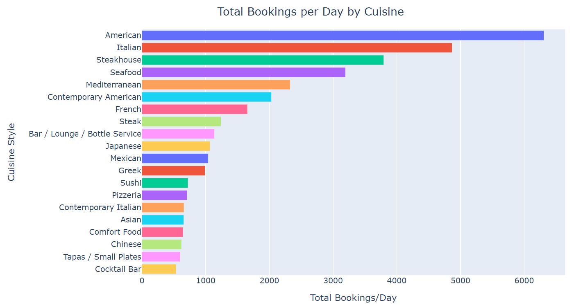
An overview of the New Yorker’s palette:
Top 20 cuisines by volume of bookings

Slide 7
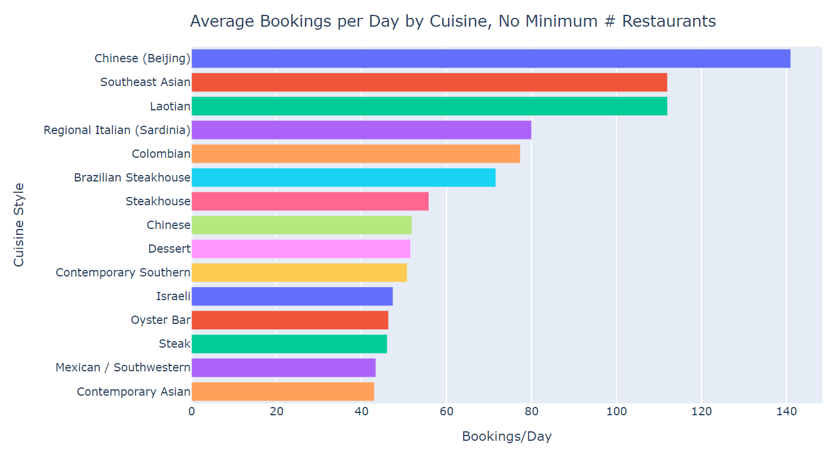
OpenTable allows 4 cuisine tags, less than 5% of restaurants use all 4
Be specific when labeling cuisine!
Being a bigger fish in a smaller pond can be a good thing

Slide 8
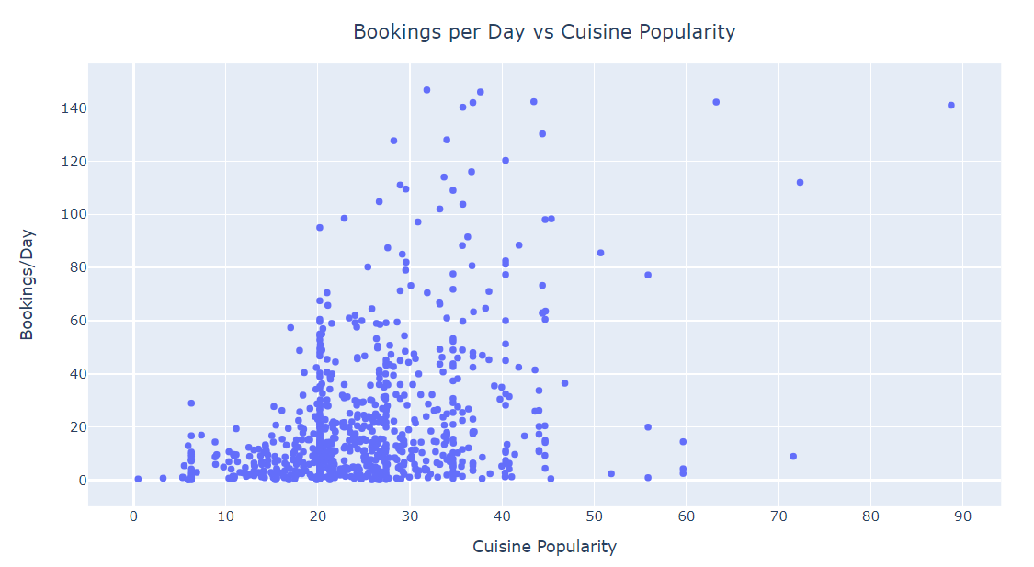
Cuisine popularity for a specific restaurant was proxied using the geometric mean of bookings/day for all tagged cuisine styles for each restaurant

Slide 9
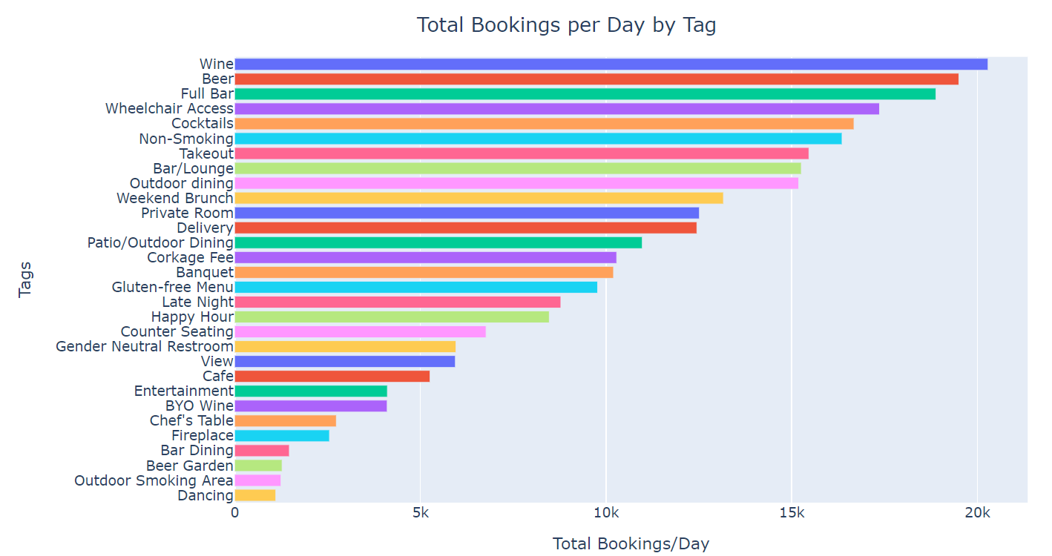
Customers value factors aside from food alone

Slide 10
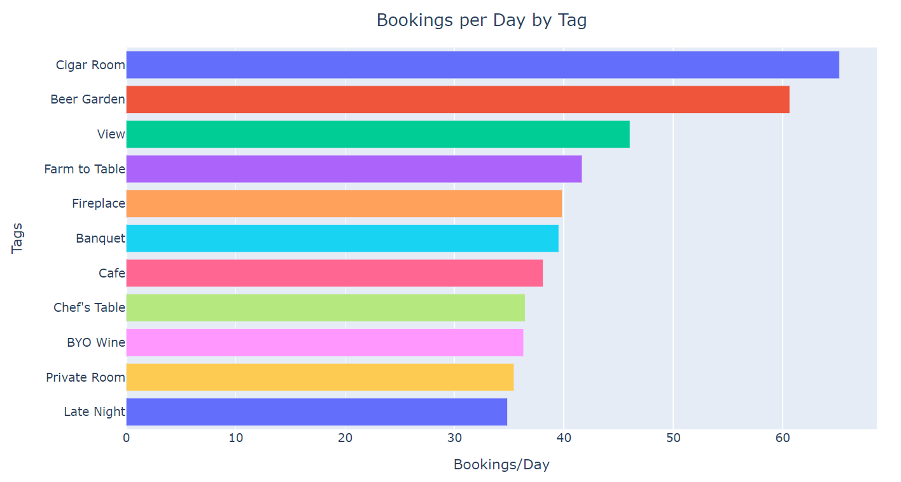
Exclusive experiences and features that enhance the dining experience result in more bookings

Slide 11

Customer ratings: the be-all, end-all?
OpenTable user reviews have 5 criteria:
Food
Service
Ambience
Value
Would you recommend it to others?

Slide 12
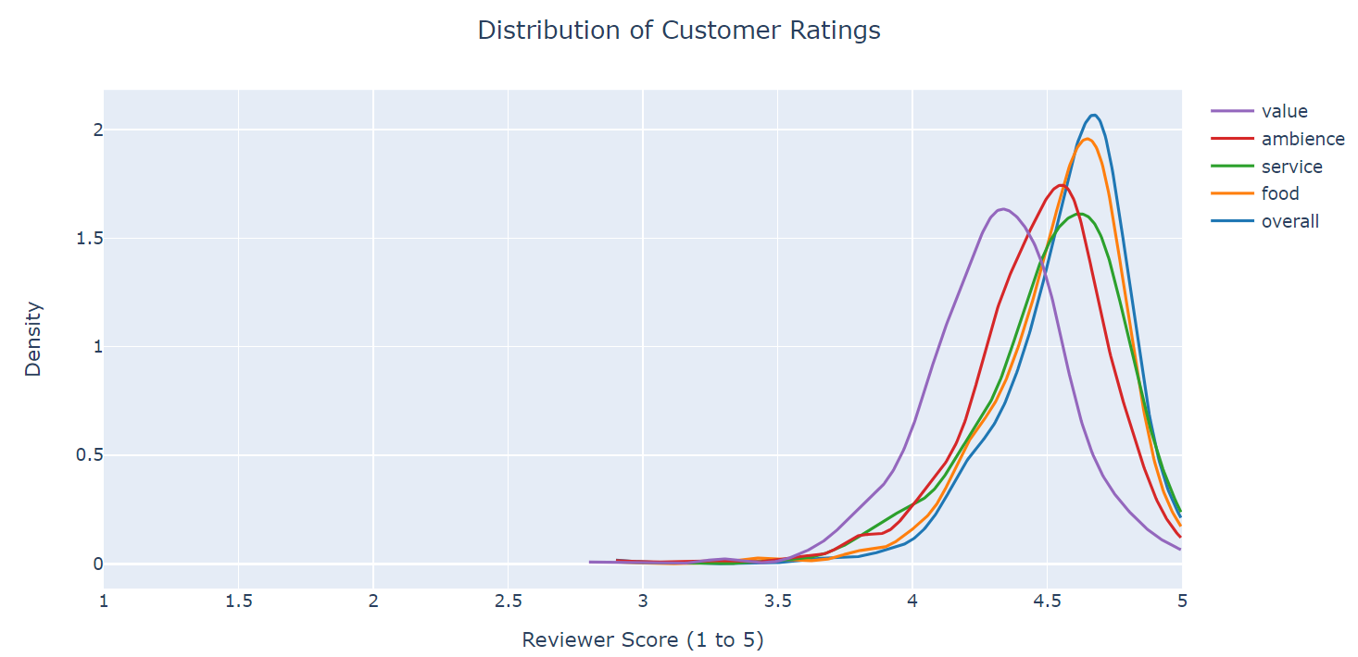
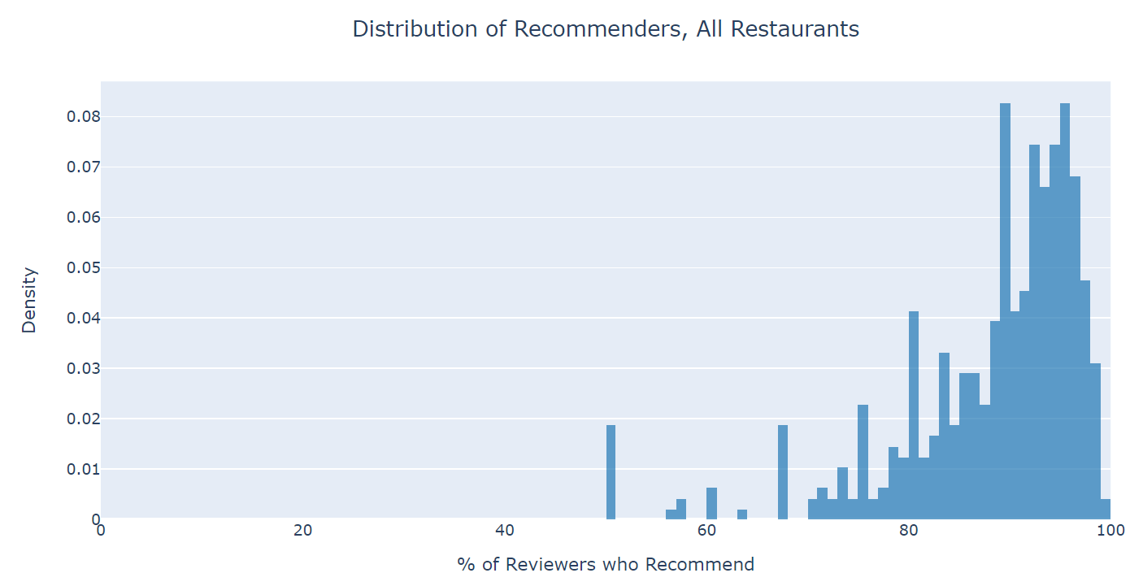
Nearly 100% of NYC restaurants on OpenTable have 4-stars or better in every individual category and overall Recommendations follow a very similar distribution clustered around 80-100% recommended

Slide 13
Explanations:
Bad to mediocre restaurants do not get enough business or are not well-known enough to make online reservation systems worth purchasing
Reviews are curated and some portion of negative reviews are removed
All levels of OpenTable partnership plans offer ‘Ratings Management’
Restaurants in New York City are just really, really good?
What factors are predictive of reservation numbers if not ratings?

Slide 14
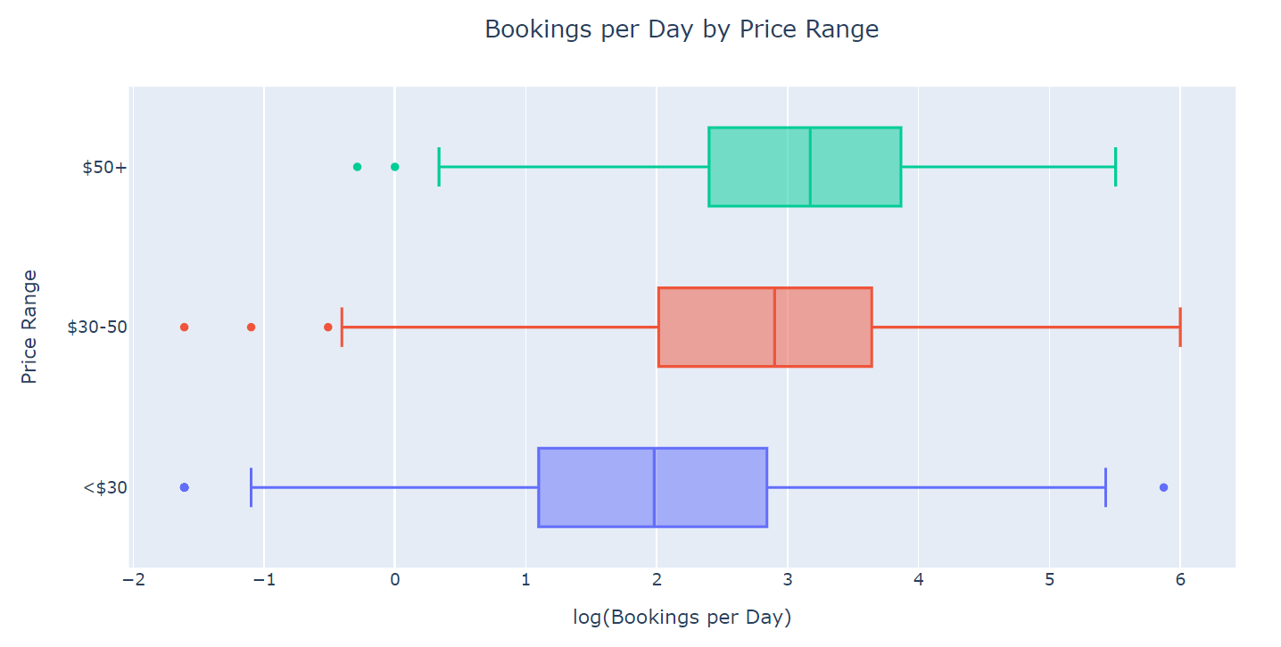
More expensive restaurants get more bookings, significant at p<0.05 level in ANOVA
Probable selection bias: cheaper/more casual restaurants tend to get more of their business from walk-ins and less from reservations

Slide 15
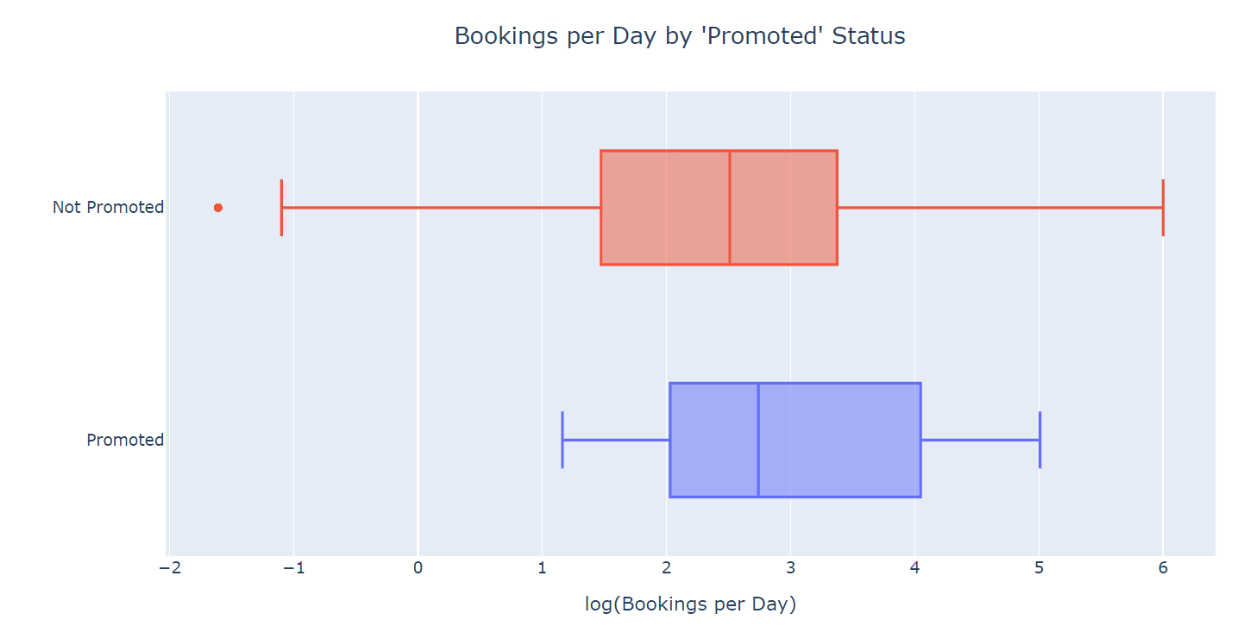
Promoted status on OpenTable results in higher numbers of bookings, significant at p<0.05 level in 2-sample t test
More on this later

Slide 16
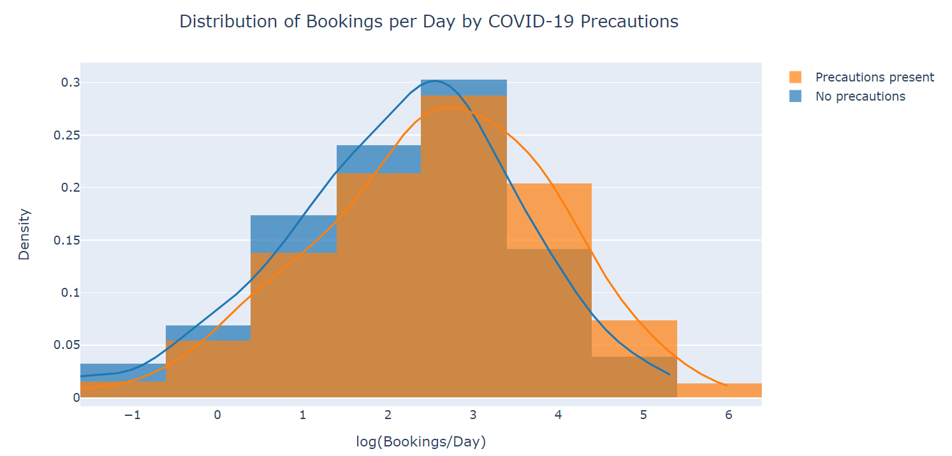
4 types of safety measures: distancing, PPE, sanitizing, and screening
Data was grouped by whether any of the 4 types were used
Small difference may be because most consumers who are dining in-person again are either vaccinated or do not weigh the risk of COVID-19 very highly
Significant at p<0.05 level in 2-sample t test

Slide 17
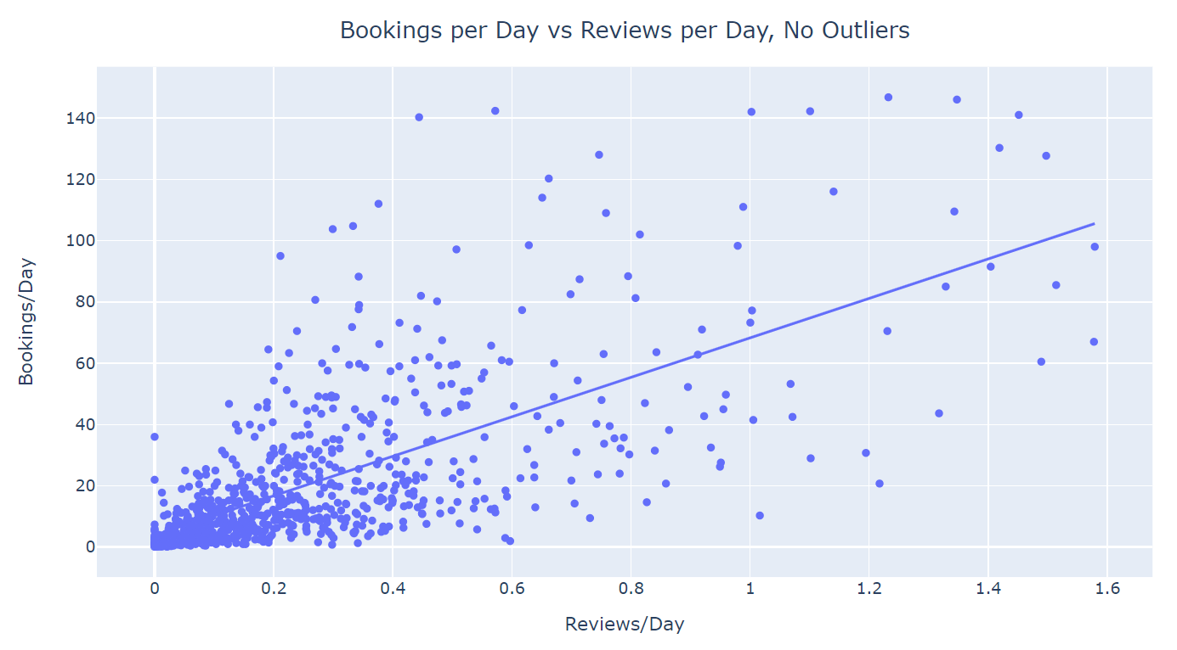
Number of reviews per day was by far the best predictor of reservation numbers
Linear model: Every review per day averages ~64 bookings per day
Much of the variance in the dataset is still unaccounted for in this model (r² = 0.47, p = 1e-113)
Ideally, data on the capacity of each restaurant could be integrated and analysis of reviews per seat per day might better control confounding factors and improve the model

Slide 18
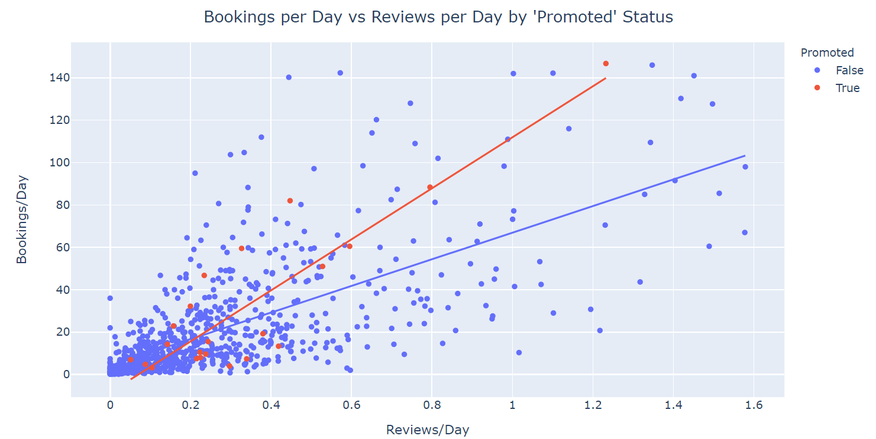
Promoted restaurants get almost twice as many bookings per review per day as non-promoted restaurants

Slide 19
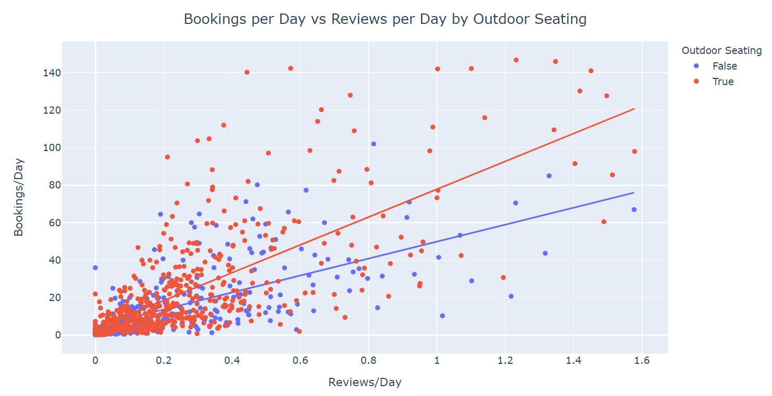
Restaurants that offer outdoor dining receive about 65% more bookings per review per day than restaurants with indoor seating only

Slide 20
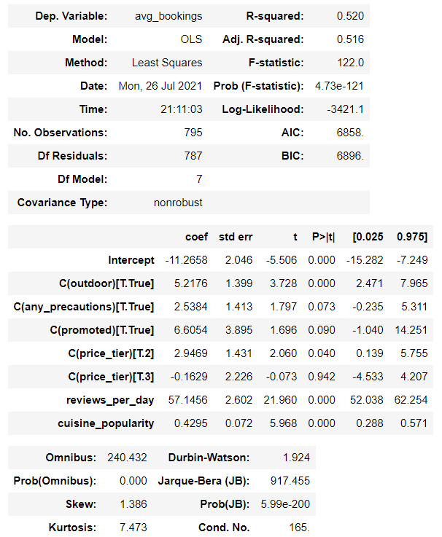
Multiple regression model only marginally better than linear regression on reviews/day
52% of variance in data explained by these factors
Important factors still unaccounted for by this analysis

Slide 21
Conclusions
Be specific about labeling the food and experiences offered, especially if you serve less-known regional or specialized cuisine
The rate at which customers make reviews, not the quality of those reviews, is the best predictor of bookings
Promoted status increases bookings per review per day by almost 100%
Profitability of promoted status depends on your profit per booking vs the cost of buying promoted status
Consumers in the post-pandemic NYC environment value outdoor seating

Slide 22
Improvements and future directions
Longer timeframe
Bookings per day data are averages from 5 days in July 2021
Ideally, pre-pandemic data could be obtained for comparison
Speed and scalability
First attempt at web scraping
I have since learned about html parsing and searching methods much more efficient than the ones used here
Causality
Controlling for physical size of restaurant and the effect that has on diners/day and by proxy reviews/day
Mapping and spatial analysis
Rent prices vs increased bookings tradeoffs by neighborhood/zip code

