Slide 1


Customer Segmentation for Credit Card Customers
Presented By
Fayrouz Mohamed

Slide 2

Summary of Findings
Dataset: 8,950 credit card customers.
Preprocessing: Handling missing values, log transformation, scaling.
Clustering: K-Means, optimal k=3 (Elbow Method + PCA visualization).
Result: 3 clear customer segments.

Slide 3
Cluster Profiles
Cluster 0 – Cash Advance Users: High balance, frequent cash advances, low purchase frequency.
Cluster 1 – Low Engagement: Minimal activity, low limits, highest full payment ratio.
Cluster 2 – High Spenders: High purchases, high frequency, strong payments and credit limits.

Slide 4
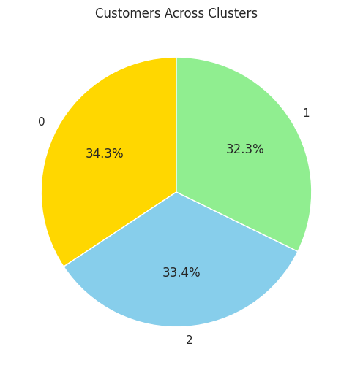
This chart shows the proportion of customers in each segment
Business Insight: The customer base is fairly evenly split across the three clusters. Strategies should target each segment proportionately, without ignoring any group.

Slide 5
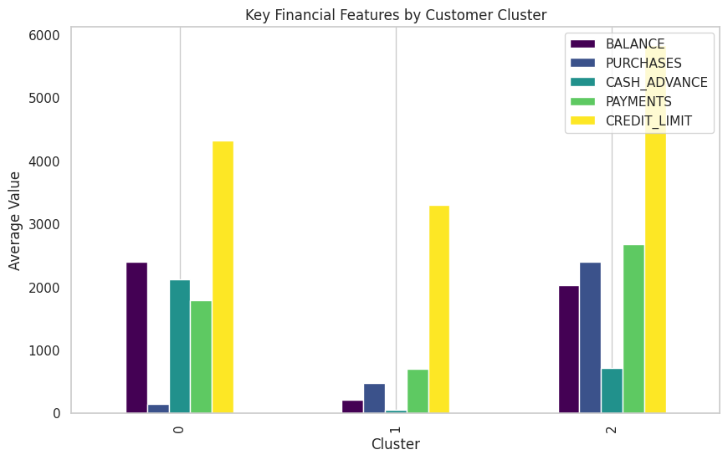
This bar plot highlights the behavioral differences across clusters in terms of spending, payments, and borrowing.
Business Insight:
Cluster 2 (high spenders) dominates in purchases and payments.
Cluster 0 is cash-advance heavy.
Cluster 1 shows very low overall activity — perfect candidates for tailored strategies.

Slide 6
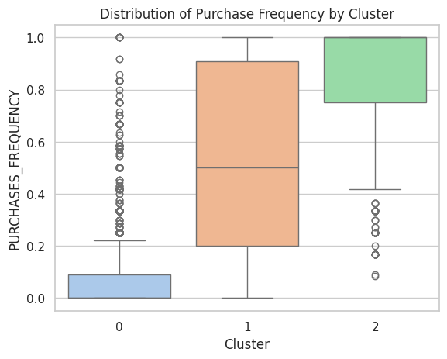
This shows how often customers in each cluster use their card to make purchases.
Business Insight:
Cluster 2 shows high engagement.
Cluster 0 almost none. may need alternative financial products.
Cluster 1 Marketing should encourage Cluster 1 to use their card more.

Slide 7
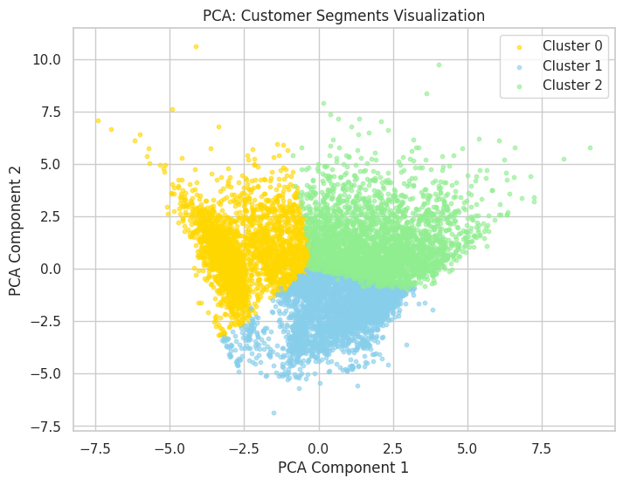
This scatter plot shows how well-separated the clusters are in reduced dimensions.
Business Insight:
The PCA confirms that the chosen segmentation captures distinct behavior groups — not randomly spread or overlapping.

Slide 8
Business Insights by Cluster
•Cluster 0 : Monitor risk; promote credit alternatives or counseling tools.
•Cluster 1 : Launch re-engagement or introductory incentives.
•Cluster 2 : Prioritize for loyalty programs, upsell premium services.

Slide 9
Enhancements or alternative approaches to the analysis.
To further enhance the analysis, we explored PCA-based dimensionality reduction and considered DBSCAN for density-aware clustering.

Slide 10

Conclusion
Segmentation revealed 3 behavior-driven clusters.
Business can now optimize outreach, retention, and risk strategies.
Clustering supports smarter customer targeting and portfolio growth.

Slide 11



Thank You

