Slide 1
Walmart Weekly Sales Forecasting Department 29
Fayrouz Mohamed

Slide 2
Problem Statement
Build a forecasting model to forecast weekly sales for Department 29

Slide 3
Dataset Overview
Source: Walmart Dataset
Period: Feb 2010 – Oct 2012
Target: Weekly_Sales
Features:
- IsHoliday
- Temperature
- Fuel_Price
- CPI
- Unemployment

Slide 4
Exploratory Analysis

Slide 5
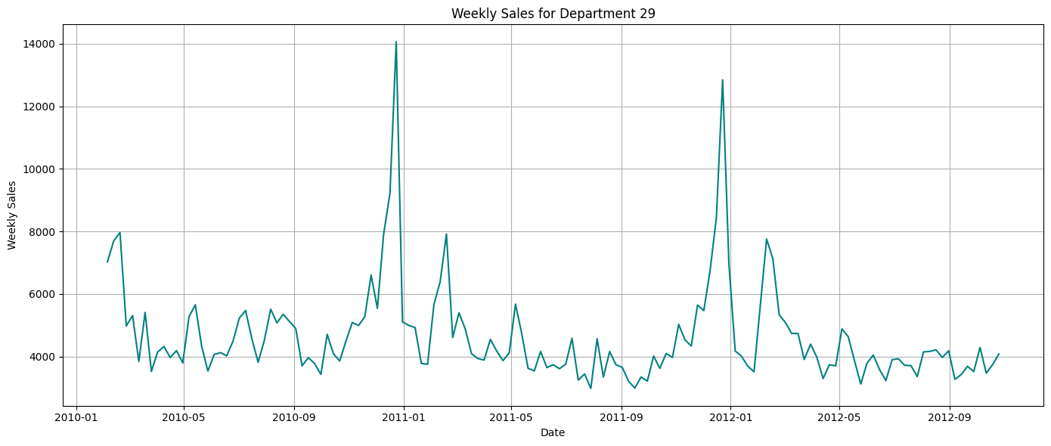

Slide 6
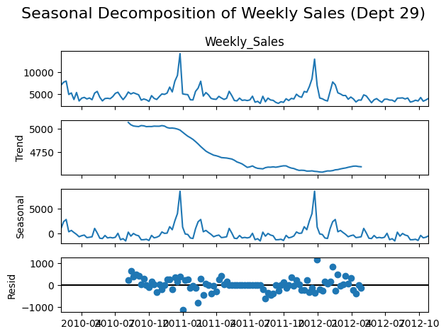

Slide 7
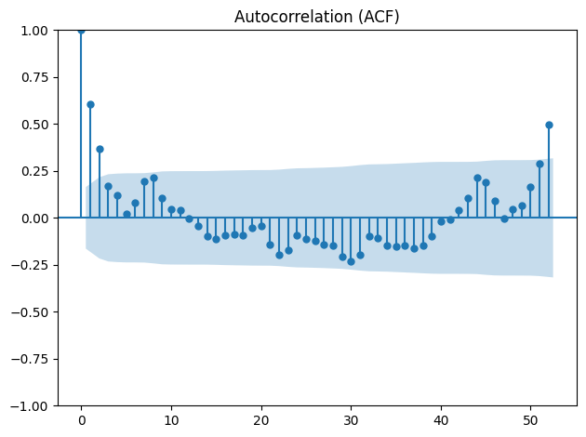
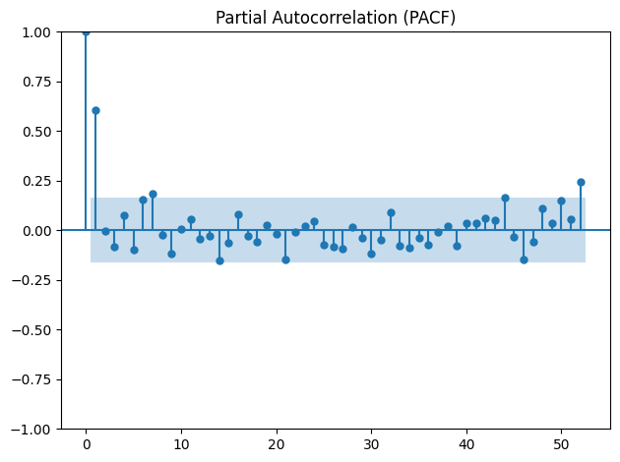

Slide 8
Models Applied
Forecasting: Naive, Moving Avg, SES, Holt, Holt-Winters
Statistical: ARIMA, SARIMA, SARIMAX
ML: RF, XGBoost, GBoost, Linear Regression
DL: ANN, LSTM
Innovation: Prophet, N-BEATS

Slide 9
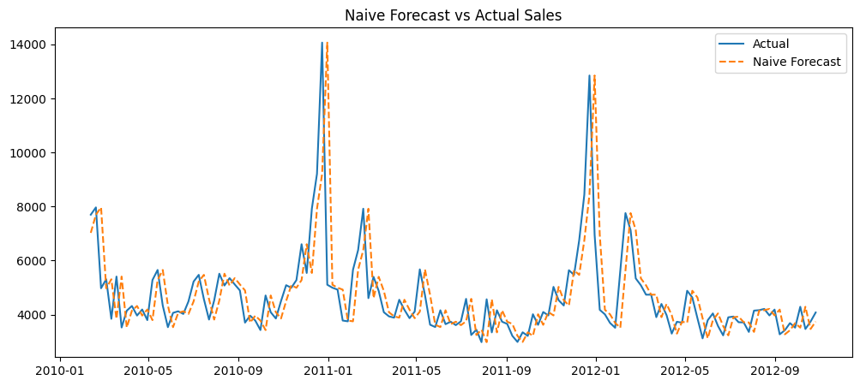
Naive Forecast
Naive Forecast:
MAE: 817.54
RMSE: 1386.73
MAPE: 16.45

Slide 10
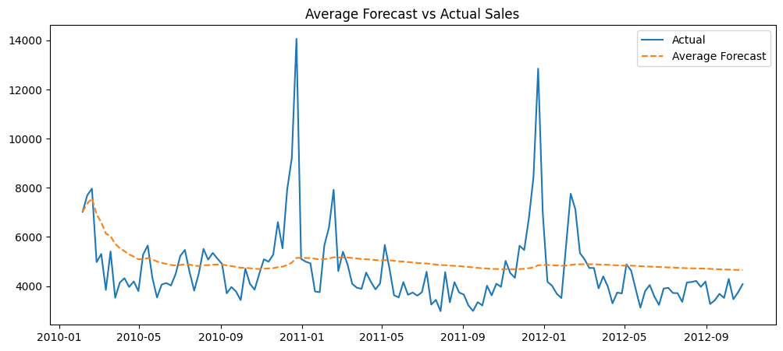
Simple Average Forecast
Average Forecast:
MAE: 1082.15
RMSE: 1555.67
MAPE: 23.46

Slide 11
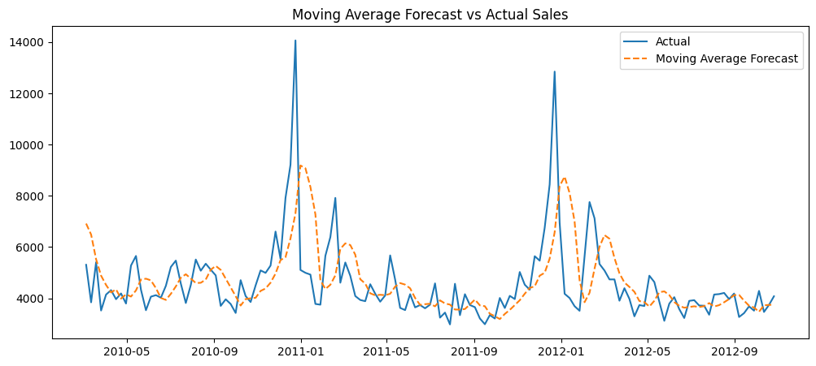
Moving Average Forecast (last 4 weeks)
Moving Average Forecast:
MAE: 971.15
RMSE: 1518.95
MAPE: 19.57

Slide 12
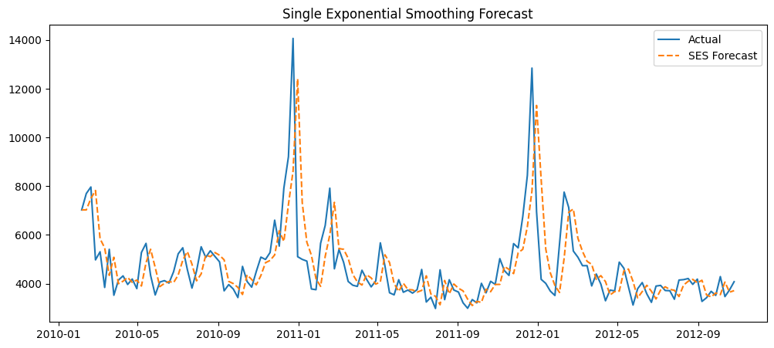
Single Exponential Smoothing (SES)
SES Forecast:
MAE: 823.15
RMSE: 1341.67
MAPE: 16.43
R2: 0.28

Slide 13
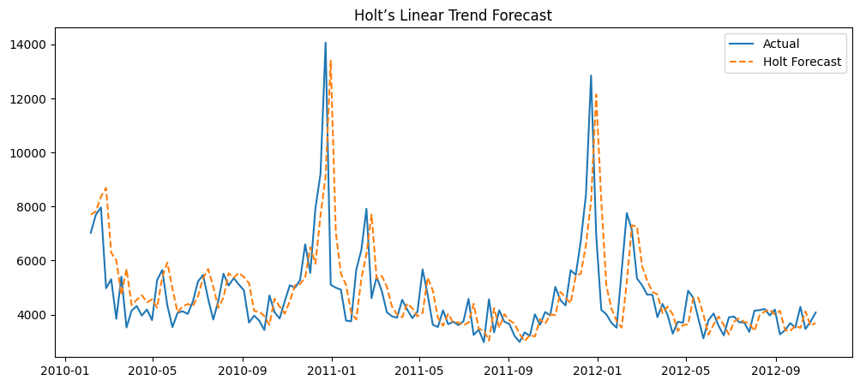
Holt’s Linear Trend
Holt’s Linear Trend Forecast:
MAE: 844.35
RMSE: 1399.34
MAPE: 17.15

Slide 14
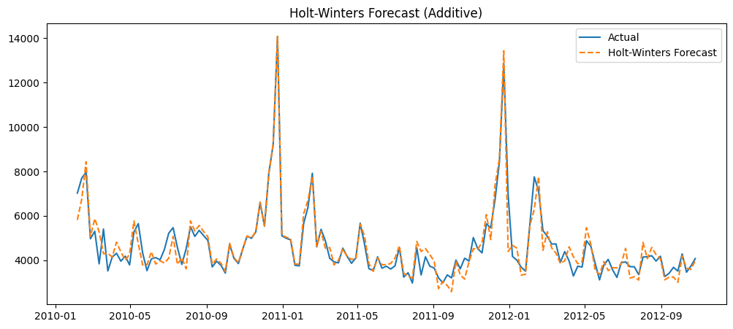
Holt-Winters Additive
Holt-Winters Forecast: MAE: 338.22
RMSE: 491.07
MAPE: 7.5

Slide 15
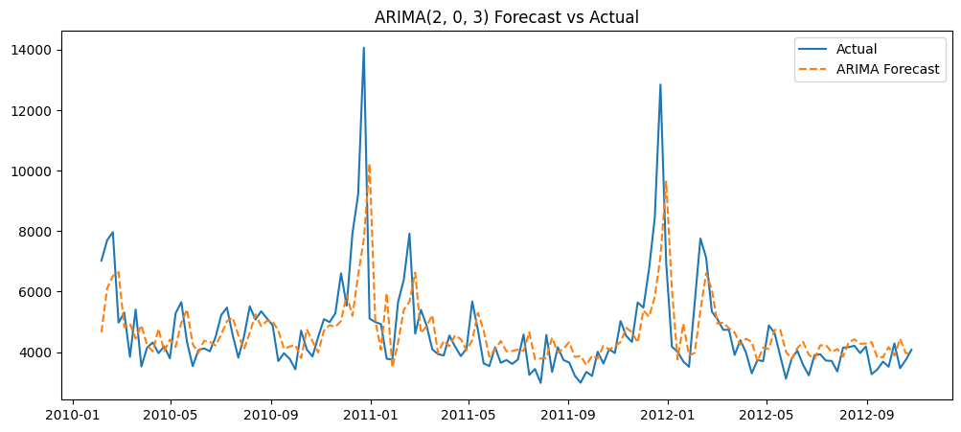
Holt-Winters Additive
ARIMA(2, 0, 3) Forecast: MAE: 786.47
RMSE: 1227.69
MAPE: 15.79

Slide 16
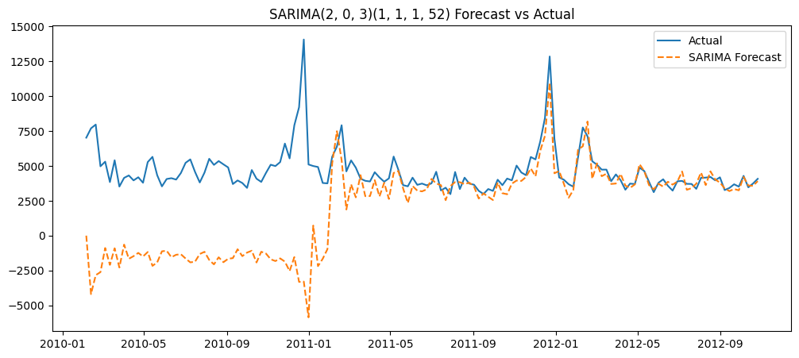
SARIMA(2, 0, 3)(1, 1, 1, 52)
SARIMA Forecast:
MAE: 2835.59
RMSE: 4358.71
MAPE: 57.09
SARIMAX Forecast (with external regressors): MAE: 4430.11 RMSE: 5353.25 MAPE: 96.14

Slide 17
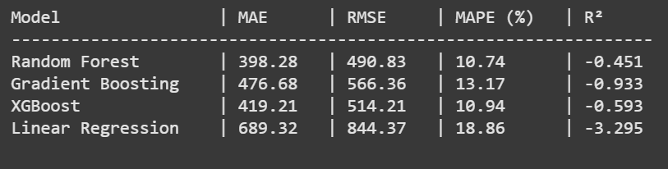

Slide 18
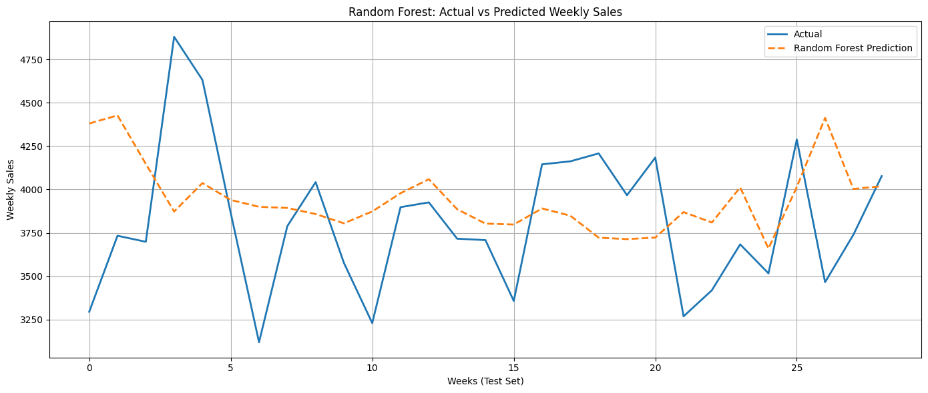
Random Forest

Slide 19
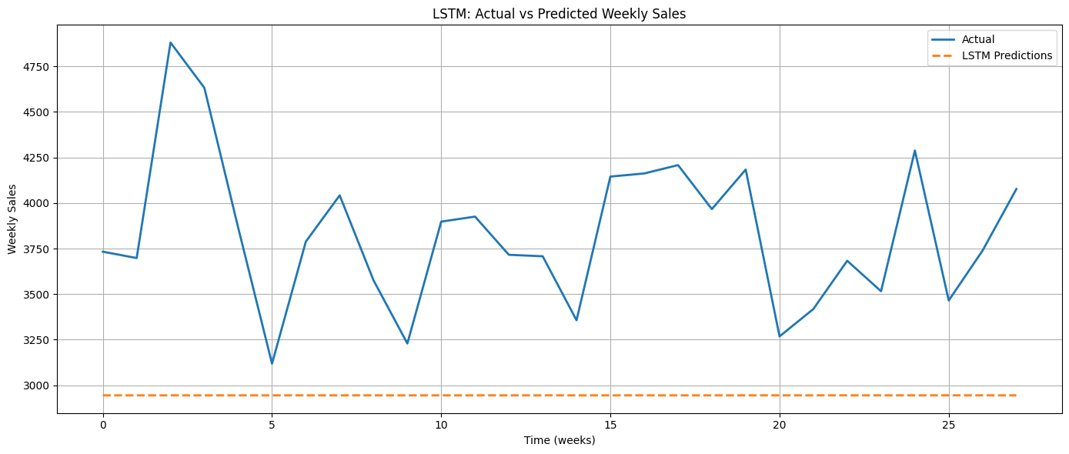
Deep learning models
ANN Performance:
MAE: 674.3
RMSE: 764.88
MAPE: 17.2 %
R²: -2.525
LSTM Performance:
MAE: 887.16
RMSE: 974.17
MAPE: 22.32 %
R²: -4.86

Slide 20
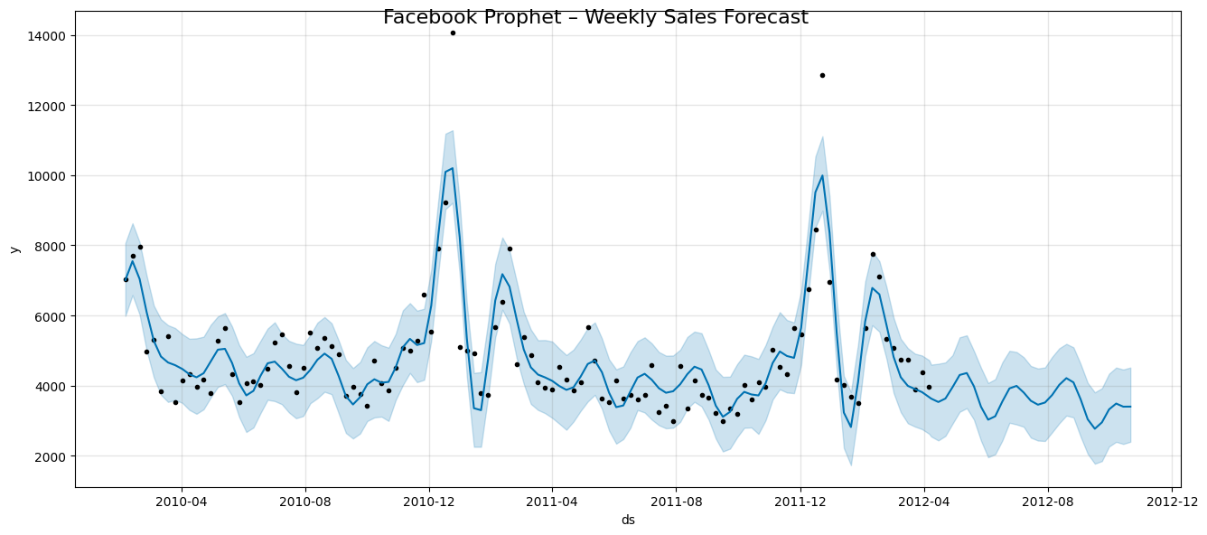
Prophet Performance
Prophet Performance: MAE: 398.77
RMSE: 498.31
MAPE: 10.42 %
R²: -0.496

Slide 21
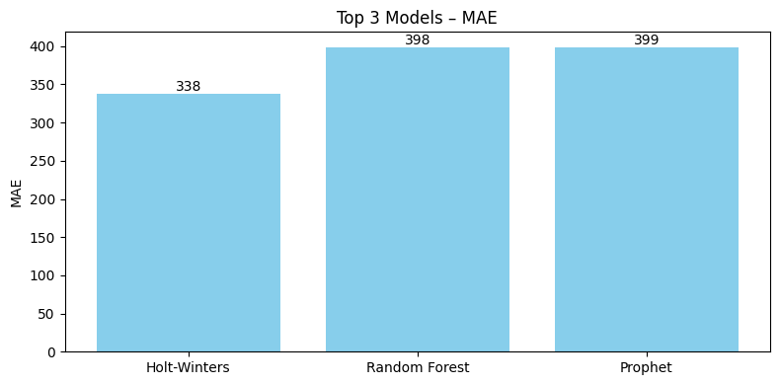
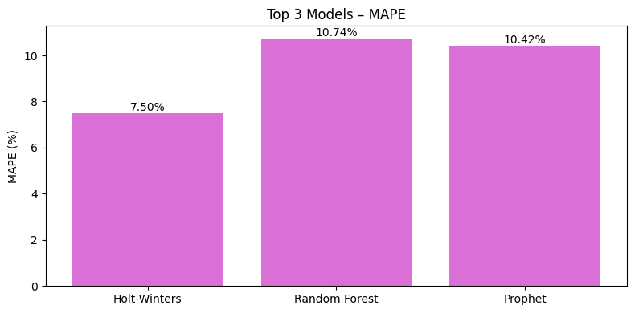

Slide 22
Model Comparison
Best Model: Holt-Winters
MAE = 338 | RMSE = 491 | MAPE = 7.5%
Prophet, RF, XGBoost followed closely
SARIMAX and N-BEATS underperformed

Slide 23
Conclusion
Holt-Winters outperformed all models
Captured holiday seasonality well

Slide 24
Thank You
Deployed as a Streamlit App
https://time-serieswalmartdataset-kctaukw6asqobp87dvrxq8.streamlit.app/
GitHub: github.com/fayrouzmgalal
LinkedIn: linkedin.com/in/fayrouz-mohamed-556a6b241

