Slide 1
What is Laravel ?
By Georgi Genov

Slide 2
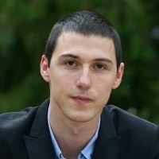


About me
Georgi Genov - 25 years old
Programming since 7 years
I wrote my first code when I was 15 years old
Graduated Mathematical School in Pazardzhik and then Technical University of Sofia, Automation engineer
Currently working as Team Leader in software company and Freelancer, so I can be up to date with the latest technologies
www.ggenov.eu
ggenov

Slide 3
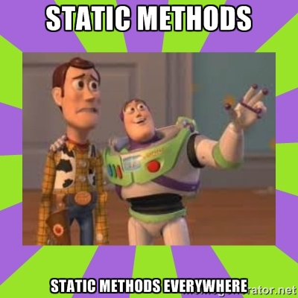

We will learn today …
What is Laravel ?
Install Laravel 5 with Composer
Files structure
What is artisan and how does it save us time?
Routing and route types
What is Middleware and how to use it?
What is Blade ?
Database and Eloquent ORM
CRUD with validation and database connection (practical task)
Best practices when coding in Laravel

Slide 4

What is ?
Laravel is MVC PHP framework created by Taylor Otwell in 2011
Free open-source license with many contributors worldwide
One of the best frameworks together with Symfony, CodeIgniter, Yii
Has powerful features, saving us time
Uses Symfony packages
Lets see some statistics

Slide 5
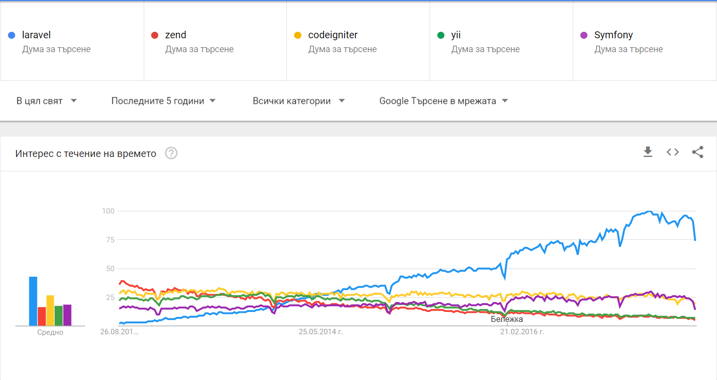
Google Trends (2012 – 2017)

Slide 6
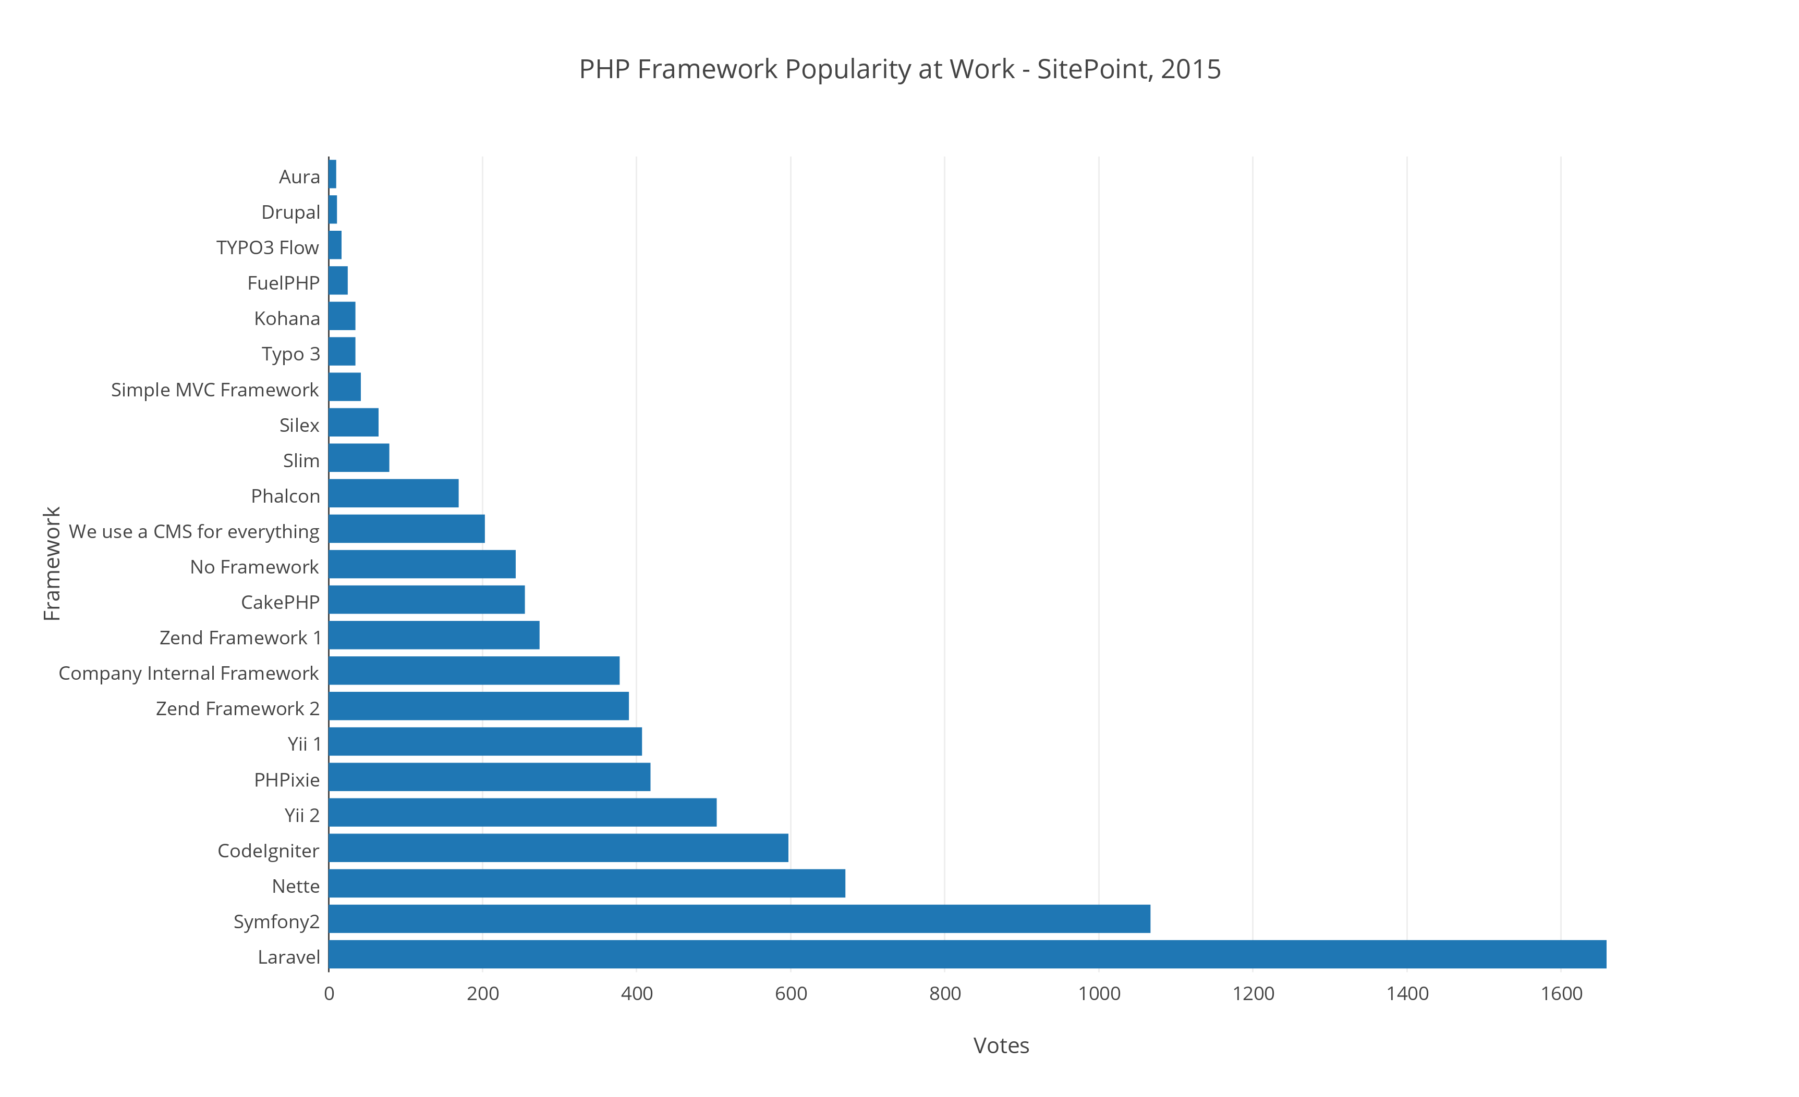
PHP Framework Popularity at Work – SitePoint 2015

Slide 7
Features
Eloquent ORM (object-relational mapping) – implements ActiveRecord
Query builder – helps you to build secured SQL queries
Restful controllers – provides a way for separating the different HTTP requests (GET, POST, DELETE, etc.)
Blade template engine – combines templates with a data model to produce views
Migrations – version control system for database, update your database easier
Database seeding – provides a way to populate database tables with test data used for testing
Pagination – easy to use advanced pagination functionalities
Forms security – provides CSRF token middleware, protecting all the forms

Slide 8
Must have packages
Laravel debugbar - https://github.com/barryvdh/laravel-debugbar
Great for debugging on local environment. Shows all the views, requests, exceptions loaded for the current page.
LaravelCollective – Forms & HTML - https://laravelcollective.com/docs/master/html
Perfect for generating forms, inputs, script tags and style tags
Laravel IDE Helper - https://github.com/barryvdh/laravel-ide-helper
The package helps your IDE with autocomplete and autosuggest methods, views, functions and more.

Slide 9

Let’s install Laravel
Laravel uses Composer to manage its dependencies
Composer is dependency management tool for PHP, like a library full of books
NOT like Yum or apt
Per project tool (vendor folder), not per system
Install by using the command:
composer create-project --prefer-dist laravel/laravel laravel-softuni

Slide 10
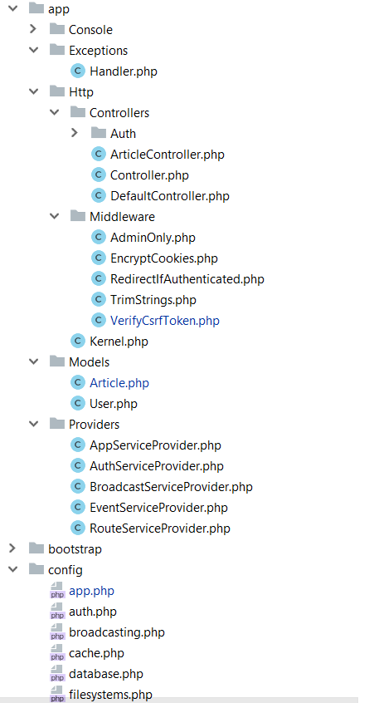
The structure
app/Http folder contains the Controllers, Middlewares and Kernel file
All the models should be located in app/Models folder
The service providers that are bootstrapping functions in our app are located in app/Providers folder
All the config files are located in app/config folder

Slide 11
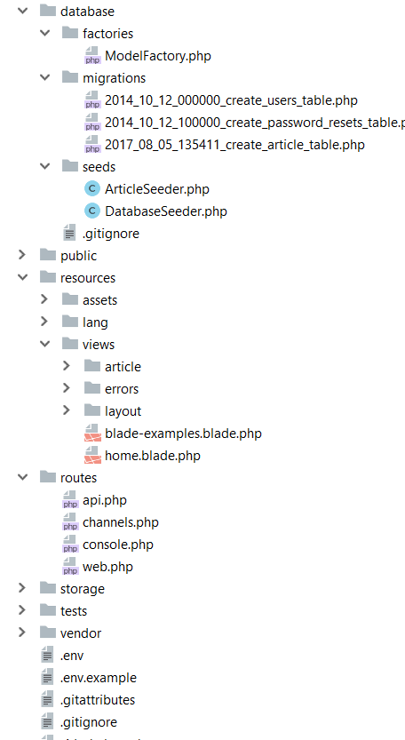
Database folder contains the migrations and seeds
The public folder is the actual folder you are opening on the web server.
All JS / CSS / Images / Uploads are located there.
The resources folder contains all the translations, views and assets (SASS, LESS, JS)
that are compiled into public folder
The routes folder contains all the routes for the project
All the logs / cache files are located in storage folder
The vendor folder contains all the composer packages (dependencies)

Slide 12
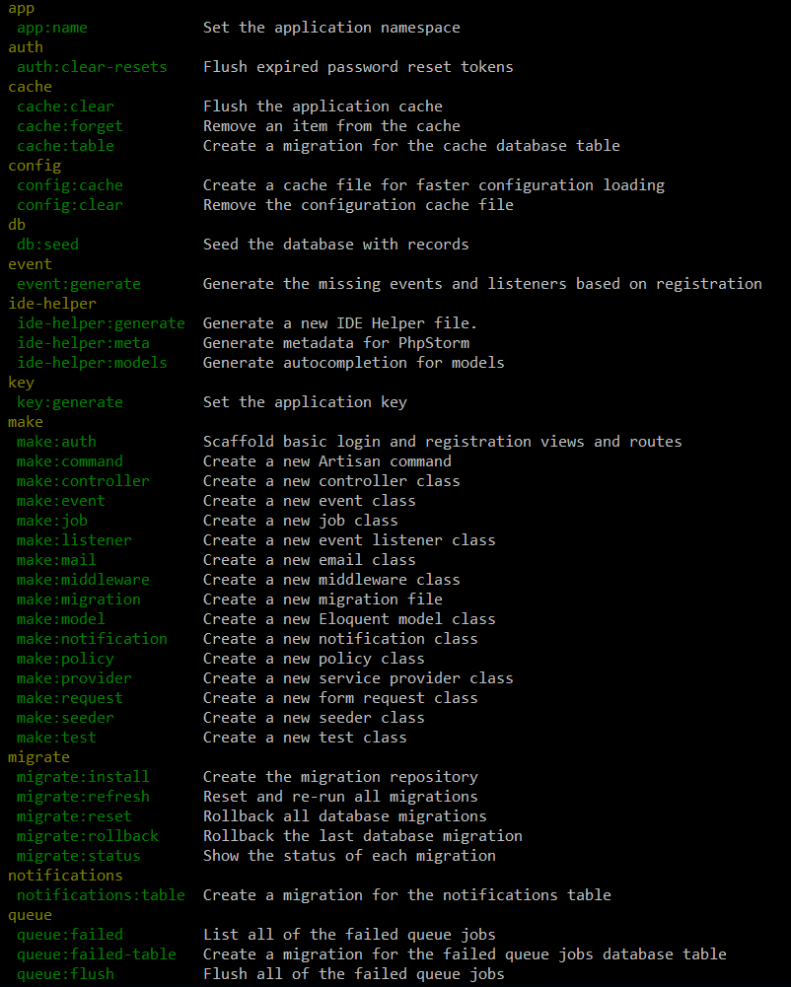
Artisan !
Artisan is command-line interface for Laravel
Commands that are saving time
Generating files with artisan is recommended
Run php artisan list in the console

Slide 13
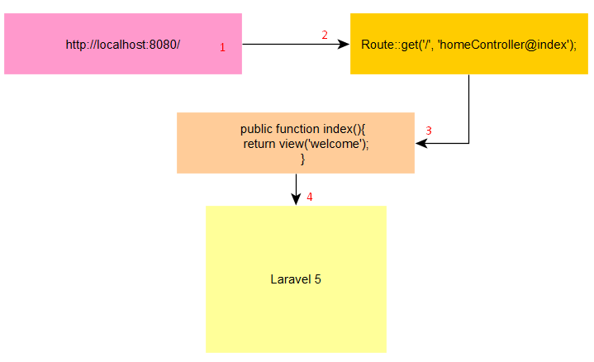
Routing
The best and easy routing system I’ve seen
Routing per middleware / prefix or namespace
Routing per request method (GET, POST, DELETE, etc.)
ALWAYS name your route !
Be careful with the routing order !
Let’s see routing examples

Slide 14
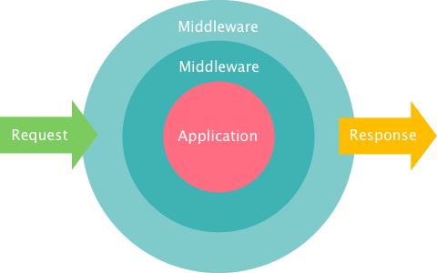
Middleware
The middleware is mechanism for filtering the HTTP requests
Laravel includes several middlewares – Authentication, CSRF Protection
The auth middleware checks if the user visting the page is authenticated through session cookie
The CSRF token protection middleware protects your application from cross-site request forgery attacks by adding token key for each generated form
Let’s create middleware

Slide 15

Blade
Blade is the powerful template engine provided by Laravel
All the code inside blade file is compiled to static html file
Supports plain PHP
Saves time
Better components mobility, extend and include partials
Let’s take a look at few examples

Slide 16
Eloquent & Database
The Eloquent ORM (Object-relational mapping) provides simple ActiveRecord implementation for working with the database
$article = new Article();
$article->title = ‘Article title’;
$article->description = ‘Description’;
$article->save();
INSERT INTO `article` (`title`, `description`) VALUES (‘Article title’, ‘Description’);

Slide 17
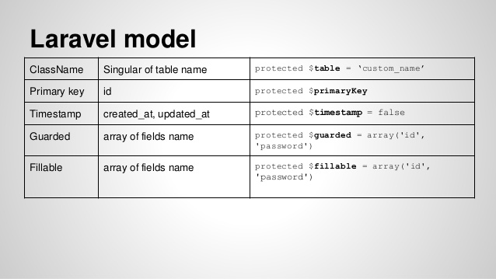
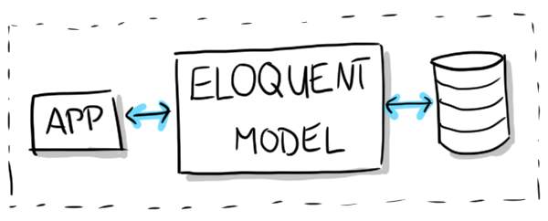
Each table has its own “Model”. You can use the model to read, insert, update or delete row from the specific table
Let’s check one model

Slide 18
Practical task
We will play with Laravel and create CRUD for recipes (Create, Read, Update, Delete).
The recipe will have the following columns / fields :
Id – primary key – not null
Title – varchar – 255 length – not null
Description – text – nullable
Status – enum [ active / inactive ] – not null – defaults to active
Created At – datetime – not null
Updated At – datetime – not null

Slide 19
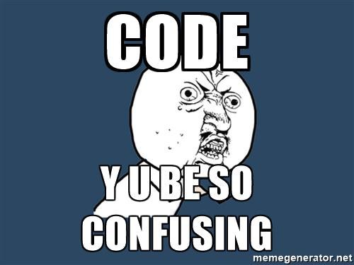
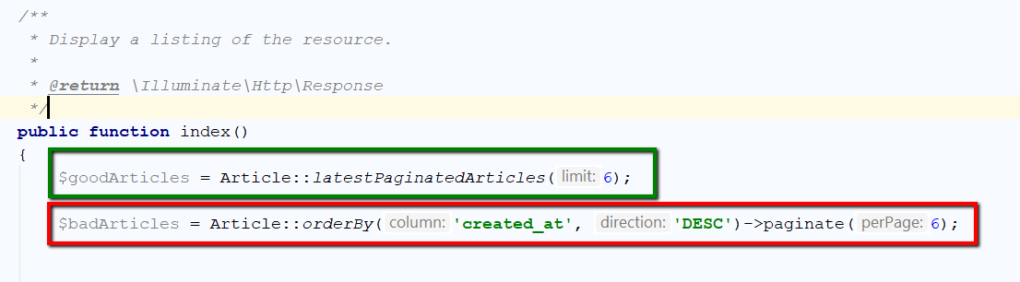
Best practices in Laravel
NEVER write queries or model logic inside the controller! The controller job is to communicate with the model and pass data to the view.

Slide 20
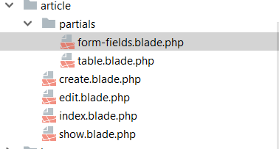
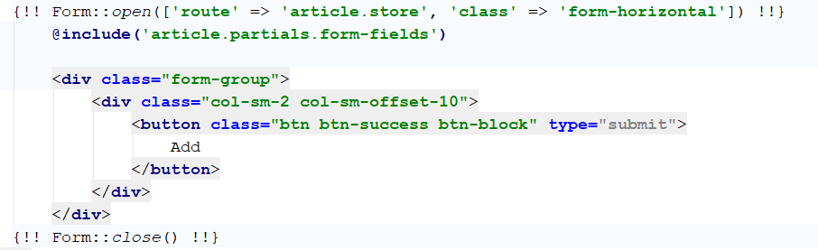
Views mobility
Extend and include partials. For example share the same form fields on 2 pages – add and edit

Slide 21
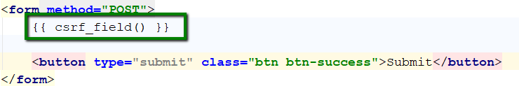
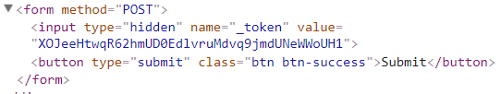
Forms security
Always use the CSRF token protection that Laravel provides in forms you create, the hackers will not be able to spam your forms and database

Slide 22
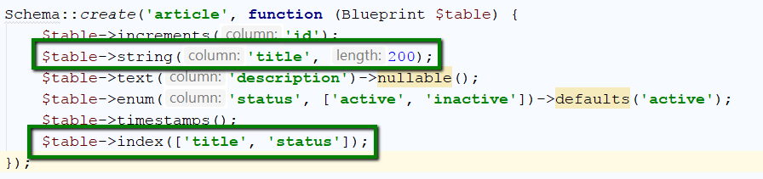
Database architecture
Be careful with the database architecture, always use the proper length for specific column and never forget the indexes for searchable columns

Slide 23
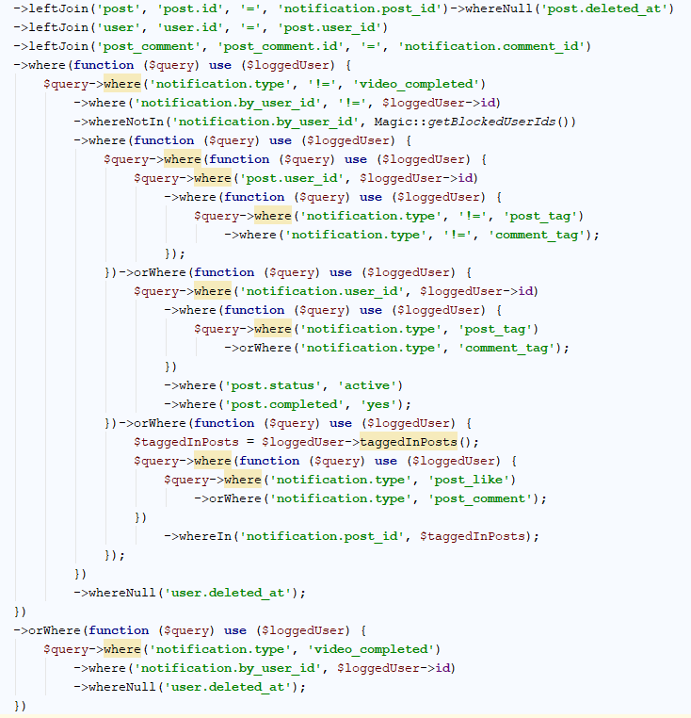
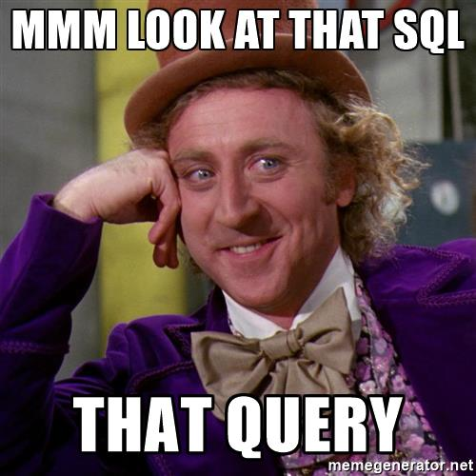
Big query
Avoid the big query unless you really have to do it. The big query is hard to debug and understand.
You can merge the small queries into one to save the CPU time on server, but sometimes the query becomes way too big.

Slide 24
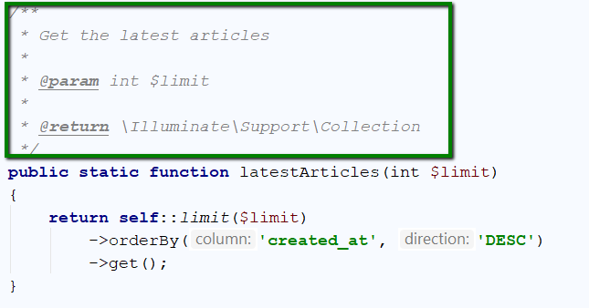
Don’t forget the PHPDoc
Don’t forget to write comments for each method or complicated logic. The PHPDoc comments are helping the IDE to autosuggest easier and the developers to understand the piece of code

Slide 25

Thank you! Questions ?

