Slide 1
Definition:-
The Event Management System is a web application designed to simplify
process of organizing and attending events. This platform allows event
organizers to create and manage events, providing all the necessary details
such as event the event name, date, location and description. On the other
side, user can browse through various events, view detailed information,
and easily enroll in the ones that interest them.

Slide 2
purpose:-
Streamline Event Registrations: To provide users with an easy platform to discover, view, and register for events, both paid and free.
Empower Organizers: To allow event organizers to efficiently create, manage, and track their events and user registrations.
Enhance User Experience: To offer users a personalized experience where they can manage their registered events in one place.
Simplify Administration: To give admins control over managing users, organizers, event categories, and system languages efficiently.

Slide 3
Key features:-
For Admin:
Manage users and organizers, including approvals and account settings.
Oversee and organize event categories.
Manage system languages to ensure the platform is accessible to different language-speaking users.
For Organisers:-
Register as an event organizer and create detailed events.
View and manage the events they've created.
Track and monitor user registrations for their events.
For Users:-
Manage users and organizers, including approvals and account settings.
Oversee and organize event categories.
•Manage system languages to ensure the platform is accessible to different language-speaking users.

Slide 4
Hardware Requirement:-
AMD Ryzen 5 5500U with Radeon Graphics [2.10 GHz]
8.00 GB RAM
64-bit operating system, x64-based processor
Software requirement:-
Font End:-
Html, Tailwindcss, Nodejs, React.js
Back End:-
Nodejs, Express.js, Mongodb

Slide 5
modules:-
Admin Module:-
•Admins can view statistics on how many users and organisers are registered.
•Admins have access to all the information about events, including details on users and organisers.
•When a new organiser registers, the admin decides whether to approve or deny the request.
•Admins can block or allow organisers from creating events.
•When an organiser requests to cancel an event, the admin decides whether to approve or reject the request. If approved, users get refunds with a reason for the cancellation.
•Admins can add, update, or remove categories and languages for events on the platform.
User Module:-
Register for Events: Users can sign up for various events.
View Registered Events: Users can see a list of events they have registered for.

Slide 6
Organiser Module:-
•Register as an Organiser: Organisers can sign up to manage events, but they need admin approval before creating events.
•Create, Update, and Delete Events: Once approved, organisers can manage their own events.
•Events can be either paid or free.
•View Registered Users: Organisers can see how many users have registered for their events.
•View and Manage Created Events: Organisers have access to all the events they've created and can update or delete them.
•Manage Profile: Organisers can update their personal or organisation information on their profile page.
•Request Event Cancellation: If an organiser wants to cancel an event, a request is sent to the admin for approval.

Slide 7
scope of project:-
implementing secure login and role-based access for Admin, Organisers, and Users.
When the Admin logs in, they will have full access to handle all the web pages and system information, including managing events, categories, and languages, approving organiser registration requests, reviewing and managing organiser permissions, and deciding on event cancellation requests. They will also have access to view user and organiser details, as well as approve refunds for cancelled events.
When the Organiser logs in, they will be able to create, update, and delete events, view how many users have registered for their events, manage their profile, and submit cancellation requests for their events, which will require admin approval. Organisers can create either paid or free events once their account has been approved by the admin.
When the User logs in, they will have access to register for events and view all the events they have signed up for.
Objectives:-
Admin can easily manage all web pages, including handling event approvals, organiser management, category and language settings, and refund processes.
Organisers can easily manage event creation, updates, cancellations, and view user registrations for their events.
Users can view and register for events, as well as see details of the events they have signed up for.

Slide 8
Data Flow Diagram

Slide 9

$$ZERO LEVEL DFD :−$$
Event
Management
System
ADMIN
LOGIN INFO
LOGIN INFO
ORGANISER
ACCESS TO SYSTEM
ACCESS TO SYSTEM
ACCESS TO
SYSTEM
LOGIN
INFO
USER

Slide 10

$1^{ST} LEVEL DFD:$-
USER
Languages
Categories
Registration
Events
Events
Organization info.
1.0
Registration
Process
2.0
Login
Process
3.0
Master
Entry
Processs
4.0
Manage
Events
5.0
User
Activity
6.0
Profile
Events
transactions
ADMIN
ORGANISER

Slide 11
$$2^{nd} LEVEL DFD for 3.0 \left(Master Entry Process\right):−$$
3.1
MANAGE
EVENTS
EVENT INFO
EVENT INFO
EVENTS DETAIL
EVENT DETAIL
EVENT DETAIL
CATEGORIES INFO
3.2
MANAGE
CATEGO-RIES
CATEGORIES INFO
CATEGORIES DETAIL
CATEGORIES DETAIL
CATEGORIES DETAIL
ADMIN
LANGUAGES INFO
3.3
MANAGE
LANGUA-GES
LANGUAGES INFO
SUBJECT DETAIL
LANGUAGES DETAIL
LANGUAGES DETAIL
ORGANISATIONS INFO
3.4
MANAGE
ORGANI-
SATIONS
ORGANISATIONS INFO
ORGANISATIONS DETAIL
ORGANISATIONS DETAIL
ORGANISATIONS DETAIL
CANCEL EVENTS INFO
3.5
MANAGE
CANCEL
EVENTS
CANCEL EVENTS INFO
CANCEL EVENTS DETAIL
CANCEL EVENTS DETAIL
CANCEL EVENTS DETAIL

Slide 12
$$2^{nd} LEVEL DFD for 4.0\left(Manage Events\right):−$$
EVENT INFO
4.1
CREATE
EVENT
EVENT INFO
EVENT DETAIL
EVENT DETAIL
EVENT INFO
4.2
UPDATE
EVENT
EVENT INFO
ORGANISER
EVENT DETAIL
EVENT DETAIL
EVENT DETAIL
EVENT INFO
4.3
DELETE
EVENT
EVENT INFO
EVENT DETAIL
EVENT DETAIL

Slide 13
$$2^{nd} LEVEL DFD for 5.0\left(User Activity\right):−$$
EVENTS INFO
5.1
VIEW
EVENT
INFO.
EVENTS INFO
EVENTS DETAIL
EVENTS DETAIL
EVENT INFO
5.2
ENROLL
IN EVENT
EVENT INFO
USER
EVENTS DETAIL
EVENT DETAIL
EVENT DETAIL
EVENT INFO
5.3
CANCEL
EVENT
ENROLL.
EVENT INFO
EVENT DETAIL
EVENT DETAIL

Slide 14

$$2^{nd} LEVEL DFD for 6.0\left(Profile\right):−$$
PROFILE INFO
6.1
VIEW PROFILE
DETAIL
PROFILE INFO
PROFILE DETAIL
PROFILE DETAIL
PROFILE INFO
6.2
UPDATE
PROFILE
DETAIL
PROFILE INFO
ADMIN/
ORGANISER
PROFILE DETAIL
PROFILE DETAIL
PROFILE DETAIL

Slide 15
$$3^{rd} LEVEL DFD for 3.1\left(Manage Events\right):−$$
EVENT INFO
3.1.1
EVENT
DETAIL
EVENT INFO
EVENT DETAIL
ADMIN
EVENT DETAIL
EVENT DETAIL

Slide 16
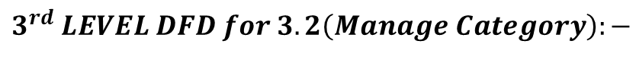
$$3^{rd} LEVEL DFD for 3.2\left(Manage Category\right):−$$
CATEGORY INFO
3.2.1
INSERT
CATEGORY
DETAIL
CATEGORY INFO
CATEGORY DETAIL
CATEGORY DETAIL
CATEGORY INFO
3.2.2
UPDATE
CATEGORY
DETAIL
CATEGORY INFO
CATEGORY
DETAIL
ADMIN
CATEGORY DETAIL
CATEGORY DETAIL
CATEGORY INFO
3.3.3
DELETE
CATEGORY
DETAIL
CATEGORY INFO
CATEGORY DETAIL
CATEGORY DETAIL

Slide 17
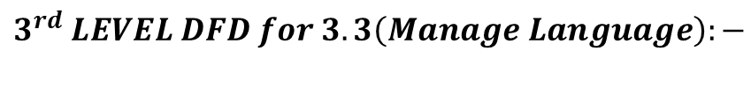
$$3^{rd} LEVEL DFD for 3.3\left(Manage Language\right):−$$
LANGUAGE INFO
3.3.1
INSERT
LANGUAGE
DETAIL
LANGUAGE INFO
LANGUAGE DETAIL
LANGUAGE DETAIL
LANGUAGE INFO
3.3.2
UPDATE
LANGUAGE
DETAIL
LANGUAGE INFO
LANGUAGE
DETAIL
ADMIN
LANGUAGE DETAIL
LANGUAGE DETAIL
LANGUAGE INFO
3.3.3
DELETE
LANGUAGE
DETAIL
LANGUAGE INFO
LANGUAGE DETAIL
LANGUAGE DETAIL

Slide 18
$$3^{rd} LEVEL DFD for 3.4\left(Manage Organiser\right):−$$
ORGANISER INFO
3.4.1
UPDATE
ORGANIS-ER PERMISS-ION
ORGANISER INFO
ORGANISER
DETAIL
ADMIN
ORGANISER DETAIL
ORGANISER DETAIL

Slide 19
$$3^{rd} LEVEL DFD for 3.5\left(Manage Cancel Events\right):−$$
3.5.1
CANCE-L EVENTS
CANCEL EVENT
DETAIL
CANCEL EVENT INFO
CANCEL EVENT INFO
ADMIN
CANCEL EVENT INFO
CANCEL EVENT INFO

Slide 20
Roles details:-

Slide 21
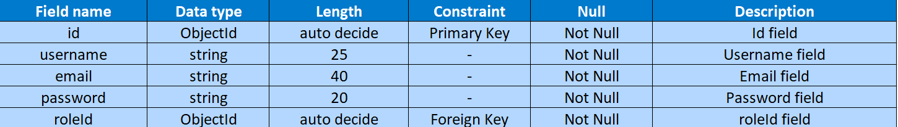
Users Details:-

Slide 22
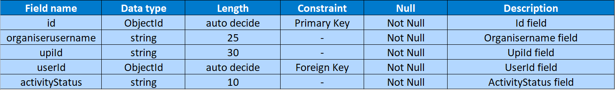
Organiserinformation details:-

Slide 23
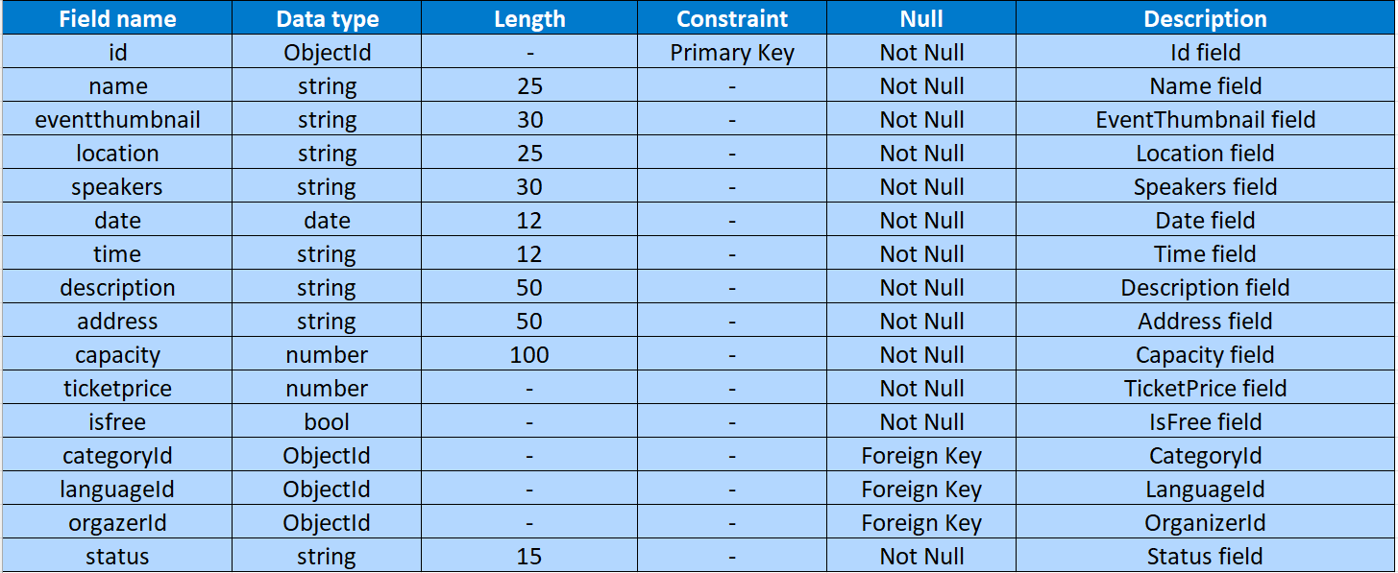
Event details:-

Slide 24
Categories details:-

Slide 25
Languages details:-

Slide 26
Joinusers details:-

Slide 27
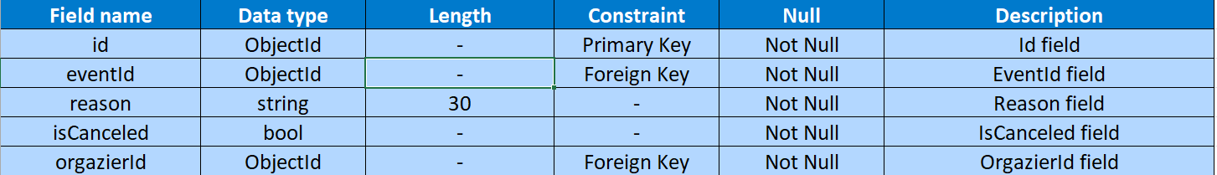
Cancel_event details:-

Slide 28
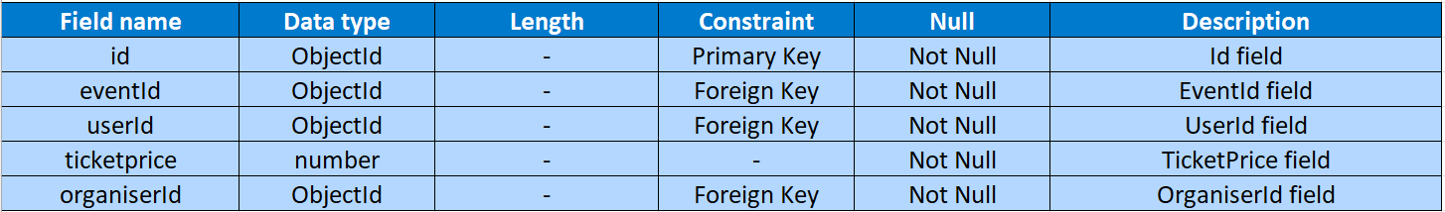
Transaction details:-

Slide 29
Admin Side

Slide 30
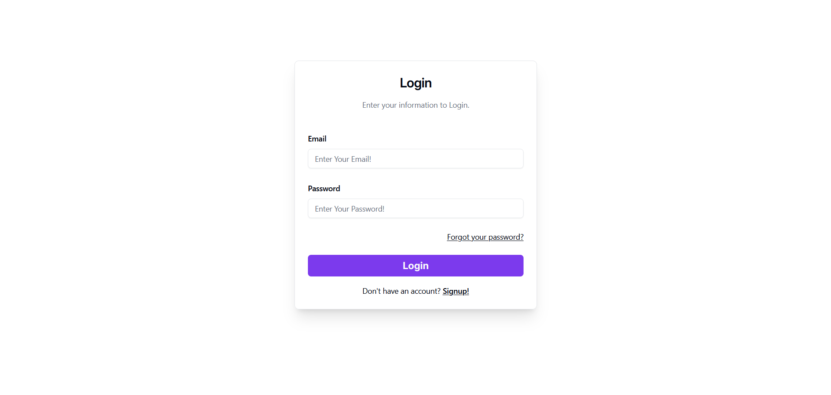

Slide 31
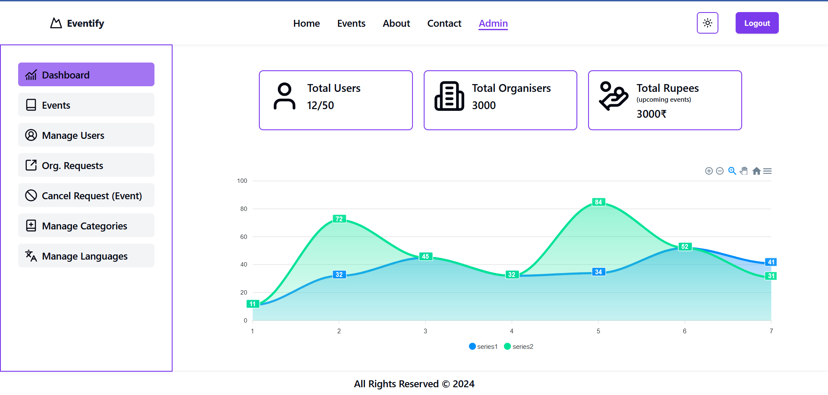

Slide 32
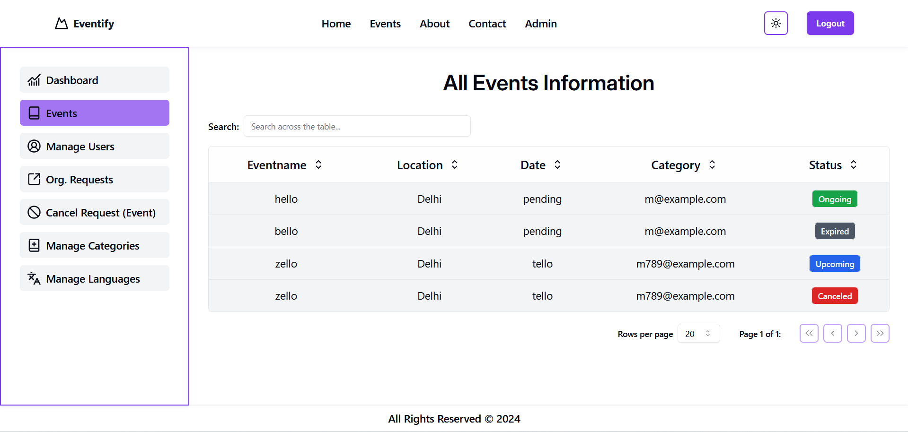

Slide 33
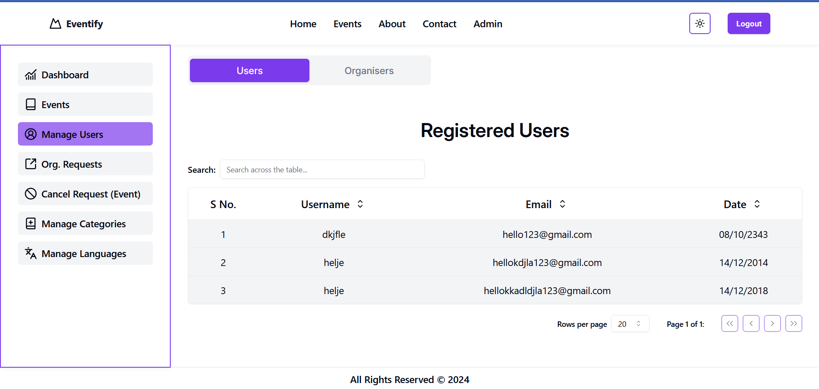

Slide 34
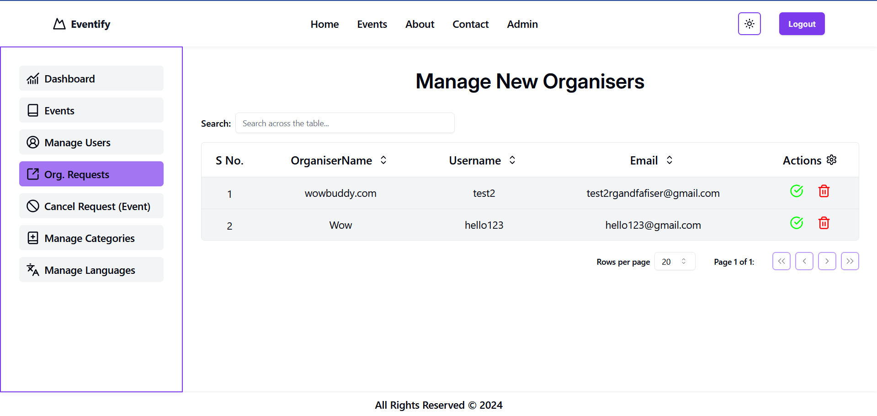

Slide 35
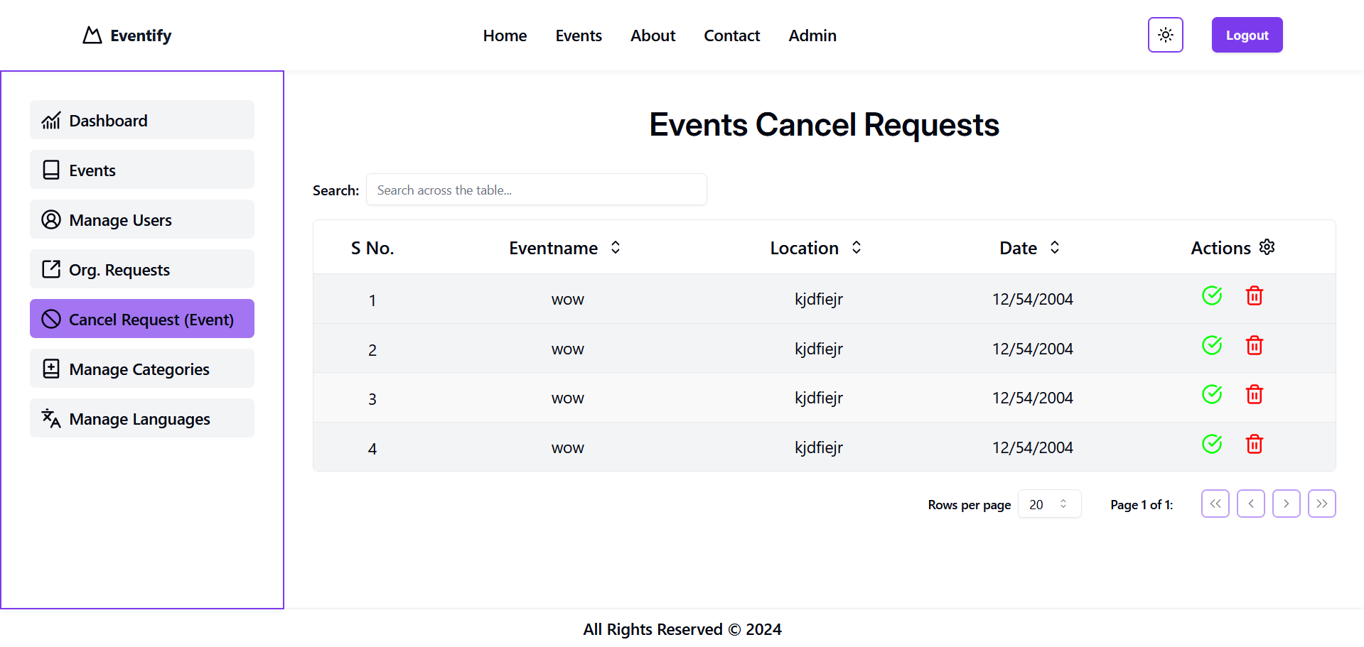

Slide 36
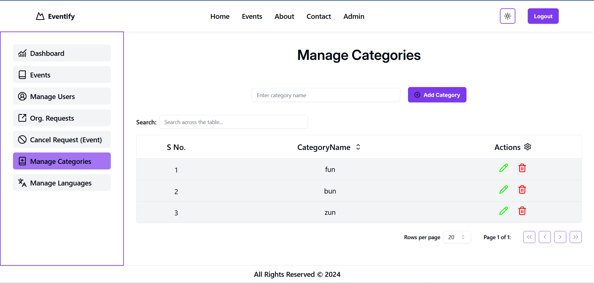

Slide 37
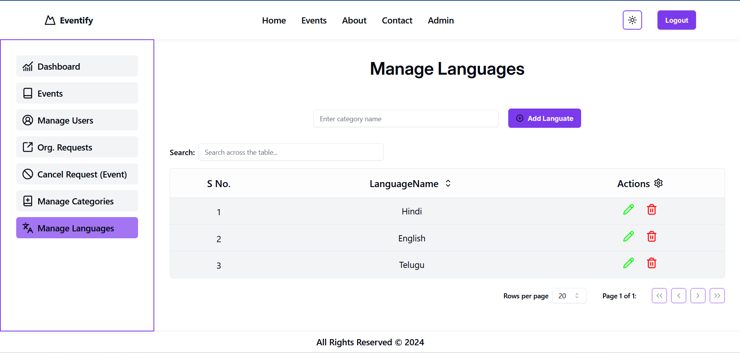

Slide 38
Organiser Side

Slide 39
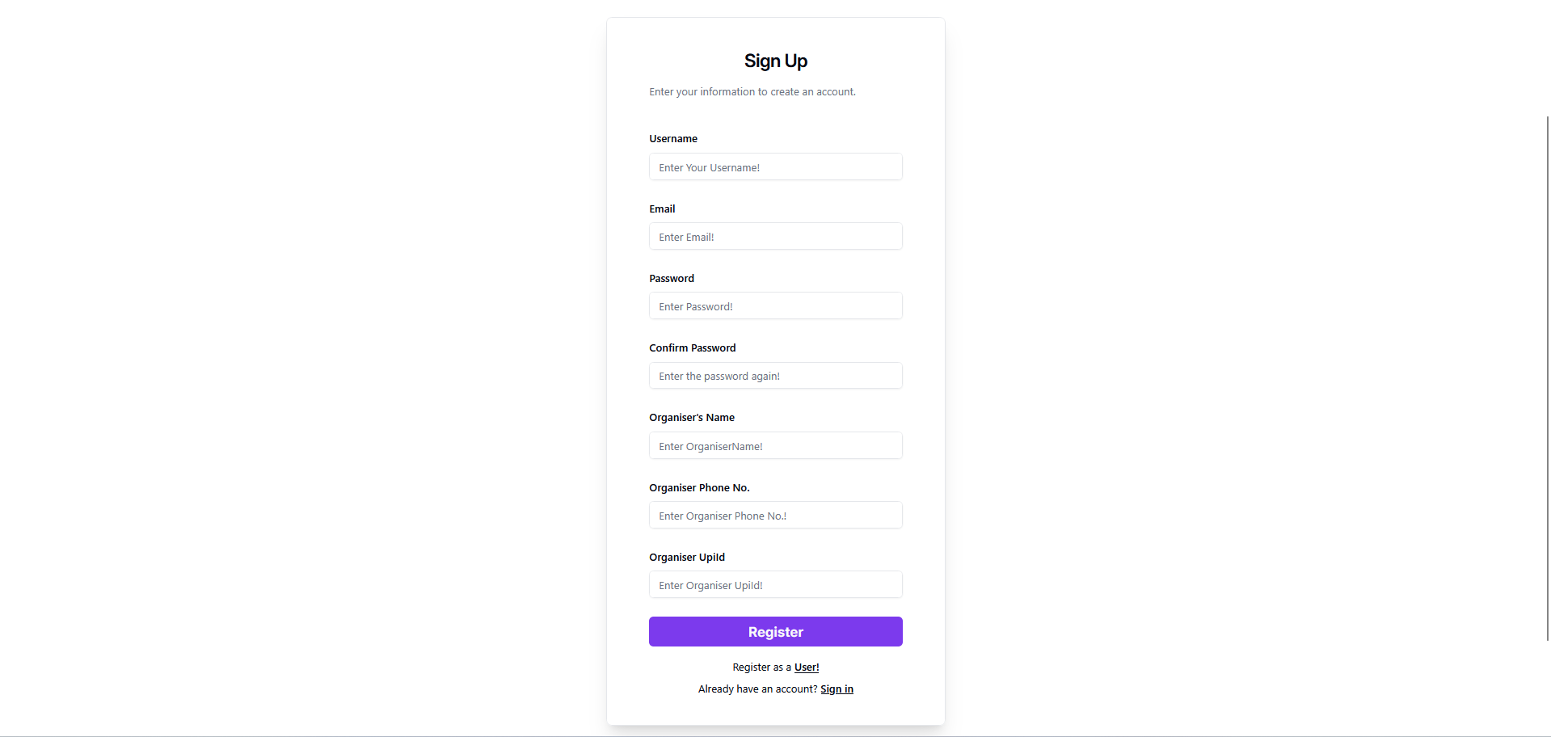

Slide 41
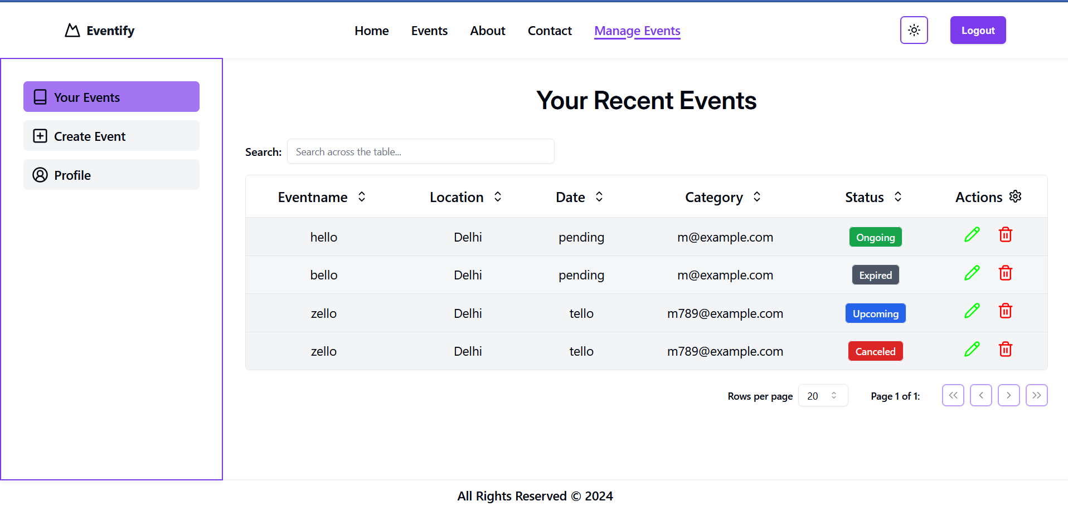

Slide 42
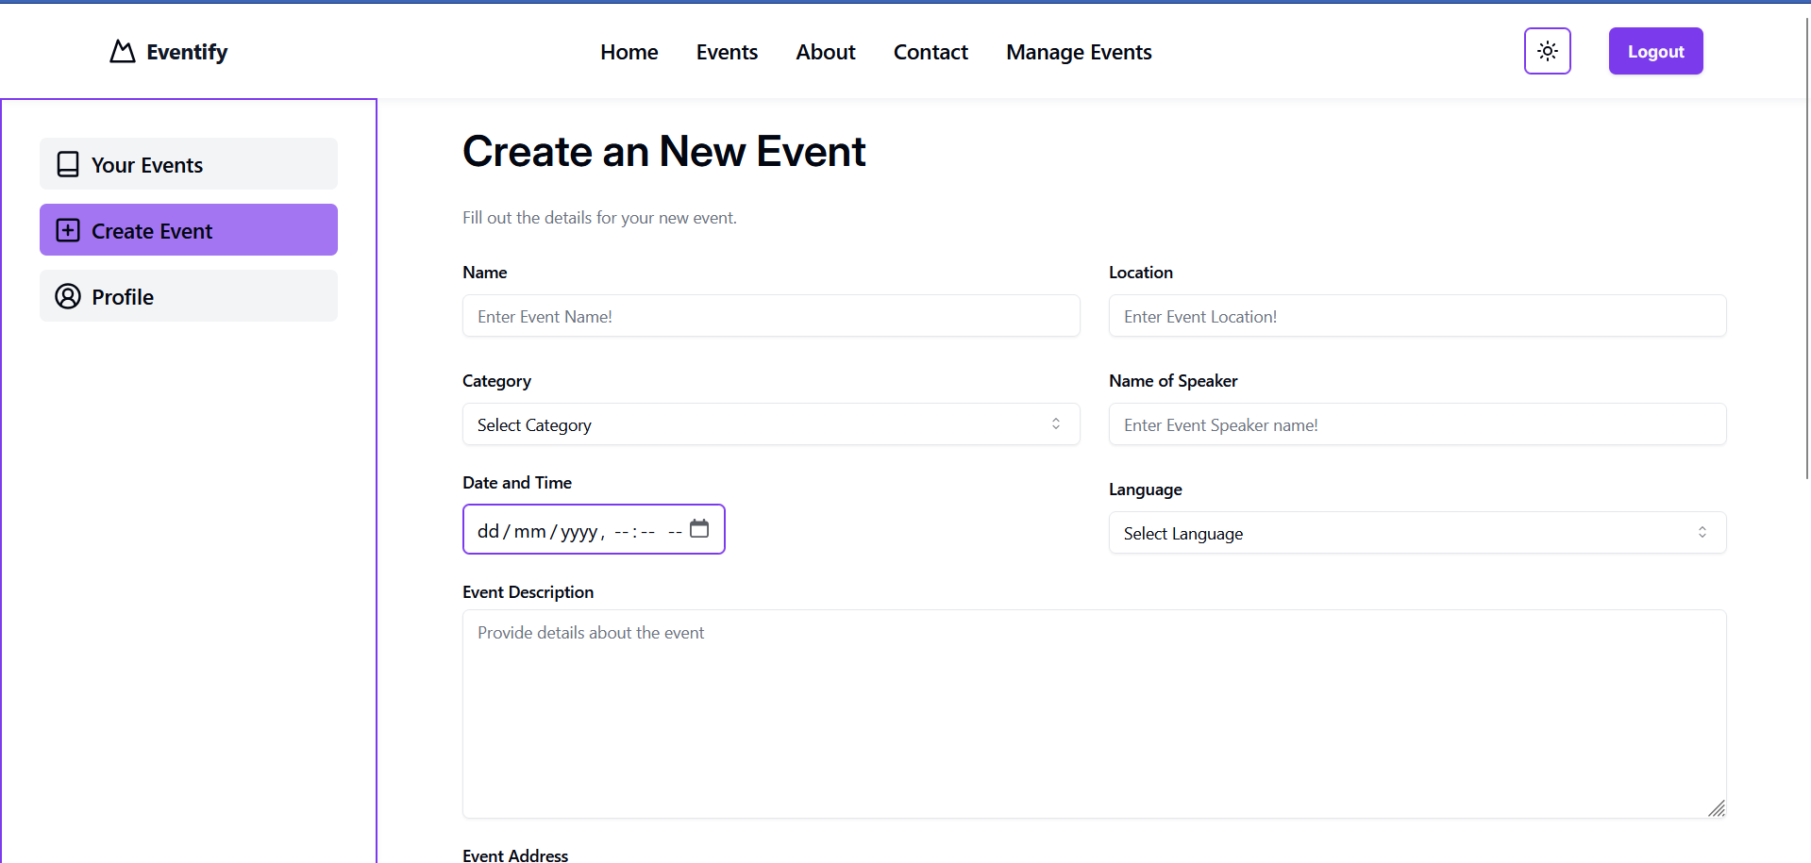

Slide 43
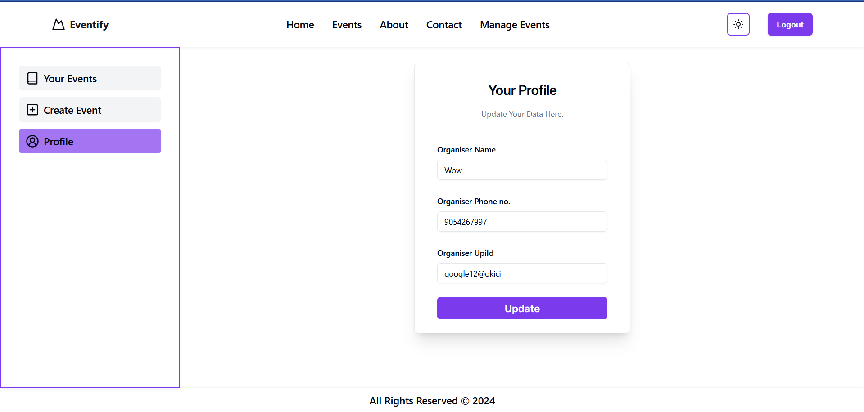

Slide 44
conclusion :-
The event management system, developed using modern web technologies including React.js, Mongodb, and Express.js, successfully meets the core objectives for which it was designed. The system provides a user-friendly platform for event organizers to create and manage events, while allowing users to easily browse event details and register for both paid and free events. The admin panel offers robust control over users, organizers, categories, and languages, ensuring smooth and efficient management of all aspects of the system. This solution streamlines the event management process, making it both efficient and easy to use.

Slide 45
Thank You...!!

