Slide 1
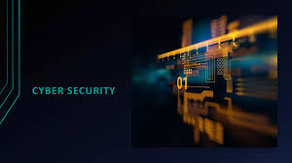
By: Fazal Abbas

Slide 2
Introduction
Since the 1970s, the use of computers has expanded rapidly, becoming integral to both business operations and everyday life.
While incredibly useful, computers are vulnerable to a variety of security risks.
Pioneers like IBM and other early tech companies began offering security software solutions as early as the 1970s.
As technology and digital platforms have evolved, so too have the nature and complexity of these threats.
To combat these growing dangers, the field of Cyber Security has emerged, focusing on protecting digital information and systems.

Slide 3
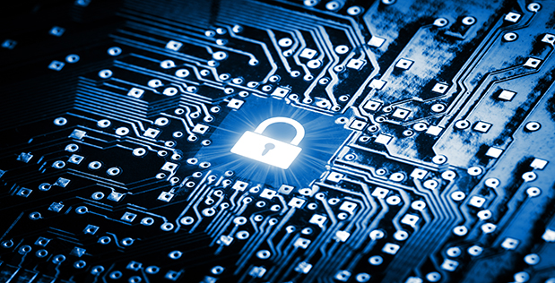
• This concept encompasses a defense mechanism designed to safeguard computers and networks against theft, • This concept encompasses a defense mechanism designed to safeguard computers and networks against theft, damage, interruptions, unauthorized modifications, or the exposure of sensitive data originating from electronic files, software applications, or hardware components.
• While the basic idea appears straightforward, the reality is far more complex due to the proliferation of advanced technologies such as smartphones, websites, smart TVs, and the Internet of Things (IoT), all of which demand a sophisticated and multi-layered cybersecurity framework. damage, interruptions, unauthorized modifications, or the exposure of sensitive data originating from electronic files, software applications, or hardware components. • While the basic idea appears straightforward, the reality is far more complex due to the proliferation of advanced technologies such as smartphones, websites, smart TVs, and the Internet of Things (IoT), all of which demand a sophisticated and multi-layered cybersecurity framework.

Slide 4
Core Components of Cyber Security
Cyber security encompasses various protection types, tailored to different functions and platforms:
Data Protection:
Every network, device, and software system contains valuable data from owners, clients, or third parties. Data protection ensures this information remains secure by restricting access exclusively to authorized users, thereby preventing unauthorized data breaches.
Application Security:
Security measures should be integrated from the initial design phase of any software. Regular updates are essential to incorporate new defenses, enabling early detection and mitigation of emerging threats.
Mobile Security:
Mobile devices such as smartphones and tablets face risks from both physical connections like USB devices and wireless channels including Bluetooth and internet access. Protecting these endpoints is critical to maintaining overall security.
Network Security:
Networks connect multiple users, increasing vulnerability to intrusions and cyberattacks. Effective security involves not only technical safeguards but also vigilant administration and monitoring by network hosts or administrators.

Slide 5
Endpoint Security: The primary vulnerabilities lie with users and their devices, which are common targets for threats like malware. While antivirus programs offer protection, the most effective defense is educating users to be cautious—such as avoiding unknown USB devices and not clicking on suspicious links.
Cloud Security: Cloud storage allows users to save and access data online. Although cloud providers implement their own cybersecurity measures, users must also exercise vigilance in managing their accounts to prevent data breaches caused by careless handling.
Database and Infrastructure Security: Security measures must protect not only software but also physical hardware, as both can be compromised or stolen. A comprehensive approach includes safeguarding digital assets and physical equipment.
Business Continuity and Disaster Recovery: Unexpected events can lead to data loss. Organizations should establish systems to back up data and recover lost information. Additionally, creating a Business Continuity Plan ensures operations can continue even when some resources or data are unavailable.

Slide 6
Why is Cybersecurity Crucial?
Cyber threats pose significant risks, potentially damaging data, hardware, software, and an organization's reputation. Beyond these, issues like data misuse and leaks are common dangers. It's vital to safeguard all forms of sensitive information, including intellectual property, non-public personal data (NPI), and confidential corporate details.
Cybercriminals continuously devise sophisticated methods to access sensitive data, making basic defenses like antivirus software insufficient. Consequently, many governments have enacted cybersecurity regulations to combat these threats. A notable example is the European Union's General Data Protection Regulation (GDPR). Numerous other nations are also establishing legal frameworks to address cyber risks.
Unfortunately, data breaches sometimes originate from within government agencies themselves. Therefore, individuals and stakeholders must exercise caution in handling data. Institutions, in particular, need to implement robust cybersecurity systems designed to prevent both accidental and intentional data leaks.

Slide 7
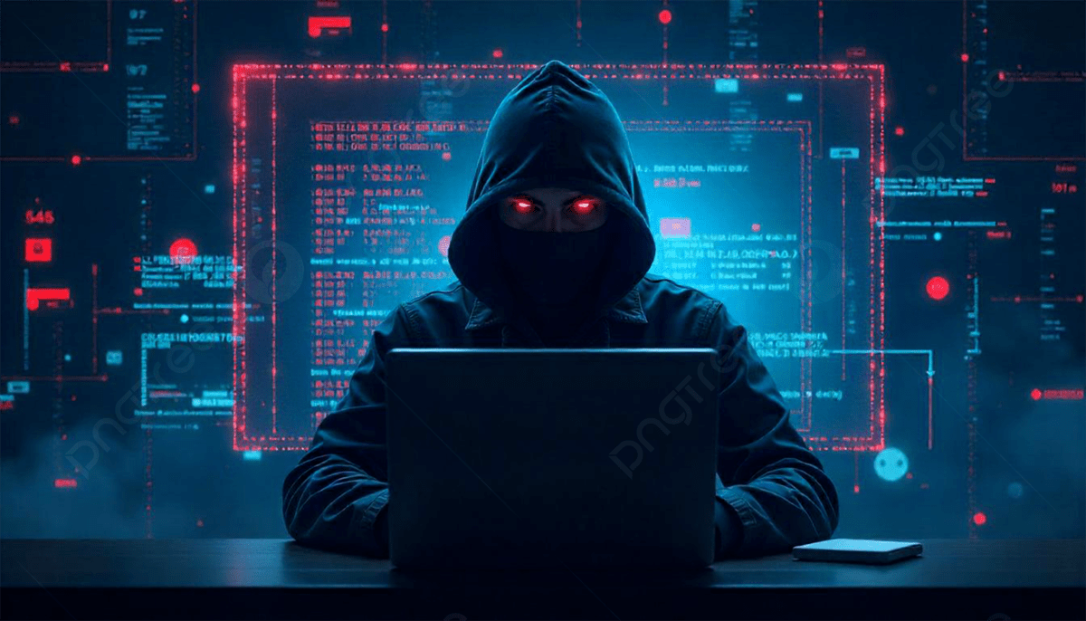
CYBER THREATS
Cyber threats fall into three main categories: cybercrime, cyber-attacks, and cyber-terrorism.
Cybercrime involves individuals or groups orchestrating illegal activities primarily for financial gain or to cause disruption.
Cyber-attacks are typically motivated by political agendas.
Cyber-terrorism consists of large-scale operations designed to instill fear and panic.
To carry out these threats, cybercriminals employ various techniques.
Examples of these methods will be detailed on the following slide.

Slide 8
Techniques Used in Cyber Attacks
Phishing: This is the most common cyber threat, involving deceptive messages that lure victims into clicking links leading to counterfeit websites or forms designed to steal sensitive personal data.
Malware: Short for Malicious Software, malware is a tool hackers use to infiltrate and control a victim’s device without permission.
SQL Injection: Named after Structured Query Language, this attack involves inserting malicious code into input fields to exploit vulnerabilities in database security.
Backdoor Access: As the term suggests, this method bypasses standard authentication processes, allowing unauthorized entry into software. These backdoors can be intentionally placed by developers or malicious actors and are notoriously difficult to detect.
Denial-of-Service (DoS) Attack: This tactic overwhelms a system by flooding it with excessive requests or incorrect login attempts, rendering the service unavailable. A related example includes networks of compromised "zombie" computers used to amplify the attack.
Direct-Access Attack: Unlike DoS attacks, this approach involves installing tools like keyloggers, worms, or hidden microphones to alter the operating system and gain direct control over the device.
Spoofing: This involves impersonation through falsified data, such as fake biometric identifiers, forged IP addresses, or counterfeit emails, to deceive systems or users.

Slide 9
Strategies for Strengthening Your Cybersecurity
Once you're familiar with the range of potential cyber threats, it's crucial to fortify your defenses. Here are some practical steps to enhance your cybersecurity framework: Be vigilant against suspicious emails, messages, or links from unknown sources, especially those requesting personal information.
Change your passwords and PINs regularly, opting for complex and unique combinations to prevent unauthorized access.
Avoid connecting to public or unsecured Wi-Fi networks, as these can expose your devices to cyber intrusions.
Maintain a reliable and secure backup of your important data.
Implement advanced cybersecurity tools such as Identity and Access Management (IAM), Security Information and Event Management (SIEM), and comprehensive data protection platforms.
Train your team and conduct regular checks to reduce risks from internal threats.
Consider adopting Third-Party Risk Management (TPRM) to oversee external vendor security.
Employ skilled IT professionals who can identify vulnerabilities and defend against hacking attempts.

Slide 10
Thank you

