Slide 1
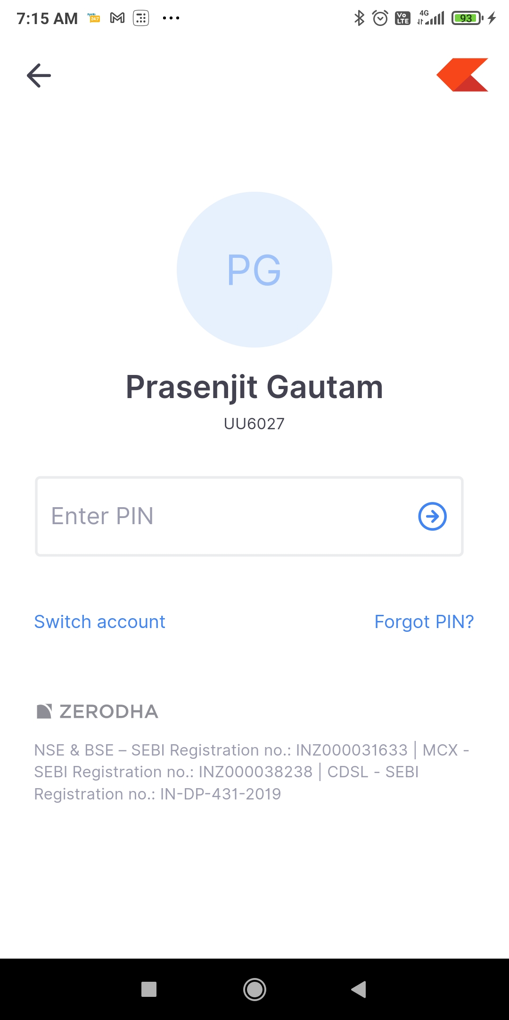


Login Screen
Application Name Application Logo
Image
UserID / Mobile Number
Like Zerodha App
Password/ PIN
New User
Forget Password

Slide 2
New User Registration Screen
Full Name
Mobile Number /Email Address
Address / Location
User ID
Password / PIN
Confirm Password / PIN
Save / confirm Details

Slide 3
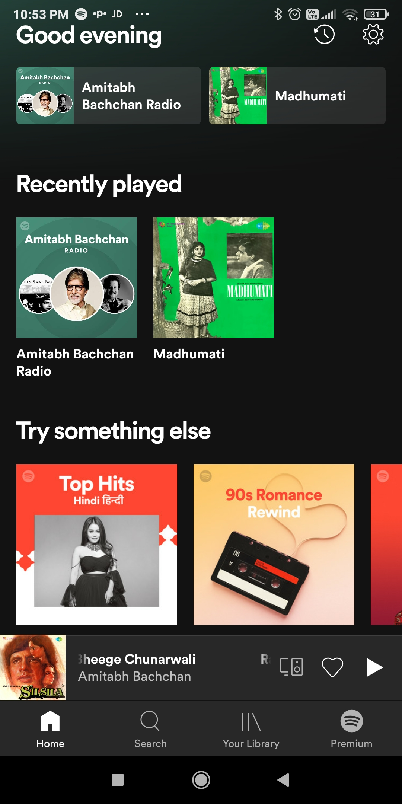





Home Screen
Good Evening
Recent View
View Vendor Promotion
Iron man
Milk Man
S C R O L L
Home Services
S
C
R
O
L
L
Maid
Iron man
Milk Man
Add New
Group
Like Spotify app
S C R O L L
Slide for Second Screen Tab / Vendor Screen
Office Services
Directors
Manager
Team
Add New
Group
S C R O L L
Outdoor Services
Car
Services
Carpenter
Parlor
Add New
Group
S C R O L L
Themes / Display Layout

Slide 4
Pop Up Add contact Screen
Details Edit / Deletion/ Modification
Add
Image
Name
Mobile No
Alternate Mobile
Address
Reference from
Select Category
Group Name
Profile
Select in dropdown list “User” / “Vendor”
Save Details
Note:- Without Category and group name can not save / add details

Slide 5

Recent View
View
Good Evening
Good Evening
Promotions
Promotions/ Category / Contacts View
S C R O L L
S
C
R
O
L
L
S
C
R
O
L
L
Categories
Directors
Manager
Milk Man
S C R O L L
Contacts
ABC
XYZ
DFG
URS
S C R O L L

Slide 6






Second Screen
SEARCH
Details Edit / Deletion/ Modification
Group Name
Group Message
Contact person Name 1
6,538
Contact person Name 2
6,538
Contact person Name 3
6,538
Contact person Name 4
6,538
Calling
Contact person Name 5
6,538
Message
Contact person Name 6
6,538
Share
Contact person Name 7
6,538
Scheduler
Contact person Name 8
WhatsApp
6,538
Exit

Slide 7
Vendor Home Screen
Create Promotions
Good Evening
Good Evening
View Request / Requisition
Add Promotions
Send Promotion
Iron man
Milk Man
Directors
Car
Services
Add text
S C R O L L
Add Promotions
S
C
R
O
L
L
Upload Image
S
C
R
O
L
L
Add
Saved Promotions
50% Off
Buy 1 Get
2
Directors
Car
Services
Add text
Save Details

Slide 8
Send Current / Saved Promotions
Good Evening
Drop down list of contact
Select
S
C
R
O
L
L
Send

