Slide 1

Smarter Bicycle Mobility in Genoa
IOT Project Simulation
Default Project
Presented by: [Fazeel Ahmed]

Slide 2


Agenda
Introduction
What I did in the project
Technical Requirements
Technology I used in the project to simulate the IOT project
The Hot Path Data and Flow
Live Monitoring of Bicycle Data using MQTT protocol
The Cold Path Data and Flow
Save and processing on Historical Data
Conclusion
Real Time Data monitoring and Data Analysis on it
Smarter Bicycle Mobility in Genoa| 2

Slide 3
Introduction
Simulation of Smart Bicycle Mobility Data
3 Smart Bicycles
Bike 1
Bike 2
Bike 3
GPS position (Latitude & Longitude)
Speed
Battery level
Acceleration (X, Y, Z)
Altitude
Parking status
Lock status
GNSS quality and satellite information
Device health and connectivity
Simulation of real-time bicycle sensor data including:
Real-time data transmission via an MQTT broker
Processing through Hot Path and Cold Path pipelines using Node-RED
Live monitoring on an interactive dashboard with map visualization
Historical data storage in CSV files for mobility analysis and reporting
Smarter Bicycle Mobility in Genoa| 3

Slide 4
Technical Requirements
Node-RED: An open-source flow-based development tool for visual programming.
Node-RED Dashboard: A set of nodes for creating dashboards in Node-RED
JavaScript: The programming language used for implementation
MQTT: A lightweight messaging protocol for streaming the sensor data
Node.js: A JavaScript runtime for simulating the sensor data
Smarter Bicycle Mobility in Genoa| 4

Slide 5
Hot Path Data
Receives real-time sensor data from the MQTT Broker.
Displays live bicycle data on the Node-RED Dashboard.
Monitors speed, GPS location, battery, acceleration, parking status, and device health.
Shows live bicycle locations on an interactive map. Calculates distance travelled, trip count, and parking duration.
Detects real-time events such as:
  Low battery
  Dangerous speed
  Harsh acceleration/braking
  Parking violations
  Unauthorized movement
  Connectivity and device health issues
Supports monitoring of individual bicycles or the entire fleet.
Smarter Bicycle Mobility in Genoa| 5

Slide 6
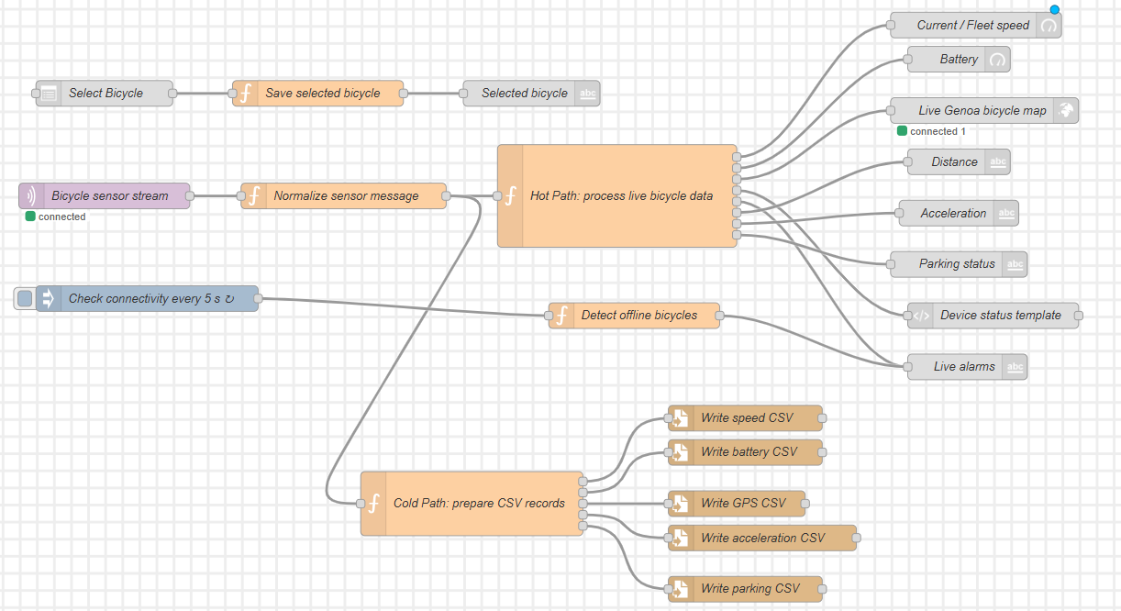
The Hot Path Flow (Live Monitoring Data)
Smarter Bicycle Mobility in Genoa| 6

Slide 7
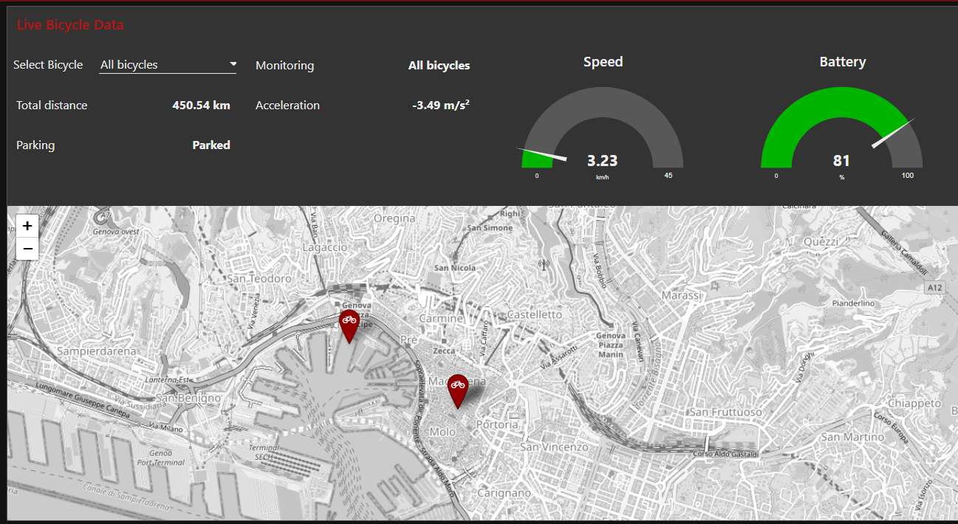
The Hot Path Flow (Live Monitoring Data)
Smarter Bicycle Mobility in Genoa| 7

Slide 8
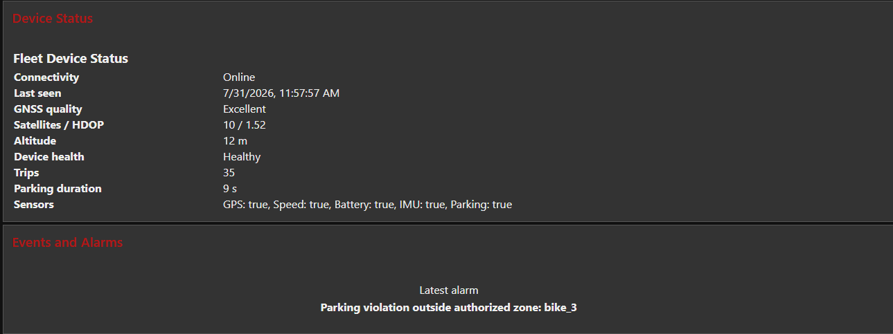
The Hot Path Flow (Live Monitoring Data)
Smarter Bicycle Mobility in Genoa| 8

Slide 9
Cold Path Data-Processing
Stores non-time-sensitive sensor data for historical analysis
Writes incoming sensor data into separate CSV files (Speed, Battery, GPS, Acceleration, and Parking)
Processes stored data to generate mobility insights and statistics
Supports long-term analysis of bicycle performance and usage
Displays historical data and analytics on the Node-RED Dashboard.
Smarter Bicycle Mobility in Genoa| 9

Slide 10
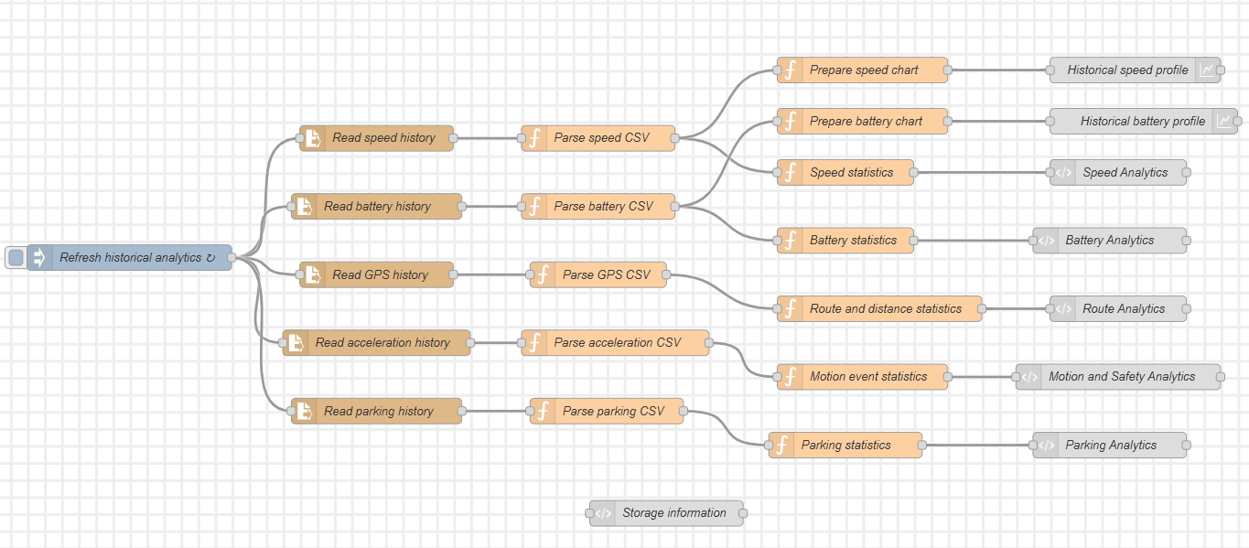
The Cold Path Flow (Computation on Historical Data)
Smarter Bicycle Mobility in Genoa| 10

Slide 11
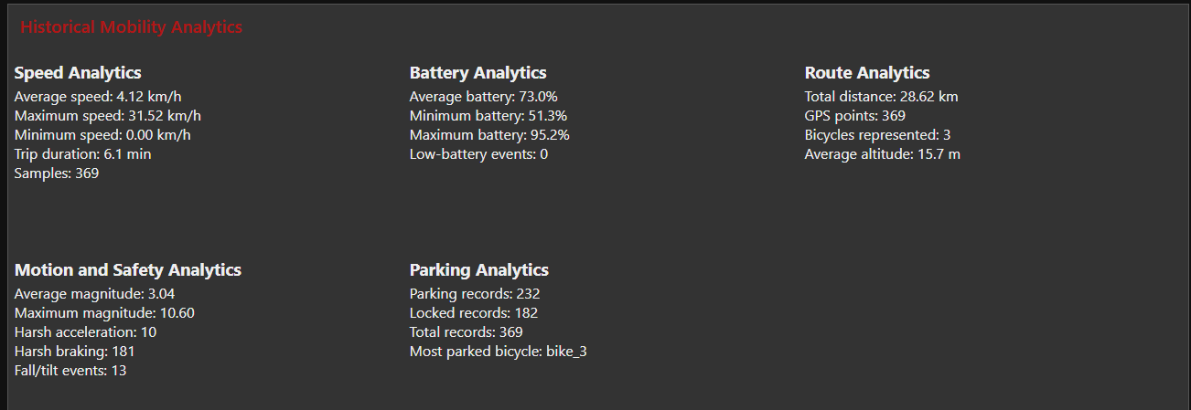
The Cold Path Flow (Computation on Historical Data)
Smarter Bicycle Mobility in Genoa| 11

Slide 12
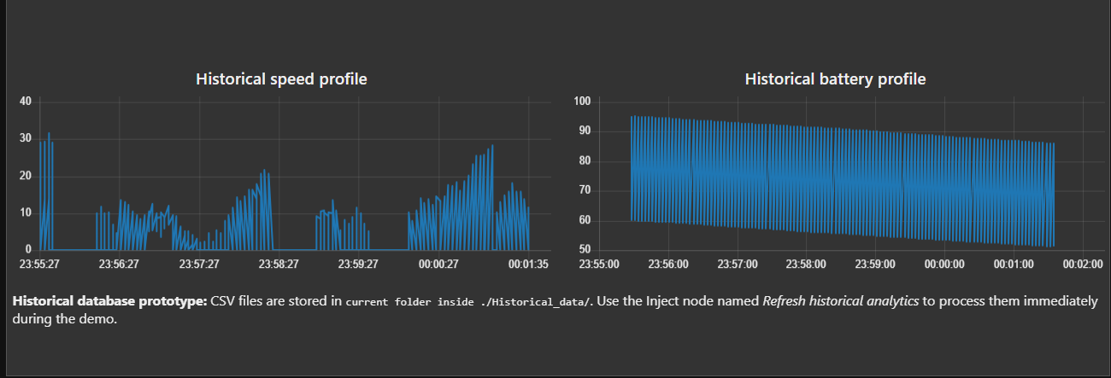
The Cold Path Flow (Computation on Historical Data)
Smarter Bicycle Mobility in Genoa| 12

Slide 13

Conclusion
Key Takeaways
Successfully developed a real-time Smart Bicycle Mobility Monitoring System using Node-RED, MQTT, and Node.js.
Implemented both Hot Path and Cold Path for real-time monitoring and historical data analysis.
Successfully visualized live bicycle data, interactive maps, and event alerts on the Node-RED Dashboard.
Gained practical experience in IoT data simulation, stream processing, and event-driven system development.
Thank you - Questions?

