Slide 1
4th Year Research Project
Proposal Presentation
ID: 15-019

Slide 2
Team Of Researches
IT12045204 K. D. A. D. Wickramaratne
IT12038374 K. D. A. I. Koonkaduwa
IT12063024 G. R. I. De Silva
IT12054114 K.A.T.D. Wijewardana

Slide 3
Analysis & Development of Dynamic TLPs
in the use of
Smart Mobile Device Communication

Slide 4
Background
We find it’s very important to focus on transport layer protocols which possess reliable, high speed and efficient data transfer methods which are vital factors in real time path navigation systems which requires information within a short time duration to discover paths, avoid hazardous encounters providing alternatives.
A solution has been discussed to introduce a new transport layer protocol (dynamic)to upgrade path finding navigation from the generic protocols.

Slide 5

Research Problem
Current applications that are being used in path finding applications, we find the reliability and efficiency is not up to the standard as they are using TCP having a higher head count, Transferring an urgent data using TCP is not the ideal solution as it takes a longer time to deliver.
Since TCP is widely used across many applications which has a reliable header taking a considerable amount of time, also we cannot determine urgent data with non urgent data when transmitted from the application layer. Use of a Dynamic transport layer protocol is more logical given the above scenario.

Slide 6
Current Systems
TCP
SCTP
UDP

Slide 7
Uniqueness
Normally there's no effect at the transport layer TCP with data comes through the Application layer. Our research is to analyze the data comes through application layer and introduce a DTL instead of the defined protocols to support the nature of data to its purpose.
Urgent Data : Small Header
Non Urgent Data : Big Header

Slide 8

Solution
To design an enhanced dynamic transport layer protocol which adapts itself according to the data that’s being transmitted across a network. For an example if there’s any urgent data that needs to be transmitted immediately, a different approach will be used rather than using the conventional transport layer protocol, TCP, which is proven to be inefficient in such situations.

Slide 9
Sub Objectives
Analysis & classification of application layer data in order to determine which method/functionality to be used in transmitting those data.
Examining the currently available transport layer protocols & analyzing their behavior to identify their drawbacks.
Handover method analysis to significantly improve the connection establishment process & to reduce the no of times a particular client has to establish a connection.
Analyzing the modifications that can be applied to the currently available protocols.

Slide 10
System Diagram

Slide 11



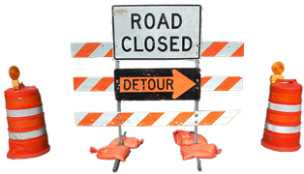


Slide 12
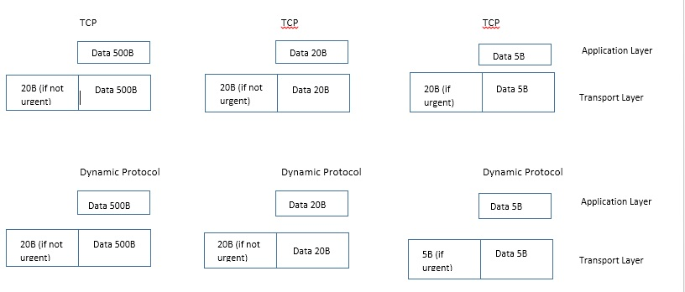

Slide 13
Methodology
Design and develop a Dynamic Transport Layer (DTL) protocol which is ideal for transporting the data with,
Urgent flags
Congestion control in the use of Smart Mobile communication

Slide 14
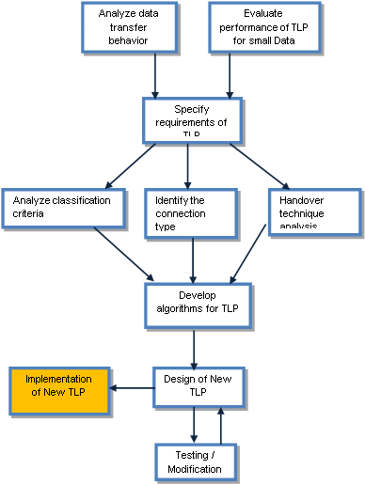
Methods and Procedures use in the System

Slide 15
Logical Framework Summary
AIM:
Design and develop a new Dynamic transport layer protocol for communication in wireless environment in an effective, efficient and reliable manner.
WHY:
Reduce congestion problem.
Maintain a stable connection.
Lower latency when transferring urgent data.
OUTCOME:
Design a protocol suitable for a wireless environment which has a faster, efficient and reliable at flagged transmissions than other transport layer protocol.
HOW:
Deep study about existing protocols.
Algorithm design for protocols.
Code for algorithms.
Simulate protocols.
Do a comparison between the expected dynamic protocols against existing protocols

Slide 16
Budget and Budget Justification
Item | Price (Rs.) | Justification
Routers | 3000*2 = 6000 | Analyses the bounce back speed
Item | Price (Rs.) | Justification
Wireshark | FREE | to study behaviors of existing protocols
Network Simulator 2 (NS2) | FREE | Simulate how new protocol performs.
C language editor/terminal | FREE | Edit suggestions, develop
Linux and Windows 7 | FREE | To Authenticate Windows 7 and Linux
Android Software | FREE | To authenticate the smart phone

Slide 17
Hardware & Software Requirements
Software:
Network Simulator II
Wireshark Software
Network Simulator
C language editor/terminal console and compiler.
Linux and Windows 7 operating systems.
Hardware:
Routers

Slide 18
Users and Benefits
Mostly targets the Way-finding application designed for vision impaired people.
Quick delivery of urgent data
Eg : Obstacle nearby
Provides reliability when required
Can also be used where mission critical systems are involved.
Eg : Remote surgery(telesurgery)

Slide 19
Expected Outcomes
Application of DTL protocol
Delivering a more reliable & efficient solution to the vision impaired people.

Slide 20
References
Dhammika H De Silva, Dr.Ian Murray “An investigation in to Dynamic TLP’s for Smartphone Communication”, in International Conference on Advances in ICT for emerging regions ICTer, 2013, p.194 – 197

Slide 21


