Slide 1
Research Prototype Presentation
Analysis & Development of Dynamic TLPs in the use of Smart Mobile Device Communication
Project ID: 15-019

Slide 2
What we intended to do
To design an enhanced dynamic transport layer protocol which is different to the conventional TLPs

Slide 3






Slide 4
How
Our research is based on the study of TCP protocol and upgrading its current status.

Slide 5
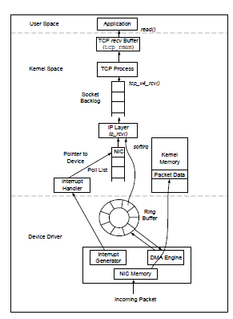
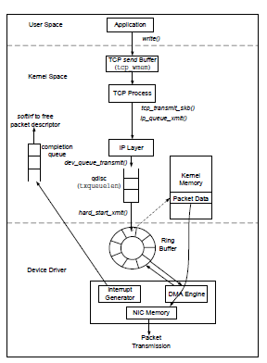
TCP

Slide 6
Drawbacks of TCP opposed to the proposed Dynamic TLP
It cant identify the data type and adjust according to the same.
Identify urgent data and prioritizing
TCP provides reliability by process to process connection establishment, flow control, error control, congestion control and finally connection termination, how ever when it comes to urgent data we would not need the same attention.
TCP is well suited to transferring large amount of data. However for smaller amount of application layer data, TCP can impose considerable overhead leading to significant additional delay effecting data transfer efficiency

Slide 7
Aim
Study of the header of TCP to suite the data coming from the application layer and possibility of advancing it according to the type of data.
Study of the possibility of sending out request via the SYN and receive the data from severs through the ACK via the 3 way handshake without having to wait for the connection establishment
Study of different methods to be invoked in TCP when transferring data according to their type ie.GPS, WiFi.

Slide 8
Tasks that were needed to carry out
Analyse data transfer behaviour
Evaluate performance of TLP for different data types
Specify requirements of TLP
Analyse classification criteria
Identify the connection type
Simulate the protocol algorithms and analyse outputs of each aspect of the protocols via Network Simulator 2 software.

Slide 9
Steps that were taken
Analyzing different data types
Analysis of different protocols in the transport layer
Analyzing the functionalities of NS2 and NS3
Debug the TCP codes using NS2 and NS3 to find out socket API functions and analyzing its behaviour on TCP code
Sending packets between two android devices through the network.
Analyzing the functions of Wireshark

Slide 10
Analyzing different data types
Data | Size | Transmission Frequency | Delivery Reliability | Direction | Network
GPS - Processed | Very Small | High | No | C → S | I
Wi-Fi - Processed | Very Small | High | No | C → S | I
Obstacle - Fixed | Medium | Triggered | Yes | C → S | I
Obstacle – non stationary | Small | Urgent | Yes | C → S C → C | A, I
Map Data | Large | Triggered | Yes | S → C, C → S | I
User Location | Very Small | High | No | C → S C → C | A, I
Sensor data -Processed | Very Small | High | No | C → S | A, I
Instruction | Small | Urgent | Yes | S → C C → C | A, I

Slide 11
Analysis of different protocols in the transport layer
 | TCP | UDP | DCCP | SCTP
Connection Oriented | Yes | No | No | No
Reliable | Yes | No | No | Yes
Congestion Control | Yes | No | Yes | Yes
Ordered/Unordered delivery | Ordered | Unordered | Unordered | Both
Retransmission flow | End to End | End to End | End to End | End to End

Slide 12
Debug the TCP codes using NS2 and NS3 to find out socket API functions and how it is working on TCP code

Slide 13
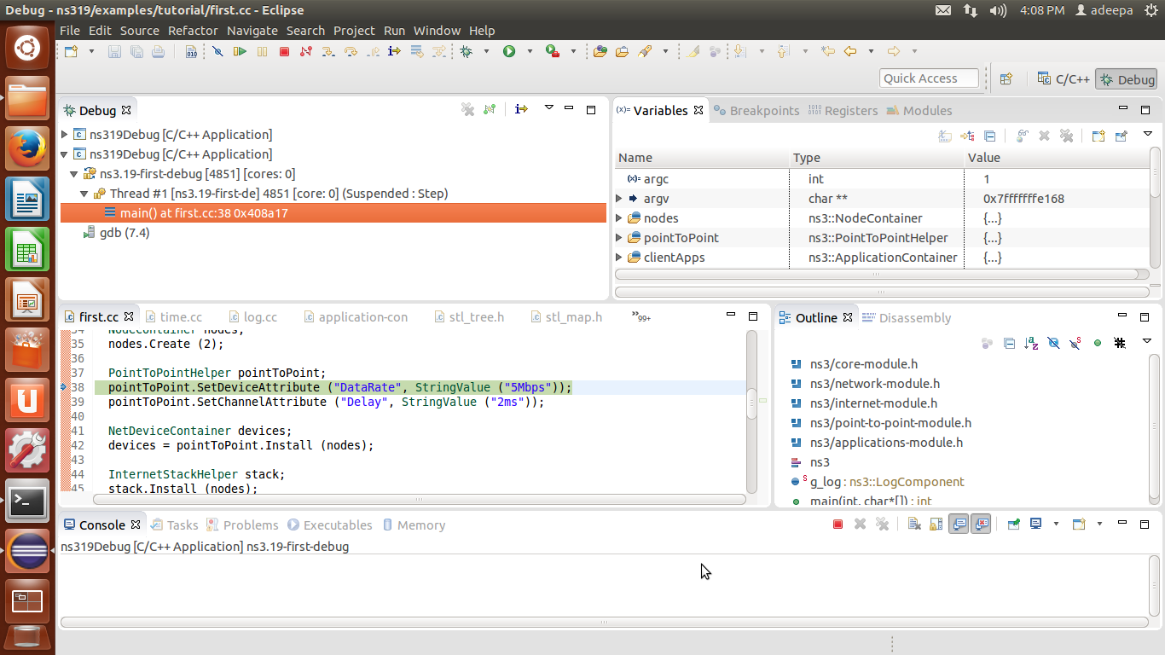
Analyzing the functionalities of sample tcp client server file (debug view of first.cc)

Slide 14
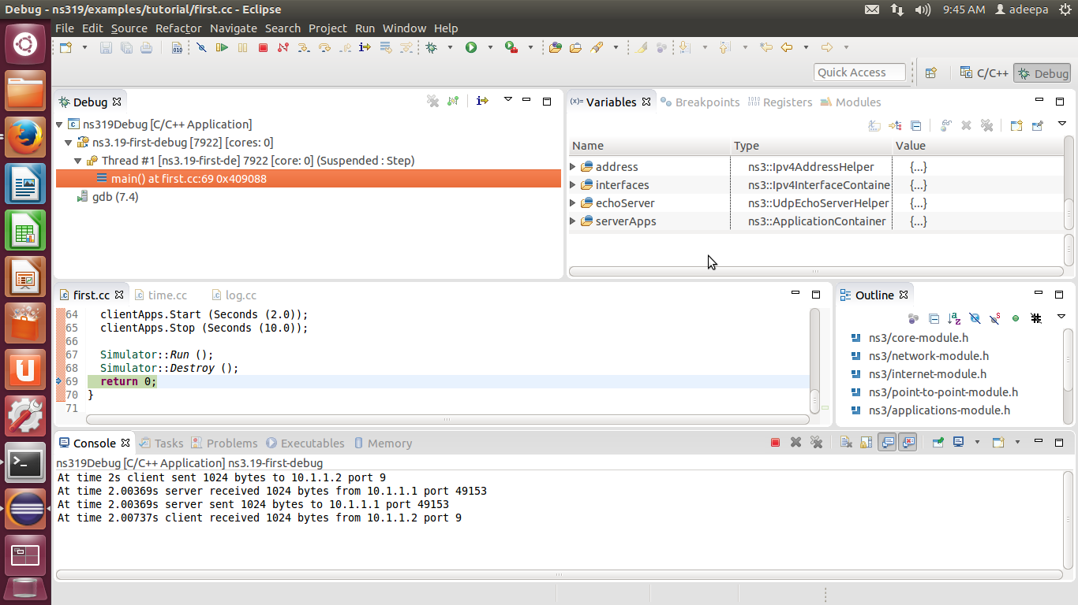
Output of the first.cc

Slide 15
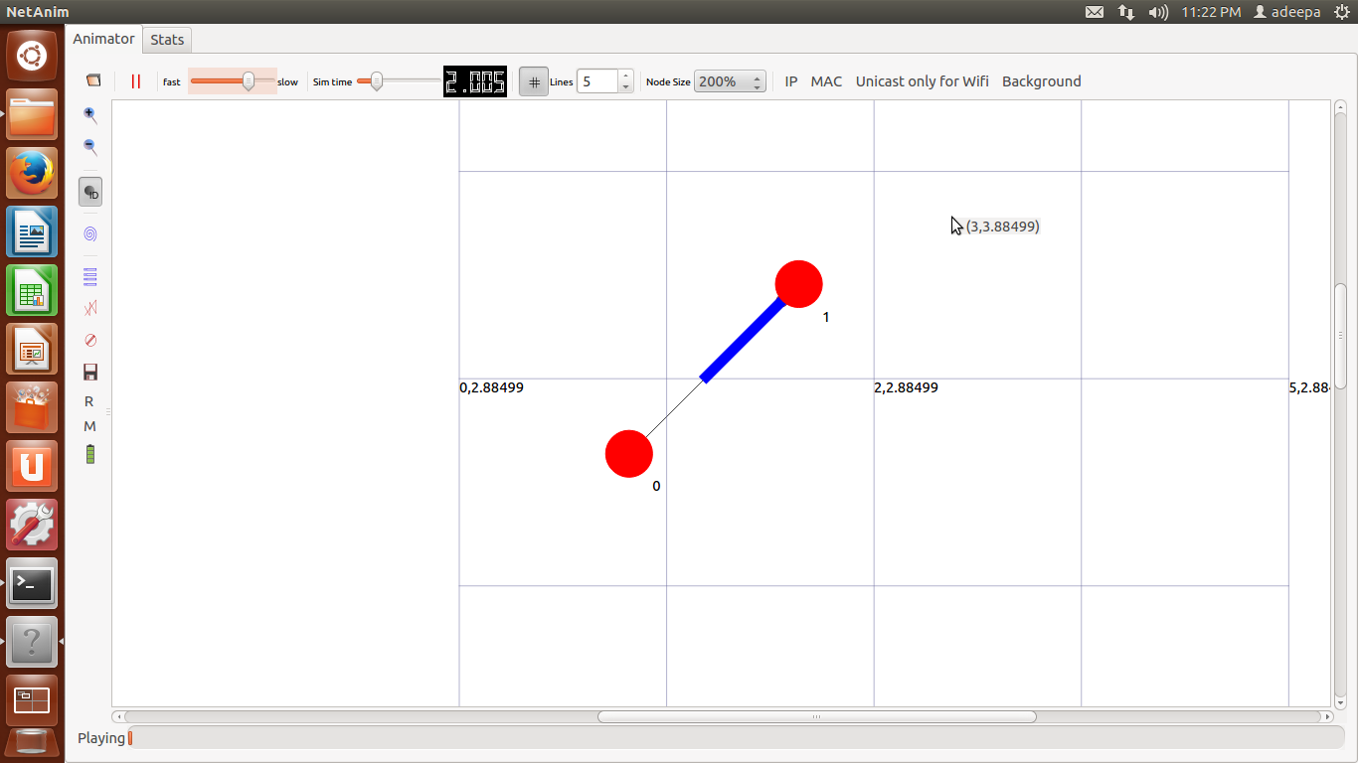
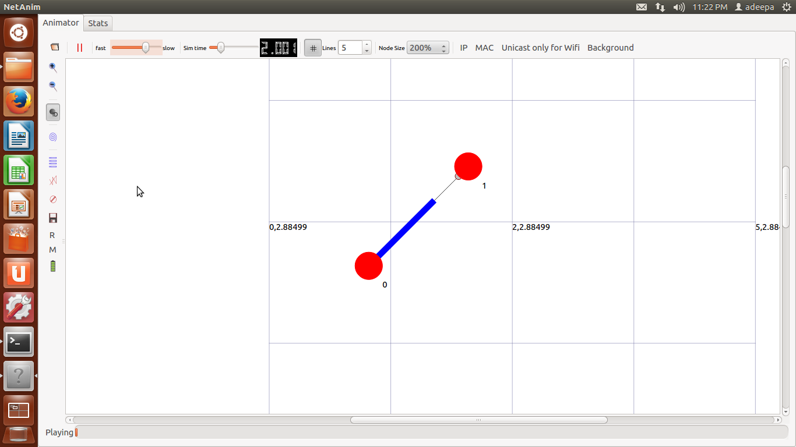
Simulation of the first.cc

Slide 16
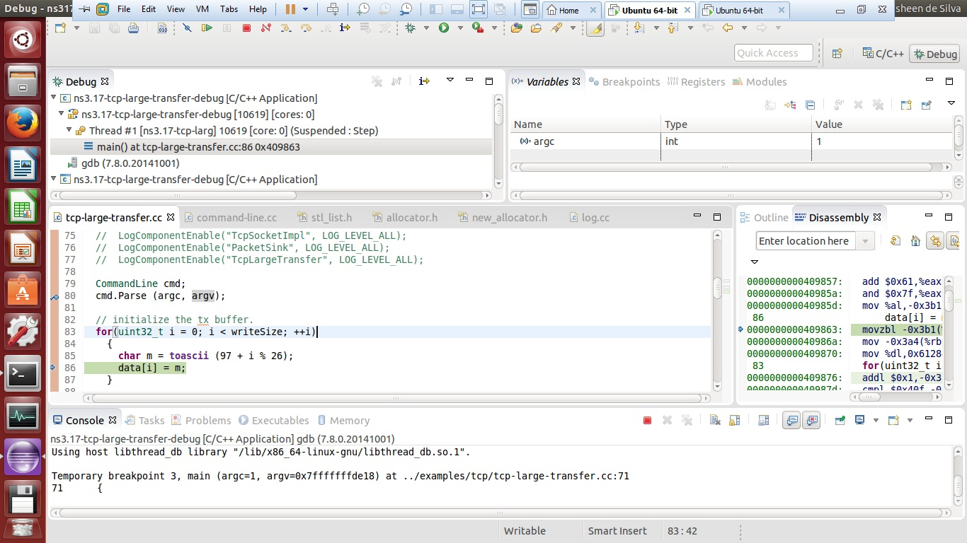
NS3 TCP-large-transfer File Debug : To analyze the Socket API method calls

Slide 17
Sending packets between two android devices through the network
Sending data between two android devices by creating 'ServerSocket' & 'Socket' at the server & client repectively.
But access to socket functions was not found.

Slide 18
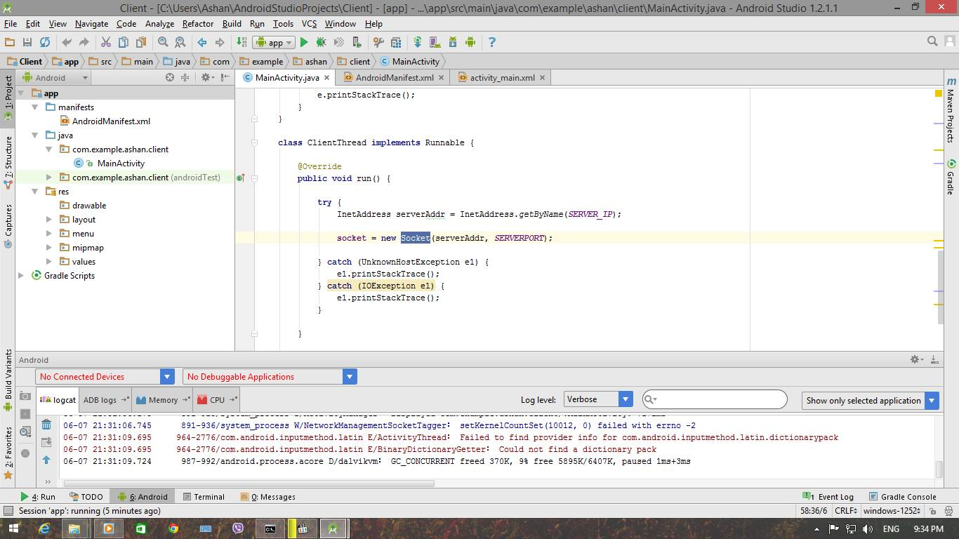
Source Code

Slide 19
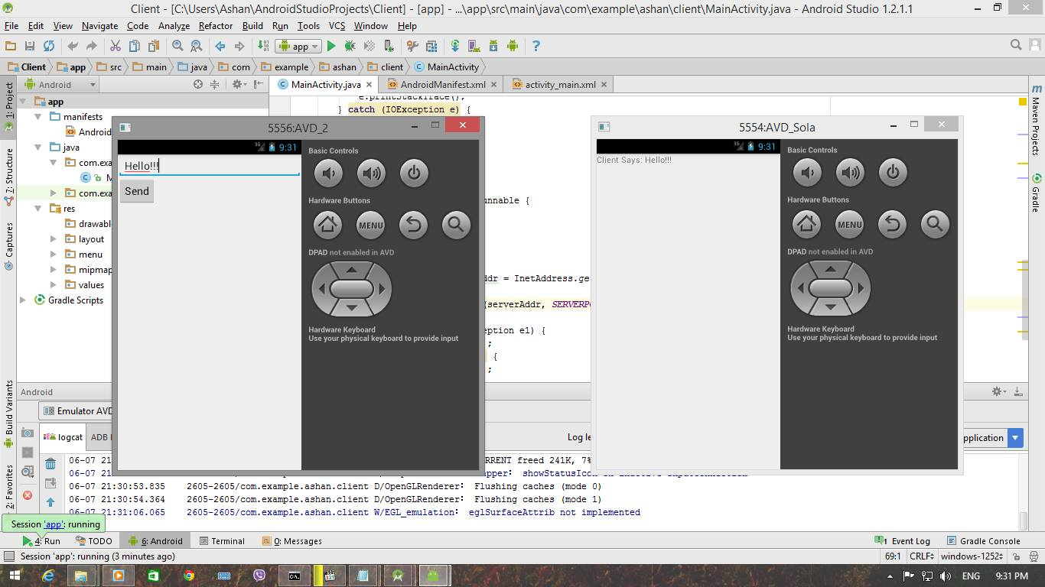
Demonstration

Slide 20
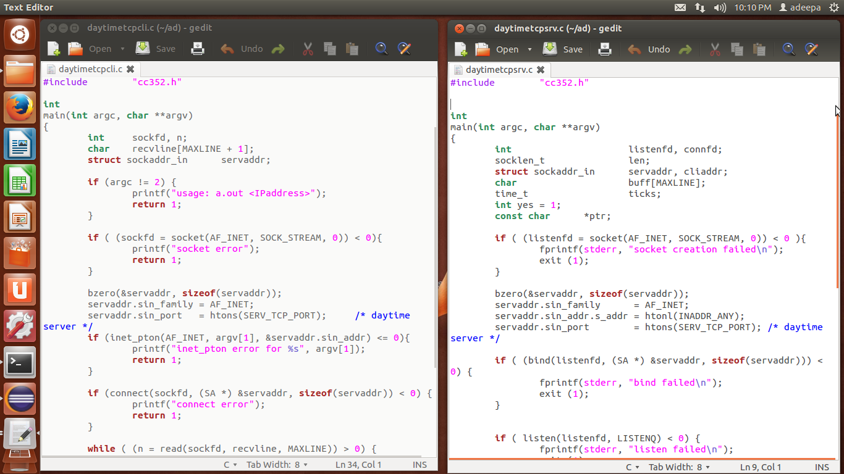
Tcp daytime client server

Slide 21
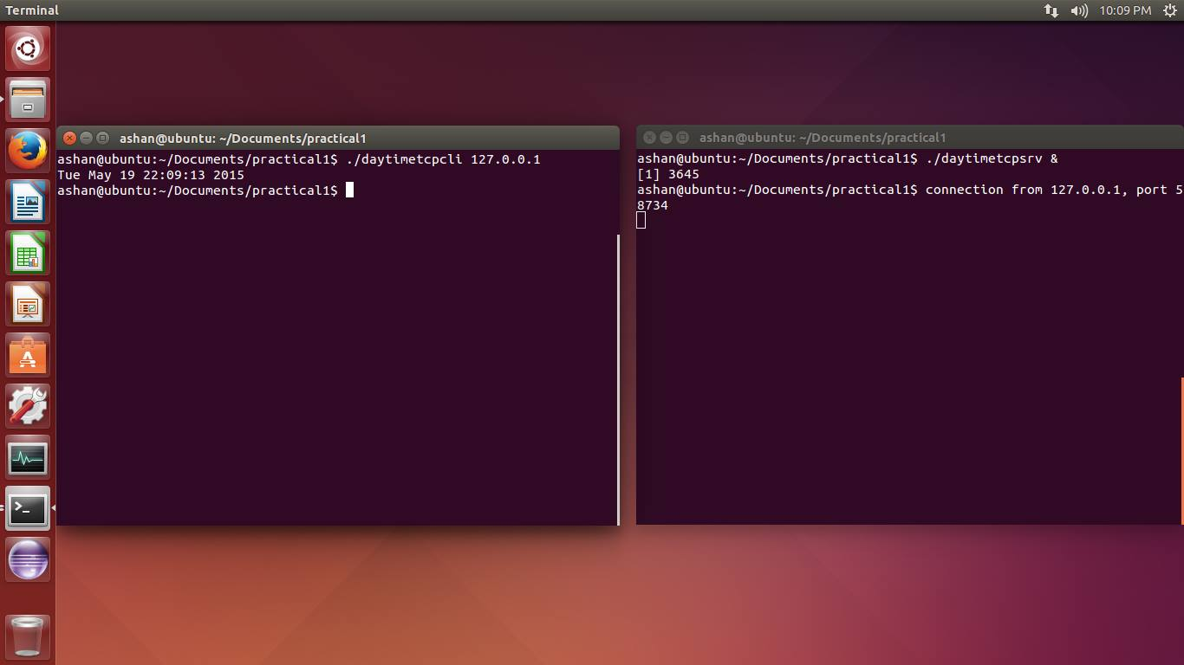
Tcp daytime client server Cont.

Slide 22
Analyzing the functions of Wireshark
Wireshark is software that "understands" the structure (encapsulation) of different networking protocols. It can parse and display the fields, along with their meanings as specified by different networking protocols. Wireshark uses pcap to capture packets, so it can only capture packets on the types of networks that pcap supports.
Data can be captured "from the wire" from a live network connection or read from a file of already-captured packets.
Live data can be read from a number of types of network, including Ethernet, IEEE 802.11, PPP, and loopback.

Slide 23
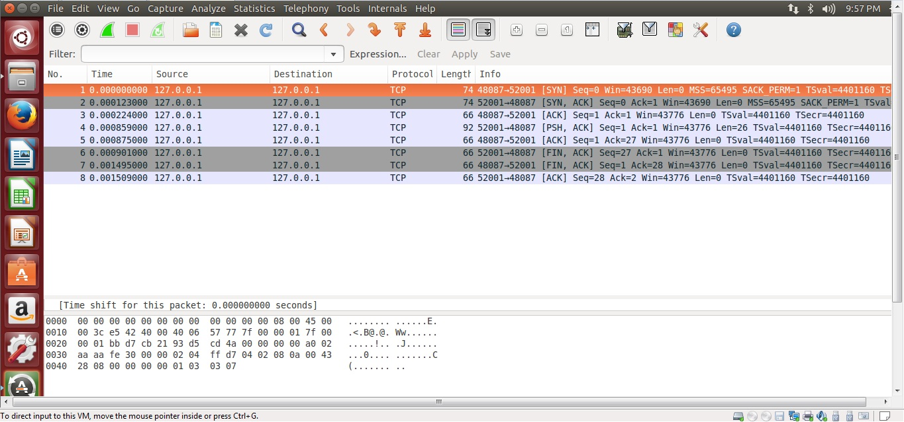
Wireshark : Output of TCP daytime Client and Server

Slide 24
Research constraints
Given the start of the research on fine tuning the TCP to be looked into a dynamic transport layer protocol use of Smart Mobile Device Communication, We came across the following constraints
Accessing the Socket API at the point of debugging via eclipse.
Accessing the kernel and changing to suit for our requirements
We found it impossible to come up with solutions to develop a complete dynamic protocol in OS/ Kernel level at the real world implementation since we don’t have access to those methods.

Slide 25
New Deviation from the proposed final outcome
Since we faced the constraints discussed, we are trying to develop the dynamic transport layer protocol in a simulation environment using NS2 and/or NS3.
Since the scope is bigger than the expected, we shall be using pre-defined data sets to identify the outcome
So far we have been able to find the place where the Socket API calls initiate in NS3.

Slide 26
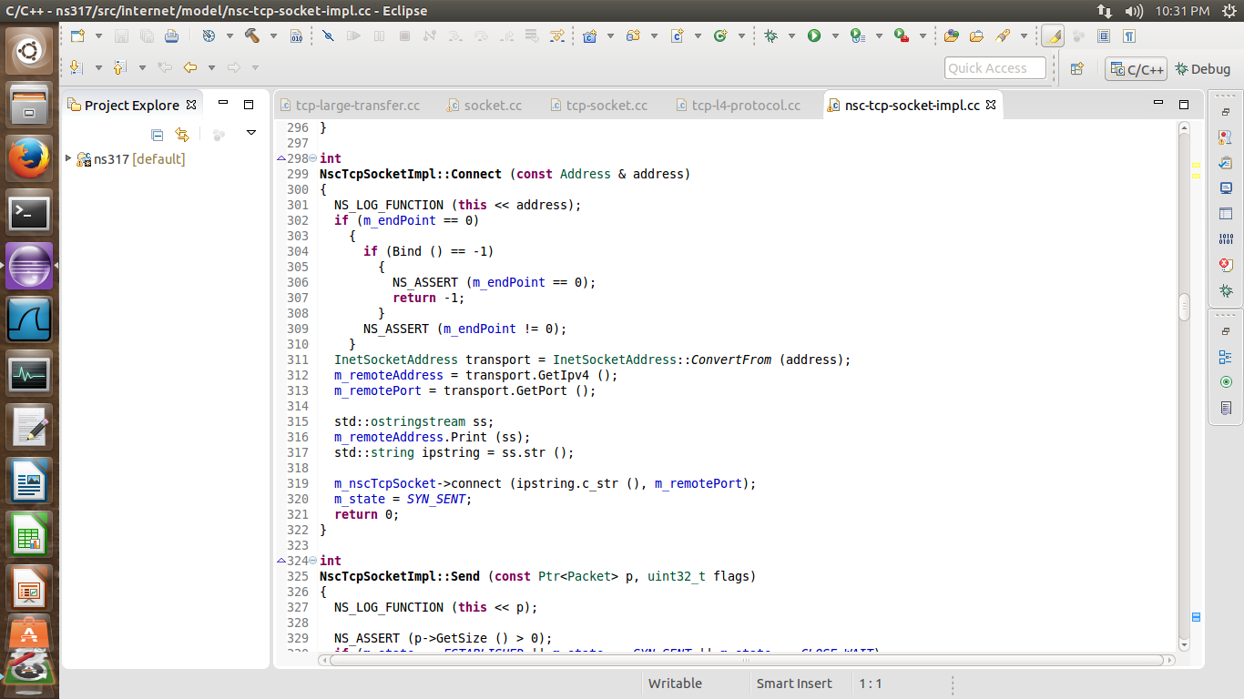
Socket API methods in NS3 project

Slide 27
Specific research areas that will be looked into when analysing the Dynamic TLP
Connection Establishment
TCP Header Size
Single ACK for several sequential requests
Altering method executions of TCP protocol

Slide 28
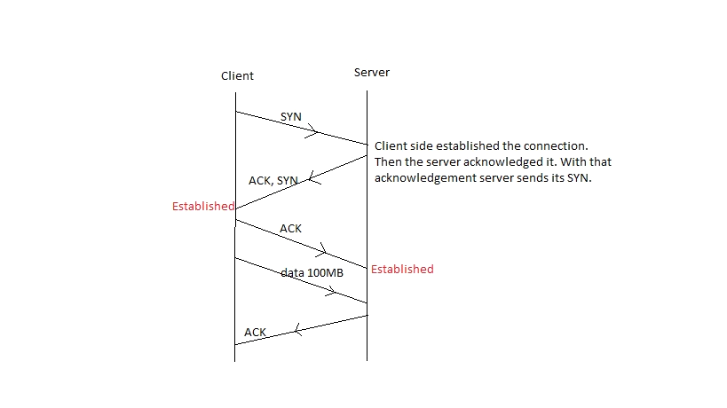
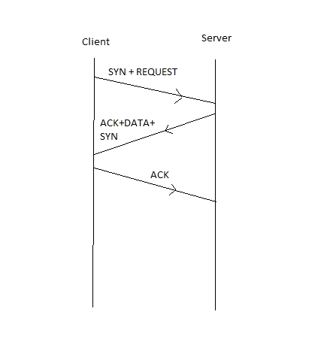
Connection Establishment
Data will be sent along with the connection establishment
Normal Scenario
Proposed Scenario

Slide 29
Additionally following will be considered
How often the modified connection establishes and terminates itself
Time taken to finish the establishment
Analyze data transfer speeds

Slide 30
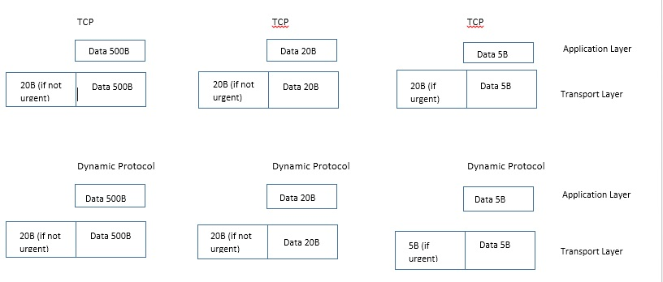
2. TCP Header Size
Header will be adjusted according to the data being transmitted. Ie. Urgent/Non Urgent

Slide 31
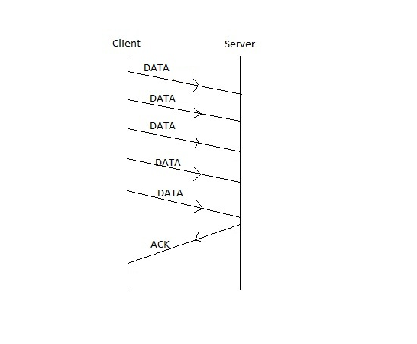
3. Single ACK for several sequential requests
We are looking into the “Batch Acknowledgement” mechanism where a single ACK is generated for several requests.
One ACK for 5 data requests/transfers

Slide 32
4. Altering the order of the execution of Methods in TCP protocol
We have found different methods ie. Traffic, Reliability, Congestion control to improve certain aspects of TCP.
A way has to be identified where we can change the order of these method executions happening in the tcp protocol in order to facilitate the requirements of the DTL protocol
Where avoiding executions of the methods which satisfy the congestion control, reliability, etc. in a situation where urgent data transfer is needed & vice versa.

Slide 33
Technical objectives
The required software in order to carry out the research is
Network Simulator 3 (NS3) - A distinct event simulator targeted at networking research. That provides extensive support for simulation of TCP, routing, and multicast protocols over wired and wireless networks.
Ubuntu- A Linux operating system that permits the use of NS3.

Slide 34
References
Dhammika H De Silva, Dr.Ian Murray “An investigation in to Dynamic TLP’s for Smartphone Communication”, in International Conference on Advances in ICT for emerging regions ICTer, 2013, p.194 – 197
http://monishgupta.blogspot.com/2011/06/network-programming-day-time-client_21.html
http://www.cems.uwe.ac.uk/~ngunton/worksheets/npws2bak.pdf

Slide 35
Thank You

