Slide 1
Research Review Document Presentation
Analysis & Development of Dynamic TLPs in the use of Smart Mobile Device Communication
Project ID: 15-019

Slide 2
Purpose
Our RRD delivers the study of TCP protocol when transmitting data as per the opted areas of the research. We are looking into the change of header as per the data transferred from the application layer, different methods to be invoked when data to be transferred and analysis of the connection establishment.

Slide 3
Scope
Study of the header of TCP to suite the data coming from the application layer and possibility of advancing it according to the type of data.
Study of the possibility of sending out request via the SYN and receive the data from severs through the ACK via the 3 way handshake without having to wait for the connection establishment
Study of different methods to be invoked in TCP when transferring data according to their type ie.GPS, WiFi.

Slide 4
Overview
Main Objective
To design an enhanced dynamic transport layer protocol which adapts itself according to the data that’s being transmitted across a network. For an example if there’s any urgent data that needs to be transmitted immediately, a different approach will be used rather than using the conventional transport layer protocol, TCP, which is proven to be inefficient in such situations

Slide 5
Sub Objectives
Analysis & classification of application layer data in order to determine which method/functionality to be used in transmitting those data.
Examining the currently available transport layer protocols & analyzing their behavior to identify their drawbacks.
Handover method analysis to significantly improve the connection establishment process & to reduce the no of times a particular client has to establish a connection.
Analyzing the modifications that can be applied to the currently available protocols.

Slide 6
Tasks that need to carry out
Analyze data transfer behavior
Evaluate performance of TLP for small Data
Specify requirements of TLP
Analyze classification criteria
Identify the connection type
Simulate the protocol algorithms and analyse outputs of each aspect of the protocols via Network Simulator 3 software.
As the final outcome, design an efficient wireless transport layer protocol.

Slide 7
Users
Disabled
Police
Surgeons
Engineers
Etc.

Slide 8
Background information and overview of previous work based on literature survey
Dhammika H De Silva, Dr.Ian Murray “An investigation in to Dynamic TLP’s for Smartphone Communication”, in International Conference on Advances in ICT for emerging regions ICTer, 2013, p.194 – 197

Slide 9
Identification and significance of the problem
Packet losses during transmission
Congestion control in data transmission
Improve wireless TCP performance
Flow Control
Performance Enhancement of TCP
Improving Transport Layer Performance in Multihop Ad Hoc Networks

Slide 10
Specific research areas that will be looked into when analysing the Dynamic TLP
Connection Establishment
Header Size
A single ACK for similar requests
Method Calling to accommodate the above 3 scenarios

Slide 11
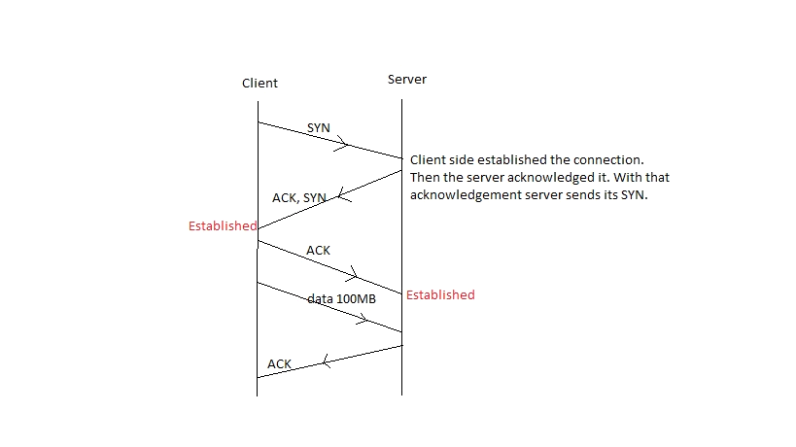
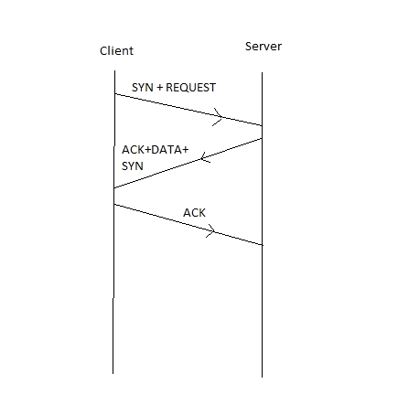
Connection Establishment

Slide 12
How?
1. How often the modified connection establishes and terminates itself
2. Time taken to finish the establishment
3. Analyze data transfer speeds

Slide 13
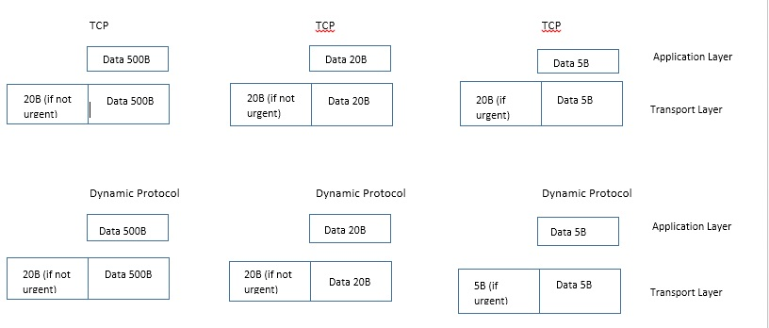
Header Size

Slide 14
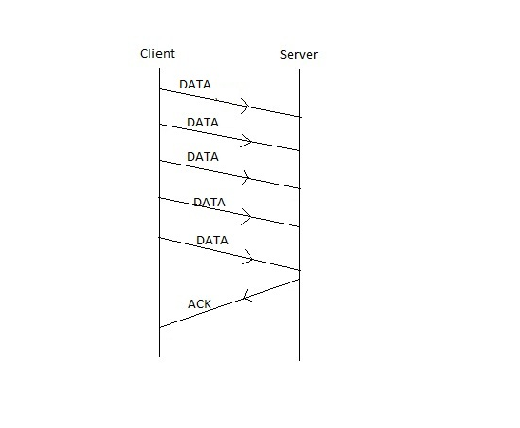
A single ACK for similar requests

Slide 15
Altering the order of the execution of Methods in TCP protocol
We have found different methods ie. Traffic, Reliability, Congestion control to improve certain aspects of TCP. A way has to be identified where we can change the order of these method executions happening in the tcp protocol in order to facilitate the requirements of the DTL protocol such as avoiding executions of the methods which satisfy the congestion control, reliability, etc. in a situation where urgent data transfer is needed & vice versa.

Slide 16
Technical objectives
The required software in order to carry out the research is
Network Simulator 3 (NS3) - A distinct event simulator targeted at networking research. That provides extensive support for simulation of TCP, routing, and multicast protocols over wired and wireless networks.
Wireshark- A network protocol analyser that conducts thorough inspection of protocol behaviour.
Ubuntu- A Linux operating system that permits the use of NS3.

Slide 17
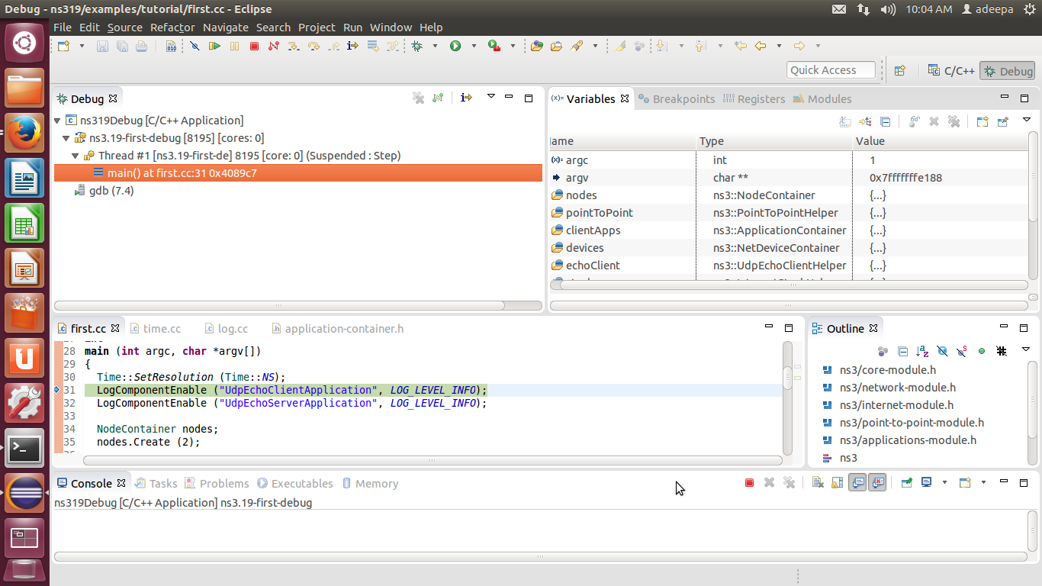
Detail design

Slide 18
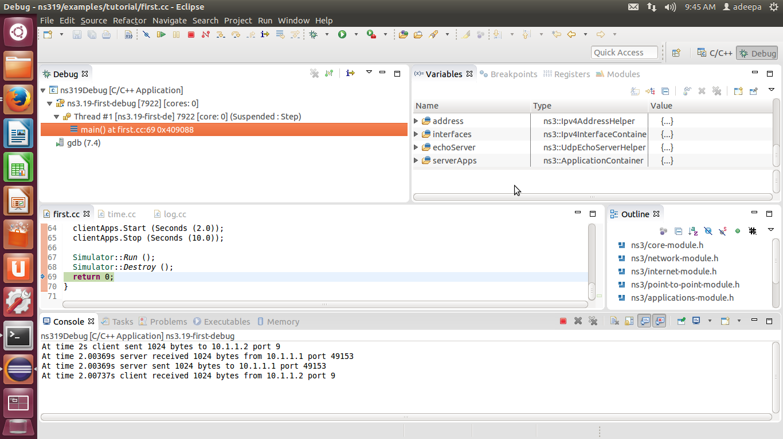

Slide 19
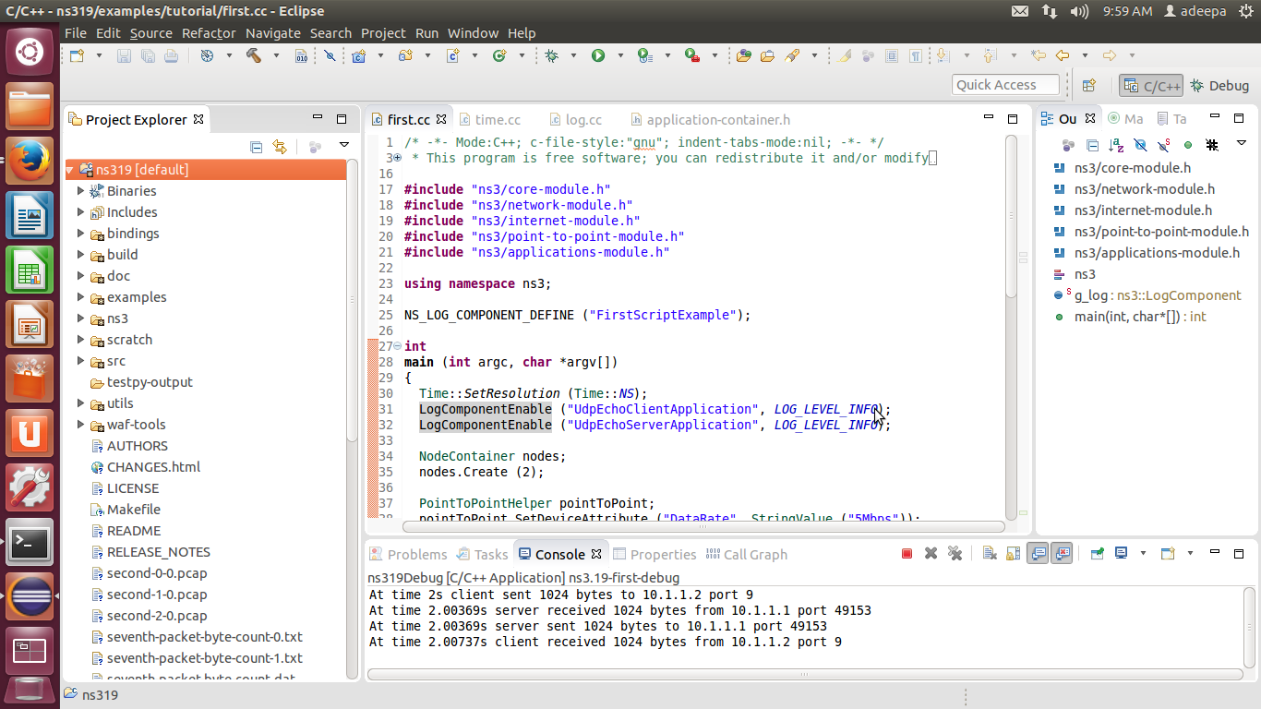

Slide 20
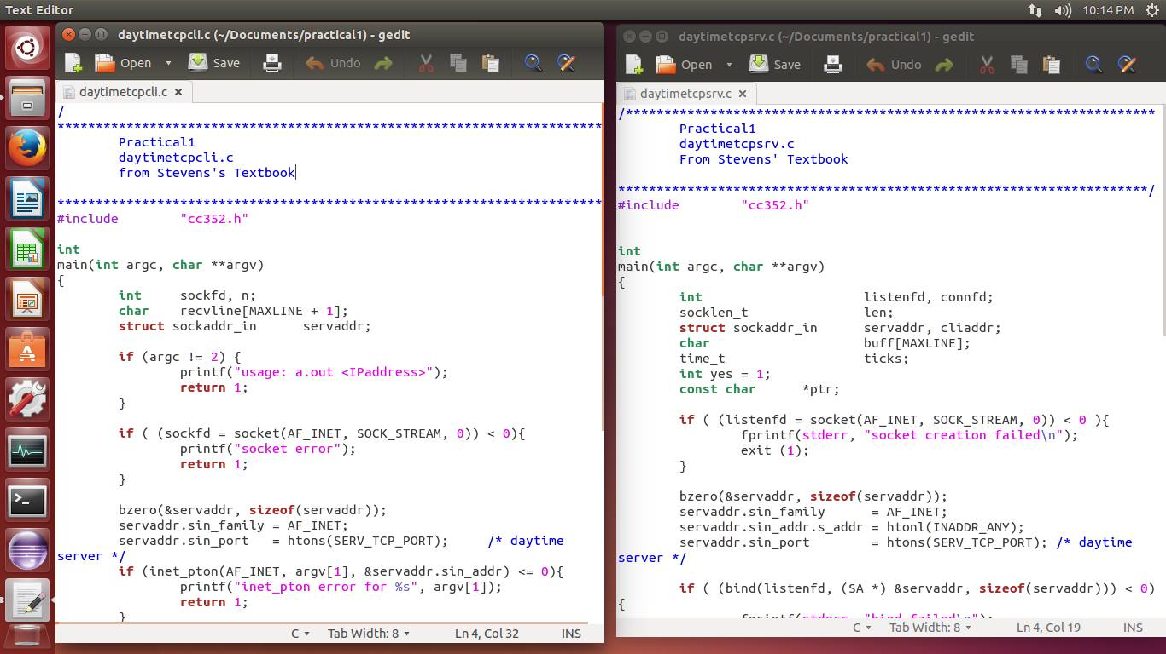

Slide 21
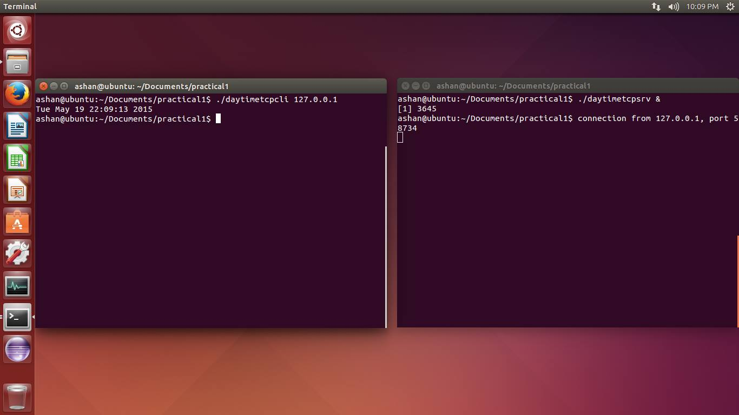

Slide 22
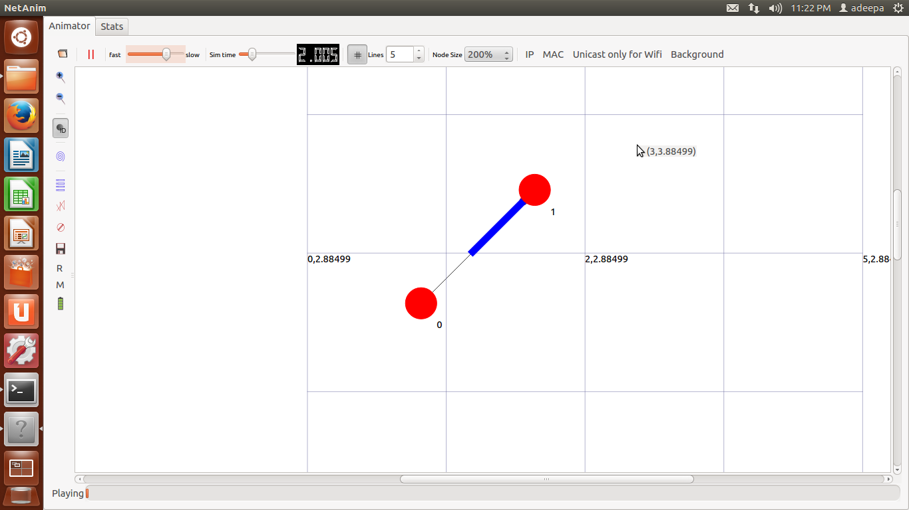
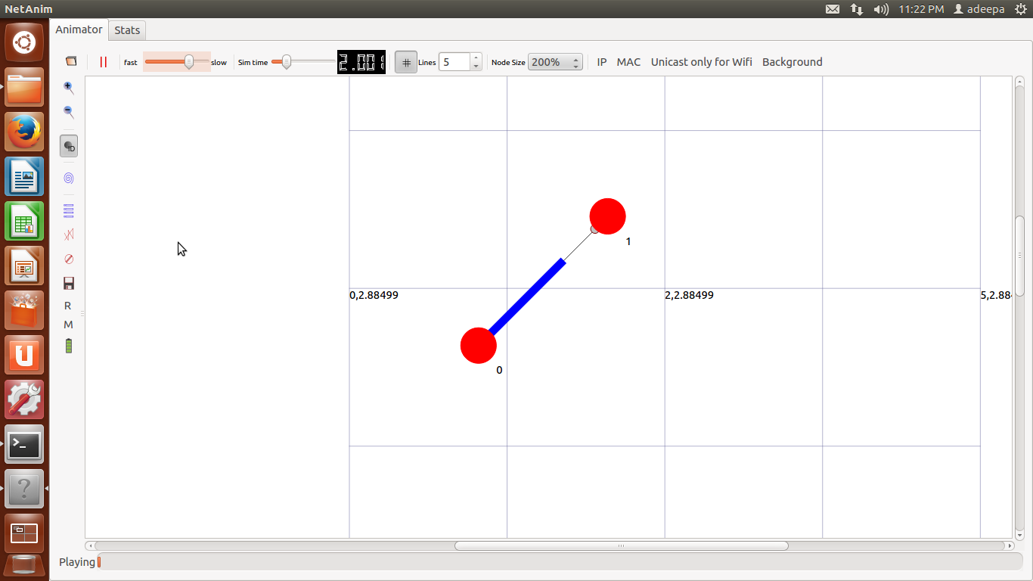

Slide 23
Sources for test data & analysis
first.cc

Slide 24
Anticipated benefits
This research will be analysing and develop a dynamic transporter layer protocol that supports less packet drops and takes a considerably less retransmission time which is able to transmit data in a quick and efficient manner within a wireless environment. This has been identified as a vital factor in real time systems; specifically in way finding applications in order to gather critical information of patients, evade hazardous situations for disable persons, and receive alternative paths in navigation systems in instances of urgent nature.

Slide 25
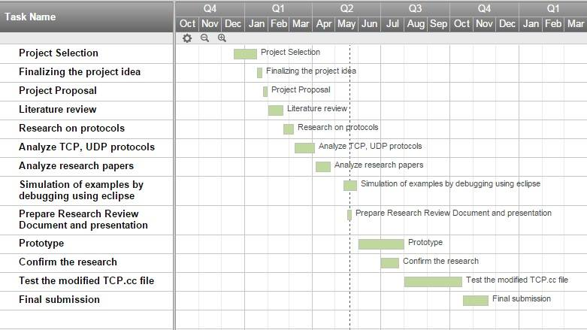
Project plan or schedule

Slide 26
Research constraints
Given the start of the research on fine tuning the TCP to be looked into a dynamic transport layer protocol use of Smart Mobile Device Communication, we have noticed a lot of restrictions when it comes to accessing the Socket API at the point of debugging via eclipse. We find it challenging to come up with solutions to develop a complete dynamic protocol given the above constraints as we need to access these methods to determine its behaviour to move forward.

Slide 27
Specified deliverables
Design and develop a new Dynamic transport layer protocol for communication in wireless environment in an effective, efficient and reliable manner.

Slide 28
Thank You

