Slide 1

Heart Disease Prediction Using Machine Learning
Presented By:
Fasila . S

Slide 2
IntroducTION
Nowadays, health disease are increasing day by day at an exponential rate due to:
Inactive Lifestyle
Unhealthy Food Habit
Physical activities have reduced drastically
The annual mortality rate per 100,000 people from cardiovascular diseases in India has increased by 128.9% since 1990, an average of 5.6% a year.

Slide 3
Goal Of The Project
- A Machine Learning Algorithm which analyze the data for patients showing attributes of heart disease and compare the accuracy of finding heart disease using different machine learning algorithms
-To predict whether a patient should be diagnosed with Heart Disease. This is a binary outcome.
Positive (+) = 1, patient diagnosed with Heart Disease
Negative (-) = 0, patient not diagnosed with Heart Disease
-To experiment with various Classification Models & see which yields greatest accuracy.
Examine trends & correlations within our data
determine which features are important in determining Positive/Negative Heart Disease

Slide 4
Python Data Frameworks
Jupyter Notebook
Pandas
XGBoost
Matplotlib
Scikit Learn

Slide 5
Data CollEction and cleaning
The real world data are MESSY!
- Various Data Sources
- Different File Formats
- Data with Odd-formats
After cleaning the data we have about 300 patients data obtained from UCI

Slide 6
Data Features And predictors
Our Predictor (Y, Positive or Negative diagnosis of Heart Disease) is determined by 13 features (X):
age (#)
sex : 1= Male, 0= Female (Binary)
(cp)chest pain type (4 values -Ordinal):Value 1: typical angina ,Value 2: atypical angina, Value 3: non-anginal pain , Value 4: asymptomatic (
(trestbps) resting blood pressure (#)
(chol) serum cholestoral in mg/dl (#)
(fbs) fasting blood sugar > 120 mg/dl(Binary)(1 = true; 0 = false)
(restecg) resting electrocardiographic results(values 0,1,2)
8. (thalach) maximum heart rate achieved (#)
9. (exang) exercise induced angina (binary) (1 = yes; 0 = no)
10. (oldpeak) = ST depression induced by exercise relative to rest (#)
11. (slope) of the peak exercise ST segment (Ordinal) (Value 1: upsloping , Value 2: flat , Value 3: downsloping )
12. (ca) number of major vessels (0-3, Ordinal) colored by fluoroscopy
13. (thal) maximum heart rate achieved - (Ordinal): 3 = normal; 6 = fixed defect; 7 = reversable defect

Slide 7
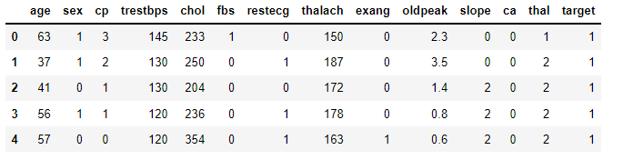
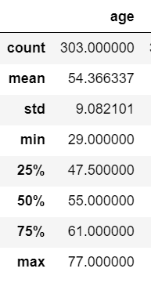
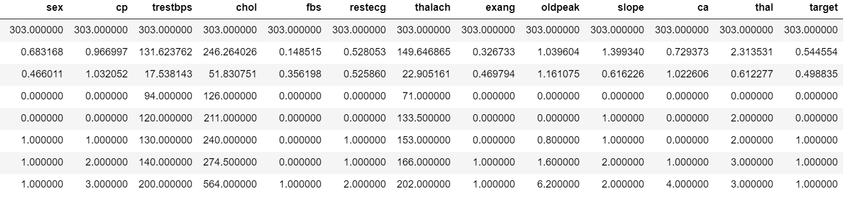
DATA ANALYSIS

Slide 8
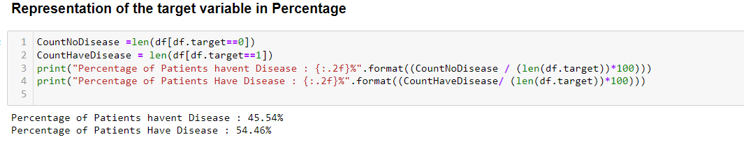
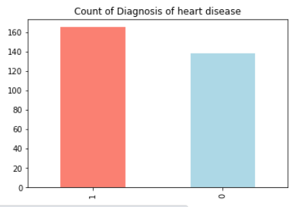
EDA
The plot shows the count of population having disease and not having disease and the count of having disease is greater

Slide 9
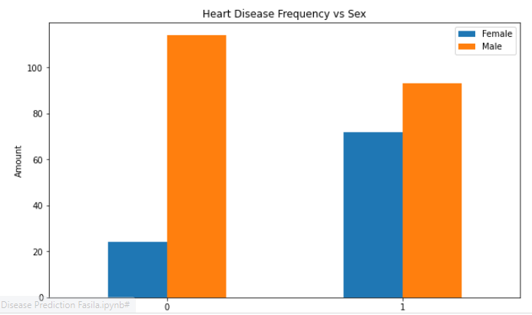
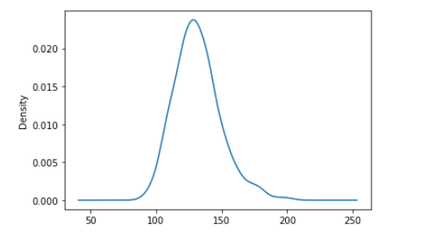
EDA
The above plot shows the ratio of population
having disease and not having disease with respect to sex
The above plot shows the density of Resting blood pressure and the maximum density is around 120-140

Slide 10
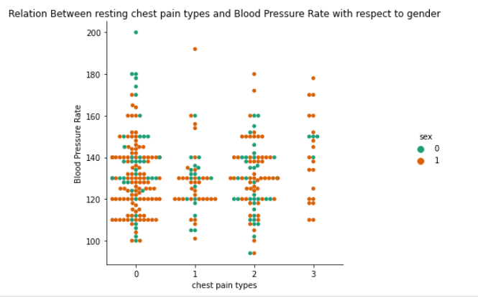
EDA
Acoording to the above catplot it is infered that males are more prone to heart attacks with comparitively higher level of blood pressure than females.

Slide 11
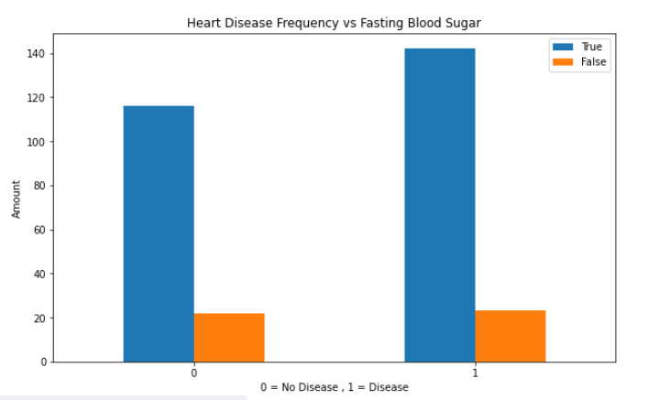
EDA
The plot shows that the sugar level does not contribute to having or not having the heart disease

Slide 12
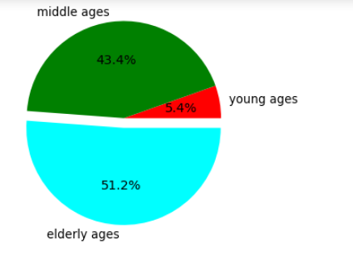
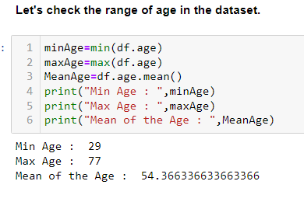
EDA
AGE ANALYSIS:
A large proportion of dataset contains Elder people.
Elderly people are more likely to suffer from heart disease.

Slide 13
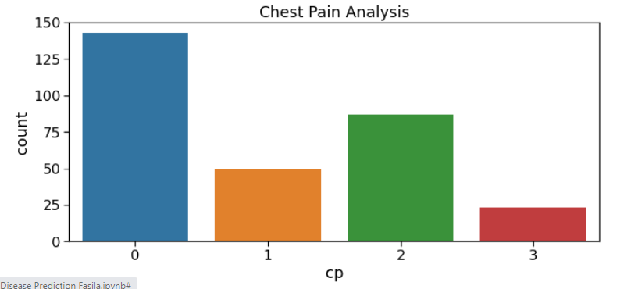
CHEST PAIN ANALYSIS:
As seen, there are 4 types of chest pain
status at least
condition slightly distressed
condition medium problem
condition too bad

Slide 14
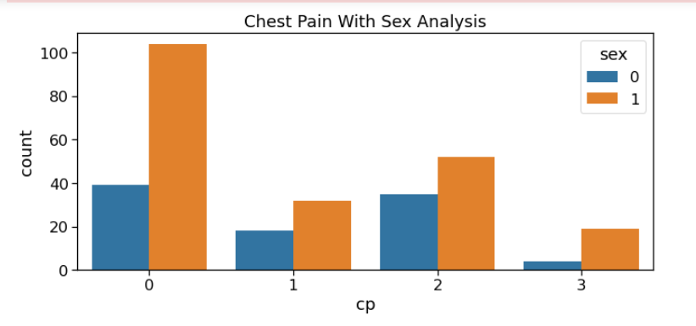
People having least chest pain are not likely to heart disease.
People having severe chest pain are likely to heart disease.
Elderly people are more likely to have chest pain.

Slide 15
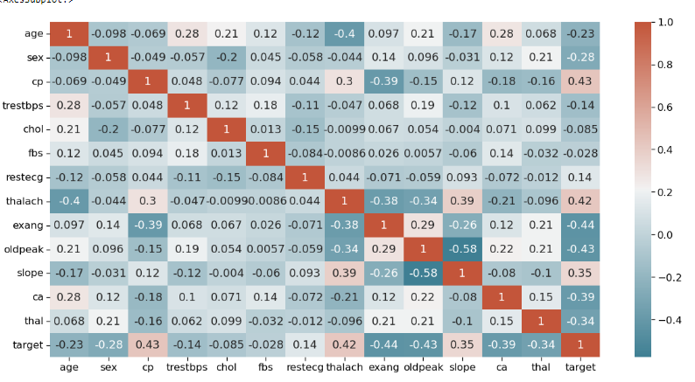
CORRELATIONS
We can see there is a positive correlation between chest pain (cp) & target (our predictor).
The greater amount of chest pain results in a greater chance of having heart disease
In addition, we see a negative correlation between exercise induced angina (exang) & our predictor.
This makes sense because when you excercise, your heart requires more blood, but narrowed arteries slow down blood flow.

Slide 16
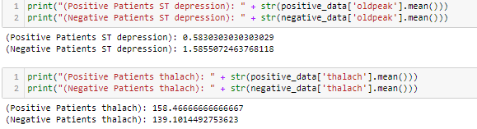
DATA ANALYSIS
Positive and Negative Patients with ST Depression
From comparing positive and negative patients we can see there are vast differences in means for many of our Features. From examining the details
we can observe that positive patients experience heightened maximum heart rate achieved (thalach) average.
In addition, positive patients exhibit about 1/3rd the amount of ST depression induced by exercise relative to rest (oldpeak)

Slide 17
3 Step Process
Split the Dataset
Train the Dataset
Compare the Algorithms

Slide 18
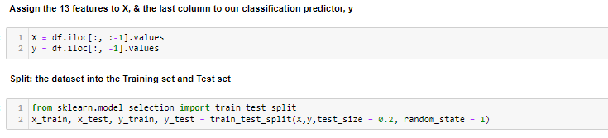
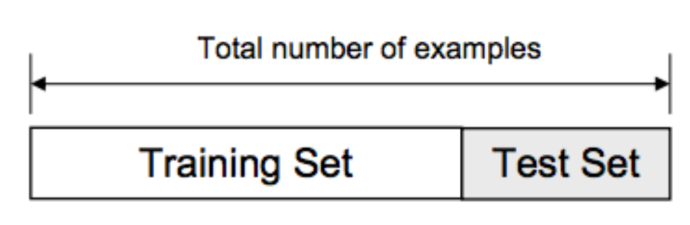
TEST AND TRAIN SPLIT

Slide 19
Modelling and training
We will now Train various Classification Models on the Training set & see which yields the highest accuracy. We will compare the accuracy of :
Logistic Regression,
K-NN,
SVM,
Naïve Bayes Classifier,
Decision Trees,
Random Forest
XGBoost
Note: These are all supervised learning models

Slide 20
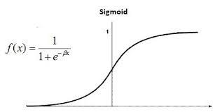
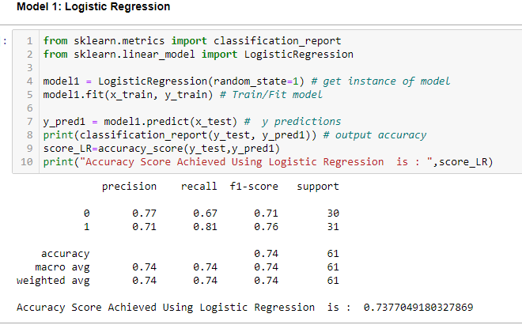
LOGISTIC REGRESSION

Slide 21
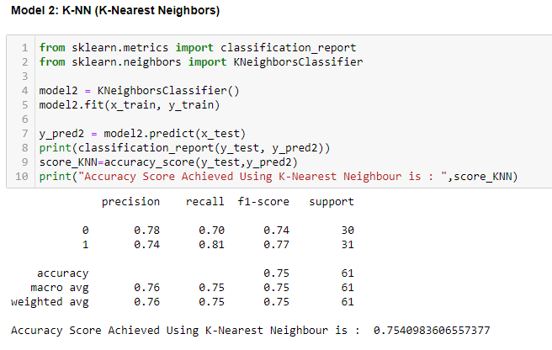
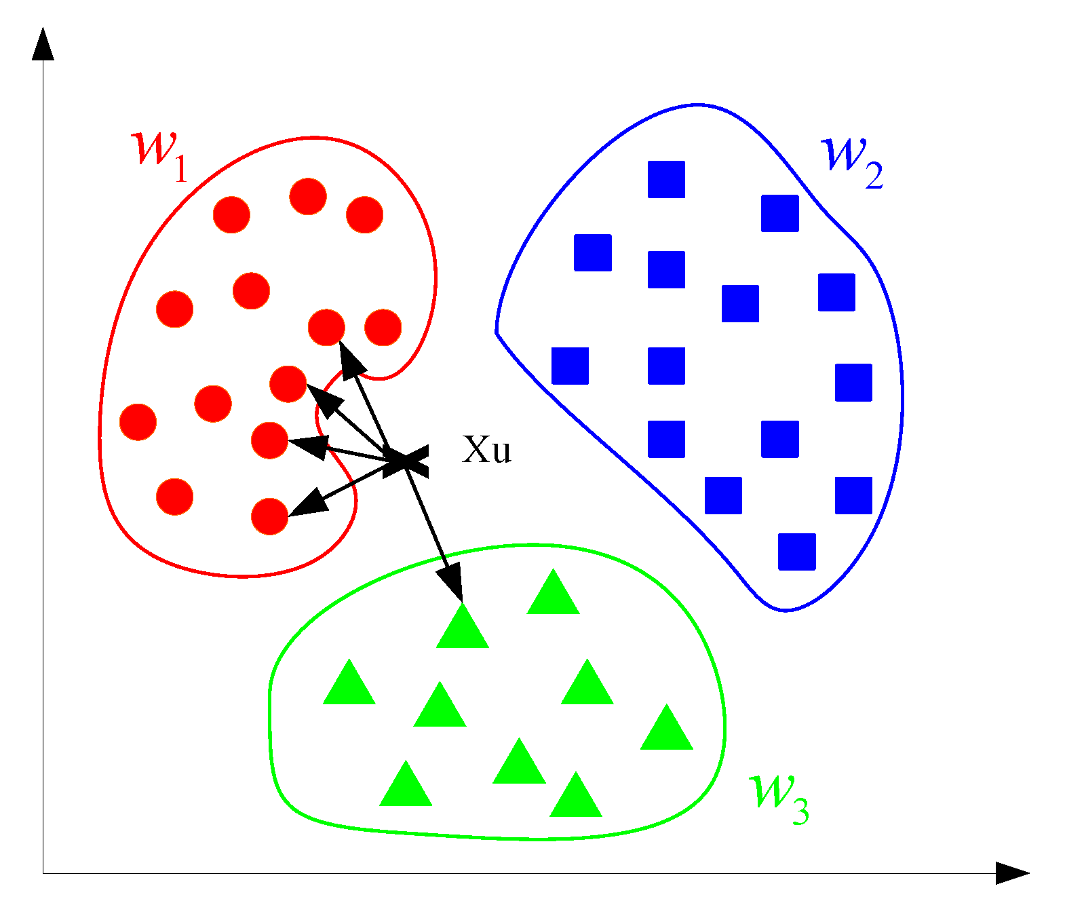
K-Nearest neighbour

Slide 22
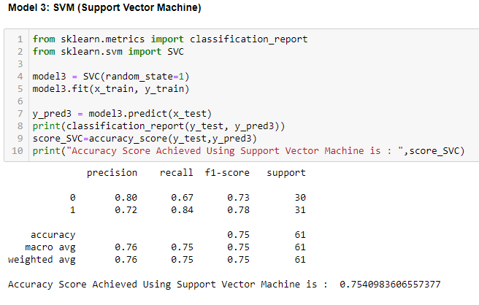
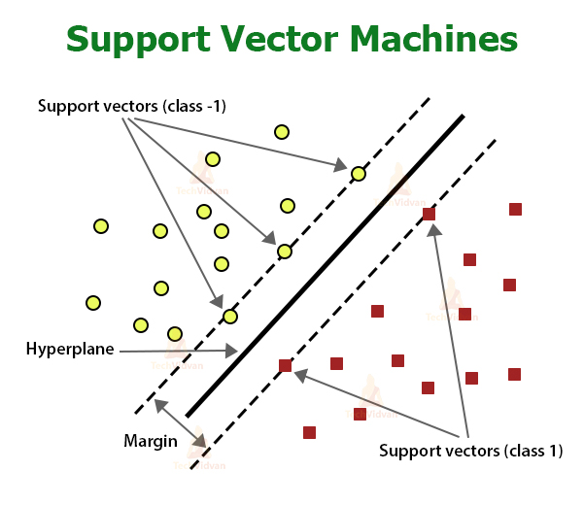
SUPPORT VECTOR MACHINE

Slide 23
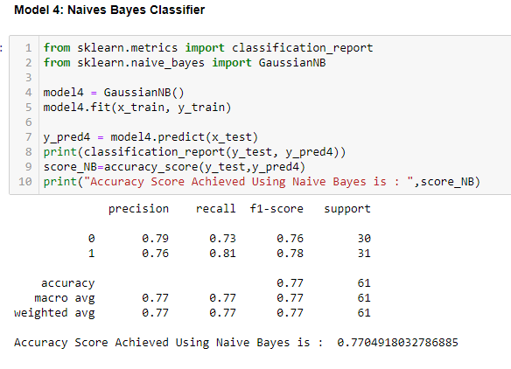
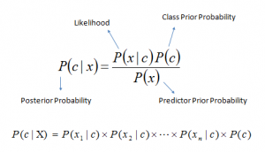
Naïve bayes classifier

Slide 24
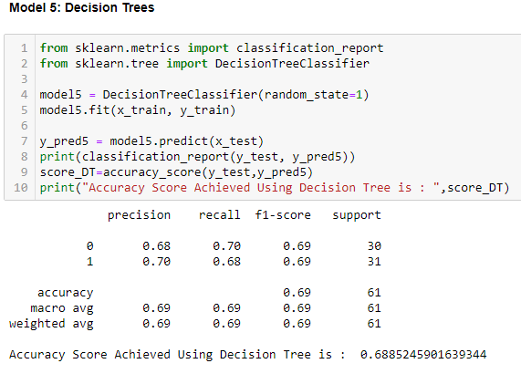
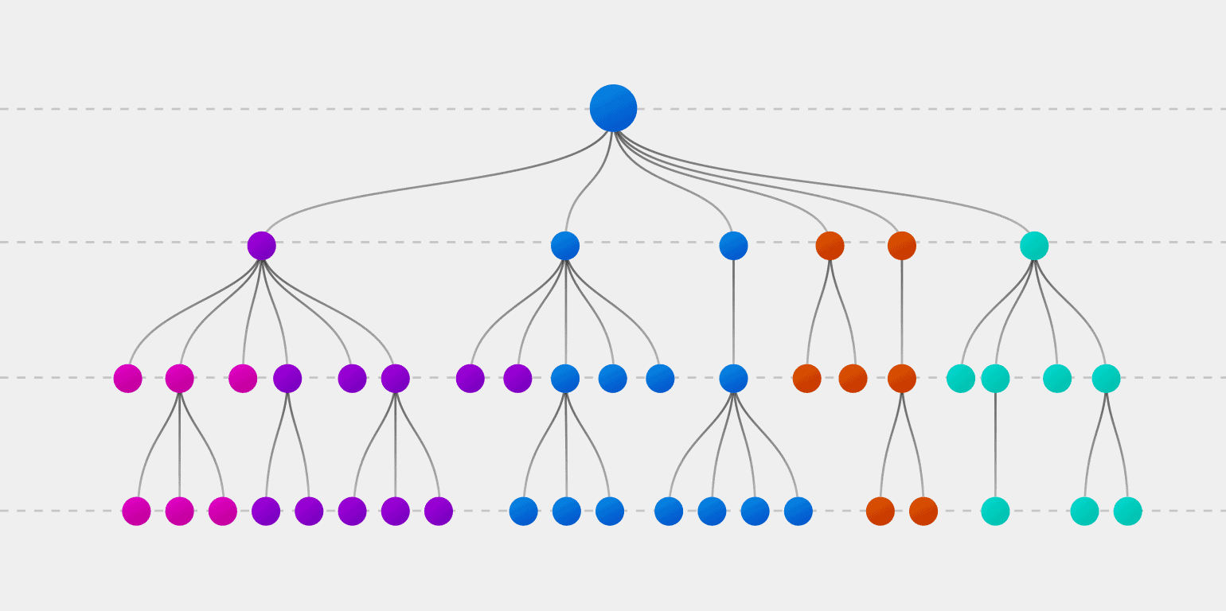
Decision tree

Slide 25
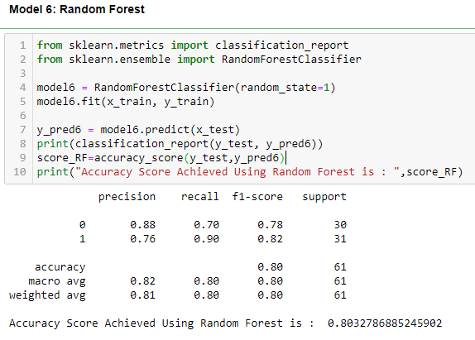
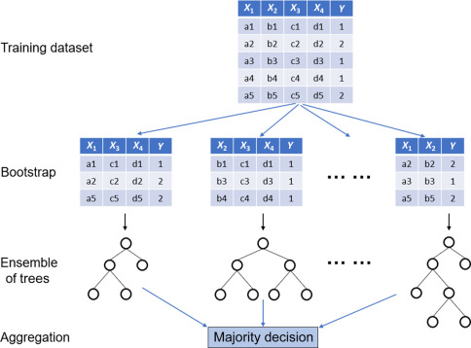
Random forest

Slide 26
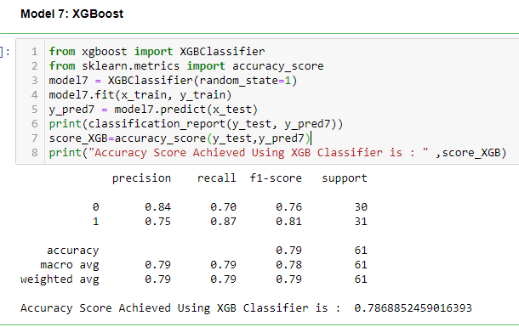
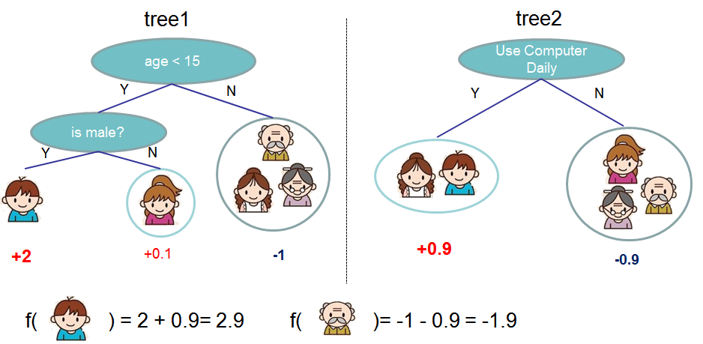
XGBOOSt

Slide 27
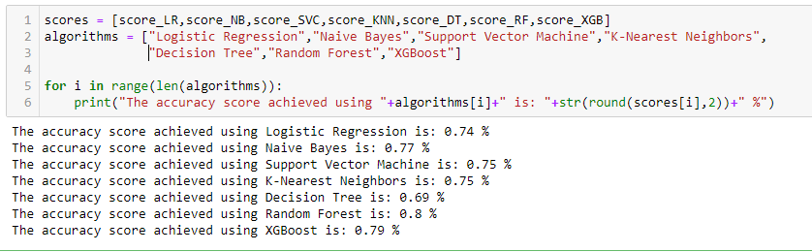
Comparing algorithm results

Slide 28
Comparison Chart of all Algorithms using different parameters
Algorithms Parameters | Logistic Regression | K-Nearest Neighbors | SVM | Naive Bayes | Decision Tree | Random Forest | XGBoost
Accuracy Score | 73 | 75 | 75.4 | 77 | 68.8 | 80 | 78.6
Precision Score | 0.71 | 0.74 | 0.72 | 0.76 | 0.70 | 0.76 | 0.75
Recall Score | 0.8123 | 0.81 | 0.84 | 0.81 | 0.68 | 0.90 | 0.87
F-Score | 0.76 | 0.77 | 0.78 | 0.78 | 0.69 | 0.82 | 0.81
Support | 31 | 31 | 31 | 31 | 31 | 31 | 31

Slide 29
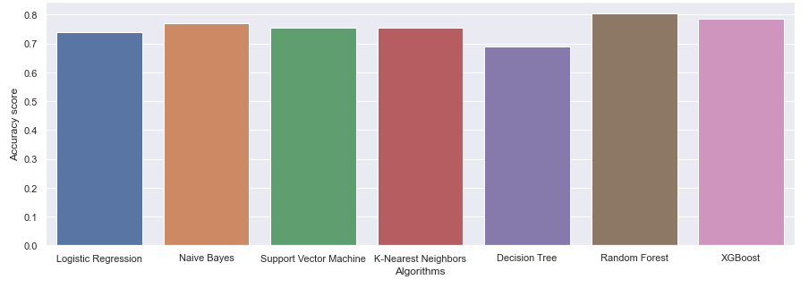
result
735
77
75.4
75
68.8
80
78.6
From comparing the 7 models, we can conclude that
Model 6: Random Forest yields the highest accuracy. With an accuracy of 80%.

Slide 30
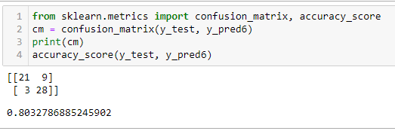
Making the Confusion Matrix of random forest
21 is the amount of True Positives in our data, while 28 is the amount of True Negatives.
9 & 3 are the number of errors.
There are 9 type 1 error (False Positives)- You predicted positive and it’s false.
There are 3 type 2 error (False Negatives)- You predicted negative and it’s false.
Hence if we calculate the accuracy ,In other words, where TP, FN, FP and TN represent the number of true positives, false negatives, false positives and true negatives.
(TP + TN)/(TP + TN + FP + FN).
(21+28)/(21+28+9+3) = 0.80 = 80% accuracy

Slide 31
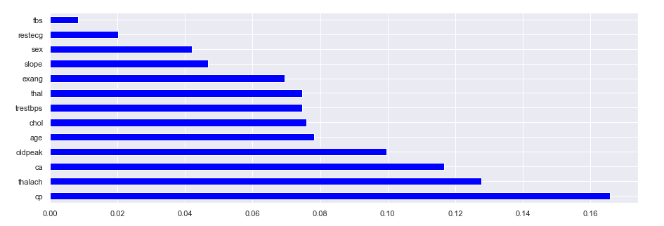
FEAture importance graph of random forest
From the Feature Importance graph , we can conclude that the top 4 significant features were
chest pain type (cp)
maximum heart rate achieved (thalach)
number of major vessels (ca)
ST depression induced by exercise relative to rest (oldpeak)

Slide 32
predictions
Scenario: A patient develops cardiac symptoms & you input his vitals into the Machine Learning Algorithm.
He is a 20 year old male, with a chest pain value of 2 (atypical angina), with resting blood pressure of 110.
In addition he has a serum cholestoral of 230 mg/dl.
He is fasting blood sugar > 120 mg/dl.
He has a resting electrocardiographic result of 1.
The patients maximum heart rate achieved is 140.
Also, he was exercise induced angina.
His ST depression induced by exercise relative to rest value was 2.2.
The slope of the peak exercise ST segment is flat.
He has no major vessels colored by fluoroscopy, and in addition his maximum heart rate achieved is a reversable defect.
Based on this information, can you classify this patient with Heart Disease?

Slide 33

Prediction testing
Yes! Our machine learning algorithm has classified this patient with Heart Disease. Now we can properly diagnose him, & get him the help he needs to recover. By diagnosing him early, we may prevent worse symptoms from arising later.

Slide 34
Conclusion
Our Random Forest algorithm yields the highest accuracy, 80%. Any accuracy above 70% is considered good. Thus, 80% is the ideal accuracy!
Out of the 13 features we examined, the top 4 significant features that helped us classify between a positive & negative Diagnosis were chest pain type (cp), maximum heart rate achieved (thalach), number of major vessels (ca), and ST depression induced by exercise relative to rest (oldpeak).
Our machine learning algorithm can now classify patients with Heart Disease. Now we can properly diagnose patients, & get them the help they needs to recover. By diagnosing detecting these features early, we may prevent worse symptoms from arising later.

Slide 35
Thank You!

