Slide 1
DRIVER DROWSINESS

Slide 2
agenda
PROBLEM STATEMENT
SOLUTION
LITERATURE REVIEW
SOFTWARE REQUIREMENTS
RESULT

Slide 3

Driver drowsiness is a critical issue that leads to numerous road accidents, causing injuries, fatalities, and substantial economic losses. The primary challenge lies in accurately and promptly detecting drowsiness in drivers to prevent such incidents.
PROBLEM STATEMENT

Slide 4

SOLUTION
The proposed solution is a driver drowsiness detection system that utilizes a combination of machine learning and computer vision techniques. This system will monitor the driver's facial expressions, eye movements, and head position in real-time using a camera mounted on the dashboard. By analyzing these parameters, the system will identify signs of drowsiness and alert the driver.

Slide 5
LITERATURE REVIEW
Facial Feature Analysis: Research indicates that changes in facial expressions, such as yawning and eye closure, are strong indicators of drowsiness. Techniques such as histogram of oriented gradients (HOG) and convolutional neural networks (CNN) have been used for facial feature extraction and analysis.
Eye Closure Detection: The percentage of eye closure (PERCLOS) is a widely used metric to detect drowsiness. Studies have shown that prolonged eye closure correlates with drowsiness. Methods like the Viola-Jones algorithm and deep learning approaches have been employed for real-time eye tracking.
Head Position Monitoring: Head nodding or tilting is another significant indicator of drowsiness. Machine learning models like support vector machines (SVM) and k-nearest neighbors (KNN) have been utilized to classify head poses.

Slide 6
Multi-modal Approaches: Combining various indicators such as facial features, eye closure, and head position has been shown to improve the accuracy of drowsiness detection systems. Recent advancements in deep learning have further enhanced the capabilities of these multi-modal systems.
Methodology
Data Collection: Gather a dataset of video recordings of drivers exhibiting both alert and drowsy states. This dataset will be used to train and test the model.
Feature Extraction: Use computer vision techniques to extract features related to facial expressions, eye closure, and head position from the video frames.
Model Training: Train a machine learning model (e.g., CNN) on the extracted features to classify the driver's state as alert or drowsy.
Real-Time Detection: Implement the trained model in a real-time system that processes live video feed from a dashboard camera.
Alert Mechanism: Develop an alert mechanism that triggers an audible or visual warning when drowsiness is detected.

Slide 7

SOFTWARE REQUIREMENTS
Programming language : Java, Kotlin, XML, HTML, MySQL
Operating system : ANY OS
Application required : Android Studio

Slide 8
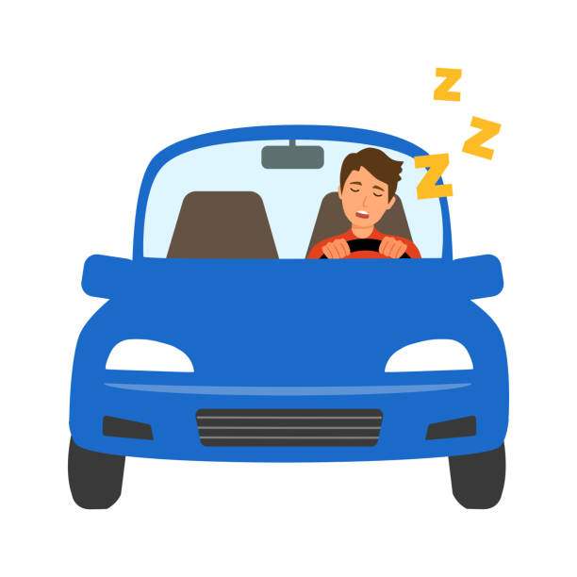
RESULT
The expected outcome of this project is a robust and accurate driver drowsiness detection system. The system should be able to:
Detect drowsiness with high accuracy in various lighting conditions and driving scenarios.
Provide timely alerts to the driver, thereby reducing the risk of accidents caused by drowsiness.
Demonstrate the effectiveness of the multi-modal approach in improving detection accuracy.
The development of a driver drowsiness detection system has the potential to significantly enhance road safety. By leveraging advancements in machine learning and computer vision, this project aims to create a practical solution that can be deployed in real-world scenarios to prevent accidents and save lives.

Slide 9
Thank you!
SUBMITTED BY:
Devyani Gupta
D. N. Shreya
Fatima Fazil
C. Beena Gowda

