Slide 1
🚀 InternNova
ENGINEERING INTERNSHIP PROJECT · WEEK 6 FINAL PROJECT
E-Commerce Sales Analytics
Data Analysis, Exploratory Data Analysis & Business Intelligence
UCI Online Retail Dataset • UCI Machine Learning Repository
Git, GitHub & Final Data Analytics Project — InternNova Data Analytics Internship, Batch-03
PM
PATAN MAHAMMAD FAZIL KHAN
Data Analytics Intern • Batch-03 • Active
Student ID: INST26DA030033 • Start Date: 01 Aug 2026
Python · Power BI · Git & GitHub

Slide 2
Project Objective
What this project sets out to achieve
1
Analyze real-world e-commerce transaction data
2
Clean and prepare raw transactional data
3
Perform exploratory data analysis (EDA)
4
Identify sales, product, country and customer patterns
5
Build an interactive Power BI dashboard
6
Generate actionable business recommendations
PROJECT WORKFLOW
Raw Data
→
Data Cleaning
→
EDA
→
Visualization
→
Power BI
→
Business Insights
→
Recommendations
E-Commerce Sales Analytics | Engineering Internship Project
2

Slide 3
Dataset & Data Preparation
DATA CLEANING PIPELINE
DATASET
Removed duplicate records
UCI Online Retail Dataset
1
UCI Machine Learning Repository
2
Removed rows with missing product descriptions
541,909
3
Identified transactions with missing CustomerID
original records
4
Removed cancelled invoices
8
5
Removed negative quantities
original columns
Dec 2010 – Dec 2011
6
Removed non-positive unit prices
transaction period
7
Created Revenue field
FINAL CLEANED DATASET
FEATURE ENGINEERING
524,878 rows × 14 columns
Year
Month
MonthName
Day
Weekday
Revenue = Quantity × UnitPrice
Cleaning steps removed inconsistent, cancelled, and invalid transaction records prior to analysis.
E-Commerce Sales Analytics | Engineering Internship Project
3

Slide 4
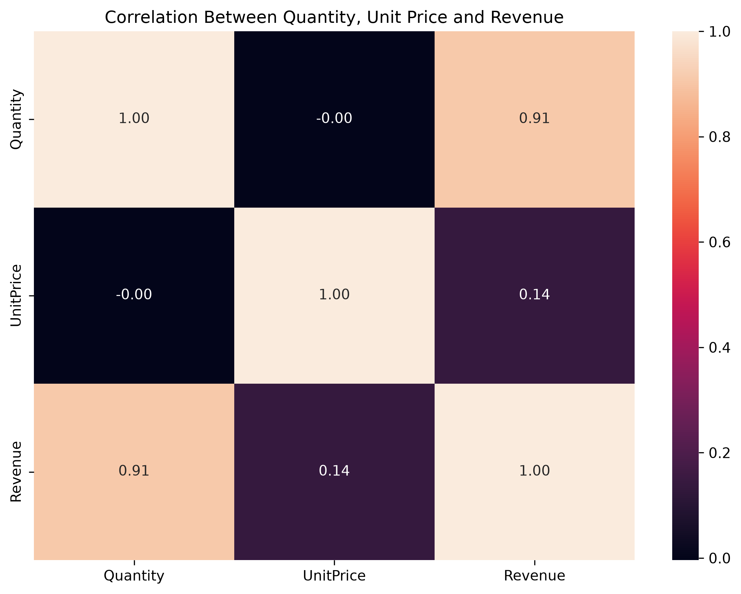
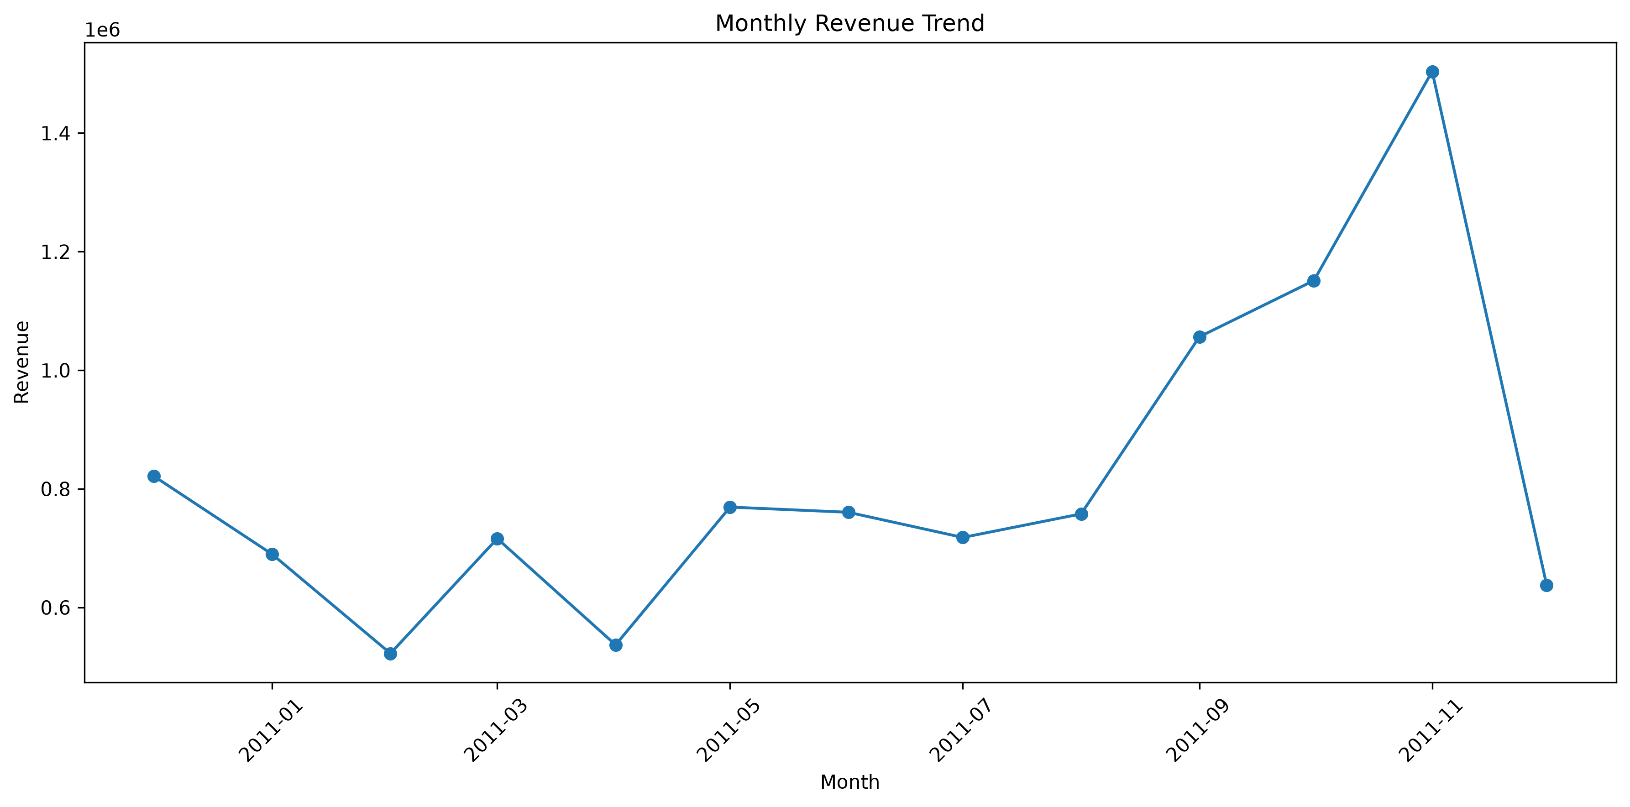
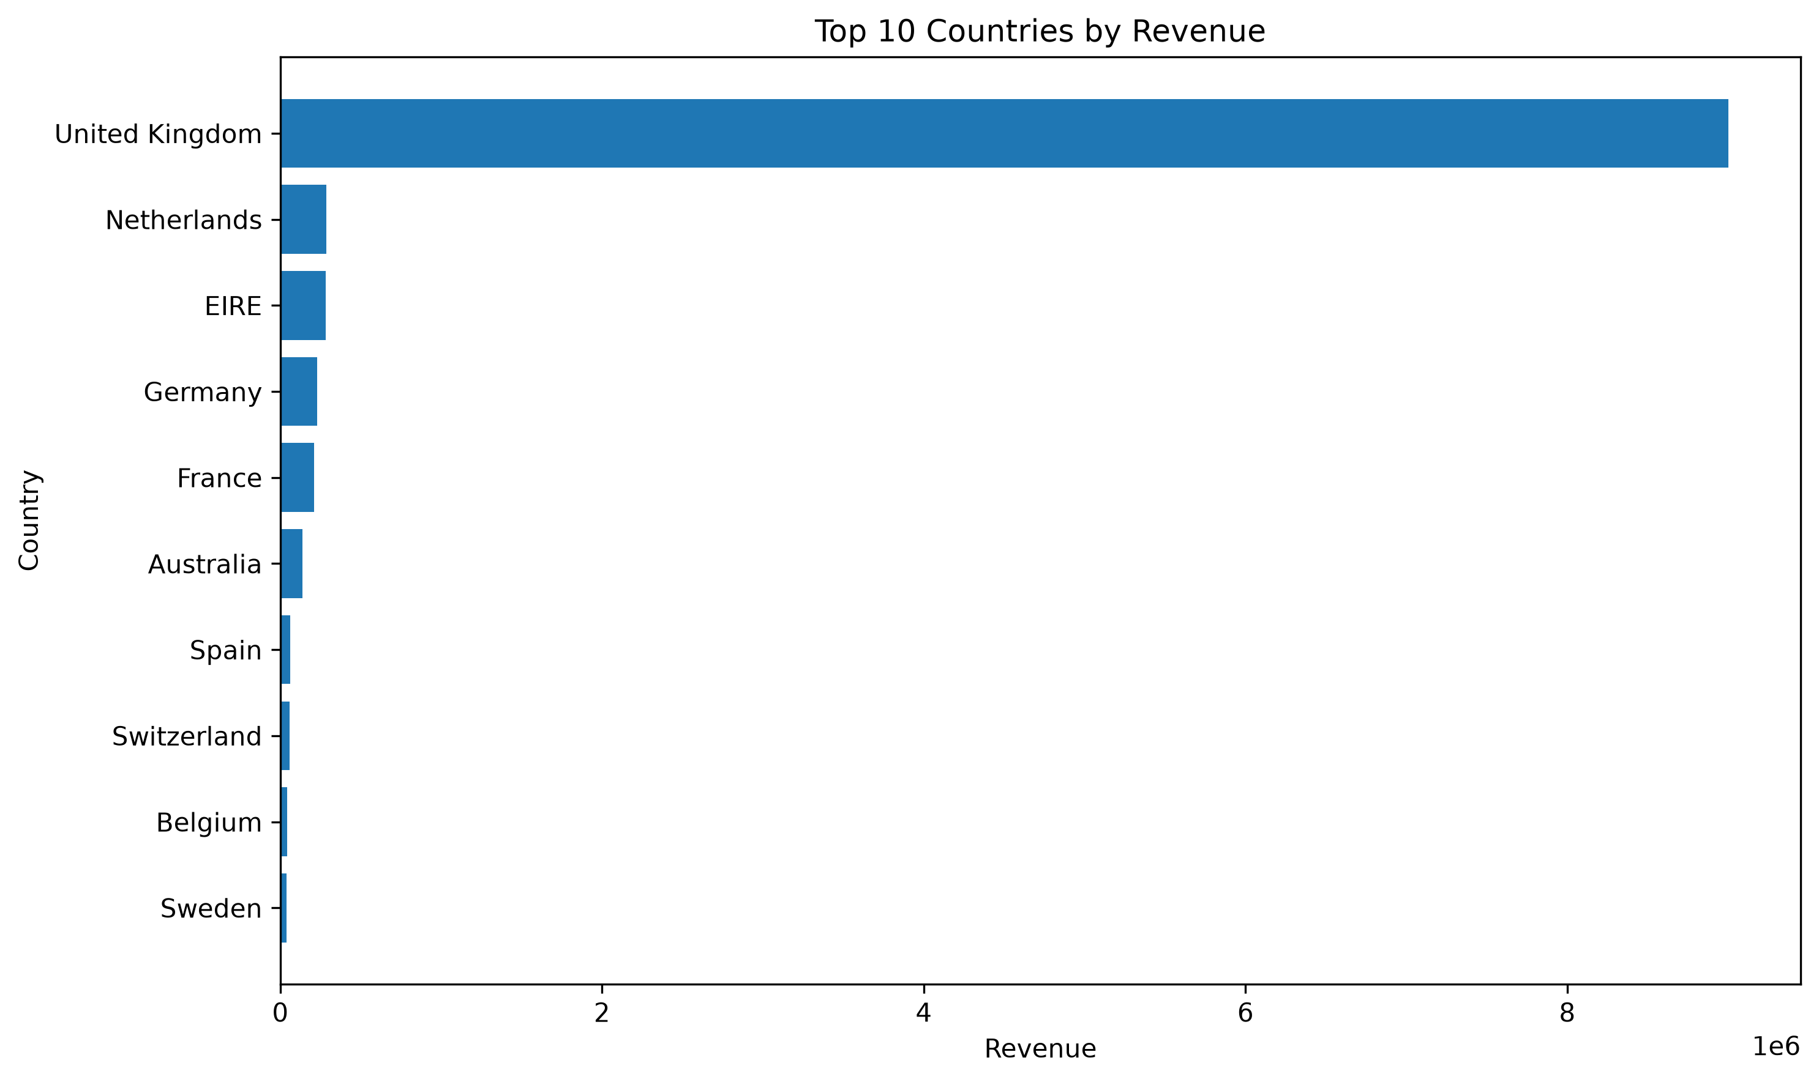
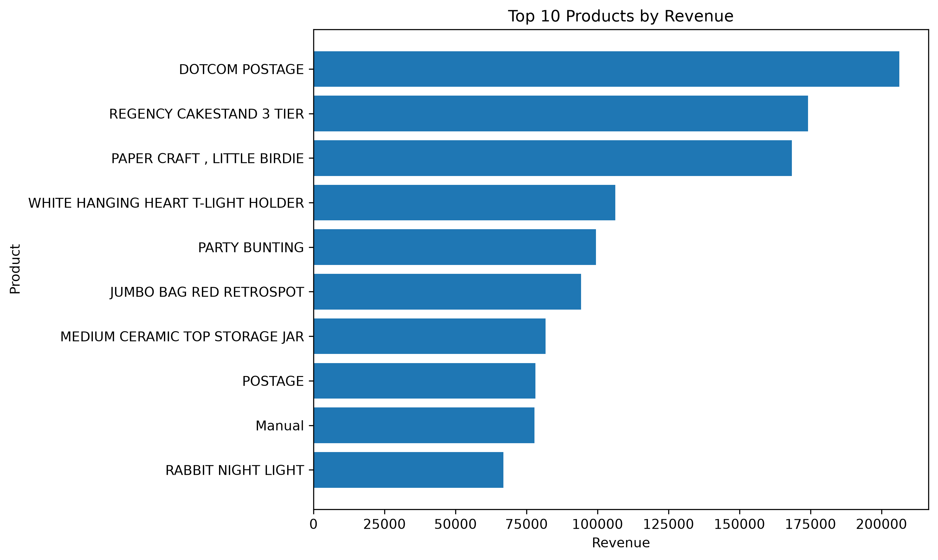
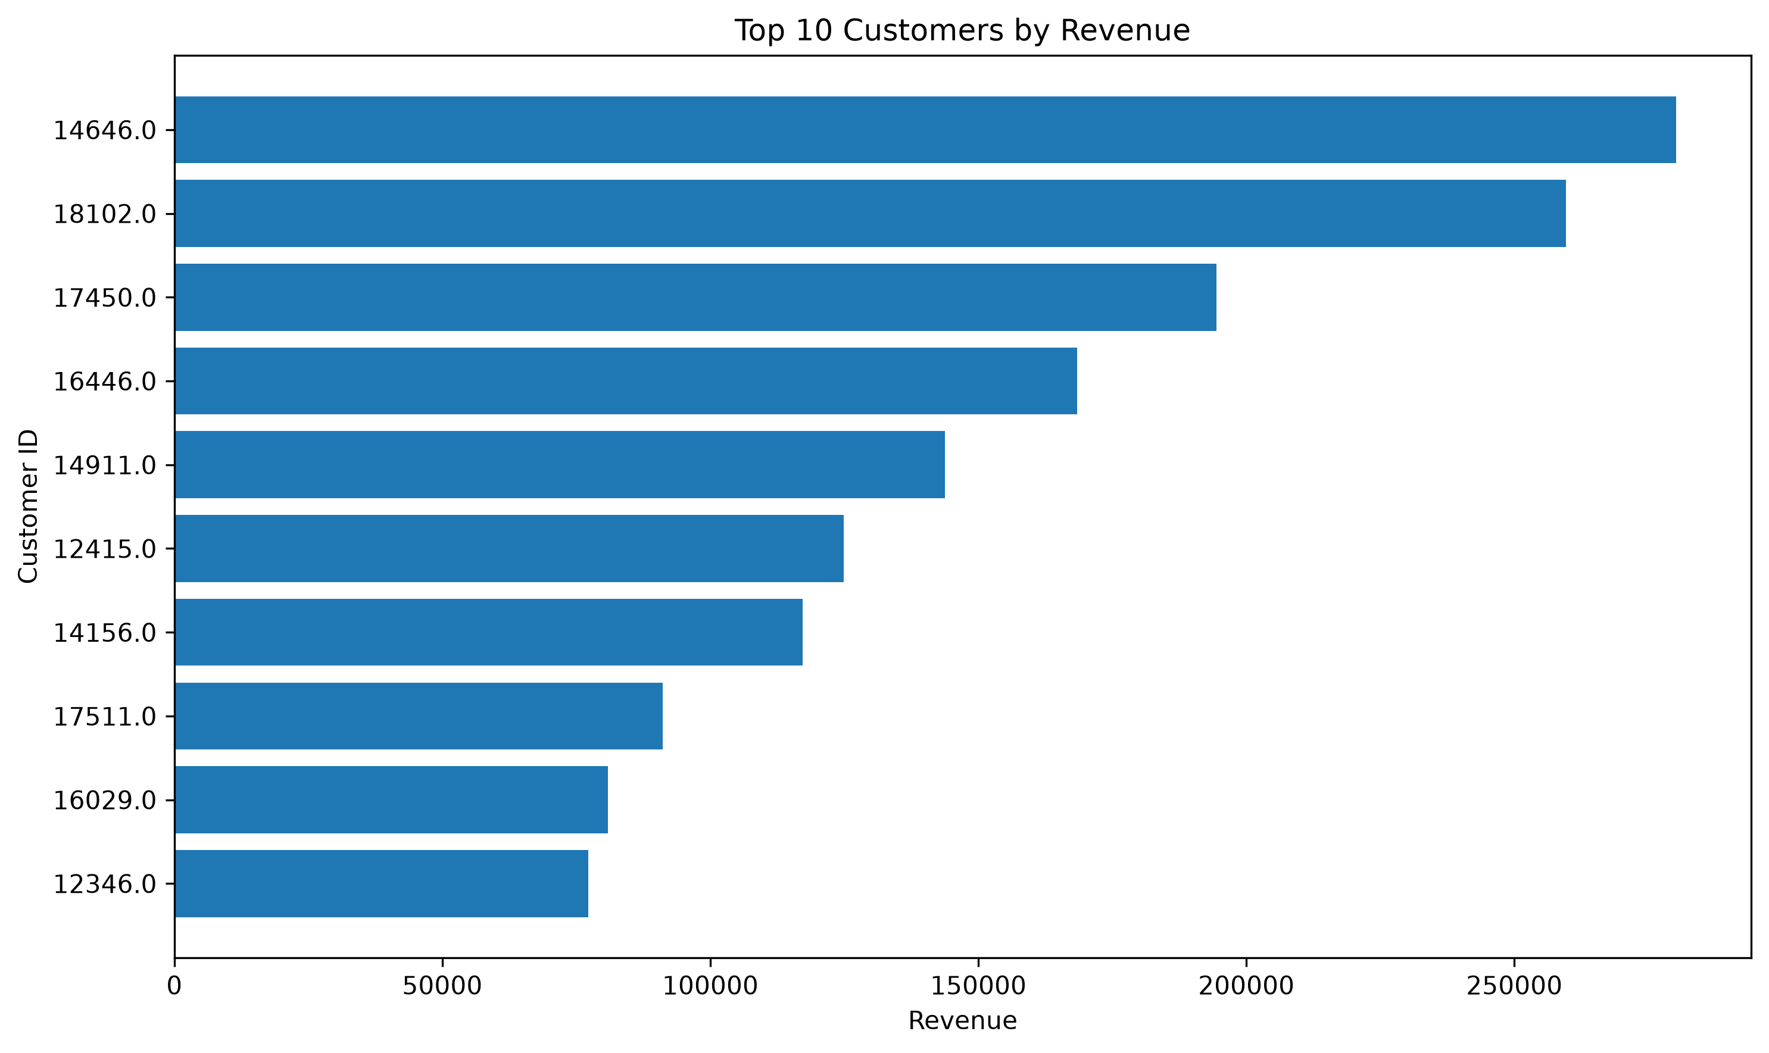
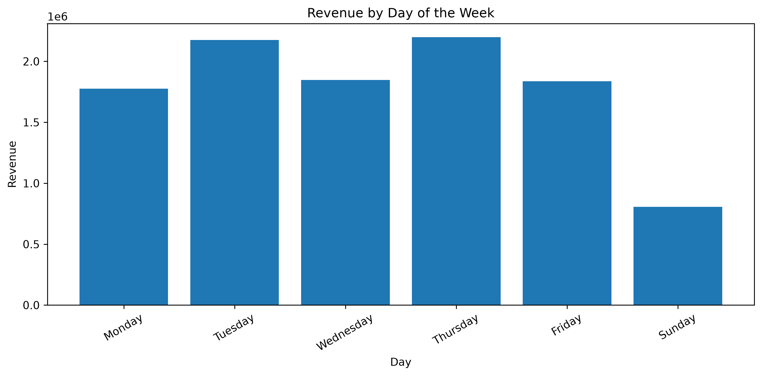
Exploratory Data Analysis
Actual analysis outputs generated in Python (Pandas, Matplotlib, Seaborn)
Correlation Analysis
Monthly Revenue Trend
Country-wise Revenue
Product Revenue Analysis
Customer Revenue Analysis
Weekday Revenue Analysis
Quantity and Revenue show a strong positive correlation of approximately 0.91. Correlation does not imply causation.
E-Commerce Sales Analytics | Engineering Internship Project
4

Slide 5
Key Sales Findings
~10.64M
~5.57M
~19,960
~4,338
TOTAL REVENUE
TOTAL QUANTITY SOLD
DISTINCT ORDERS
IDENTIFIABLE CUSTOMERS
ADDITIONAL FINDINGS
The United Kingdom is the dominant revenue-generating market.
Netherlands, EIRE, Germany and France are important additional markets.
Revenue is concentrated among high-performing products.
High-value customers contribute significantly to overall revenue.
Quantity has a strong positive association with revenue.
E-Commerce Sales Analytics | Engineering Internship Project
5

Slide 6
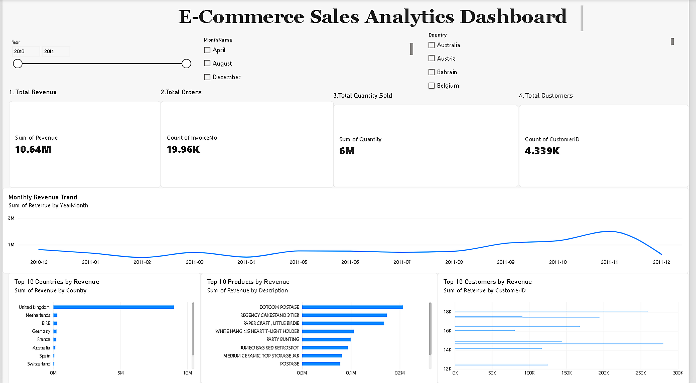
Interactive Power BI Dashboard
Actual dashboard built in Microsoft Power BI — live screenshot
E-Commerce Sales Analytics | Engineering Internship Project
6

Slide 7
Business Insights
1
Market Concentration
2
International Opportunity
The United Kingdom is the dominant revenue-generating market.
Netherlands, EIRE, Germany and France provide opportunities for further growth.
3
Product Concentration
4
Customer Concentration
A relatively small group of products contributes a significant share of revenue.
High-value customers are important contributors and should be prioritized for retention.
5
Sales Volume Relationship
6
Data Quality
Strong positive Quantity–Revenue correlation (~0.91) — higher quantities associate with higher revenue.
Missing CustomerID values limit complete customer-level analysis.
E-Commerce Sales Analytics | Engineering Internship Project
7

Slide 8
Recommendations & Conclusion
1
Strengthen inventory availability in the UK market.
2
Explore targeted expansion in promising international markets.
3
Prioritize high-revenue products in inventory planning.
4
Create loyalty programs and personalized offers for high-value customers.
5
Use monthly sales trends for demand forecasting.
6
Improve customer information collection.
7
Monitor cancellations and returns separately.
Data-driven analysis and interactive visualization can help businesses understand sales performance, identify growth opportunities, improve inventory planning and support better strategic decisions.
Thank You
E-Commerce Sales Analytics | Engineering Internship Project
8

