Slide 1
IBM University Engagement Project Submission
“Exploring the Power of Agentic AI with IBM Granite and LangFlow”

Slide 2

Project Title : KisanLink – AI-Powered Cotton & Groundnut Market Linkage Platform
Domain of Project : Economic Development (Agriculture Market Linkage)
Student Name | Recent Passport Photo | Email ID | Mobile number [WhatsApp]
Jaiswal Dhruv |  | dhruvjaiswal130307@gmail.com | 8128413241
GitHub Repository: github.com/fazilkhan0786/KIsan_Link_IBM
Live Demo: fazilkhan0786.github.io/KIsan_Link_IBM

Slide 3
Problem Statement -
Problem Statement : AI-Powered Cotton & Groundnut Market Linkage Platform
The Challenge
Gujarat is one of India's leading producers of cotton and groundnut, yet farmers frequently face price exploitation by middlemen, lack access to real-time mandi prices, and have limited bargaining power in direct market linkages. Without transparent, real-time price data, most farmers sell in distress, well below the fair modal price, with little visibility into when to sell, when to hold, or which buyer offers the best deal.
The Objective
Build an Agentic AI-powered Market Linkage Platform that gives cotton and groundnut farmers real-time price intelligence, sell-or-hold advisory, and direct buyer access. The solution should:
Real-Time Mandi Price Intelligence – Track live APMC modal prices and 7-day price trends for cotton and groundnut across Saurashtra mandis.
AI Sell-or-Hold Advisory – Recommend the best time to sell using Granite-powered reasoning over arrivals, demand, and price momentum.
Direct Buyer-Farmer Matching – Connect farmers directly with verified mills and buyers, eliminating middleman commission.
Storage & Selling Timing Guidance – Help farmers decide whether to store or sell immediately based on price forecasts.
Multi-Agent System –
Mandi Price Forecasting Agent (live and historical APMC price tracking)
Direct Buyer-Farmer Matching Agent (verified mill/buyer connections)
Storage & Selling Timing Advisor Agent (sell-or-hold recommendation)
Quality Grading Assistance Agent (crop quality inputs for fair pricing)
Farmer Income Dashboard Agent (tracks earnings gained vs. middleman route)
Farmer Income Dashboard – Show a side-by-side comparison of income earned via the middleman route versus a direct KisanLink sale.

Slide 4
Proposed Solution -
Proposed Solution: KisanLink – AI-Powered Cotton & Groundnut Market Linkage Platform
The proposed solution is a multi-agent AI-powered market linkage platform built using LangFlow, IBM watsonx.ai, and Granite Models to give cotton and groundnut farmers real-time price transparency and direct buyer access. The system addresses price exploitation, delayed price discovery, and weak bargaining power through an intelligent, modular architecture.
At its core, the solution uses a Retrieval-Augmented Generation (RAG) pipeline to fetch live APMC/mandi price data and historical trends for cotton and groundnut across Saurashtra districts. This data is embedded and stored in a vector database, enabling the system to retrieve and reason over price patterns using Granite models.
The system consists of key agents:
Mandi Price Forecasting Agent fetches and tracks live and historical APMC modal prices.
Sell/Hold Advisory Agent recommends the best selling window based on arrivals, demand, and price momentum.
Direct Buyer-Farmer Matching Agent connects farmers to verified mills, removing middleman commission and unfair weighing losses.
Farmer Income Dashboard Agent tracks and visualizes earnings gained versus the traditional middleman route.
The solution includes a farmer-friendly dashboard (built with HTML/JS on the frontend) that shows live mandi prices, 7-day price trends, sell-or-hold advice, verified buyers, and a real-time income impact calculator.
LangFlow is used to orchestrate agent workflows, while watsonx.ai ensures scalable model deployment, embeddings, and AI governance. Granite models power reasoning, price advisory, and personalization.
Overall, this solution delivers an end-to-end market linkage assistant that puts fair, transparent pricing and direct buyer access in the hands of every cotton and groundnut farmer in Gujarat.

Slide 5
Technology Used
Langflow platform -For designing and orchestrating multi-agent workflows visually
IBM Granite model - for eg – ibm-granite-3-2-8b – For natural language understanding, reasoning, and personalization
IBM Cloud – It provides the infrastructure to build, deploy, and scale the KisanLink agents efficiently. IBM Cloud enables a reliable, secure, and scalable environment for deploying the KisanLink market linkage agents.
RAG– RAG to fetch real data first, then generate intelligent answers, making mandi price and buyer information more trustworthy and effective.
IBM Watsonx.ai - For model deployment, embeddings, and AI governance
Vector Database (FAISS/Chroma) – For RAG-based retrieval of APMC price history and market data

Slide 6
Langflow component Used -
1) Chat Input – Interface where the farmer enters queries such as crop, district, and quantity to check prices or get sell/hold advice.
2) IBM watsonx AI Agent - Processes mandi price data using Granite models to generate sell-or-hold advisory and income insights.
3) Name of IBM Granite model - Granite-13B → Fast, efficient reasoning for real-time price advisory
4) Chat output -Displays AI-generated responses such as sell/hold recommendation, matched buyers, and income impact.
5) File component - Stores and retrieves live APMC price data, verified buyer records, and farmer income history for analysis and tracking.
6) API/Tool component – Fetches live Agmarknet/APMC mandi price feeds for Saurashtra districts.

Slide 7
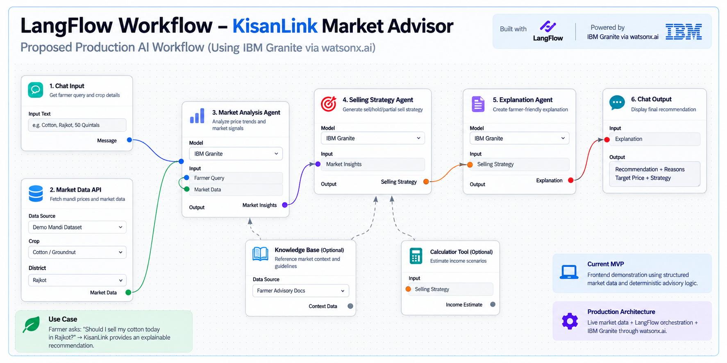

Slide 8
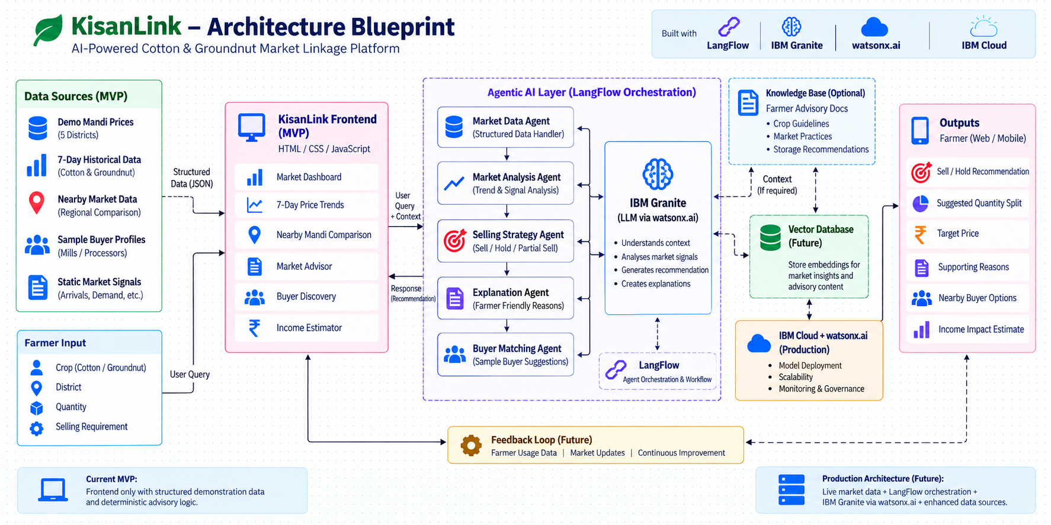

Slide 9

Role of Agentic AI in the solution
Role of Agentic AI in KisanLink
Agentic AI enables KisanLink to function as an intelligent, autonomous market advisor rather than a simple price lookup app. Using IBM watsonx.ai and IBM Granite models, it coordinates multiple specialized agents to deliver a complete sell-or-hold decision, not just a raw price.
Each agent performs a specific role—such as tracking mandi prices, forecasting demand, matching verified buyers, and calculating income impact—while working collaboratively. This multi-agent approach ensures accurate, trustworthy advisory for every farmer query.
Agentic AI also brings context awareness, understanding the farmer's crop, district, and quantity to generate tailored advice. It supports real-time adaptation, continuously updating recommendations as APMC arrivals and mill demand change.
Additionally, agents communicate with each other, enabling better decision-making and higher-confidence sell/hold outcomes.
Overall, Agentic AI makes the system proactive, personalized, and goal-driven, acting like a trusted digital market advisor that helps every farmer earn a fairer price.

Slide 10
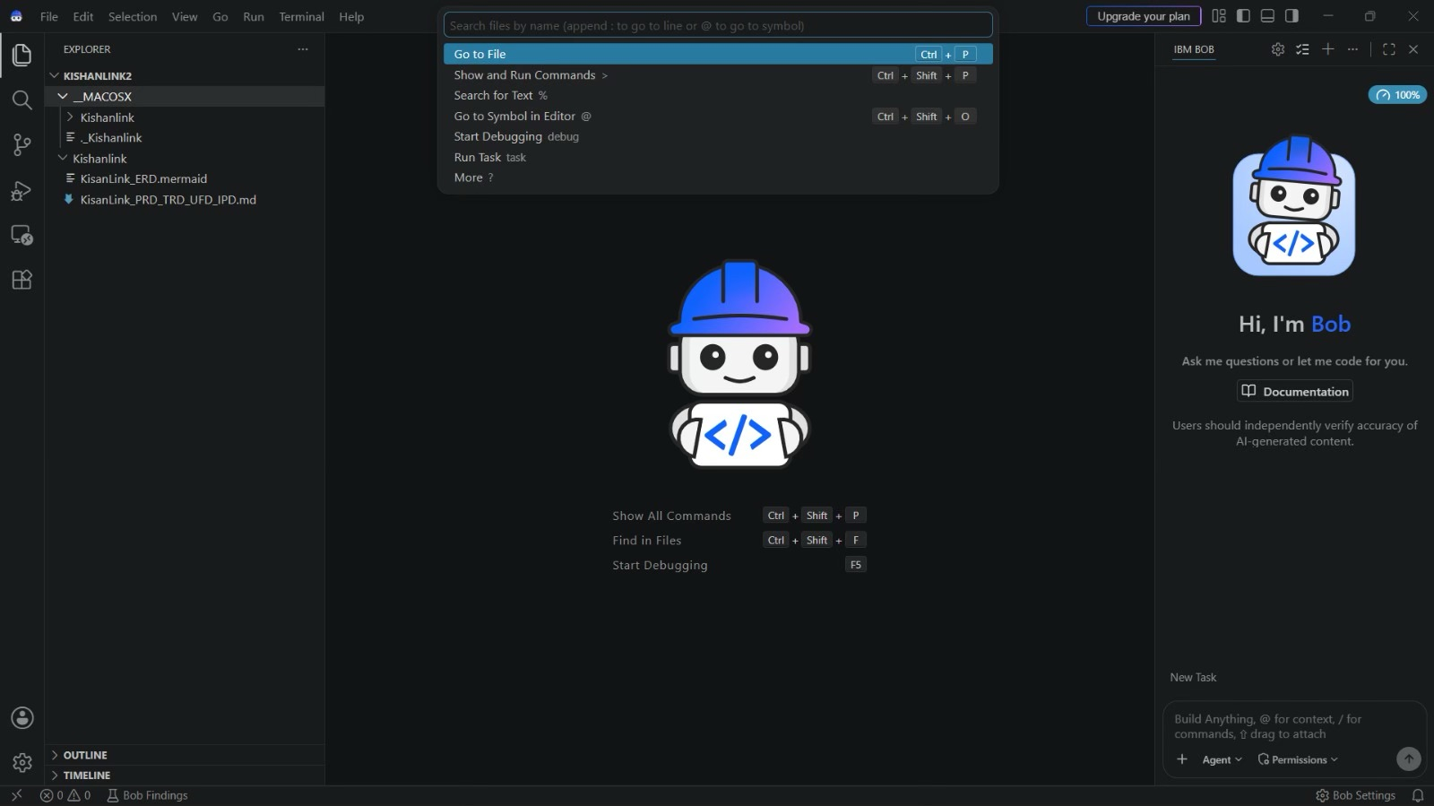
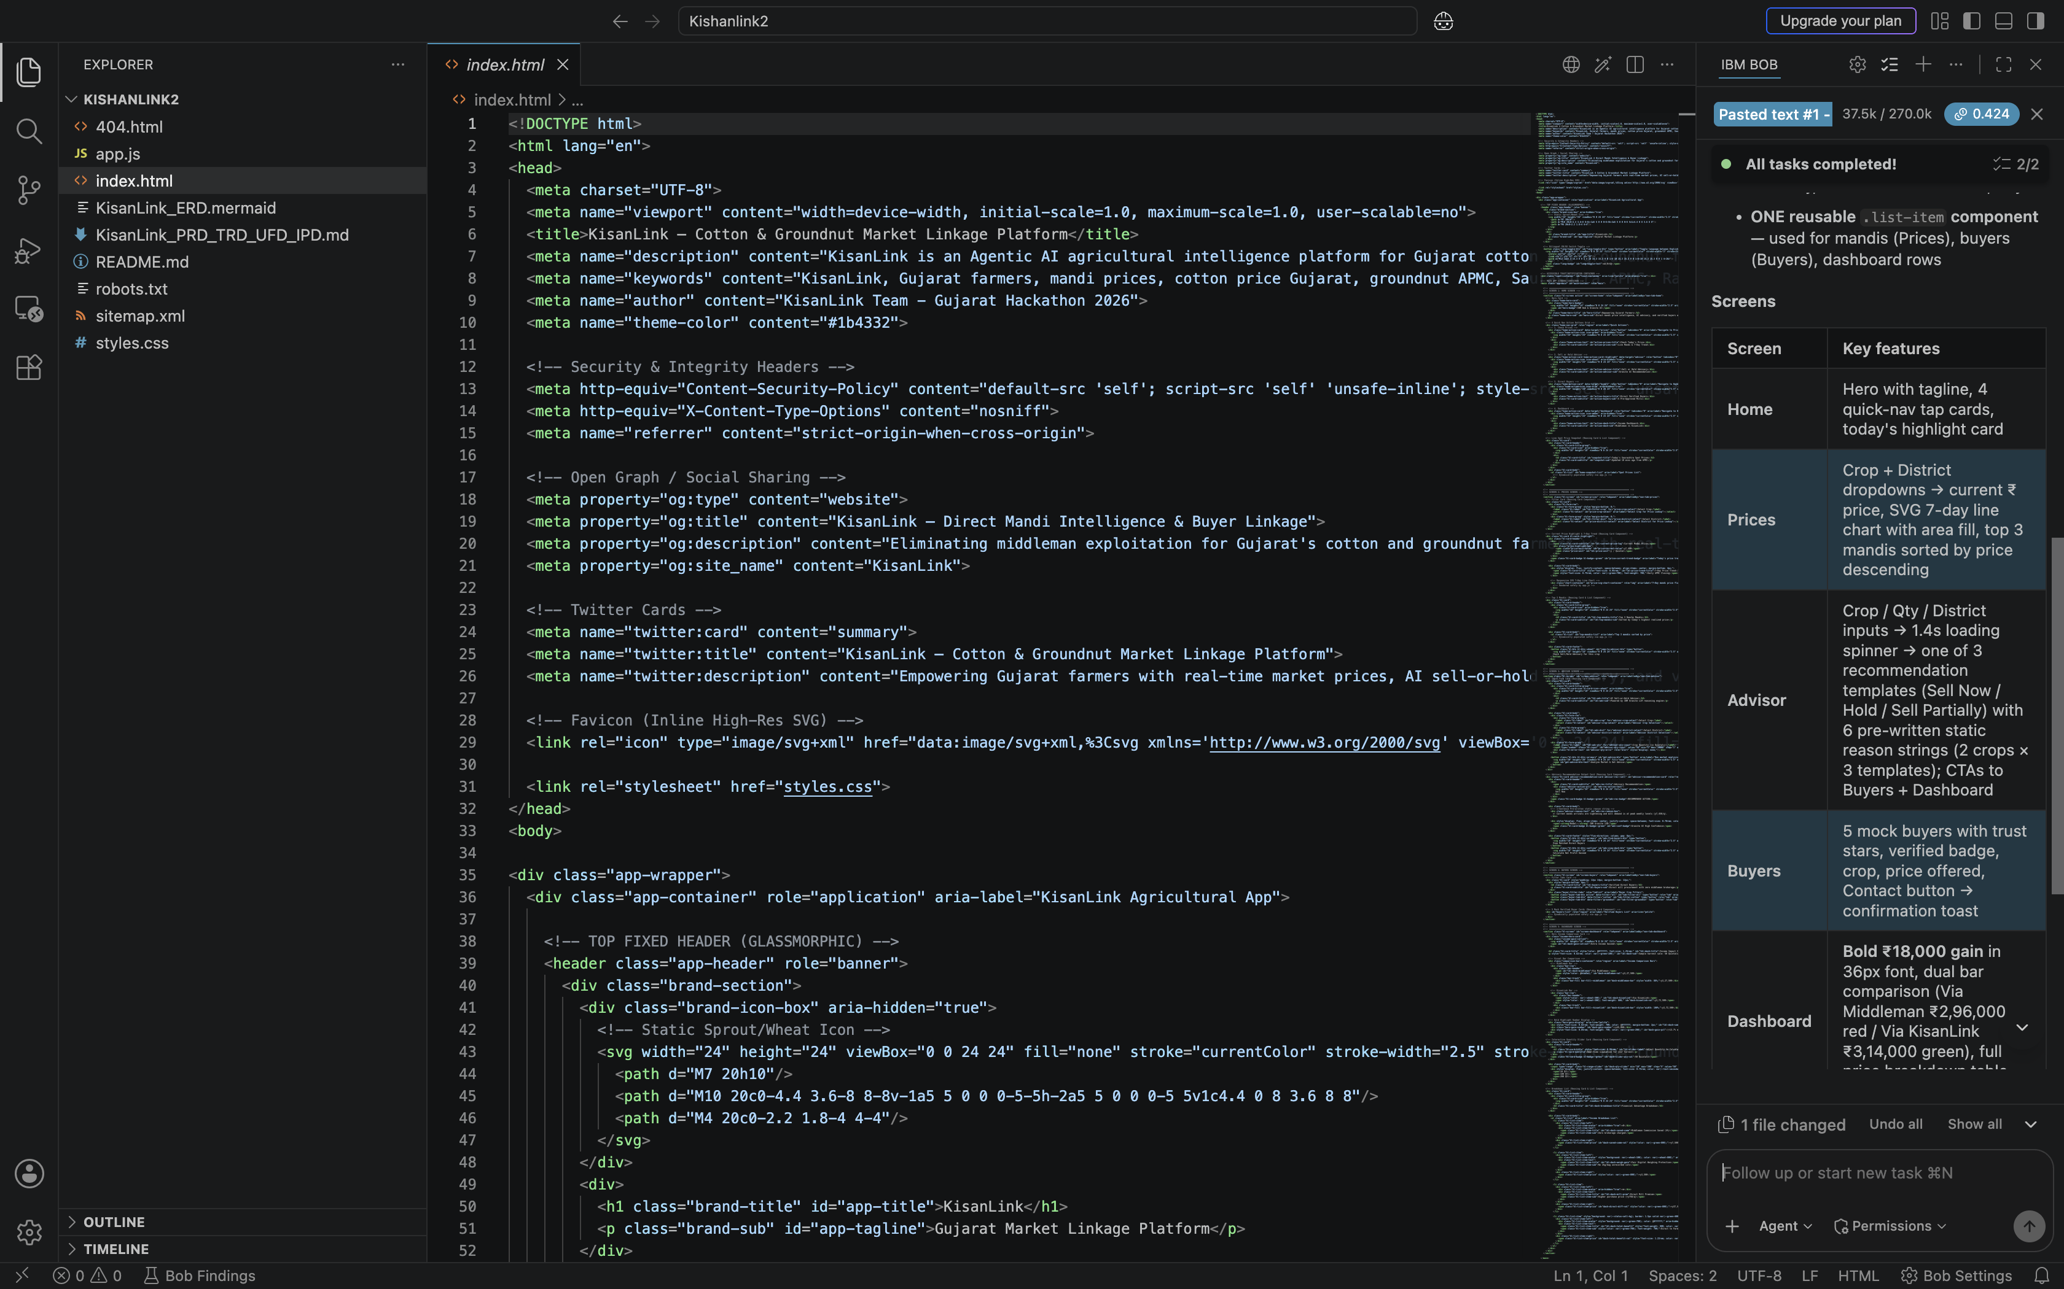
Token Usage
Before Prompt
After the Prompt
·
·
·

Slide 11
Novelty and Uniqueness
KisanLink stands out by combining Agentic AI, real-time price data, and direct buyer linkage into a single intelligent system.
Multi-Agent Intelligence – Instead of a single price-checking app, multiple specialized agents collaborate to deliver accurate and context-aware selling advice.
RAG-Based Accuracy – Integrates real-time APMC data retrieval with AI generation, reducing stale prices and ensuring trustworthy recommendations.
Middleman Elimination – Connects farmers directly to verified mills, removing commission cuts and unfair weighing losses.
Real-Time Sell/Hold Loop – Continuously adapts recommendations based on live mandi arrivals and mill demand.
Income Transparency – A live income impact calculator shows the exact rupee gain from selling via KisanLink versus the middleman route.
Multilingual Access – Built with Gujarati-language support so farmers can use it in their own language.
Scalable & Enterprise-Ready – Built on IBM watsonx.ai with IBM Granite models, ensuring reliability and governance.
This makes the solution a smart, adaptive, and proactive digital market advisor, not just a static mandi price display.

Slide 12
Git Hub Link
GitHub Repository: https://github.com/fazilkhan0786/KIsan_Link_IBM
Live Working Demo: https://fazilkhan0786.github.io/KIsan_Link_IBM/
Repository contents: 1) Full source code for the KisanLink web app 2) KisanLink project presentation (Fazil)(.pdf) 3) KisanLink project presentation (Dhruv)(.pdf)

Slide 13
Future Scope
1. Weather-Integrated Price Forecasting & Crop Insurance Linkage –
KisanLink can integrate satellite and weather data to predict how rainfall, temperature, and sowing patterns will affect cotton and groundnut arrivals and prices weeks in advance. This will also enable linkage to crop insurance schemes, helping farmers protect their income against weather-related crop damage.
2.AI-Powered Voice Assistant & Multilingual Support –
Adding a Gujarati and Hindi voice assistant will let farmers with limited literacy check prices and get sell/hold advice by simply speaking into the app, making KisanLink accessible to every farmer, not just smartphone-literate ones. Future versions can also expand to more crops beyond cotton and groundnut, and add blockchain-based payment tracking for full transaction transparency.

Slide 14
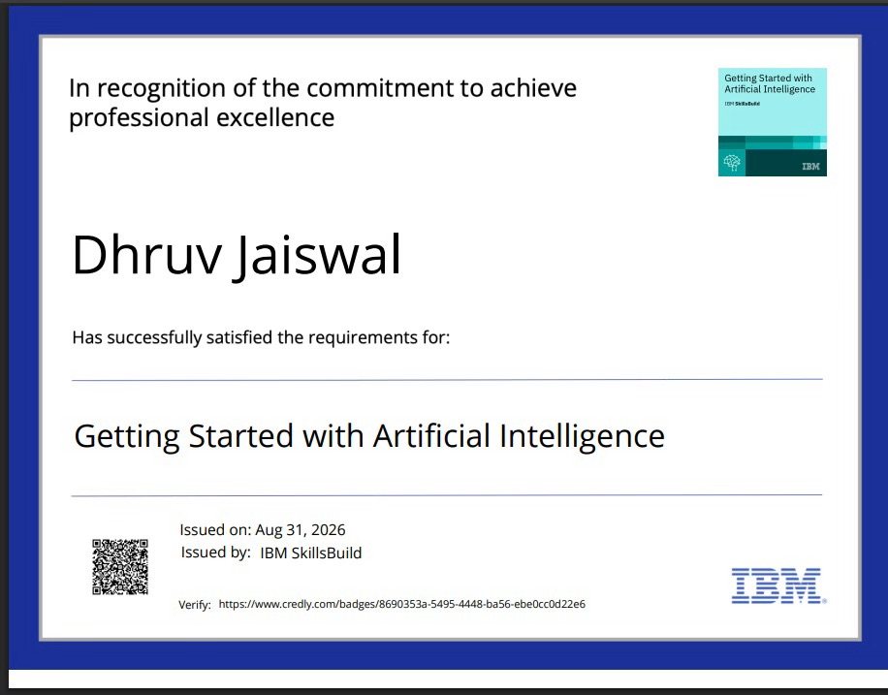
Certificates Earned:
[Insert your Credly certificate image here]

Slide 15
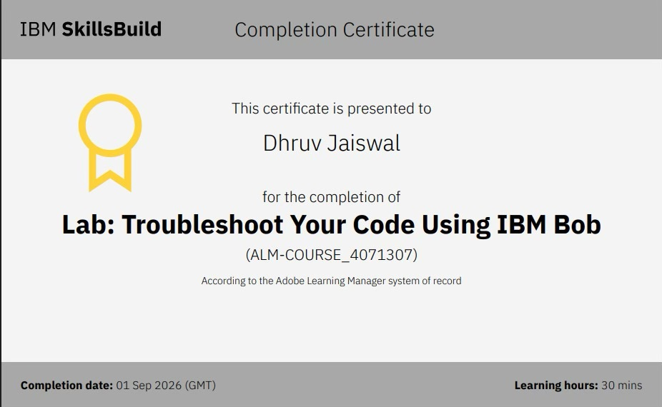
Certificates Earned:​
[Insert your IBM Bob completion certificate image here]

Slide 16


