Slide 1
ICT Cell Center Maintenance and Management System

Slide 2
SPL-2 Project
Proposal Presentation
Team Member
Project Supervisor
Fazle Rabbi (ASH1825004M)
Mahfujur Rahman (ASH1825024M)
Foyzul Karim Pathan (ASH1825033M)
Dipok Chandra Das
Lecturer,
IIT, NSTU

Slide 3
IMMS(ICT Cell Center Maintenance And Management System)
A platform where we can maintain and control the ICT Center Cell and manage and interact with it’s user.

Slide 4
Why IMMS?
Scope?

Slide 5
Features:
Admin module:
Add a new equipment item with label, type, expiry date, included date etc.
Remove an equipment
Update equipment information
See report
Send notification after recover or detect detection to user who send report
Send and edit notice
Edit Authority Details of ICT cell center
Remove notice
See equipment’s details with equipment type, number of equipment type etc.
Change password and log out into the system
See user details and delete user from the System

Slide 6
Features:
User Module:
Log into the system
Send report with description
To update their personal details
See the Authority details
See equipment’s details with equipment type, number of equipment type etc.
Change password and log out into the system
Recover the password
See notice
Log out to the system

Slide 7
Objective
Our main target is to learn:
Benefits from Stakeholder’s perspective:
Working with Database
Making a Web Portal
Making SRS & Database Design
Gathering experience
Control the whole management
Easily maintain the System

Slide 8
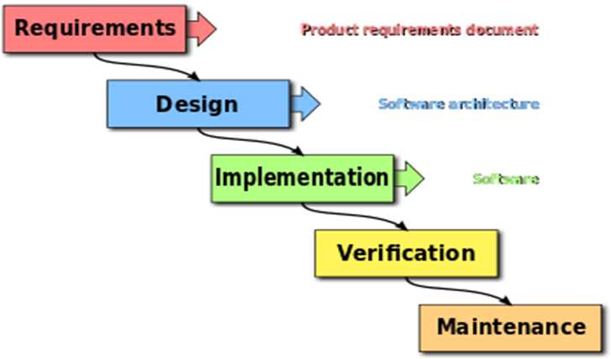
Process Model
In this project, we follow waterfall model. In the waterfall model, the following phases are followed in order:

Slide 9
Technology that can be used
Web Technology
Web 2.0
Language:
Front End | HTML , CSS , JavaScript , JQuery , BootStarp
Back End | PHP, MySql ,Ajax
Change Management:
GitHub

Slide 10
Hardware Requirements
PROCESSOR : Intel dual Core ,i3
RAM : 1 GB
HARD DISK : 80 GB

Slide 11
Software Requirements
Editor | Notepad, Sublime_Text
Database | XAMPP
Project Management | Freedcamp
Change Management | Gitt

Slide 12
Proposed Timeline
Task | Deadline
Project Proposal | 12th of February
Requirement Analysis, Specification, SRS | Within 8th of March
Designing & Study | From 28th of March
Coding | Within 15th of April
Final Testing | From 3rd of May

Slide 13
Work Distributions
Task | Members
Proposal | Fazle Rabbi , Mahfujur Rahman , Foyzul Karim Pathan
Requirement Analysis, Specification | Fazle Rabbi , Mahfujur Rahman , Foyzul Karim Pathan
Design | Fazle Rabbi , Mahfujur Rahman , Foyzul Karim Pathan
Study | Fazle Rabbi , Mahfujur Rahman , Foyzul Karim Pathan
Coding | Fazle Rabbi , Mahfujur Rahman , Foyzul Karim Pathan
Testing | Fazle Rabbi, Mahfujur Rahman , Foyzul Karim Pathan

Slide 14
Deliverables
Stakeholders:
Source code(if requires)
User manual
SPL – II Committee:
Project Proposal Document
SRS
Project analysis Document
Database Design
UI(User Interface) Design
Source code

Slide 15
Conclusion
ICT Cell maintenance and management project will be a great opportunity for us to build up our self as a good software engineer. This project will helpful for ICT Cell and also for our IIT. we hope this project will be a game changer for us.

Slide 16


