Slide 1
CASE STUDY OF SERVICE RETAIL STORE
BDM Capstone Project — Viva Presentation
85 days
71 SKUs
₹91,675
₹20,210
Observation period
Products analysed
Revenue
Gross profit
Submitted by: FAZLUN NISHA
Roll No. 24f1000564 | IITM Online BS Degree Program
1

Slide 2
1. Organization Background
• Small community/campus retail outlet in Kolkata.
• Serves students, hostel residents, local residents and staff.
• Main product groups: Food, Cleaning, Personal Care and Stationery.
• Study focus: inventory imbalance, margin leakage and cross-category selling.
4
3
Product categories
Linked data sheets
924
179
Sales lines
Purchase records
2

Slide 3
2. Problem Statements / Objectives
01
02
03
Inventory imbalance
Margin leakage
Cross-category selling
Identify understocked fast-moving items and overstocked slow-moving items.
Compare category margins and wastage to identify where profitability is being lost.
Identify category combinations that can support simple cross-selling actions.
3

Slide 4
3. Data Collection & Methodology
85 days
71
141
3
Primary data: 02 May–25 Jul 2026
SKUs
Inventory count entries
Sales / Purchase / Inventory
• Source: shopkeeper's sales register, purchase records and rolling physical stock counts.
• Excel: cleaning, formulas, summaries and category analysis; Python: cross-check and presentation-quality charts.
• Inventory: ABC-style classification + stock cover + indicative reorder point.
• Margins: category margin statistics + wastage analysis.
• Cross-selling: customer-segment affinity + same-day customer-type proxy basket.
4

Slide 5
4. Data Cleaning & Validation
• Checked missing core fields and recovered values from register records where possible.
• Flagged duplicate-looking rows and verified them manually.
• Screened Quantity Sold and Revenue outliers using the IQR rule.
• Standardised product names/categories using a lookup table and XLOOKUP.
• Recomputed Revenue and Inventory closing stock to validate results.
₹91,675
Recomputed revenue
₹71,465
Cost of goods sold
₹20,210
Gross profit
5

Slide 6
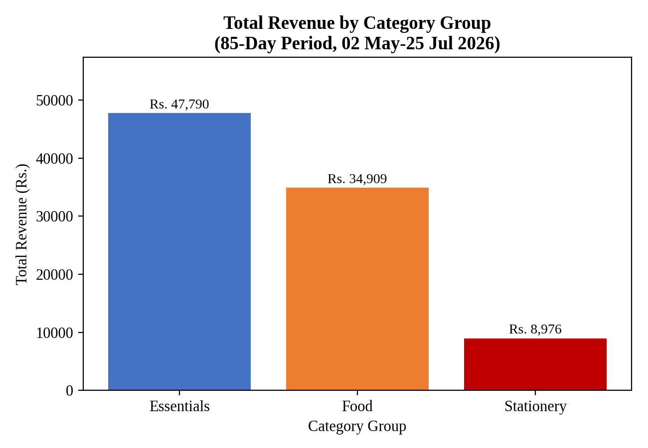
5. Results — Revenue & Profitability
• Essentials: ₹47,790 (52.1%) of revenue.
• Food: ₹34,909 (38.1%).
• Stationery: ₹8,976 (9.8%).
• Overall gross profit: ₹20,210 on ₹91,675 revenue.
6

Slide 7
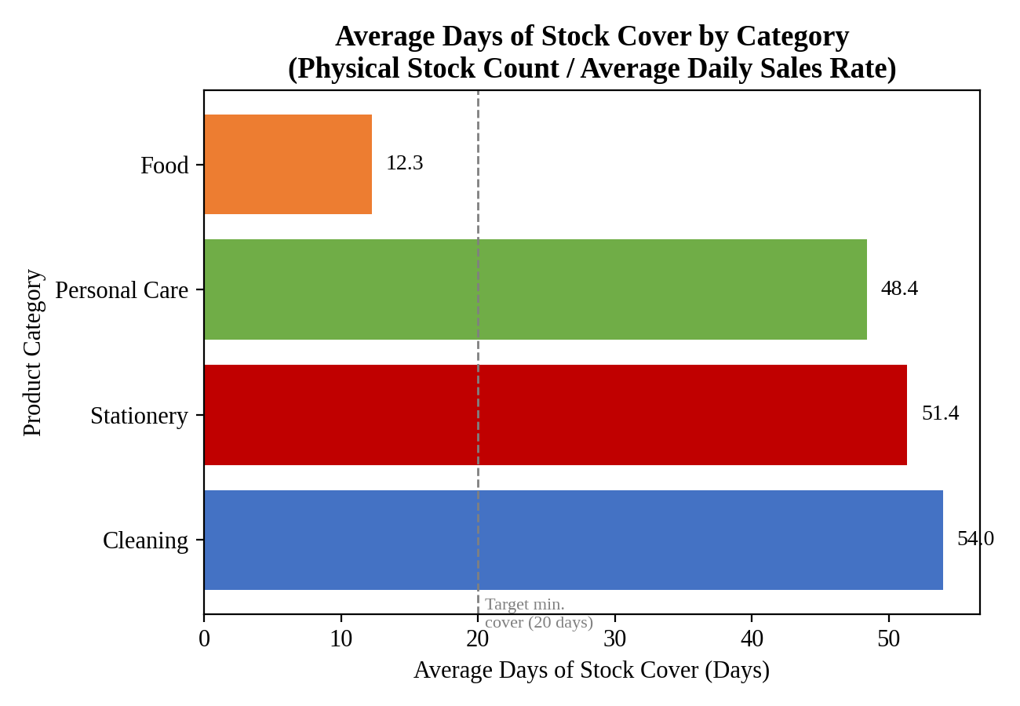
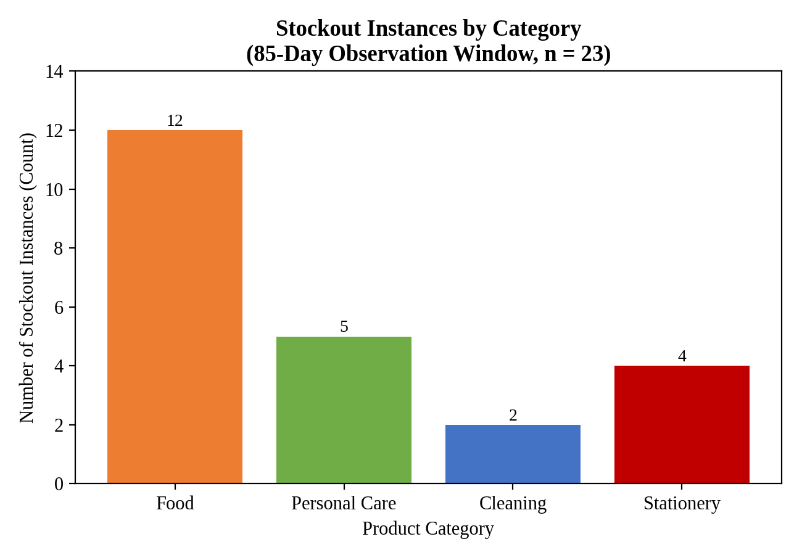
6. Results — Inventory Imbalance
• Food: 12.3 days of stock cover and 12 stockout instances.
• Cleaning: 54.0 days; Personal Care: 48.4; Stationery: 51.4.
• 23 stockout instances were recorded in total.
• 24 products had more than 45 days of stock cover.
7

Slide 8
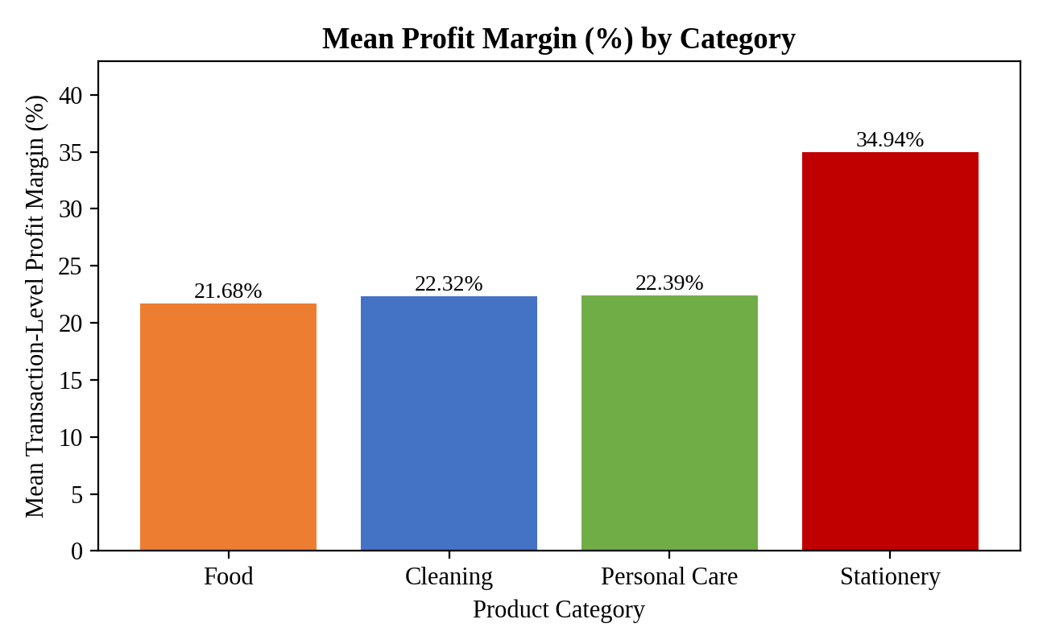
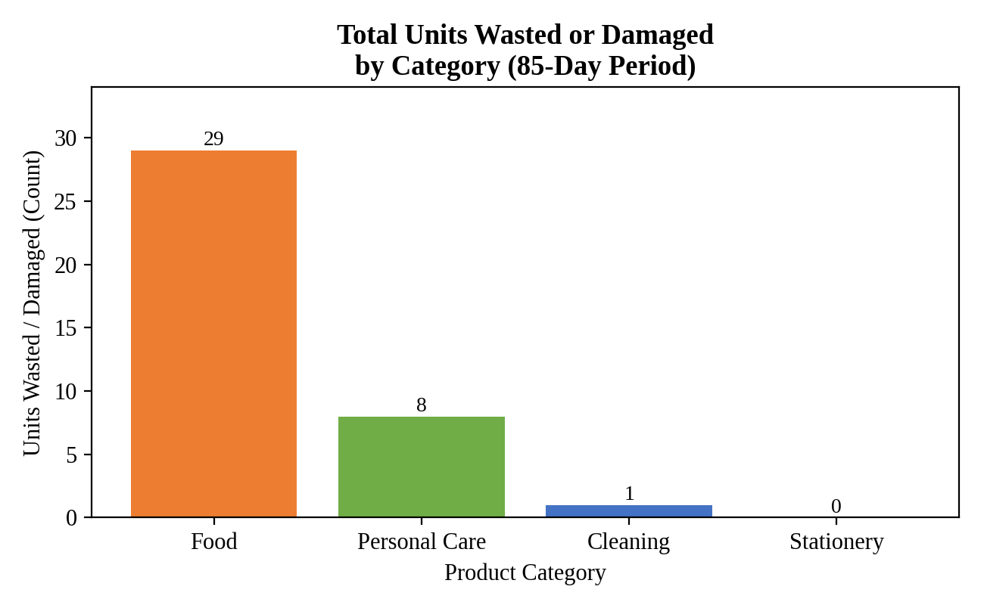
7. Results — Margin & Wastage
• Stationery had the highest mean transaction margin: 34.94%.
• Food had the lowest mean transaction margin: 21.68%.
• Food had the highest recorded wastage: 29 units.
• Food's margin gap is linked in the report to wastage and stockout-related lost sales.
8

Slide 9
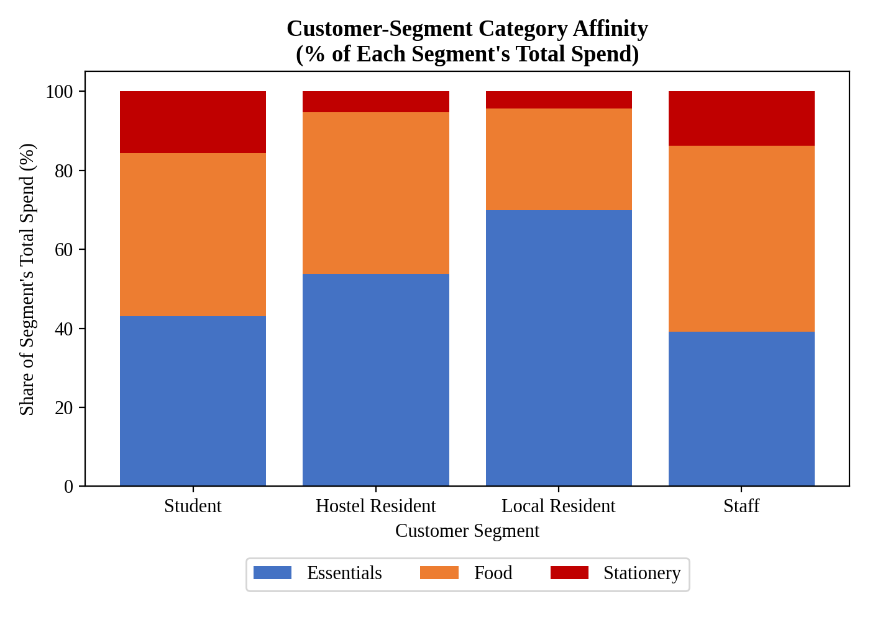
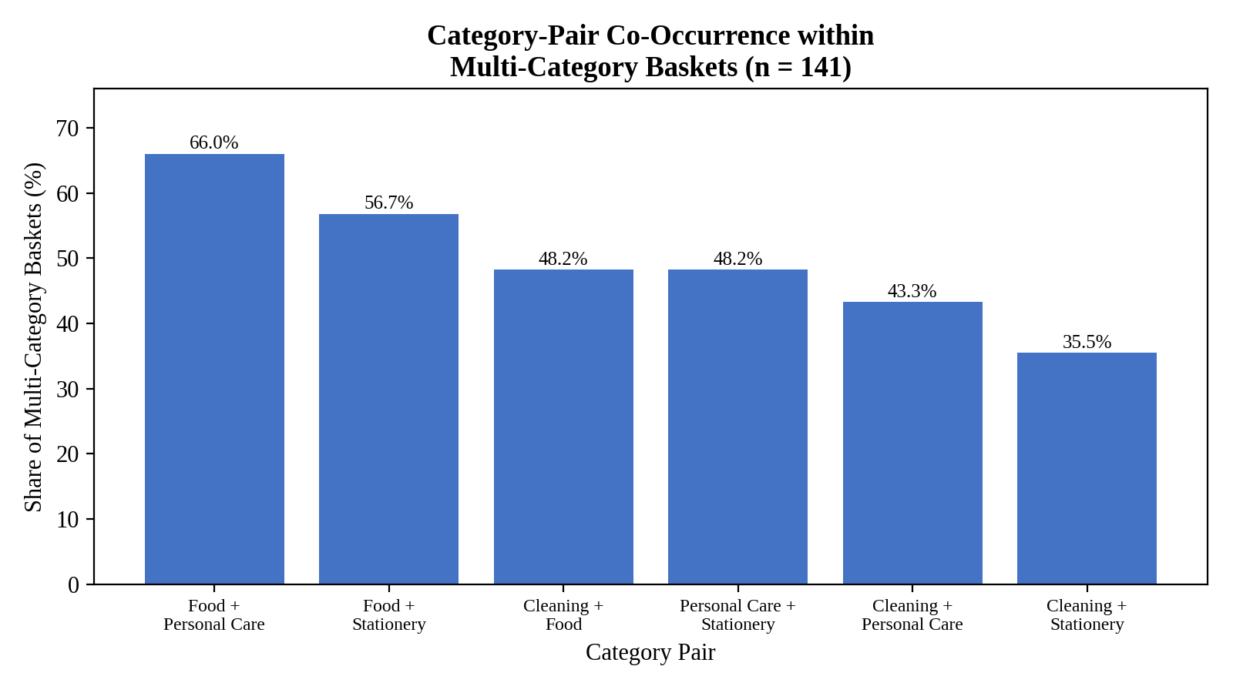
8. Results — Cross-Category Selling
• 150 customer-type/day groupings; 141 (94%) included more than one category.
• Food + Personal Care was the most frequent pairing: 66.0%.
• This is a proxy analysis because no transaction/basket ID was available.
9

Slide 10
9. Recommendations & Conclusion
• Increase Food restocking frequency; use ~22 units as an indicative reorder trigger.
• Reduce order quantities for slow-moving SKUs above 45 days of cover.
• Use markdown/clearance triggers before Food items approach expiry.
• Test Food + Personal Care shelf adjacency or a small bundle.
• Track outcomes with a simple before/after comparison.
KEY TAKEAWAY
The three issues are connected:
• Food is fast-moving but understocked.
• Food also has the highest wastage and lower margin.
• Cross-selling can be tested alongside inventory correction.
The recommendations are low-cost and based on the existing store data.
10

