Slide 1
Observer Pattern
CS 477 Design Patterns with Java
Go4 # 19 HFDP #2
Week #10

Slide 2
Intent
Define a one to many dependency between objects so that when one object changes state, all its dependents are notified and updated automatically.(Go4)

Slide 3
Dilemma
You have successfully partitioned a system into loosely coupled entities, but now consistency must be maintained across the division.
A change to one object requires the change to an unknown number of other objects.
Objects need to notify other objects of an event taking place, but don’t need to know what kind of objects they are - (i.e. you don’t want to violate encapsulation)

Slide 4
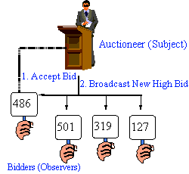
Conceptual Solution

Slide 5
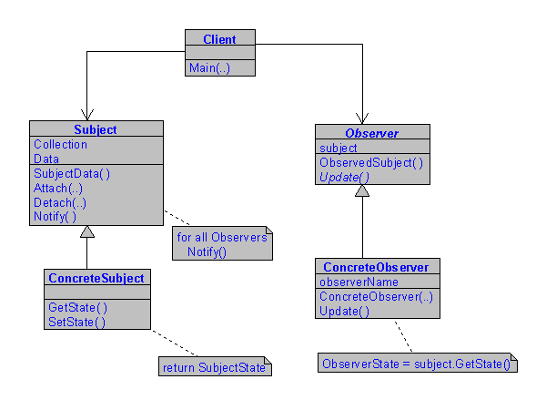
Structure

Slide 6
In Practice
Purpose
Decouple independent sender from dependent receivers
When to use
To support multiple views of the same model
Decouples model from number and type of views
Views are capable of getting info from model

Slide 7
Examine Some Code
Simple Observer Example
Accumulator Observer Example (simple)
Accumulator Observer Example (complex)

Slide 8
Weather Station Example
public class WeatherData {
public void measurementChanged()
{
float temp = getTemperature();
float hum = getHumidity();
float pres = getPressure();
currentConditionsDisplay(temp, hum, pres);
statisticsDisplay(temp, hum, pres);
forecastDisplay(temp, hum, pres);

Slide 9
Weather Station (tightly coupled)
public class WeatherData { // TIGHTLY COUPLED
public void measurementChanged()
{
float temp = getTemperature();
float hum = getHumidity();
float pres = getPressure();
currentConditionsDisplay(temp, hum, pres);
statisticsDisplay(temp, hum, pres);
forecastDisplay(temp, hum, pres);

Slide 10
Weather Station (tightly coupled)
public class WeatherData { // TIGHTLY COUPLED
public void measurementChanged()
{
float temp = getTemperature(); Get data
float hum = getHumidity(); from MODEL
float pres = getPressure();
currentConditionsDisplay(temp, hum, pres);
statisticsDisplay(temp, hum, pres);
forecastDisplay(temp, hum, pres);

Slide 11
Weather Station (tightly coupled)
public class WeatherData { // TIGHTLY COUPLED
public void measurementChanged()
{
float temp = getTemperature();
float hum = getHumidity();
float pres = getPressure();
currentConditionsDisplay(temp, hum, pres); send to
statisticsDisplay(temp, hum, pres); VIEW
forecastDisplay(temp, hum, pres);

Slide 12
Weather Station (tightly coupled)
public class WeatherData { // TIGHTLY COUPLED
// CONTROLLER
public void measurementChanged()
{
float temp = getTemperature();
float hum = getHumidity();
float pres = getPressure();
currentConditionsDisplay(temp, hum, pres);
statisticsDisplay(temp, hum, pres);
forecastDisplay(temp, hum, pres);

Slide 13
Weather Station (looser)
public class WeatherData implements Subject{ //LOOSER
ArrayList observers = new ArrayList();
public void registerObserver(Observer o)
{
observers.add(o);
}
public void removeObserver(Observer o)
{
int index = observers.indexOf(o);
if (index >=0) observers.remove(index);
}
: // VIEWS add themselves, CONTROLLER knows nothing

Slide 14
Weather Station (looser)
public class WeatherData implements Subject{ // CONT.
:
public void measurementsChanged()
{
notifyObservers();
}
public void notifyObservers()
{
for (int i=0;i<observer.size(); i++)
{
Observer observer = (Observer)observers.get(i);
observer.update(temp, hum, pres);
}
}
:
// Updating VIEWS requires no knowledge of them

Slide 15
Weather Station (looser)
public class WeatherData implements Subject{ //CONT.
:
public void setMeasurements(float t, float h, float p)
{
temp = t;
hum = h;
pres = p;
measurementsChanged();
}
// CONTROLLER does know about the MODEL
}

Slide 16
How Can We Do Better?
The fewer dependencies of the Controller on the View and the Model – the better!
We’ve eliminated the connection between the Controller and the Views with the Observer pattern
What about the Model?

Slide 17
Weather Station (loosely coupled)
public class WeatherData implements Subject{ //LOOSELY
implements Observer
ArrayList observers = new ArrayList();
public void registerObserver(Observer o)
{
observers.add(o);
}
public void removeObserver(Observer o)
{
int index = observers.indexOf(o);
if (index >=0) observers.remove(index);
}
: // VIEWS add themselves, CONTROLLER knows nothing

Slide 18
Weather Station (loosely coupled)
public class WeatherData implements Subject{ // CONT.
implements Observer
:
public void measurementsChanged()
{
notifyObservers();
}
public void notifyObservers()
{
for (int i=0;i<observer.size(); i++)
{
Observer observer = (Observer)observers.get(i);
observer.update(Object oForView);
}
}
:
// Updating VIEWS passing in unknown information

Slide 19
Weather Station (loosely coupled)
public class WeatherData implements Subject{ //CONT.
implements Observer
:
model.registerObserver(this); // CONTROLLER observes MODEL
public void update(Object oFromModel)
{
oForView = oFromModel;
}
// CONTROLLER does NOT know about the MODEL or its data
}

Slide 20
Dual Observer-Observer Example
Sets up an arbitrarily long cascade of objects observing the previous one
Acts like an execution stack during a recursive program

Slide 21
public class DualClass extends Observable implements Observer{
private static int value = 1;
private int num;
public DualClass(int num) {
this.num = num;
}
public void begin(){
setChanged();
notifyObservers(new Object());
}
public void update(Observable o, Object obj){
System.out.println("Object " + num + ", Value " + value);
value = value * 2;
setChanged();
notifyObservers(new Object());
System.out.println("Object " + num + ", Value " + value);
value = value * 2;
}
}

Slide 22
Observer-Observable Structure
HEAD

Slide 23
Observer-Observable Structure
HEAD

Slide 24
Observer-Observable Structure
HEAD

Slide 25
Observer-Observable Structure
HEAD

Slide 26
Observer-Observable Structure
HEAD

Slide 27
public class Init {
private int LISTSIZE = 11;
private DualClass head, tempNode1, tempNode2;
public Init() {
head = new DualClass(0);
tempNode1 = new DualClass(1);
head.addObserver(tempNode1);
for(int i=2;i<=LISTSIZE;i++){
tempNode2 = new DualClass(i);
tempNode1.addObserver(tempNode2);
tempNode1 = tempNode2;
}
head.begin();
}
public static void main(String args[]){
Init init = new Init();
}
}

Slide 28
Object 1, Value 1
Object 2, Value 2
Object 3, Value 4
Object 4, Value 8
Object 5, Value 16
Object 6, Value 32
Object 7, Value 64
Object 8, Value 128
Object 9, Value 256
Object 10, Value 512
Object 11, Value 1024
Object 11, Value 2048
Object 10, Value 4096
Object 9, Value 8192
Object 8, Value 16384
Object 7, Value 32768
Object 6, Value 65536
Object 5, Value 131072
Object 4, Value 262144
Object 3, Value 524288
Object 2, Value 1048576
Object 1, Value 2097152

Slide 29
Observer-Observable Structure
HEAD

Slide 30
Observer-Obserable Structure
HEAD
Value: 1

Slide 31
Observer-Obserable Structure
HEAD
Value: 2

Slide 32
Observer-Obserable Structure
HEAD
Value: 4

Slide 33
Observer-Obserable Structure
HEAD
Value: 8

Slide 34
Observer-Obserable Structure
HEAD
Value: 1024

Slide 35
Observer-Obserable Structure
HEAD
There is no link from Head “downstream”,
in fact, there are only upstream links
in the entire structure.
How does execution go back “up”
this structure?

Slide 36
Push vs. Pull
PUSH: Subject sends ALL information out to the observers, who can pick and choose
PULL: Observers pick and choose which information to obtain from the subject

Slide 37
Push vs. Pull Implementation
Let’s write some code!

Slide 38
Conclusion
Basic idea is to be able to separate cause and effect, but maintain consistency across many, loosely coupled classes

Slide 39
Discussion
It has been said that the Observer-Observable pattern is like having a listener for “whatever you want” in what ways do you agree with this?
What are other applications for this pattern?

