Slide 1
Template Method Pattern
CS 399 Design Patterns with Java
HFDP # 8 Go4 #22
Week # 6
Week #6
Template Method Pattern

Slide 2
Intent
Define the skeleton of an algorithm in an operation, deferring some steps to subclasses. Template Method lets subclasses redefine certain steps of the algorithm without changing the algorithm’s structure.(Go4)
Week #6
Template Method Pattern

Slide 3
Dilemma
Have to implement several similar algorithms, all that differ in specific sub-portions
A large number of subclasses have a common behavior
You need to allow subclasses, but don’t want to support arbitrary extensions. You only want children that conform to specific constraints to be allowed.
Week #6
Template Method Pattern

Slide 4
Digression
Four ways sub-classes use parent’s methods
  Inherit concrete methods
  Implement abstract methods
  “Hook” methods default that is meant to be overwritten
  Template methods (DP) - methods that call any combination of those three types
Week #6
Template Method Pattern

Slide 5
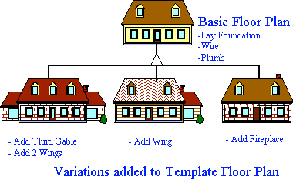
Conceptual Solution
Week #6
Template Method Pattern

Slide 6
In Practice
Purpose
  Common algorithm and placeholders in base class, variable steps in sub-classes
When to use
  Individual steps of an algorithm are definable or replaceable
  System needs to provide hooks for future extensibility
  The invariant parts of an algorithm are implemented in one place and reused in others
Week #6
Template Method Pattern

Slide 7
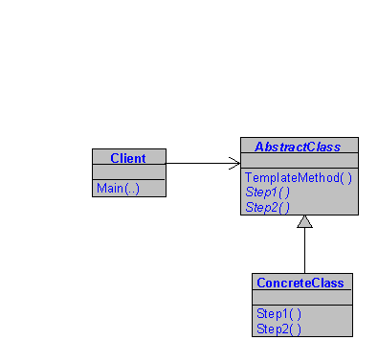
Structure (Go4)
Cool, another easy one...
Week #6
Template Method Pattern

Slide 8

London Vacation Calculator
Three different options:
London Sights, European Cities, English Countryside Biking
Week #6
Template Method Pattern

Slide 9
London Vacation
All vacations have:
  Roundtrip flight from Cleveland to London
  One night stay in London on arrival
Each option has custom features:
  Additional travel depending on plans
  Additional lodging depending on destinations
Week #6
Template Method Pattern

Slide 10
Three Implementations
Separate Methods
  Different method for each option
Single Combined Method
  Different options handled with conditionals
Template Method Pattern
  Different options handled by sub-classes
Week #6
Template Method Pattern

Slide 11
Examine the Code!
Week #6
Template Method Pattern

Slide 12
Separate Methods
Repeated code
Maintenance issues (changes to repeated code)
Extensions independent, but require more repeated code
Week #6
Template Method Pattern

Slide 13
Combined Method w/ Conditionals
Avoids repeated code
Maintenance issues (multiple conditionals)
Extensions difficult, code is tightly coupled
Week #6
Template Method Pattern

Slide 14
Template Method
Avoids repeated code
Few maintenance issues (encapsulated)
Extensions easy! Code is loosely coupled
Week #6
Template Method Pattern

Slide 15
Conclusion
Template Method pattern supports code re-use
Define overall types and sequences steps of an algorithm
Allows subclasses to make specializations within those parameters
Week #6
Template Method Pattern

Slide 16
Discussion
How can the Template method pattern and the Strategy pattern be used together?
How can the TM and the Decorator be used together?
Can TM be done with composition?
Is this a cool pattern, or what?
Well, *I* think it’s cool!
Week #6
Template Method Pattern

