Slide 1
Decorator Pattern
CS 399 Design Patterns with Java
Week #5
Week #5
Decorator Pattern

Slide 2
Intent
Attach additional responsibilities to an object dynamically. Decorators provide a flexible alternative to sub-classing for extending functionality.(Go4)
Week #5
Decorator Pattern

Slide 3
Dilemma
You have lots of features that you want to add to objects (not classes) dynamically
Because of the wide combinations of features, sub-classing would be a nightmare
Subclassing impacts ALL created objects
Adding new features should not depend on previously added features.
Week #5
Decorator Pattern

Slide 4
StarBuzz Coffee
A set of basic classes (Latte, HouseBlend, etc.)
Lots of ways to augment (whip, soy, mocha)
Produce a combinatorial explosion of subclasses in using inheritance (whipSoySoyLatte)
Need to dynamically change the augmentations
Need to do it seamlessly w.r.t existing code
Week #5
Decorator Pattern

Slide 5
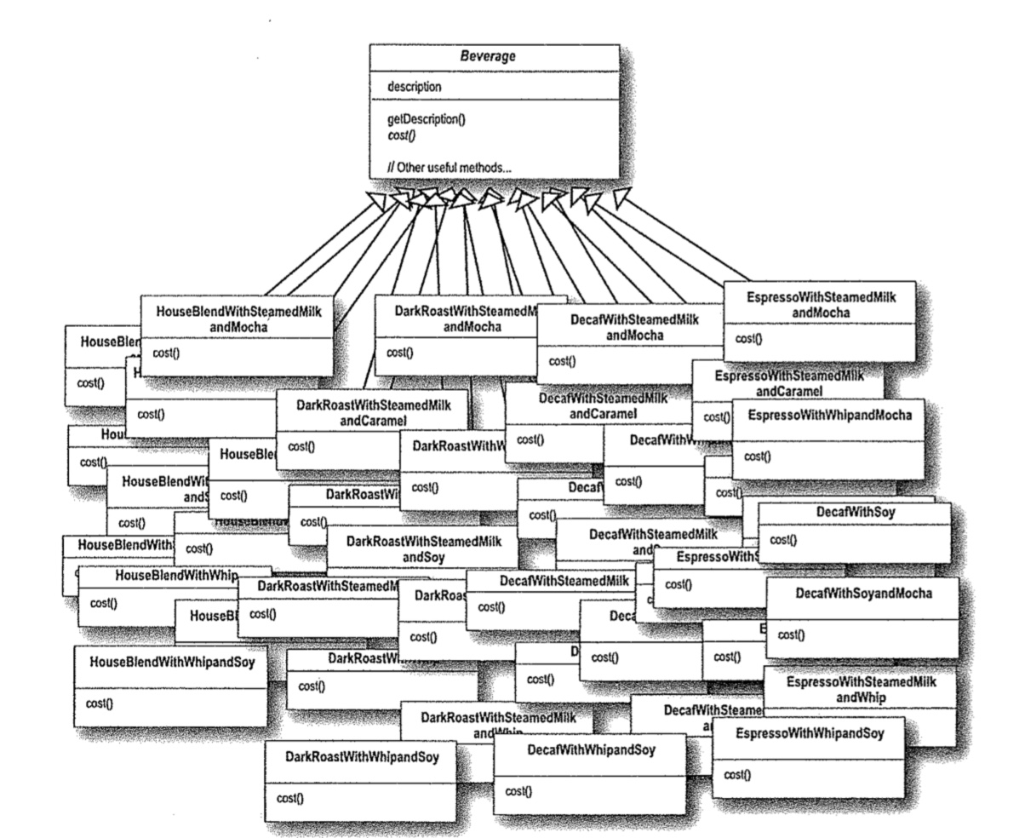
Class Explosion
Week #5
Decorator Pattern

Slide 6
In Practice
Purpose
  Recursive wrappering that supports object-specific, incremental embellishment
When to use
  You need runtime flexibility
  Layerable functionality, each embellishment has a transparent interface to the nested component
  Removable functionality
Week #5
Decorator Pattern

Slide 7
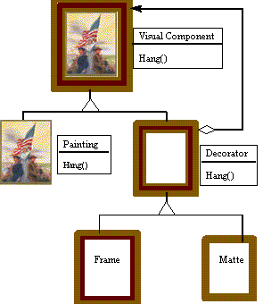
Conceptual Solution
Week #5
Decorator Pattern

Slide 8
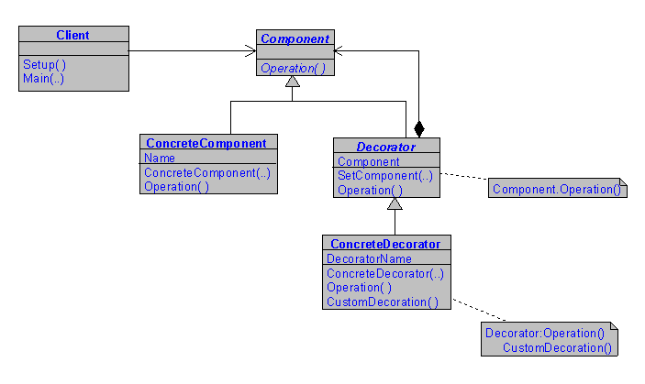
Structure
Week #5
Decorator Pattern

Slide 9
Verse Program
Haiku and Limericks
Verse Decoration same class as Verse
Can add
  Top and bottom frills
  Author
  Type indicator
Week #5
Decorator Pattern

Slide 10
Whitecaps on the bay
A broken signboard banging
In the April wind.
HAIKU:
Whitecaps on the bay:
A broken signboard banging
In the April wind.
HAIKU:
Whitecaps on the bay:
A broken signboard banging
In the April wind.
Richard Wright
Week #5
Decorator Pattern

Slide 11
@=@=@=@=@=@=@=@=@=@=@=@=@=@=@=@
HAIKU:
Whitecaps on the bay:
A broken signboard banging
In the April wind.
Richard Wright
###############################
Week #5
Decorator Pattern

Slide 12
public abstract class Verse {
public abstract void display();
}
Week #5
Decorator Pattern

Slide 13
public class Haiku extends Verse{
private String firstFiveSyl, sevenSyl, secondFiveSyl;
public Haiku(String line1, String line2, String line3) {
firstFiveSyl = line1;
sevenSyl = line2;
secondFiveSyl = line3;
}
public void display(){
System.out.println(firstFiveSyl);
System.out.println(sevenSyl);
System.out.println(secondFiveSyl);
System.out.println();
}
}
Week #5
Decorator Pattern

Slide 14
public abstract class VerseDecorator
extends Verse{
protected Verse component;
public void display(){
component.display();
}
}
Week #5
Decorator Pattern

Slide 15
public class TypeTitle extends VerseDecorator{
private String title;
public TypeTitle(String title, Verse comp) {
component = comp;
this.title = title;
}
public void display(){
System.out.println(title + ": ");
component.display();
}
}
Week #5
Decorator Pattern

Slide 16
public class TypeAuthor extends VerseDecorator{
public TypeAuthor(Verse comp, String author) {
component = comp;
}
public void display(){
component.display();
System.out.println(“ “+author);
System.out.println();
}
}
Week #5
Decorator Pattern

Slide 17
Haiku haiku1 = new Haiku(
“Whitecaps on the bay”,
“A broken signboard banging”,
“In the April wind.”);
haiku.display();
haiku = new TypeTitle(“HAIKU”, haiku);
haiku.display();
haiku = new Author(haiku,“Richard Wright”);
haiku.display();
Week #5
Decorator Pattern

Slide 18
Whitecaps on the bay
A broken signboard banging
In the April wind.
HAIKU:
Whitecaps on the bay:
A broken signboard banging
In the April wind.
HAIKU:
Whitecaps on the bay:
A broken signboard banging
In the April wind.
Richard Wright
Week #5
Decorator Pattern

Slide 19
haiku = new TopFrill(haiku);
haiku = new EndFrill(haiku);
haiku.display();
Week #5
Decorator Pattern

Slide 20
@=@=@=@=@=@=@=@=@=@=@=@=@=@=@=@
HAIKU:
Whitecaps on the bay:
A broken signboard banging
In the April wind.
Richard Wright
###############################
Week #5
Decorator Pattern

Slide 21
Haiku Example
Concrete component: Haiku
Decorator: VerseDecorator
Component: Verse
ConcreteDecoratorA: TopFrill
ConcreteDecoratorB: EndFrill
ConcreteDecoratorC: Author
ConcreteDecoratorD: TypeTitle
Week #5
Decorator Pattern

Slide 22
Decorated Haiku
EndFrill
TopFrill
Author
Title
Haiku
Week #5
Decorator Pattern

Slide 23
Examine the Code
Week #5
Decorator Pattern

Slide 24
More StarBuzz
Calculation of cost
Passed up and down through the hierarchy
  Calculate the cost for a:
    “Whipped, Mocha, Mocha, Soy, HouseBlend”
  Whipped adds 20 cents
  Mocha adds 60 cents (twice)
  Soy adds 40 cents
  HouseBlend base price $1.89
Requests for cost travels down
Concrete costs travel up (see next slide)
Week #5
Decorator Pattern

Slide 25
Whipped Double Mocha Soy HouseBlend
Bev.cost()
Whipped
Mocha
Mocha
Bev.cost()
Soy
Bev.cost()
House
Bev.cost()
Bev.cost()
Bev.cost()
1.89
1.89
+ .40
2.29
+ .60
2.89
3.49
+ .60
3.69
+ .20
Week #5
Decorator Pattern

Slide 26
Issue
Decorators can replace primary component behavior - how’s that work?
Need to add a new decoration: Rating
  Clean - just state that the poem is clean
  Dirty - change the behavior
Then set the rating at creation time
Week #5
Decorator Pattern

Slide 27
Clean Limerick
display()
Top Frill
Bottom Frill
Rating
display()
Author
display()
Limerick
display()
display()
Display()
Fully Decorated
Limerick
Week #5
Decorator Pattern

Slide 28
@@@@@@@@@@@@@@
<clean>
There are creatures who write code on Saturn And unlike smart people that learn Their code was a waste They'd only cut 'n paste They never heard of a Design Pattern
J. Hacker
#########################
Week #5
Decorator Pattern

Slide 29
Dirty Limerick
display()
Top Frill
Bottom Frill
Rating
display()
Author
display()
Limerick
display()
Partially Decorated
Blacked Out Limerick
Week #5
Decorator Pattern

Slide 30
@@@@@@@@@@@@@@
<dirty>
XXXXXXXXXXXXXXXXXXXXXXXXXXXXX
XXXXXXXXXXXXXXXXXXXXXXXXXXXXX
Get your mind out of the Gutter
XXXXXXXXXXXXXXXXXXXXXXXXXXXXX
XXXXXXXXXXXXXXXXXXXXXXXXXXXXX
#########################
Week #5
Decorator Pattern

Slide 31
public class Rating extends VerseDecorator{
private boolean isClean;
public Author(boolean isClean, Verse comp)
{ this.isClean = isClean;
component = comp;
}
public void display()
{
if (isClean) {
System.out.println(“<clean>”);
component.display();
}
else
{
System.out.println(“<dirty>”);
System.out.println(“xxxxxxxxxxxx”);
// etc. // no cascading
} // display call
}
}
Week #5
Decorator Pattern

Slide 32
Discussion: Localize Rating
Adding a decorator for censoring is blunt
Better approach – have the verse itself contain the status: clean / dirty
How to implement?
Week #5
Decorator Pattern

Slide 33
Consider this Issue Before Solving Previous One: StarBuzz
What do you think of their solution to the size issue? (tall, grande, venti?)
They implement another method getSize() to determine the cost of the condiments.
Discussion:
  Analysis of this design solution
  Positives vs. Negatives
Week #5
Decorator Pattern

Slide 34
What’s Going On?
Whipped
Mocha
Mocha
Soy
HouseBlend
Size information is here
Week #5
Decorator Pattern

Slide 35
It’s Worse Than You Think!
Whipped
Mocha
Mocha
Mocha
Mocha
Soy
Mocha
Soy
HouseBlend
Soy
Soy
HouseBlend
HouseBlend
Get size
HouseBlend
Get size
HouseBlend
Get size
Get size
Week #5
Decorator Pattern

Slide 36
We Can Do Better! How?
Week #5
Decorator Pattern

Slide 37
We Can Do Better! How?
Whipped
Mocha
Mocha
Soy
Send the size back!
since all intermediate
classes need it, why not?
HouseBlend
Week #5
Decorator Pattern

Slide 38
Conclusion
The Decorator pattern uses recursive composition to remove any distinction between primitives and decorations of those primitives
Separation supports information hiding from clients
Arbitrary combinations of decorations can be easily created
New kinds of components are easily added - each new one more than doubles the number of new objects possible
Week #5
Decorator Pattern

Slide 39
Discussion
Ultimately the decorator pattern adds features to an existing class, why not just sub-class the new feature?
Why is it important that a decorator object's interface conforms to the interface of the component it decorates?
Does this pattern violate the IS-A requirement for inheritance hierarchies? Discuss!
Week #5
Decorator Pattern

