Slide 1
Customer Demographics and Purchase Behavior Analysis
Presented By
  A FAZMINA

Slide 2
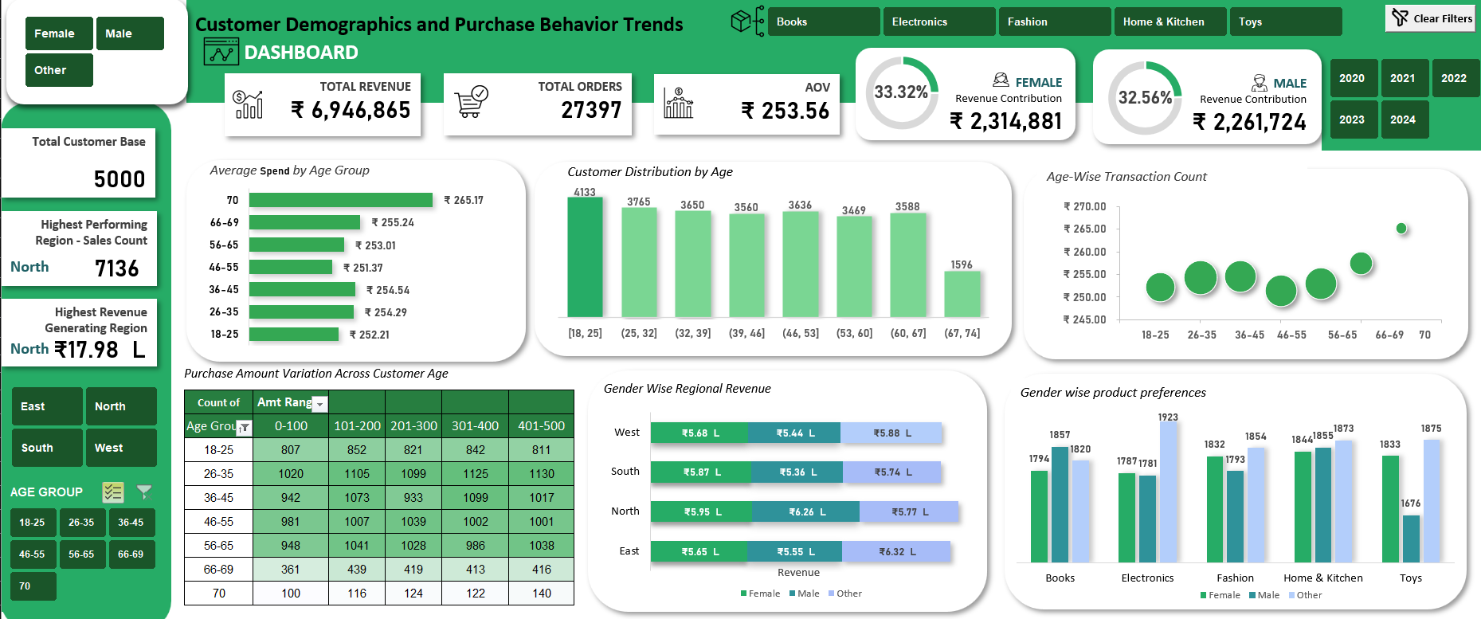

Slide 3
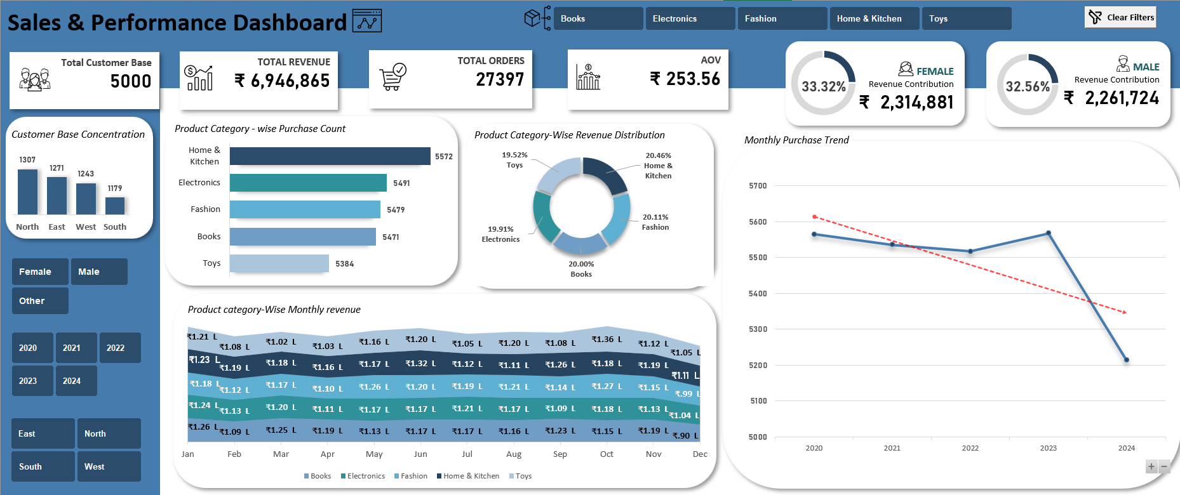

Slide 4
AGENDA
Introduction & Objective
Insights & Findings
Interactive dashboard Demonstration
Strategic Recommendations
Projected Business Impact
Discussion & Q&A
Notes:
Purpose and business questions we aim to answer

Slide 5
Introduction & Objective
Purpose
The objective of this analysis was to identify the purchase behavior trends across customer demographics and product categories to support data-driven marketing and inventory strategies
Methodology
Data from 2020-24 sales transactions was analyzed using Excel. Metrics such as Purchase Counts, Purchase amounts and demographic segmentation were examined to uncover patterns in purchasing behavior

Slide 6
Customer Distribution By Age

Slide 7
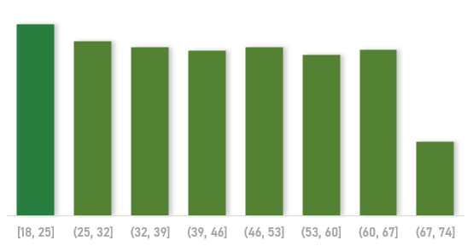
Insights
  Customer aged 18-25 form largest group
  Customers 66+ are the smallest group
  Young customers dominate the retails store’s customer base
BUSINESS ACTIONS
  Youth Engagement: Create youth-focused marketing campaigns (student discounts).
  Senior Attraction: Explore reasons for low senior engagement ( product relevance, accessibility, store experience)
  Demographic Balance: Run family-oriented promotions and offer bundled products appealing to multiple generations.

Slide 8
Variability in Purchase Amounts Across Product Category

Slide 9
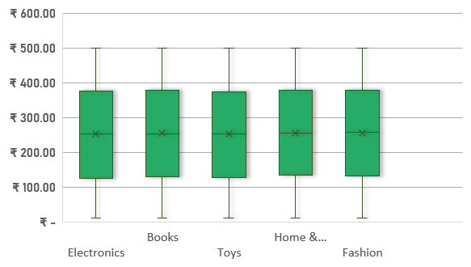
INSIGHTS
Similar Distribution Across Categories
    Median purchase amounts are closely aligned (~₹252–₹256) across all categories.
    Price variability is consistent — similar interquartile ranges and maximums (~₹500).
Slightly Higher Entry Price in Home & Kitchen & Fashion
    Q1 values are marginally higher (~₹133 vs ₹125 in Electronics).

Slide 10

INSIGHTS
Product Category | Q1 | Median | Q3 | Average | Maximum | Total Revenue | Revenue Share
Electronics | ₹ 125.47 | ₹ 251.78 | ₹ 376.62 | ₹ 125.41 | ₹ 500.00 | ₹ 1,382,889 | 19.91%
Books | ₹ 130.21 | ₹ 253.04 | ₹ 378.10 | ₹ 123.77 | ₹ 499.69 | ₹ 1,389,448 | 20.00%
Toys | ₹ 127.14 | ₹ 252.59 | ₹ 373.15 | ₹ 123.16 | ₹ 499.90 | ₹ 1,355,855 | 19.52%
Home & Kitchen | ₹ 133.80 | ₹ 254.66 | ₹ 377.97 | ₹ 121.60 | ₹ 499.82 | ₹ 1,421,337 | 20.46%
Fashion | ₹ 131.87 | ₹ 256.45 | ₹ 378.99 | ₹ 122.72 | ₹ 499.99 | ₹ 1,397,337 | 20.11%
Revenue Leaders
    Home & Kitchen holds the highest share (20.46%) despite lower average purchase amount.
    All categories have evenly distributed revenue shares (~19.5–20.5%), indicating balanced contribution.
Average Purchase Amounts Are Lower Than Medians
    Suggests a presence of lower-value purchases pulling averages down.

Slide 11
BUSINESS ACTIONS
Price Optimization:
      Electronics & Toys could explore increasing lower-end price points to lift Q1 values.
Bundle & Upsell Strategies:
      For categories with lower averages (Toys, Electronics), introduce bundles to increase per-transaction revenue.
Marketing Investment Allocation:
      Home & Kitchen already leading in revenue — leverage cross-selling into Fashion and Books.
Discount Strategy Review:
      Too many low-value purchases may be due to deep discounts — assess profitability impact.

Slide 12
Customer Distribution By Region

Slide 13
INSIGHTS
North has the highest customer share (26.05%), slightly ahead of East (25.04%).
South (24.29%) and West (24.62%) have slightly smaller customer bases, with only ~1.7% gap between highest and lowest.

Slide 14
BUSINESS ACTIONS
North (Leader) - Maintain strong engagement through loyalty programs and exclusive deals to defend the lead.
East (Close Second) - Launch targeted acquisition campaigns to overtake North’s position.
South & West (Lagging) - Boost awareness via localized marketing, partnerships, and regional promotions.

Slide 15
Product Category-wise Revenue Distribution

Slide 16

Insights
Revenue is quite evenly distributed across all product categories, each contributing ~19–20%.
Home & Kitchen leads slightly at 20.46%, followed by Fashion and Books.
Toys has the lowest share at 19.52%

Slide 17
BUSINESS ACTIONS
Home & Kitchen: Introduce premium SKUs or bundle offers to lift the average purchase amount while retaining the high volume.
Toys: Run seasonal promotions (e.g., festivals, holidays).
      Evaluate product mix - maybe introduce trending or educational toys to increase demand.
Fashion & Books: Since they’re mid-level and stable, focus on loyalty programs to maintain repeat purchases.

Slide 18
Gender-wise Regional Revenue

Slide 19
INSIGHTS
By Region
  North leads in total revenue (₹1.80M), followed by East (₹1.75M).
  South and West are slightly lower (~₹1.70M each) and have room to improve - total revenue gap is ~₹100k compared to North.
By gender:
  Male customers spend the most in North.
  Other (gender not mentioned) has high revenue in East and West.
  Female spending is relatively consistent across all regions

Slide 20
BUSINESS ACTIONS
North - Male Focus
      Push Home & Kitchen bundles and Book promotions targeting male customers.
      Seasonal campaigns (festive cookware sets, bestseller book offers) could maximize this high-spend male base.
East - ‘Other’ Gender Focus
      Promote Electronics & Home & Kitchen with targeted ads on platforms popular with diverse customer groups.
      Loyalty programs for repeat purchases in these categories.
South - Female Focus
      Strengthen Books & Home & Kitchen promotions.
      Host community engagement events (cooking contests, book clubs) to deepen brand connection.

Slide 21
BUSINESS ACTIONS
West – Mixed Strategy
      Promote Fashion and Electronics for ‘Other’ gender segment through influencer marketing.
      Improve Toys category for males with trend-based toy lines.
Cross-region action
      Toys category revamp — especially in South (male) and West (male) segments — through trending product lines, bundling, and seasonal offers.

Slide 22
Age wise Purchase Distribution Across Regions

Slide 23

INSIGHTS
West - Strongest 26–35 (21.41%) & balanced mid-age (36–45 at 19.93%). Weak senior share (66+ at 9.49%).
South – Leads in 46-55 (20.41%) and high 55-65 (18.52%), mature customer base
North – Highest 56-65 share (20.99%), solid 36-45 (19.47%), weak 66+ (8.72%)
East – Even spread across 26-45 & 46-55, above average 66+ (10.87%)
All region – youth (15-25) low, limited penetration

Slide 24
BUSINESS ACTIONS
West - Focus on 26–35 with tech/lifestyle offers; launch senior engagement.
South - Target mature customers with health, wellness, and premium comfort products.
North - Use loyalty for 56–65; boost 66+ via senior discounts.
East - Maintain balance; run multi-generational bundles.
All - Digital-first youth campaigns to close 15–25 gap.

Slide 25
Product category-Wise Monthly revenue

Slide 26
Insights
Consistent Leaders:
  Books maintained steady sales, peaking at ₹1.26L in Jan & strong in Sep–Oct.
Seasonal Spikes:
  Toys saw the highest jump in Oct (₹1.36L), likely festive-driven.
Mid-Year Dip:
  Electronics, Fashion, and Home & Kitchen saw minor declines around Apr–Jul.
End-of-Year Drop:
  Most categories experienced declines in Dec,

Slide 27
BUSINESS ACTIONS
Leverage Festive Peaks: Boost inventory & marketing for Toys before Oct to maximize seasonal demand.
Stabilize Mid-Year: Introduce promotions in Apr–Jul to offset seasonal dips.
Address Year-End Drop: Plan December clearance events or bundles to sustain sales.
Cross-Sell Opportunities: Use Books as a traffic driver to upsell related categories.

Slide 28
Age - Purchase Amount Relationship

Slide 29
INSIGHTS
18 years: Noticeable high purchase margin - likely early-stage adopters or gift-driven spending.
30–40 years: Consistently high purchase amounts - strong earning stage with higher discretionary spend.
40–69 years: Stable but mid-range spending; minimal spikes, indicating steady but not premium purchases.
50 years: Lowest purchase amount across all ages - possible disengagement or spending constraints.
70 years: Highest purchase amount - peak margin spenders, likely due to lifestyle and disposable income.

Slide 30
BUSINESS ACTIONS
Youth-focused campaigns for 18-year segment - trend-driven offers, influencer marketing.
Upsell & cross-sell for 30–40 segment - premium product bundles, loyalty rewards.
Reactivation strategy for 50-year-olds - targeted offers, re-engagement surveys.
Senior premium targeting for 70+ group - luxury, wellness, travel, and gifting-focused promotions.
Maintain steady-value offers for 40–69 bracket to retain baseline revenue.

Slide 31
Product Category - wise Purchase Count

Slide 32
INSIGHTS
Home & Kitchen leads with 5,572 purchases, indicating the highest consumer interest.
Electronics, Fashion, and Books are closely competitive with purchase counts in the 5,470–5,490 range.
Toys has the lowest purchase count at 5,384, though the gap between categories is not very large.
Purchase volumes are fairly balanced, suggesting a diverse demand spread across categories.

Slide 33
BUSINESS ACTIONS
Maintain strong stock and marketing in Home & Kitchen to capitalize on demand.
Explore cross-selling opportunities between Electronics, Fashion, and Books due to similar purchase volumes.
For Toys, consider:
  Promotional offers or bundles to boost interest.
  Targeted marketing for parents and gift seasons.
Continue broad product variety to retain balanced demand across categories.

Slide 34
How Different Age Groups Spend?
Heatmap Analysis

Slide 35
INSIGHTS
Count of | Amount Ranges
Age Groups | 0-100 | 101-200 | 201-300 | 301-400 | 401-500
15-25 | 807 | 852 | 821 | 842 | 811
26-35 | 1020 | 1105 | 1099 | 1125 | 1130
36-45 | 942 | 1073 | 933 | 1099 | 1017
46-55 | 981 | 1007 | 1039 | 1002 | 1001
56-65 | 948 | 1041 | 1028 | 986 | 1038
66+ | 461 | 555 | 543 | 535 | 556
26–35 years -> Highest purchases across all ranges, peak at ₹401–500 range.
66+ years -> Lowest purchases in all ranges, sharp drop in ₹0–100 range but strong second in ₹401–500, suggesting a preference for high-margin products.
36–65 years -> Steady moderate spending, no extreme peaks or dips.
15–25 years -> Active buyers but less likely to make high-value purchases.

Slide 36
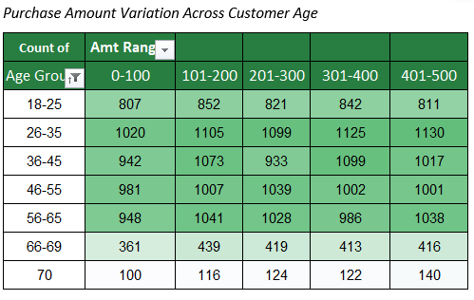

Slide 37
BUSINESS ACTIONS
Premium targeting for 26–35 with high-value bundles & loyalty rewards.
Upsell campaigns for 15–25 & 36–45 to move them into higher ranges.
Position high-margin offers to 66+ (luxury, quality-focused products).

Slide 38
Monthly Purchase Trend

Slide 39
Insights
Overall Downward Trend: Purchases have declined from ~5,560 in 2020 to ~5,220 in 2024.
Short-Term Recovery in 2023: Slight rebound seen in 2023 before a sharp drop in 2024
2024 Decline is Significant: Largest year-over-year drop observed between 2023 and 2024.
Q4 2024: Purchases fell below 1200 — the lowest in the 5-year period.
Dec 2024: The sharp decline in Q4 2024 is entirely due to December
Only 12 days data is available for December month showing decline
Stable Performance Until Oct 2024: Jan–Oct 2024 follows a normal range, indicating no gradual deterioration.
Trendline Impact: The entire downward bend in the yearly/quarterly trendline is due to this single month’s data point.

Slide 40
BUSINESS ACTIONS
Root Cause Analysis: December 2024
      Audit operations, campaigns, inventory, customer support, etc., specific to Dec.
      Cross-check for system errors or supply chain breakdowns.
Mitigation Strategy for Future Peaks
      Create business continuity plans for high-dependency months.
      Build redundancy in fulfillment/logistics for Q4 months.

Slide 41
Key findings
Core customers: Ages 26–35 (and 36–45) are the revenue backbone across regions — highest purchase counts and strong presence in premium bins.
High-value microsegment: Age 70 is the top spending single-age cohort; category spend for 70s is highest in Home & Kitchen and Fashion, with strong gift behavior (Books, Toys).
Mid-life dip: ~50 shows the lowest purchase amounts — a re-engagement gap.
Home & Kitchen leads nationally: highest purchase count and revenue share (~20.5%) — consistent across regions.
Books > Electronics (per-revenue): Books generate higher revenue per unit than Electronics even with similar counts → Books have higher ASP.
Toys trailing in volume: lowest purchase count overall but strong seasonally (Oct); opportunity for seasonal promotions.
West: youngest skew (26–35 dominant) → Fashion & Electronics should be prioritized here (digital channels).
North: large customer base + higher older-age share (56–65) → Home & Kitchen and senior-friendly products perform well; loyalty programs will pay.
East: balanced but slightly higher senior share → Books, Home & Kitchen and gifting bundles resonate.
South: higher 46–55 share → family & comfort product messaging (Home & Kitchen, Fashion family bundles).
Seasonality: predictable peaks in May/Jun and Oct (Toys/Fashion), Dec 2024 appears artificially low (incomplete data) — do not act on Dec without cleaning.

Slide 42
Recommendations
Validate and pilot a “70-plus” premium offer (curated bundles and loyalty perk).
Re-engage the ~50 age cohort with tailored offers + survey (diagnose product/price fit and test incentives).
Raise AOV with smart bundling across categories (mixed bundles: Books + accessory, Electronics + home add-ons).
Premiumize Electronics mix — add high accessories, warranties; reduce heavy discounting on low-margin items.
Use Home & Kitchen as traffic anchor for cross-sell (promote higher-margin add-ons at checkout).
Focus on south region – Promote Fashion products- High potential to increase revenue
Seasonal readiness for May/Jun/Oct — align inventory and marketing for Toys & Fashion (pre-order & bundles).
Targeted retention & acquisition by region-age mix (West = digital youth; North = seniors + loyalty; East/South = mid-age family offers).

Slide 43
THANK YOU

