Slide 1

STEP 2 · DESIGN SYSTEM
One Lifa, every screen
The same tokens, components and gallery on web, iOS and Android (Google Play and Huawei), with HarmonyOS built from the same source.
WZDRY (Pty) Ltd · Build review, October 2026
Notes:
Step 2 turns the brand palette and type into one design system. Every screenshot in this deck is a real render: web from Chromium, Android from Robolectric and Roborazzi on GitHub Actions, iOS from the iPhone simulator on GitHub macOS runners.

Slide 2
What step 2 built
1
34
22
78/78
token file feeds every client
colours, each with a light and a dark value
components, the same on all four UI stacks
colour pairings pass WCAG contrast
Plus the type scale, 24 shared icons, radius 10 / 14 / 18 / 24, a 4-point spacing scale and 44 pt touch targets (48 dp on Android), all generated from one source.
Source: design/tokens/tokens.json · contrast checked by design/generators/contrast.mjs
Notes:
Four numbers to anchor the review. The contrast figure is 39 colour pairings, each checked in light and dark mode. Four UI stacks cover five clients, because the Google Play and Huawei Android builds share one codebase.

Slide 3
One source, four generated themes
tokens.json
Compose
SwiftUI
Android, Google Play and Huawei
iOS, with Dynamic Type
Colours, type, radius, spacing, sizes and motion. Contrast-tested before anything is generated.
ArkUI
CSS variables
HarmonyOS NEXT
Web app and back office
Brand palette, plus darker text variants for leaf, warning and borders where the brand colours fall below 4.5:1.
CI fails if a generated file drifts from the tokens, or if any pairing drops below its contrast minimum
Notes:
The generator is Style Dictionary 5.6.0 with small per-platform templates. Swatches, left to right: forest, primary, gold, leaf, cream, warning, critical. Leaf scores 3.8:1 and warning 4.4:1 on cream, so text uses darker leaf-text and warning-text tokens.

Slide 4
Five ways Lifa reaches people
Distribution | Client | Status
Web · any browser | React app, phone and desktop | Rendered
iOS · App Store | SwiftUI app on the iPhone simulator | Rendered
Android · Google Play | Compose app, gms build | Rendered
Android · Huawei AppGallery | Same Compose app, hms build, no Google services | Rendered
HarmonyOS NEXT · AppGallery | ArkTS app for Huawei phones without Android | Code only, not yet rendered
Each rendered section shows the whole gallery in light, dark and large text · every image is a real render, none are mock-ups
Notes:
One section per distribution follows. HarmonyOS is the honest gap: written but not yet compiled or rendered.

Slide 5
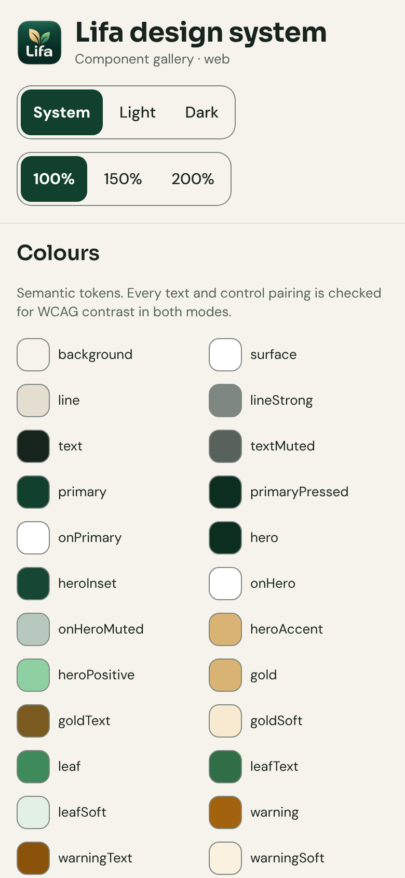
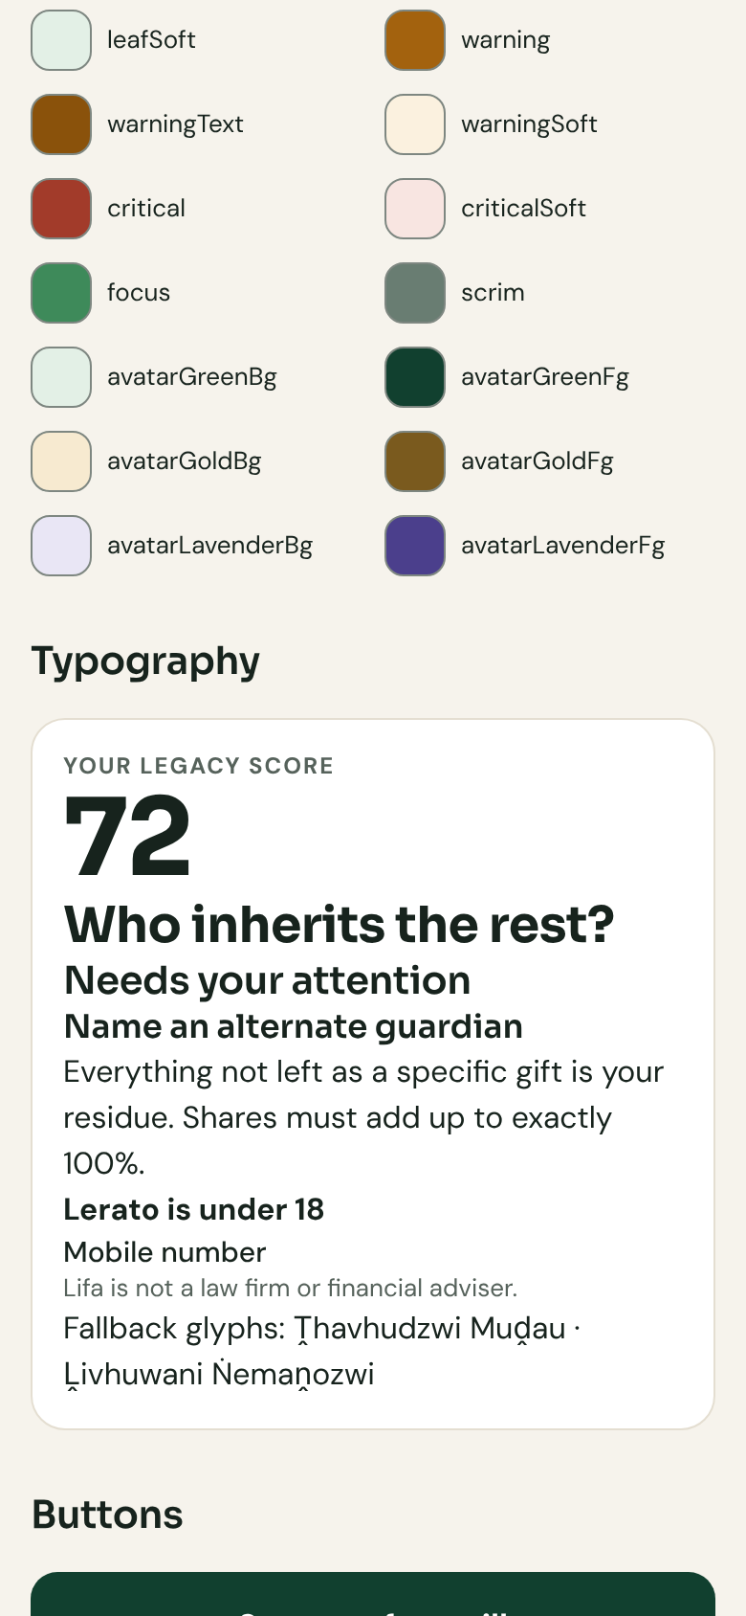
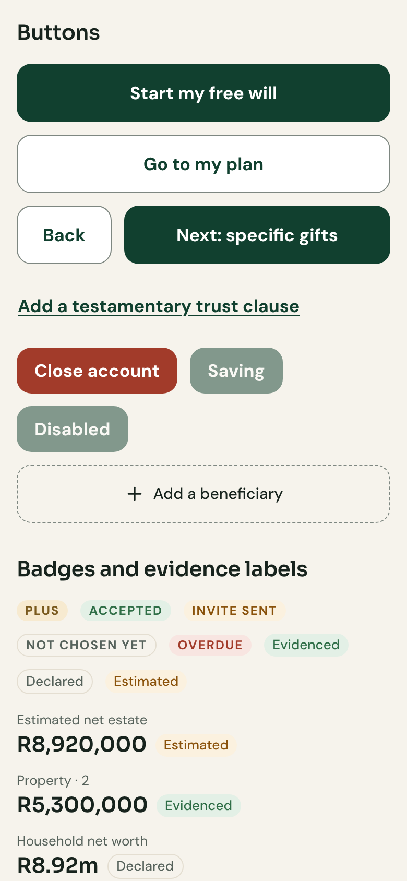
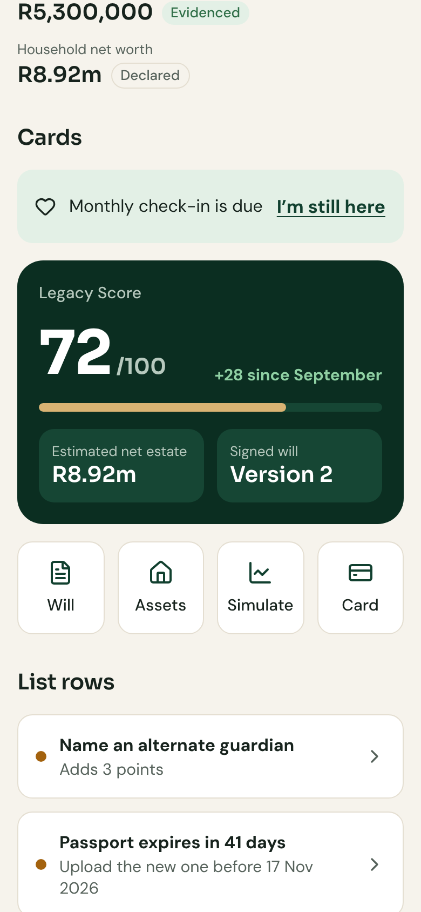
Phone width, screens 1–4 of 8
WEB · ANY BROWSER · LIGHT
Header, theme and text-size controls, colours
Colour tokens and type scale
Buttons, badges and evidence labels
Amounts, check-in banner, Legacy Score, quick actions
Chromium (Playwright 1.56.1), 390 × 844 viewport, 2× pixel density · the built web app
Notes:
The full web gallery at phone width in light mode, top to bottom across this slide and the next.

Slide 6
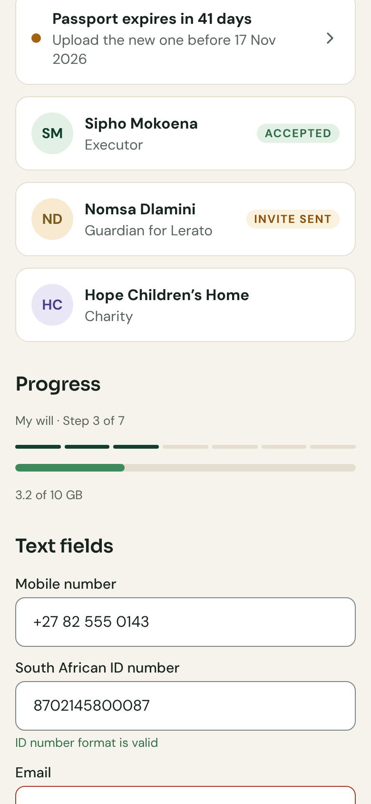
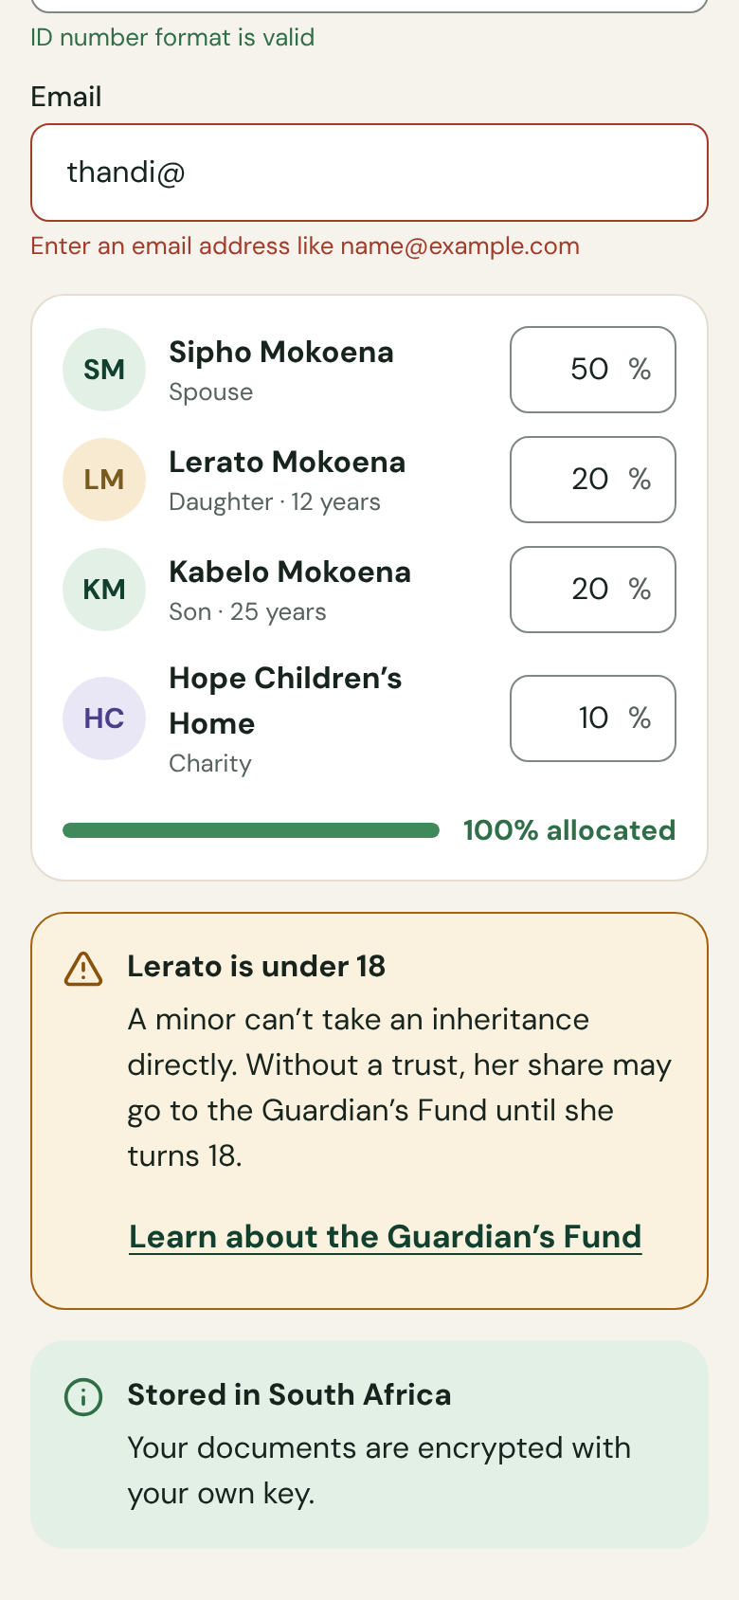
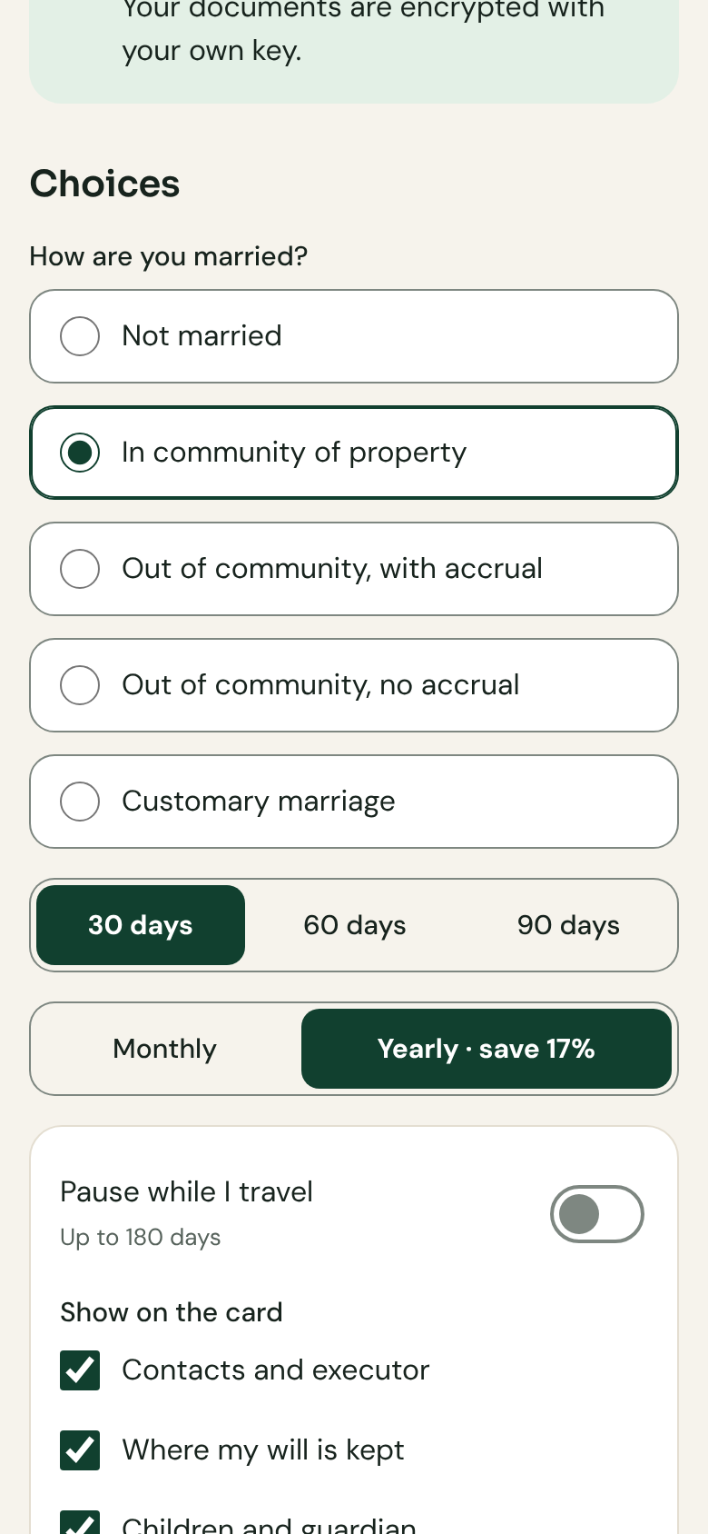
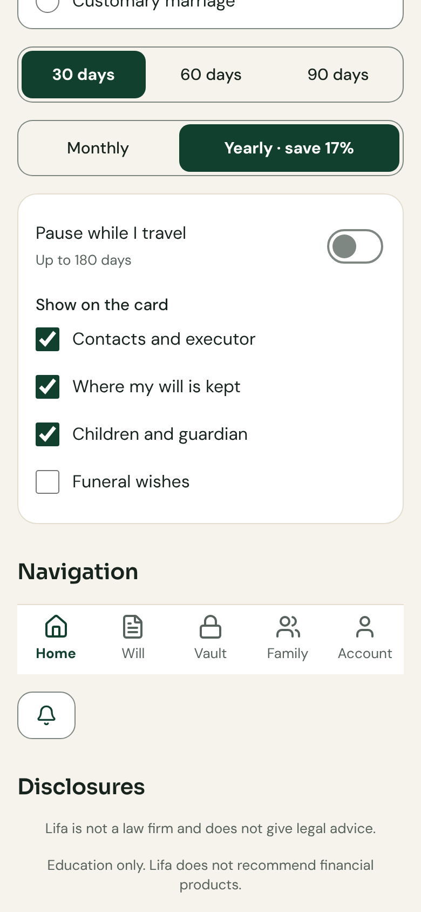
Phone width, screens 5–8 of 8
WEB · ANY BROWSER · LIGHT
List rows, progress, text fields
Validation, share allocation, under-18 callout
Residency callout, marital-regime choices, segmented controls
Toggles, checkboxes, navigation, disclosures
Chromium (Playwright 1.56.1), 390 × 844 viewport, 2× pixel density · the built web app
Notes:
Forms, choices and navigation in light mode.

Slide 7
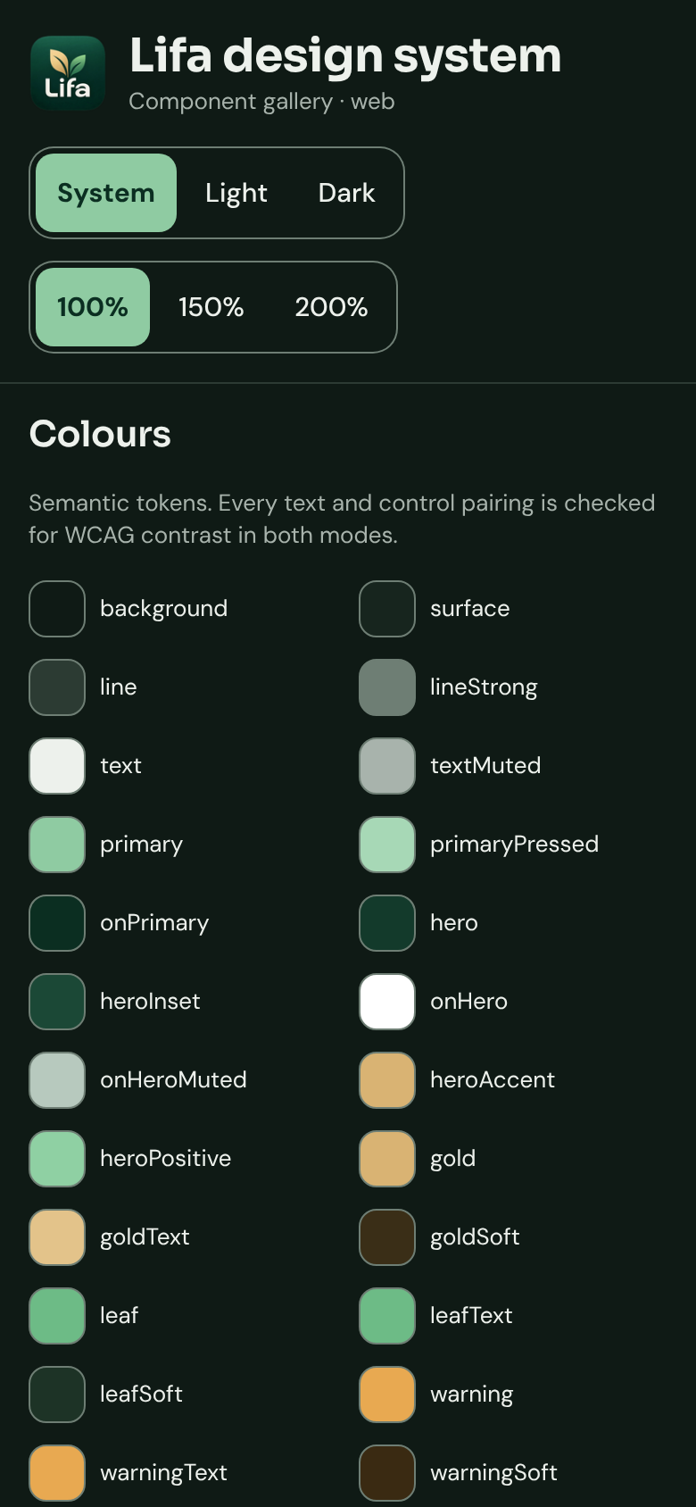
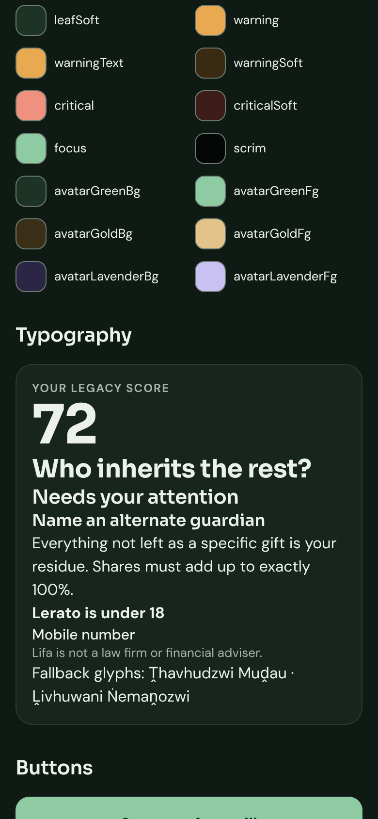
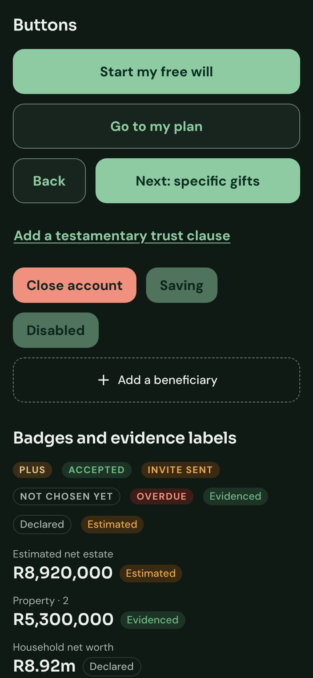
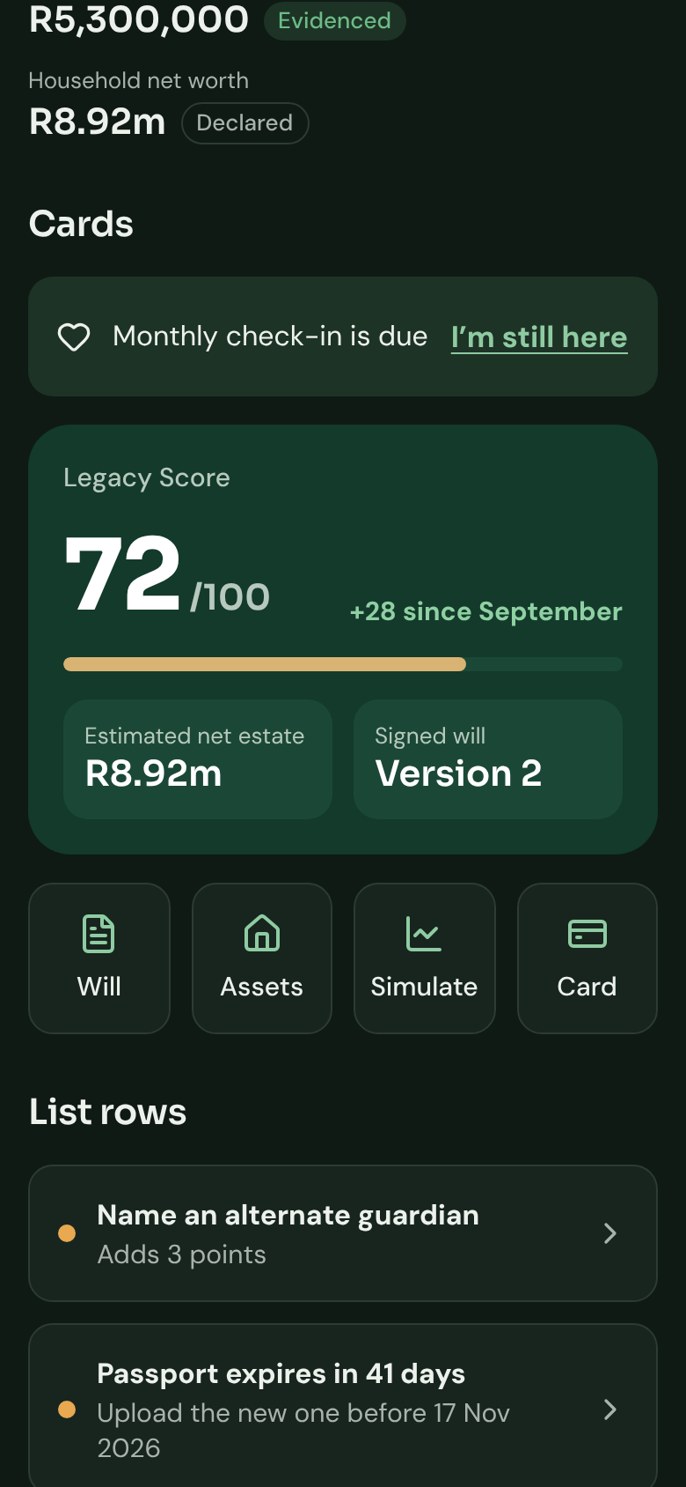
Phone width, screens 1–4 of 8
WEB · ANY BROWSER · DARK
Header, theme and text-size controls, colours
Colour tokens and type scale
Buttons, badges and evidence labels
Amounts, check-in banner, Legacy Score, quick actions
Chromium (Playwright 1.56.1), 390 × 844 viewport, 2× pixel density · the built web app · dark follows the system setting
Notes:
The same screens with the phone in dark mode; the app follows prefers-color-scheme.

Slide 8
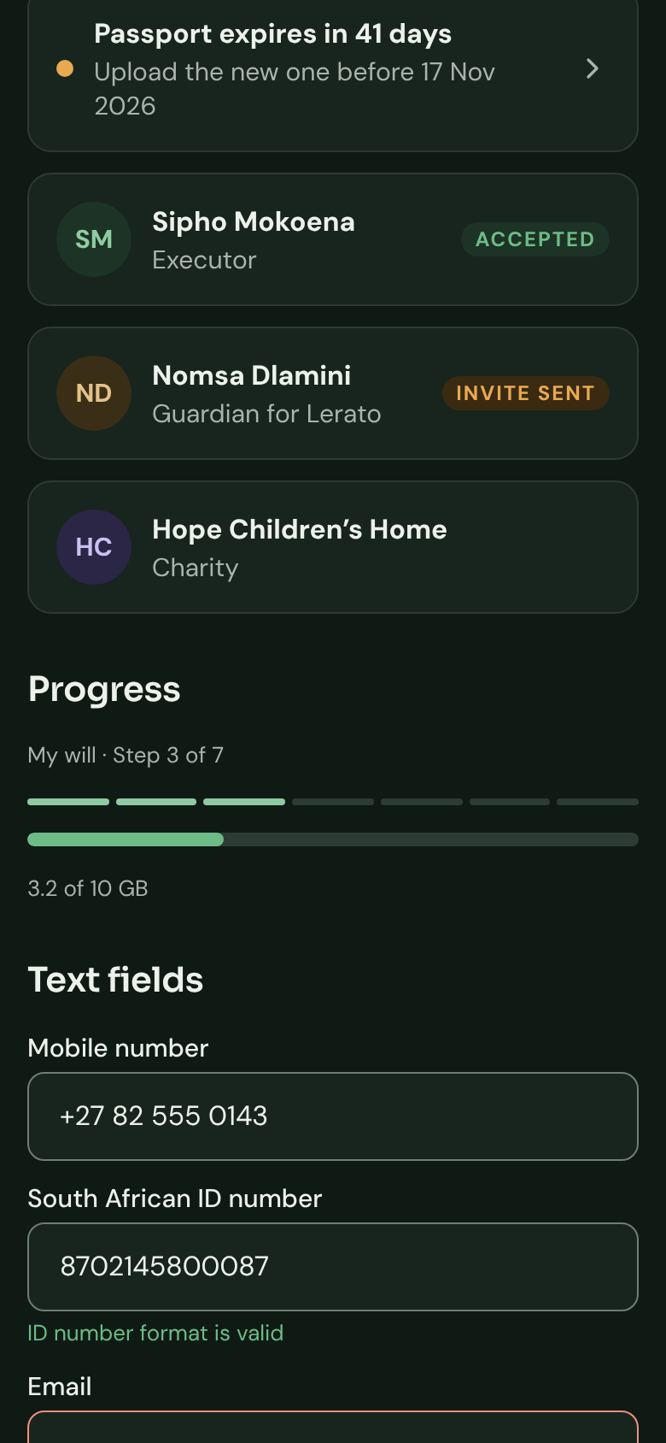
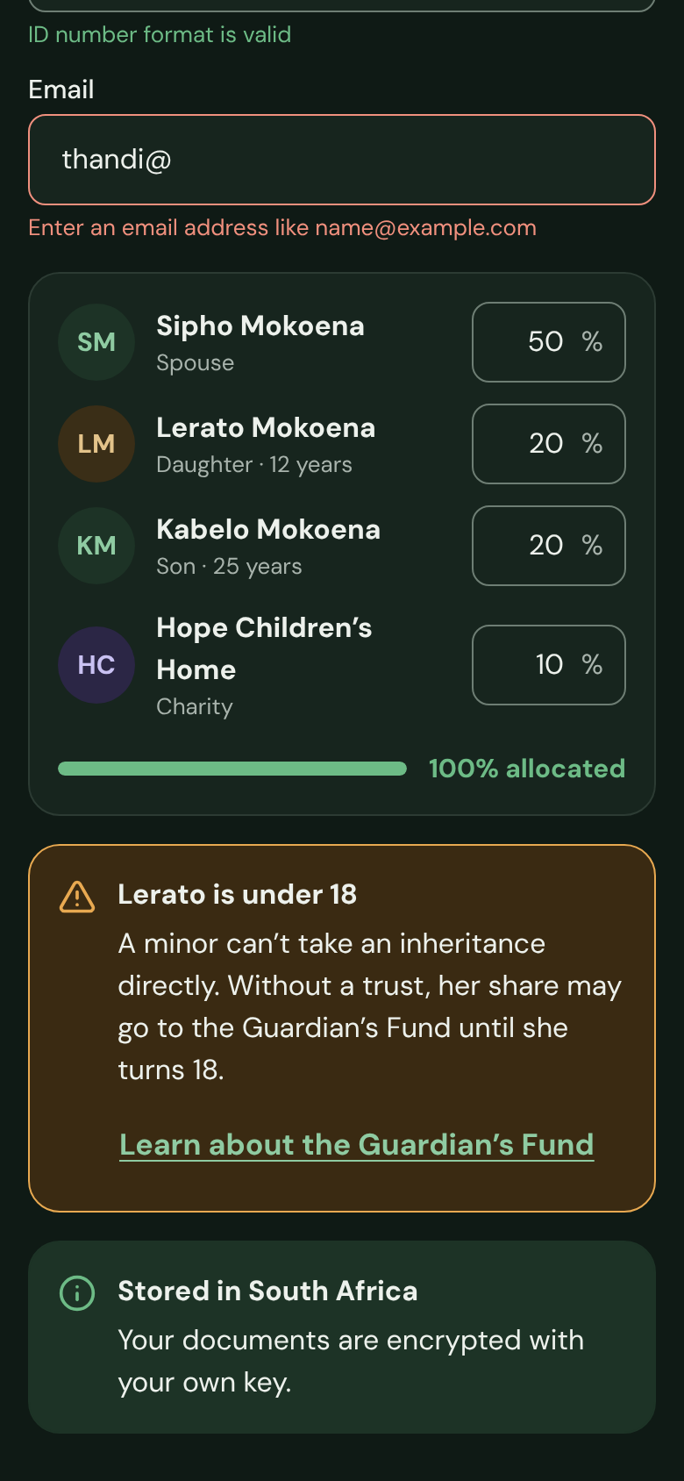
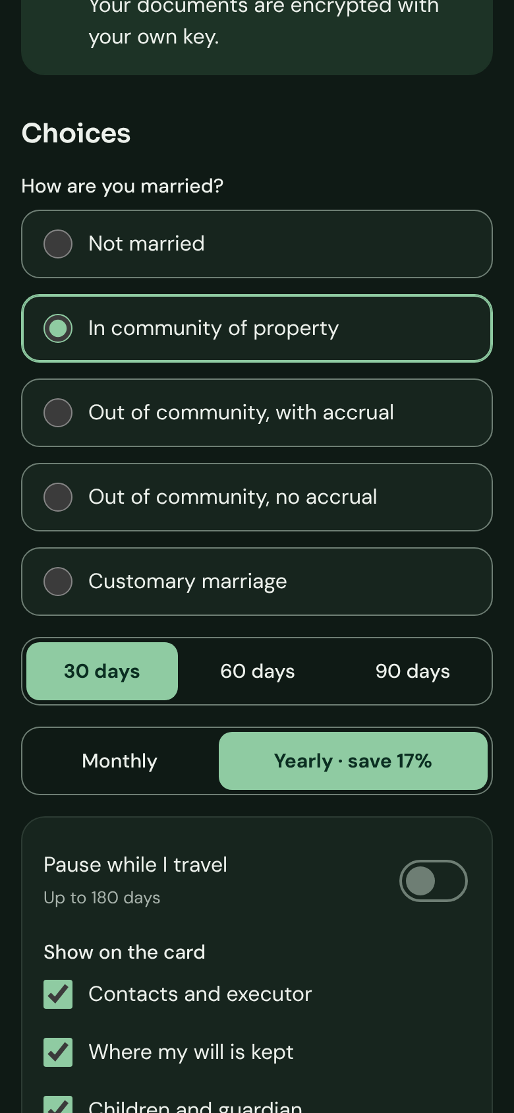
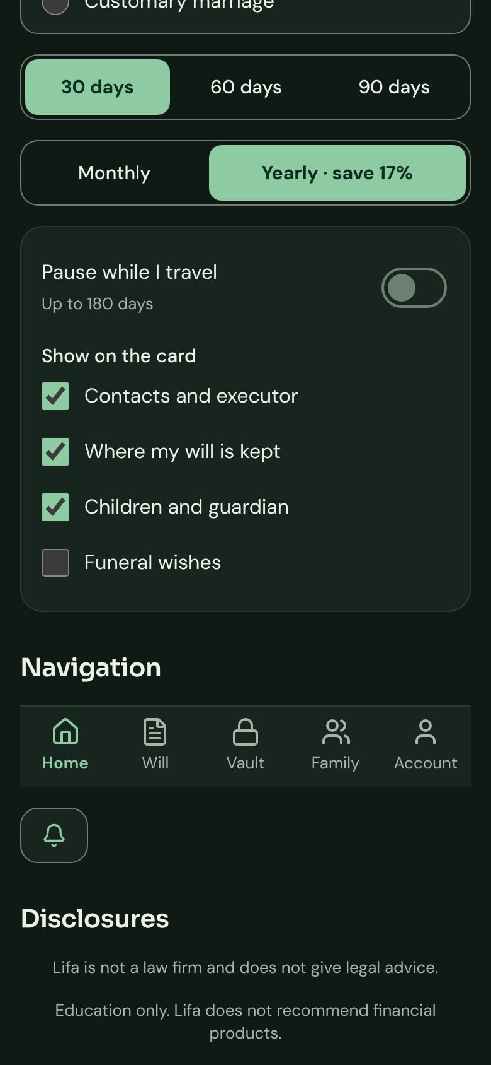
Phone width, screens 5–8 of 8
WEB · ANY BROWSER · DARK
List rows, progress, text fields
Validation, share allocation, under-18 callout
Residency callout, marital-regime choices, segmented controls
Toggles, checkboxes, navigation, disclosures
Chromium (Playwright 1.56.1), 390 × 844 viewport, 2× pixel density · the built web app · dark follows the system setting
Notes:
Dark mode, second half.

Slide 9
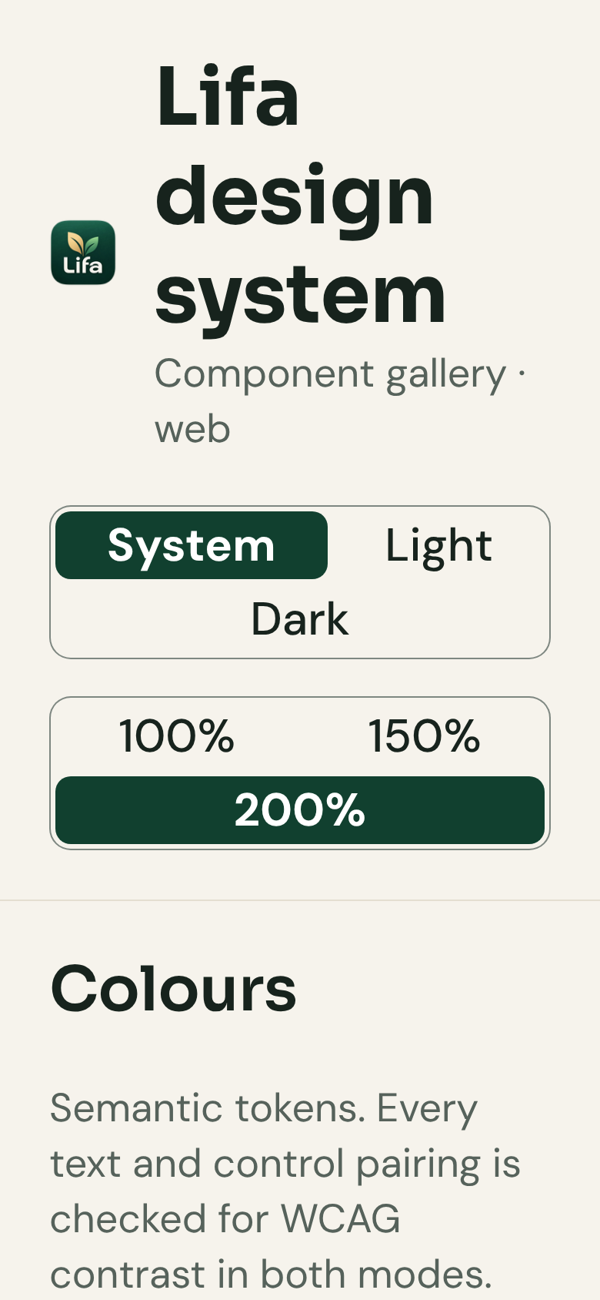
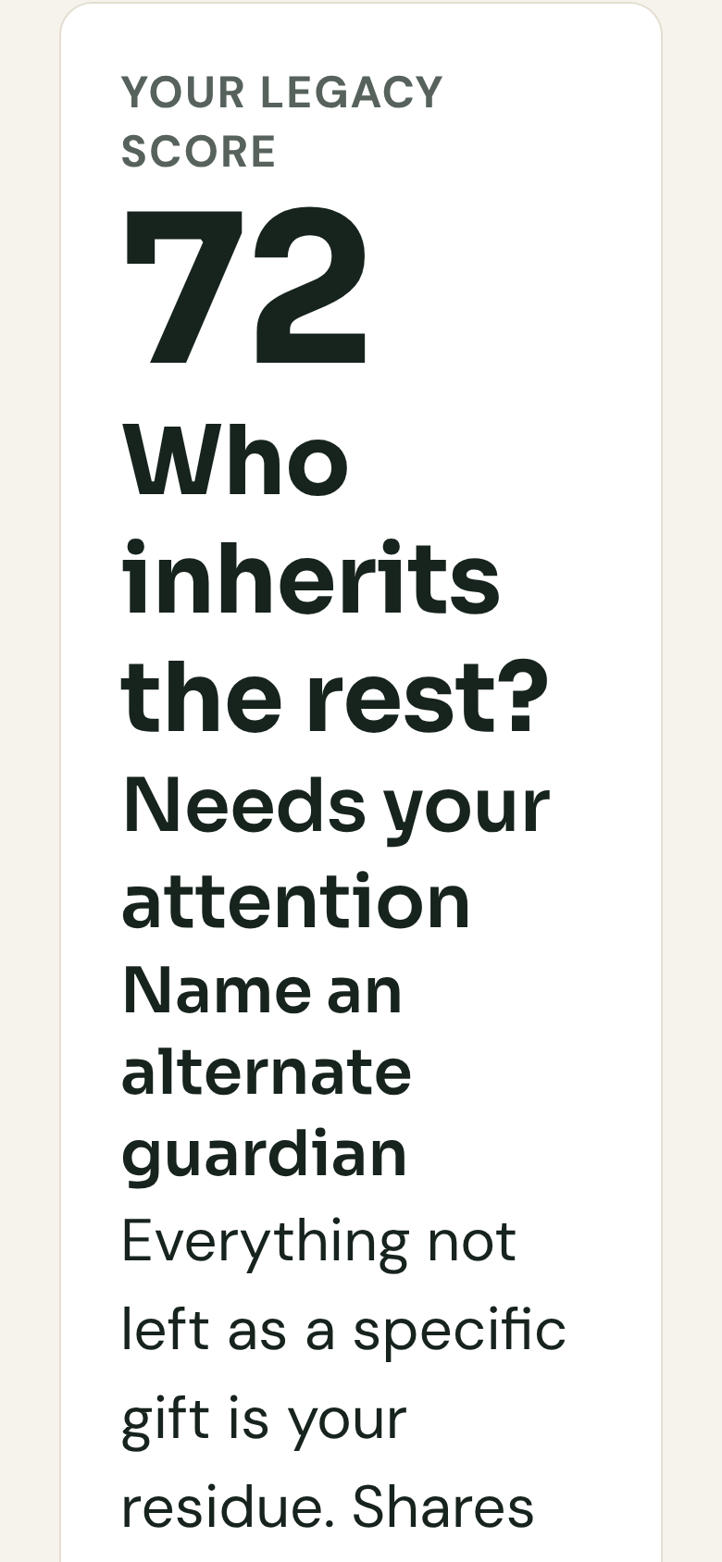
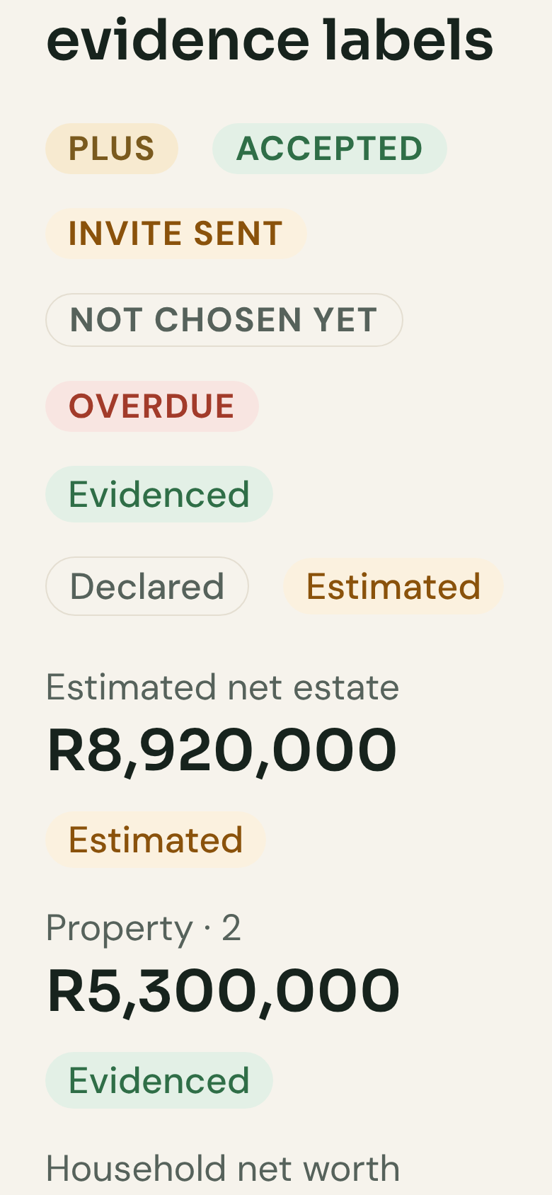
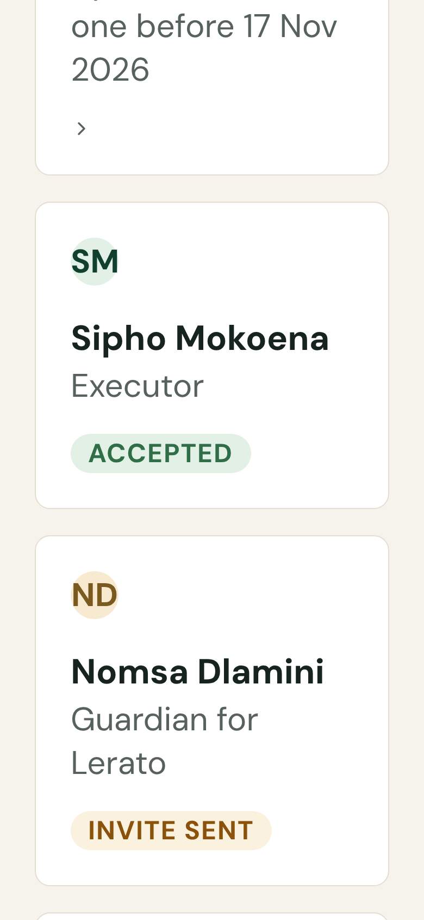
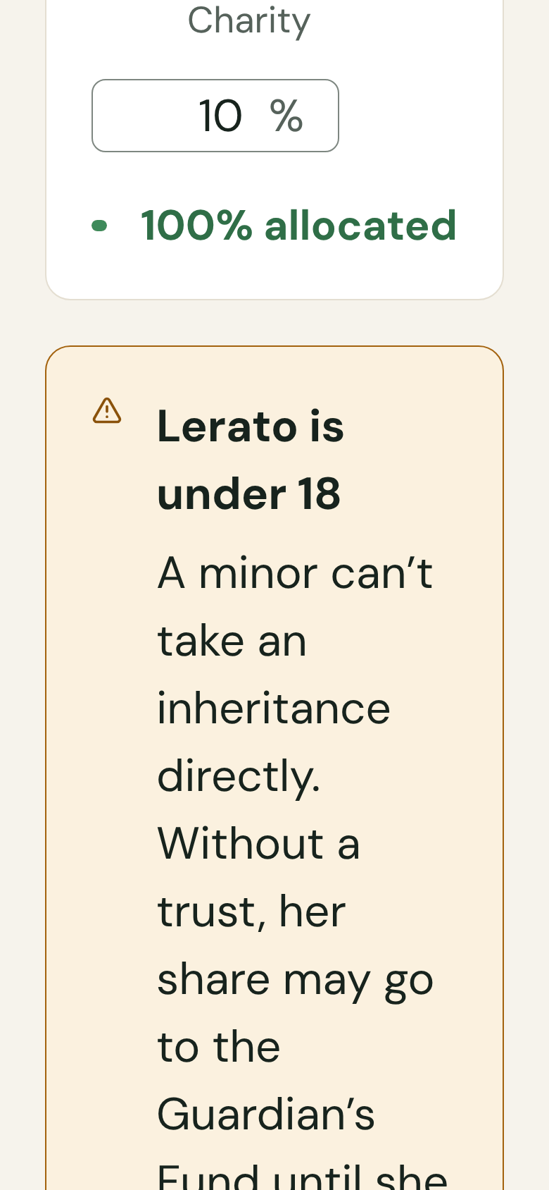
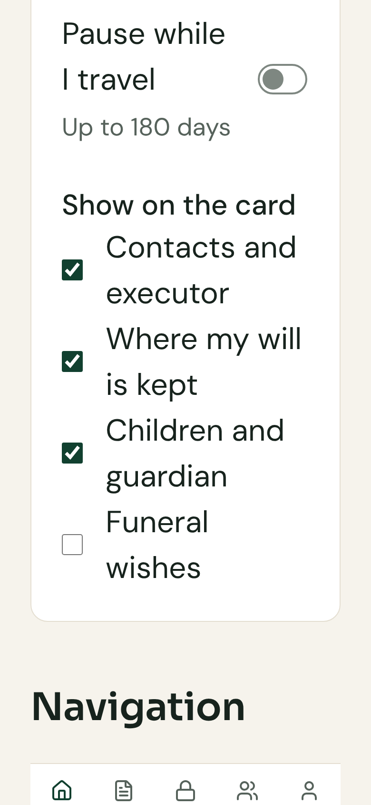
Large text reflows instead of clipping
WEB · ANY BROWSER · 200% TEXT
Header: title wraps, controls stack
Type scale
Badges wrap one per line
People rows stack the role badge
Allocation and the under-18 callout
Toggles, checkboxes and navigation
6 of the 22 screens the gallery needs at 200% text · same viewport, light mode
Notes:
At double text size the web gallery grows from 8 to 22 screens. Rows wrap and stack; nothing is cut off or scrolls sideways.

Slide 10
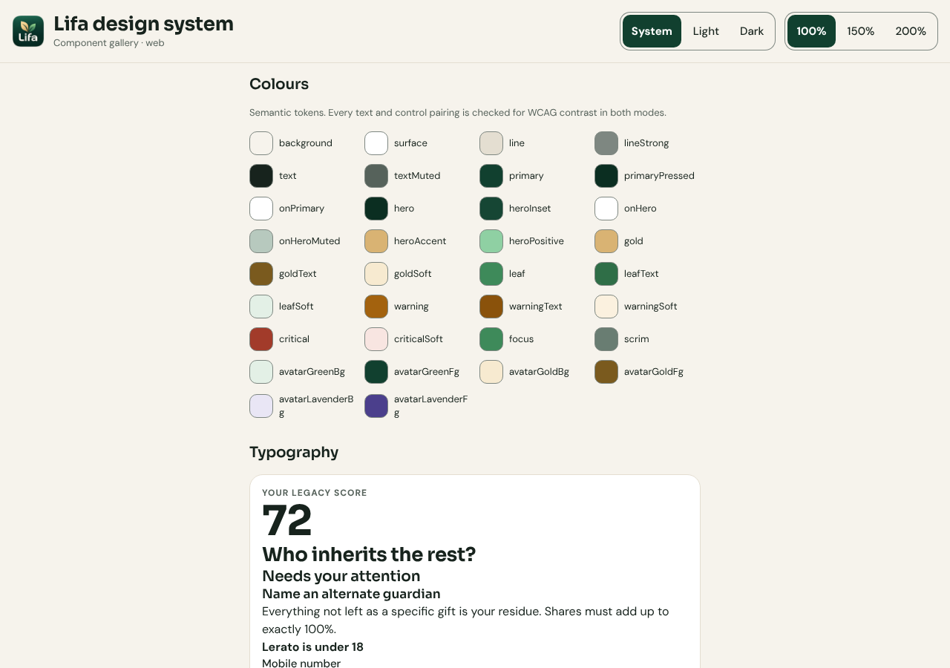
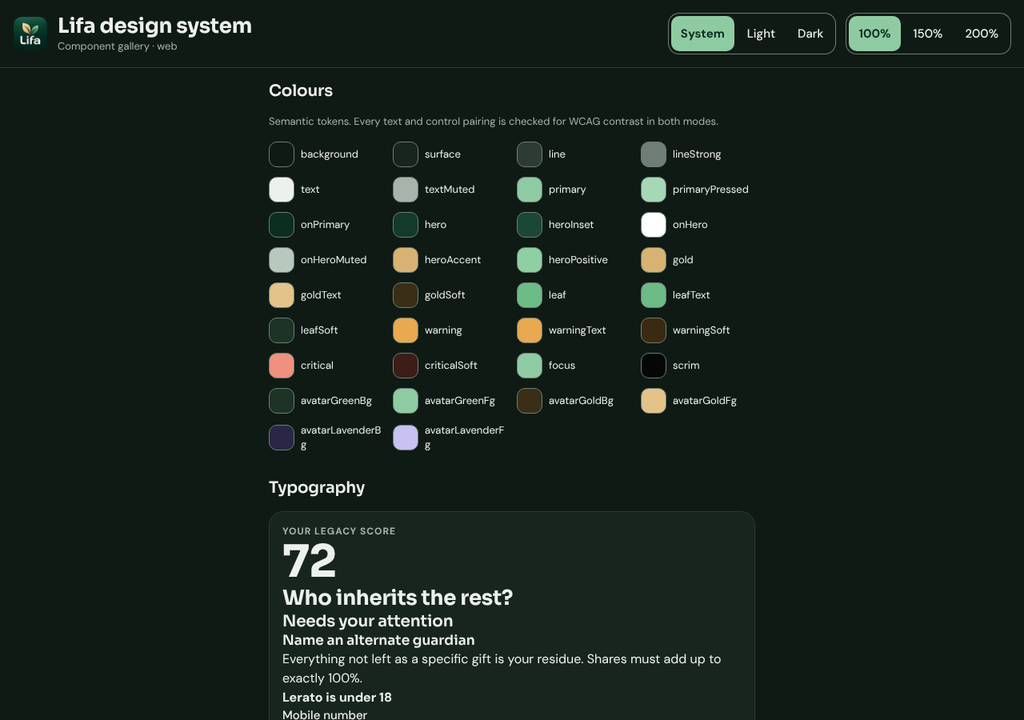
The same components on a desktop browser
WEB · ANY BROWSER · DESKTOP
Light
Dark
Chromium, 1280 × 900 · the back-office console is built from this component library too
Notes:
Desktop width in both modes. The back-office console shares these components.

Slide 11
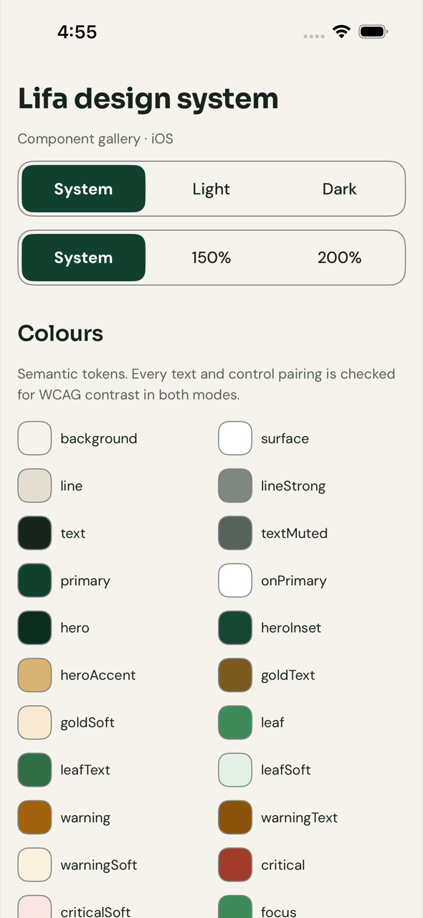
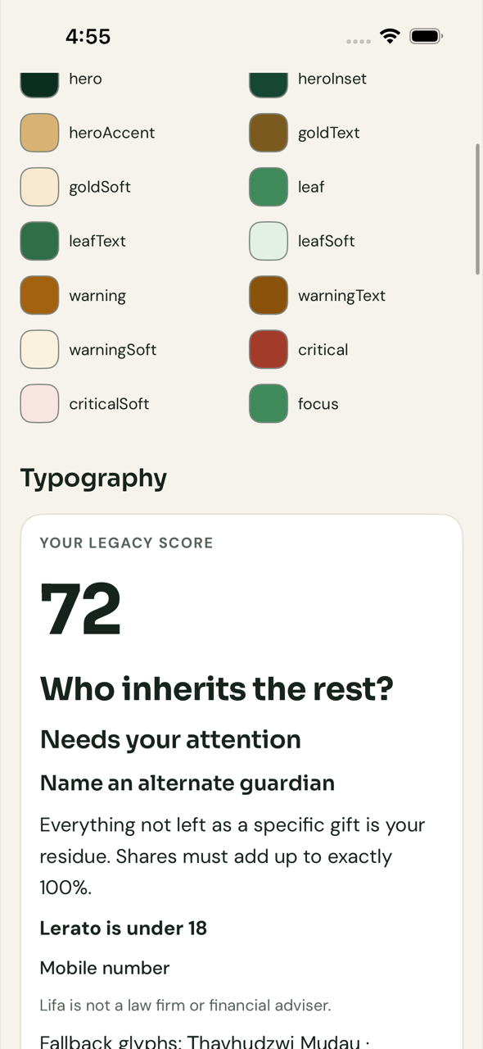
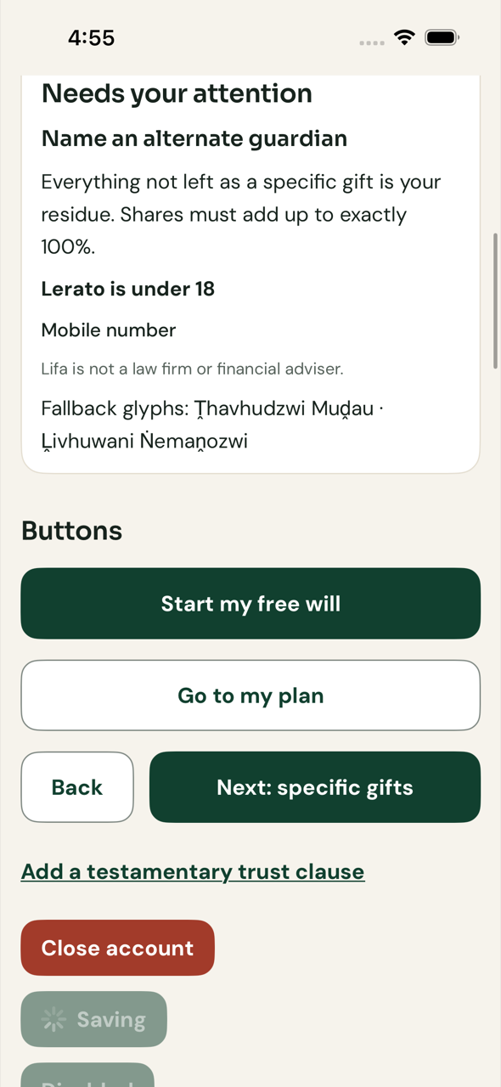
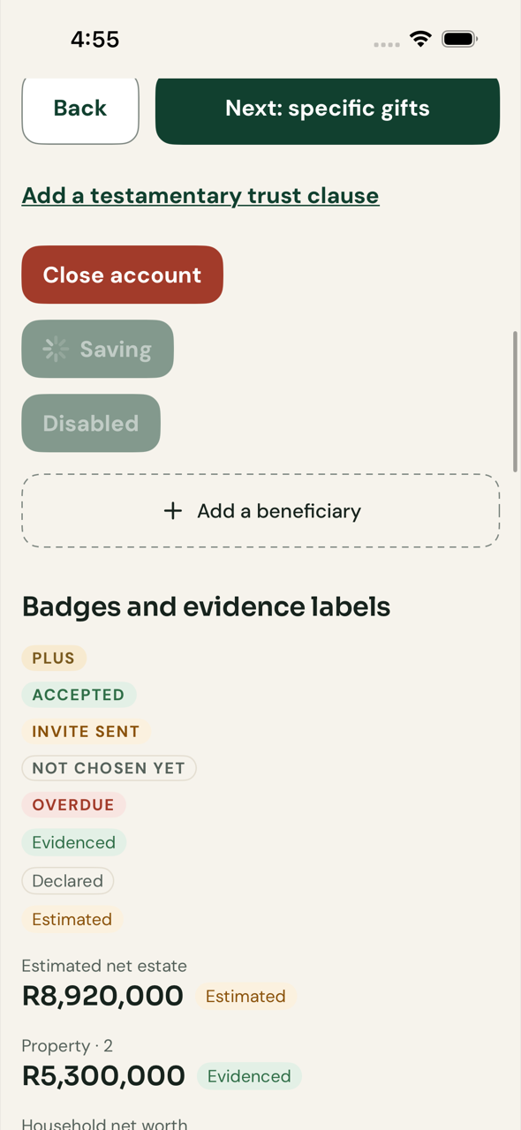
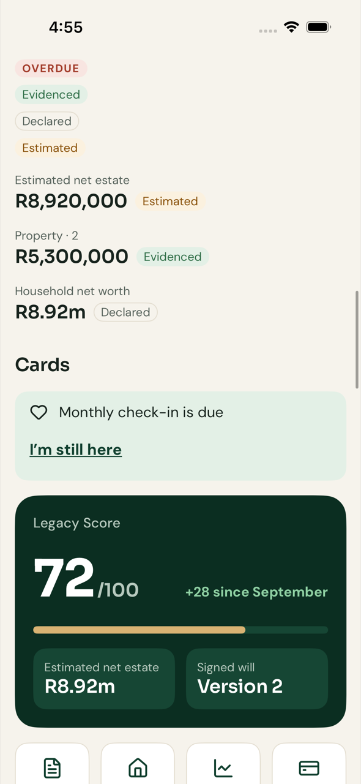
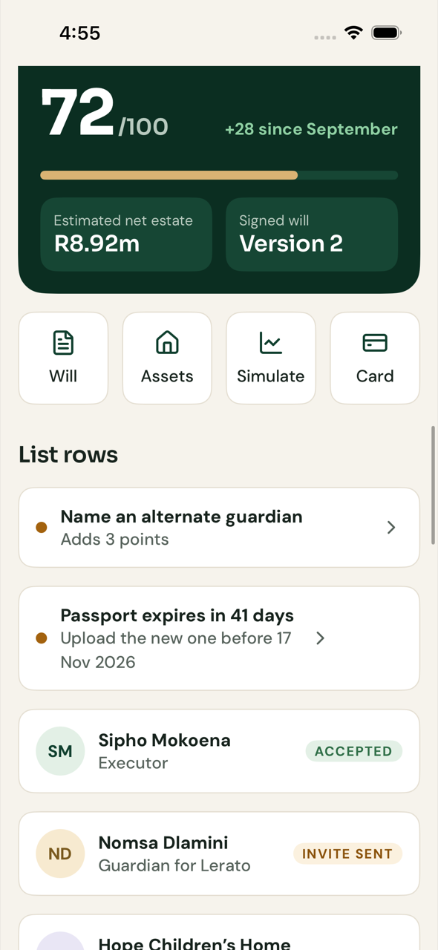
iPhone, screens 1–6 of 11
IOS · APP STORE · LIGHT
Header, theme and text-size controls, colours
Colour tokens and type scale
Type scale and buttons
Buttons, badges and evidence labels
Amounts, check-in banner, Legacy Score
Quick actions and list rows
Real app on the iPhone simulator (Xcode, GitHub macOS 15 runner) · XCUITest screenshots · iOS 18
Notes:
The SwiftUI app itself, launched by the UI tests on the iPhone simulator, scrolled top to bottom.

Slide 12
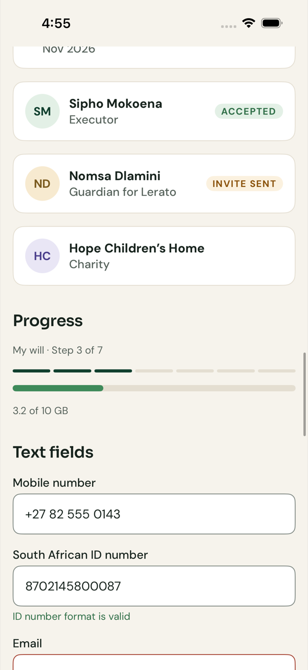
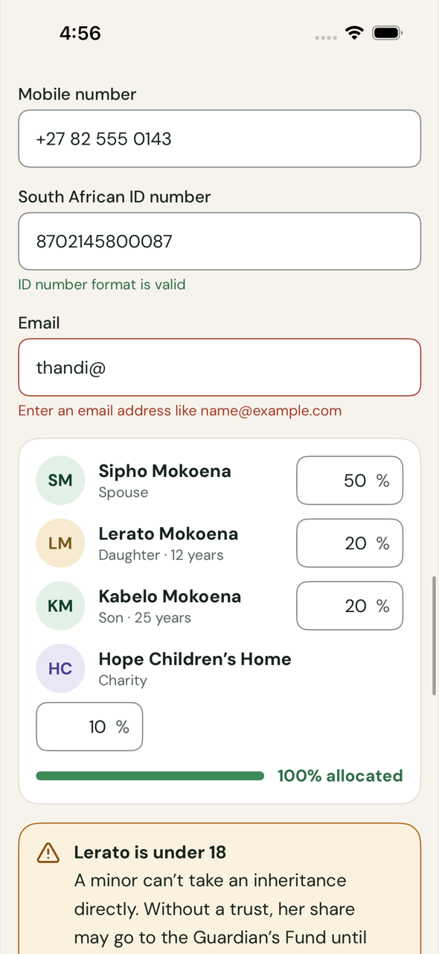
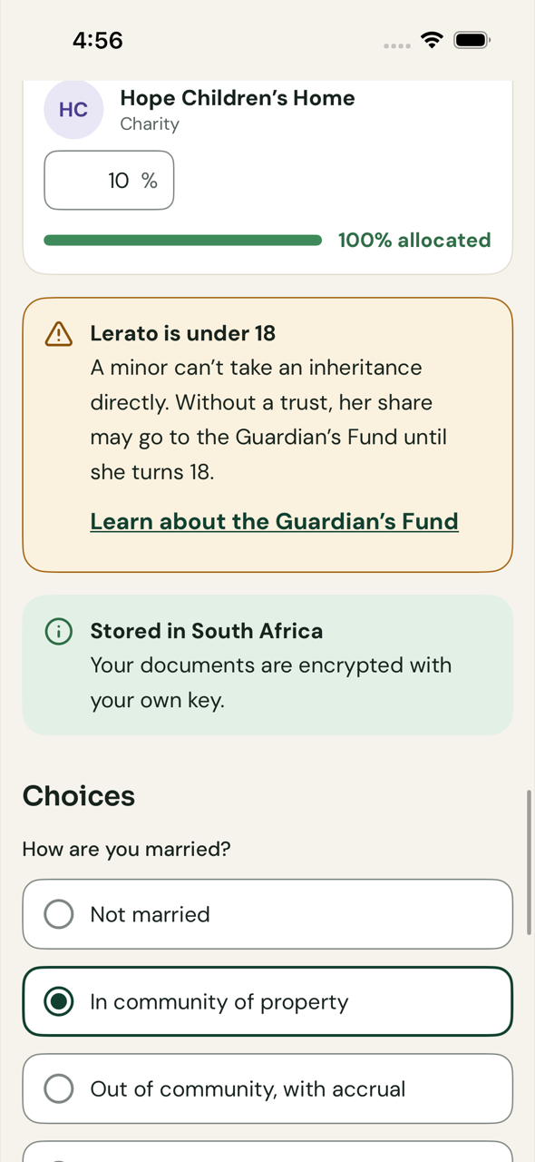
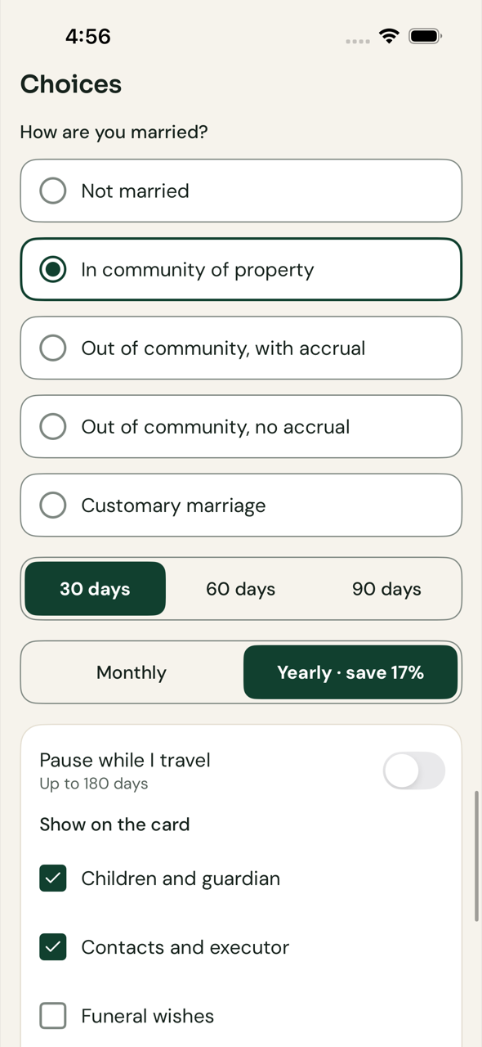
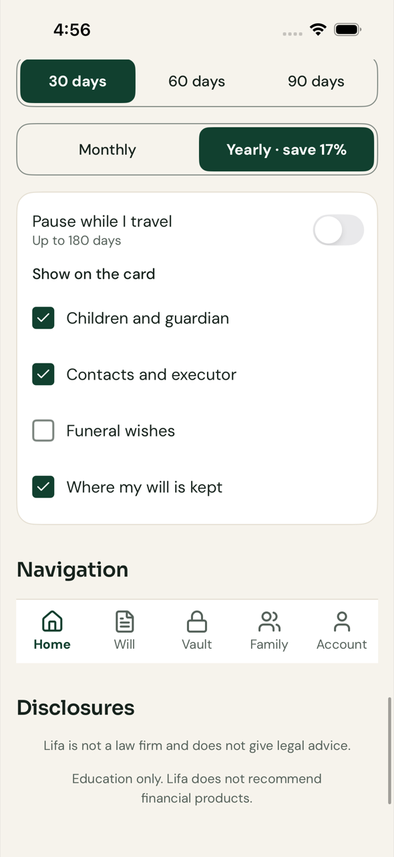
iPhone, screens 7–11 of 11
IOS · APP STORE · LIGHT
People rows, progress, text fields
Validation and share allocation
Callouts and marital-regime choices
Segmented controls and toggles
Checkboxes, navigation, disclosures
Real app on the iPhone simulator (Xcode, GitHub macOS 15 runner) · XCUITest screenshots · iOS 18
Notes:
Forms, choices and navigation in light mode.

Slide 13
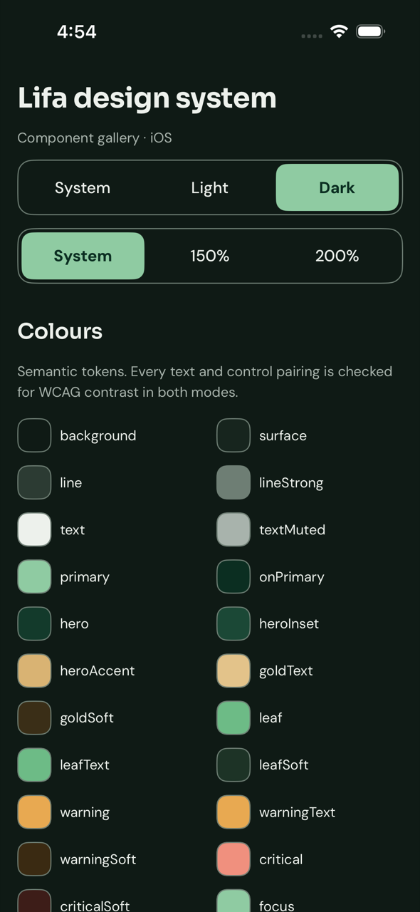
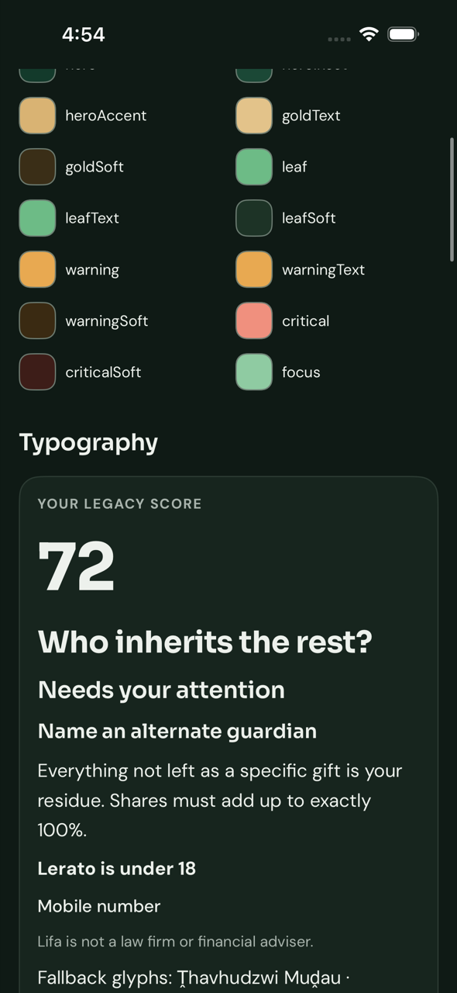
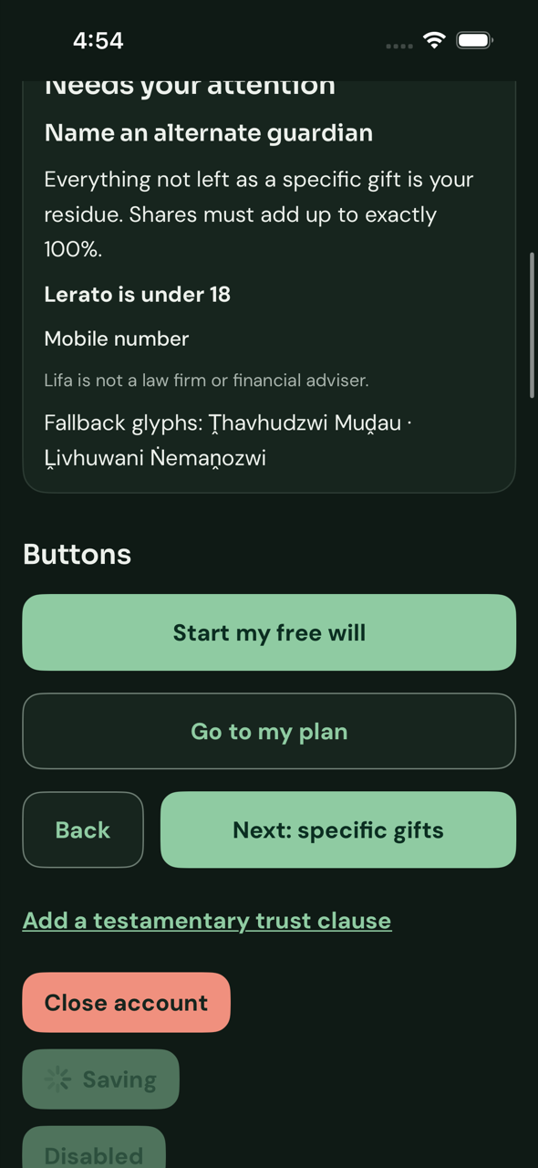
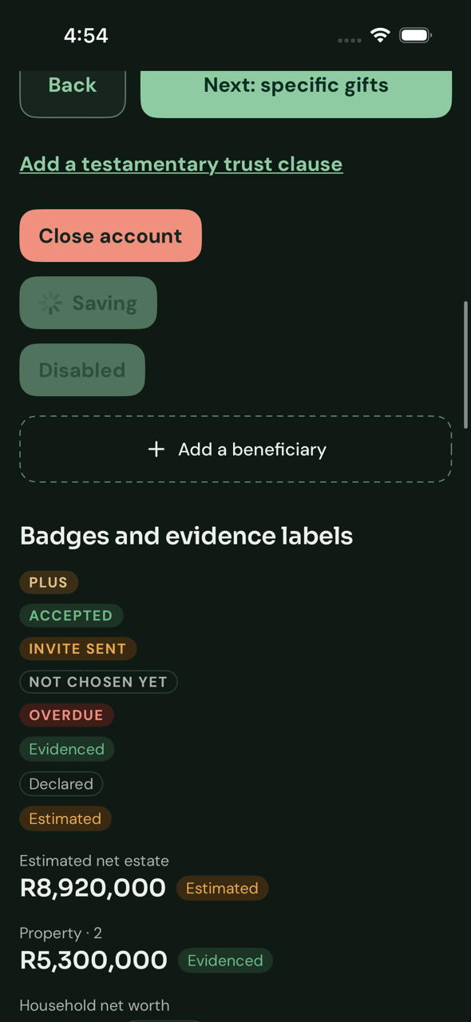
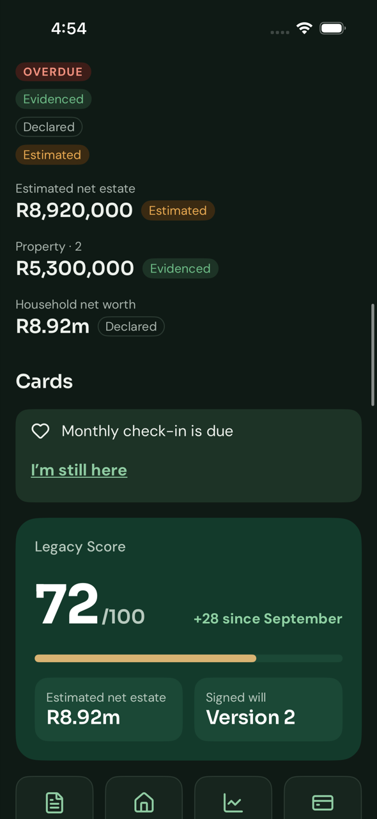
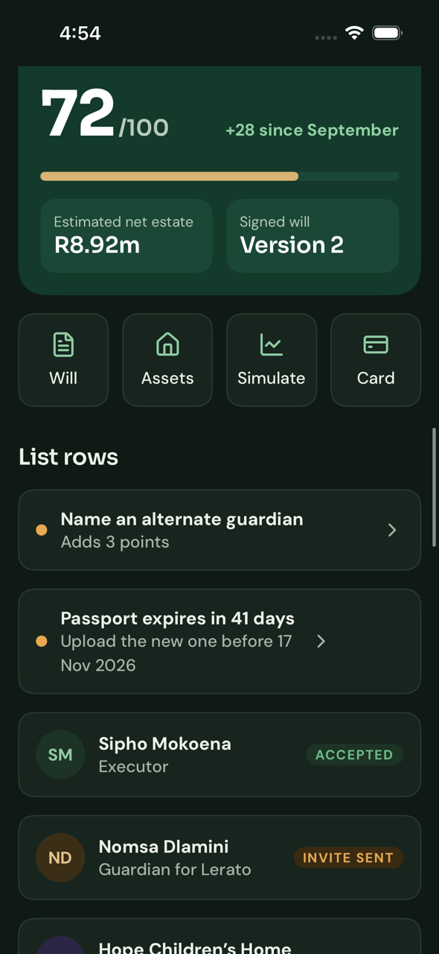
iPhone, screens 1–6 of 11
IOS · APP STORE · DARK
Header, theme and text-size controls, colours
Colour tokens and type scale
Type scale and buttons
Buttons, badges and evidence labels
Amounts, check-in banner, Legacy Score
Quick actions and list rows
Real app on the iPhone simulator (Xcode, GitHub macOS 15 runner) · XCUITest screenshots · iOS 18 · dark mode
Notes:
The same screens in dark mode.

Slide 14
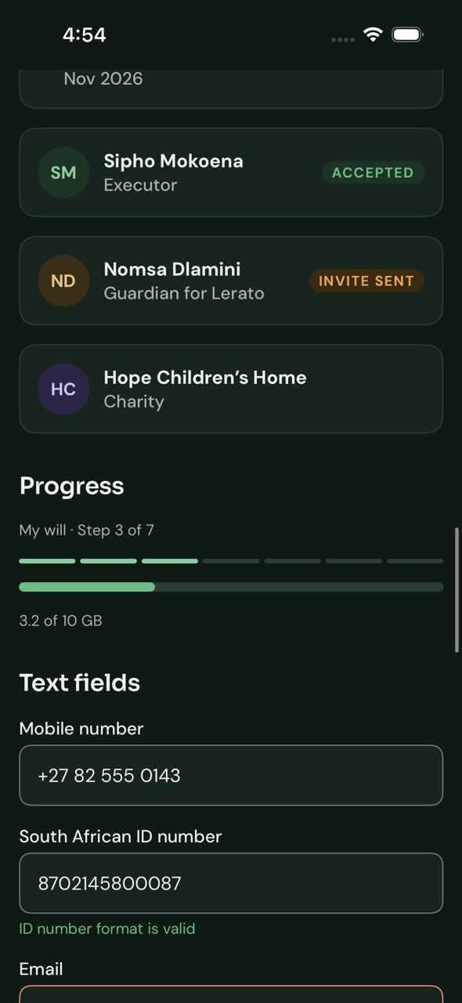
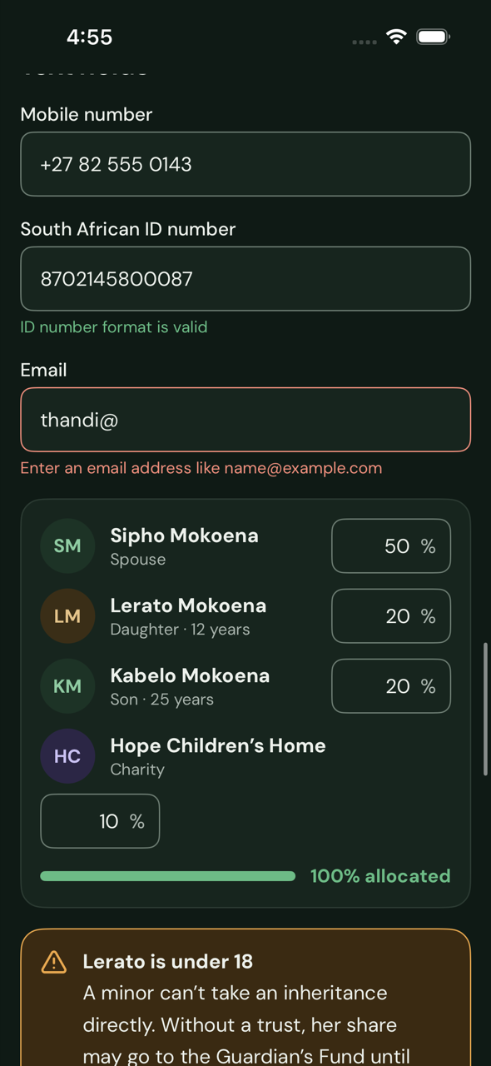
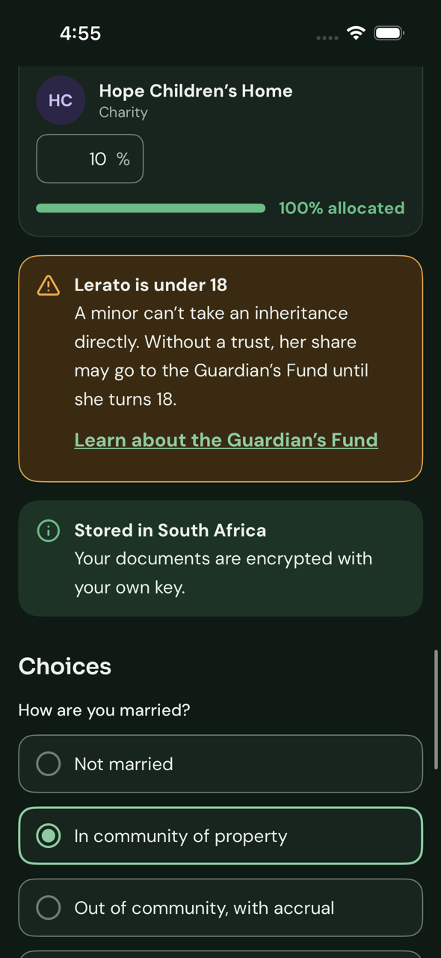
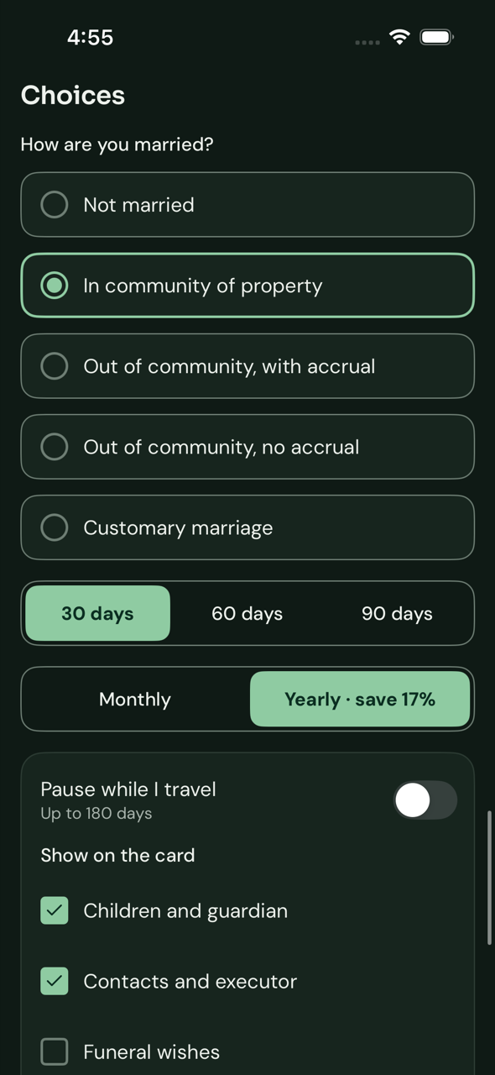
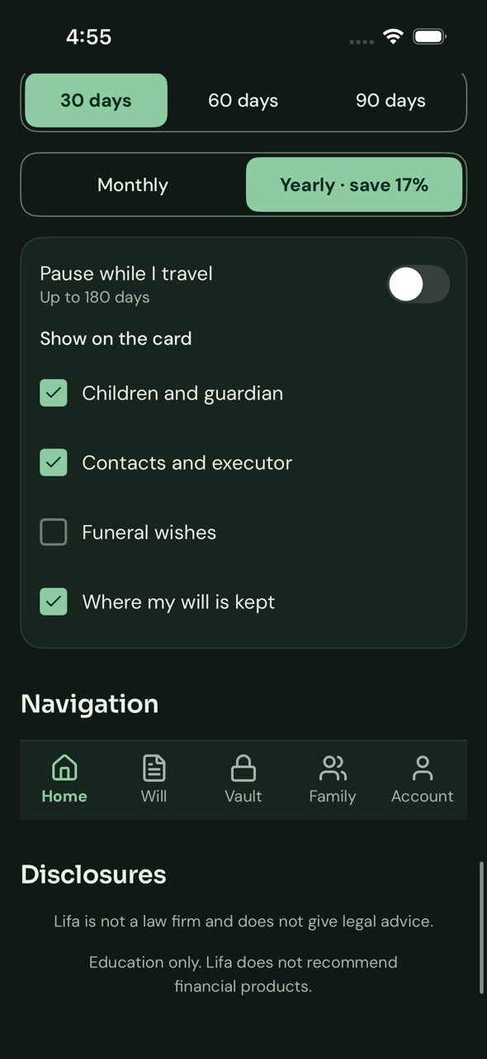
iPhone, screens 7–11 of 11
IOS · APP STORE · DARK
People rows, progress, text fields
Validation and share allocation
Callouts and marital-regime choices
Segmented controls and toggles
Checkboxes, navigation, disclosures
Real app on the iPhone simulator (Xcode, GitHub macOS 15 runner) · XCUITest screenshots · iOS 18 · dark mode
Notes:
Dark mode, second half.

Slide 15
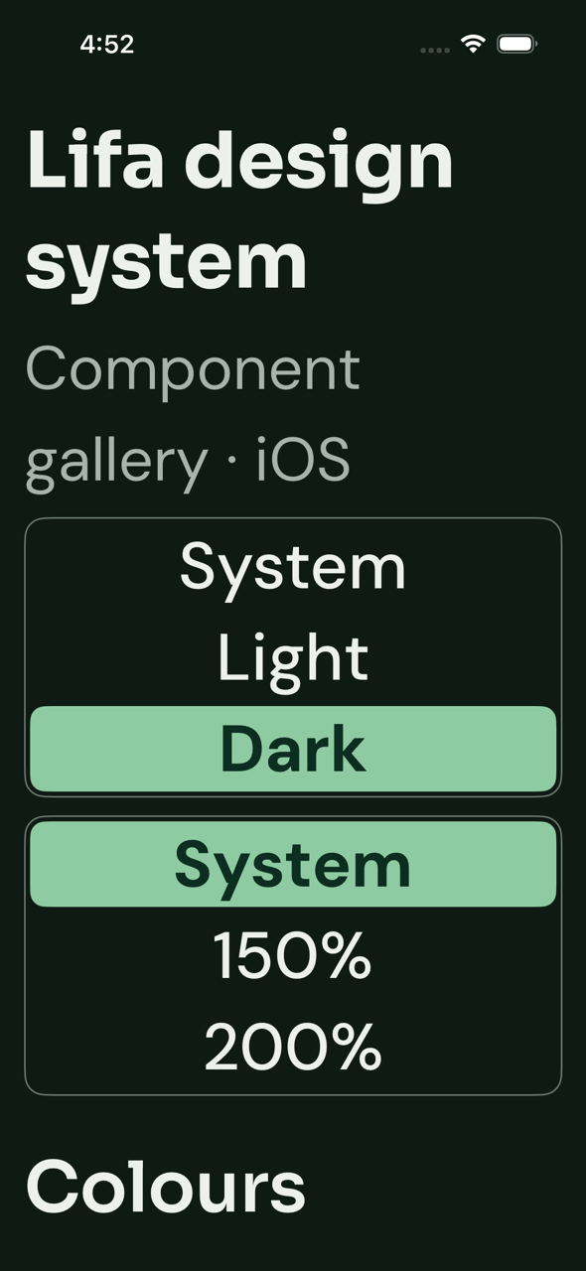
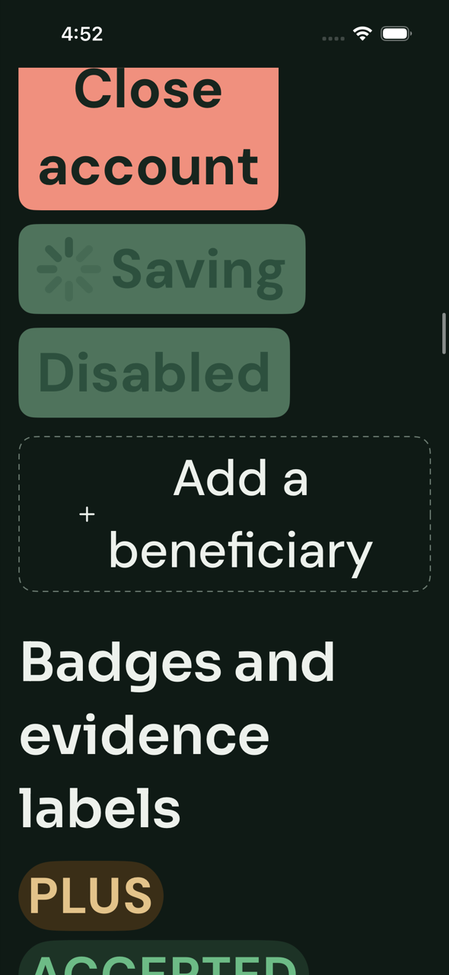
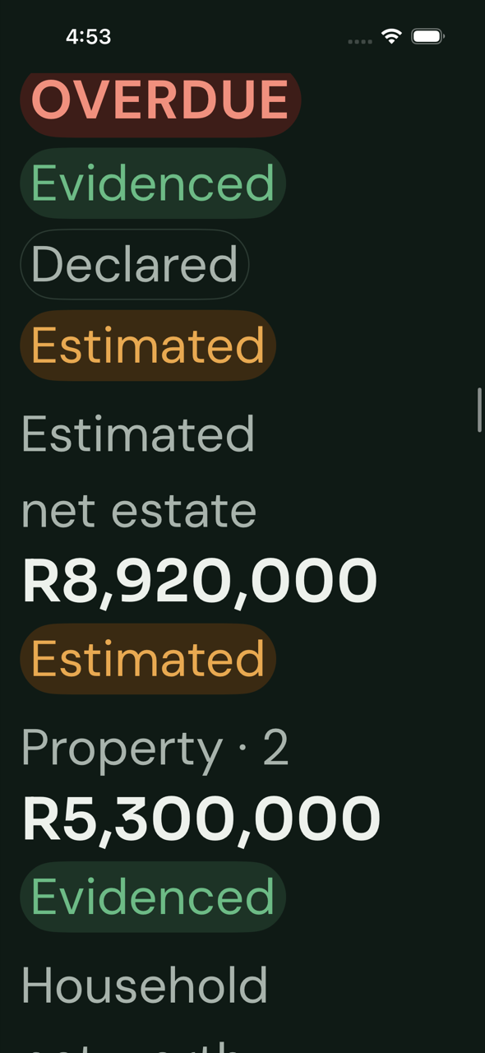
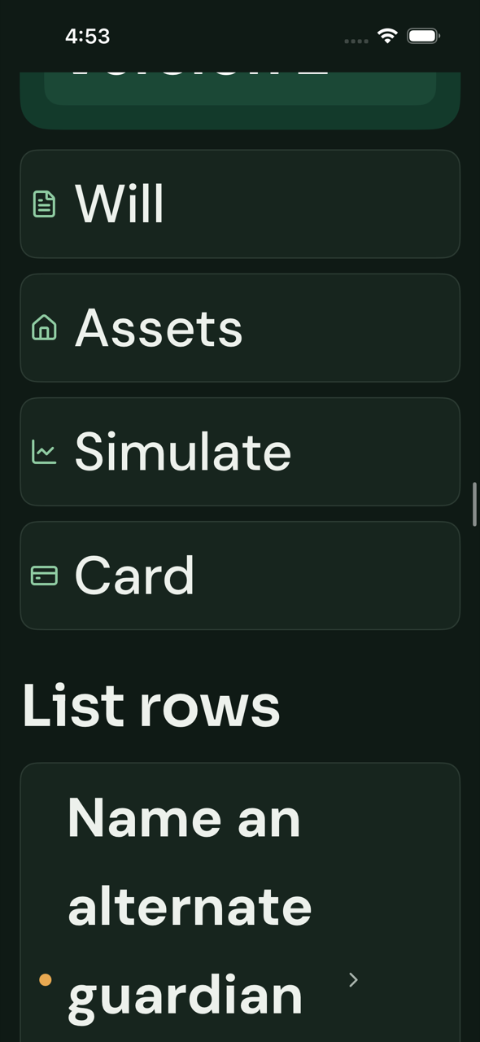


Largest text size: layouts adapt instead of breaking words
IOS · APP STORE · LARGEST ACCESSIBILITY TEXT
Header and controls wrap
Buttons stack in a column
Badges and amounts wrap
Quick actions become full-width rows
Share fields widen with the text
Tab bar: icons only, long-press shows the label
6 of 36 screens at the system’s largest text size (Accessibility XXXL), dark mode · fixed after screenshots showed words breaking mid-word
Notes:
The first captures at this size broke words in buttons, quick actions, share fields and the tab bar. Now the rows stack, quick actions become rows, fields widen and the tab bar shows icons with the Large Content Viewer, as the system tab bar does.

Slide 16






The Google Play build, all six screens
ANDROID · GOOGLE PLAY · LIGHT
Header, store label, colour tokens
Type scale and buttons
Badges, amounts, check-in banner, Legacy Score
List rows, progress, text fields
Validation, allocation, callouts
Choices, toggles, navigation, disclosures
Real MainActivity of the gms build · Robolectric 4.17 + Roborazzi 1.76.0 on GitHub Actions · 411 × 914 dp, xxhdpi
Notes:
Launched from the Google Play flavour itself; the header reads Android, Google Play. Play Billing and Firebase push are bound into this flavour in step 4.

Slide 17






Same build with the phone in dark mode
ANDROID · GOOGLE PLAY · DARK
Header, store label, colour tokens
Type scale and buttons
Badges, amounts, check-in banner, Legacy Score
List rows, progress, text fields
Validation, allocation, callouts
Choices, toggles, navigation, disclosures
Real MainActivity of the gms build · Robolectric 4.17 + Roborazzi 1.76.0 on GitHub Actions · 411 × 914 dp, xxhdpi · system night mode
Notes:
The theme picker is on System; the phone is in night mode and the app follows it.

Slide 18






System font scale 2.0
ANDROID · GOOGLE PLAY · 200% TEXT
Header and colours
Type scale and buttons
Badges and amounts wrap
List rows and text fields
Allocation and callouts
Choices and navigation
Shared Compose design module used by both store builds · Robolectric + Roborazzi · font scale 2.0
Notes:
Captured from the shared design module, which both Android builds use unchanged.

Slide 19

The Huawei build, all six screens
ANDROID · HUAWEI APPGALLERY · LIGHT
Header, store label, colour tokens
Type scale and buttons
Badges, amounts, check-in banner, Legacy Score
List rows, progress, text fields
Validation, allocation, callouts
Choices, toggles, navigation, disclosures
Real MainActivity of the hms build · Robolectric 4.17 + Roborazzi 1.76.0 on GitHub Actions · 411 × 914 dp, xxhdpi
Notes:
The Huawei flavour for phones running Android with HMS. CI checks this build contains no Google Play services or Firebase.

Slide 20

Same build with the phone in dark mode
ANDROID · HUAWEI APPGALLERY · DARK
Header, store label, colour tokens
Type scale and buttons
Badges, amounts, check-in banner, Legacy Score
List rows, progress, text fields
Validation, allocation, callouts
Choices, toggles, navigation, disclosures
Real MainActivity of the hms build · Robolectric 4.17 + Roborazzi 1.76.0 on GitHub Actions · 411 × 914 dp, xxhdpi · system night mode
Notes:
Identical UI to Google Play by design; only billing and push providers differ, and those arrive in step 4.

Slide 21
System font scale 2.0
ANDROID · HUAWEI APPGALLERY · 200% TEXT
Header and colours
Type scale and buttons
Badges and amounts wrap
List rows and text fields
Allocation and callouts
Choices and navigation
Shared Compose design module used by both store builds · same images as the Google Play section
Notes:
Same images as the Google Play section: large-text behaviour lives in the shared design module.

Slide 22
HarmonyOS NEXT: no screenshots yet
This build has not been compiled, so there is nothing real to show.
What exists
What is missing
The ArkTS design package with all gallery components, themes generated from the same tokens, the entry app and its UI tests.
Huawei’s DevEco build tools and an emulator or device to render on. They are not on GitHub’s hosted runners and need a Huawei developer account to download.
Decision needed: set up a HarmonyOS build machine for CI, or capture screens by hand in a developer’s DevEco Studio
Notes:
This is the one distribution with no evidence yet. The code mirrors the other clients, but until it compiles we should not claim it works.

Slide 23
How it was checked
Web
Android
iOS
Unit tests and Playwright with axe on every section, in light, dark and 200% text. Passing.
Compose UI tests pass, including 48 dp touch targets. Both store builds assemble; the Huawei build has no Google services. Passing.
Package tests, UI tests and accessibility audits pass. Screenshots found real bugs (ignored system text size, words breaking at large sizes); all fixed.
Tokens
Icons
HarmonyOS
Contrast test 78/78, plus a drift check that fails CI if generated themes are out of date.
24 Lucide icons generated per platform and checked pixel-identical against the source.
Built from the same tokens, but not compiled yet: DevEco tooling is not available in CI.
Known gap: Sora and DM Sans lack the Tshivenda letters ḓ ḽ ṅ ṋ ṱ, so those letters render in a fallback font
Notes:
Web, Android and iOS are all green in CI. One check is deliberately excluded: the runtime Dynamic Type audit at the default size flags a different element each run with no truncation visible, so Dynamic Type is audited with the app launched at the largest size instead. This is recorded in design/README.md for a device check before release.

Slide 24
YOUR REVIEW
Approve step 2, then on to the backend
Look and feel: colours, type and components on each platform
A font choice for Tshivenda names, or accept the fallback
HarmonyOS: a CI build machine, or hand-captured screens
Step 3: Spring Boot services, Terraform for Azure South Africa, CI/CD and seed data
Nothing in step 3 starts until step 2 is approved
Notes:
Close with the decisions needed. Step 3 builds the services behind the 210 public API operations already specified, in the South Africa North region.

