Slide 1

END-TO-END DEMO · MOBILE
Lifa on mobile, end to end
Ten journeys, from sign-up to an executor closing the estate, and the technology behind every step on Android (Google Play and Huawei), iOS and HarmonyOS NEXT.
WZDRY (Pty) Ltd · Architecture review, October 2026
Notes:
This deck walks the product end to end on a phone. It is the designed system: the architecture (step 1) and the design system (step 2) are done; the backend (step 3) and the feature screens (step 4) are next. The phone images are real renders of the design-system components each journey is built from, not finished feature screens.

Slide 2
What is real today, and what this deck shows
WHERE WE ARE
Done
Next
In this deck
Architecture for all of R1–R4 (step 1)
OpenAPI 3.1 contract: 210 public operations, every one tagged with its FR ID
Design system on every client, tested in CI (step 2)
Step 3: Kotlin/Spring backend, Terraform for Azure South Africa North, CI/CD, seed data
Step 4: feature screens on Android first, then web, iOS and HarmonyOS
Step 5: device and end-to-end test suites
Each journey as designed: steps, API calls, security and platform technology
Phone images are real component renders, labelled with the client they came from
Later-release features shown with the release flag that gates them
Source: docs/architecture/01–09, api/openapi (210 public operations), DECISIONS.md D-001 to D-047
Notes:
Set expectations first: nothing in the journeys runs end to end yet. What exists is the contract every client and the backend will share, and the components the screens will be built from.

Slide 3
Ten journeys across the life of an estate
THE MAP
1
2
3
4
5
Sign up and secure the phone
Legacy Score
Write the will
Assets and family
Document vault
FR-ONB
FR-SCR
FR-WIL
FR-AST · FAM
FR-VLT
6
7
8
9
10
Access and emergency card
Check-ins
Activation
Executor workspace
Plans and billing
FR-PRM · EMG
FR-DMS
FR-ACT
FR-EXE
FR-SUB
Shaded: activation-related journeys that stay switched off in production until the red-team and four-eyes gates pass. Journey 10 applies throughout.
Journeys 1–6 are R1/R2 scope. 7–10 run behind release flags until their FRS 13.2 launch gates pass (D-026)
Notes:
The order follows a real owner: secure the account, see where they stand, write a will, record what they own, store documents, decide who sees what, keep checking in. Activation and the executor workspace are what happens after the owner dies or loses capacity.

Slide 4
One architecture, three native toolkits
MOBILE TECHNOLOGY STACK
Screens
Feature modules: onboarding, score, will, estate, family, vault, access, emergency, check-in, activation, executor, plans
Jetpack Compose · SwiftUI · ArkUI
Design system
Generated themes and 22 shared components from one tokens.json (step 2)
core:design · LifaDesign · design HAR
Data and offline
Repositories, encrypted local cache, sync; entitlement keys drive what the UI offers (never plan names)
Room/GRDB/RelationalStore + SQLCipher
API client
Generated from the OpenAPI 3.1 contract; DPoP proof and step-up token added by interceptors; certificate pinning
Retrofit/OkHttp · swift-openapi-generator · @ohos.net.http
Security
Hardware device key, biometric step-up, attestation, root/jailbreak signals, secure screens
Keystore/StrongBox · Secure Enclave · HUKS
Store providers
Billing, push, integrity and document scanning behind interfaces, one implementation per store
Google Play · Huawei · Apple · HarmonyOS Kits
Android modules per 08-platforms §8.3; iOS mirrors them as Swift packages, HarmonyOS as HAR modules
Notes:
Read top to bottom: screens sit on the shared design system; under that, data, a generated API client, security and the store-specific providers. Only the bottom layer differs between Google Play and Huawei builds.

Slide 5
Each platform, capability by capability
MOBILE TECHNOLOGY STACK
Capability | Android · Google Play | Android · Huawei | iOS | HarmonyOS NEXT
UI | Jetpack Compose | same code | SwiftUI | ArkUI (ArkTS)
Sign-in (OIDC + PKCE) | MSAL Android | MSAL (no GMS) | MSAL iOS, native auth | System browser + PKCE
Device key and biometrics | Keystore (StrongBox) + BiometricPrompt | same | Secure Enclave + LocalAuthentication | HUKS + User Authentication Kit
Attestation | Play Integrity | HMS Safety Detect | App Attest | Device Security Kit
Push | FCM | Huawei Push Kit | APNs | Push Kit
Billing | Play Billing | Huawei IAP | StoreKit 2 | IAP Kit
Encrypted cache | Room + SQLCipher | same | GRDB + SQLCipher | RelationalStore (encrypted)
Emergency widget | Glance widget | Glance widget | WidgetKit lock screen | Service widget
Document scanner | ML Kit | HMS ML Kit | VisionKit | Camera Kit
Secure screens | FLAG_SECURE | FLAG_SECURE | App-switcher blur, capture block | setWindowPrivacyMode
From docs/architecture/08-platforms §8.1 · versions pinned when each client is built
Notes:
The Huawei build is the same codebase as Google Play; only billing, push, integrity and scanning swap. CI fails the Huawei build if any Google Play services or Firebase dependency appears. HarmonyOS NEXT is a separate native app because it does not run Android apps.

Slide 6
The path of one request from the phone
EVERY TAP THAT TOUCHES DATA
Phone
Front Door + WAF
API Management
Service
Entitlement
Policy
Audit ledger
Access token (10 min) + DPoP proof signed by the device key (+ step-up token)
OWASP rules, bot manager, DDoS protection
JWT check, rate limits, signed claims header
Verifies DPoP binding, step-up scope and freshness
Limits by feature key, cached 60 s
Deny by default: role × item × estate state × release rule
Hash-chained, append-only; written before content returns
All of this runs in Azure South Africa North. Personal data never leaves South Africa (NFR-PRV-001).
Messages between services carry IDs only, never estate content; each consumer fetches what it needs with its own policy check.
docs/architecture/03 §3.3 · if policy or audit is down, reads of content fail closed (503)
Notes:
Every journey that follows uses this path. A stolen token alone is useless because each request must also be signed by the hardware key on the bound device.

Slide 7
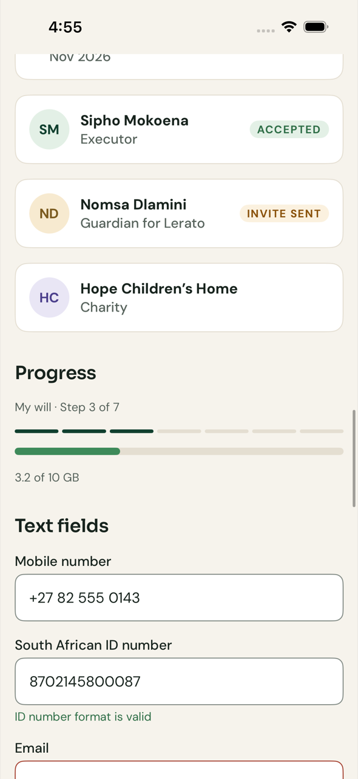
Sign up and secure the phone
JOURNEY 1 OF 10 · PHONE IMAGE: DESIGN-SYSTEM RENDER
1
Create the account
Email and password with an email code, through Microsoft Entra External ID (native sign-in, PKCE)
Entra External ID · MSAL
2
Bind this phone
A P-256 key is created in hardware and registered with an attestation verdict
POST /v1/devices
3
Verify the mobile number
SMS code plus a SIM-swap check through Clickatell
POST /v1/me/mobile-verification · …/confirm
4
Record consent per purpose
Planning consent is required; marketing is opt-in and off by default
PUT /v1/me/consents
5
Check the ID number
SA ID checksum and date of birth; minimum testamentary age from configuration
PUT /v1/me/identity-document
6
Unlock with biometrics
On every cold start and after 5 minutes in the background; unlocks the local cache key
iOS
Text fields with live validation
BiometricPrompt · LocalAuthentication · User Authentication Kit
FR-ONB-001..007 · D-009, D-022 · account is active only when email, mobile and planning consent are recorded
Notes:
Show how sign-up ends with a phone that is cryptographically bound to the account. A new phone starts at reduced trust and every other device is notified.

Slide 8
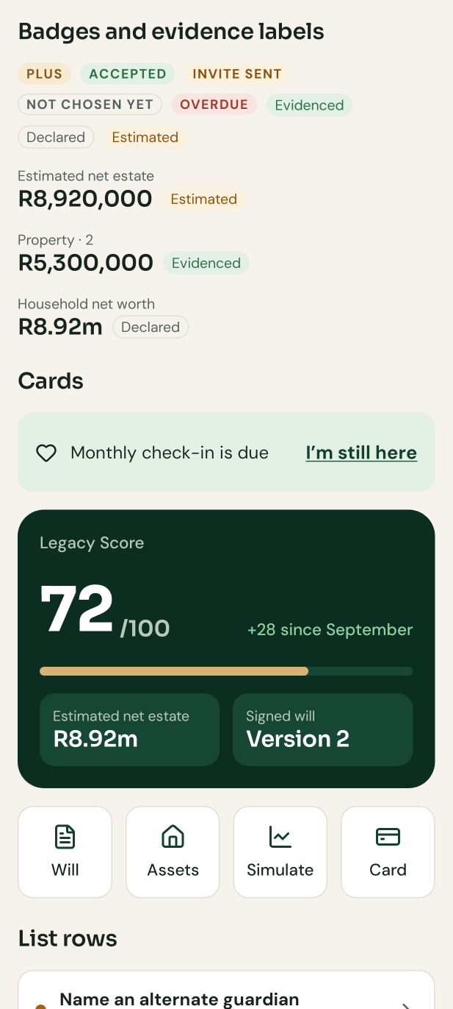
See where you stand: the Legacy Score
JOURNEY 2 OF 10 · PHONE IMAGE: DESIGN-SYSTEM RENDER
1
Answer the readiness questions
A short assessment; the question bank is versioned content
GET /v1/assessment · PUT /v1/assessment/answers
2
Get a score out of 100
Weights: Will 25 · Assets 20 · Protection 20 · Family 20 · Documents 15 (D-018)
GET /v1/score
3
See the next best actions
Each action shows the points it adds, e.g. "Name an alternate guardian · Adds 3 points"
GET /v1/score/actions
4
See what happens without a will
An intestate-succession preview, clearly labelled education, not advice
GET /v1/score/intestate-preview
5
Watch it change
Any estate change publishes estate.changed; the score service rescores
Service Bus · estate.changed → score
Android · Google Play
Score card and quick actions
FR-SCR-001..009 · score history and life events need the scr.history and scr.life_events keys (Plus and Family)
Notes:
The score is the home screen hook: one number, the evidence behind it and the next action.

Slide 9
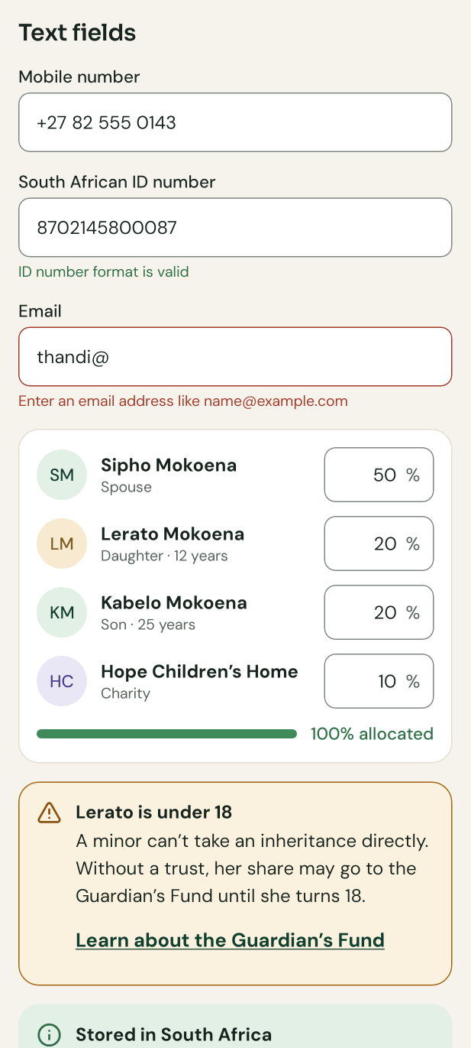
Write the will
JOURNEY 3 OF 10 · PHONE IMAGE: DESIGN-SYSTEM RENDER
1
Marital regime
In or out of community of property, with or without accrual, or customary marriage
POST /v1/wills · PATCH /v1/wills/{willId}
2
Divide the residue
Shares must total exactly 100%; anything else blocks with a plain message
PUT /v1/wills/{willId}/residue
3
Gifts, guardians, executors
A minor’s share triggers the Guardian’s Fund warning; nominations do not count toward role limits
…/bequests · …/guardianship · …/executors
4
Review and signing pack
Attorney-approved clauses render to a PDF signing pack with witness instructions
POST /v1/wills/{willId}/signing-pack · docgen
5
Record the signing
Lifa never e-signs: the owner records the wet-ink signing and witnesses
POST /v1/wills/{willId}/execution
6
Keep it current
Life events and a 3-year check mark the will stale and prompt a review
Android · Google Play
Share allocation, under-18 callout
will.stale · life-event.declared
FR-WIL-001..018 · Free tier keeps one draft (D-015) · will templates ship as [VERIFY] until the attorney signs off
Notes:
Stress the guardrails: Lifa prepares the document and explains the rules, but never gives legal advice and never e-signs a will.

Slide 10
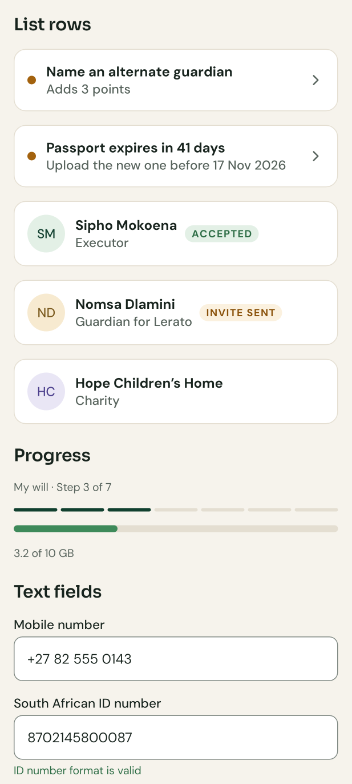
Record assets and family
JOURNEY 4 OF 10 · PHONE IMAGE: DESIGN-SYSTEM RENDER
1
Add people
Spouse, children, beneficiaries; a minor’s status updates automatically at 18
POST /v1/estate/persons · GET /v1/estate/family-tree
2
Add assets and debts
Each value carries its evidence: Evidenced, Declared or Estimated
POST /v1/estate/assets · /v1/estate/liabilities
3
Read a statement for me
Upload a statement and confirm the extracted fields (behind release.extraction)
POST /v1/extractions · …/confirm
4
See the balance sheet
Net estate, with values older than 12 months flagged for refresh
GET /v1/estate/balance-sheet
5
Track net worth monthly
A monthly snapshot and a gentle balance-update prompt
GET /v1/wallet/snapshots · POST …/balance-update
Android · Huawei
People rows with roles and status
FR-AST-*, FR-FAM-*, FR-WAL-* · Free: 15 asset and debt records, 10 people (ast.max_records, fam.max_people)
Notes:
This is shown on the Huawei build on purpose: same code, same screens, no Google services.

Slide 11
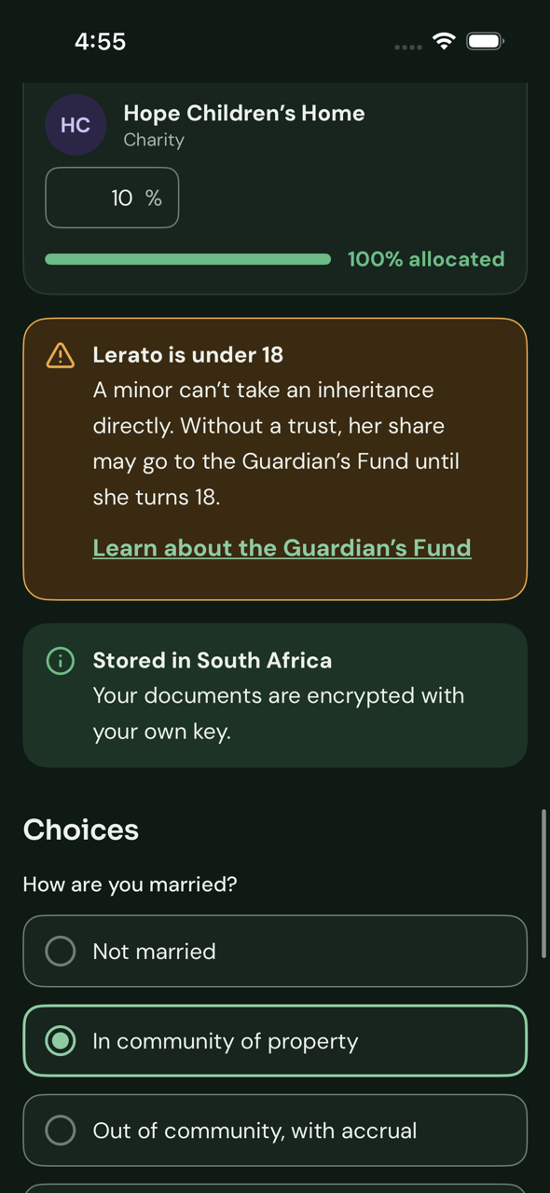
Store documents in the vault
JOURNEY 5 OF 10 · PHONE IMAGE: DESIGN-SYSTEM RENDER
1
Step up with biometrics
The device key signs a server challenge; the step-up token lasts 5 minutes, scope vault.write
POST /v1/step-up/challenges · /verifications
2
Upload or scan
Platform scanner (ML Kit, HMS ML Kit, VisionKit); bytes never written to the photo library
POST /v1/vault/documents
3
Encrypt per document
A fresh data key per file, wrapped by the owner’s own key in Azure Managed HSM
Managed HSM · owner-kek/{ownerId}
4
Scan and check
ClamAV malware scan; detection of passwords, PINs and seed phrases, which Lifa never stores
document.uploaded → scan · SecretScanner
5
Read, with an audit trail
Every read is written to the ledger before any byte is returned; screenshots blocked
GET /v1/vault/documents/{id}/content
iOS · dark
“Stored in South Africa” callout
FR-VLT-001..011 · vault runs in the isolated pool B with its own database and storage account · Free 500 MB, Plus 10 GB
Notes:
A compromise of the main services yields no document content and no unwrapped keys, because only pool B can call the HSM.

Slide 12
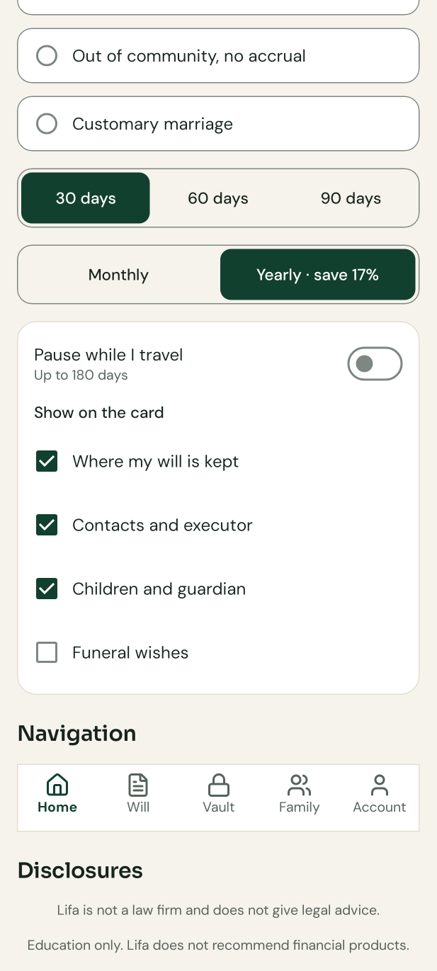
Decide who sees what, and the emergency card
JOURNEY 6 OF 10 · PHONE IMAGE: DESIGN-SYSTEM RENDER
1
Invite trusted people
Roles such as emergency contact, executor or verifier; they accept on their own device
POST /v1/access/grants · /v1/invitations/{token}/accept
2
Set release rules
Per item: now, on incapacity or on death; changing a rule needs step-up release.write
PUT /v1/access/release-rules/{type}/{id}
3
Revoke in one tap
Removing access never needs step-up; caches bust on grant.revoked
DELETE /v1/access/grants/{grantId}
4
Emergency card
Opt-in lock-screen widget, contacts only by default, read with a narrow revocable token
POST /v1/emergency-card/widget-tokens
5
Owner told about every access
Each read by someone else notifies the owner; push text never contains estate content
access.occurred → notification
Android · Google Play
Toggles and “Show on the card”
FR-PRM-001..007, FR-EMG-001..003 · D-016, D-017 · Free: one role holder (emergency contact only)
Notes:
Granting access takes a biometric step-up; taking it away never does.

Slide 13
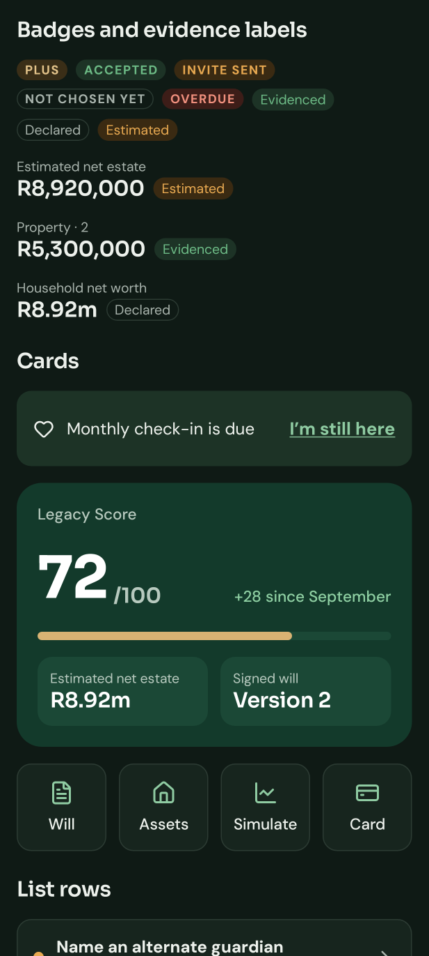
Stay in touch: check-ins
JOURNEY 7 OF 10 · PHONE IMAGE: DESIGN-SYSTEM RENDER
1
Choose a rhythm
Every 30, 60 or 90 days, with chosen verifiers
PUT /v1/check-in/settings
2
Get a quiet reminder
Push says only "You have a Lifa reminder"; nothing personal on the lock screen
checkin.due → FCM · Push Kit · APNs
3
Tap "I’m still here"
One tap confirms; travel pause up to 180 days
POST /v1/check-ins · /v1/check-in/pause
4
Missed check-ins escalate
SMS and email, then verifiers are asked to confirm the owner is safe
checkin.missed · verifier.notify
5
Never declares death
Reports only open a verification case for human review
POST /v1/verifier/requests/{id}/reports
Android · Huawei · dark
The check-in banner
FR-DMS-001..007 · behind release.dms until the SIM-swap and travel-pause end-to-end test passes
Notes:
The switch is a safety net, not a trigger. It cannot release anything by itself.

Slide 14
Activation: releasing access after death or incapacity
JOURNEY 8 OF 10
Request
Evidence
Four-eyes review
72-hour notice
Activated
Requester with a matching role uploads evidence
Family plan: 2 verifiers or a death certificate
Two trained Operations staff approve; SLA 2 business days
Every owner channel is told; any owner login cancels
Release rules apply; executor workspace opens
POST /v1/activation-requests
FR-DMS-005
back-office queue
FR-ACT-004
activation.completed
Safeguards against a false activation
A reviewer can never approve a case they opened. The 72-hour notice can be waived only by the Compliance Officer, with a documented reason and an alert.
Incapacity releases only items whose rule says "on incapacity". Every decision is in the hash-chained audit ledger.
FR-ACT-001..008 · D-027, D-038 · behind release.activation until a red-team false-activation exercise fails to activate
Notes:
This is the highest-risk flow in the product. On the phone it is mostly notifications and status; the decisions happen in the back-office console with two people.

Slide 15
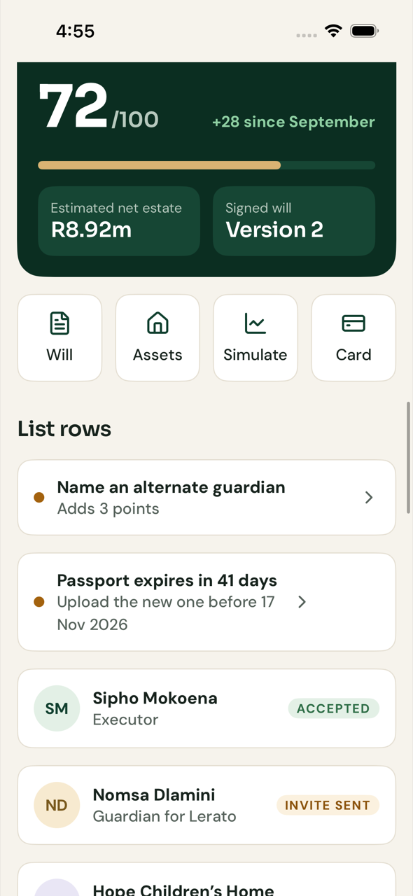
The executor’s workspace on the phone
JOURNEY 9 OF 10 · PHONE IMAGE: DESIGN-SYSTEM RENDER
1
Estate file opens
Created on activation from a frozen copy of the owner’s plan
GET /v1/estate-files/{id}
2
Work the checklist
Tasks and statutory deadlines with reminders (content from an estates attorney)
…/tasks · …/deadlines
3
Contact institutions
Letters generated for banks and insurers; claims tracked
…/institutions · …/letters · …/claims
4
Keep beneficiaries informed
Updates go to beneficiaries, who see only their own view
…/updates · /v1/shared/estates/{id}/beneficiary-view
5
Hand over and close
Exports and the full claims register are on the web; mobile covers the day-to-day
…/exports · …/distribution-complete
iOS
List rows with status, for checklists
FR-EXE-001..013 · behind release.executor · Lifa never acts for the executor; it organises their work
Notes:
Executors use any client. The phone covers the checklist, updates and documents; the full workspace with exports is on the web (08 §8.5).

Slide 16
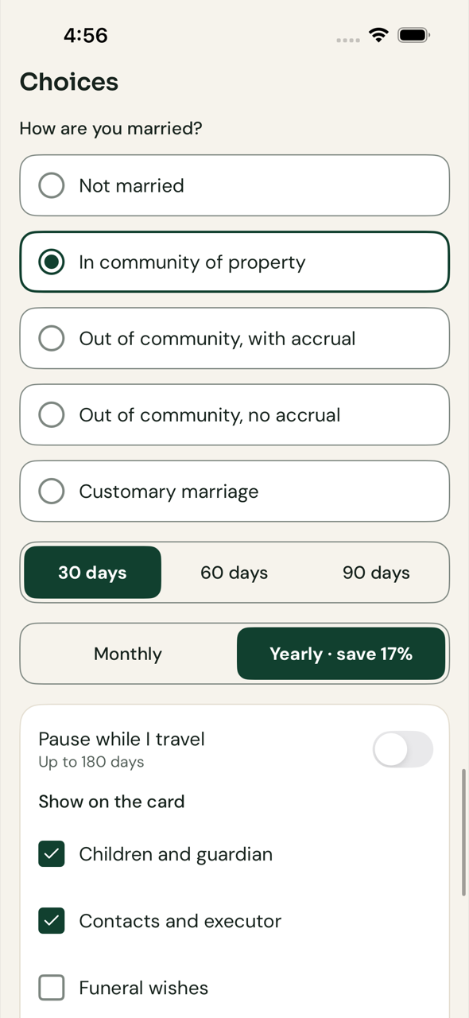
Plans and billing
JOURNEY 10 OF 10 · PHONE IMAGE: DESIGN-SYSTEM RENDER
1
Show what each plan includes
The catalogue comes from the server; the app checks feature keys, never plan names
GET /v1/catalogue · GET /v1/entitlements
2
Buy in the store
StoreKit 2, Play Billing, Huawei IAP or IAP Kit, each linked to the Lifa account
appAccountToken · obfuscatedAccountId · developerPayload
3
Confirm on the server
Store notifications are the source of truth; the app’s receipt only speeds up the first grant
POST /v1/purchases/verifications · store webhooks
4
Unlock instantly
entitlement.changed reaches every device by silent push
Service Bus → silent push
5
Downgrade safely
Nothing is deleted: items over the new limit become read-only; 14-day grace on failed payments
subscription.changed
iOS
Segmented control and choices
FR-SUB-001..008 · D-004, D-007 · prices and trial terms come from the plan catalogue, not the app
Notes:
Billing is per store, but entitlements are one set per person. If two channels are active, the higher tier wins and the owner is told how to cancel the other.

Slide 17
More features, each behind its own release flag
ALSO IN RELEASE A
Estate simulator
Digital legacy
Trust planner
If I died today, scenarios and liquidity gaps
Accounts, wishes and a sealed instruction split among chosen holders
Education and a suitability questionnaire
release.simulation · tax tables approved
release.digital_legacy
release.trusts · attorney-approved templates
Marketplace
AI adviser
ID verification
Find and book verified professionals; Paystack split payments
Education answers from a curated SA knowledge base (OpenAI models, Azure SA North preferred)
Vendor identity check at sign-up
release.marketplace · 50 verified listings
release.ai_adviser · 300-question evaluation
release.identity_verification · vendor contracted
Clients read flags from GET /v1/client-config and hide switched-off entry points; servers enforce them on every route
Notes:
All built now, all switched off in production until their FRS 13.2 gate passes and Compliance records the approval in the audit ledger.

Slide 18
What protects an owner’s data on the device
SECURITY ON THE PHONE
Bound to the device
Step-up for sensitive actions
Pinned connections
Every call is signed by a non-exportable hardware key (DPoP); a stolen token alone is useless
Vault, release rules, grants, export and deletion need a fresh biometric signature
SPKI pins for the API hosts, refreshed through signed client config
Encrypted local cache
Honest about rooted phones
Nothing on the lock screen
SQLCipher or encrypted RelationalStore; key released only by biometric unlock
Planning keeps working; vault, upload, widget and export are blocked, with an explanation
Push text is generic; analytics carry no names, amounts or IDs
docs/architecture/06 · NFR-SEC-*, NFR-PRV-*
Notes:
These controls are the same on every mobile platform, implemented with each platform’s own hardware-backed APIs.

Slide 19
Backend and cloud stack
BEHIND THE APPS
Services
Platform
Data and keys
Identity and vendors
Delivery
Kotlin + Spring Boot on JVM 21
22 modules shipped as 12 deployables
Contract-first OpenAPI 3.1, generated clients
AKS with Istio mTLS, three isolated node pools
Front Door Premium + WAF, API Management
Azure Service Bus with transactional outbox
Postgres Flexible Server, separate servers per pool
Blob storage for encrypted documents
Managed HSM: one key per owner
Microsoft Entra External ID
Clickatell (SMS, SIM-swap), ACS Email
Paystack (web, marketplace), OpenAI via Azure
Terraform for every environment
GitHub Actions per client and service
Dependabot, CodeQL, MobSF, Trivy, checkov
D-008, D-009, D-010, D-019, D-020, D-028, D-036 · all hosting in Azure South Africa North; DR in South Africa West
Notes:
This is what step 3 builds. Vault, policy, lifecycle and executor run in the isolated pool B; the AI adviser runs in pool C with no route to pool B and egress only to the model endpoint.

Slide 20
NEXT
From designed journeys to working ones
Approve step 2 (design system) and start step 3: backend, Terraform and CI/CD in Azure South Africa North
Step 4: Android journeys 1–6 first (Google Play and Huawei), then web, iOS and HarmonyOS
Supply content still marked [VERIFY]: will templates, question bank, tax tables, executor checklist
Decide how HarmonyOS gets built and tested: a CI build machine or hand-captured screens
Lifa never gives legal, tax or financial advice, never e-signs wills and never acts for the executor
Notes:
Close with what moves this from design to working software, and the inputs needed from the owner.

