Slide 1
SZCO Website Notes
Ahmed Jamil
3/14/17 Testing

Slide 2
Login screen sometimes gets stuck – at two times spent 30 seconds on the “Please wait while your data is being processed”
Site moves very slowly sometimes (11:11am 3/14/2017)
Logging in again takes very long time (12:27pm 3/14/2017)
Logging in taking long again (1:25pm on 3/14/2017
Website takes long to load (1:50pm 3/14/2017)

Slide 3
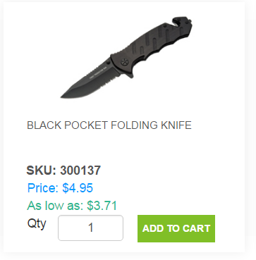
We can remove one space from here. Understand that it may affect a small number of items with 3 line descriptions but we will deal with that later.

Slide 4
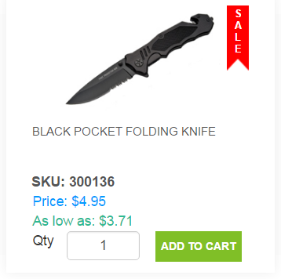
When an item is on sale, there should only be ONE price showing. It should not say “As low as”.
The “Price” should show the Sale Price, not the standard price

Slide 5
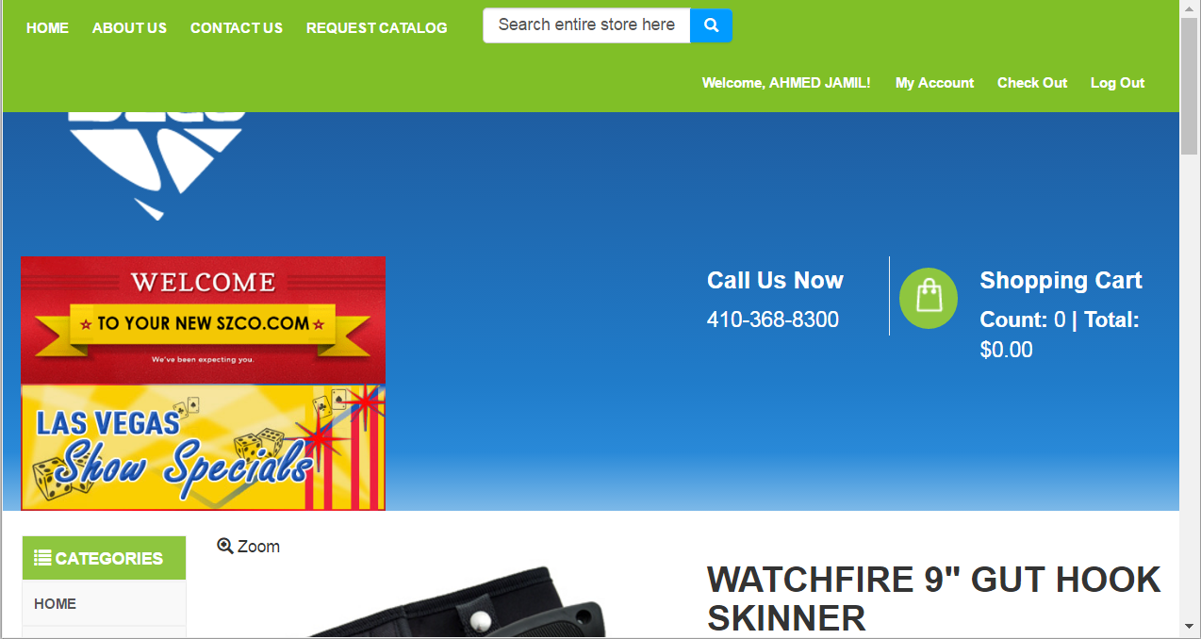
I’ve mentioned this before
I know the HTML5 does some stuff to the formatting, but there has to be some way to lock certain things in place. I reduced the browser size only slightly, and it starts doing all these weird formatting things
Green Bar enlarges
Logo gets cutoff
Blue bar enlarges by a lot
Banners start stacking
If we need to add those bars on the side of the site (like many sites
We want to lock the site in place and people need to scroll left and right if they make the browser smaller. We don’t want it to wrap.
Check out Mastercutlery.com on your phone browser – they have a separate mobile site that operates differently than their regular site. That’s what we should develop for phone and tablet users.

Slide 6
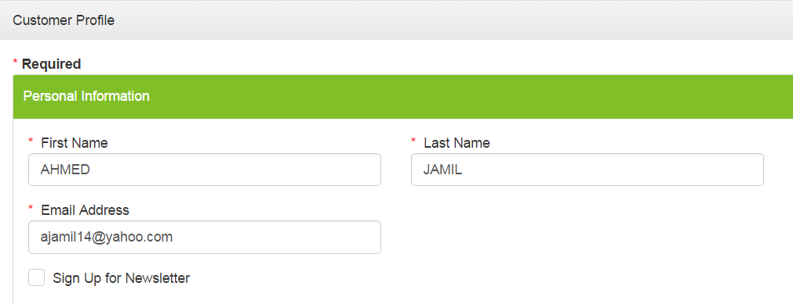
How do we connect this to constant contact?

Slide 7
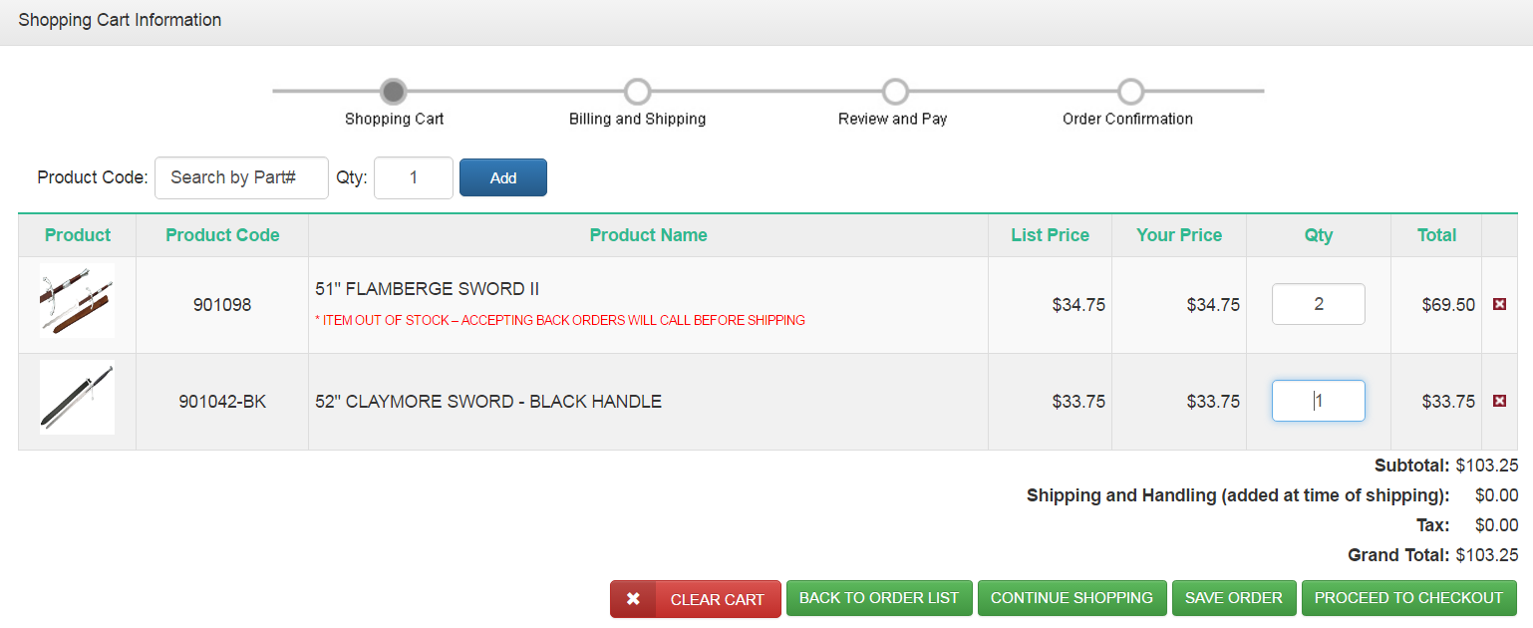
If an item is out of stock, it should not be adding to the order total
It should be showing as 0 in the “Total” column

Slide 8
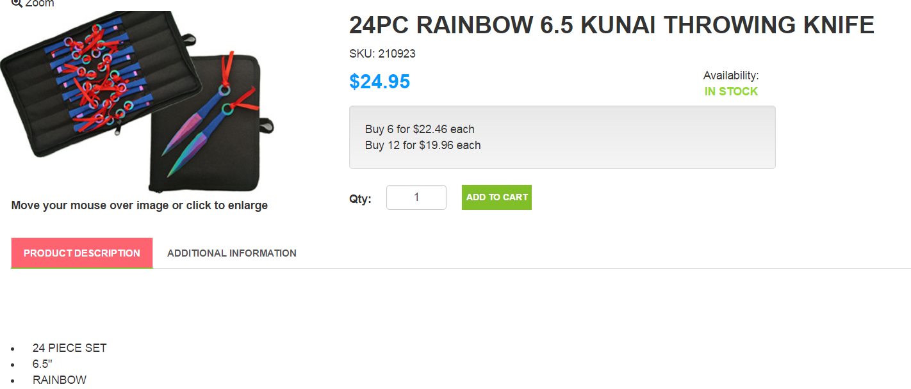
Descriptions should always be forced to start right under product description
I think bringing the descriptions over, some of ours didn’t start on the first line because it didn’t matter before.

Slide 9
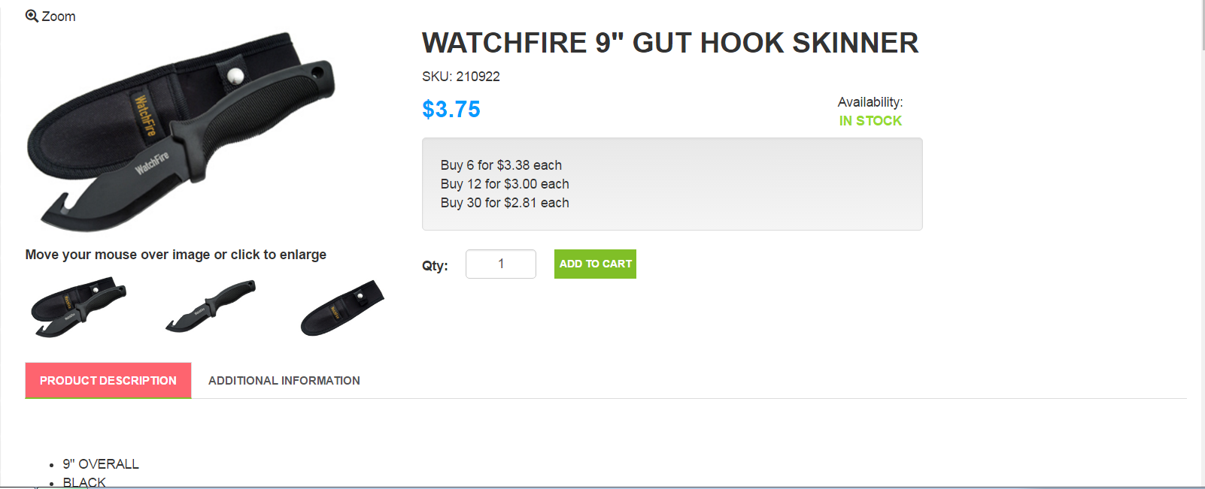
Everything gets pushed to the right by an inch or so, whatever the size of the thumbnail is
Could you do a mock of moving the additional images to the left of the main picture?
I don’t like the extra amount of white space on the left side of the screen
This way, description will get moved up so customer can see everything on one screen, and there’s not lot of empty space

Slide 10
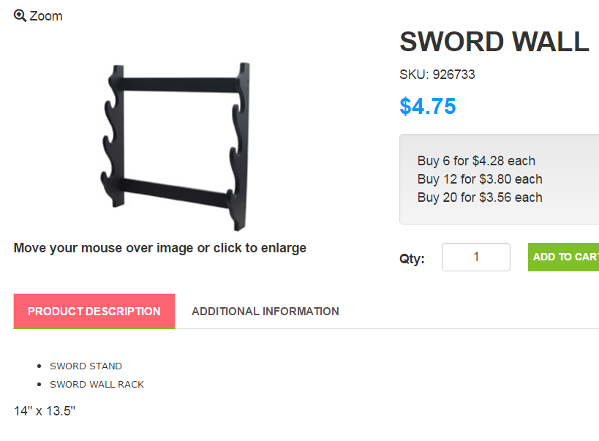
Can we force the system to update the item description format? See this description doesn’t have the font or font size of our normal description.

Slide 11
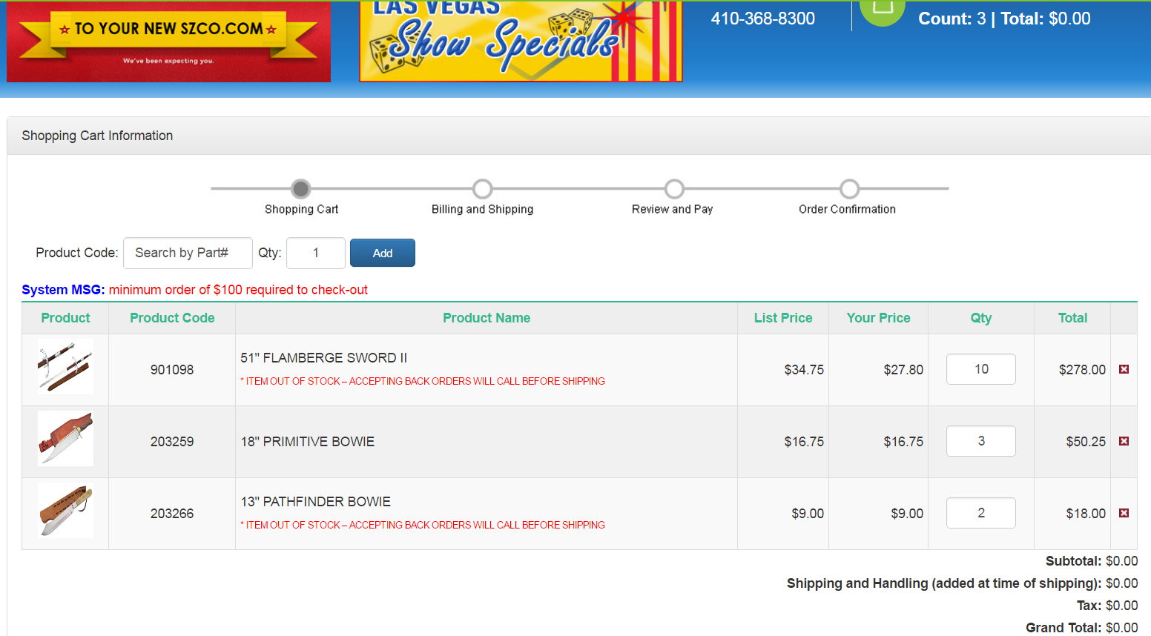
Continued on Next Slide
Confused about what’s going on here
Total in corner reads $0.00
Out of stock items are getting calculated
In stock items are being calculated
But no addition is happening in card

Slide 12
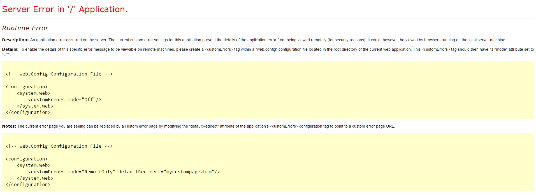
System MSG said I needed to get above $100 so I tried changing 203259 (the only in stock item) to 10 pcs and then I got this error
Now when I try to clear, I get the same error
Eventually just logged out, and logged back in

Slide 13
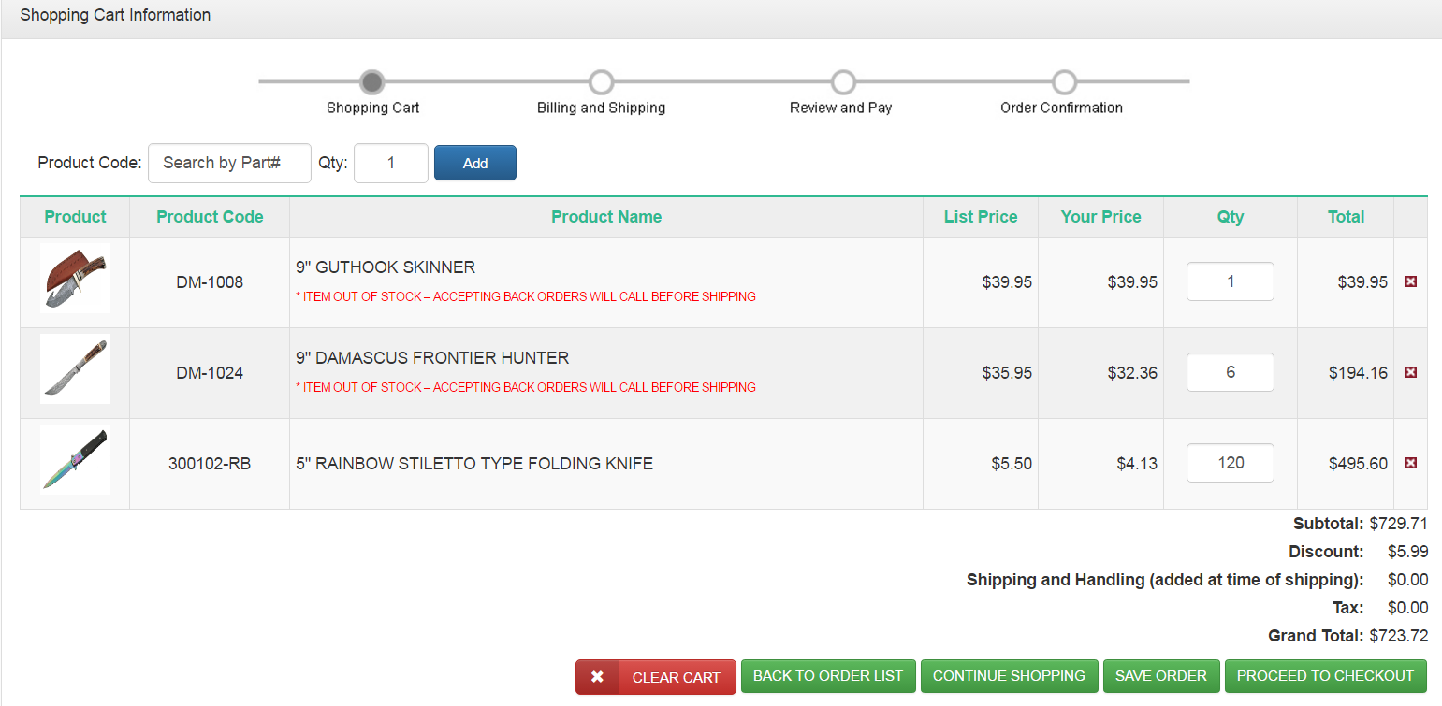
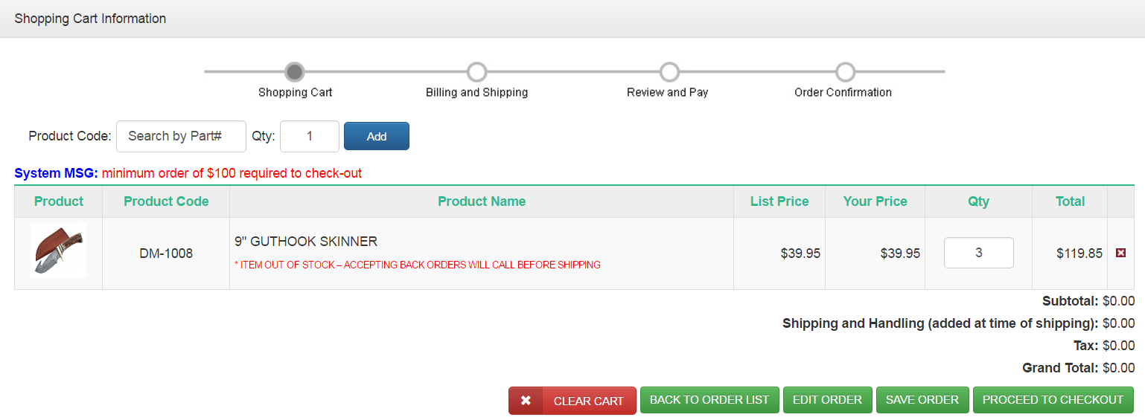
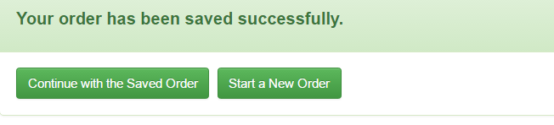
1
3
I clicked “Start New Order”, it took me back to the home screen, and then I somehow already have one item in my cart. Not sure why this is being pulling.
Start New Order takes very long time to load
Before I have saved the cart
Now I have saved the cart, but when I click “Continue with Saved Order”, it says “Please wait while the data is being processed”, and then nothing happens. I think when you click this, all the items should go back to the card and it should take you to the cart screen
2

Slide 14
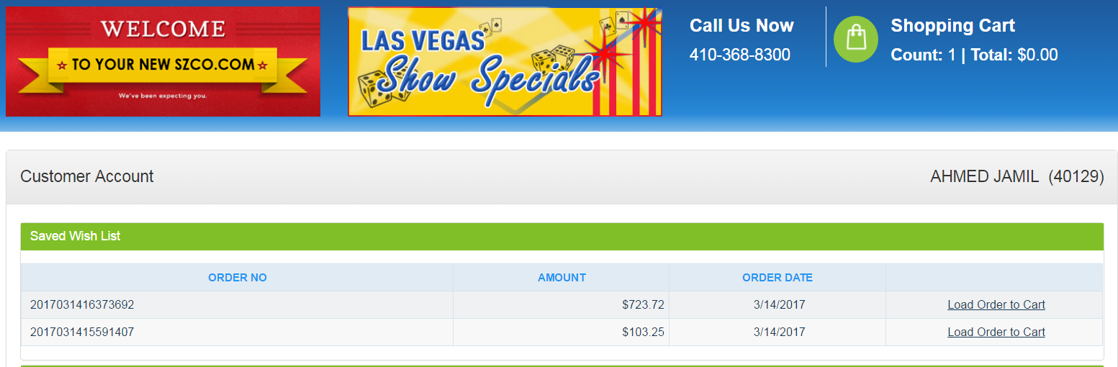
When I click “Load Order to Cart”, it says “Wait for your data etc”, but then nothing happens. Shopping Cart total remains unchanged, and it doesn’t take me to the cart. It should take me to the cart with the order populated

Slide 15
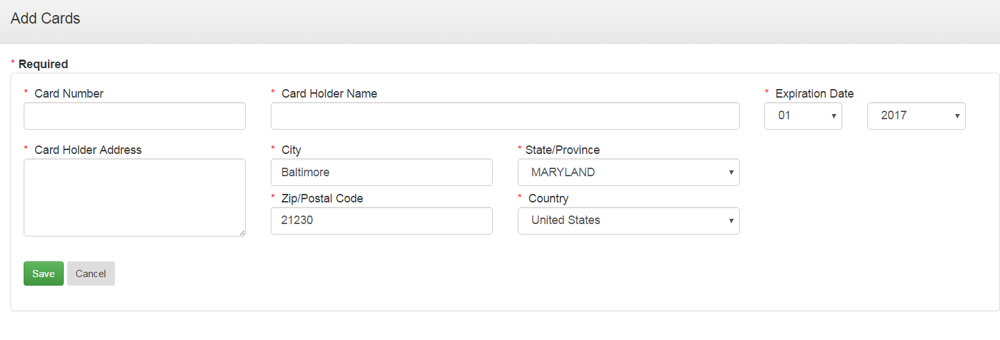
Card Holder Address Doesn’t need to be so big. It’s usually only one line

Slide 16
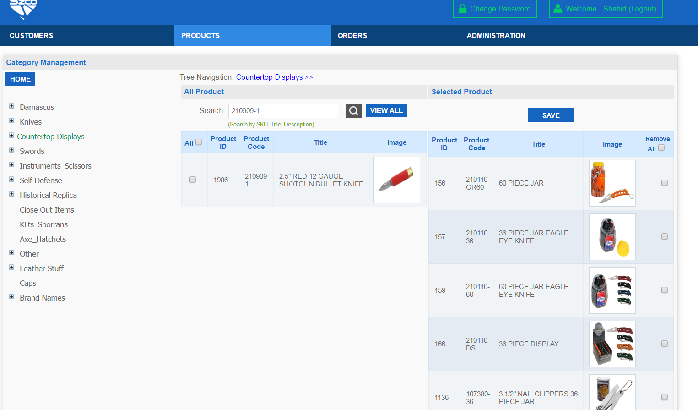
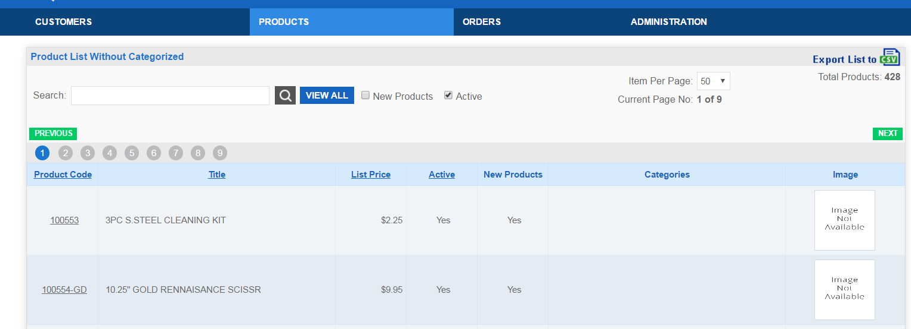
On the page “Product List Without Categories”, there’s no way to go into the item and add it to a category
You have to go to the Categories page to add, which seems counterintuitive. I should be able to do it from both
Can’t figure out how to add items to categories online
Also I’m not sure if it gives me the option to automatically add to the main category
For example, if I put a knife into the subcategory “Quick Assist Knives”, it should also go into the main category of “Knives”

Slide 17
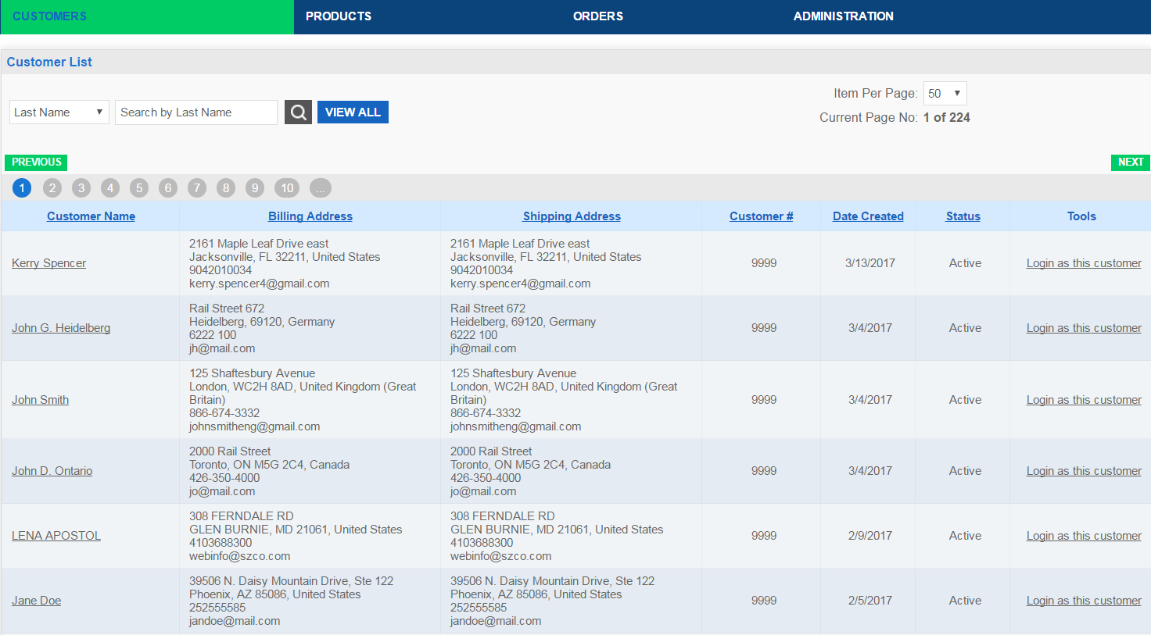
Where do I approve customers who have requested Online Access to browse? (but not place an order, so they’re not going in FACTS yet)

Slide 18
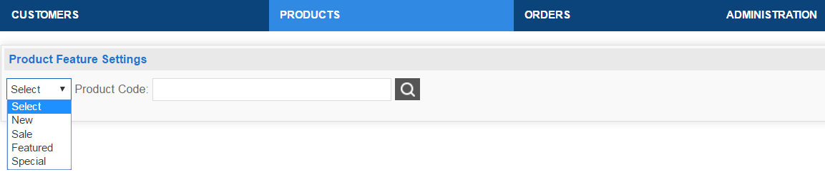
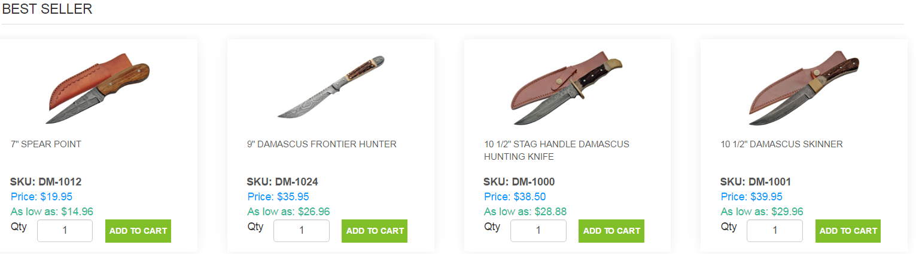
I don’t see a breakdown for “Best Sellers” on the “Product Feature Settings” Page
I think we will just delete this section and have it all just be “Featured” items
Best Sellers also comes up when you click Special on the home page, it should only be “Special”

Slide 19
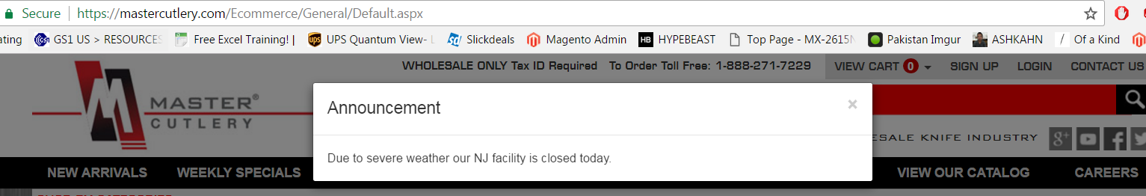
On the master cutlery website, they have the ability to add an announcement as a pop-up – we want this also, like bad weather days

